Slide 1
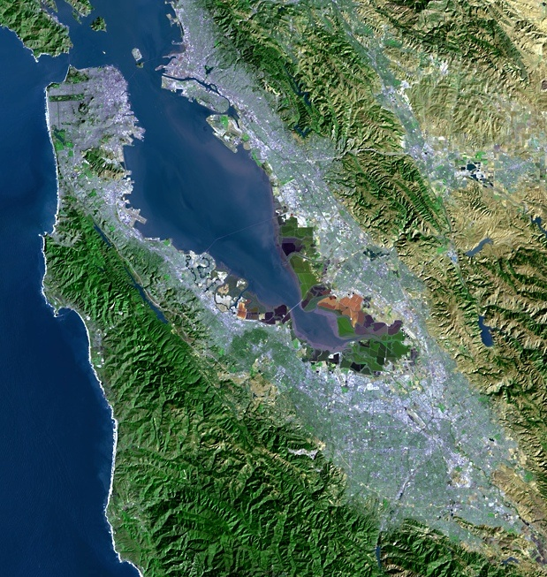
Current Water Supply Conditions and Conservation Update
“A multicounty agency authorized to plan for and acquire supplemental water supplies, encourage water conservation and use of recycled water on a regional basis.”
[Bay Area Water Supply and Conservation Agency Act, AB2058(Papan-2002)]
Andree Johnson
Water Resources Specialist
Bay Area Water Supply and Conservation Agency
March 18, 2015

Slide 2
Drought Update
Precipitation is running below median, and snowpack is deteriorating.
The 10% extra conservation needs to continue through 2015.
Mid-April SFPUC will issue the final estimate of available water supply to the wholesale customers.
SWRCB has adopted new water use restrictions

Slide 3
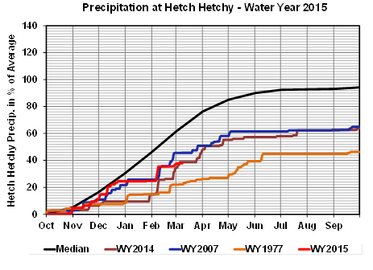
Cumulative Precipitation

Slide 4
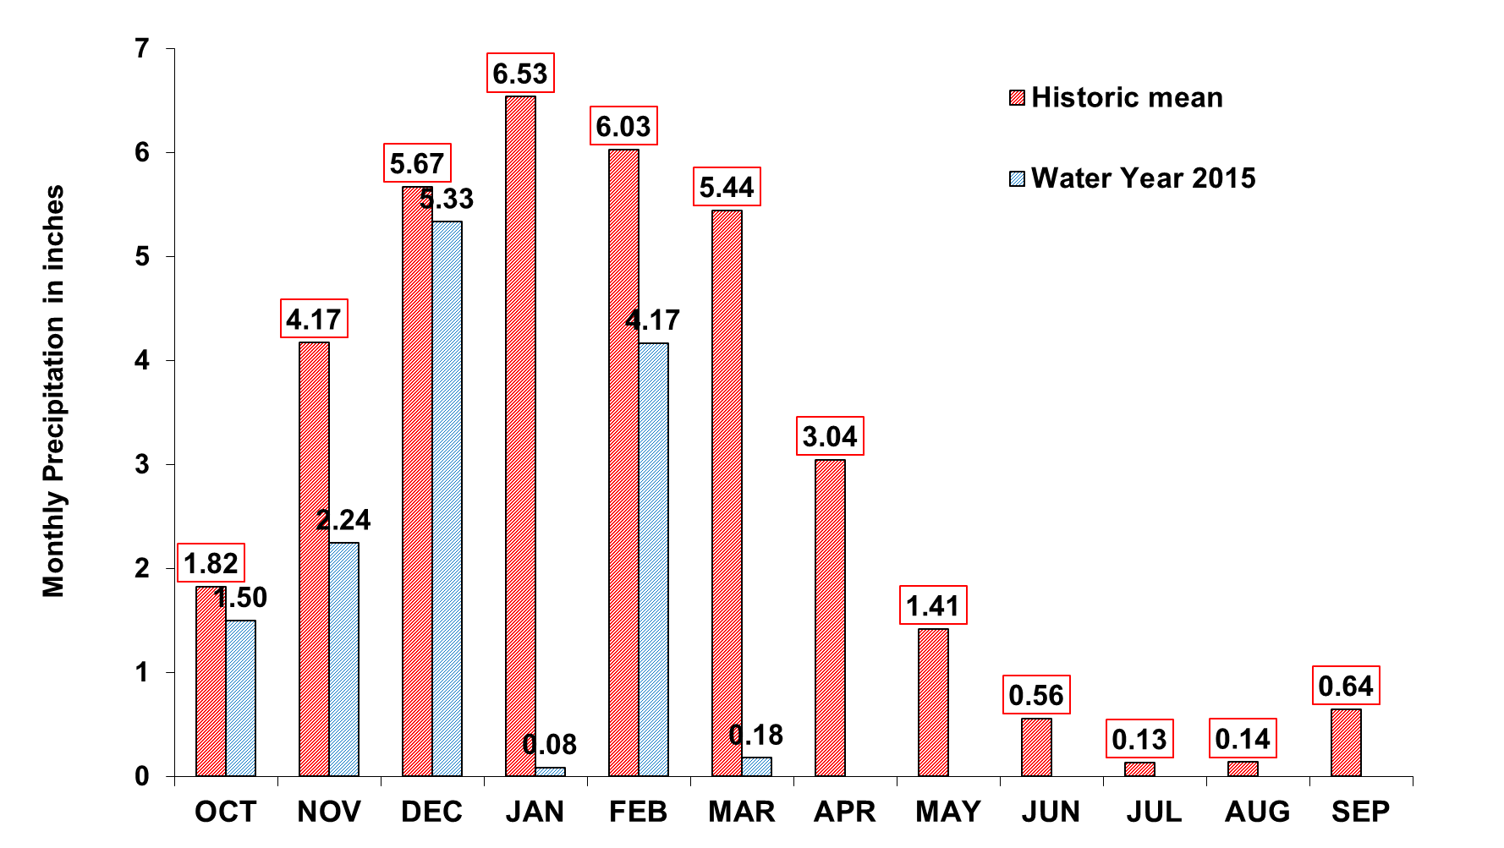
Upcountry 6-station Precipitation index as of March 8th
Annual Total: 35.6 inches
YTD Total: 13.50 inches
As of March 8th
Notes:
S:\Modeling\Forecast Ops Model\5000 Technical\5400 Monthly Forecasts\5470 2015 Forecast
Six_station_index_Precip_2000.xls
Fill in table “Current WY monthly precip” with data from http://hhmocc/Opsum/Pages/Opsum_View.cfm
Resize width 10”
Send image to back of slide (so “annual total” label shows)

Slide 5
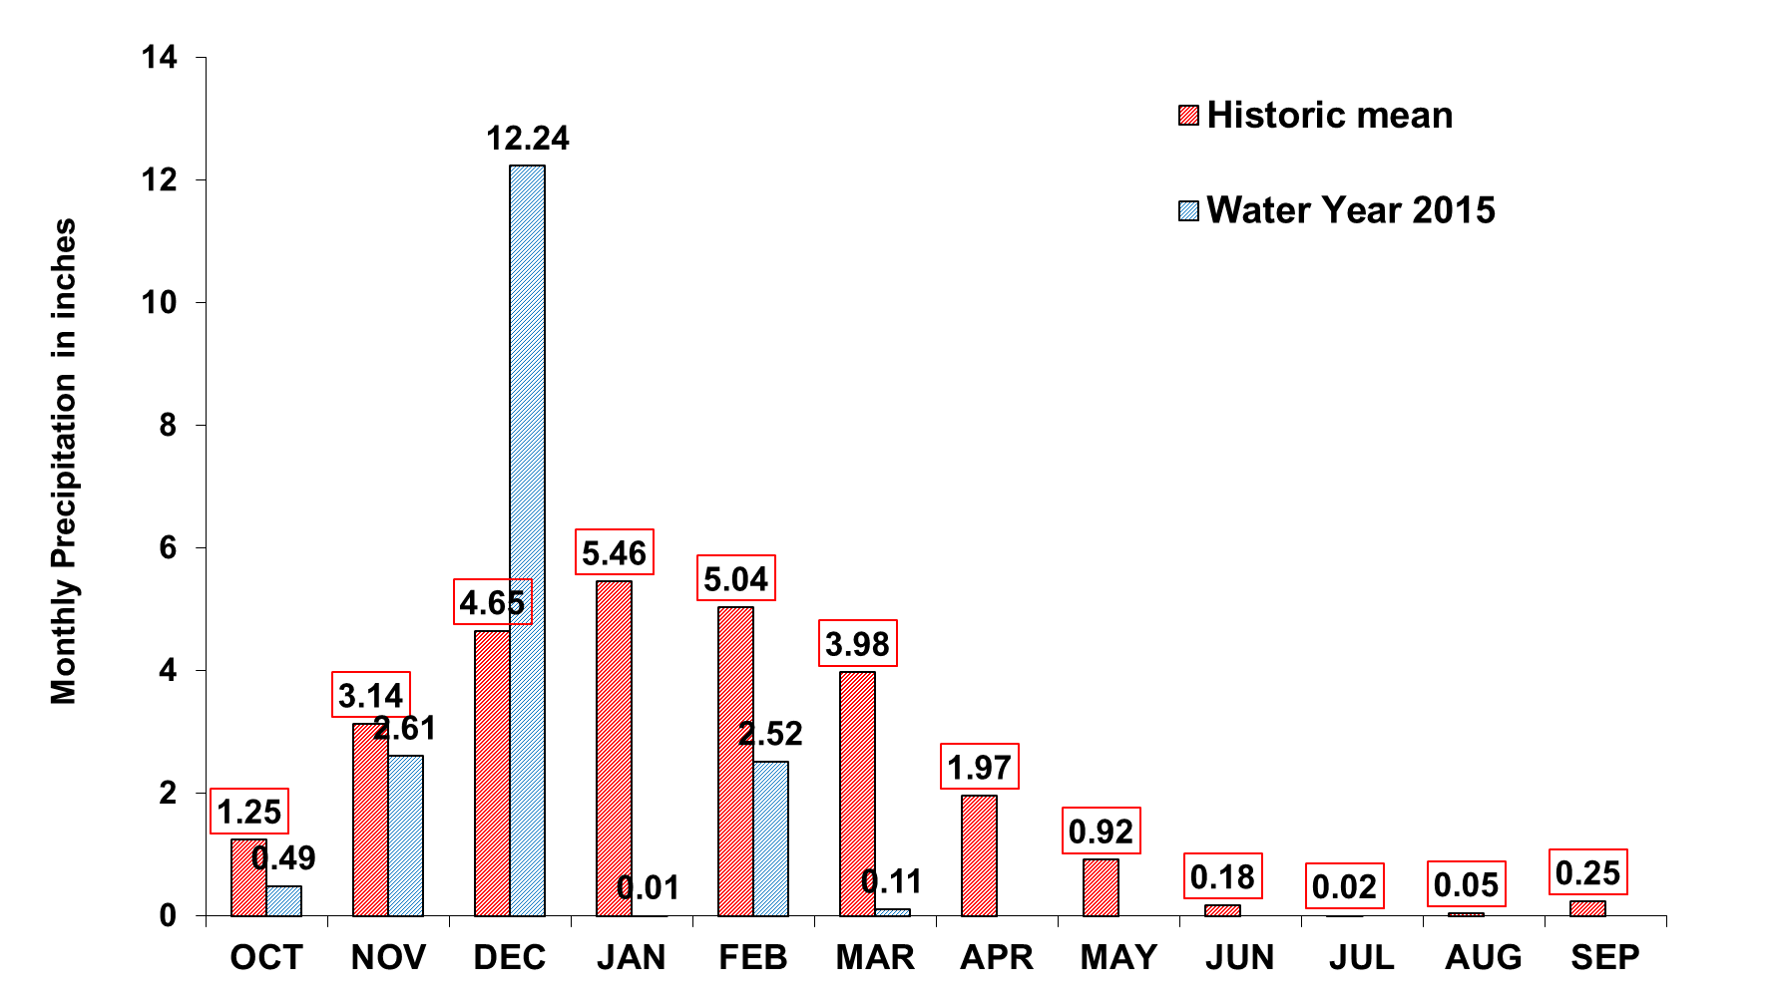
Bay Area Precipitation
Annual Total: 26.9 inches
YTD Total: 17.99 inches
As of March 8th
Notes:
S:\Modeling\Forecast Ops Model\5000 Technical\5400 Monthly Forecasts\5470 2015 Forecast
Seven_station_index_Precip-2015.xlsx
Open DWR file, sheet “Main Data”
Mt Hamilton data are from http://alert.valleywater.org/reports/pgi_report.php?id=1512

Slide 6
Statewide Snowpack History

Slide 7
Historic Water Available to SF
Worst 3 consecutive years
Drought

Slide 8
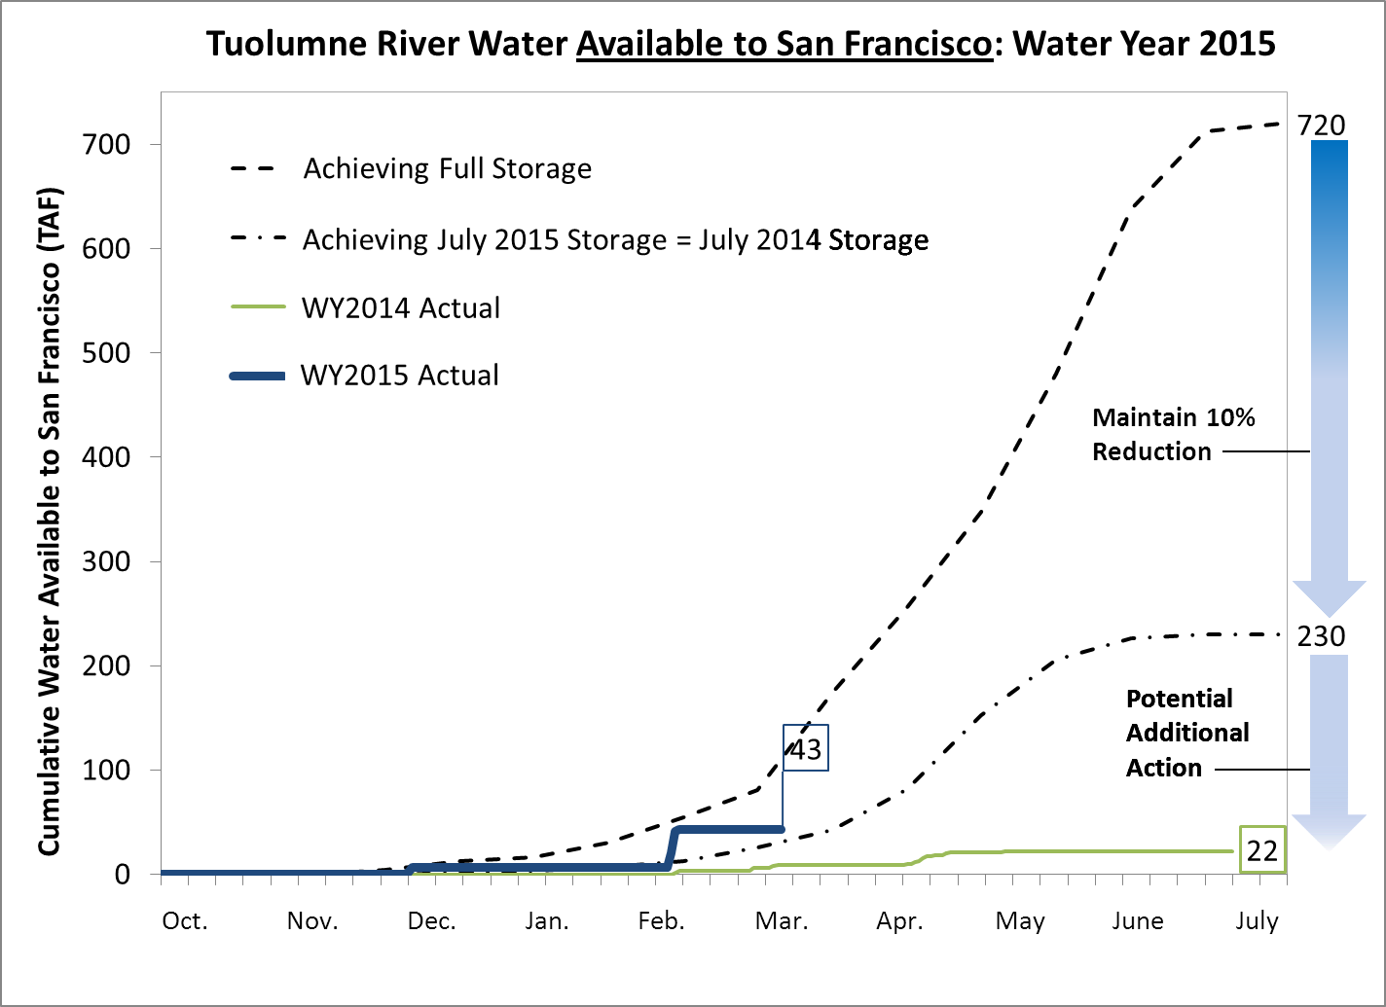
Tuolumne River Water Available to SF
Notes:
Picture height = 6.23”

Slide 9
March 8, 2015 Reservoir Storage Levels
Percent of
Current
Maximum
Available
Maximum
Reservoir
Storage
1,2,3
3,4
Storage
Capacity
Storage
(AF)
(AF)
(AF)
Tuolumne System
Hetch Hetchy
249,060
360,360
111,300
69.1%
Cherry
190,820
273,500
82,680
69.8%
Eleanor
20,980
27,113
6,133
77.4%
Water Bank
247,248
570,000
322,752
43.4%
Total Tuolumne Storage
708,108
1,230,973
522,865
57.5%
Local System
Calaveras
23,166
96,670
73,504
24.0%
San Antonio
35,802
50,637
14,835
70.7%
Crystal Springs
52,530
58,309
5,778
90.1%
San Andreas
15,675
19,027
3,352
82.4%
Pilarcitos
2,465
3,069
604
80.3%
Total Local Storage
129,639
227,711
98,073
56.9%
Total System Storage
837,747
1,458,684
620,938
57.4%
Total without water bank
590,499
888,684
298,186
66.4%
1
Upcountry storage is average of previous day's storage from USGS website
2
Water bank storage reported by HHWP for 3/8/2015
3
Local data from Daily Water Report
4
Upcountry maximum storage is with flashboards, taken from rating curve
Notes:
Receive WB number for Sunday night from Michael Tsang or Chris Graham (between 10 and 11am)
Use shortcut “Current Water Storage Summary – Shortcut”, open most recent file “Current System Storage_2014_11Aug2014.xlsx”
input WB data
Excel Data->Refresh all. Local data is in : T:\DWR\DWR 14-15. If data missing, call Millbrae Dispatch 3-5900. Sheet “Main Data”. Refresh all again.
Paste table as image
Change image height to 6.24”

Slide 10
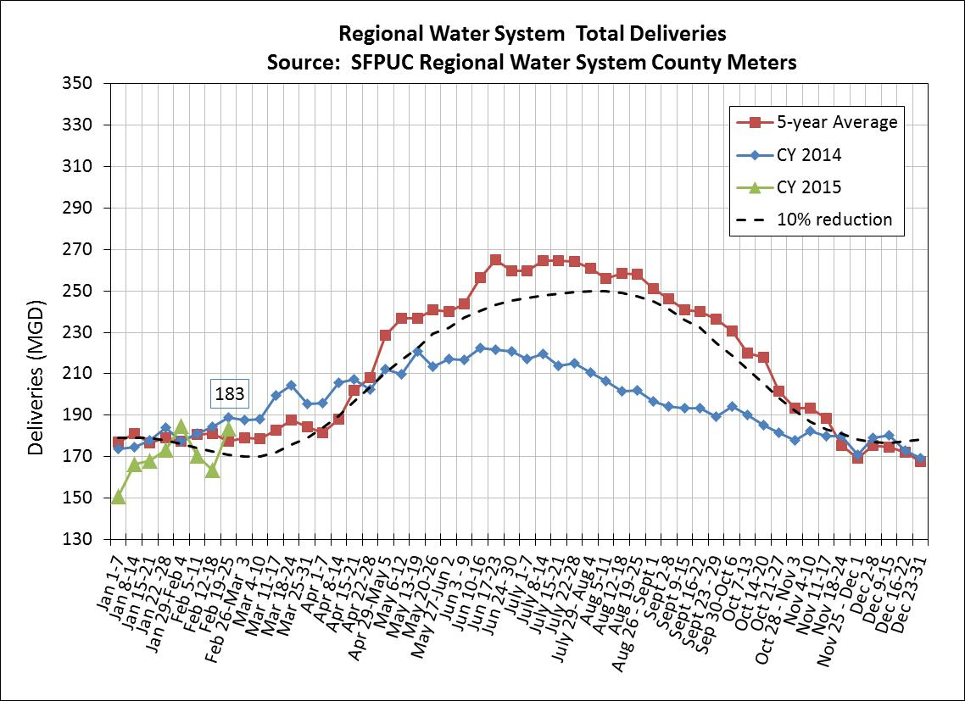
Total System Water Deliveries
Notes:
T:\WS_Ops\Operations\Engineering\Demands\demands\Monitoring Year 9 2015
Consumption Report v2.6_2014.xlsm
Check that plot is current.
Add data label to last point.
Resize to 6.24 height

Slide 11
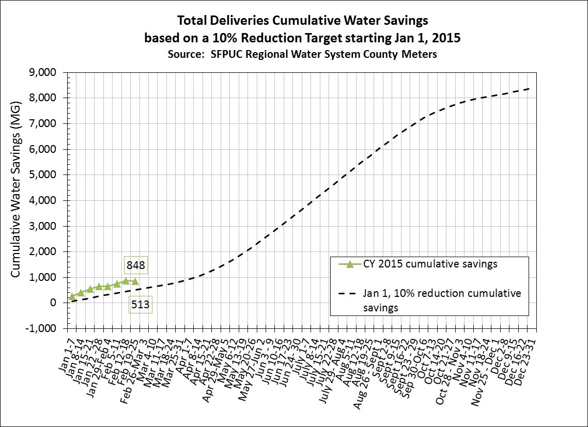
Total System Water Savings
Notes:
Add data labels to last points.

Slide 12
9-County Bay Area Lowest Per Capita Consumption Jan 2015 (gpcd)
Coastside County Water District |  |  |  |  | 37
North Coast County Water District |  |  |  |  | 37
City of Menlo Park |  |  |  |  |  |  | 41
Golden State Water Co. (Bay Point) |  |  |  |  |  |  |  | 44
SFPUC |  |  |  |  |  |  |  |  | 45.16
Dublin San Ramon Services District |  |  |  |  |  |  |  |  | 45.4
City of Daly City |  |  |  |  |  |  |  |  | 45.5
City of East Palo Alto |  |  |  |  |  |  |  |  |  | 46.39
Westborough Water District |  |  |  |  |  |  |  |  |  | 46.43
Cal Water South San Francisco |  |  |  |  |  |  |  |  |  | 47
City of Mountain View |  |  |  |  |  |  |  |  |  |  | 49.5
City of Milpitas |  |  |  |  |  |  |  |  |  |  | 51
City of Hayward |  |  |  |  |  |  |  |  |  |  |  | 52
City of Sunnyvale |  |  |  |  |  |  |  |  |  |  |  | 52

Slide 13
SWRCB Adopted Additional Water Use Prohibitions on March 17th
Prohibiting irrigation of turf and ornamental landscapes within 48 hours of rainfall events.
Hospitality sector restrictions on serving water and cleaning linens per request.
Urban water suppliers must impose limits on the number of days per week that irrigation is allowed
Default is 2 days per week if individual water supply does not have limits in place
Will vary among Bay Area agencies
Additional reporting requirements on compliance and enforcement

Slide 14
New Water Wise Gardening Website Launched
www.BayAreaGardening.org
Notes:
Goal of website is to promote outdoor water conservation
Revisions included:
New Watering Calculator
Updated interface and content
New URL

Slide 15
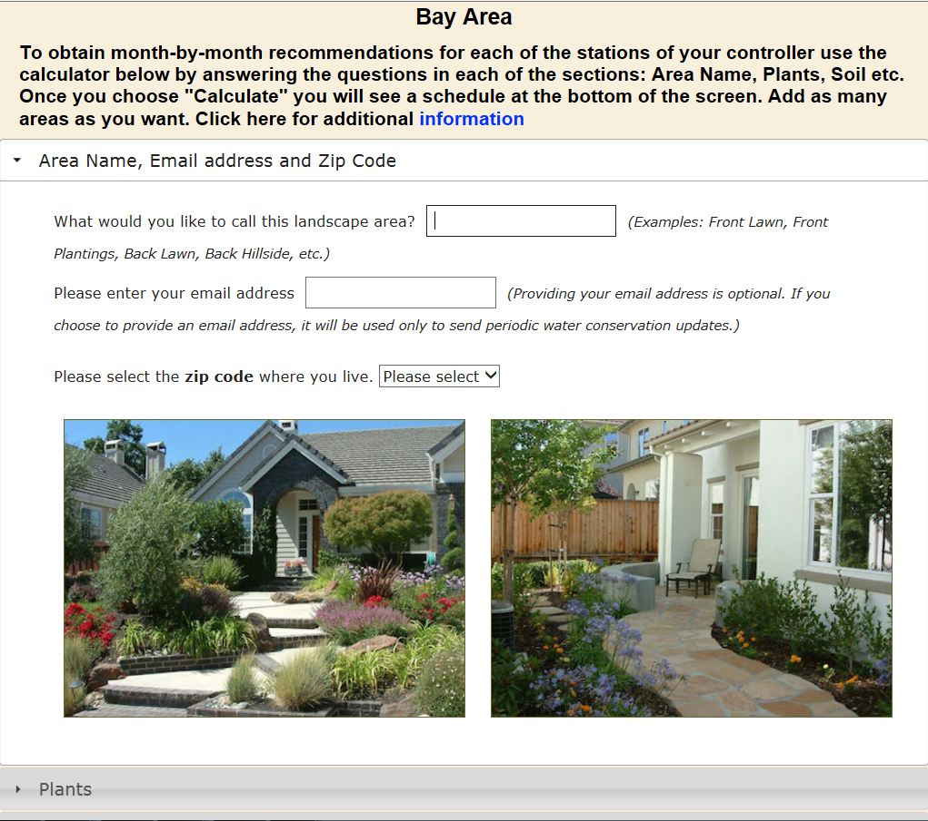
Key Feature: Water Calculator
Notes:
Water Calculator provides optimized irrigation schedule
A recommended monthly watering schedule based upon:
Location
Plant type
Irrigation system
Other factor
A monthly irrigation controller adjustment schedule for controllers with a Seasonal Adjust % feature
Drought restrictions currently in place for each member agency (by zip code)
An e-mail sign-up feature for future notifications

