Slide 1
BAWSCA’s Strategy
In 2009, BAWSCA embarked on the Long-Term Reliable Water Supply Strategy to:
Determine the Water Supply Problem
When, where, and how much additional water is needed in normal years and dry years.
Develop Solutions
Identify specific water supply management projects for implementation.
Notes:
BAWSCA’s Long-Term Reliable Water Supply Strategy is designed to
Quantity the water needs for this regional area
- Plan for and implement water projects to meet those needs

Slide 2
Strategy Was Direct Response to Significant Reliability Issues
Water demand in BAWSCA service area was projected to be greater than available supplies in both normal and drought years
Unilateral decision by SFPUC to limit Regional Water System (RWS) supplies available to BAWSCA member agencies to 184 mgd through 2018
Anticipated RWS system-wide supply shortages up to 20% resulting in even greater cutbacks to BAWSCA agencies
Additional identified environmental, regulatory and political threats to RWS reliability

Slide 3
Strategy Development was Phased to Achieve Results
Strategy developed in Phases
Phase I (Scoping): July 2009 – May 2010
Phase IIA: July 2010 – July 2012
Phase II Final Report: February 2015
Study focus changed along the way in response to findings and changed conditions

Slide 4
Phase II Significant Finding: Demands 20% Lower Than Previous Estimates

Slide 5
Updated Normal Year Demands 20% Lower Than Previous Estimates
Projected 2035 total normal year water demands with passive conservation are roughly 20% lower than previous forecast
341 mgd (2008) vs. 275 mgd (2014)
Key factors for lower demand projections
Higher projected retail water rates
Stricter plumbing and building codes and Statewide conservation requirements
Slower population and job growth
Notes:
As you know, BAWSCA has been developing ………
The two key
One of the key recommendations coming out of the Phase IIA Report of the Strategy was the need for an update of demand and conservation projections using common methodology

Slide 6
2040 Supply Shortfall in Drought Year Only
2040 Supply Sources, Normal Year
2040 Supply Sources, Drought Year
(20% System-wide Shortage)
43
mgd
117 mgd
124 mgd
117 mgd
168 mgd
Anticipated
SFPUC Purchases
Other
Sources
Reliability Shortfall

Slide 7
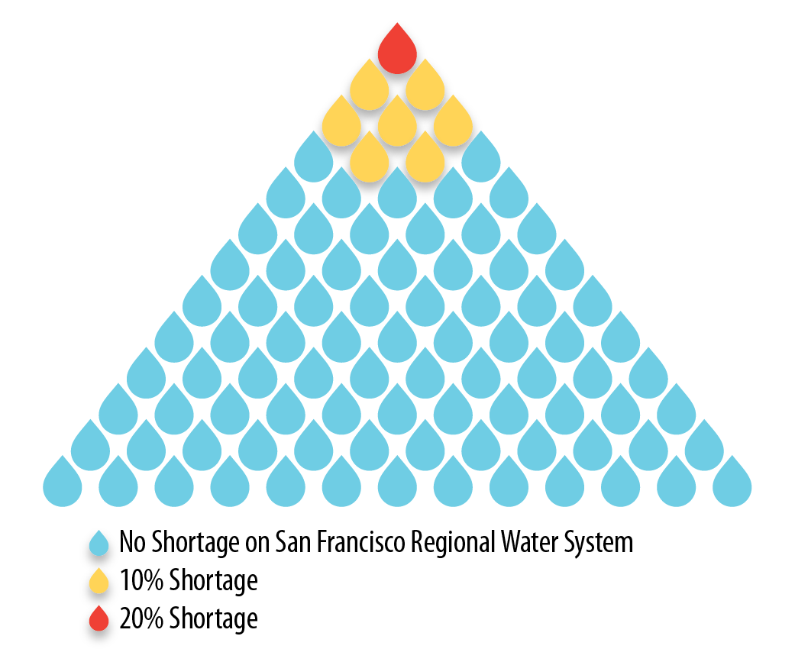
How Frequent are Droughts Anticipated on the SF RWS?
System subject to drought 1 in 11 years (assuming 2040 demands)
Using historical record
Analysis informs decision-making
How often will supplemental supplies be needed
Effective cost of supply increases if only used during drought
Notes:
Based on SFPUC’s model for their system, shortages are estimated to occur on average 1 in every 10 years at the future demand level
SFPUC has two levels of demand reductions……
What does this mean for the region as a whole and the indivdiual agencies?

Slide 8
Supply Shortfalls Can Have Significant Economic Impacts to the Region
Regional business sales impacts could be up to $2.0B annually (in 2010 dollars)
In 2035, impacts could be up to $8.9B annually
Some BAWSCA agencies could receive cutbacks of up to 40%
Uncertainty in frequency of drought due to changing climate

Slide 9
Review of Supply Projects has Been Comprehensive
Phase I – identified 65+ projects with potential regional benefits, outlined an evaluation process and criteria to assess projects
Phase IIA – refined list of projects to 17, identified near-term opportunities
Phase II Final – presented refined project list of 10, full analysis of supply projects against objectives
Note: Agencies may have other supply projects, but did not want to include them in the Strategy
Notes:
Outline:
Prepare you to review the Strategy document
Focus on Findings
Get BPC input on presentation of findings
Discuss Next Steps
The Strategy was always envisioned as a Three Phase process
In Phase 1 –
extent of reliability issue,
identified 65+ projects with potential regional benefits,
outlined an evaluation process and criteria to assess projects
Phase IIA –
refined list of projects and scope to match changing conditions,
identified near-term opportunities,
the Pilot transfer
Update the demand and conservation data
Phase II Final –
will present updated reliability needs,
refined project list,
review analysis of supply projects and portfolios,
identify potential next steps
Phase III – Implementation of Phase II

Slide 10
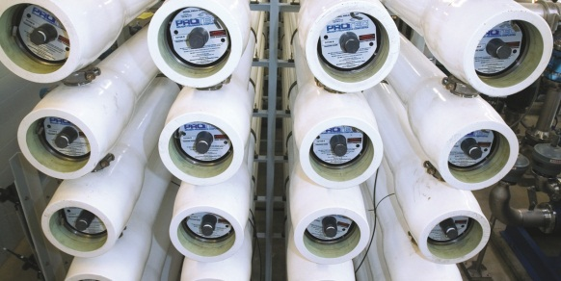
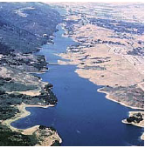
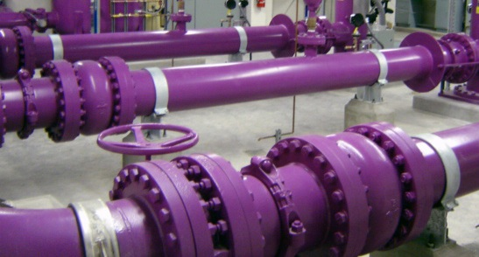
Five Project Types that Provide Regional Benefits Were Identified
Recycled water
Groundwater
Desalination
Water transfers
Local capture and reuse
Notes:
New and other supply types also being tracked going forward (e.g. Indirect/Direct Potable Recycling)
Different projects warrant consideration of different types of near-term actions
Core actions
Implementation actions
Regional benefits
Local agency support

Slide 11
Project Type 1: Non-Potable Recycled Water
Four projects included:
City of Daly City - Colma Expansion Project
City of Mountain View
City of Palo Alto – Recycled Water to Stanford Research Park
City of Redwood City – Regional Recycled Water Supply
Up to 6.5 mgd of potential supply, but limited customer demand
Capital and O&M costs range from $1,950 - $3,310/AF
Absent other motivations (e.g., discharge requirements), limited demand results in high “dry-year” costs
Notes:
If you are doing this purely to increase dry year reliability

Slide 12
Project Type 2: Groundwater
Expanded use of new/converted wells in Sunnyvale is the only identified Strategy groundwater project
This project would develop up to 2.1 mgd of capacity
Additional groundwater development likely to be undertaken independently by member agencies
Capital and O&M costs range from $1,230 - $1,350/AF
SCVWD groundwater production charges add significantly to overall costs
Originally seen as a “normal year” supply, drought year yield would be almost 20% lower

Slide 13
Project Type 3a: Brackish Desalination
Brackish desal involves use of groundwater wells
Estimated project yield ranges from 0.7 - 6.5 mgd
Significant uncertainty in project yields, conductivity of “Bay Mud” will be key in determining ultimate yield
Capital and O&M costs range from $1,400 - $4,700/AF
“Dry-year” cost significantly higher
Project better suited to normal year demands
Brackish projects generally have fewer environmental impacts than open intake desalination
Notes:
Vertical or horizontal

Slide 14
Project Type 3b: Open Bay Intake Desalination
Project yield of 15 mgd considered in the Strategy
Capital and O&M costs range from $2,100 - $2,400/AF
Smaller cost range due to greater yield certainty
“Dry-year” cost significantly higher
Project better suited to normal year demands
Facility siting issues more challenging than brackish

Slide 15
Project Type 4: Water Transfers
Following Phase IIA recommendations, work has been ongoing for development of dry-year transfers
Currently have MOUs with East Bay Municipal Utility District and Santa Clara Valley Water District
Full-scale transfer yield could be as great as 20 mgd
Pilot water transfer is less than 1 mgd
Capital and O&M costs range from $950 – $1,750/AF
“Dry year” costs are lower than other projects because assume no capital costs necessary
BAWSCA water transfers require participation of and agreement with a large number of other agencies

Slide 16
Project Type 5: Local Capture and Reuse
Rainwater Harvesting
Collection and storage of rainwater runoff from roof surfaces for later use
2040 project yield ranges from 0.2 - 0.6 mgd Simple household systems - $2,900 – $4,800/AF
Graywater
Collection, filtering, and pumping graywater from a home’s laundry, shower and bath to irrigate plants
Project yield ranges from 1.1 – 2.7 mgd in 2040
Wide variety of systems ranging from $550/AF – $10,000/AF
Notes:
Graywater may be more preferable than ____ b/c of
No long term assurance that water supply will reliably be available

Slide 17
Diverse Set of Objectives Used to Evaluate Potential Projects
Objectives
Increase Supply Reliability
Provide High Level of Water Quality
Minimize Cost of New Supplies
Reduce Potable Demand
Minimize Environmental Impacts of New Supplies
Increase Implementation Potential of New Supplies
Notes:
Regional benefits
Local agency support
Criterion 3A –Criterion 3B – Effective Cost

Slide 18
Summary of Strategy Project Evaluation & Rankings
Project Type | Dry Year Yield | Effective Cost | Local Control | Time to Implement | Environ-mental
1. Recycled Water Projects
2. Groundwater Project (Sunnyvale)
3. Water Transfers
4a. Desal - Open Bay
4b. Desal - Brackish Well
5. Local Capture and Reuse
Performance on selected criteria:
Scores high
Scores in the middle
Scores low
Notes:
The intent tonight is not to

Slide 19
Finding: Water Transfers are a High Priority
Consistently score high and should represent a high priority for BAWSCA
Existing infrastructure and ability to match to dry year demands results in low effective costs
Addition of storage capability would improve flexibility
Recommended Action:
Continue to lead development of water transfers
Identify and evaluate water storage options (e.g. enlarged Los Vaqueros)

Slide 20
Finding: Desalination Needs Partner to be Viable
Partner would pay for and utilize supplies during normal years
Provides sizable yield, but high costs & permitting make it a poor dry year only option
Recommended Action:
Facilitate desalination partnerships
Pursue outside funding for further studies (e.g., Bay-Mud conductivity testing)

Slide 21
Finding: “Other Projects” Have Limited Dry Year Benefits
Recycling, groundwater, etc. provide tangible, though limited regional benefits
Low dry year yield nominally addresses regional needs
Need to move forward on all options
Recommended Action:
Support agency-identified projects
Participate in cooperative regional planning (e.g., Bay Area Regional Reliability Partnership)

Slide 22
Summary: Drought Year Shortfall Only, but Supply Options Limited
Recent studies confirm need to focus on dry-year supplies (e.g., transfers, groundwater storage)
Focus is now on drought supply
Lack of normal year need greatly impacts the “effective” or “dry-year” cost of projects
Continued need to explore normal year supplies (e.g., recycling, desalination) for threats to existing supplies and changing local supplies
Strategy implementation activities primarily reflected in allocation of BAWSCA staff time
BAWSCA partnering with Cal Water to pursue brackish groundwater desal project
Notes:
Cite importance of 184 mgd for long term SFPUC commitment to agencies
Long-Term Reliable Water Supply
regional assessment of water supply reliability needs
evaluation of potential water management actions

