Slide 1
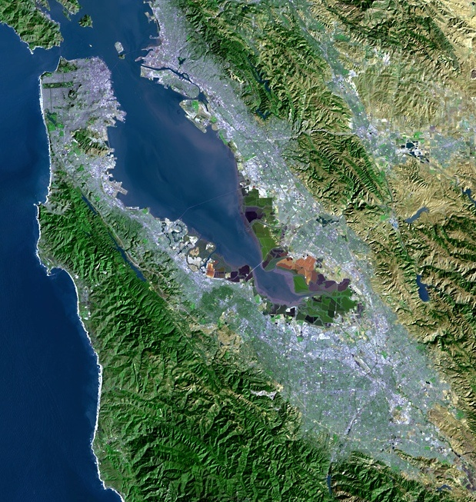
Current Water Supply Conditions and Conservation Update
“A multicounty agency authorized to plan for and acquire supplemental water supplies, encourage water conservation and use of recycled water on a regional basis.”
[Bay Area Water Supply and Conservation Agency Act, AB2058(Papan-2002)]
Adrianne Carr
Senior Water Resources Specialist
Bay Area Water Supply and Conservation Agency
April 15, 2015

Slide 2
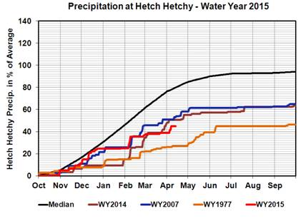
Cumulative Precipitation

Slide 3
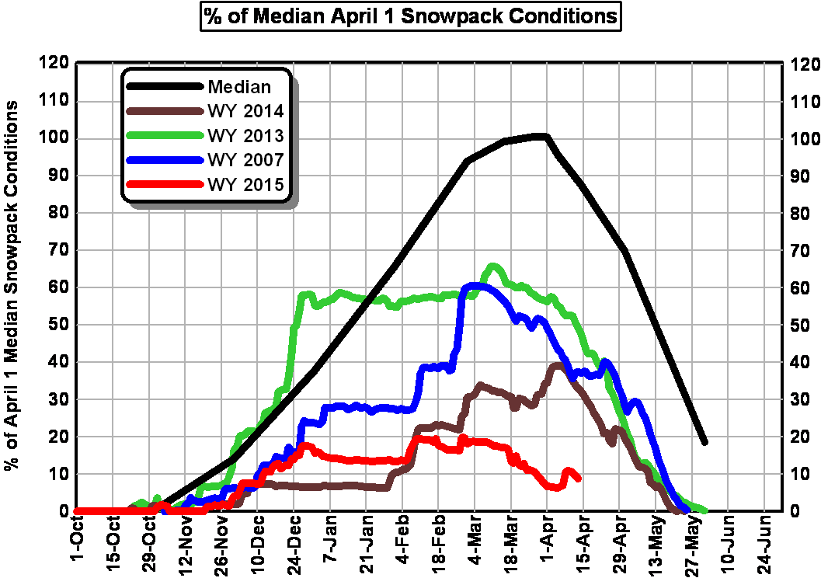
Snowpack

Slide 4
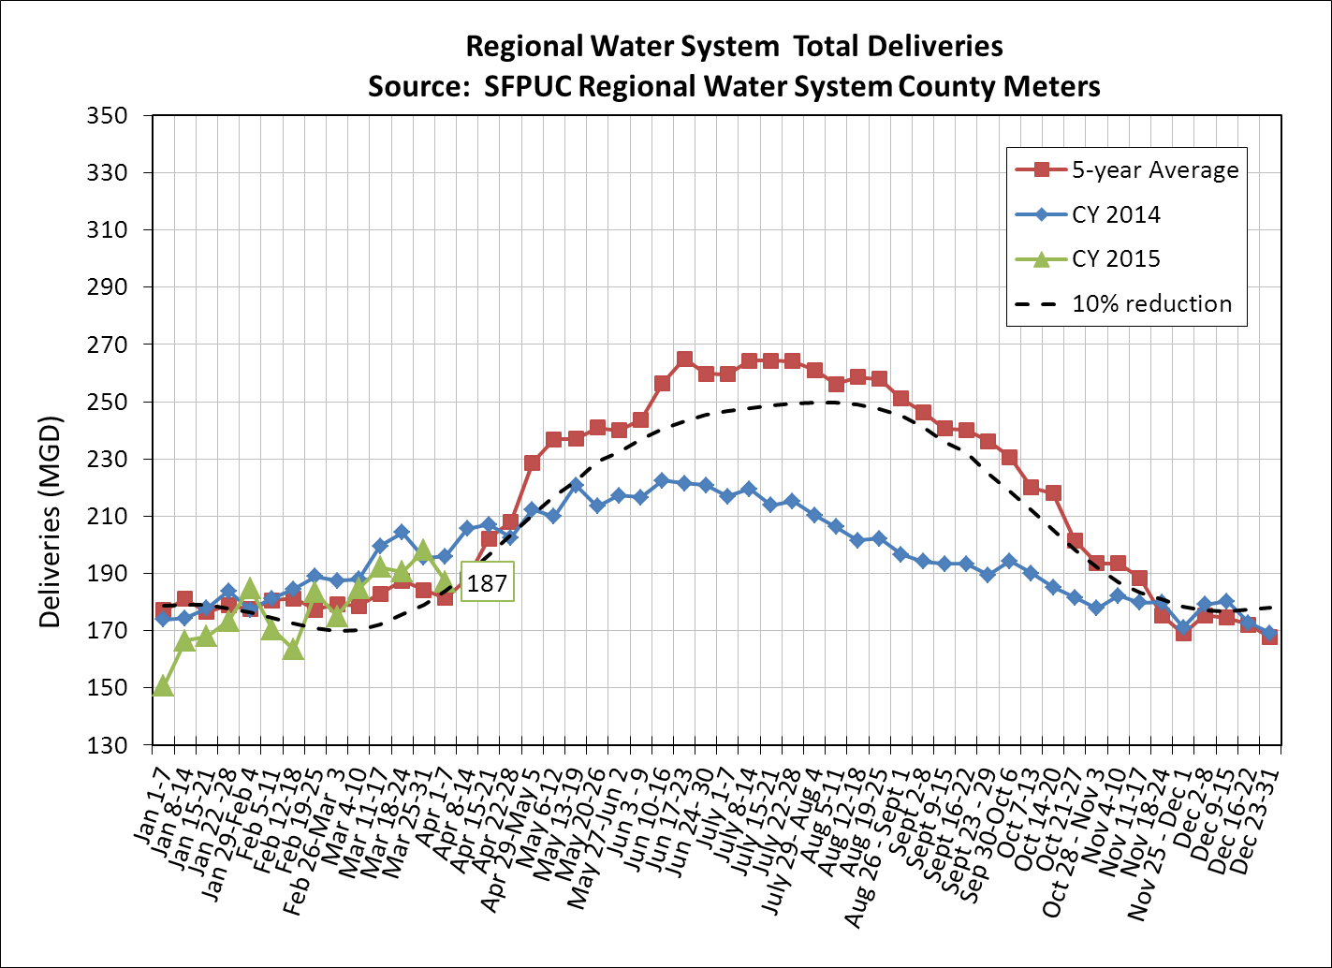
Total Deliveries
Notes:
T:\WS_Ops\Operations\Engineering\Demands\demands\Monitoring Year 9 2015
Consumption Report v2.6_2014.xlsm
Check that plot is current.
Add data label to last point.
Resize to 6.24 height

Slide 5
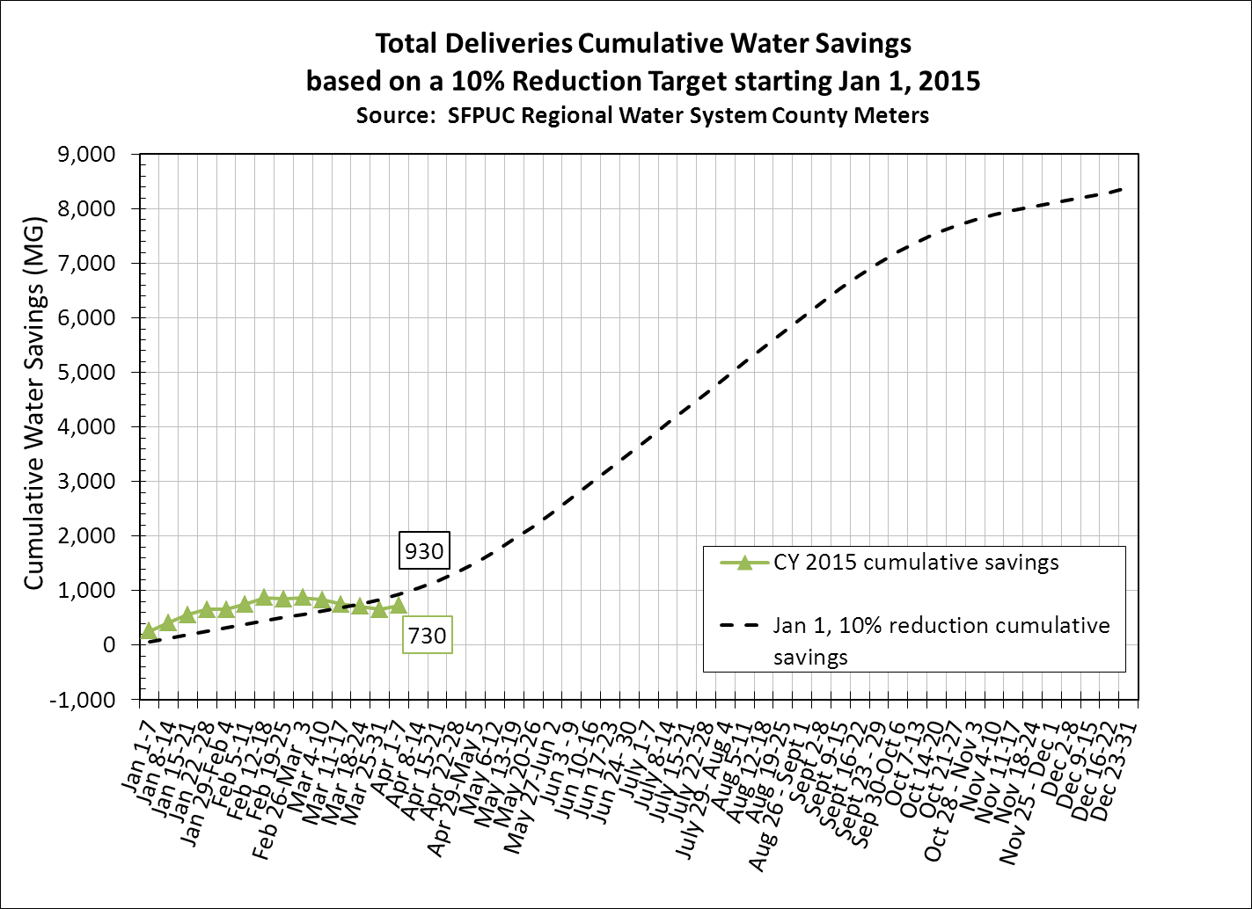

Slide 6
Drought Update
The snowpack is pathetic
Even with a dry year, at this point we anticipate Hetch Hetchy will reach at least 80% of capacity
The Governor’s April 1st Executive Order may end up requiring conservation savings of ~20% for the BAWSCA region
San Francisco had planned to continue the call for 10% reduction for the region
The Governor’s order changes the way BAWSCA agencies have been looking at savings and will require many agencies to cut water use beyond what San Francisco is requesting

Slide 7
Governor Orders 25% Statewide Water Use Reduction
Order requires State Water Board to impose restrictions to achieve a statewide 25% reduction in potable water use
Residential use in September 2014: basis for required cutbacks
Reduction targets will apply to total use, includes all customer categories (e.g. commercial, industrial)
Residential GPCPD Range | Conservation Standard | # of BAWSCA Agencies
Under 55 | 10% | 6 (5 in SMC)
55-110 | 20% | 15 (9 in SMC)
110-165 | 25% | 1 in SMC
Over 165 | 35% | 2 in SMC

Slide 8
Snowpack Was a Primary Driver for Governor’s Action

Slide 9
Requirements for Reporting and Enforcement Increased
The Governor’s order put into motion significant additional reporting monthly reporting requirements
Increased enforcement on water suppliers
Informal enforcement - clear reminder of requirements and what’s necessary to comply, no monetary penalty
Formal enforcement - actions include Cease and Desist Orders to stop non-compliant activity, potential fines up to $10,000 a day
All aspects of Executive Order subject to compliance and enforcement
State Board approval of regs is expected in early May following public hearings

Slide 10
Executive Order Includes Other Urban Measures
Collectively replace 50 million square feet of lawns
Prohibits irrigation of public street medians with potable water
Requires all new homes and buildings to use drip irrigation or microspray systems to water landscape
DWR will update State Model Water Efficient Landscape Ordinance
CA Energy Commission to update efficiency standards for water appliances via emergency regs

Slide 11
Summer Drought Campaign to be Implemented with SFPUC
Goal is to begin campaign in June
Considering similar themes to 2014 campaign with new messages and advertising platforms
Video/print material development
Grassroots outreach
Direct mail

Slide 12
New Drought Campaign Materials

