Slide 1
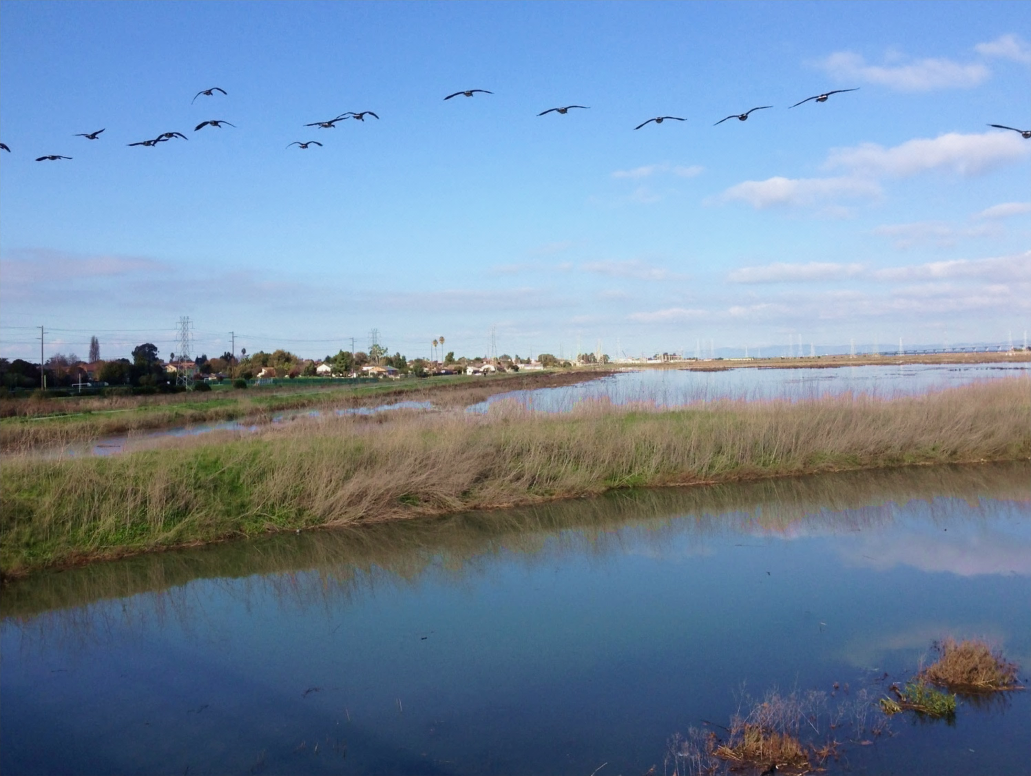

C/CAG Water Committee 1.6.16
San Francisquito Creek Joint Powers Authority
Len Materman, Executive Director

Slide 2
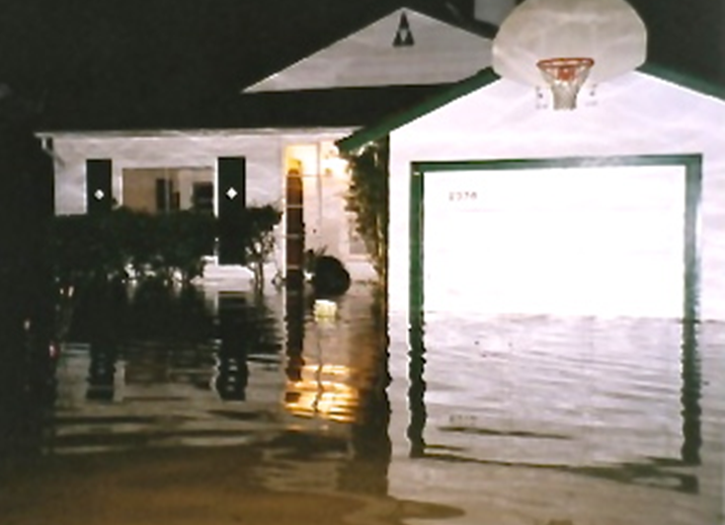
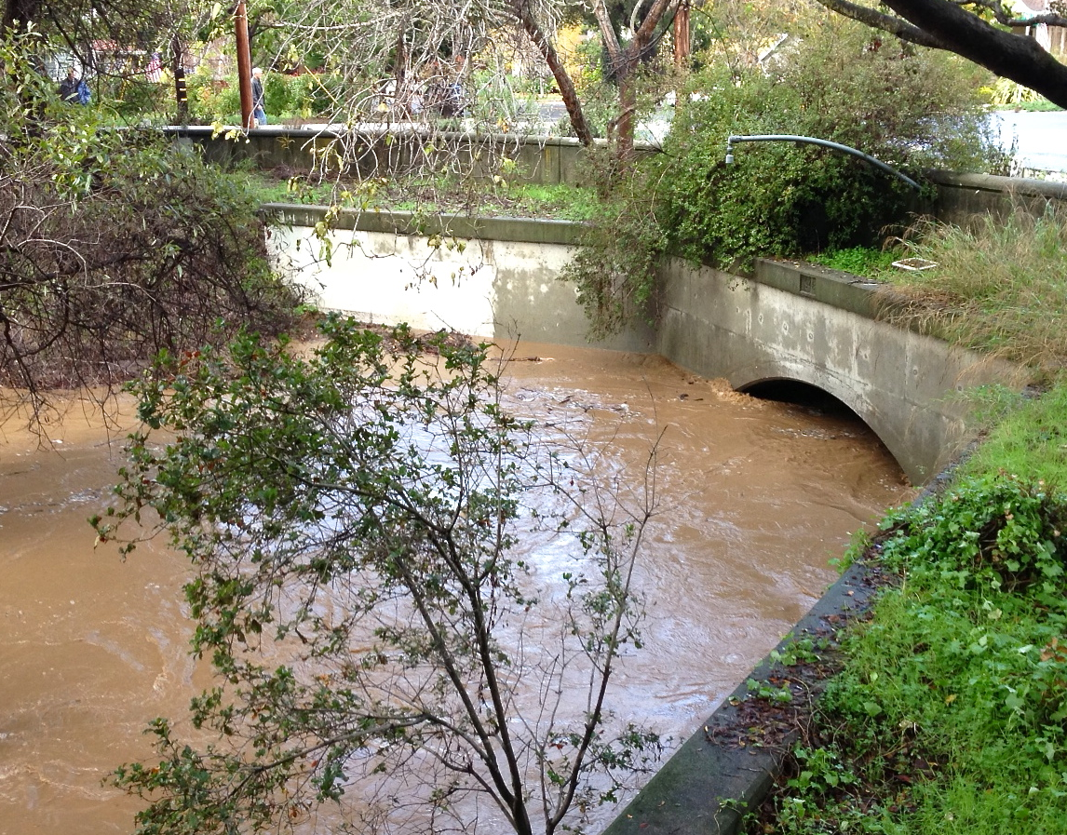
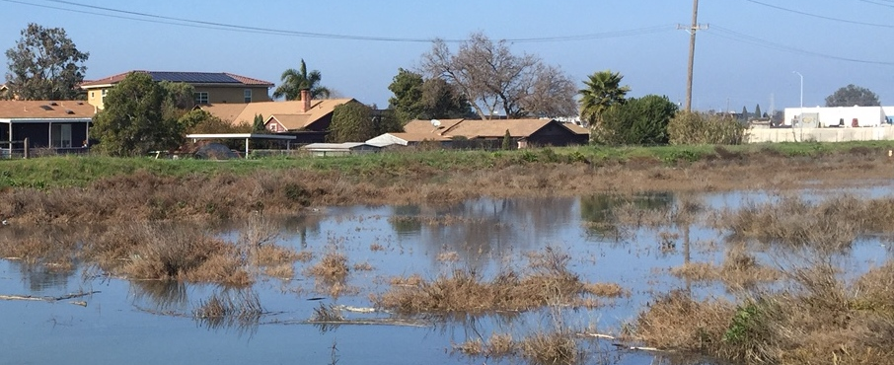
2012
1998
2014

Slide 3
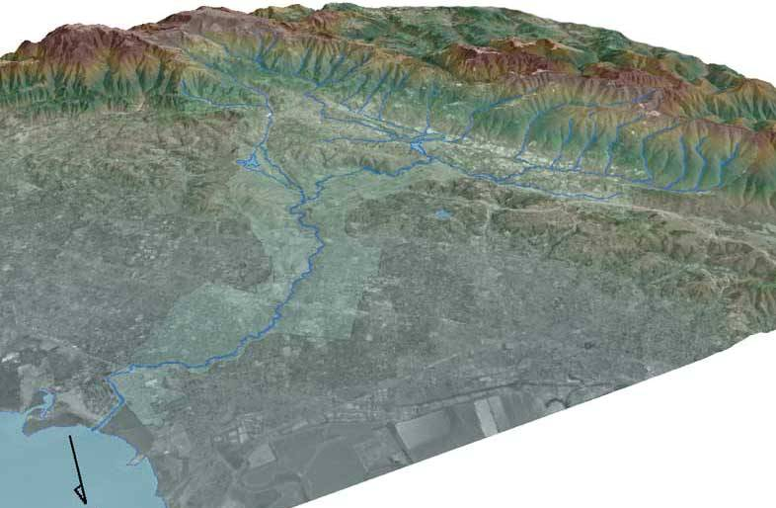
San Francisquito Creek
Watershed
Santa Clara Valley Water District
Palo Alto
San Mateo County Flood Control District
Menlo Park
50 square miles; two counties; six towns; local, state and national parks sites; major rail & highways,
regional airport and USPS facility, and major research university
East Palo Alto
Floodplain

Slide 4

An independent regional government agency founded by three cities and two countywide agencies divided by San Francisquito Creek and united by its watershed and floodplain.
The SFCJPA leads projects along the creek and S.F. Bay that reduce a proven flood threat, enhance ecosystems and recreational opportunities, and connect our communities. It receives funding from its founding agencies, as well as state, federal and private sources.

Slide 5


San Francisquito Creek area
floodplains and projects
N
East
Palo Alto
X
X
Redwood
City
Menlo Park
Over $70 million in local, state, federal and private funding commitments since 2010
Palo Alto
Mt.
View
Approximate number of parcels in the 100-year floodplains
= Creek floodplain only (3,500 parcels)
= Bay floodplain only with 3’ Sea Level Rise (over 2,700 parcels)
= Overlap of creek and Bay floodplains (2,200 parcels)

Slide 6

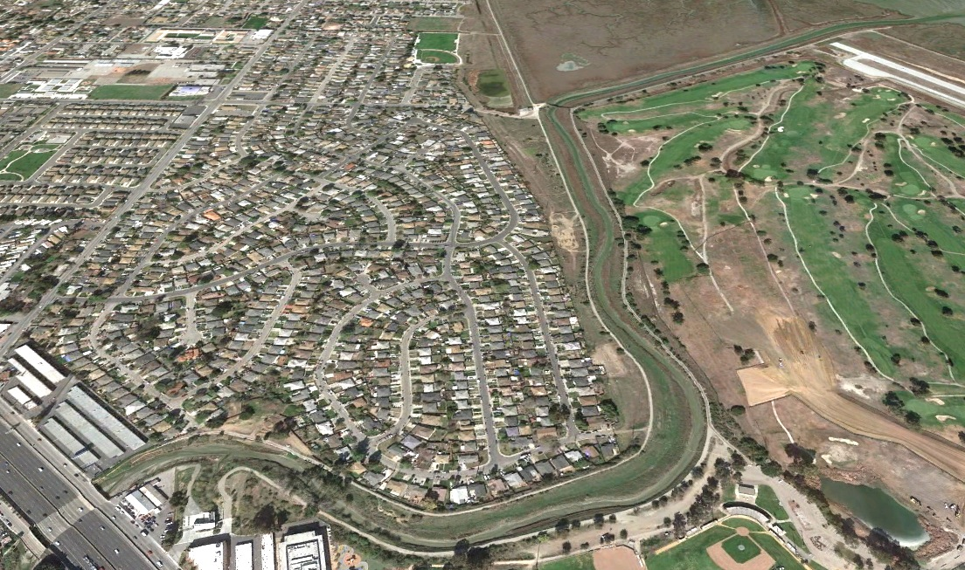

San Francisquito Creek S.F. Bay-Highway 101 project
Protect previously flooded people and property along San Francisquito Creek from SF Bay to Hwy. 101 against a 100-year creek flow during a 10-year tide with 26” of Sea Level Rise
Fill low area of marsh levee to protect endangered species
Improve water quality by keeping high flows to the Bay within a new marsh channel rather than over streets and through homes
Create about 15 acres of new marsh habitat
Reconnect creek to adjacent tidal marsh area
Enable flood protection work upstream
Provide new, safer PG&E gas pipeline
Enable East Palo Alto to receive recycled/purified water
Improve the Bay Trail and Creek/Bay public information
Degrade
Bay levee
New levee
set back into
golf course
East Palo Alto
Palo Alto
Palo Alto
Floodwalls
Project includes changes requested by regulatory agencies

Slide 7


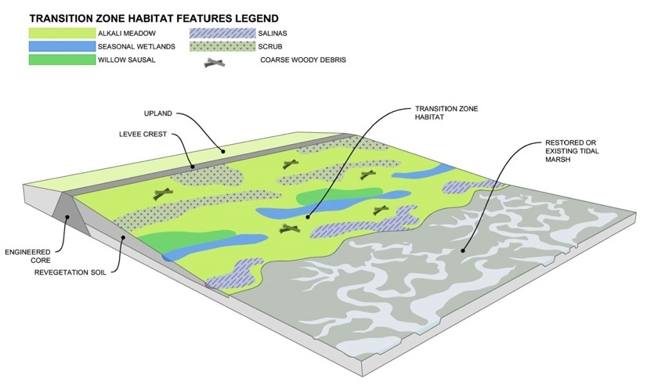
N
SAFER Bay Project
Protecting and enhancing assets
East
Palo Alto
Redwood
City
Menlo Park
Mt.
View
Palo Alto

Slide 8
SAFER Bay Project
Protect 5,000 properties & major infrastructure, restore marshes, connect communities through trails
Funders as of January 2016
California Dept. of Water Resources
California Coastal Conservancy
Facebook
Cities of Palo Alto, East Palo Alto, and Menlo Park
U.S. Fish & Wildlife Service
Design and analyze (through an EIR) project elements to remove properties from the FEMA floodplain (100-year tide + 2’ freeboard), with 3’ of Sea Level Rise.
Construction (not yet funded) may occur in phases (1 FEMA, 2 SLR), and may be geographically or temporally separable.

Slide 9
Coordinated work to reduce El Niño flood risk
Removing debris in creek within regulatory constraints
Raising creek banks that flooded or may flood
Providing earlier and more clear flood warning
Improving coordination among emergency response agencies
Communicating with the public about these activities, and what they can do to protect themselves.

Slide 10
2014 – Debris removed in creek channel by location and responsible agency
= Menlo Park
= Palo Alto
= SCV Water District
= Stanford University
= San Mateo County FCD
= East Palo Alto

Slide 11
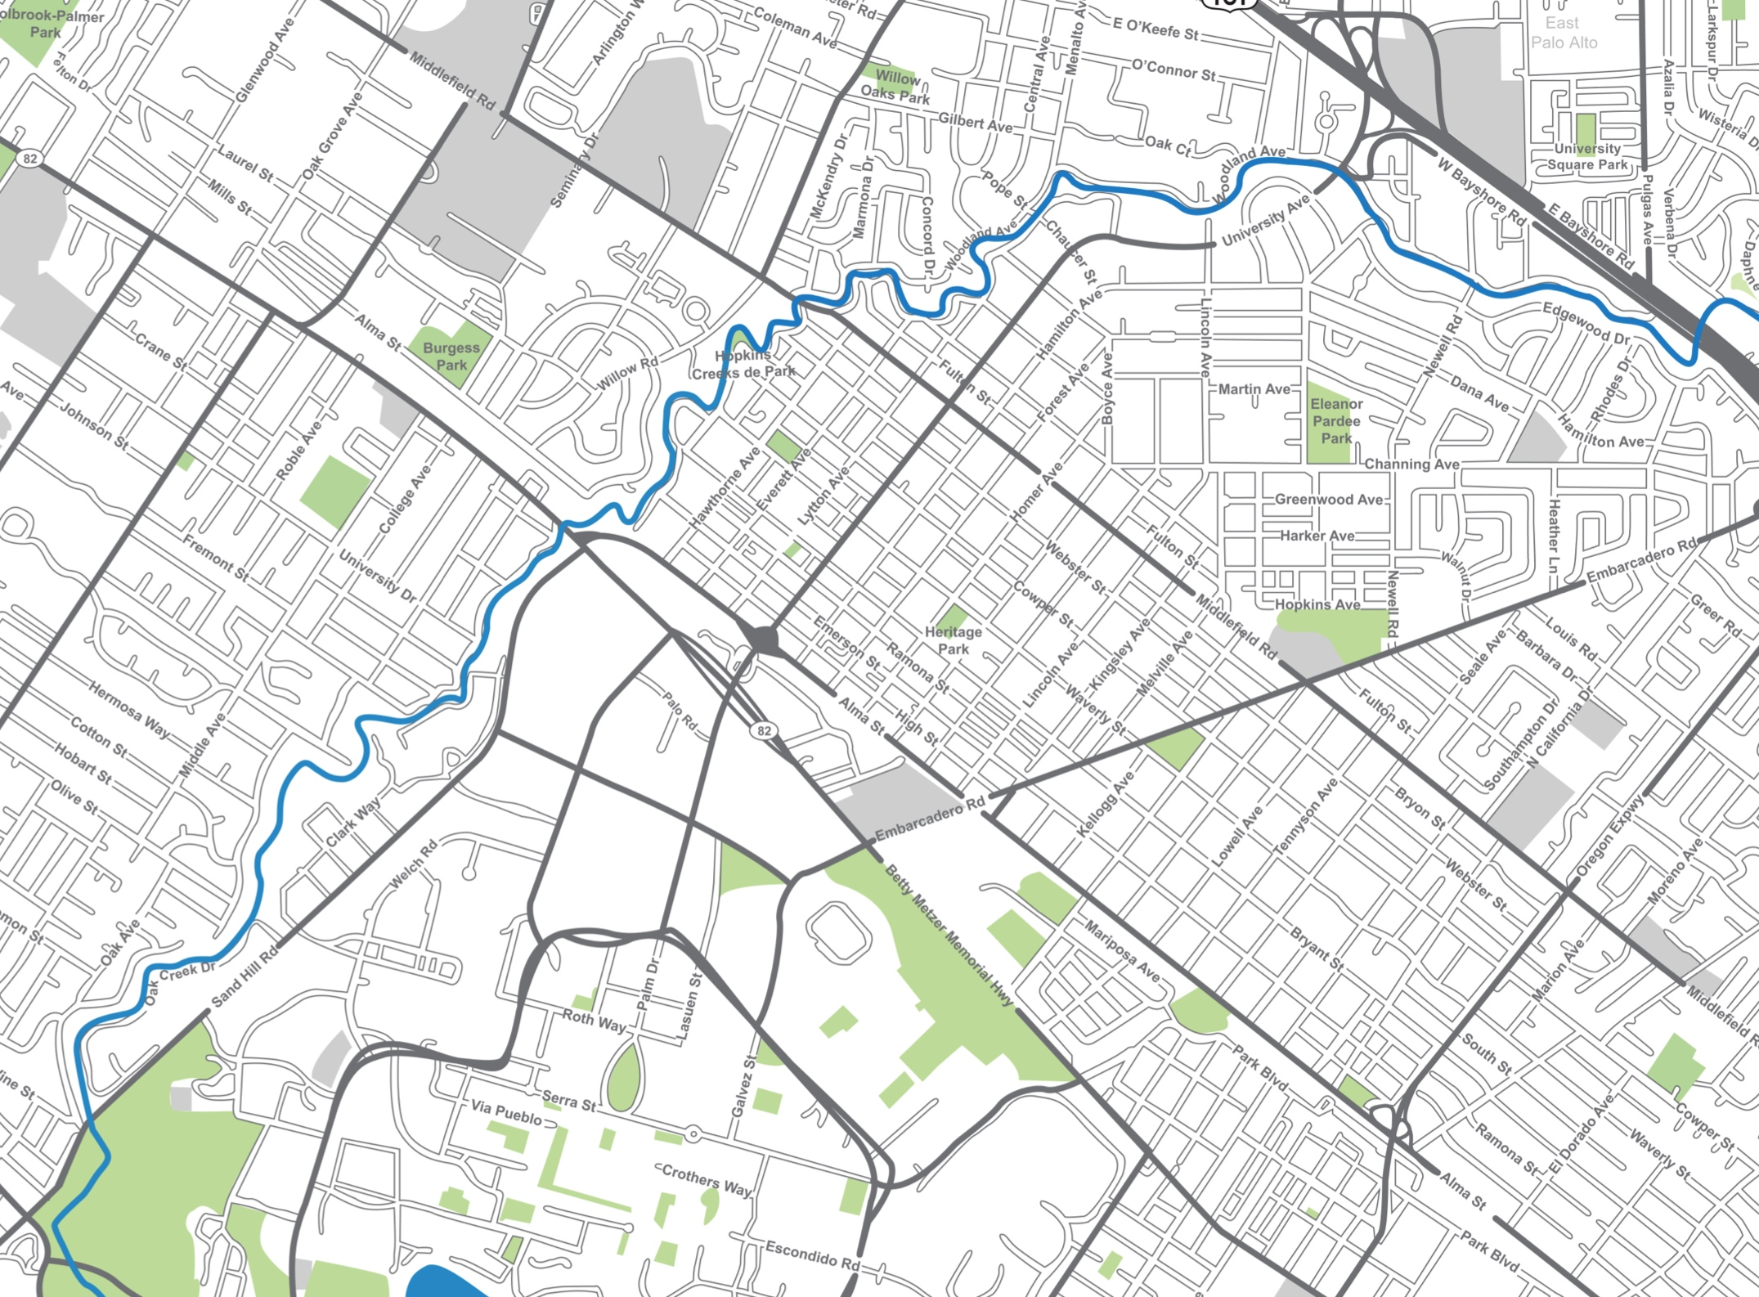
2015 – Debris removed in creek channel by location and responsible agency
= Menlo Park
= Palo Alto
= SCV Water District
= Stanford University
= San Mateo County FCD
= East Palo Alto

Slide 12
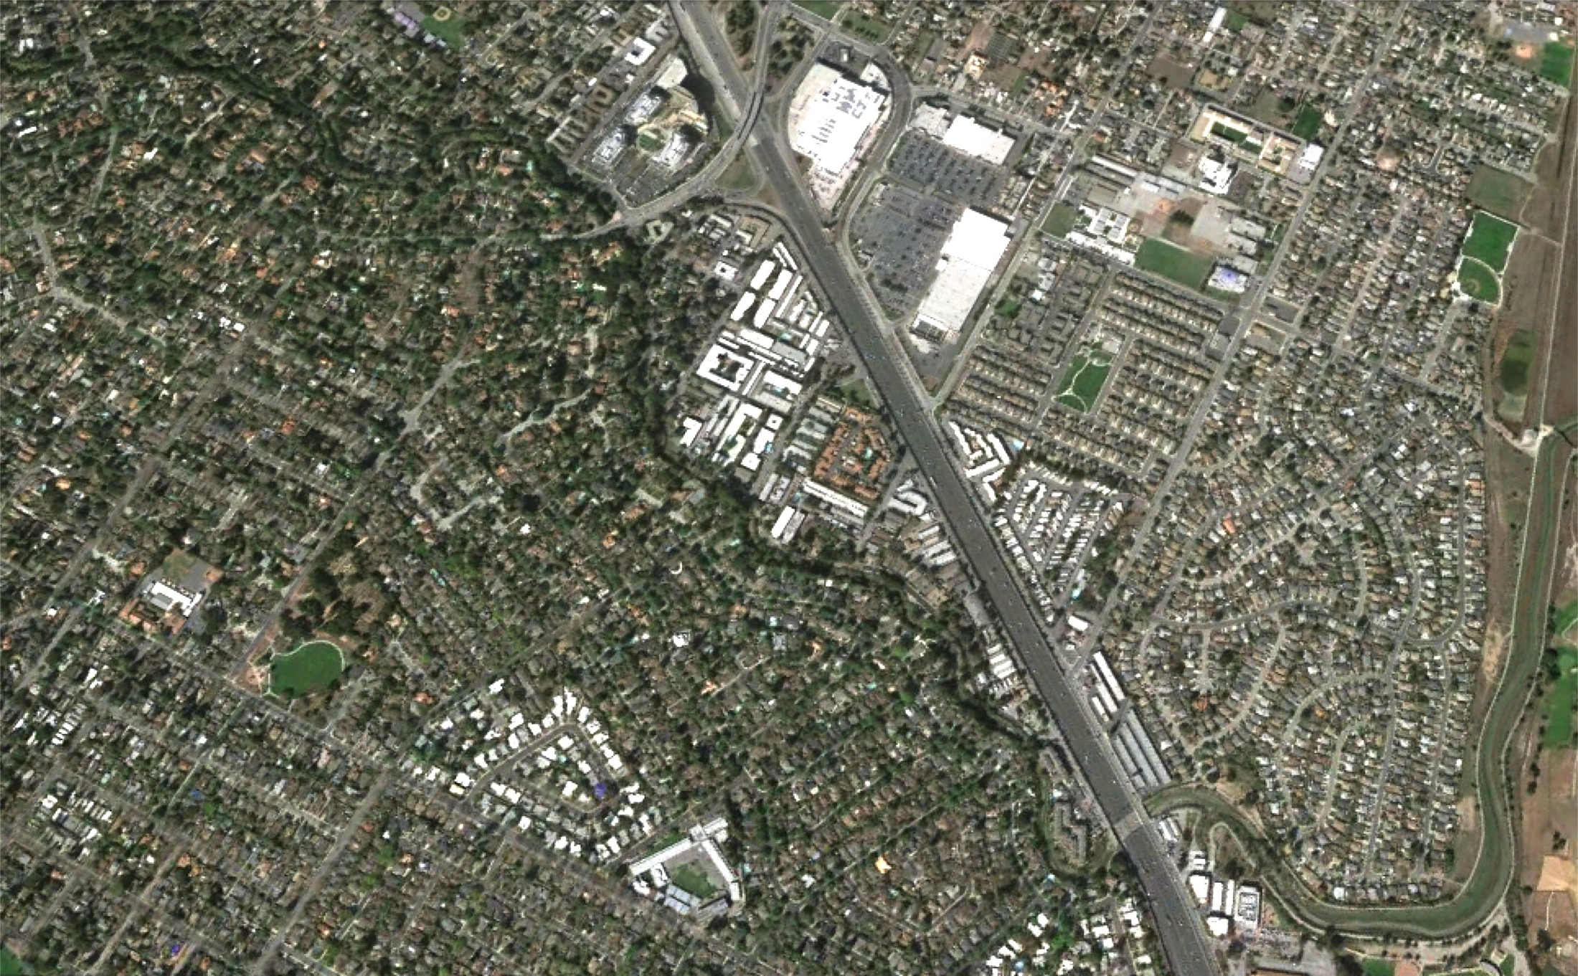
Reducing flood risk
Menlo Park
City actions to keep more water
in channel at selected locations
Sept. 2015
Nov. 2015
Aug. 2015
East Palo Alto
Palo Alto
Dec.
2015
2013
Dec. 2015

Slide 13
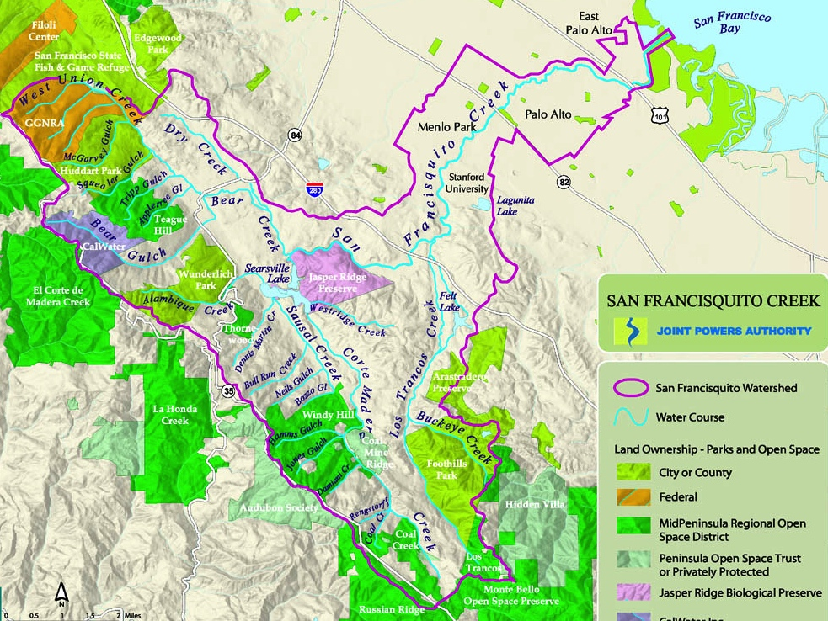
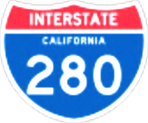

Improving the flood warning system
Pope-Chaucer depth gauge
Tide gauge
West Bayshore depth gauge
USGS flow gauge
(45 mins to Pope-Chaucer)
Stanford flow gauges
(1:45 to P-C)
New Rain gauges (3:15 to P-C)

Slide 14
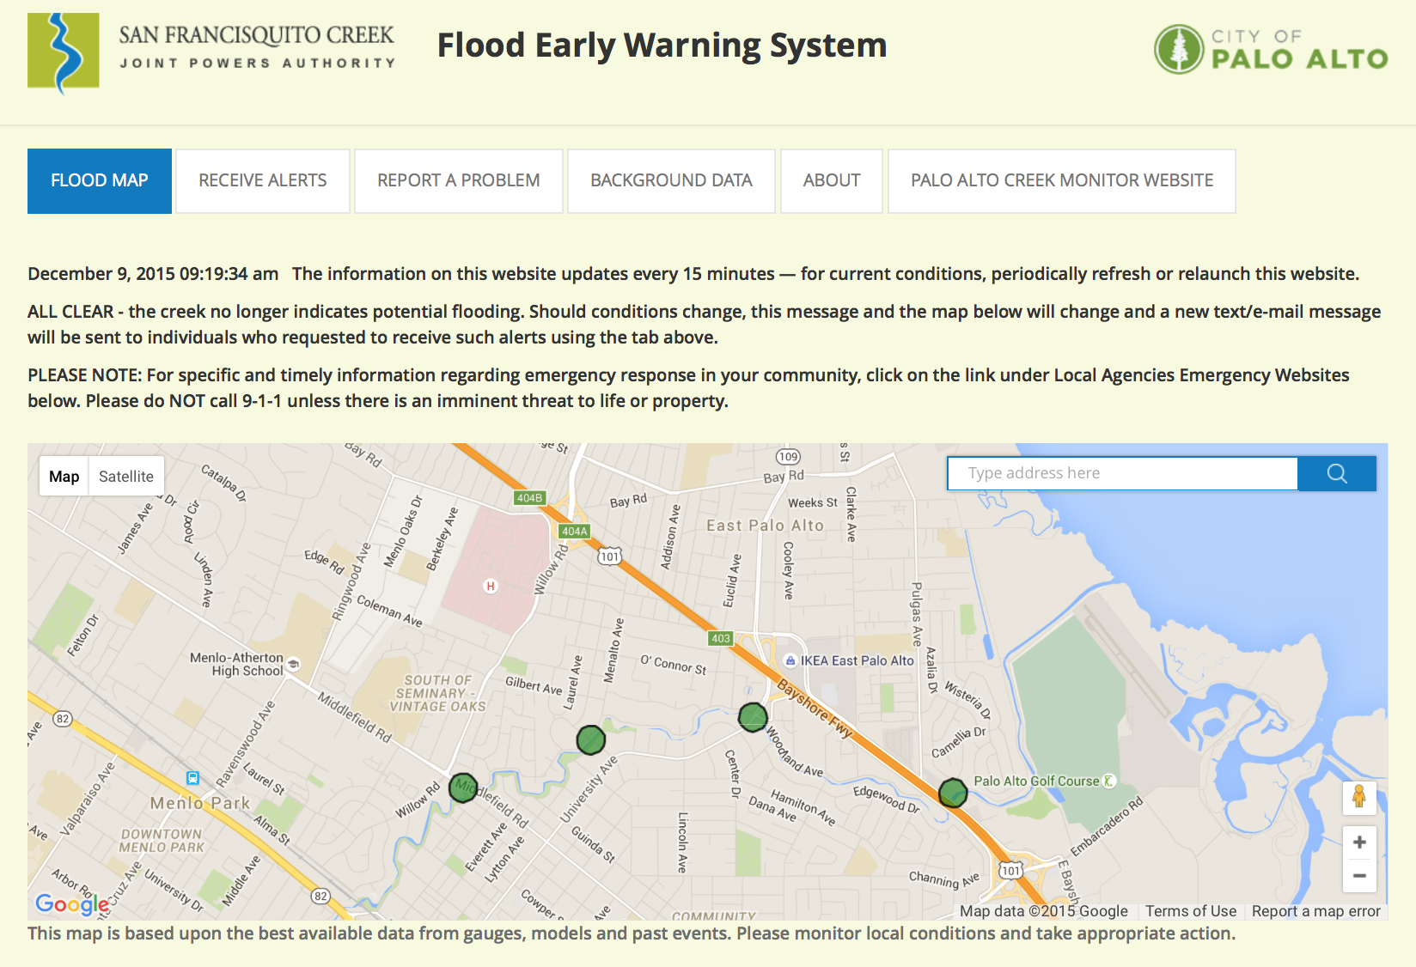
sfcjpa.org/floodwarning

Slide 15
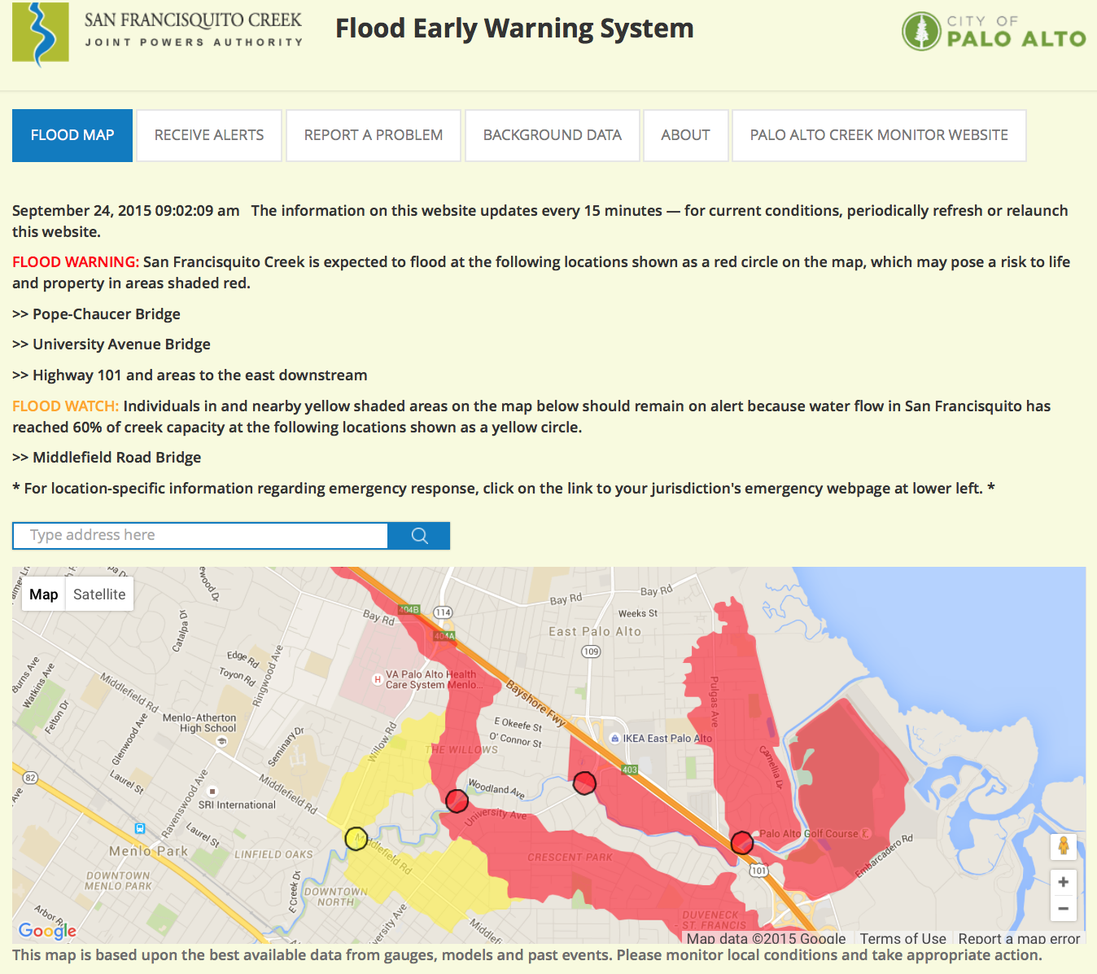

Slide 16
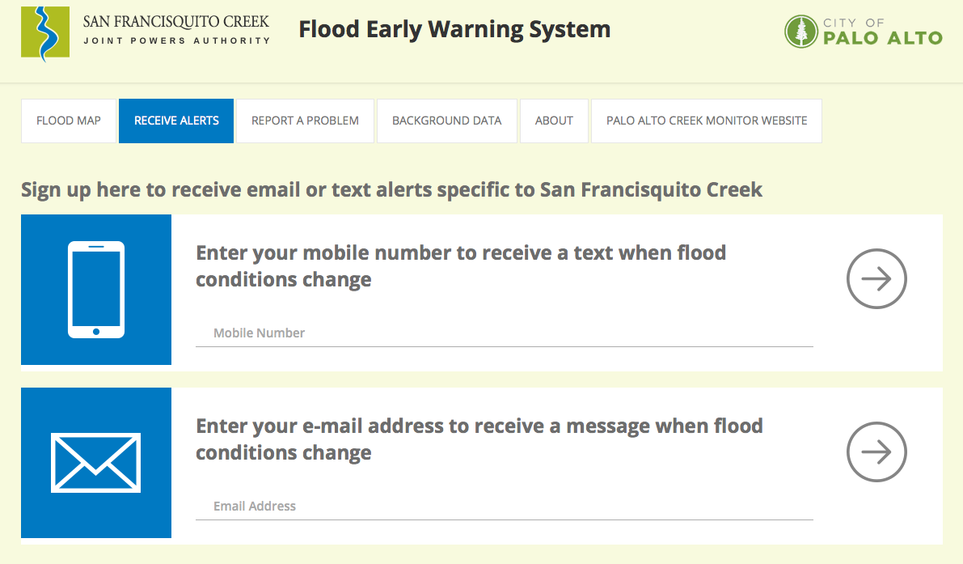

Slide 17
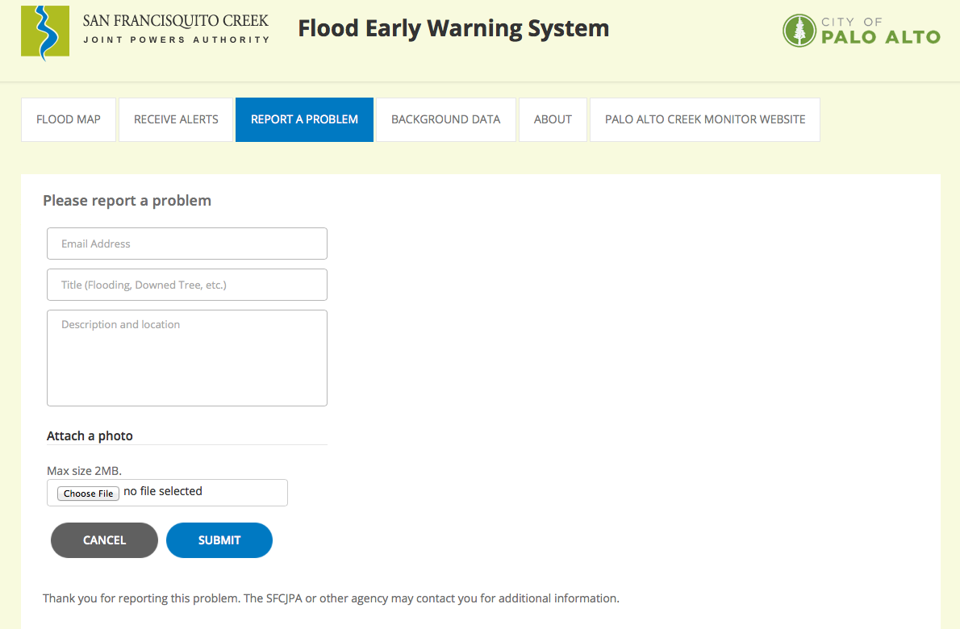

Slide 18
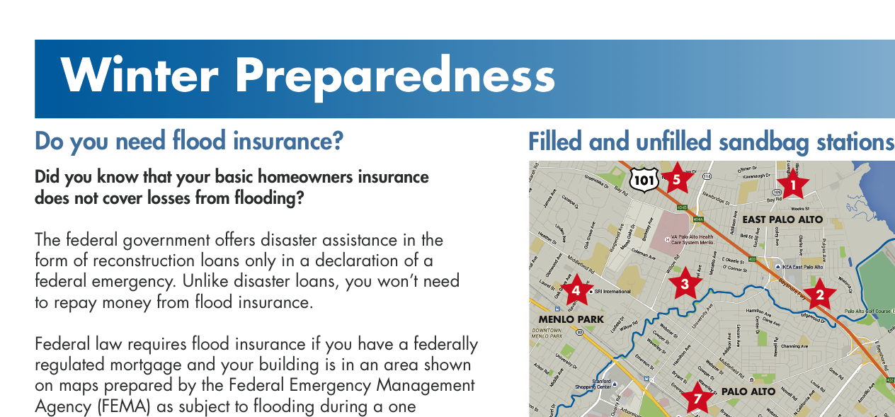
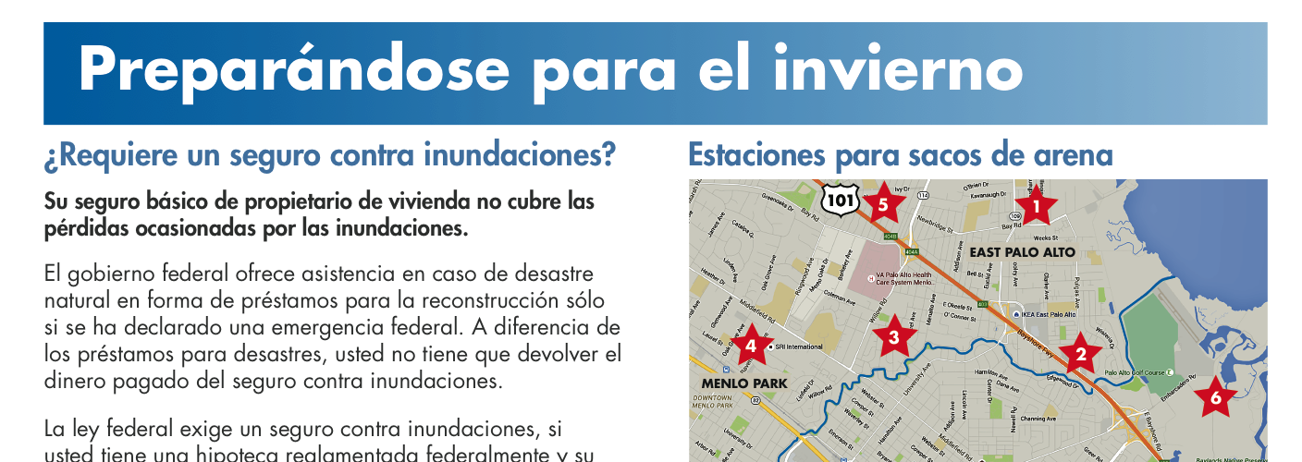
Public outreach through
English & Spanish mailings to 8,800 property owners and 4,000 renters, and many
community meetings

Slide 19
Questions and Answers

Slide 20
Levee heights from Friendship Bridge to Highway 101
2012: In one area, EPA levee higher by up to 12 inches.
Otherwise, PA levee higher by up to 6 inches.
Elevation in feet
2013: EPA raised
its levee
Dec. 2012 EPA flooding
19
18
East Palo Alto
17
Palo Alto
16
2015: EPA raised its levee where it was below PA levee; PA matched new height
15
14
13
Current maximum water elevation during high tide
Friendship
Bridge
End of Daphne Way
500 feet
E. Bayshore / Highway 101

