Slide 1
Advanced Water Meter Project
Jim Burch, Deputy Director, Maintenance & Operations
jburch@sanbruno.ca.gov
650-616-7179

Slide 2
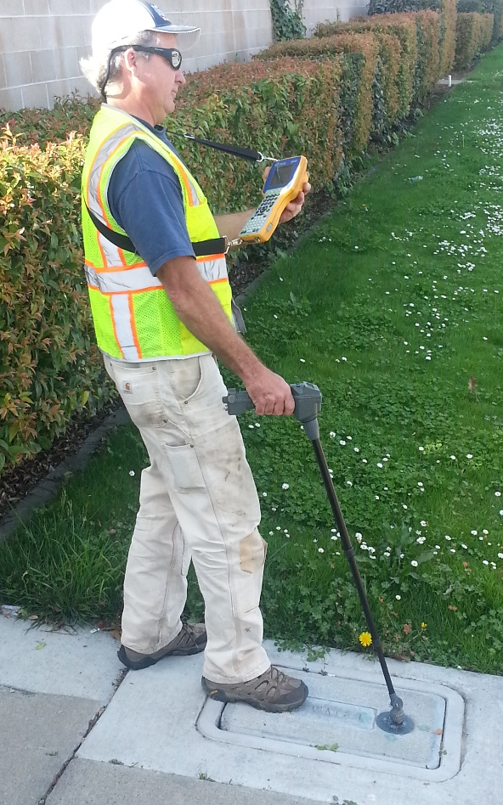
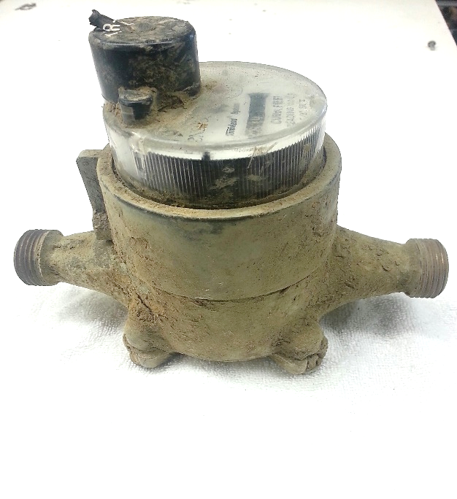
Existing Water Meters
10,511 residential meters City-wide
Installed in 1993 expected life of 20 years
Meters are increasingly inaccurate at low flow
Replace/Repair 500+ meters per year
Manual touch read system

Slide 3
Water Meter Repairs
2012-2013
2013-2014

Slide 4
Advanced Water Meter Project
Phase I
Total Construction Cost: $4.7M
Replace existing residential water meter system: $1.8M
Upgrade to advanced meter system: $2.1M
Project management & Inspection: $300,000
Construction Contingency 15%: $621,500
Schedule
July 2015 – March 2016
Phase II
Commercial Meters $1.5M

Slide 5
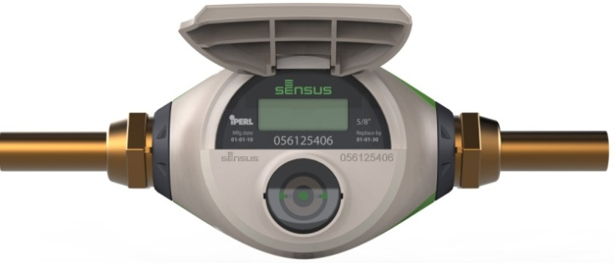
Advanced Meter System Features
Reduce Maintenance & Operations Costs
Reduce Water Loss & Water Leak Costs
Reduce Pumping and Power Costs
50% less head loss/meter
Enhanced, Proactive Customer Service

Slide 6
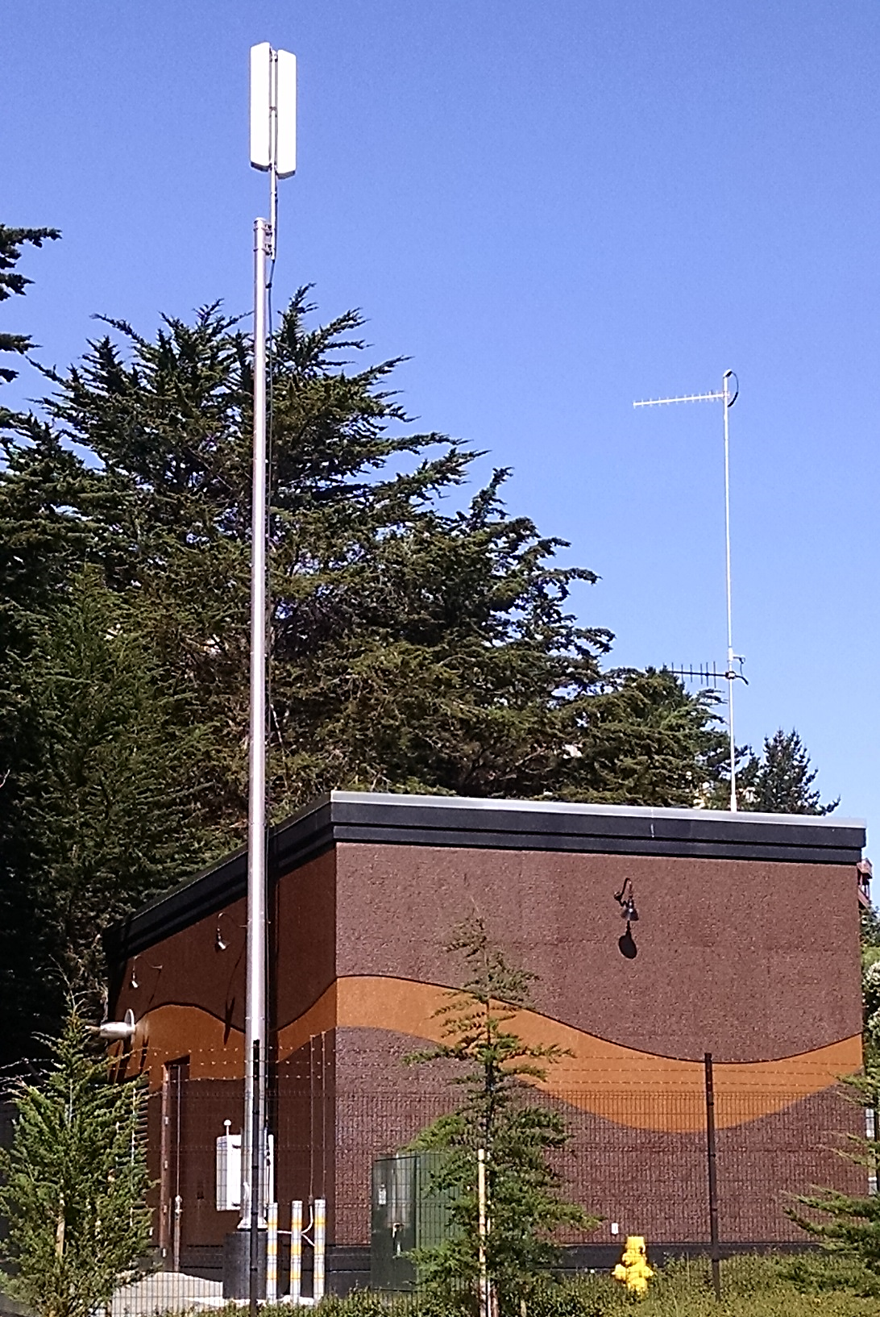
(4) Base Stations
(2) at Water Storage Tanks

Slide 7
Challenges During Implementation
Installation & Aging Infrastructure
Data integration & Billing
Customer Service & Information Sharing
Staff Training & Acceptance

Slide 8
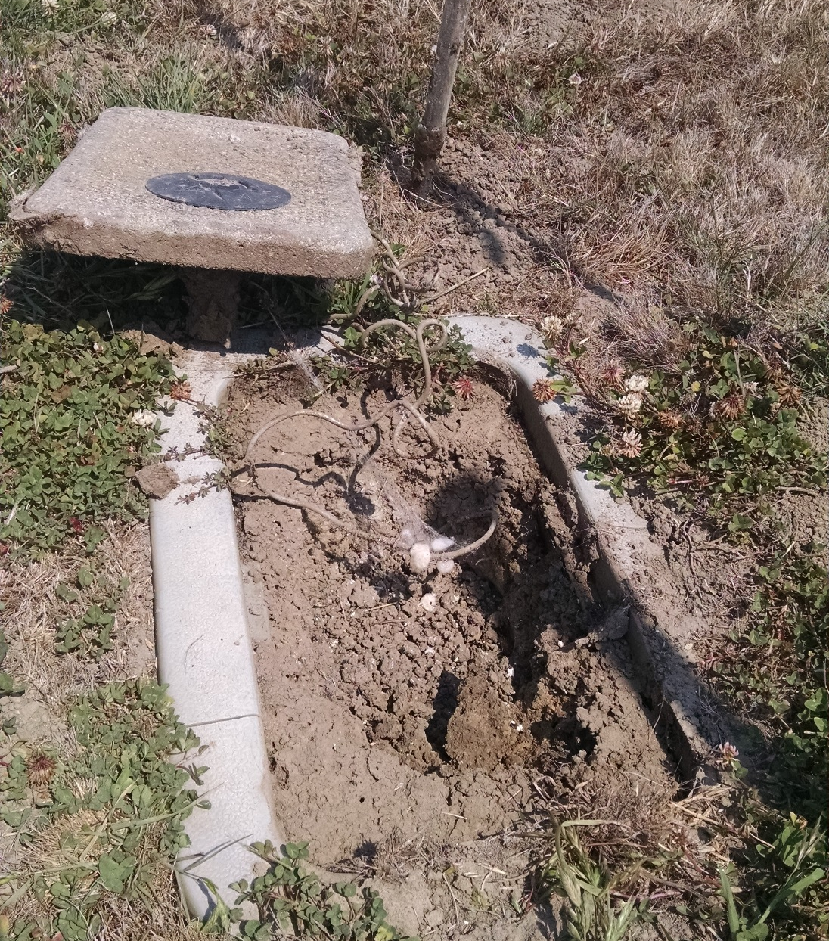
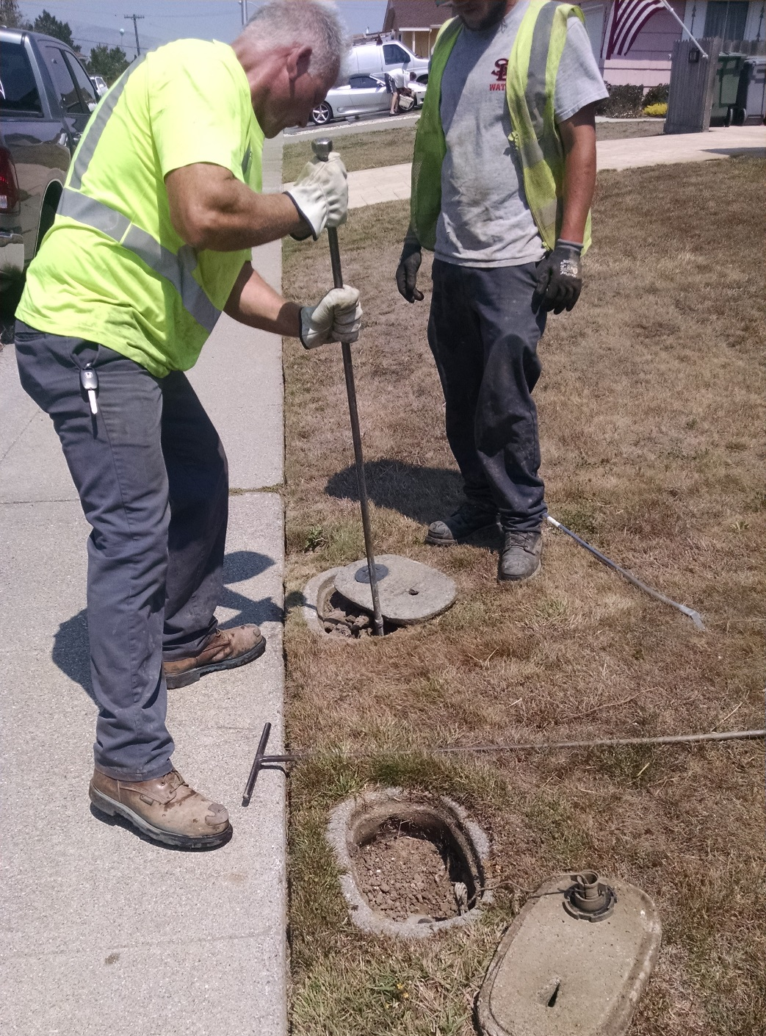

Slide 9
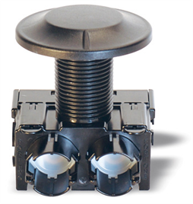
Enhanced Customer Service
Proactive alerts for leak detection
Real-time billing/usage data
Direct customer notification
Self-service /monitoring of usage
Reporting & analysis

Slide 10
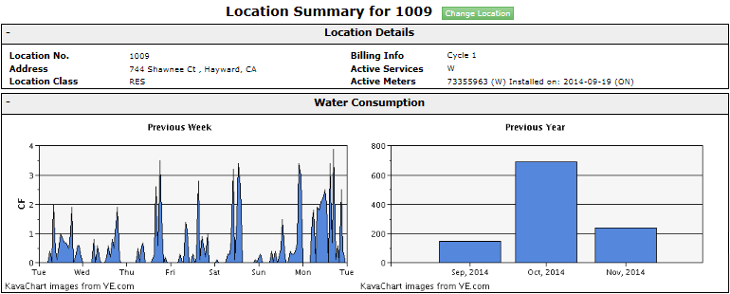
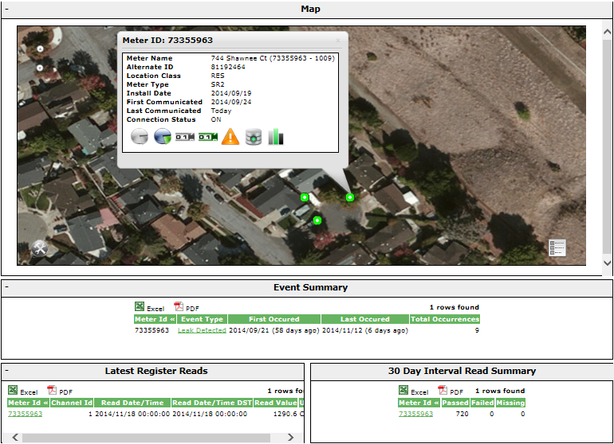
Customer Service Screen Shot

Slide 11
Water Conservation
Educate water users to keep track of their own usage
Managing water effectively by monitoring system
Reporting of water usage and conservation efforts

Slide 12
Customer Connect – Daily usage report
Customer Self-Service Screen Shot

Slide 13
THE END

