Slide 1
Peninsula Advanced Energy Community (PAEC)
Overview
Notes:
This presentation will focus on integrating renewables with cost-effective intelligent grid solutions, including demand response, storage, and advanced inverters. The presentation will show how to address grid reliability challenges (steep ramps, over-generation, voltage control, and minute-to-minute fluctuations) with preferred resources, staying aligned with California goals.

Slide 2
Clean Coalition Mission
To accelerate the transition to renewable energy and a modern grid through
technical, policy, and project development expertise
Notes:
2

Slide 3
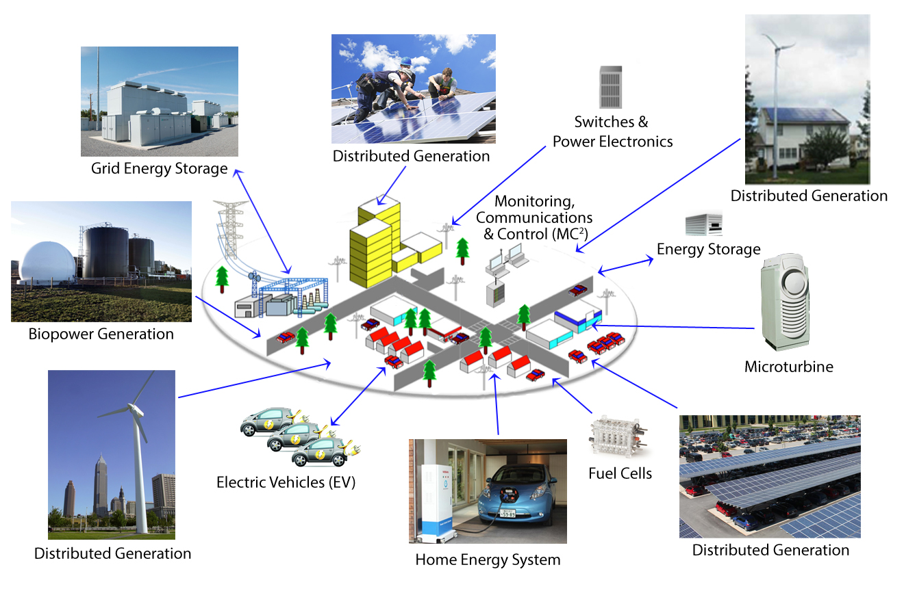
Clean Coalition Vision: Clean Local Energy
Notes:
Our goal: A cleaner, more reliable and more affordable power system.
3

Slide 4
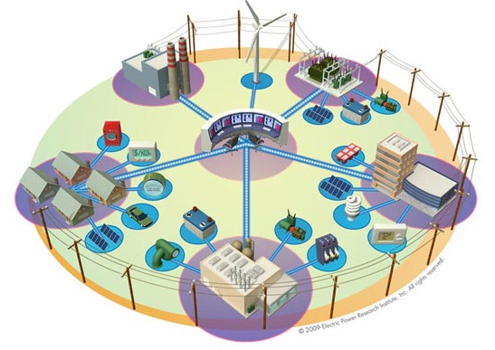


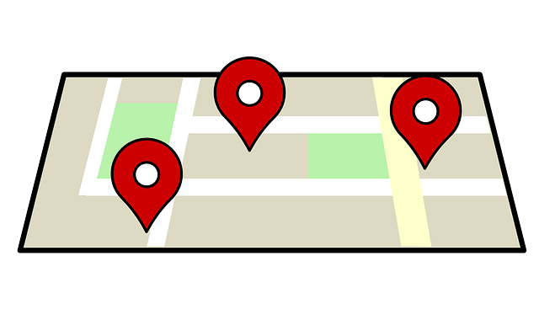
Clean Coalition Expertise
Community Microgrid Projects
Program Design
Grid Modeling & Optimization
Analysis & Planning
Renewable energy siting surveys
Full cost and value assessment
Powerflow modeling
Optimize local energy resources
Procurement and interconnection design
Design and implement innovative community-wide projects
Notes:
These steps build on one another and are interrelated. We have done work with electric utilities, regulatory agencies, legislators, and cities.
Distribution level modeling and optimization
DER siting
Also bring substantial policy & communications expertise
4

Slide 5
Peninsula Advance Energy Community (PAEC)
Funding: 20-month, $1.3 million California Energy Commission (CEC) planning & design grant to stage policy and project implementations that facilitate and showcase Advanced Energy Communities (AECs).
Policy: Identify best-practice AEC policies associated and stage to proliferate them policies throughout the PAEC region and beyond.
Projects: Identify showcase AEC projects and cross-fertilize them to projects throughout the PAEC region and beyond.

Slide 6
California Energy Commission (CEC) Funding
EPIC (Electric Program Investment Charge)
  $162 million annually from 2012‐2020
  “Addresses policy and funding gaps related to the development, deployment, and commercialization of next generation clean energy technologies”
  Funds must benefit the ratepayers of California’s three investor-owned utilities (IOUs) - PG&E, SCG&E, & SCE
Phase I EPIC grant
  $1.3 million over 20 months
  Planning and design of an AEC
  12 awards statewide, 4 in PAEC category (NorCal, non-EJ)
Phase II EPIC grant
  Must be a successful Phase 1 recipient to complete for Phase II
  Up to $8 million over 5 years
  Match Funding ≥ EPIC funds
  Build-out of an AEC
  Expect 1 award in PAEC category (NorCal, non-EJ)

Slide 7
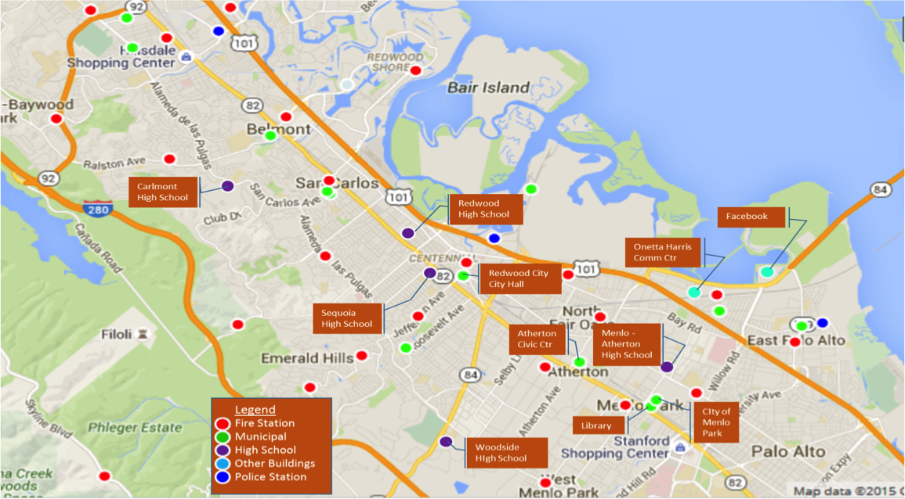
PAEC Geography
Core region: Southern San Mateo County within the boundaries of Redwood City, Atherton, Menlo Park, and East Palo; including embedded unincorporated areas.
Broad region: San Mateo County in its entirety plus City of Palo Alto.
California & beyond: PAEC region is representative of suburban California, largely built-out a facing development pressure; ensuring wide PAEC replication with relative ease.

Slide 8
PAEC Core Tasks
Streamlining of Permits, Codes, and Ordinances that facilitate AECs
Streamlining interconnection of AEC projects to the grid
Financial and Business Models that facilitate AECs
Solar Emergency Microgrids (SEM)
Electric Vehicle Charging Infrastructure (EVCI) Master Plan
Atherton Civic Center Net Zero Energy (NZE) & Fuel Switching (FS) Showcase
Solar Siting Survey (SSS)
PAEC Case Study & Master Community Design

Slide 9
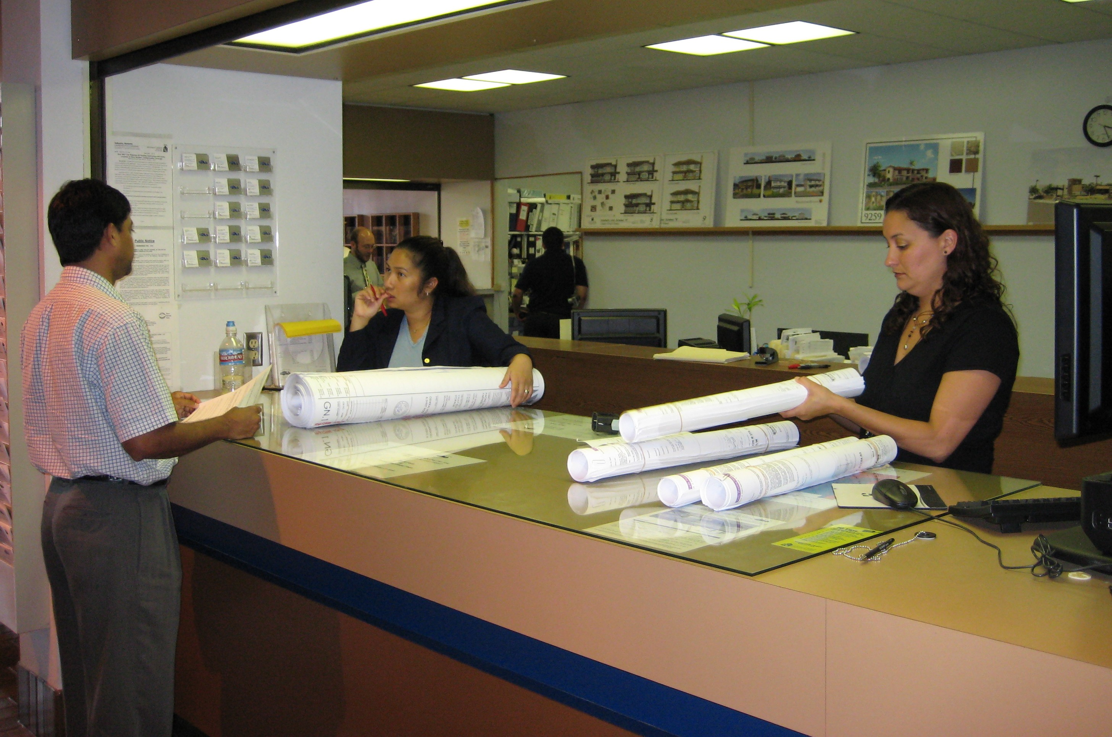







Streamlining AEC project approval
Identify Best Practices
  Renewable Energy, Energy Efficiency, ZNE, EV charging, …
  Title 24, Reach Codes, LEED, BIG, …
Identify gaps separating current and best practices; recommend improvements
Benefits-Cost Analysis of recommendations
Develop Model Ordinances for San Mateo County jurisdictions
Countywide working group will review and comment on recommendations
GAP
Analysis

Slide 10
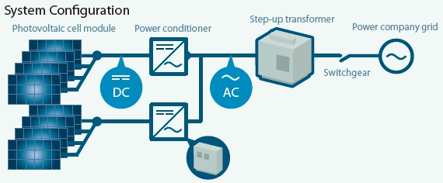
Streamlining Interconnections
Goal: Reduce the time, cost, and uncertainty associated with interconnecting AEC projects to the electrical grid
Recommend utility interconnection process enhancements
Review Status of Rule 21 implementation by the utilities
Examine utilities data collection and access practices
Identify necessary steps for Fast Track and process automation
Evaluate interconnection cost responsibility
Investigate methods to refine dispute resolution procedures
With PG&E, design a pilot streamlined interconnection procedure for commercial scale renewables
Assist public agencies and other entities in navigating the interconnection process
Recommended siting opportunities with high Interconnection Hosting Capacity

Slide 11

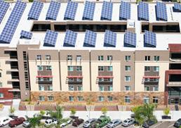
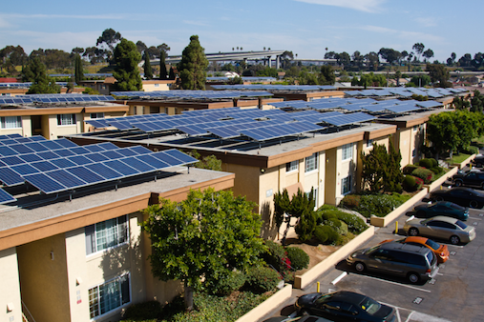
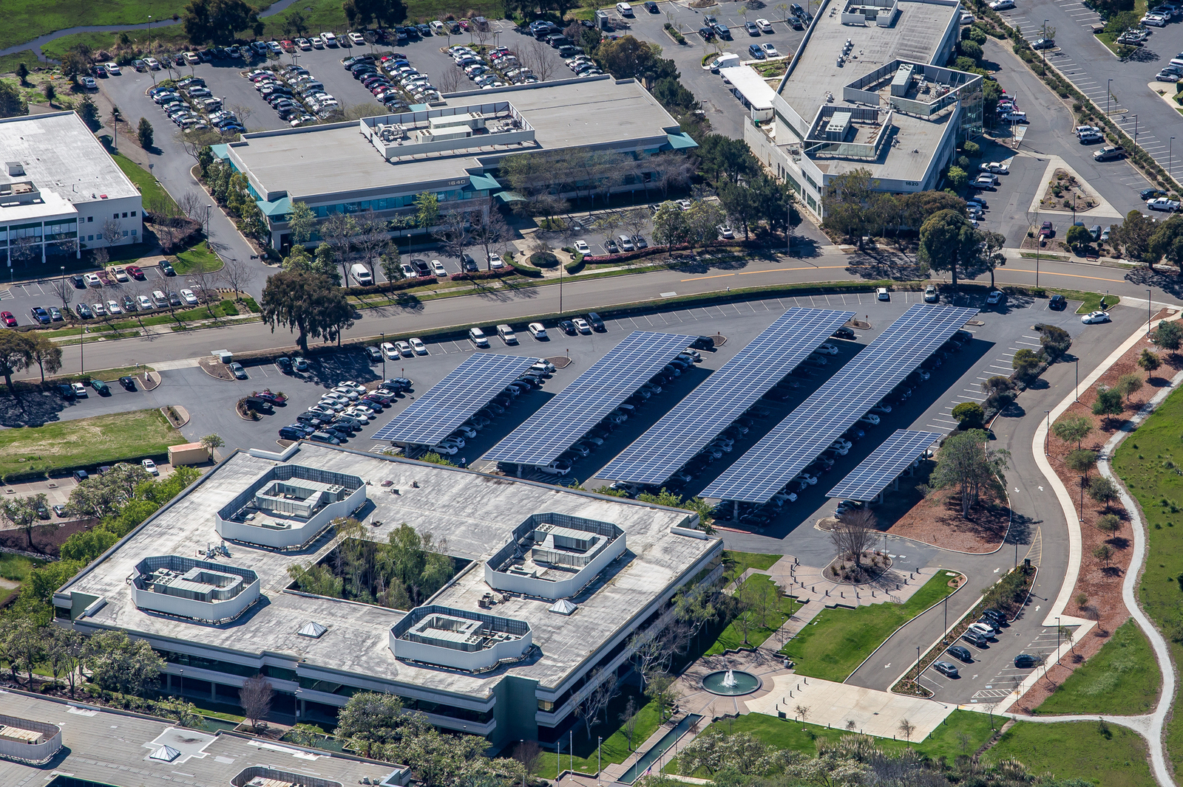
Finance and Business Models for AEC projects
Valuing AEC components
  Financial model, including cost of capital, risk/return & maturity
Capital & Financing for AEC projects
  PACE, FIT, Green Bonds
  Incentives and disincentives
  Owner and non-owner occupied buildings
Benefits-Cost Analysis of AEC projects
  Energy Storage, EVCI, EE, RE
Economic Analysis of building retrofits
Recommend best practices for benchmarking and tracking energy usage

Slide 12
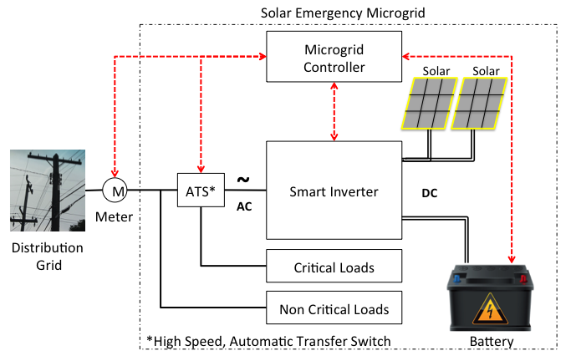
Solar Emergency Microgrid
The PAEC project will plan and design a Solar Emergency Microgrid (SEM) for a critical facility
  Solar power, energy storage, monitoring & control
The SEM will provide indefinite back-up power for critical loads
Ideal for police and fire stations, emergency operations centers and shelters, pumping stations, etc.
Displaces dirty, expensive, non-renewable diesel generators

Slide 13
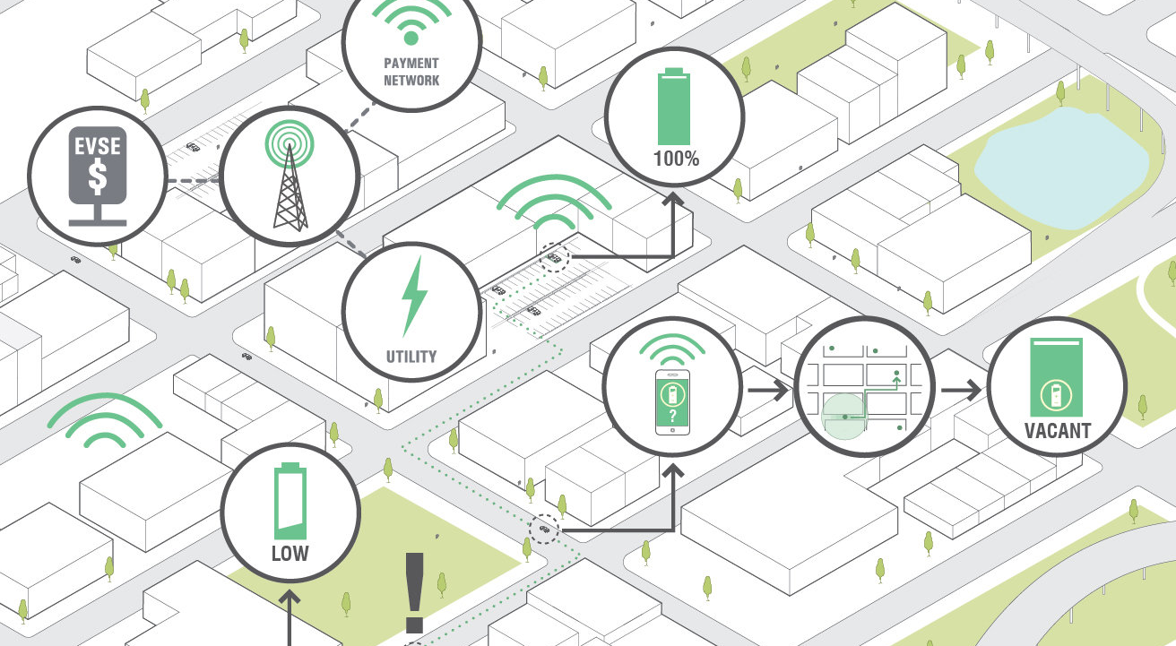
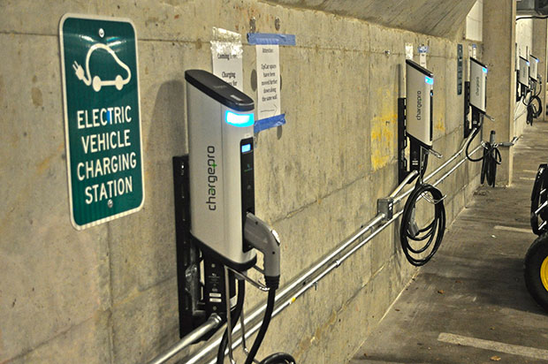
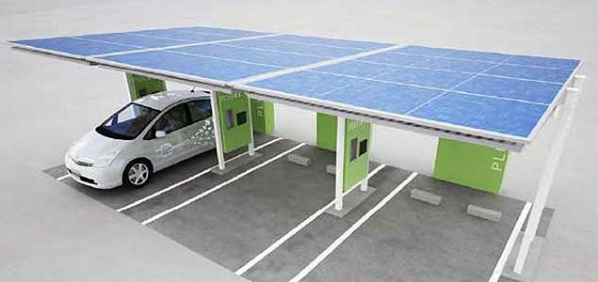
Electric Vehicle Charging Infrastructure (EVCI)
Develop and EVCI Master Plan for one PAEC city
Evaluate
  EVCI quantity and locations
  Charger type(s) & expected demand
  Feeder locations and hosting capacity
  Construction, ADA, & regulatory requirements
  Cost and financing
Present prioritized list of chargers to the City for approval and adoption

Slide 14
Atherton Civic Center Showcase
Design Development of Civic Center’s Sustainability Features
  ZNE, EE, RE, Fuel Switching, water saving and storage
  No natural gas service (no natural gas plumbing whatsoever)
  Scorecard of potential green building initiatives
  Benefit-Cost Analysis
Project timed to begin build-out in 2018, perfect for PAEC Phase II

Slide 15
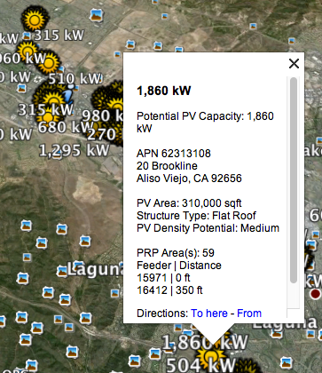
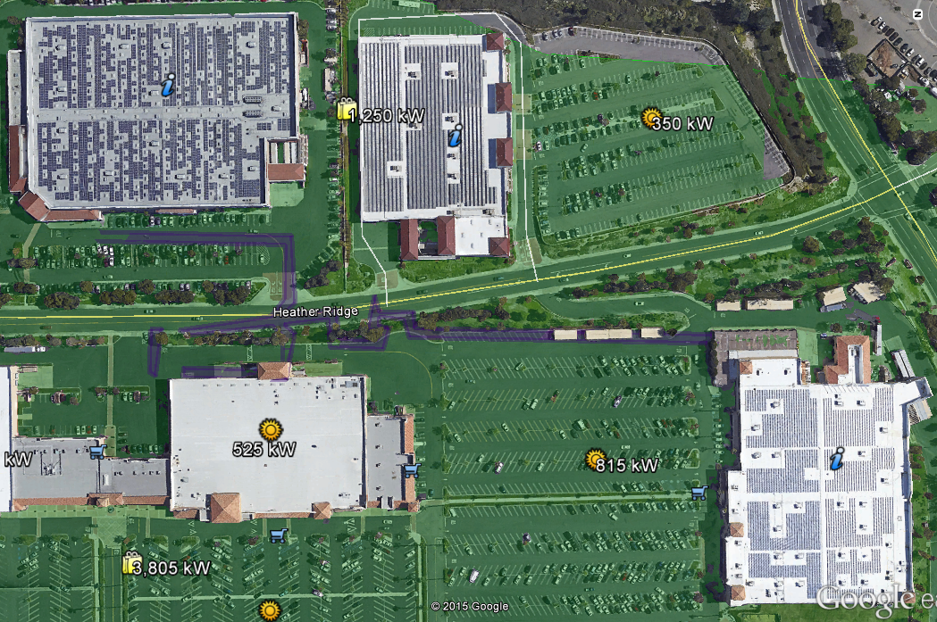
Solar Siting Survey (SSS)
Commercial scale (>100 KW AC) solar siting survey of entire PAEC region
  Generation potential, accounting for location, roof clutter, shading, etc.
  Include roofs and parking lots
  Estimate feeder distance and hosting capacity
Results presented in graphical and tabular form (Google earth & Excel)
Low
High
Medium

Slide 16


SSS Example from SCE Preferred Resources Pilot
PRP Solar Potential by site size
PRP Solar Potential by site type

Slide 17



















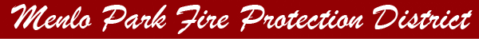
PAEC Collaborators – So Far

Slide 18
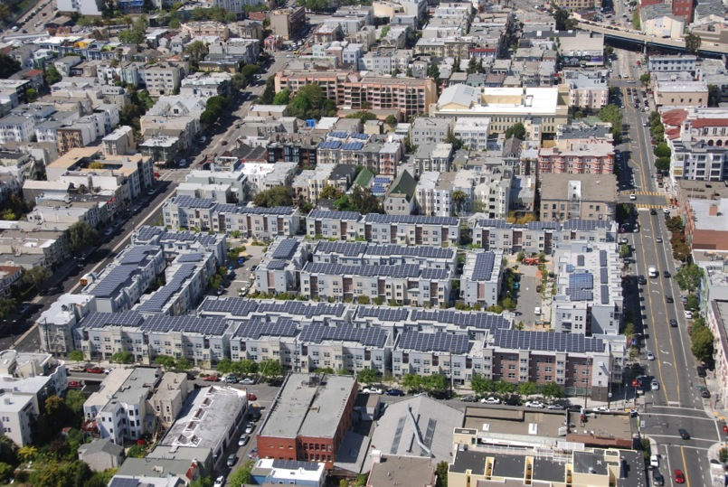
Peek at the PAEC Future
Ecoplexus project at the Valencia Gardens Apartments in SF. ~800 kW meeting ~80% of the total annual load.
Notes:
18

Slide 19
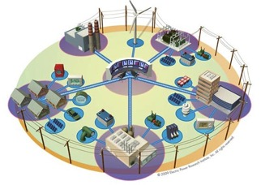
Ultimate PAEC = Community Microgrids
A Community Microgrid is a new approach for designing and operating the electric grid with high penetrations of local renewables and achieving a more resilient and cost-effective energy system.
Key features:
A targeted and coordinated local grid area served by one or more distribution substations
High penetrations of local renewables and other Distributed Energy Resources (DER) such as energy storage and demand response
Ongoing renewables-driven power backup for critical and prioritized loads across the grid area
A solution that can be readily extended throughout a utility’s service territory – and replicated across utilities

Slide 20
Community Microgrid in Long Island (50% Solar)

Slide 21
Backup

Slide 22
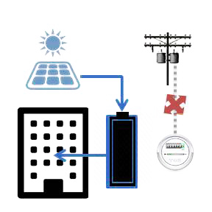




Vision of an Advanced Energy Community (AEC)
Streamlined Project
Approvals
ZNE Buildings Everywhere
Solar Microgrids at
All Critical Facilities
ADVANCED ENERGY
COMMUNITY
EVs Everywhere
Solar Everywhere
Low Cost
of Capital
Feed-In Tariff
= Fair ROI
Streamlined Interconnects

Slide 23
Vision of an Advanced Energy Community (AEC)
A high percentage of power generated from local, renewable sources
Energy is used as efficiently as possible
New commercial construction is 100% ZNE before the 2030 Title 24 requirement
More than 50% of existing commercial buildings retrofit to ZNE before 2030 Title 24 requirement
Approval of AEC projects is quick and efficient
Capital to fund AEC projects is readily available
Interconnecting local renewables to the grid is straightforward
The grid is stable, robust, and reliable
Energy storage is affordable and widespread
Electric transportation replaces the internal combustion engine and electric vehicles support the grid
Solar Emergency Microgrids are installed at all critical facilities, including police and fire stations, emergency operations centers, and emergency shelters, increasing resiliency

Slide 24
PAEC Core Tasks
Streamlining of Permits, Codes, and Ordinances: Recommend policies that PAEC municipalities should take to facilitate the planning and deployment of AECs.
Financial and Business Models for Advanced Energy Communities: Develop comprehensive financial and business models to help make AECs financially attractive to similar community developments without advanced energy attributes.
Streamlining the connection of AECs to the grid: Reduce the time, cost, and uncertainty associated with interconnecting DER projects to the electric grid.
Solar Emergency Microgrids: Design at least one solar emergency microgrid (SEM) within the PAEC region that will provide renewables-driven power backup to critical facilities.
Electric Vehicle Charging Infrastructure Master Plan: Create an electric vehicle charging infrastructure master plan for one jurisdiction within the PAEC region.
Atherton Civic Center Sustainability Features: Assess the technical and economic feasibility of incorporating sustainability features, beyond code requirements, into Atherton’s new Civic Center.
Solar Siting Survey: Identify feasible, commercial-scale sites for installing 100 kW or larger solar PV and assessing the Interconnection Hosting Capacity for each site

Slide 25
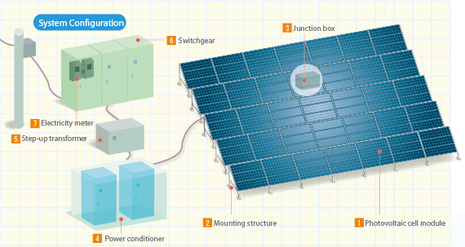
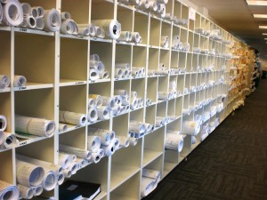
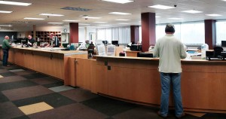
Backup Graphics

