Slide 1
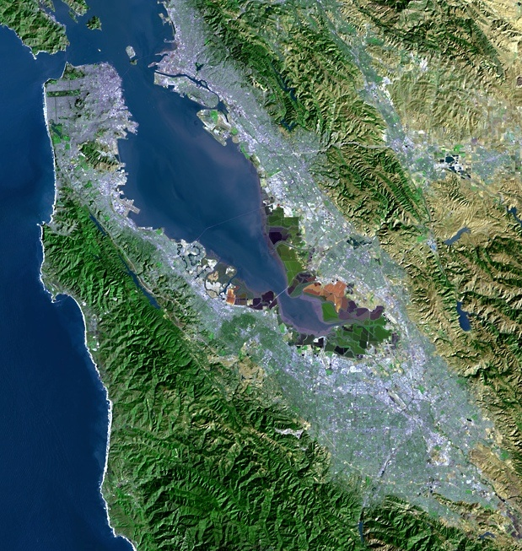
Update on Water Supply Conditions and Recent State Actions
“A multicounty agency authorized to plan for and acquire supplemental water supplies, encourage water conservation and use of recycled water on a regional basis.”
[Bay Area Water Supply and Conservation Agency Act, AB2058(Papan-2002)]
Adrianne Carr
Senior Water Resources Specialist
Bay Area Water Supply and Conservation Agency
May 18, 2016

Slide 2
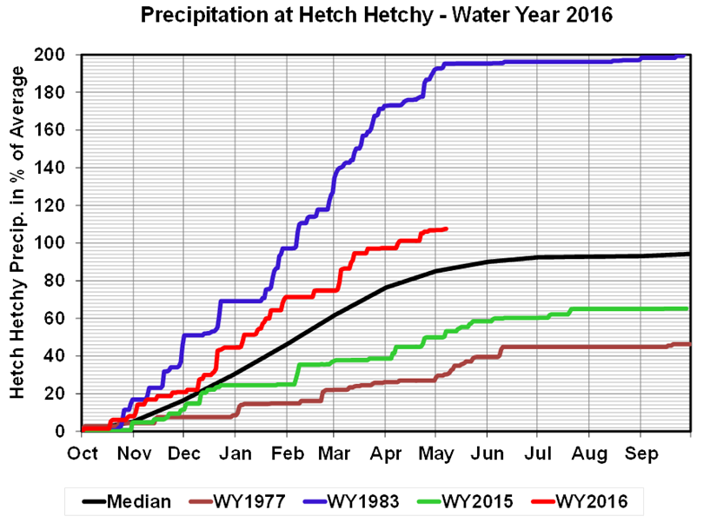
Precipitation

Slide 3
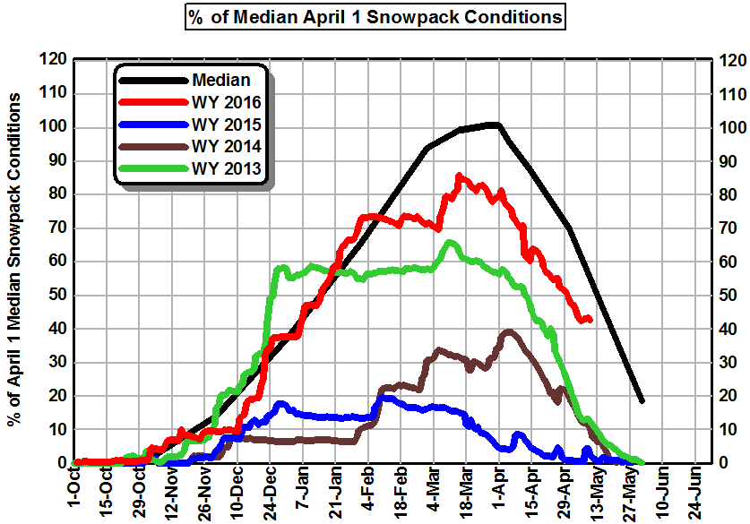
Snowpack

Slide 4
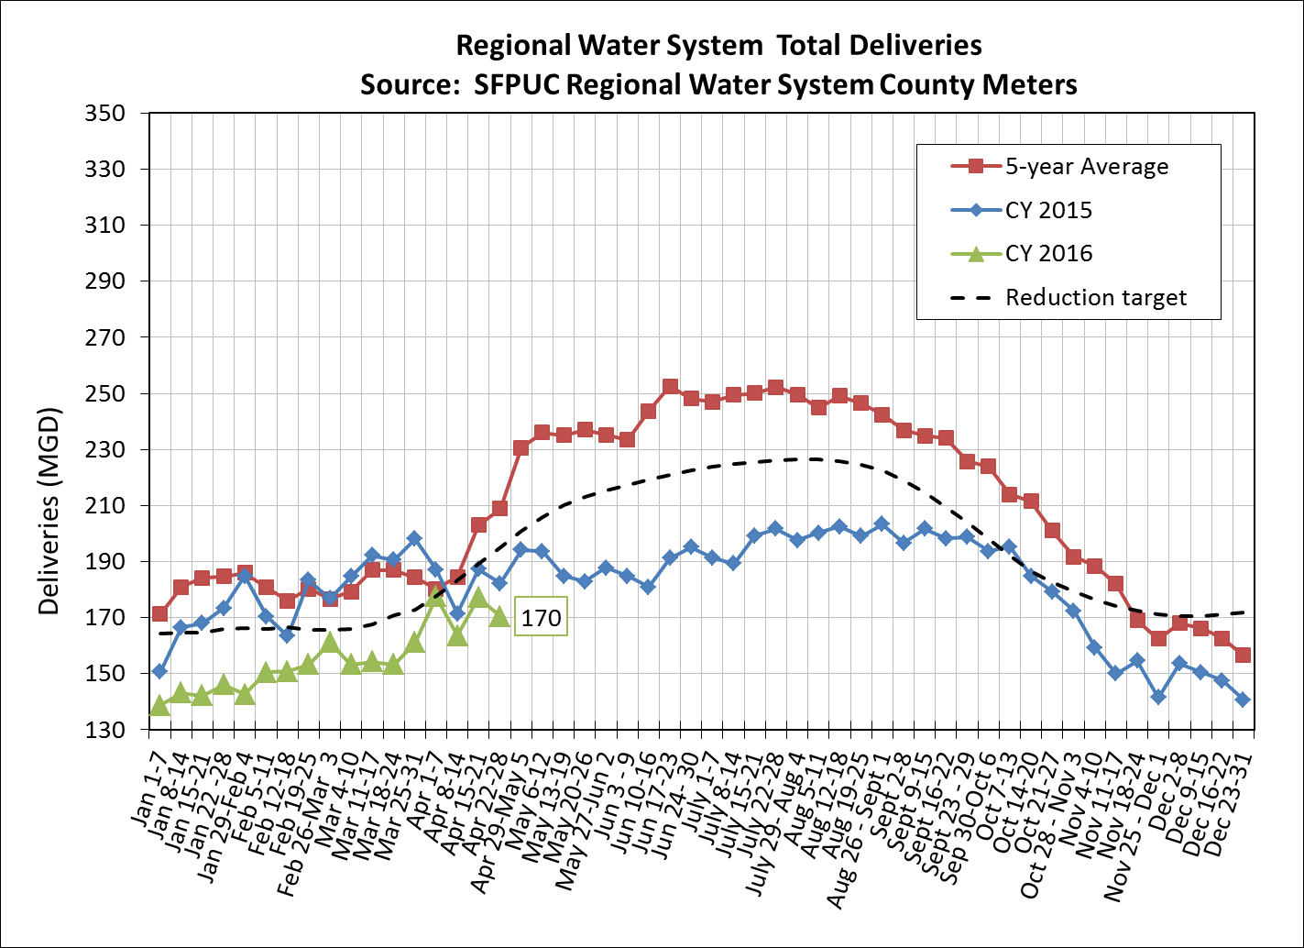
Total Deliveries

Slide 5
Agencies Achieved 26.3% Cumulative Savings June 2015 through Mar. 2016
26.3% Cumulative Savings from 2013

Slide 6
Governor and State Board Issued New Conservation Directives
May 9th Executive Order (EO) extends SWRCB emergency regulations through January 2017
Concurrent with EO, the State Water Board released a proposal to amend current emergency regulations
Proposed regulations make substantive changes to current mandates
State Board to adjust current emergency regs based on local water supply & demand conditions
Regulations scheduled to be adopted today
Notes:
and to address more frequent and persistent future drought conditions.

Slide 7
Governor Provides Direction to DWR, SWRCB and Others
State Board must prepare a proposal to achieve mandatory reductions should drought extend into 2017
Directs Dept of Water Resources & State Board to develop a new permanent framework for urban water use reductions
Draft permanent regulations by end of 2016
Shall be based on strengthened standards for:
Indoor residential per capita water use
Outdoor irrigation
Commercial, industrial, and institutional use
Water lost through leaks
Notes:
and to address more frequent and persistent future drought conditions.

Slide 8
Executive Order Addresses Each Agency’s Long-term Planning Role
DWR shall strengthen requirements for urban Water Shortage Contingency Plans
DWR, SWRCB and CPUC shall direct actions to minimize water system leaks
SWRCB shall permanently prohibit identified practices
Permanently requires Agricultural Water Management Plans by specified water suppliers
Notes:
and to address more frequent and persistent future drought conditions.

Slide 9
There is Much to Like in Proposed SWRCB Regulations
Replaces state developed standards with locally developed standards based upon an individual agency’s supply reliability
Urban water suppliers would “self-certify” level of available supplies assuming three additional dry years
Any calculated shortage would determine the level of conservation necessary to assure adequate supply

Slide 10
There is Much to Like in Proposed SWRCB Regulations
Urban water wholesaler shall calculate volume of water that it expects to annually deliver in the next three years under the assumptions by June 8th
Agencies must determine, certify, and report new conservation standard to SWRCB by June 15, 2016
Compliance with new standard begins June 1, 2016
Compliance with conservation standard measured monthly and assessed on a cumulative basis through January 2017

Slide 11
SFPUC to End Call for Mandatory Conservation
Wholesale water supplies must also “self-certify” and provide data to retailers by June 8th
Calculations show no need for mandatory conservation going forward
Likely to continue call for voluntary reductions of 10%
Use water wisely
Individual BAWSCA agencies with multiple supplies may still require mandatory conservation
All agencies still required to report water use to State

