Slide 1
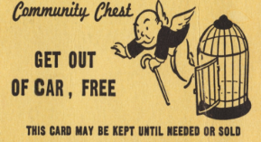
Reduce Bay Area Commuting 25%
Smart Mobility Project
Commute Trip Reduction – CTR
steve.raney@jointventure.org
Goal: Inform, stimulate long-range thinking.

Slide 2
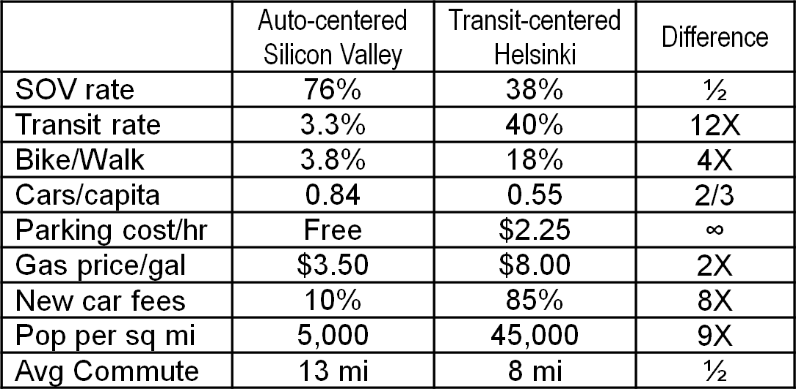
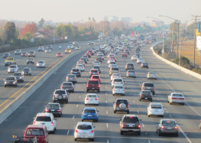
Silicon Valley Loves Cars
San Francisco ≈ Helsinki
42% SOV, 32% transit, 13% bike/walk
Downtown SF: 9% SOV

Slide 3
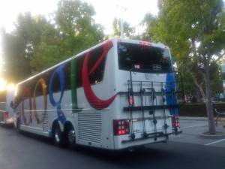
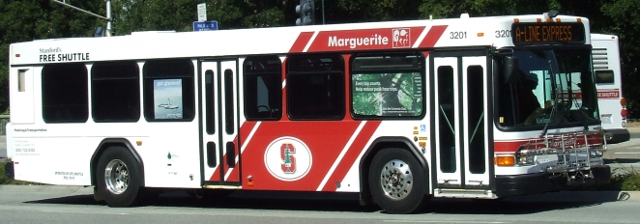
Scalable CTR versus Expensive
50% SOV
By Palo Alto Caltrain: 38% SOV
Scalable: Stanford carrots / sticks
75% to 50% SOV
$3/day SOV fee ➔ $ for bike, carpool, transit (feebate)
Saved $107M in new parking structures.

Slide 4
State / Regional Policy
US outlier ➔ change vector
Climate & congestion
20% of 1990 transport emissions by 2040
Large GHG reduction via EV
- 15% per capita driving/VMT
Carpool freeway lanes: HOV/T 2 ➔ HOV/T 3
HOV/T 3 ➔ 3 general purpose lanes

Slide 5
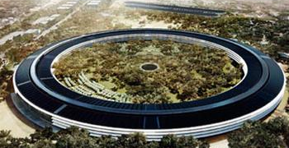
Silicon Valley Trip Caps
Apple, N. Bayshore, FB, Sunnyvale Peery (‘89 Stanford GUP)
Max SOV commute mode share: 30% to 66%
Facebook: $50/day/trip over
Enterprise CTR software
Real-time dashboard with commute mode & parking use
Employer can provide dashboard to city & region
IoT ➔ detect commute mode (SOV, carpool, bike, Scoop, transit, ..)
Carrots & sticks (paycheck)
11 pilots by employers.

Slide 6
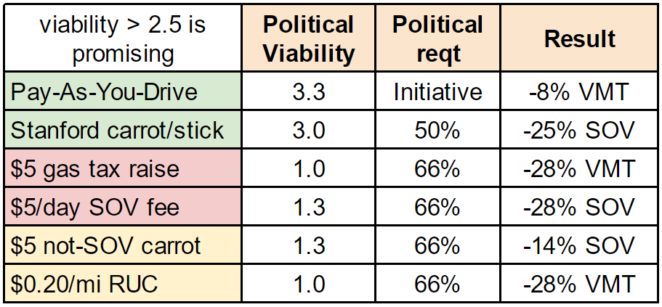
Most Politically Viable Pricing?
Pricing: a) balance transport budget, b) change behavior
Proposition 26 ➔ 66% vote on many fees

Slide 7
Fair Value Commuting
ECTR
Enterprise Commute Trip Reduction
MobAg
Mobility Aggregation
Feebate
Similar-to-Stanford Carrot/Stick
Gap-Fill
New commute options
Systemic Obstacles
integrate
ECTR- automate employer commute program
MobAg – app replaces your car
Feebate - $3 SOV fee is rebated to non-SOV
Gap-Fill – WAZE RideWidth, etc
At ~40% ➔ 100% in two years

Slide 8
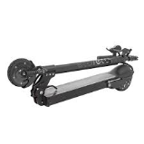
Innovative business model / 6 way “win” for main stakeholders
Draft bill with high political viability
Project: 11 pilots progress 5 components

Slide 9
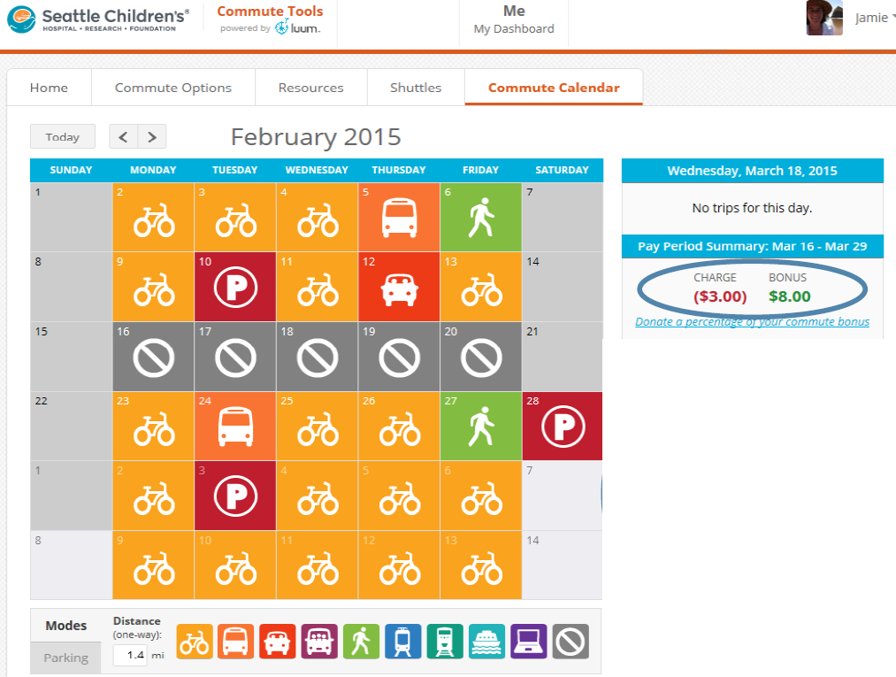
Enterprise CTR: employee calendar
Automate calendar-filling
Hard: SOV v. HOV v. bike
“Well-solved in 2017.”

Slide 10
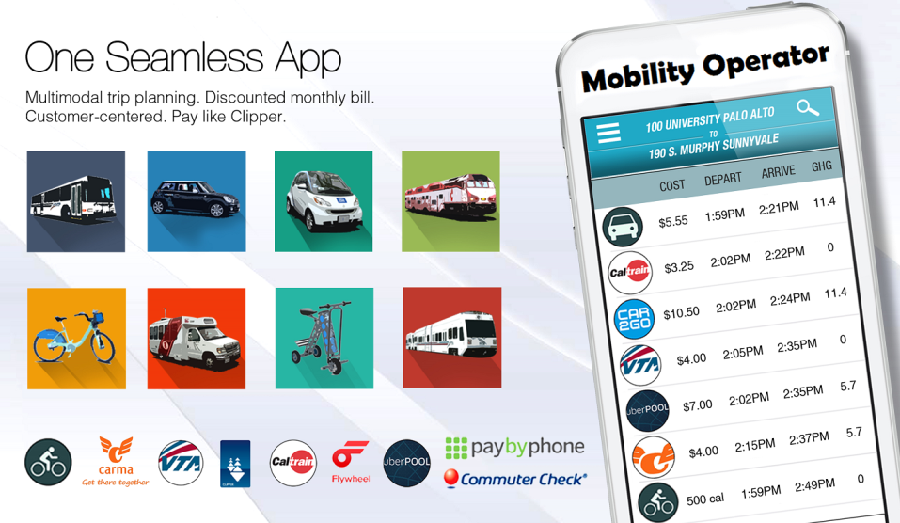
Mobility Aggregation: app replaces your car Ventra/Cubic/Moovel, MoovIt, Transit App, Urban Engines, Xerox (GoLA), etc

Slide 11
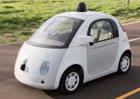
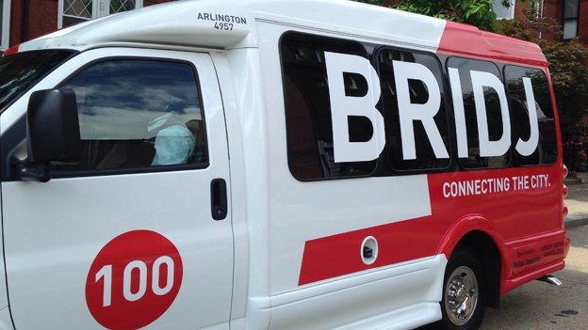
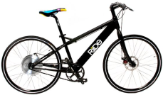
Gap-Filling: Better Commute Options

Slide 12
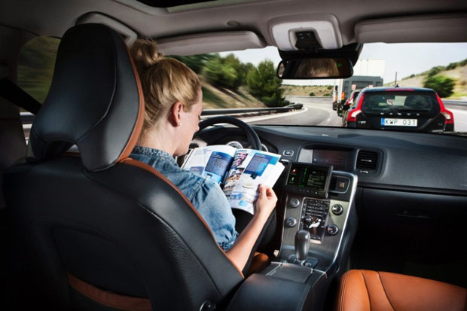
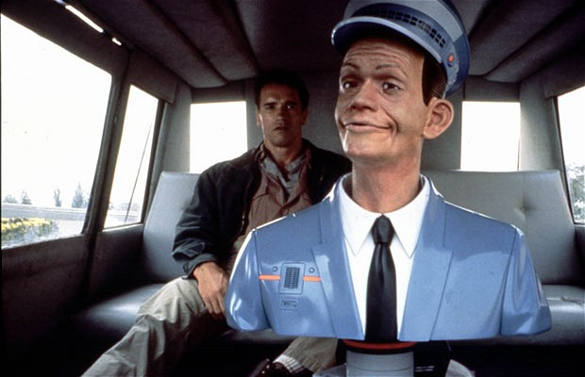
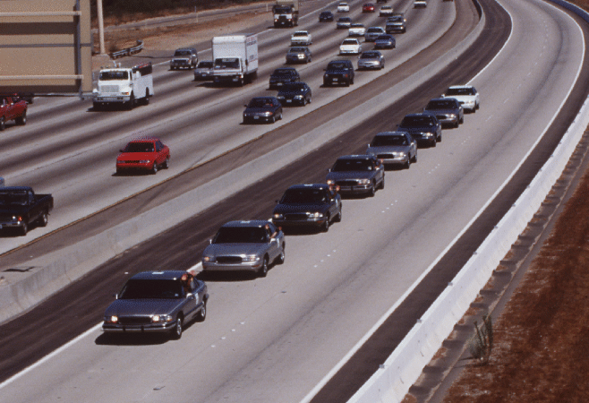
Autonomous impact is not so immediate
Year | (Flawed) Prediction
2020 | Read-a-Magazine-on-Freeway RoboCar
2023 | 5% RoboCars on freeway
2023 | 3 geo-fenced Robotaxi systems
2028 | Large RoboTaxi/Van impact
2028 | 30% RoboCars on fwy ➔ platooning

Slide 13
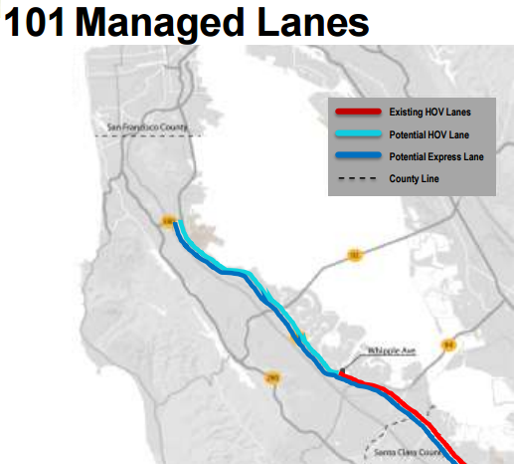
2021 SMC Highway 101 Managed Lane
State / regional objectives ➔ pricing
Accelerates demand for HOV/T 2 and 3
Gap-Filling increases occupancy
Eventually, too many SOV EVs
35% EVs on Hwy 237

Slide 14
THANK YOU
steve.raney@jointventure.org

