Slide 1
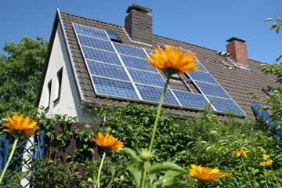
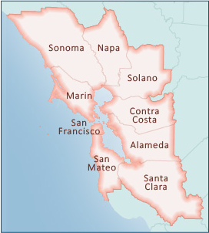
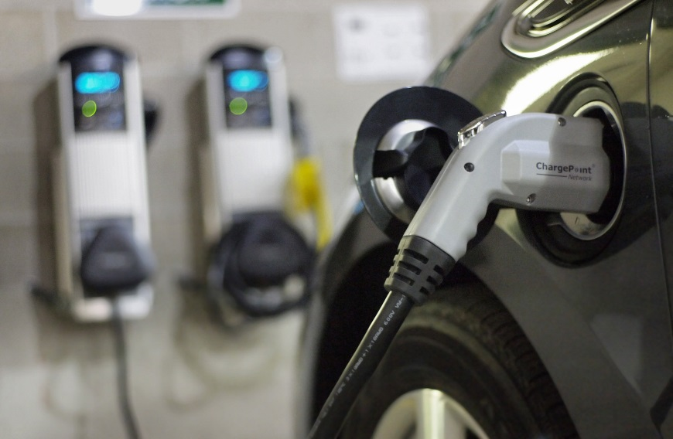
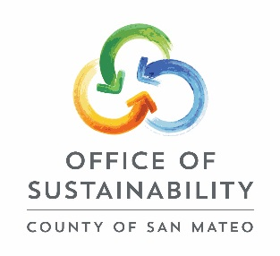
SunShares Program
Community solar and electric vehicle bulk procurement initiative

Slide 2
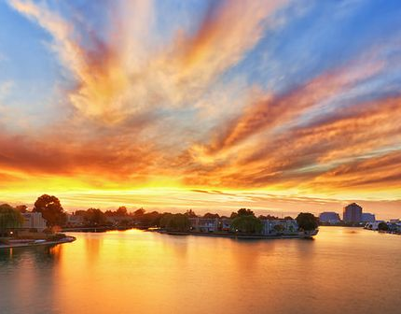
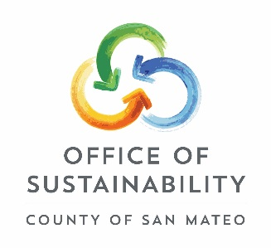
2015
Foster City spearheaded program with non-profit Vote Solar
1,100 participants and 200+ installations
975 kW of solar energy
Community Outreach
Participating jurisdictions included:
Belmont
Brisbane
Burlingame
Daly City
East Palo Alto
Foster City
Menlo Park
Millbrae
Portola Valley
Redwood City
San Carlos
County of San Mateo (unincorporated)

Slide 3
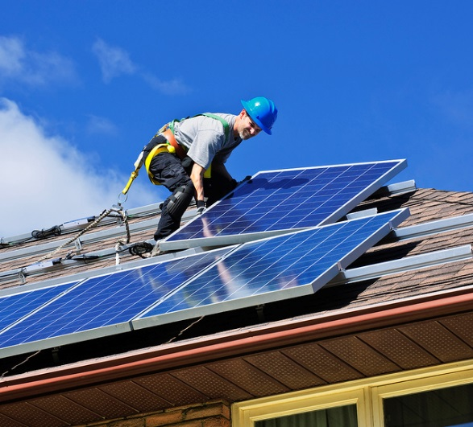
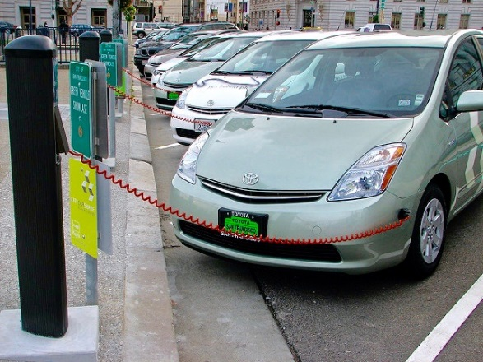
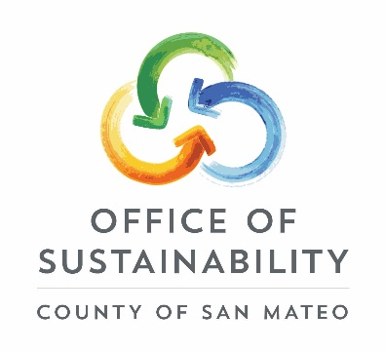
2016
BC3 spearheading program
Selecting service providers
Large employer participation
Electric Vehicle offering
Participating jurisdictions include:
Brisbane
Burlingame
Daly City
Foster City
Menlo Park
Portola Valley
Redwood City
San Carlos
County of San Mateo (unincorporated)

Slide 4
Next Steps
Registration begins August 1st and will end on October 28th
Send signed Letter of Support to BC3
Spread the word!
Contact: Andrea Chow achow@smcgov.org, (650) 363-4125

