Slide 1
San Mateo County Energy Watch
RMCP Committee
7/20/2016

Slide 2
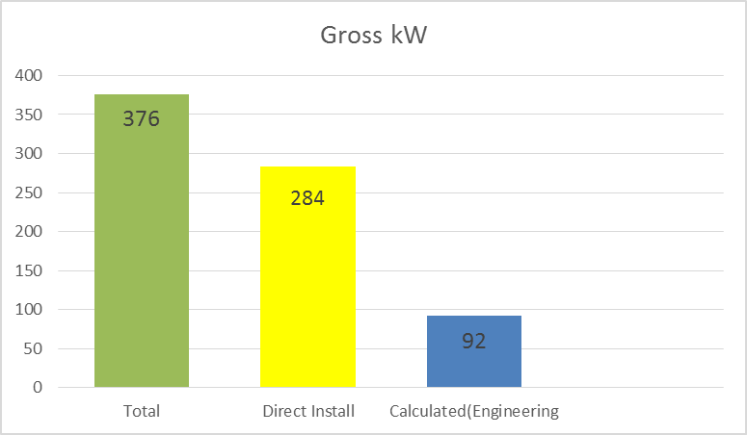
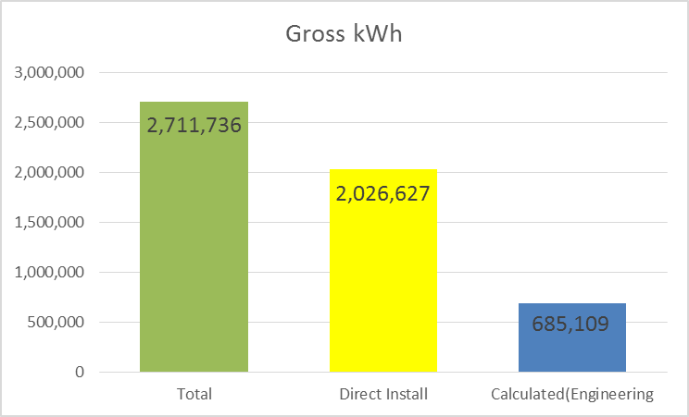
Goals for 2016
Natural Gas Therms = neutral
(roughly the same goals as last year)
Notes:
Direct Install- through Ecology Action and always deliver on their goals. They have already reached their goal through committed projects- but not all have implemented.
Same as last year

Slide 3
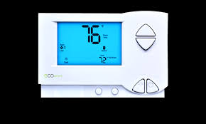
Projects Closed in 2016
kW | kWh
85 | 871,214
City Projects:
Daly City
Menlo Park
San Bruno
Commercial:
Auto Shops
Small Hospitality

Slide 4
Project Pipeline
Project | kW | kWh | Therms
Belmont (SST) | 158 | 874,440 | 29,567
Menlo Park - chiller, pool, EMS | 92 | 397,042 | 2,755
County- Parks Various sites | 33 | 84,327
San Mateo Waste Water Treatment Plant | 5 | 20,746 | 0
Woodlake HOA | 11 | 19,515 | 0
Subtotals | 298 | 1,396,070 | 32,322

Slide 5
Strategic Energy Resources
GHG Emissions Inventories
Community-scale
Local Government Operations
Belmont,Brisbane, Burlingame, Colma, Daly City, Foster City, Menlo Park, Millbrae, Portola Valley, Redwood City, San Carlos, Unincorporated
Climate Action Plans
Draft- Atherton, San Bruno, C/CAG TCAP
Adoption
Updates-Millbrae, Portola Valley
Open Data Portal
Working with County ISD
RICAPS meetings
Bi-monthly in-person
webinar

Slide 6
Zero Net Energy Initiatives
Educational Materials
Templates for Widespread Use
ZNE County Strategic Plan
*Developed through CPUC Pilot
Workshop Materials
*Collection of presentations, handouts and supplemental materials
ZNE Templates for Cities
*Developed through BayREN
Webinars
*Recorded Webinars from ZNE professional
ZNE Lease Language
*Developed through PAEC Grant
Videos
*Short educational, animated vides explaining ZNE

Slide 7
ZNE Strategic Plan Pilot Program
San Mateo County
SMCEW - New Buildings Institute - CPUC
Goals & Outcomes of the Pilot
Create a completed ZNE Plan document that serves as a model other organizations can learn from.
Improve the workbook format and function to meet the needs of various organizations
Gain feedback on the refinement of the templates and worksheets
STEP 1 – Target Setting
STEP 2 – Stakeholder Engagement Plan
STEP 3 – Integrating ZNE into Buildings
and Policies

Slide 8
ZNE Template Development
BayREN
SMCEW
DNVGL
San Mateo County jurisdictions requested template language to support the adoption of ZNE policies countywide.
RFP Language
Incentive Program (Permitting)
BayREN has allocated 2016 Codes & Standards funding to support the development and implementation of Zero Net Energy replicable templates through a consultant
Gap Analysis
Template Development
Compilation of relevant ZNE policy and ordinance examples
Notes:
-From RICAPS meeting last December Cities voted that templates were the top priority moving forward

Slide 9
Green Lease Language- PAEC Grant Assistance
Clean Coalition
SMCEW
DNVGL
Develop lease language options aimed at passing the costs of Advanced Energy Solutions from the property owners to tenants and overcome the split incentive problem associated with leased spaces
Investigate tools to allow building owners and tenants to assess and benchmark energy use and associated economics.
Organize workshops for Advanced Energy project developers and local government building departments

Slide 10
Contact Information
Website
smcenergywatch.com
SMCEW Email
http://smcenergywatch.com/contact-us
Jacki Falconio
jfalconio@smcgov.org
650-599-1402

