Slide 1
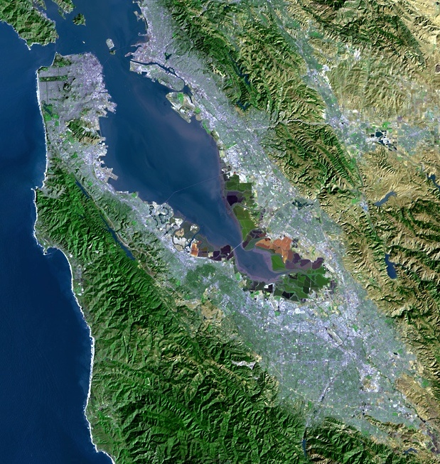
Update on BAWSCA’s Long-Term Reliable Water Supply Strategy
“A multicounty agency authorized to plan for and acquire supplemental water supplies, encourage water conservation and use of recycled water on a regional basis.”
[Bay Area Water Supply and Conservation Agency Act, AB2058(Papan-2002)]
Adrianne Carr
Senior Water Resources Specialist
Bay Area Water Supply and Conservation Agency
November 16, 2016

Slide 2
BAWSCA’s Strategy
In 2009, BAWSCA embarked on the Long-Term Reliable Water Supply Strategy to:
Determine the Water Supply Problem
When, where, and how much additional water is needed in normal years and dry years.
Develop Solutions
Identify specific water supply management projects for implementation.
Notes:
BAWSCA’s Long-Term Reliable Water Supply Strategy is designed to
Quantity the water needs for this regional area
- Plan for and implement water projects to meet those needs

Slide 3
10% Less Water Used Today in Service Area Despite 25% More People
2013-14: 224 mgd
2014-15: 195 mgd
2015-16 will be lower
Source: BAWSCA FY 2013-14 Annual Survey

Slide 4
Demand Study Confirmed Need to Focus on Drought
2040 Supply Sources, Normal Year
2040 Supply Sources, Drought Year
(20% System-wide Shortage)
43
mgd
117 mgd
124 mgd
117 mgd
168 mgd
Anticipated
SFPUC Purchases
Other
Sources
Reliability Shortfall

Slide 5
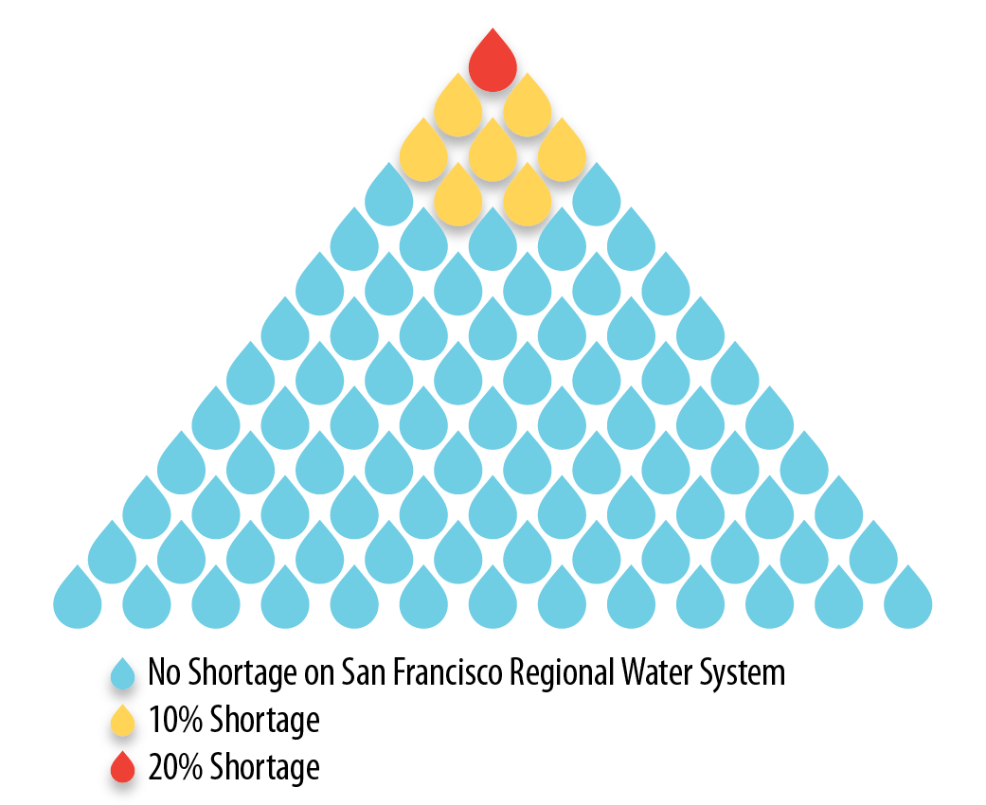
How Frequent are Droughts Anticipated on the SF RWS?
System subject to cutbacks 1 in 11 years (assuming 2040 demands)
Using historical record
Analysis informs decision-making
How often will supplemental supplies be needed?
Effective cost of a supply increases if only used during drought
Notes:
Based on SFPUC’s model for their system, shortages are estimated to occur on average 1 in every 10 years at the future demand level
SFPUC has two levels of demand reductions……
What does this mean for the region as a whole and the indivdiual agencies?

Slide 6
Strategy Included a Comprehensive Review of Supply Projects
Phase I – identified 65+ projects with potential regional benefits
Phase IIA – refined list of projects to 17, identified near-term opportunities
Phase II Final – presented refined project list of 10
Analysis of projects against multiple objectives
Note: Agencies may have other supply projects, but did not want to include them in the Strategy

Slide 7
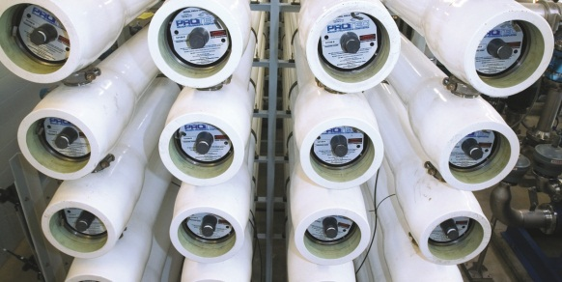
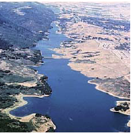
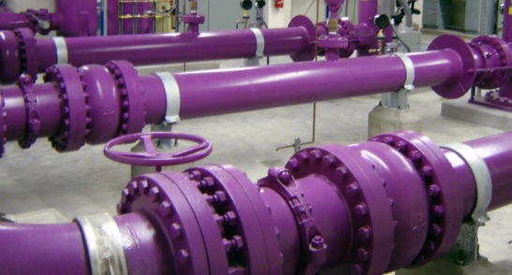
Five Project Types that Provide Regional Benefits Were Identified
Recycled water
Groundwater
Desalination
Water transfers
Local capture and reuse
Notes:
New and other supply types also being tracked going forward (e.g. Indirect/Direct Potable Recycling)
Different projects warrant consideration of different types of near-term actions
Core actions
Implementation actions
Regional benefits
Local agency support

Slide 8
Diverse Set of Objectives Used to Evaluate Potential Projects
Objectives
Increase Supply Reliability
Provide High Level of Water Quality
Minimize Cost of New Supplies
Reduce Potable Demand
Minimize Environmental Impacts of New Supplies
Increase Implementation Potential of New Supplies
Notes:
Regional benefits
Local agency support
Criterion 3A –Criterion 3B – Effective Cost

Slide 9
Strategy Presented Key Findings and Recommended Actions
Key Finding
Water transfer are a high priority
Desalination needs a partner to be viable
“Other Projects” like recycling, groundwater, etc. have limited dry year benefits
Recommended Action
Continue to lead development of transfers for implementation Identify and evaluate water storage options
Facilitate partnerships to implement Pursue outside funding for further studies
Support member agency projects Participate in cooperative regional planning
Notes:
Feb 2015 Strategy Phase II Final Report

Slide 10
Implementation of Strategy is Under Way
Strategy recommended pursuing more research on many of the projects
No major investments required to continue planning
Lower demands mean that decisions to invest in new supplies can be made more deliberately
Water supply project implementation is a long process
Notes:
Included priorities and recommended actions

Slide 11
Historic Drought has Increase Public Interest in Water
Public interest in water during drought is useful
Conservation programs being utilized
Potable reuse (purified water) entered the discussion
Increased focus on local capture and reuse projects
Data on these types of projects was limited when completing the Strategy Report
BAWSCA participates actively in the on-site water reuse discussion in the region
Historic drought has forged new relationships
Isreal-CA Greentech Partnership
Lessons learned from Australia

Slide 12
Purified Water Projects Gaining Traction
BAWSCA Strategy noted potential of potable reuse, but projects not far enough along to enable detailed analysis
Multiple water and wastewater agencies taking steps to develop potable recycled water supplies
Factors driving progress include:
Drought
Additional regulatory requirements on wastewater treatment plants
Change in public perception
Development of regulations governing potable reuse
BAWSCA partnering with other agencies to study preliminary feasibility of different purified water projects

Slide 13
Drought Response Analysis will Inform Strategy Implementation
BAWSCA proposing analysis to evaluate:
What drove the demand reductions
Projected demand and supply need
Responsiveness and appropriateness of existing shortage provisions
Drought preparedness of member agencies and other regional suppliers
Qualitatively identify local economic impacts
Host regional workshop on financial impacts of drought
Notes:
This task would perform a complete review of customer response in the service area including: review water demand response to voluntary and mandatory cutbacks, review responsiveness and appropriateness of existing shortage provisions, review member agencies’ and other regional suppliers’ (e.g., SCVWD) drought preparedness and its impacts on the member agencies, host regional workshop to facilitate discussion of water utlitity financial best management practices to identify potential actions that can assist agencies in addressing the financial impacts of drought, and conduct a workshop with member agencies to identify local economic impacts. BAWSCA will use the results of this work to update as appropriate the projected 2040 water demand and supply need for the region.

Slide 14
BAWSCA’s Strategy: Where are We and What’s Next?
Current Strategy activities in work plan
Purified water feasibility studies
Signed MOU with Silicon Valley Clean Water, SFPUC, Cal Water
Potential partnerships with SCVWD and ACWD
Plan for potential water transfer via Hayward during extended 2018 Hetch Hetchy shutdown
BAWSCA participating in Enlarged Los Vaqueros studies with SFPUC
Groundwater Reliability Partnership for the San Mateo Plain
Post-drought demand response analysis
Modifications to BAWSCA’s drought allocation plans must be examined for potential adoption
Notes:
Other items in work plan:
Modeling
Structured decision making

Slide 15
Strategy recommended actions being implemented today
Regular reports provided to BAWSCA Board of Directors
BAWSCA’s goal remains “A reliable supply of high quality water at a fair price”
Implementation of Strategy necessary to achieve goal

Slide 16
Questions
and
Comments
Adrianne Carr
ACarr@BAWSCA.org
650-349-3000

Slide 17
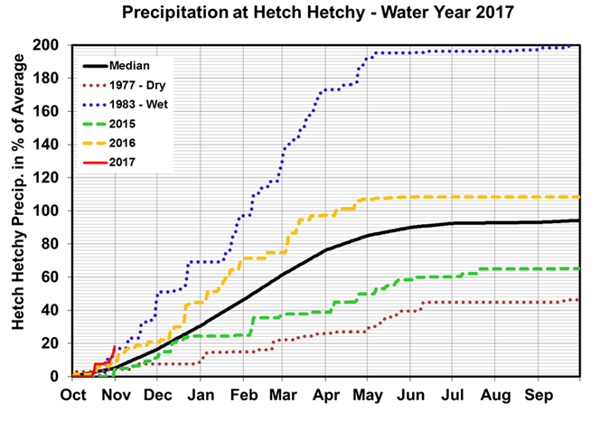
Precipitation

Slide 18
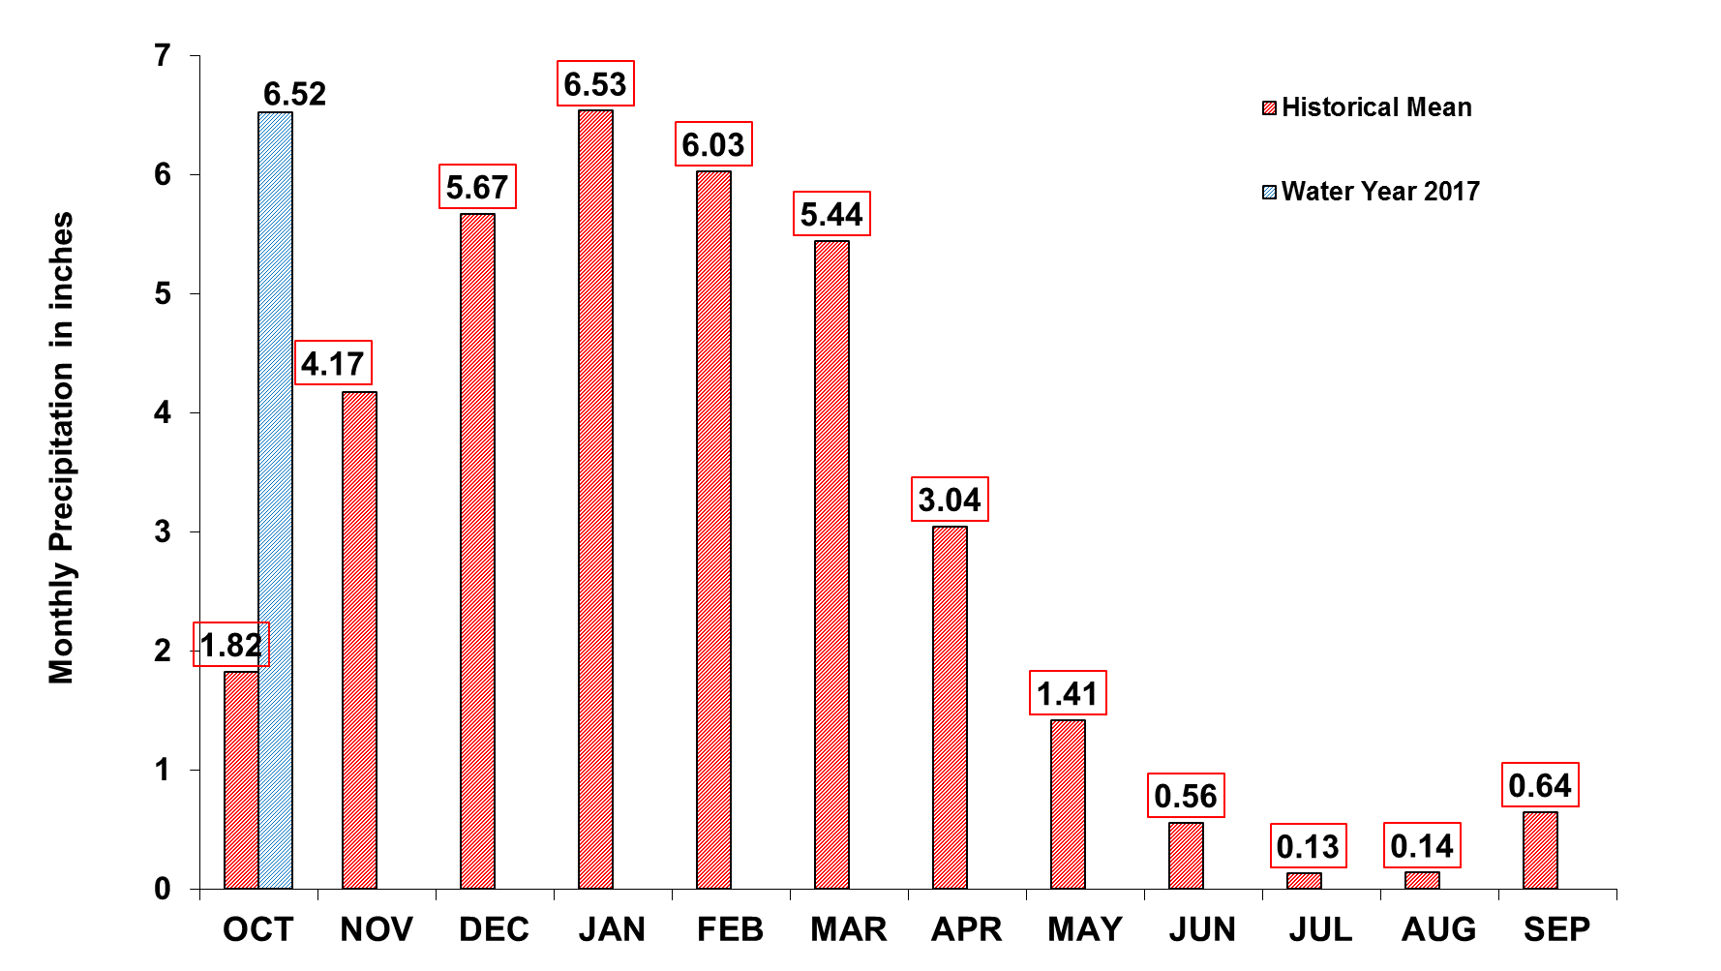
Upcountry 6-station Precipitation index as of October 30th
Annual Total: 35.6 inches
YTD Total: 6.5 inches

Slide 19
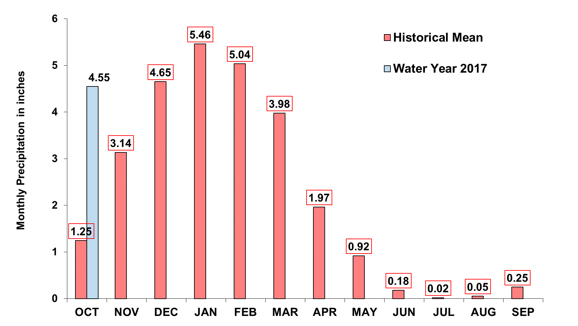
Bay Area 7-station Precipitation Index as of October 30th
Annual Total: 26.9 inches
YTD Total: 4.6 inches

Slide 20
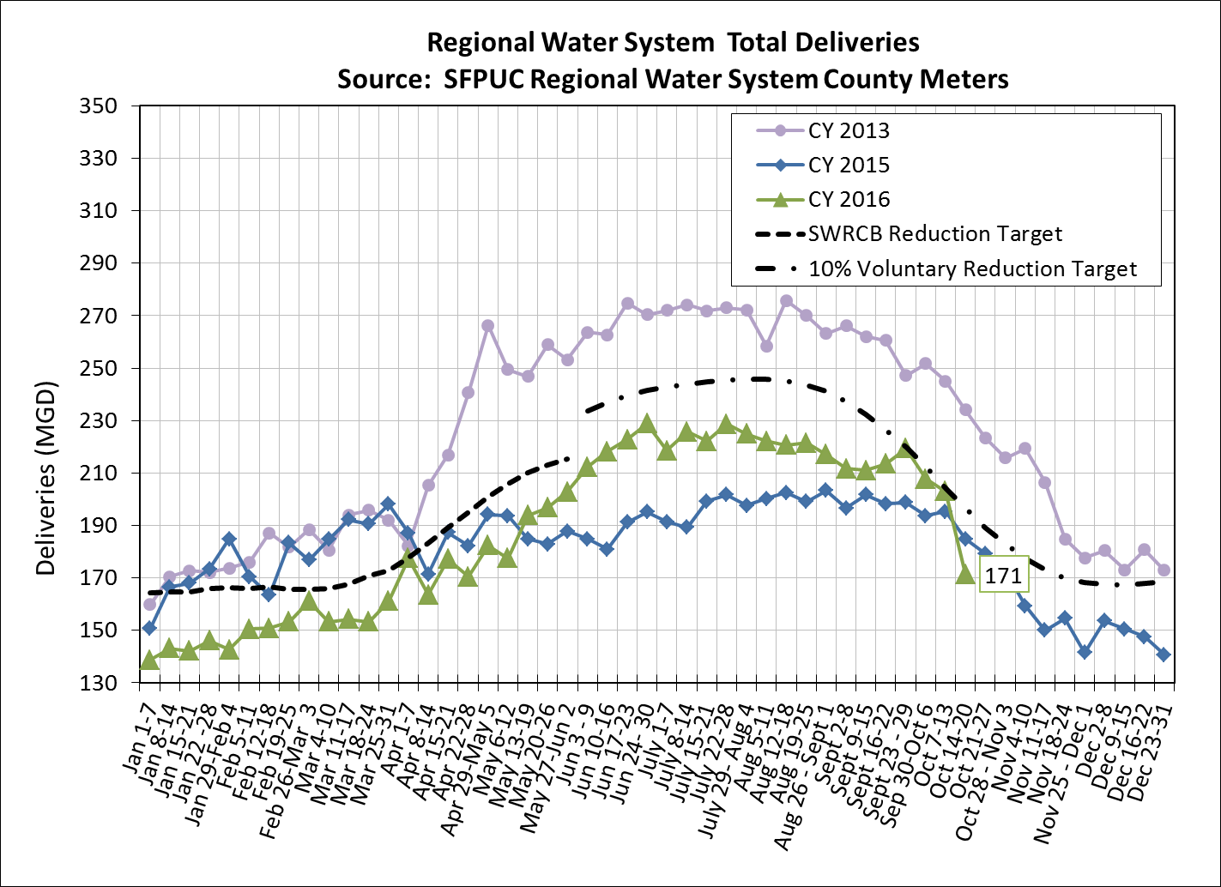
Total Deliveries

