Slide 1
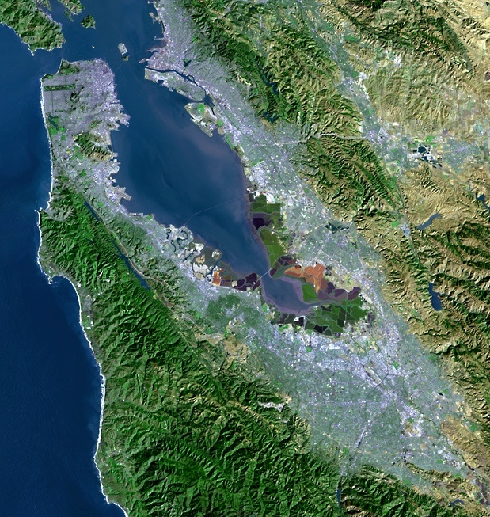
BAWSCA Update on Current Water Supply and Conservation
“A multicounty agency authorized to plan for and acquire supplemental water supplies, encourage water conservation and use of recycled water on a regional basis.”
[Bay Area Water Supply and Conservation Agency Act, AB2058(Papan-2002)]
Adrianne Carr
Senior Water Resources Specialist
Bay Area Water Supply and Conservation Agency
August 16, 2017

Slide 2
Total Water Storage as of August 13

Slide 3
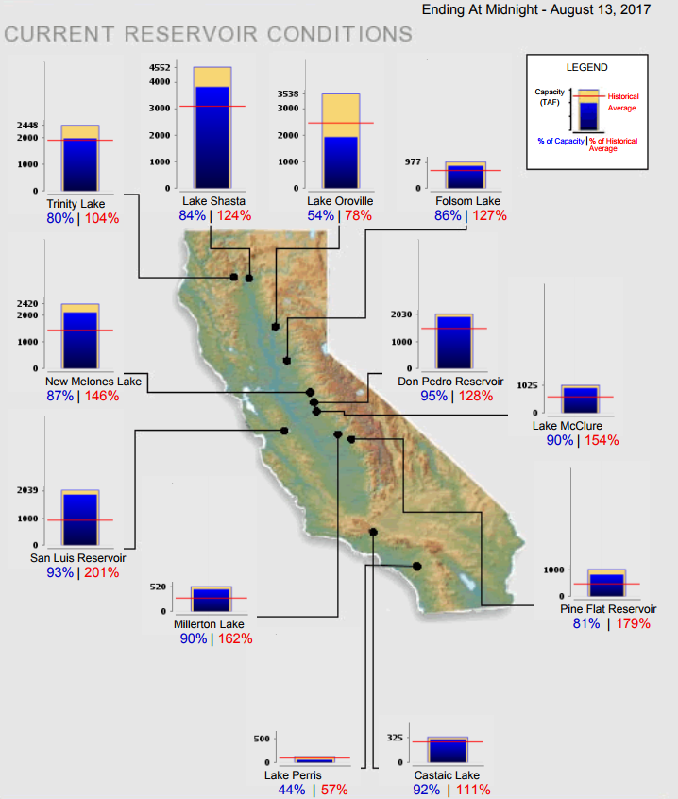
Other California Reservoirs

Slide 4
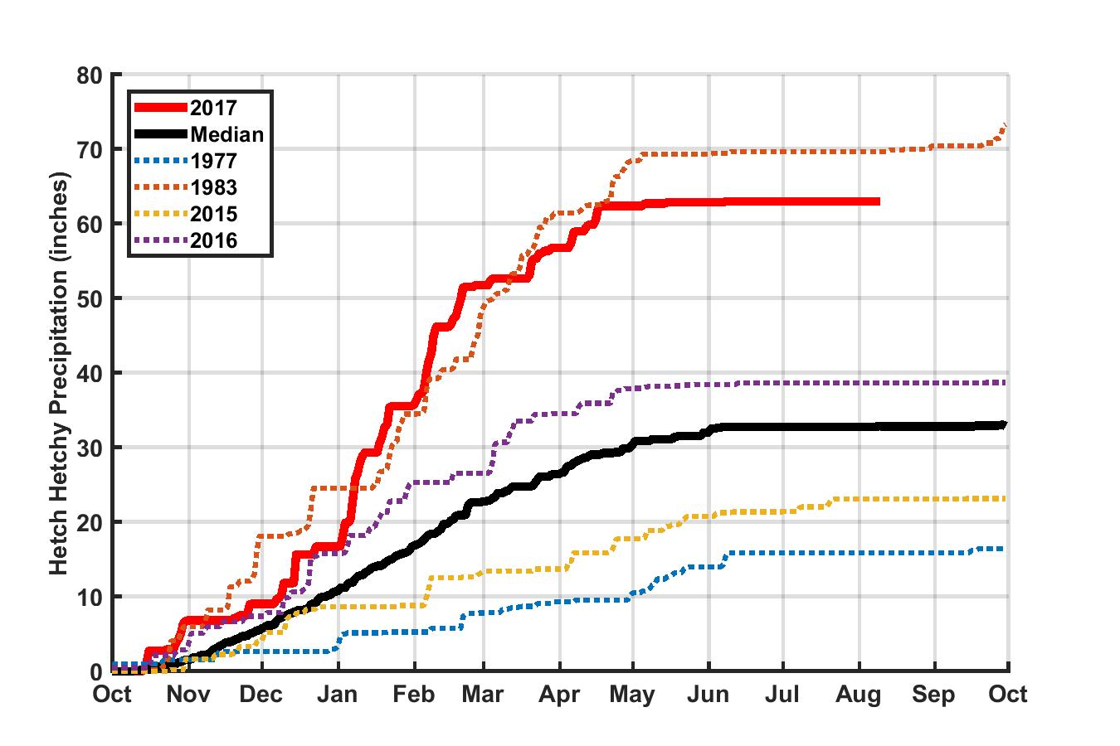
Upcountry Precipitation – Water Year 2017

Slide 5
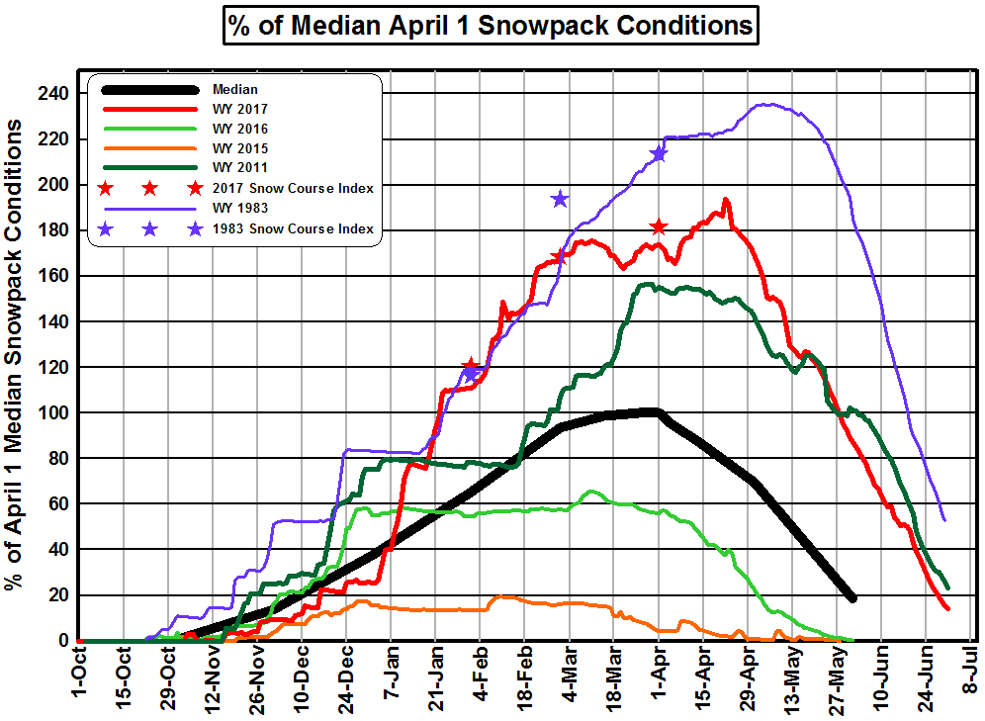

Slide 6
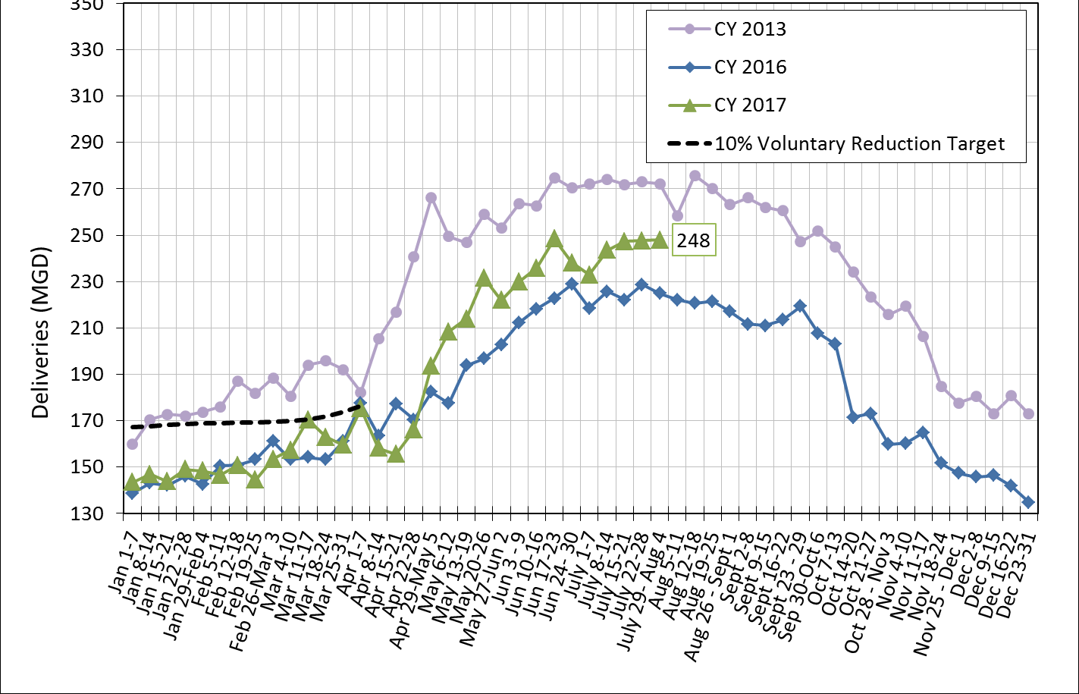
Total Deliveries – SF Regional Water System

Slide 7
BAWSCA May 2017 Total Potable Water Use 23% Less Than May 2013

Slide 8


Slide 9
BAWSCA Drought Report Posted Today
BAWSCA Drought Report documents:
  Drought response actions during 2014 – 2017 drought
  Critical knowledge gained through these actions
Report intended to serve as reference document for future drought response and planning efforts
Available at: bawsca.org/water/reliability

Slide 10
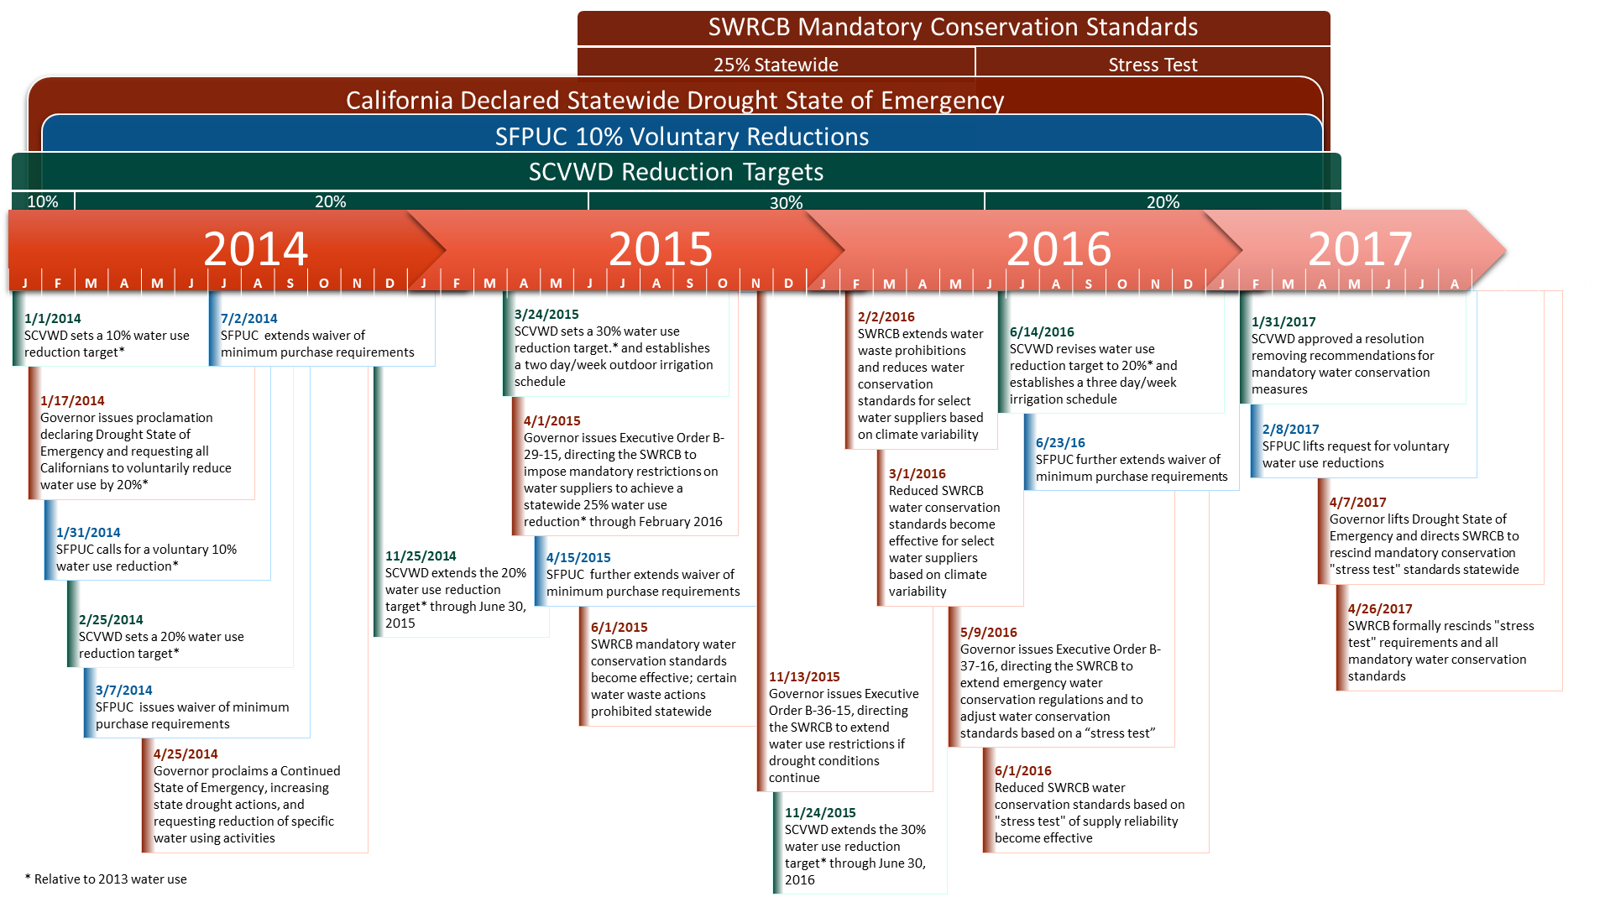
Timeline of State and Local Drought Response Actions

Slide 11
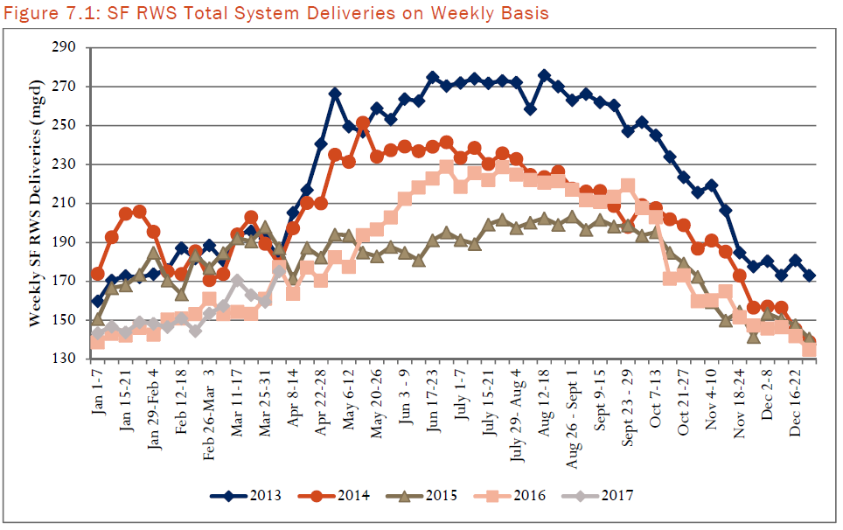
SF RWS Drought Water Use

Slide 12
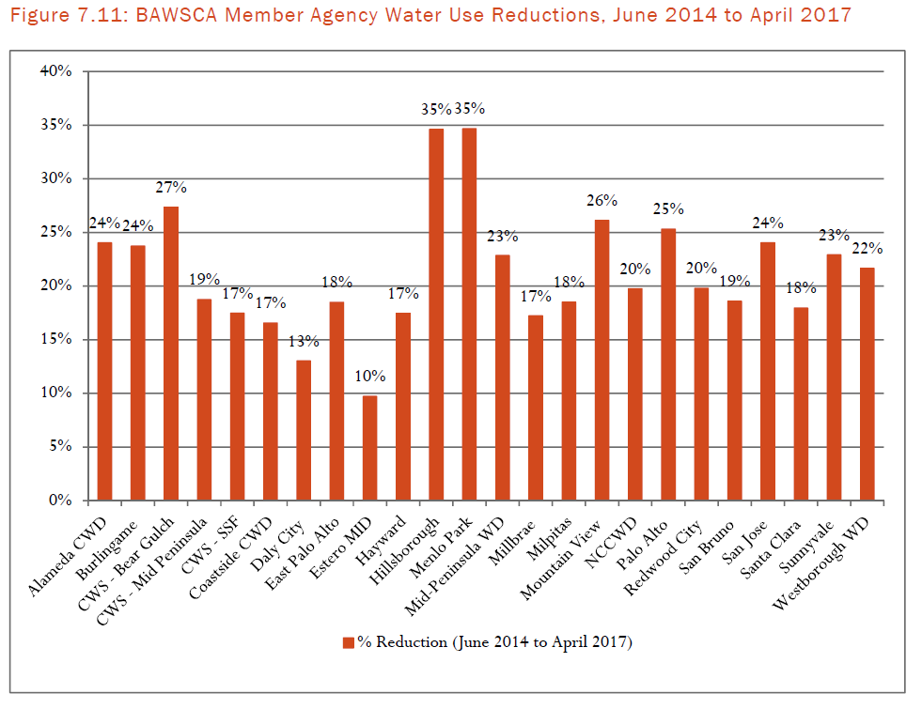
Total Water Savings by Agency

Slide 13
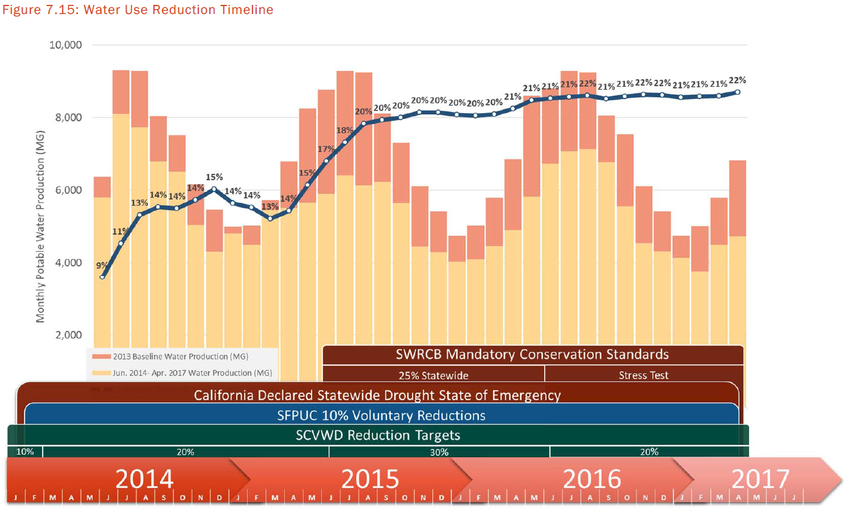
BAWSCA Water Savings Timeline

