Slide 1
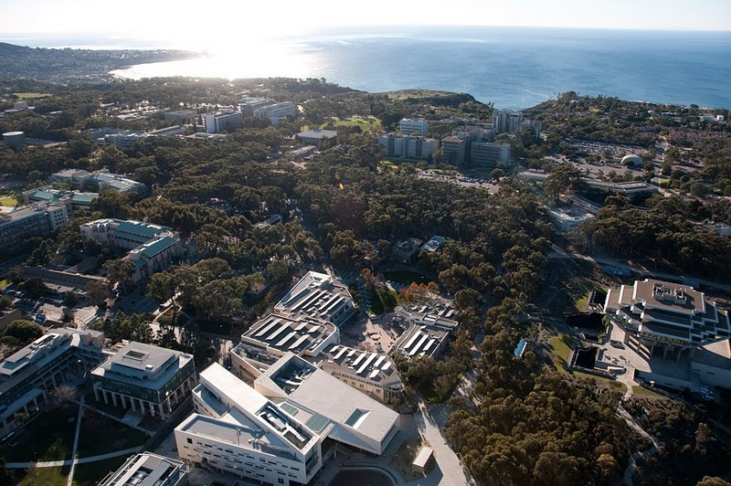
UC San Diego
Dave Weil, PE, QCP
Director, Campus Sustainability

Slide 2
Sustainability Goals
UC/UCSD will be carbon neutral by 2025:
  Scope 1 (direct) & 2 (indirect) emissions by 2025
  Scope 3 (commuter and air travel) by 2050.
  Maximize use of onsite/grid renewable energy.
Reduce water use 36% from baseline by 2025.
Zero Waste by 2020.
New buildings will be LEED Silver, strive for Gold:
  “Near ZNE”...tough for labs, medical centers.
Exceed T24 energy efficiency by 20%, strive for 30%:
  “Whole Building Energy Performance Targets” (kBtu/sf).

Slide 3
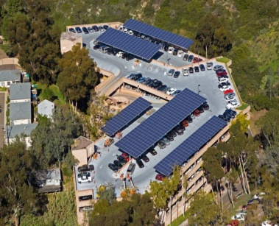
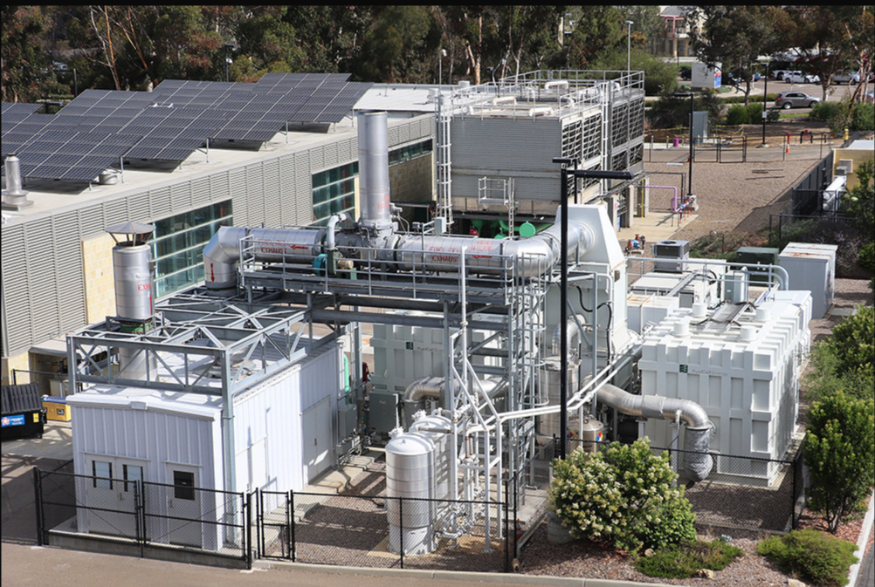
UCSD Campus Overview
Daily population 50,000+
  Growing to over 60,000.
19 million GSF, 800+ Bldgs
  25 million GSF by 2025.
3 medical centers, 900 labs
  2x’s the energy density.
Peak load over 45 MWs
  3rd largest in region.
Generate 85% of campus energy.

Slide 4
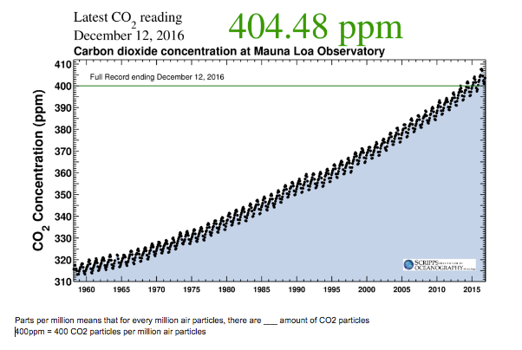
UC San Diego and its Scripps Institution of Oceanography has long been internationally recognized for pioneering research in global climate change.
We feel it is imperative to have commensurate leadership in the sustainability of UC San Diego’s operations.
As a living laboratory for climate solutions, UC San Diego will be an early adopter for real-world tools and leading-edge technologies for California and global marketplace.
A History in Climate Research

Slide 5
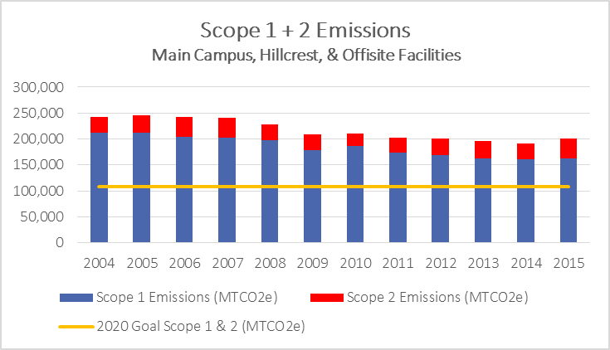
Current Emissions & Trends

Slide 6
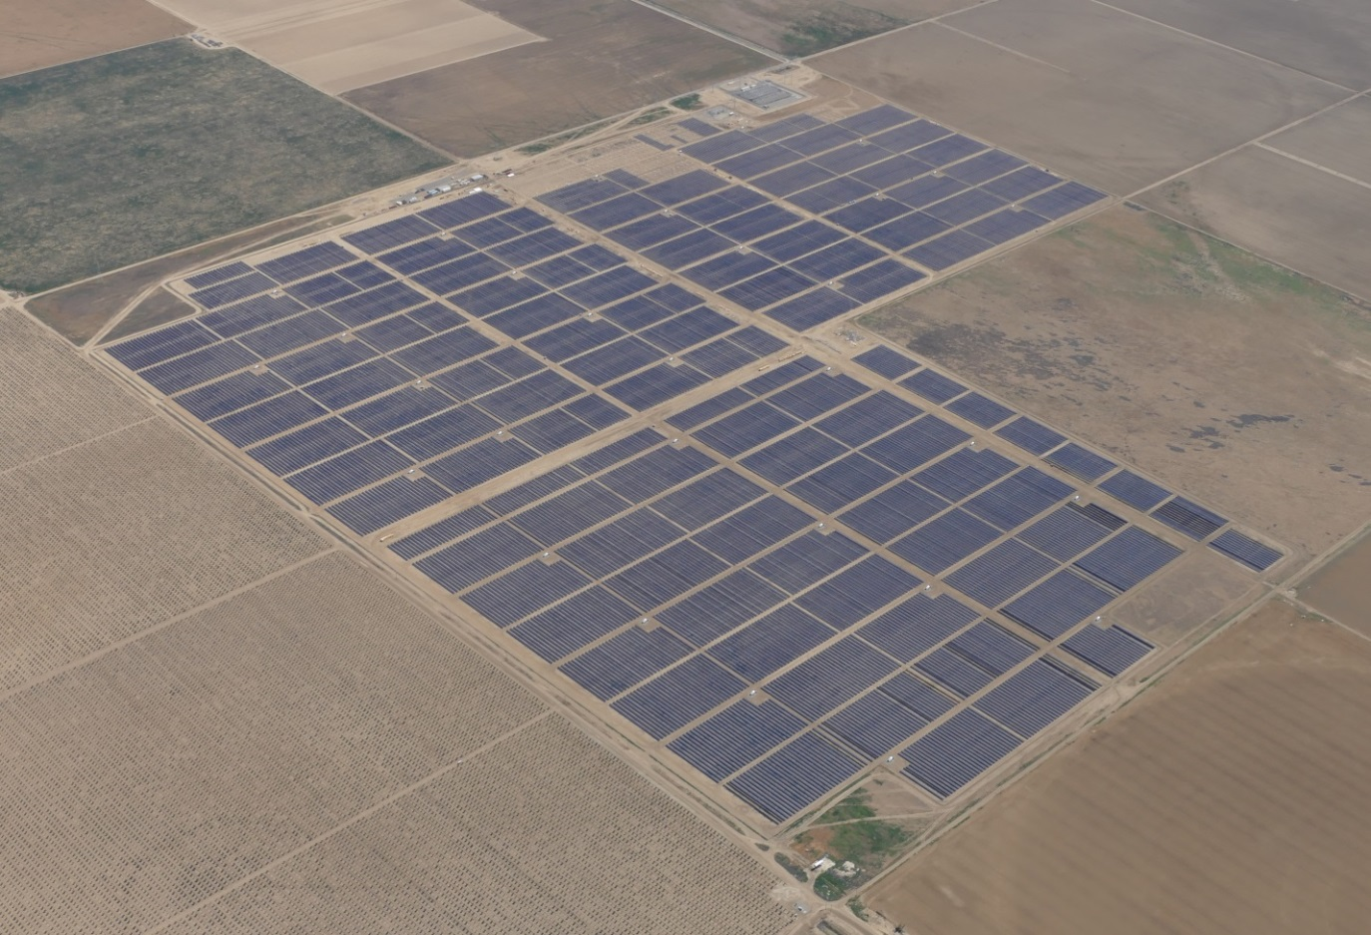
Wholesale Power Program
Greener, less-expensive electricity provided by UC’s “electricity company” managed by the Energy Services Governing Board.
The UC-funded 400-acre, 60-MW solar project in Five Points, CA is now on-line, supplying carbon neutral electricity to seven direct access campuses
Another 20MWs this month.

Slide 7
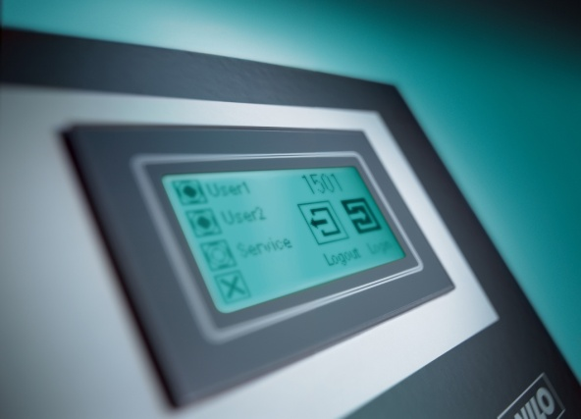
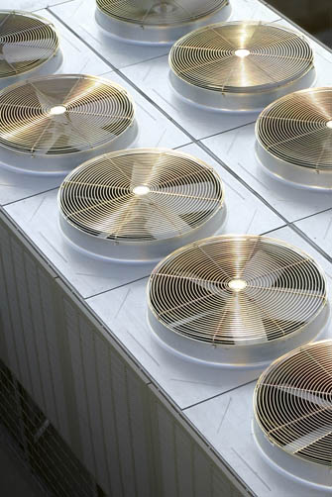
Energy Efficiency
Completed $100M in energy retrofits, reducing energy use by over 20%, saving $12M/year.
Another $99M planned by 2025, over $7M in savings.
Energy Intensity (kBtu/sf)
260
EE measures:
Lighting change outs
HVAC retrofits
Reducing air changes
Monitoring Based Commissioning (MBCx)
2008
240
220
2017
200
180
160

Slide 8
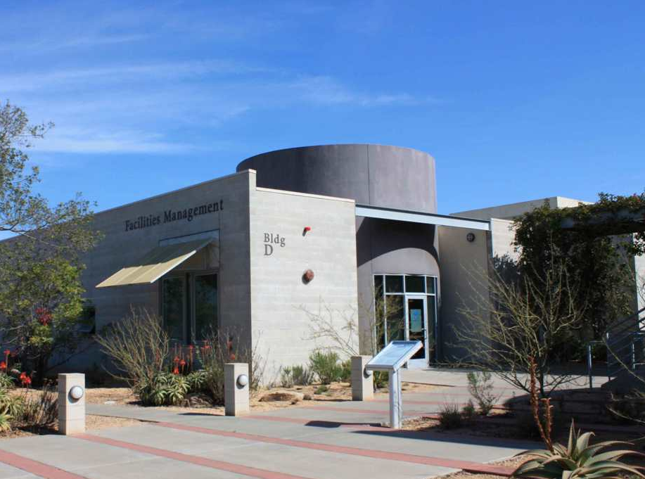
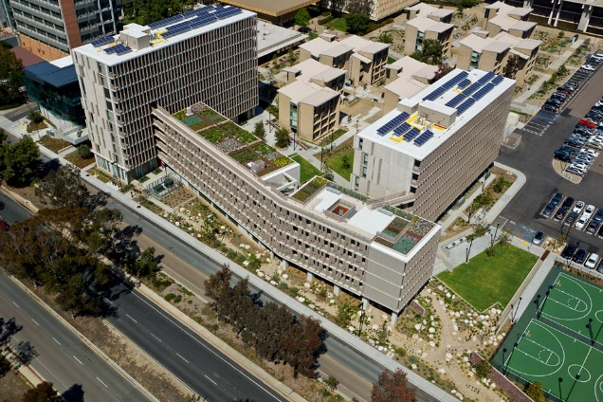
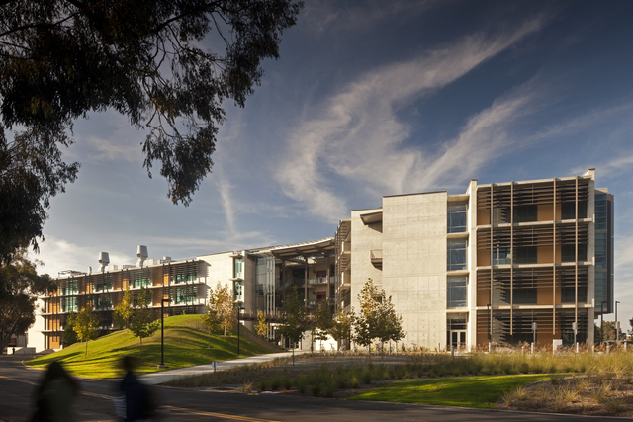
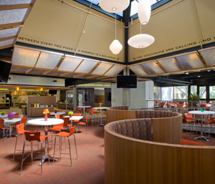

Green Building Practices
LEED-EB Silver:
Campus Services Complex
LEED-NC Platnum:
Keeling Apartments
UCSD will achieve a LEED Silver and strive for Gold on all new construction and major renovations.
35 LEED certified buildings:
28 LEED BD+C
4 LEED O+M
3 LEED ID+C
LEED-NC Gold:
Structural & Materials Bldg.
LEED-CI Gold:
Stewart Commons
New buildings striving for “near” ZNE...labs, medical centers difficult .
All new construction and retrofits in MBCx...80% of campus metered.

Slide 9
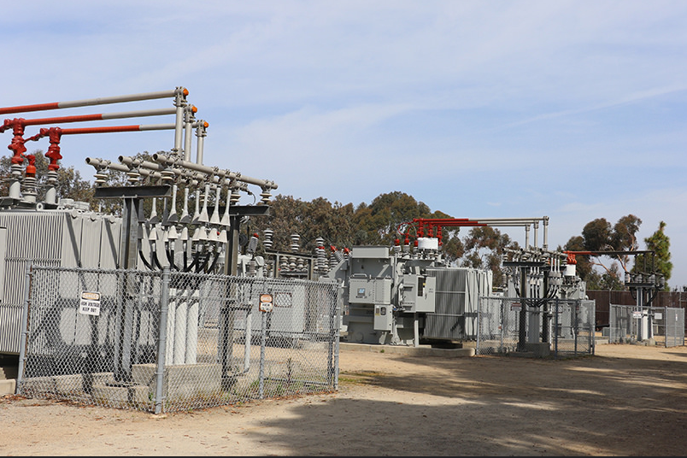
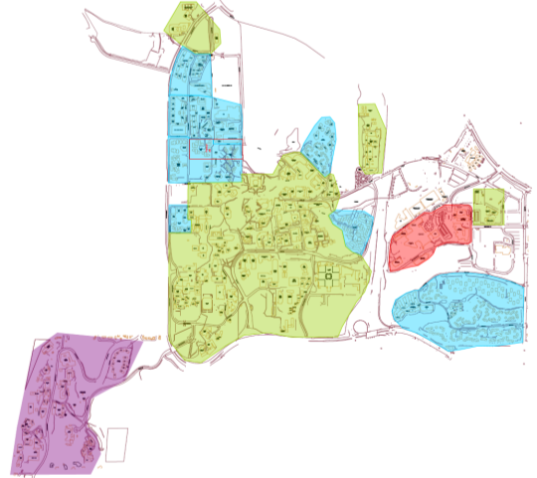
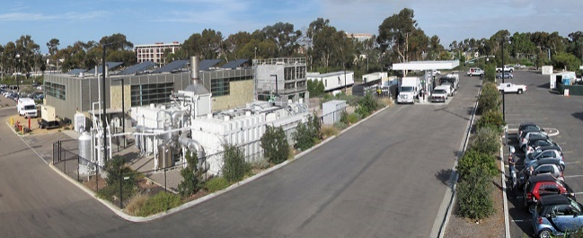

Campus Microgrid
69 KV single point of connection to Grid
45+ MW Peak Load (259.3 MWh)
12 KV distribution
30 MW Cogeneration (CHP) plant
2.8 MW Bio-methane Fuel Cell
2.2 MWs Solar generation
Provides Campus
  Resiliency
  Reliability
  Redundancy
  Security

Slide 10
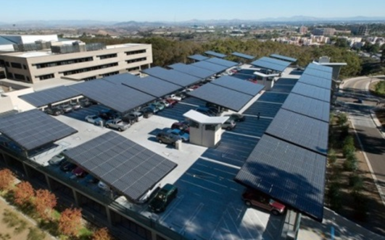
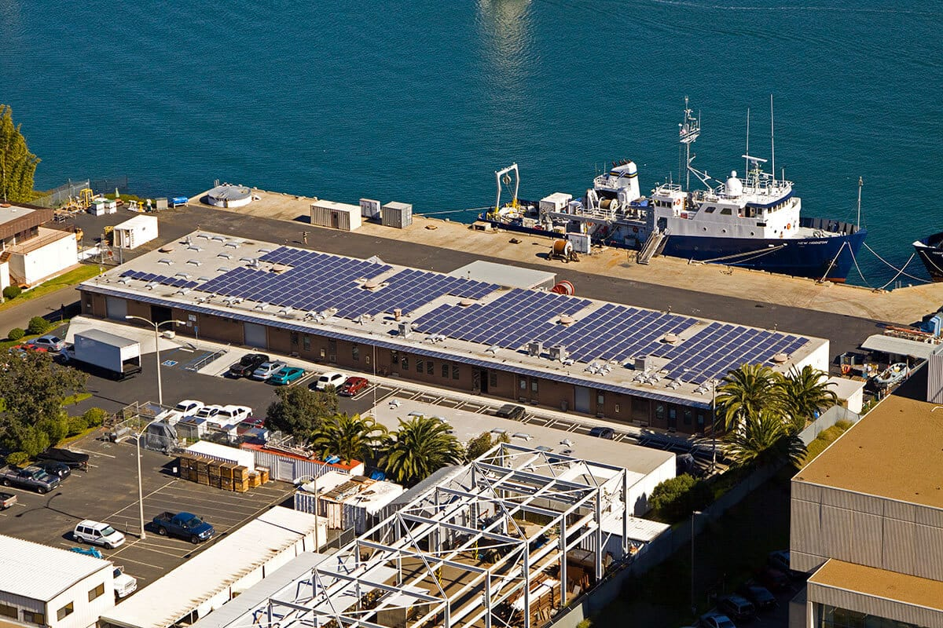
Solar Generation
3 MWs total on/off campus
  2 MWs on microgrid
    2 MWs campus owned
      CREBs financing
    1 MW 3rd Party PPA
Provides stable energy costs
Potential for additional 6 MWs

Slide 11
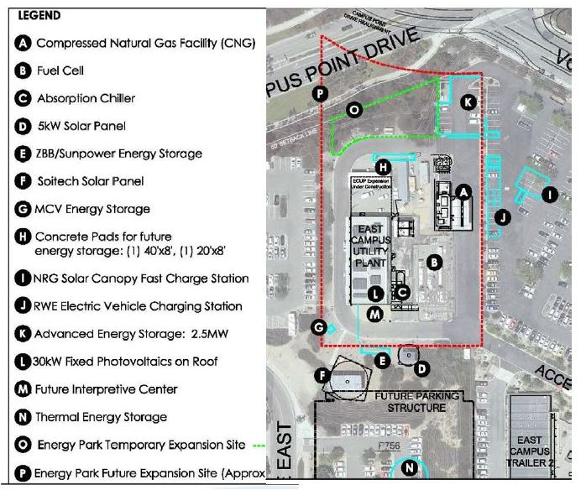
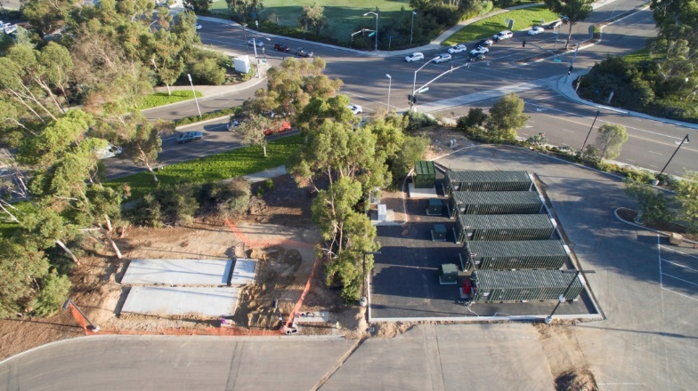
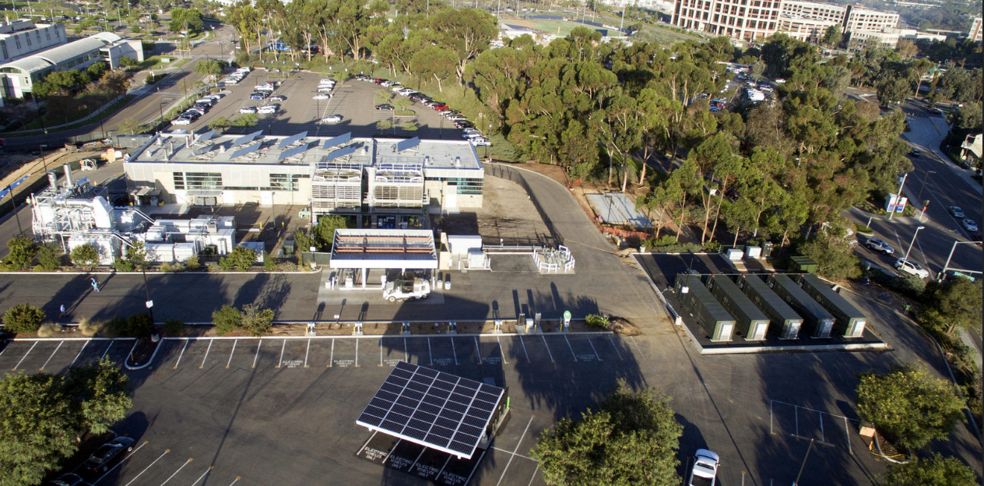
Energy Research Park

Slide 12
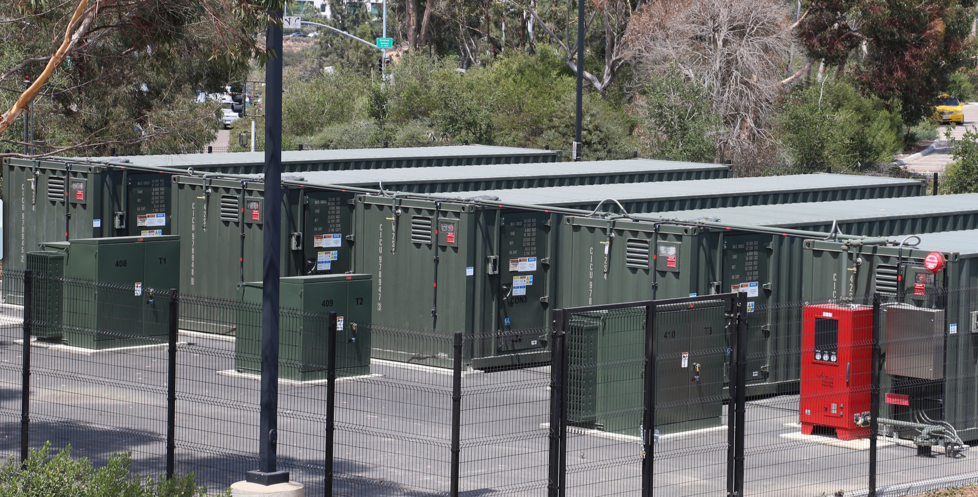
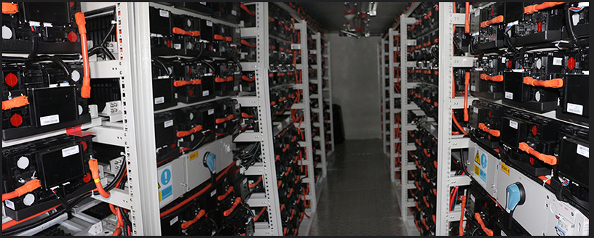
Energy Storage
  2.5 MW / 5 MWh LI-ion Energy Storage (SGIP funding)
    Demand reduction
    Peak Shaving
    Voltage & frequency stabilization.
  250 kW/ 500 KWh solar
  integrated energy storage
    Solar Forecasting
    Smooths Intermittency.

Slide 13
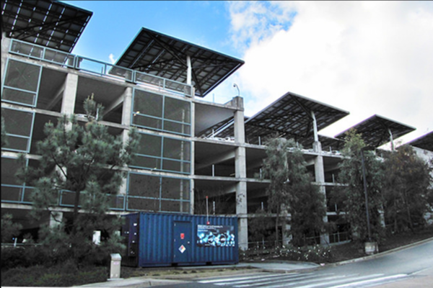
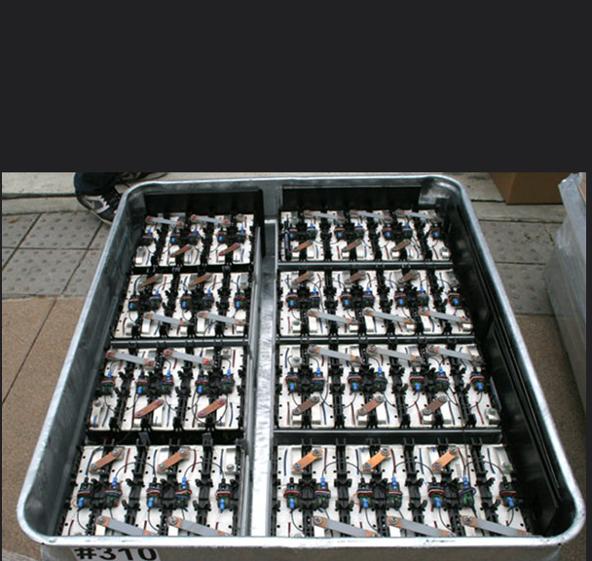
Energy Storage
  108 kW /180 kWh BMW 2nd life battery demonstration site:
    330 kW building PV
    Level 2 EV Charging
  8 kW Sunverge Energy Storage
  with 60 kW PV system
  28 kW Maxwell Ultra-Capacitor:
    Coupled with Solar Forecasting
    Smooths Intermittency

Slide 14
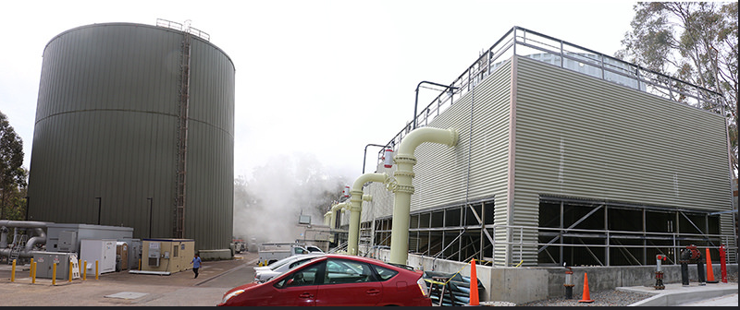
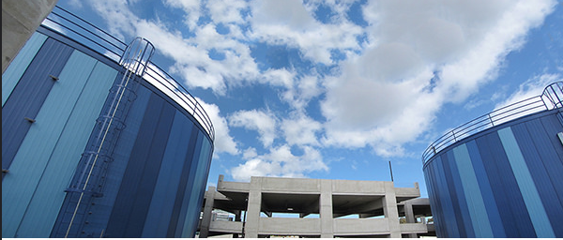
Energy Storage
  Thermal Energy Storage
  3.8 Mgal at Cogen Plant
    Main campus loop
    Demand Reduction
  3.8 Mgal on East Campus
    Demand reduction
  San Vicente Pumped Storage
  500 MWs / 8 hours
  All renewable energy

Slide 15
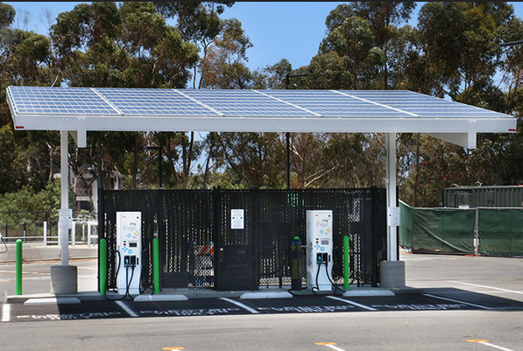
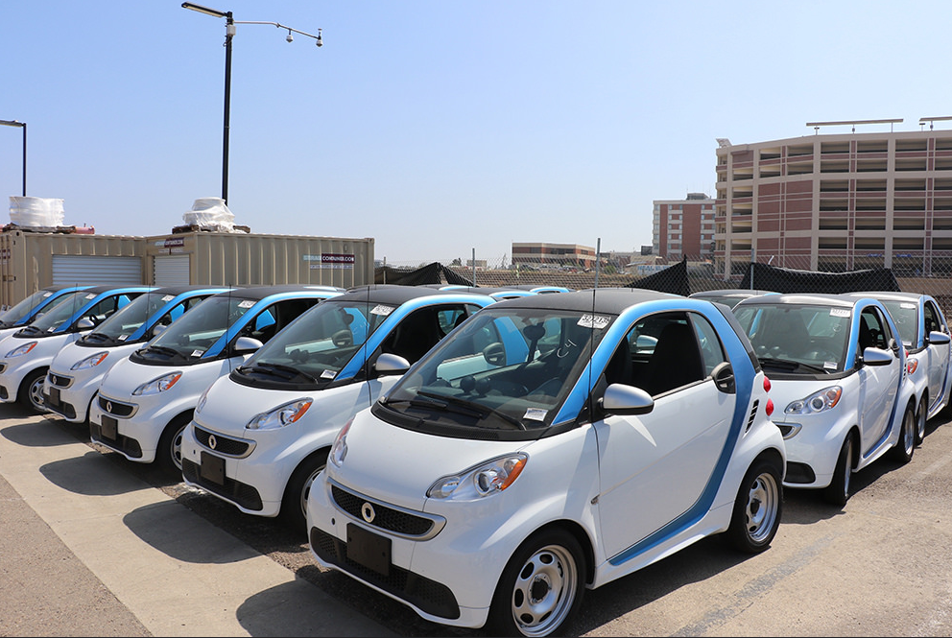
EV Grid Integration
  Integrating EVs into microgrid
    57 EVs in campus fleet
    Over 300 EV drivers on campus
      EV leasing program
    50 L2 & 7 DC fast chargers
      Plan to have 200+
    100 kWh solar integrated Fast Charger
  EV Smart Charging (V2G)
    ISO 15118
    Solar integrated increases value of PV

Slide 16
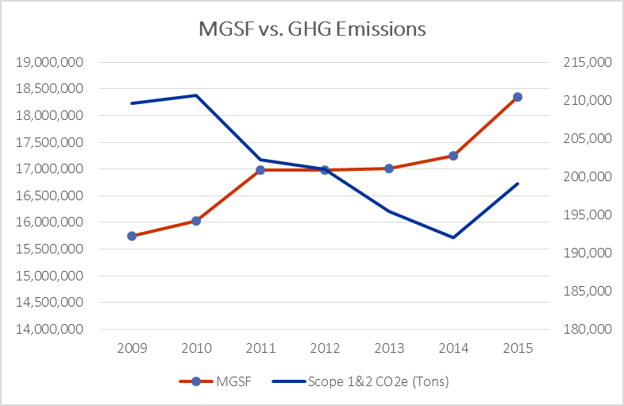
Significant Progress
Greenhouse Gas Emissions vs. Campus Growth

Slide 17
Perspectives
Nationwide, microgrids are:
  Better managing energy use, lowering costs.
  Increasing value of distributed/renewable generation.
  Helping to meet sustainability goals.
  Improving reliability, resiliency, energy security.
  Providing access and flexibility...portfolio approach:
    Single point of control (grid, generation, storage, EMS)
    Alternative grid solutions (CCA/DA)
    Multiple generation sources...cogen, solar, fuel cell, biomass, anaerobic generation, energy storage
    EV infrastructure integration.

Slide 18
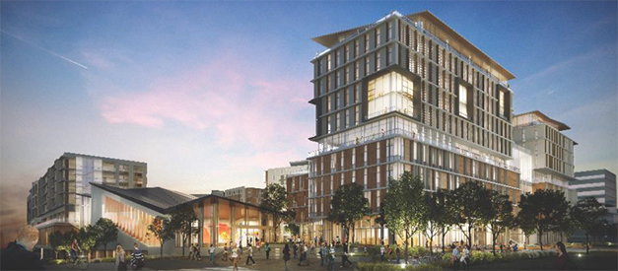
Challenges
Need strong, senior leadership support.
Community engagement...engage stakeholders early.
Funding should not be limiting...use OPM:
  CREBS, SGIP, CEC, NEM 2.0, VNEM/Meter aggregation.
Need portfolio approach...consider site constraints:
  CEQA, available space, existing conditions/infrastructure.
Will always take longer than planned...planning often takes longer than implementation.
Always have a plan B!

Slide 19
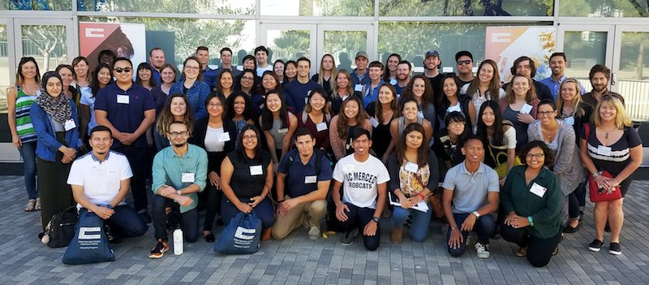
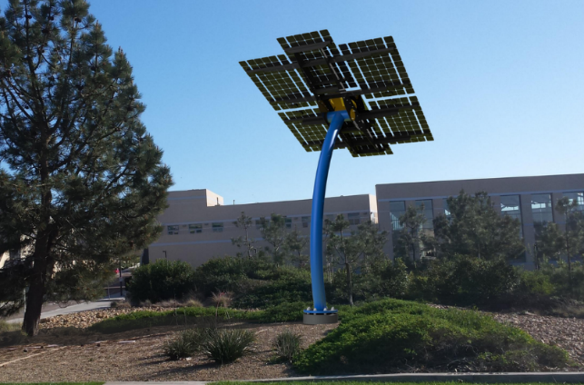
Future Challenges
Smaller, cheaper energy storage options.
Continued funding for implementation.
Improved methods of solar forecasting.
Implementation of smart inverter standards.
Integration of solar & energy storage to make PV a more dispatchable and firm resource.

Slide 20
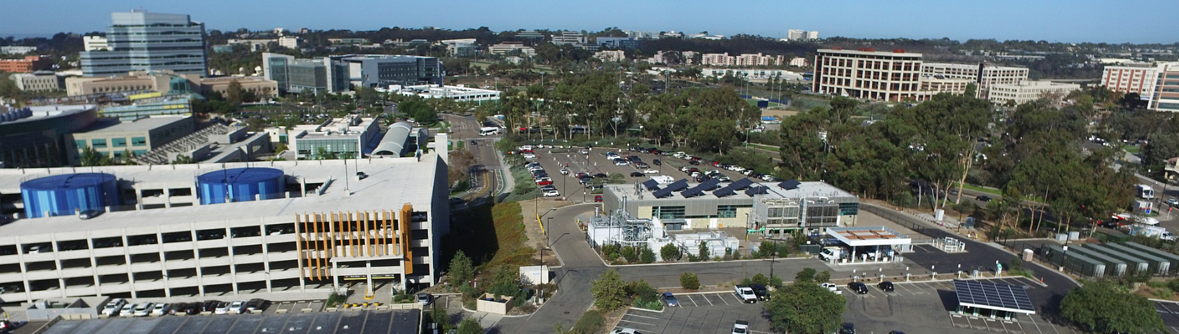
Thank You!
Dave Weil, PE, QCP
Director, Campus Sustainability
dweil@ucsd.edu

