Slide 1
Fuel cell electric vehicles and hydrogen fueling in California

Slide 2
CaFCP Members
Air Liquide
Alameda-Contra Costa Transit District (AC Transit)
Automotive Fuel Cell Cooperation
BAE Systems
Ballard Power Systems
Bay Area Air Quality Management District
California Air Resources Board
California Department of Food and Agriculture
California Energy Commission
California State University - Los Angeles
CALSTART
The Center for Energy Efficiency and Renewable Technologies (CEERT)
Center for Transportation and the Environment (CTE)
Comdata
Energy Independence Now
FASTECH
FirstElement Fuel, Inc.
General Motors
Honda
Hydrogenics
Hydrogen-XT, Inc.
HyGen
Hyundai
ITM Power
Institute of Transportation Studies, UC Davis
Ivys Energy Solutions
Kobelco
KPA
Linde North America, Inc.
Look, Inc.
Mercedes-Benz
National Fuel Cell Research Center, UC Irvine
National Renewable Energy Laboratory (NREL)
Nel Hydrogen
NICE America Research, Inc.
Nissan
Office of Governor Edmund G. Brown Jr.
Sandia National Laboratories
Shell
South Coast Air Quality Management District
Southern California Gas Company
SunLine Transit Agency
Toyota
United Hydrogen
U.S. Department of Energy
U.S. Environmental Protection Agency
University of California, Berkeley
Volkswagen
2

Slide 3
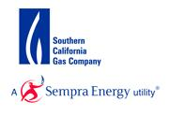
CaFCP Members
3

Slide 4
Just to be clear…
EVs come in two flavors
Battery and fuel cell
I am not a scientist nor an engineer
Be gentle when asking questions
I will not engage in EV Death Match
Fuel cells and batteries are not in a fight to the death

Slide 5
How a fuel cell works
Notes:
I know show you a video on, “how a fuel cell works”.

Slide 6
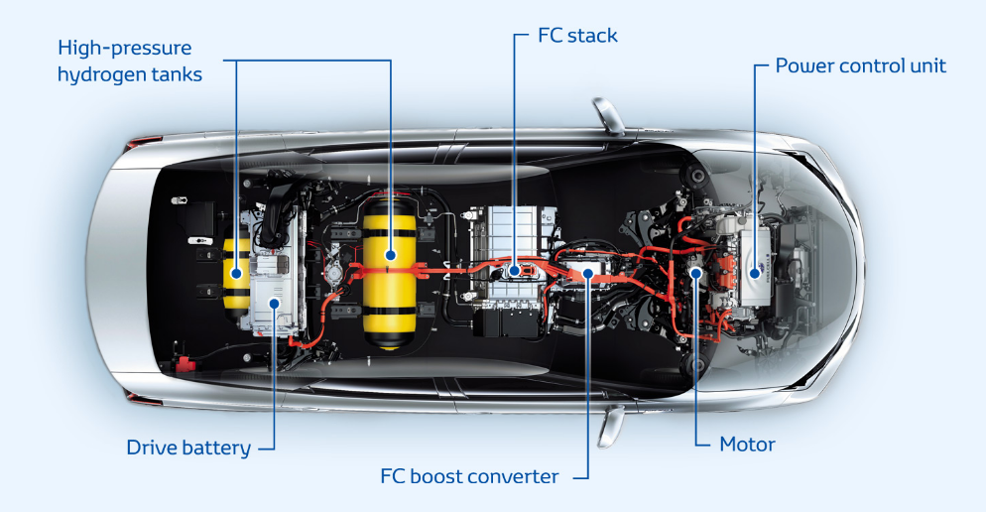
FCEVs are electric vehicles
Fuel cell stack
Notes:
The most important thing to know about FCEVs is that they are electric vehicles and have zero tailpipe emissions. FCEVs are an essential part of automakers’ portfolio of electric drive vehicles and enable them to electrify larger, longer-range full-function vehicles.
Many of the components of FCEVs are the same as plug-in Evs - electric motors, controllers, even batteries. But instead of plugging in, FCEVs are refueled with hydrogen at a fuel station, much as we refill our cars today. It takes 5 minutes and a full tank will take you 250 – 400 miles.

Slide 7
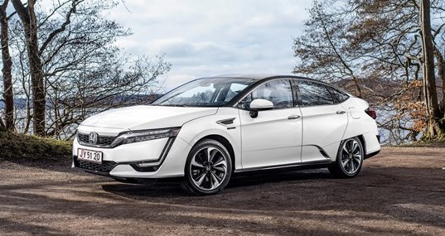
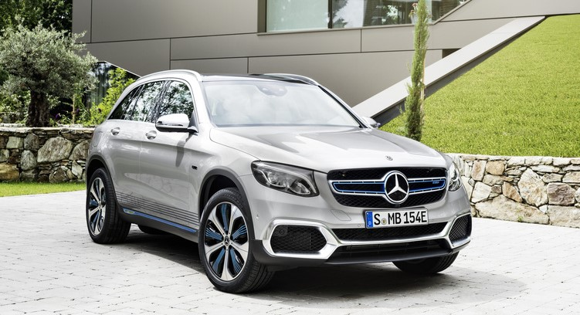
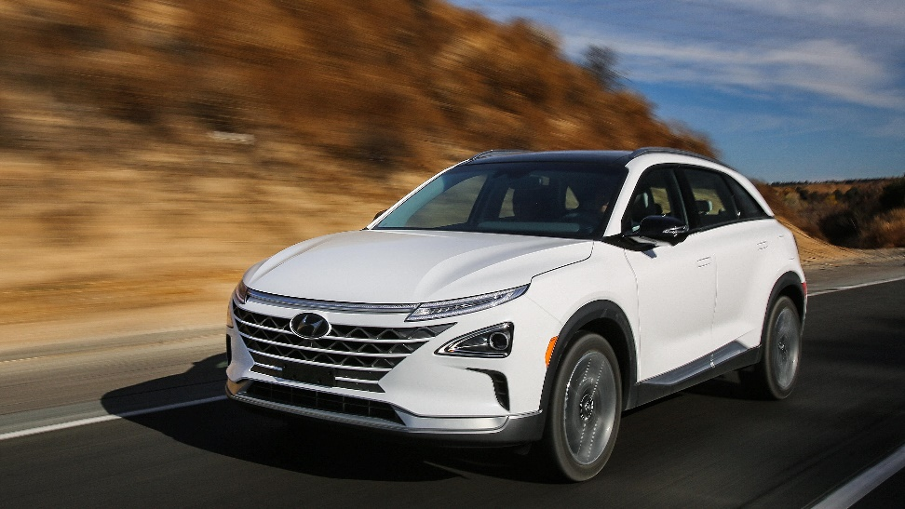
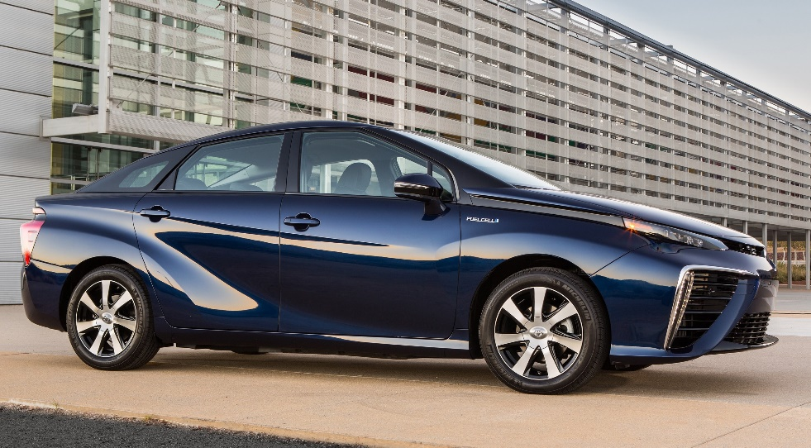
They’re here. And more are coming…
Fuel cell technology is an integral part of Daimler's powertrain strategy.
Daimler media release, 2017

Slide 8
Today in California
Passenger
Bus
Truck
Forklift
4,200+ passenger cars
4
transit agencies
2
truck
20,000+
forklifts
32
retail stations open
21
buses
10+
funded
34
retail stations in development
32
buses funded
100
station milestone
4
shuttles funded

Slide 9
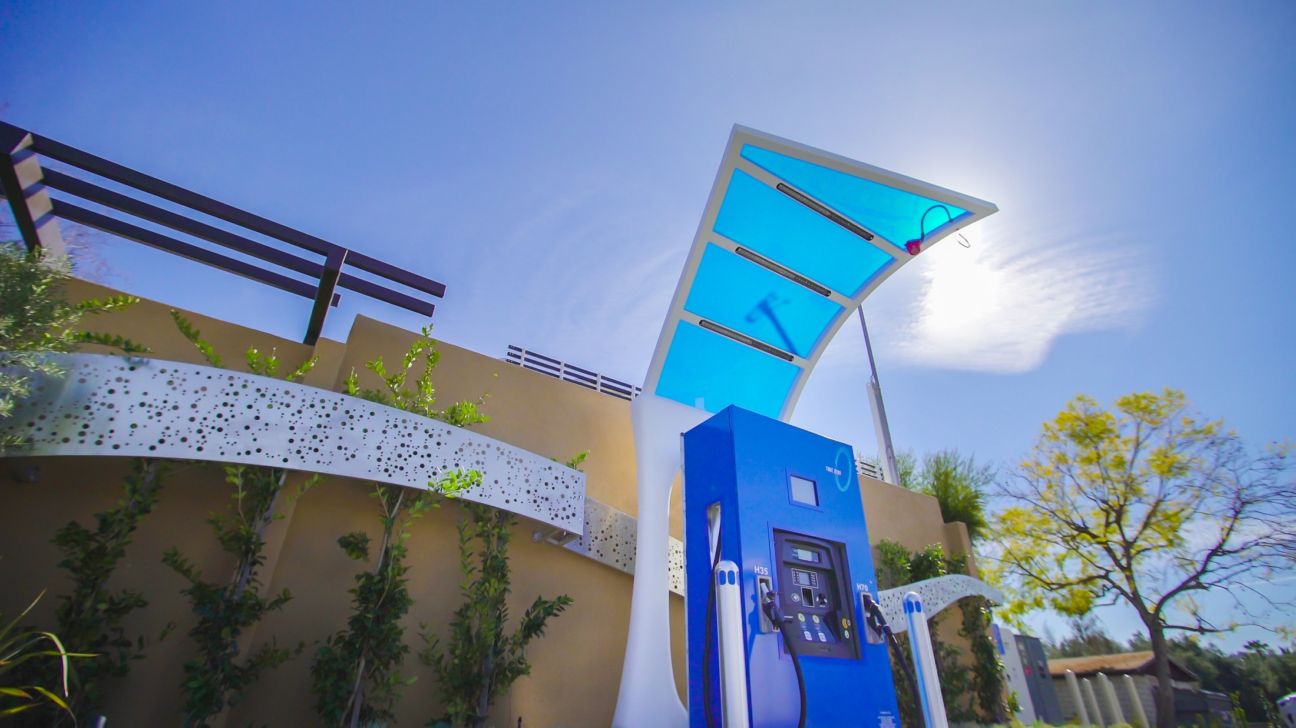
Hydrogen stations
La Canada Flintridge hydrogen station

Slide 10
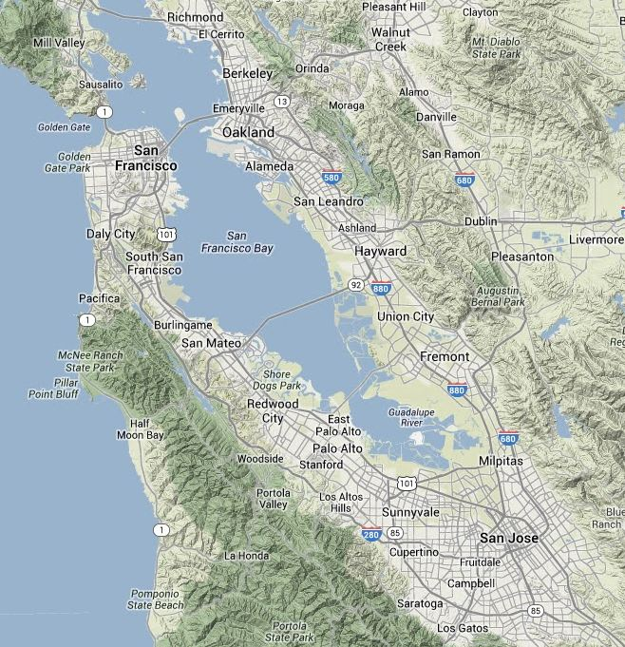
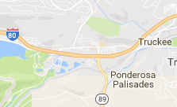
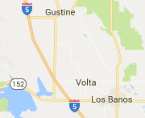
March 2018
Lake Tahoe-Truckee
Northern CA
Hydrogen Stations
Retail: Open
Citrus Heights
Campbell - Winchester Blvd
Fremont
Hayward
Mill Valley
Mountain View
San Jose
San Ramon
Saratoga
South San Francisco
Lake Tahoe-Truckee
West Sacramento
Sacramento
West Sacramento
Other: Open
Emeryville – AC Transit
Oakland – AC Transit
Retail: In Development
Berkeley
Campbell - East Hamilton Ave
Citrus Heights
Emeryville (Upgrade)
Oakland - Grand Ave
Palo Alto
Redwood City
Sacramento
San Francisco - Third St
San Francisco - Harrison St
San Francisco - Mission St
Santa Nella
Sunnyvale
Walnut Creek
Woodside
California Fuel Cell Partnership
www.cafcp.org/stationmap
Santa Nella

Slide 11
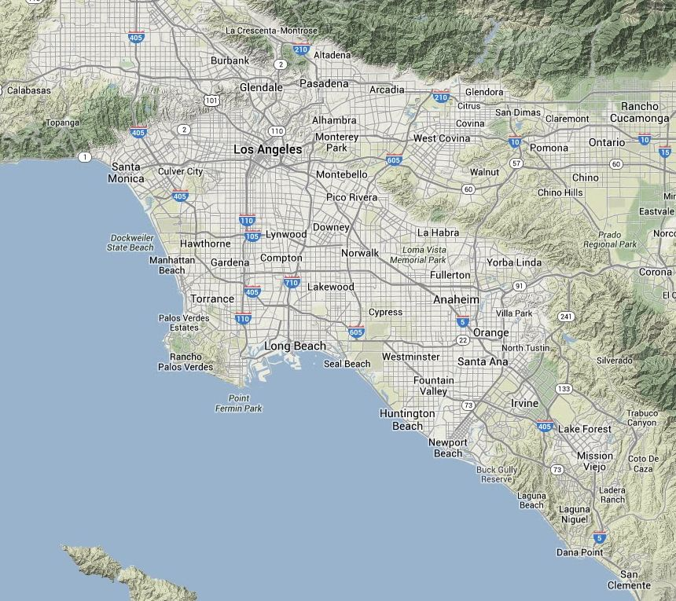
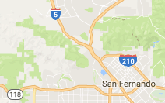
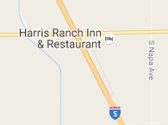
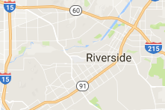
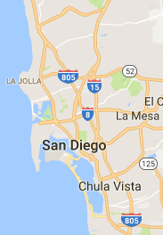
March 2018
Southern CA
Hydrogen Stations
Santa Clarita
Harris Ranch
Retail: Open
Anaheim
Costa Mesa
Del Mar
Diamond Bar
Fairfax-LA
Harris Ranch
Hollywood
La Cañada Flintridge
Lake Forest
Lawndale
Long Beach
Playa Del Rey
Riverside
San Juan Capistrano
*Santa Barbara
Santa Monica - Cloverfield Blvd
South Pasadena
Torrance
UC Irvine
West LA
Woodland Hills
Other: Open
Burbank
Newport Beach
*Thousand Palms – SunLine Transit
California Fuel Cell Partnership
www.cafcp.org/stationmap
Retail: In Development
Burbank (upgrade)
Beverly Hills
Cal State LA
Chino
Huntington Beach
Irvine
LAX (upgrade)
Mission Hills
Ontario
Rancho Palos Verdes
San Diego
Santa Clarita
Santa Monica - Lincoln Blvd
Sherman Oaks
Studio City
*Thousand Oaks
Del Mar
*Not shown on map

Slide 12
How many H2 Stations are needed?
California | Gasoline | Diesel
Total registered LDVs | 24,487,807 | 650,252
Total retail fueling stations in state | ~9,000 | ~3,845
% stations selling 50% of retail fuel by vol. | 21% | 3%
# stations selling 50% of retail fuel by vol. | 1,890 | 115
Estimated # of H2 Stations to Support/Provide Confidence in Early FCEV Market:
Total retail gasoline stations in CA | ~9,000
Consumer coverage concern greatly reduced for alternative fuel (% of total retail stations) (NREL 2012) | 10%
Resulting # of H2 stations needed to significantly reduce consumer coverage concern statewide | ~900
H2 Stations Needed to Begin Commercial Rollout of FCEVs:
Cluster, destination & connector stations | 68-100
# strategically placed H2 stations to reach 50% of CA pop. w/in 10 min. drive | 100
Sources: CaFCP, CEC, CA DMV, IHS Automotive, NREL, UCI

Slide 13
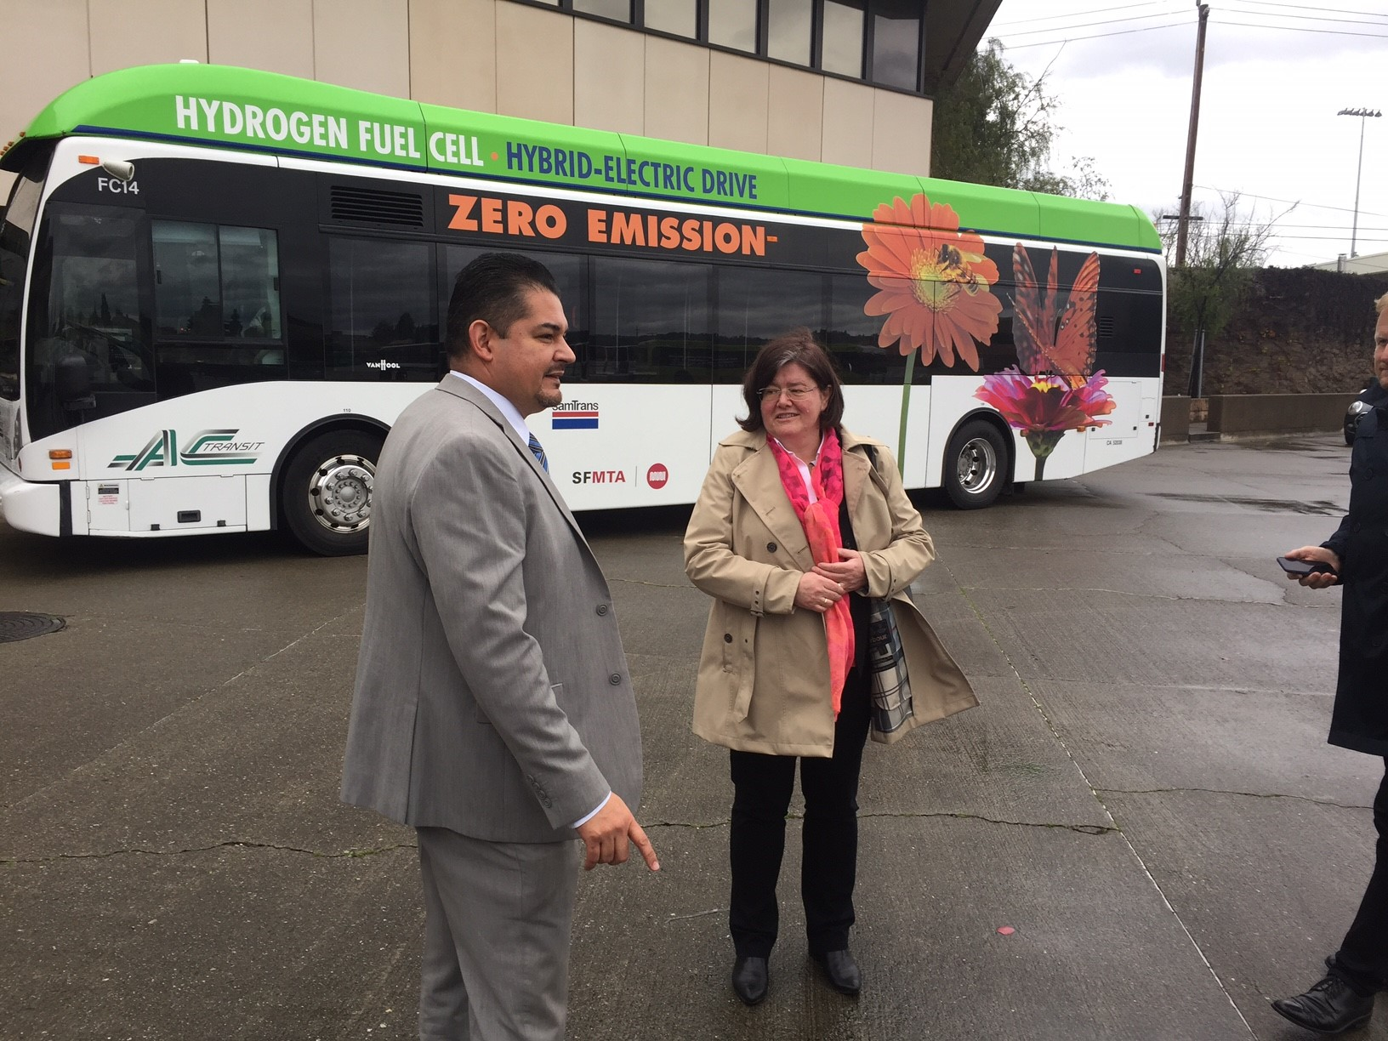
Fuel cell electric buses in California
20 buses in revenue service
Another 33 funded
17 years of experience
13 years of federally collected performance data
>2.7M miles in service
>2.5M passengers carried
Buses adopt technology first, pave the way for heavy-duty vehicles.

Slide 14
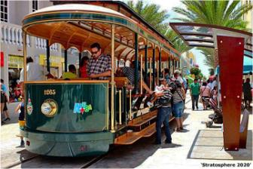
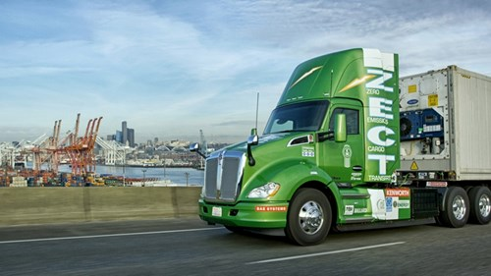
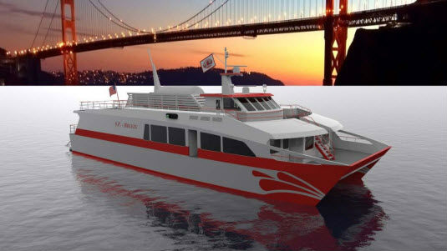
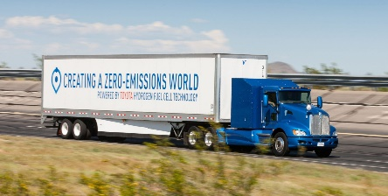
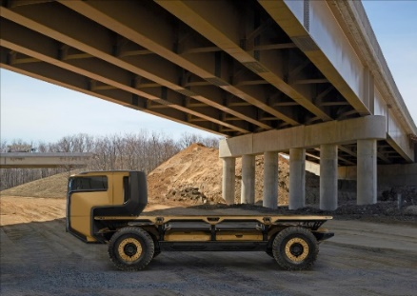
Trucks and heavy duty in California
Demonstration truck projects on the road or soon to roll out at ports include
Toyota’s Project Portal
Kenworth fuel cell truck
“Our testing shows that this truck performs equally as well, if not better than, current diesel trucks on the market.” -Kenworth
Notes:
CaFCP developed a fuel cell electric truck action plan. Being updated to include stakeholder input.

Slide 15
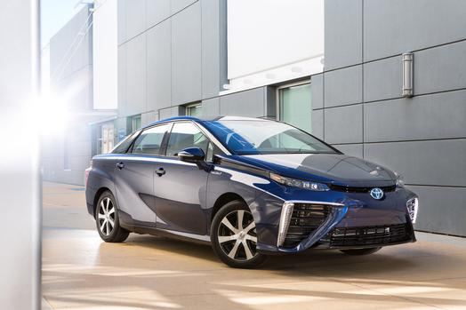
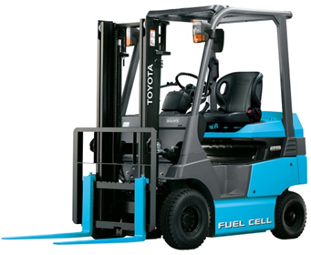
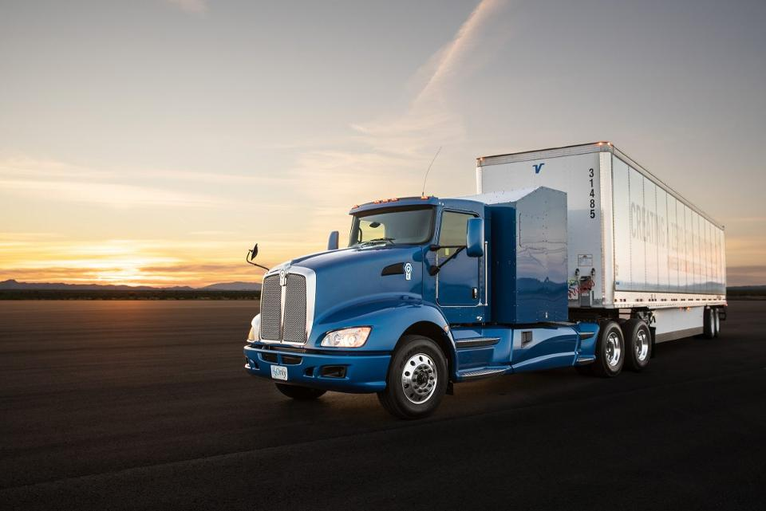
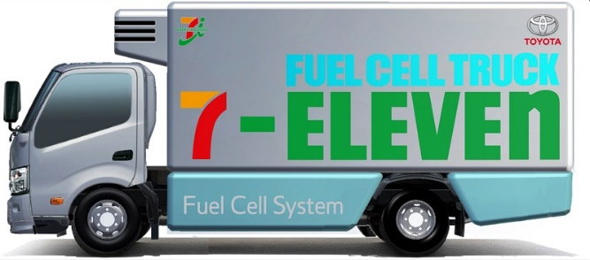
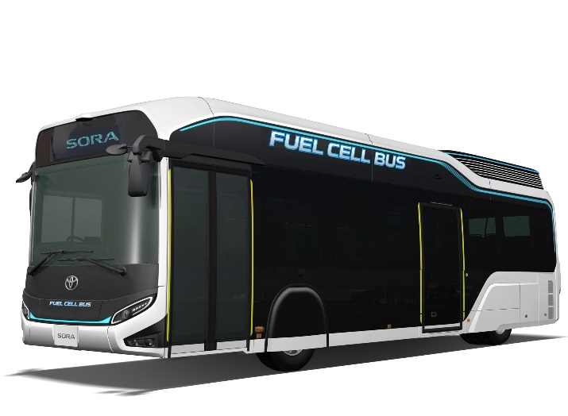
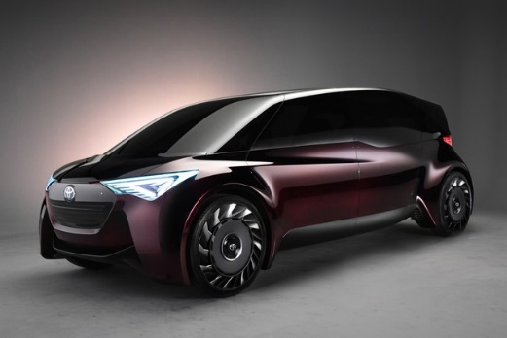
Toyota

Slide 16
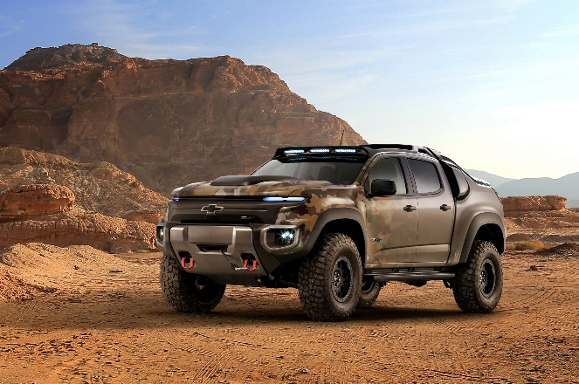
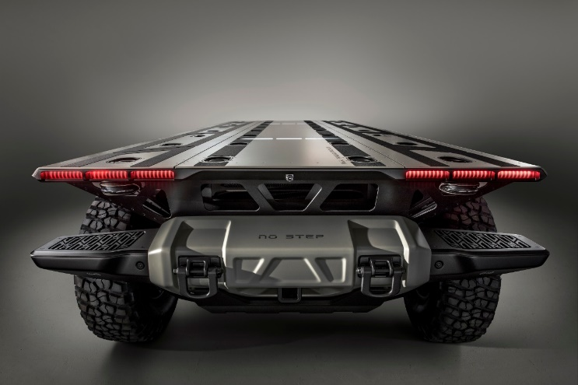
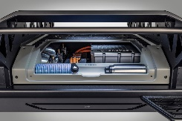
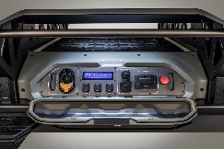
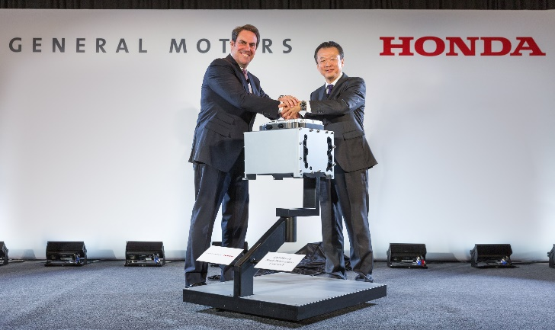
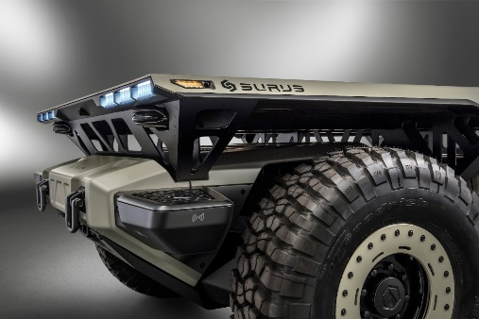
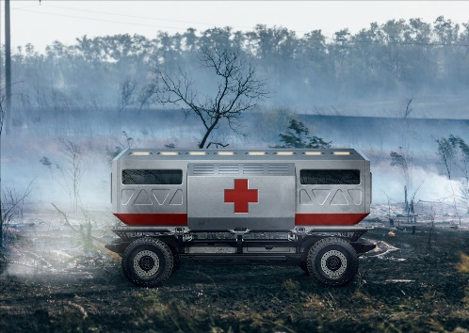
General Motors
Notes:
GM Chevy Colorado outfitted with fuel cell technology.
The military is testing this one-of-a-kind vehicle at army bases across the U.S.
Benefits:
Quiet, electric-drive technology
Lower heat signature, harder to detect with infra-red sensors
Can get 90% closer to a target
Fuels quickly
Fuel can be made from a variety of sources, including jet fuel, narrowing supply lines
Output is water, used on reconnaissance missions where water is important
Works well in extreme temperature environments

Slide 17
Hydrogen is on renewable pathway Like electricity
California requires 33% of hydrogen fuel to be renewable
Renewable H2 road map is in draft
California Energy Commission has a grant funding opportunity to build demonstration project(s) for renewable hydrogen transportation fuel
Stakeholders educating policy makers about renewable hydrogen and energy storage

Slide 18
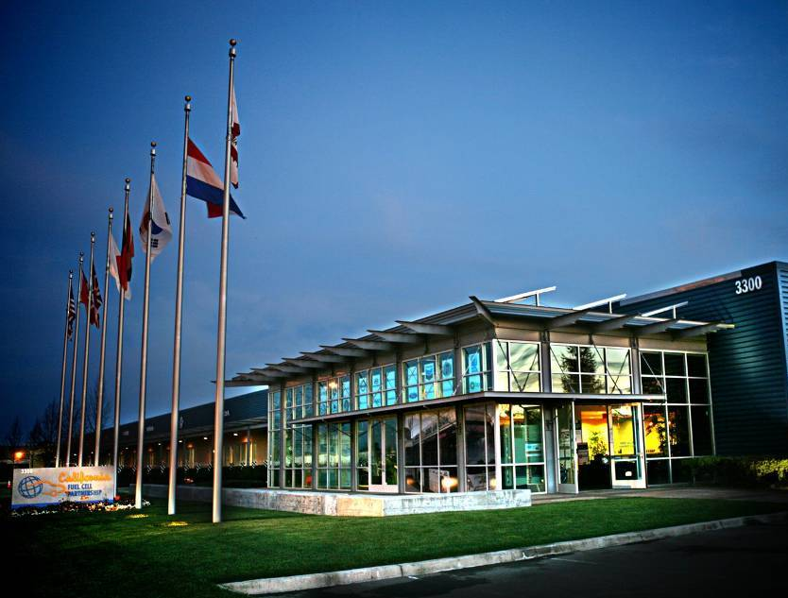
Keith Malone
kmalone@cafcp.org
www.cafcp.org
Follow us on Facebook, Twitter and LinkedIn
#fuelcell #driveH2

