Slide 1
San Mateo County Energy Strategy 2025
City/ County association of governments
Board Meeting
June 14, 2018

Slide 2
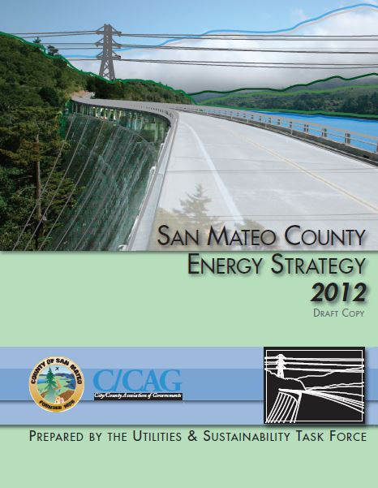
Energy Strategy 2012
Utilities Sustainability Task Force
Addresses:
Energy, Water,
Collaboration, Economics, Leaderships
2006 to 2008 adopted by BOS
2009 adopted by cities
Task complete - RMCP

Slide 3
Times have changed:
Energy:
New state goals
PCE established
Micro and smart grid
Electrified transportation
Water:
Drought
Past conservation goals met
Automated Metering Infrastructure (AMI)
Water recycling and groundwater sustainability

Slide 4
Guiding Principles:
Energy and Water Supply and Infrastructure in San Mateo County:
Sustainable - the lowest possible carbon footprint for delivered and consumed energy and water
Equitable - the energy and water is provided equally, regardless of socioeconomic or other status
Abundant - water and energy is available at a capacity to serve current and future needs
Reliable - energy and water is there when you go to use it
Resilient - energy and water is there when you go to use it, even if it isn’t somewhere else
Affordable - at a cost that is competitive or economically stable
Safe - not a hazard, cyber-secure, safe to consume, for utility workers and the community

Slide 5
Proposed Topics Covered:
Energy
Current and historic snapshot of supply and trends
Legislation and other issues
Energy efficiency
Renewable energy
Demand-side programs
Microgrid
Smart grid
Electrified transportation
Battery storage
Energy-Water Nexus
Fuel switching
Water
Current and historic snapshot of supply and trends
Legislation and other issues
Leak detection
Water auditing and efficiency
Alternative water supplies
Groundwater
Non-potable reuse (potable discussed)
Onsite non-potable reuse
Desalination

Slide 6
Stakeholders:
Energy
PG&E
Peninsula Clean Energy
El Concilio or other nonprofit in energy
County of San Mateo
San Mateo County Community College District
Clean Coalition
City/Town Council (2)
SamTrans/ Caltrain
City/Town Public Works/Fleet Vehicles
Electric vehicle/bus manufacturer
Battery Storage Integrator
Solar Comp
Water
BAWSCA
County of San Mateo
Water agencies (2-3)
Environmental Health
Silicon Valley Clean Water
San Mateo WWTP
West Bay Sanitary District

Slide 7
Energy Framework:
Water Framework:

Slide 8
Time Line:
*Potentially held as two separate meetings on the same day

Slide 9
Kim Springer
Resource Conservation Programs Manager
County of San Mateo, Office of Sustainability
kspringer@smcgov.org
650-599-1412
City/ County association of governments
Board Meeting
June 14, 2018

