Slide 1
San Mateo Plain Groundwater Sub-basin Elevation Monitoring
RMCP - August 21, 2019

Slide 2
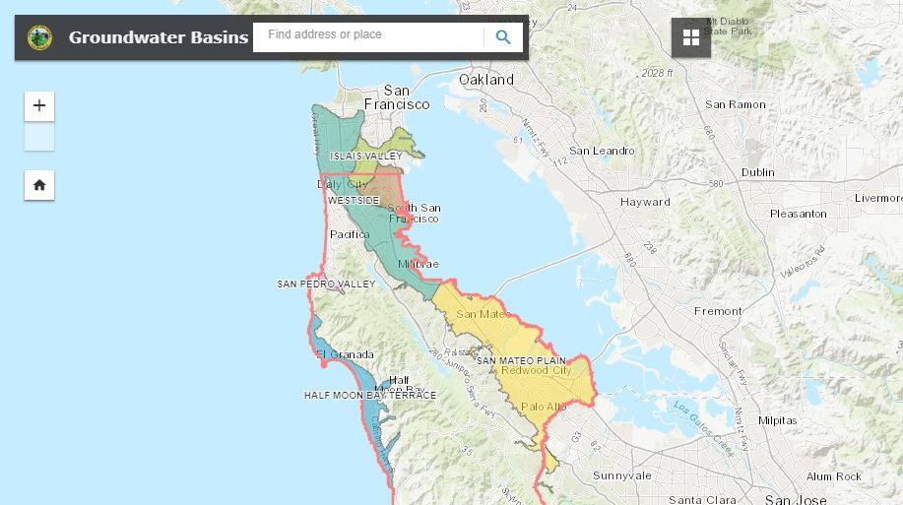
Background
Location of Basin
Prior to Hetch Hetchy
County Assessment
Completed Assessment:
SMPGWSB Final Report

Slide 3
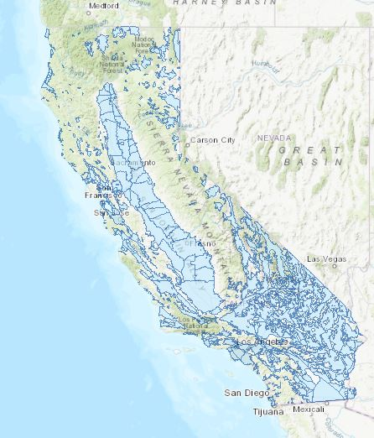
Basin Prioritization and CASGEM Monitoring
DWR Groundwater Basin Prioritization
San Mateo Plain management not required
at this time under SGMA
DWR CASGEM Monitoring
Began in 2009
Statewide database
CASGEM monitoring plans
Upload elevation data

Slide 4
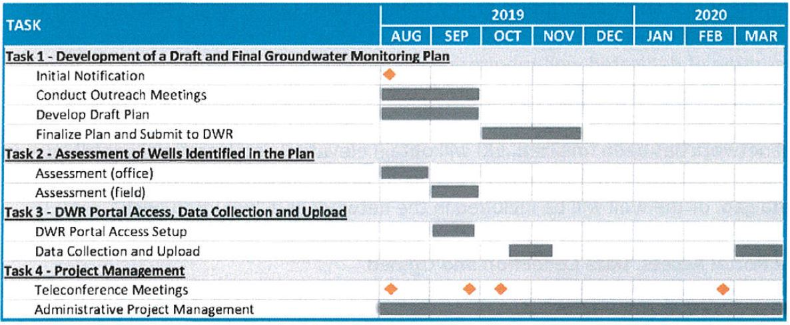
San Mateo Plain groundwater Sub-basin
Procurement for CASGEM Monitoring
EKI Environment and Water, Inc.
Scope of Work
Initial notification
Conduct Outreach Meetings
Draft and Final Plan
Assess wells for and in plan
Set up DWR Database Portal
Collect two sets of data and upload

Slide 5
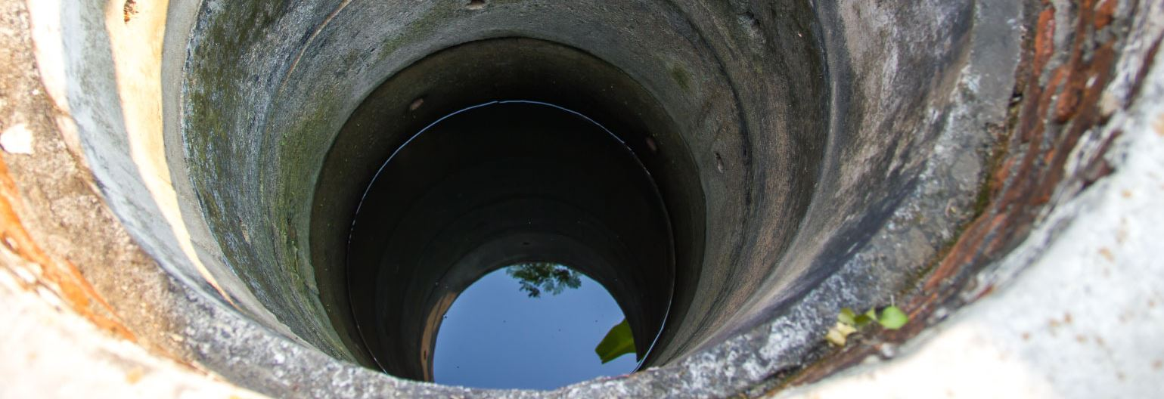
Next Steps
Finalize list of stakeholders
Send letter to stakeholders asking for support and well access
Initial Notification to DWR
Well identification and assessment
Draft CASGEM Plan
Monitoring
Well owner participation (funding and access) ongoing monitoring

