Slide 1
RHNA 6 Overview
Joshua Abrams abrams@bdplanning.com 510.761.6001 21 Elements

Slide 2
21 Elements
Collaboration
Better Policy
Time and Money Saved
Stakeholder Involvement
Working Relationship with HCD
Local and Regional
A collaboration among all jurisdictions in San Mateo County to improve housing planning and support policy implementation, with the goals of saving jurisdictions time and money, to better meet our collective housing needs.
APA
Best
Practice
APA
Best
Practice
Notes:
Thank you for C/CAG’s support.
Spreading to other regions

Slide 3
21 Elements
Covid
Covid
Covid
Covid
Covid
Covid
A collaboration among all jurisdictions in San Mateo County to improve housing planning and support policy implementation, with the goals of saving jurisdictions time and money, to better meet our collective housing needs.
APA
Best
Practice
APA
Best
Practice

Slide 4
Timing
Spring 2020 HCD releases number for the region
May 2020 Draft Blueprint (which may affect RHNA allocations)
July 2020 Draft methodology / hints at allocations
Sep 2020 Final Blueprint
March 2021 Final methodology / draft allocations
Sep 2021 Final allocations
Dec 2022 Housing Elements due
Notes:
A word about timing.
Make sure everyone knows the vocabulary – RHNA = . Sites inventory =

Slide 5
Key Definitions
RHNA or Regional Housing Needs Allocation: The target or number of homes needed in your community
Available Sites or Sites Inventory: The list of all the sites for housing

Slide 6
RHNA 5 to RHNA 6
Available Sites
RHNA
Notes:
We hired a crack team of graphic designers and had them labor for weeks for an image that conveys what to expect. Here is what they came up with. In past cycles, RHNA requirements are getting greater. And the pool of available sites is getting smaller.

Slide 7
RHNA - Current Cycle
Notes:
We’re going to talk about two things, the size of the pie and the size of SMC’s slice.
The size of the pie or the overall number for the region, comes from the state.
SMC’s slice of the pie is decided by a ABAG committee, called the RHNA methodology committee. I am on it as a staff representative and Council members Bonilla and Romero are also on it.
Last cycle, the total number for the region was about 188K, and
SMC’s share was 16,400
Mathmatically, SMC had about 8.7% of the regions total and has about 10 percent of the regions population.

Slide 8
2-3 Times Regional Increase
San Mateo County
38,000
Notes:
The first big take away is the RHNA for the region is getting bigger, probably 2, maybe 2.5 times bigger. So if SMC’s proportion stays the same, the number will be maybe 38,000.
This is probably what you are expecting, because that is what we were talking about, a 2-3 times increase for RHNA. But this is really important, that is assuming San Mateo County’s share stays the same. The pie will double, but what about San Mateo County’s slice of the pie.
After attending several of the RHNA methodology committee’s meetings, I think it will go up.

Slide 9
Based on Population
San Mateo County
43,800
Notes:
San Mateo County has about 10.1% of the regions population. So if it increased so we were average it would go up to 43,800. But what if our RHNA just increases to our share of the population. It goes up to 43,800.

Slide 10
Likely Factors
San Mateo County
43,800
Jobs
Transportation
Good Schools
Notes:
But the formula is heavily weighted to jobs, transportation and good schools. Compared to much of the region, SMC does well for all 3 of these.
So what if they just expected us to provide enough housing for our residents. This is the jobs housing gap that we have been talking about from the beginning.

Slide 11
Likely Factors
San Mateo County
81,000
Jobs
Transportation
Good Schools
Disclaimer: This is all speculation
Notes:
Then our RHNA has gone from 16,400 to 81,000. That is a dramatic increase. But what if they expect us to make up not only for our existing inbalance, but for new jobs that will be created in the planning period. I didn’t’ even prepare a slide for that, but my point is the RHNA could be higher than 81,000. Instead of 2-3 times our last RHNA, we could see 4-6 times.
<<pause>>
I don’t know the future, but I can tell you many people on the committee that are deciding the RHNA number are frustrated with SM, SC and SF because of the jobs housing balance and I don’t know if it is likely, but it a possiblility that the region will expect counties to fix their jobs housing balance.
Assuming the number is that high, and it might not be, the methodology is not started even out in draft form, but assuming we need to zone for five times more housing than we have been doing, how to do we talk to our residents.

Slide 12
Rules of RHNA 6
Rule 1 Scrutiny for Small, Large and Non-vacant Sites
Rule 2 Limits on Reusing Sites
Rule 3 Definition of Vacant Sites changed
Rule 4 Many Sites Used
Rule 5 Buffer Needed
Notes:
4 golden rules when
It’s not all vacant sites that face increased scrutiny, its only if you use a lot of them.
Legislature is really dubious about vacant sites.
Basically, oh, you really need these, we’ll make it harder.

Slide 13
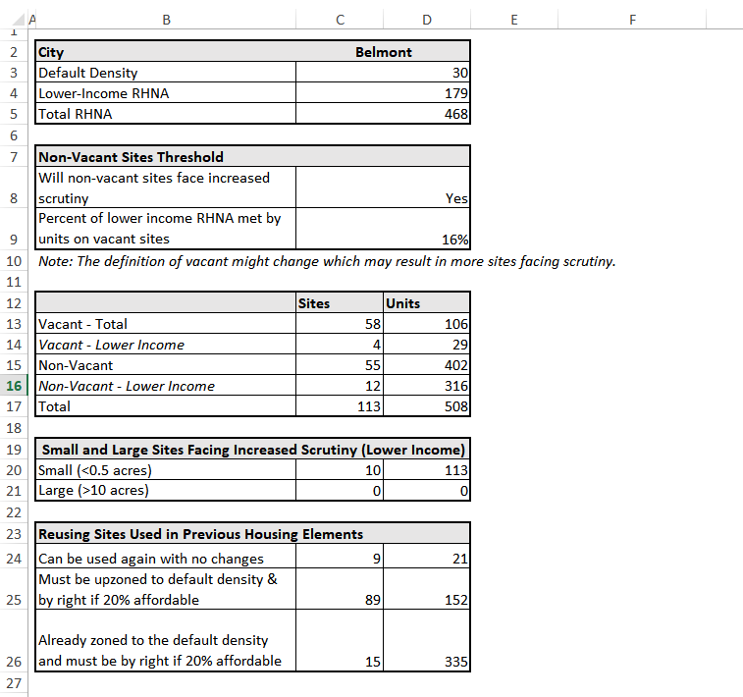
Case Study
Notes:
We made this chart for all cities..

Slide 14
What’s Available

Slide 15
What to Do About It
Conduct sites inventory early
Collaborate about feasibility analysis
Collaborate on Housing Element
Start rezoning soon
See it as an opportunity
Notes:
To review – Higher RHNA, Fewer Sites

Slide 16
Questions

