Slide 1

Quarterly Project Update
SMCTA, JPA and C/CAG Board Meetings May 2020

Slide 2
AGENDA
  Construction Progress
  COVID-19 impacts and opportunities
  Public Outreach

Slide 3
  Construction Progress
  COVID-19 impacts and opportunities
  Public Outreach

Slide 4
PROJECT SCHEDULE
Caltrans Project
Approval (South and North)
Nov 2018
Begin Toll Systems Installation
Spring
2021
Begin Toll Systems Testing
Summer 2022
Open
Express Lanes
Late 2022
Express
Lane
Addition
JPA Formed July 2019
100% PS&E
Sep 2019
Begin Construction
March 2020
End Construction Spring 2022
North of
Whipple
2018
2019
2020
2021
2022
South of
Whipple
Begin
Construction
Mar 2019
Substantial Construction Completed
Feb 2020
HOV to
Express Lane
Conversion
Begin Toll
Systems
Installation
Spring 2020
Begin Toll Systems
Testing
Spring 2021
Open Express Lanes
Late 2021
Notes:
Add time now line
“Potential” to “Planned”
Switch toll system to Fall

Slide 5
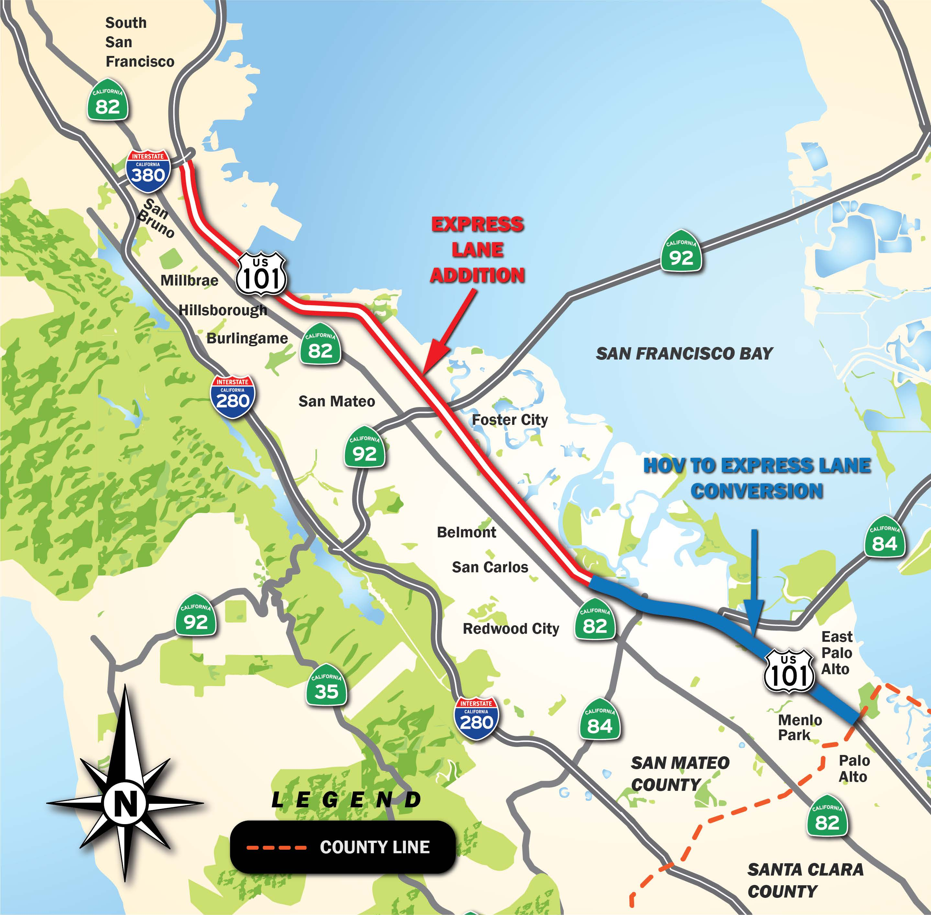
PROJECT LIMITS

Slide 6
CONSTRUCTION ACTIVITIES COMPLETED
    South of Whipple:
    $62.0M of $67.8M work completed (91%)
      26 signs installed
      2+ miles of concrete barrier constructed
      28+ miles of conduit placed
      17.4 miles of fiber optic cable installed
    Substantial civil construction completion achieved February 2020

Slide 7
CONSTRUCTION ACTIVITIES COMPLETED

Slide 8
CONSTRUCTION ACTIVITIES COMPLETED
    North of Whipple:
    $27M of $325M work completed (8.3%)
      95% of vegetation removed
      18 construction yards established
      105,000 feet of temporary barrier placed
      100% of temporary lane restriping complete
      2.5 soundwalls demolished
      Sanitary sewer relocation started April 30th

Slide 9
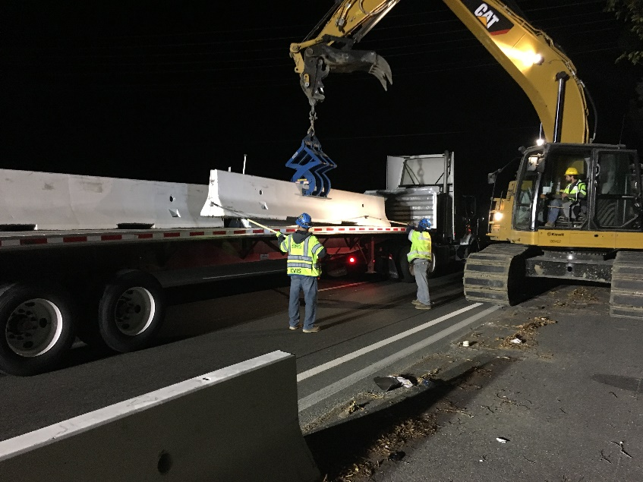
NORTH CONTRACT WORK UNDERWAY
Placing Concrete Barrier cote barrier

Slide 10
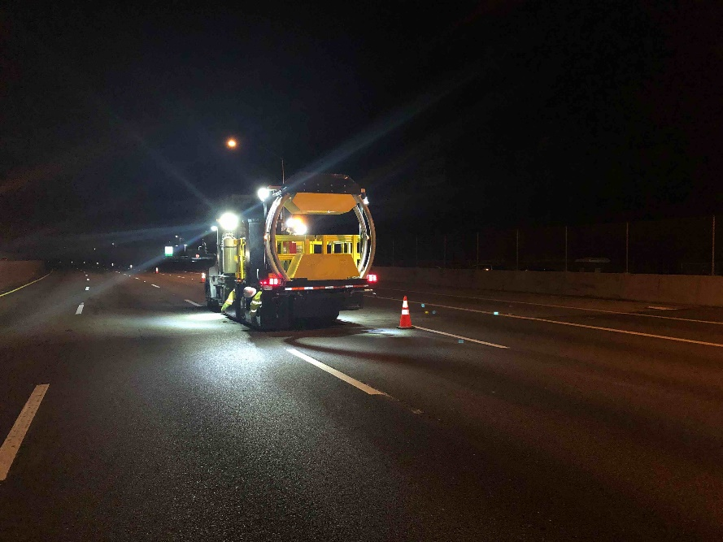
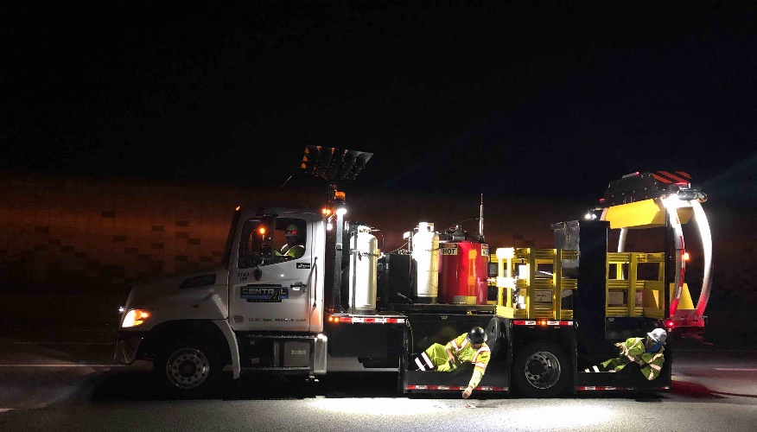
NORTH CONTRACT WORK UNDERWAY
Temporary Restriping and Traffic Loops

Slide 11
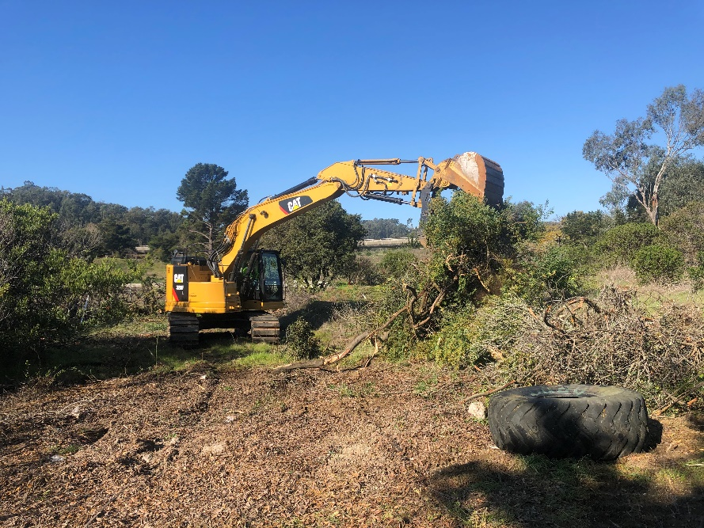
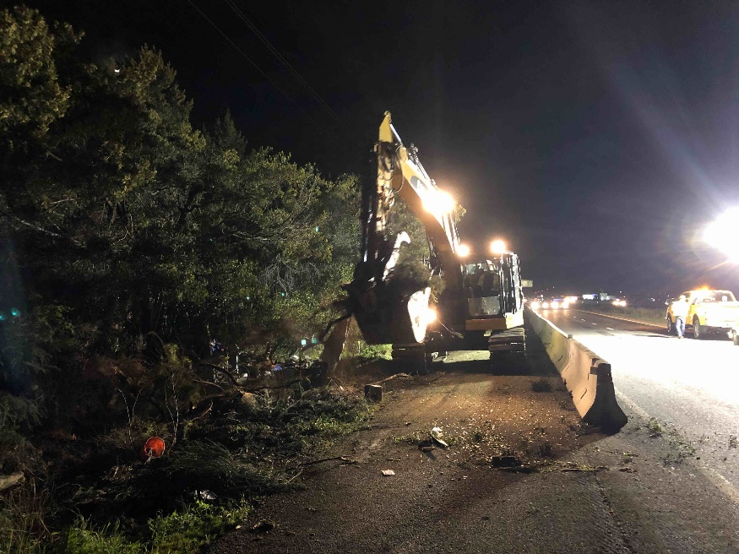
NORTH CONTRACT WORK UNDERWAY
Removing vegetation

Slide 12
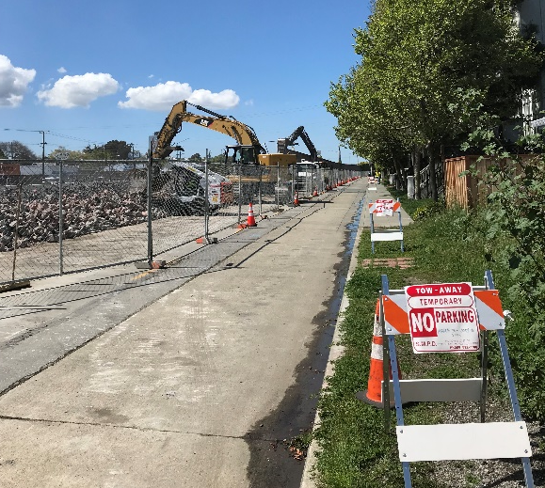
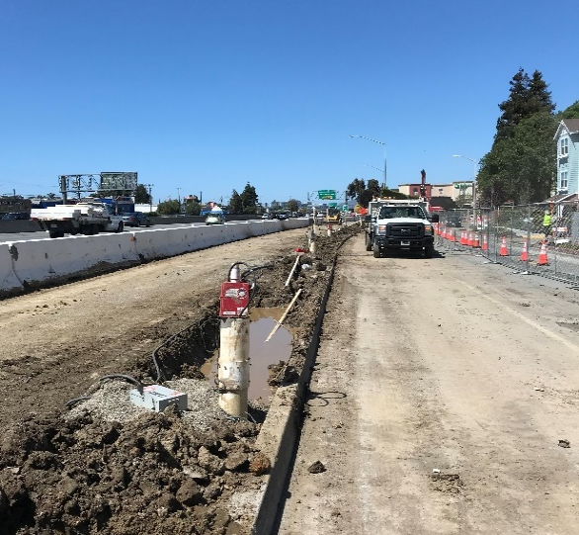
NORTH CONTRACT WORK UNDERWAY
Soundwall demolition
Notes:
Compliment City of San Mateo

Slide 13
UPCOMING WORK: May – July
Sewer line relocation near Dore Ave.
Sound wall reconstruction
  south of Kehoe
  north of Dore (pile drilling starts May 18th)
Preparation for PG&E and AT&T service
Pavement removal and grading
Electrical work
Notes:
For the “northern contract” or second phase, there will be work in Palo Alto on both the freeway and on City Streets (confirmed by contractor)

Slide 14
CURRENT PROJECT COST
 | Budget | Expended thru 3/20 | Estimate at Completion
Environmental, Design & ROW | $ 64.7 | $ 52.2 | $ 62.5
South Civil Contract | $ 74.8 | $ 66.0 | $ 74.8
North Civil Contract | $ 388.7 | $ 12.3 | $ 390.9
Toll System Contract | $ 45.0 | $ 0.1 | $ 45.0
Toll System Early Opening | $ 3.1 | $ 0.0 | $ 3.1
Highway Planting | $ 4.8 | $ 0.0 | $ 4.8
 | $ 581.1 | $130.6 | $ 581.1
in $millions
Notes:
Line 1 difference: R/W Capital, Risk Contingency, Permitting costs and possibly some savings
Line 2 difference: $3M No. K-rail, $1.4M SFM, $0.6 Contingency, $2M COS balance, unpaid CCOs

Slide 15
  Construction Progress
  COVID-19 impacts and opportunities
  Public Outreach Plan

Slide 16
OPPORTUNITIES
Events following Shelter in Place Directive
Kiewit response:
  Determined it was in the safety interest of their employees to stand down from the project
  The crews were demobilized for two weeks: Mar. 17 - 28
Caltrans response:
  Determined that their work is essential and communicated that determination to all of its partners
  Given the light freeway traffic, Caltrans has approved Contractor requests to extend lane closure hours
Joint response:
  Kiewit and Caltrans have modified closure hours to improve access and increase production
Notes:
Highlight original plan
Note what is gained

Slide 17
OPPORTUNITIES
Extended work hours during Shelter in Place
Nighttime freeway lane closures (Sun. through Thurs. nights):
  Starting as early as 7:00 pm (from 9:00 pm) and
  Picking up no later than 6:30 am (from 5:30 am)
Daytime single lane closures (Mon. through Fri.):
  Single lane closure from 6:00 am to 2 pm
  Starting: NB Woodside Rd. to SR-92 Interchange
  Extending: SB SR-92 Interchange to Woodside Rd.
  Maximum: SB Broadway to SR-92 Interchange
Dore Off-ramp weekend closure:
  Sat., May 16, 7:00 pm through Mon., May 18, at 6:00 am
San Mateo City street lane closures (Mon. through Fri.):
  8:00 am to 5:00 pm (from 8:30 am to 4:00 pm)
Notes:
Note what is gained

Slide 18
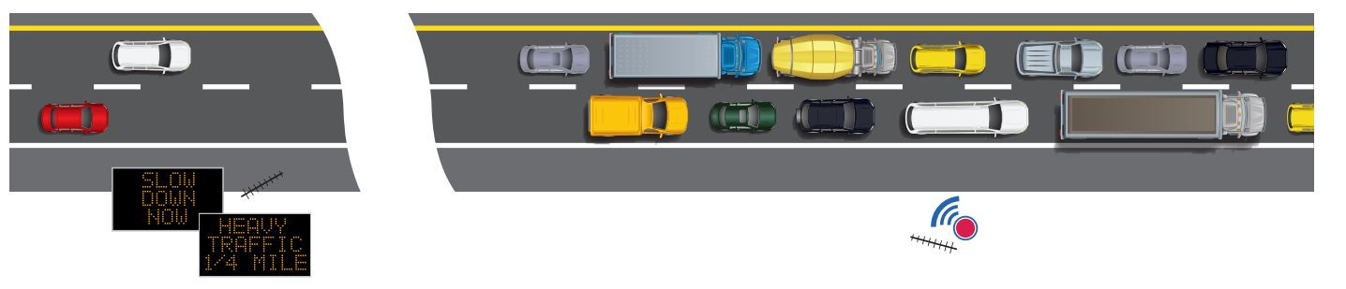


TRAFFIC INFORMATION SYSTEM
SLOW DOWN NOW
HEAVY TRAFFIC
¼ MILE
Caltrans has installed 42 sensors to monitor traffic along the project corridor
Real-time traffic information is displayed on 30 changeable message signs (i.e. delay times, congestion points, etc.)
Displayed messages 24x7 will vary throughout the corridor based on the location of the congestion

Slide 19
  Construction Progress
  COVID-19 impacts and opportunities
  Public Outreach

Slide 20
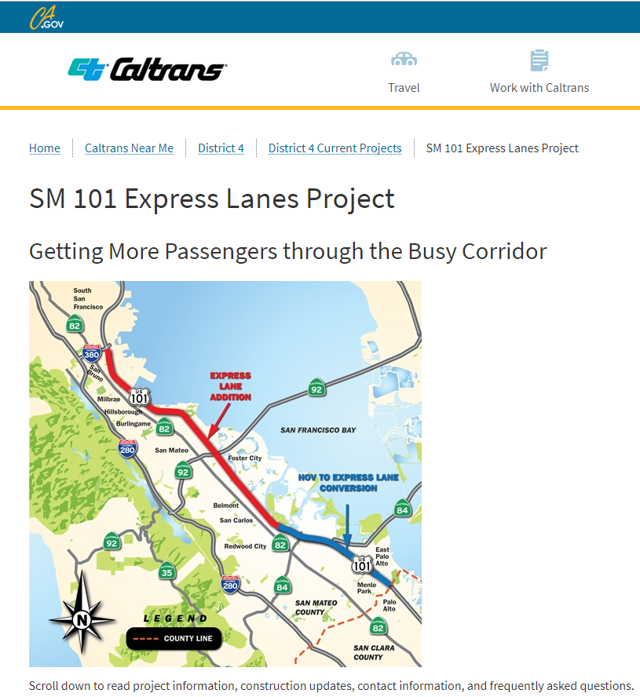
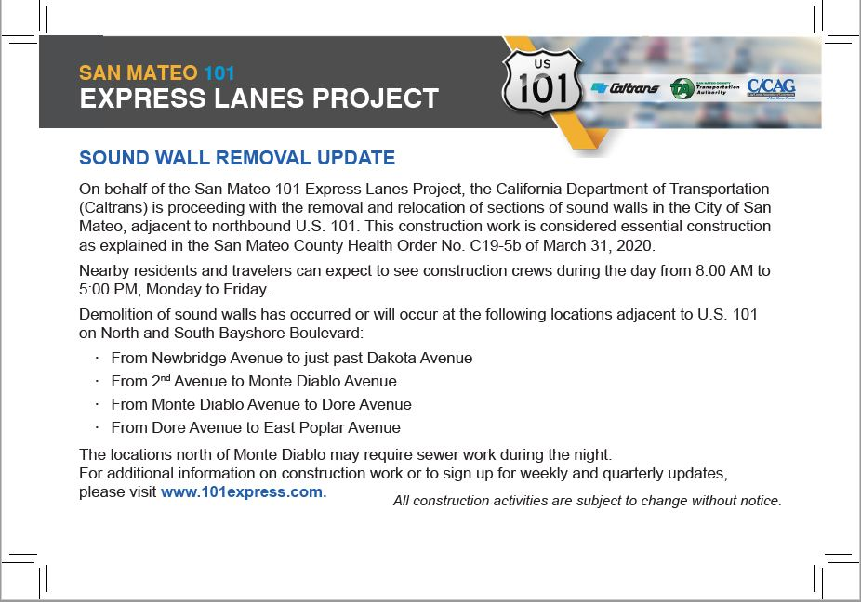
ONGOING CONSTRUCTION OUTREACH
Email blast (639 subscribers), website, and social media updates
Coordination with 511.org
Targeted weekly emails to SFO
Door hangers and post cards for sewer and sound wall work
Targeted radio ads when needed in the future
Notes:
Twitter feed provided to City of San Mateo prior to start of wall demo which they reTweeted

Slide 21
CONSTRUCTION E-MAIL INQUIRIES
Currently: 665 subscribers to weekly email blast
This figure shows aggregated counts of all email inquiries to 101express@dot.ca.gov over time
Notes:
The majority of the inquiries are asks to be included on the weekly email blast.

Slide 22
ACCESSING PROJECT INFORMATION
  For more information on the project, visit 101express.com
  To sign up for updates, email 101express@dot.ca.gov with “Weekly” or “Quarterly” in the subject line.
  To ask a question about the project, contact:
    Caltrans PIO, Alejandro Lopez, (510) 286-4948, 101express@dot.ca.gov

Slide 23
Questions?

