Slide 1

Alternative Fuel Readiness Plan
for San Mateo County
Overview of AFRP
Presented to RMCP Meeting
January 21, 2015

Slide 2
Outline
Why do we need to be Alternative Fuel Ready?
What does it mean to be ready?
Which Alternative Fuels?
How can the plan best serve you?

Slide 3
Relevant Legislation & Goals
AB32: CA Global Warming Solutions Act
  Cap and trade will expand to include fuels in 2015
EO S-01-07: Low Carbon Fuel Standard
  Producers of gasoline and diesel must meet annual fleet Carbon Intensity target using alternative fuels and other measures
SB 375: Sustainable Communities Strategies
  Bay area plans to reduce GHGs from cars and light-duty trucks 10% per capita by 2020 and 16% by 2035
EO B-16-12: Zero Emission Vehicles Goals
  1 million ZEVs in CA by 2020
  1.5 million ZEVs in CA by 2025
  Reduce GHG emissions from transportation sector to 80% below 1980 levels by 2050
Notes:
Originally passed in 2006. Under cap-and-trade, the state sets a limit to the total greenhouse gas emissions for the state and auctions off carbon permits to covered industries. This cap will decline 3% per year. Alternative fuels will provide a way for obligated parties to reduce their total emissions by buying carbon offsets.
Part of ZEV program is that the state will provide $20 million annually to build H2 stations until they have reached 100. 48 stations are expected to be completed by the end of 2015.
In September of this year, the state surpassed 100,000 PEVs sold in CA.

Slide 4
Why do we need an Alternative Fuel Readiness Plan?
Prepare local agencies for the increased use of AFVs.
Prepare cities for handling safety, zoning, and permitting issues related to AFVs.
Contribute towards climate change mitigation, climate action plans, and air quality goals.
Help to identify potential cost savings for city fleets or individuals.
Create attractive location for environmentally conscious businesses and individuals using AFVs.

Slide 5
Impact of AFs on the County
Public or Private
Pathway
Feedstock
Transport
Production
Distribution
Vehicle Use
Activities in San Mateo County
Facility Construction and Operation
Truck Transport
Charging Station
Fuels Station
Government Scope
Infrastructure and Fleet Development for Government
Permitting of Private and Government Facilities
Fire/Safety Training
Financing and Outreach
Administer regulations on delivery trucks in tunnels AFV parking, etc.
Notes:
Shows the chain of effects of Afs and AFVs and how they relate to this county.
Here’s what happens in the pathway, here’s what happens in San Mateo, here’s what happens at the government level.

Slide 6
AFV Readiness Report Topics
Content | Definition
Challenges | Zoning, regulation, and permitting- need for clarity Vehicle and infrastructure growth- rate is difficult to predict
Economics | Life cycle cost- vehicle costs more, maintenance costs less Incentives- rebates, tax credits, insurance discounts Policy- how best to encourage AFVs in SM County?
Training and outreach | Safety training- fire officials, first responders, consumers Consumer awareness- benefits, costs, availability
Permitting and construction | Building & fire safety codes- need for training Burdensome expectations for new facilities- disincentive
Notes:
Fuel production and fueling facility codes and standards
Fire suppression
- Sprinklers, fire hydrants
Permitting time
Fuel station and residential codes
Fuel delivery by truck
Truck traffic, bridges, tunnels
Accessibility to fueling sites
Fuel unloading time
Vehicle accident response
Fuel escape from relief valves
Access with electrical wiring, batteries, fuel lines

Slide 7
Which Alternative Fuel Vehicles?
Battery Electric Vehicles (BEVs)
Plug-in Hybrid Electric Vehicles (PHEVs)
Compressed Natural Gas Vehicles (CNG)
Liquid Natural Gas Vehicles (LNG)
Hydrogen Fuel Cell Electric Vehicles (FCEV)
Flexible Fuel Vehicles running on 85% Ethanol (E85)
Biodiesel Vehicles (BD)
Liquefied Petroleum Gas Vehicles (LPG)

Slide 8
ARB LCF Volume Projections
Notes:
The ARB released an illustrative summary of fuel volumes to achieve compliance with the LCFS. Graph shows ARB projections based on the average of a variety of production methods and feedstocks. For example, the CI for renewable natural gas shown by ARB ranged from 33 to 38 g CO2/MJ and fossil natural gas CI values ranged from 78 to 91 g CO₂/MJ. The CI values are preliminary and the fuel volumes are shown on an energy equivalent basis.

Slide 9
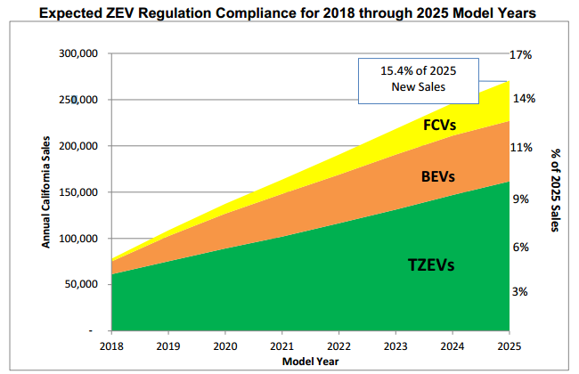
ARB ZEV Projections
Source: Advanced Clean Cars: Initial Statement of Reasons, ARB December 2011
Notes:
California ARB’s projections of ZEVs needed through 2025 to achieve fleet goals.
Plug in hybrids are considered Transitional ZEVs- The current regulation establishes a minimum ZEV credit percentage requirement for manufacturers for the 2018 through 2025 and subsequent model years. The requirement represents the percentage of passenger cars and light duty trucks produced by a manufacturer and delivered for sale in California that must be ZEVs (credit-weighted based on the advanced vehicle technology chosen). Vehicle manufacturers can meet some or all of this requirement with TZEVs, depending on vehicle volume and year. The expectations for ZEV production were reduced in 2014 to allow more TZEVs.

Slide 10
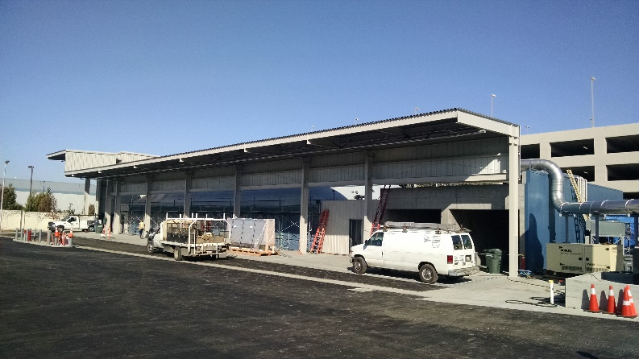
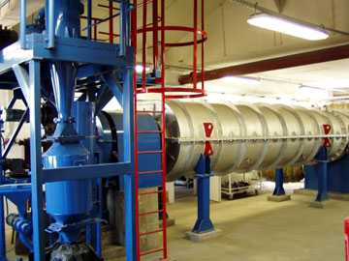
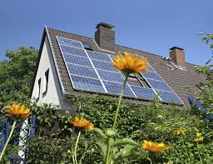
Fuel Production Infrastructure
Anaerobic Digester
Fuel Processing
Solar Powered EV
Notes:
Issues of safety, permitting, zoning

Slide 11
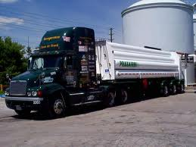
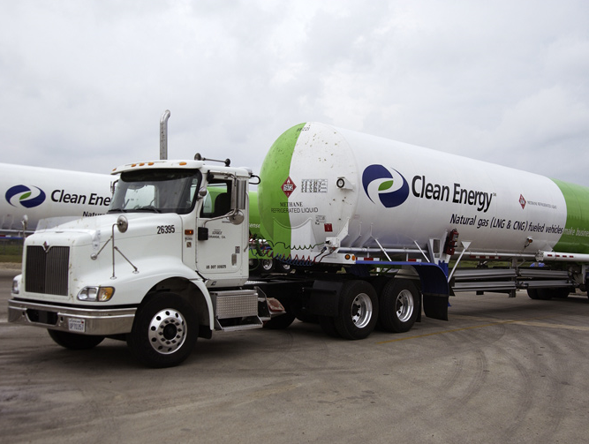
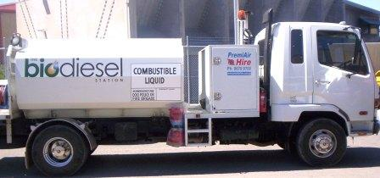
Fuel Transport
Hydrogen Tube Trailer
Liquid Fuel Delivery Truck
LNG Truck
Notes:
Safety, regulations, emergency response, where can they go?

Slide 12

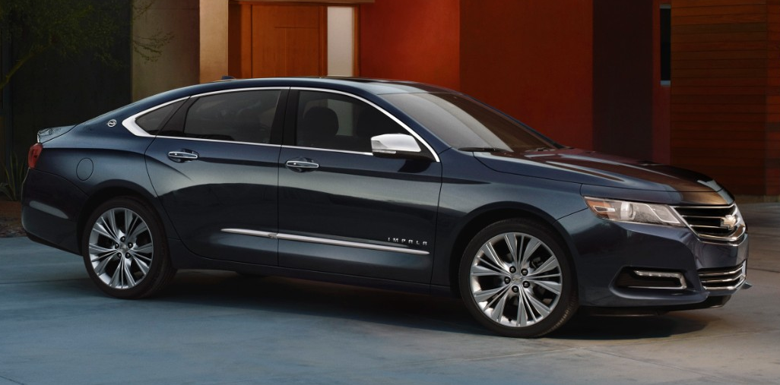
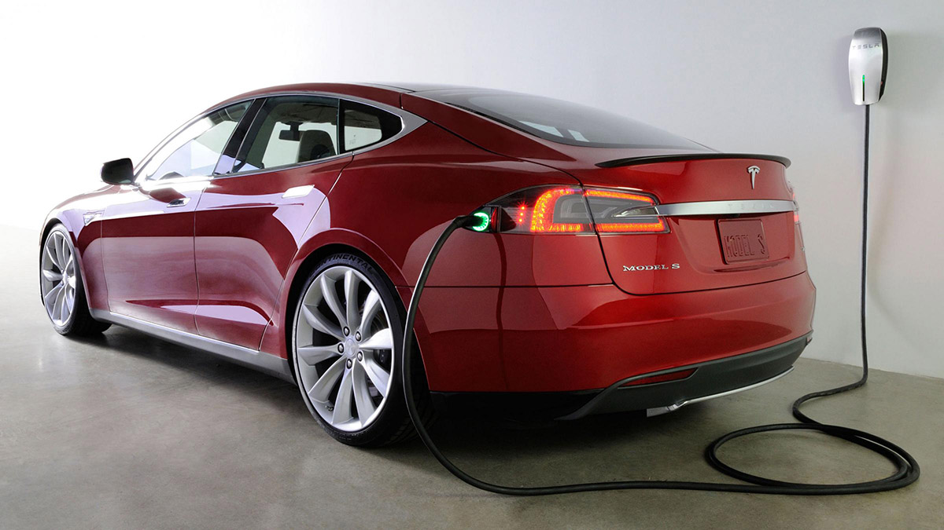
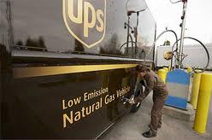
Alternative Fuel Vehicles
Fuel Cell Vehicle – 2015 Hyundai Tucson
E85 FFV - 2014 Chevy Impala
Electric Vehicle - 2015 Tesla Model S
CNG fueled UPS Truck
Notes:
How many can we expect to have on our roads? Safety concerns? Benefits?

Slide 13
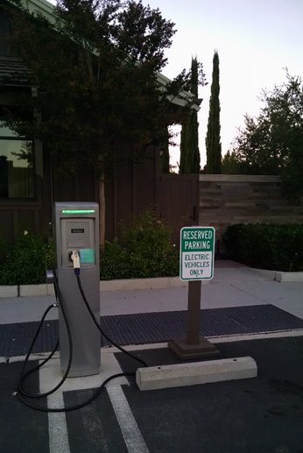
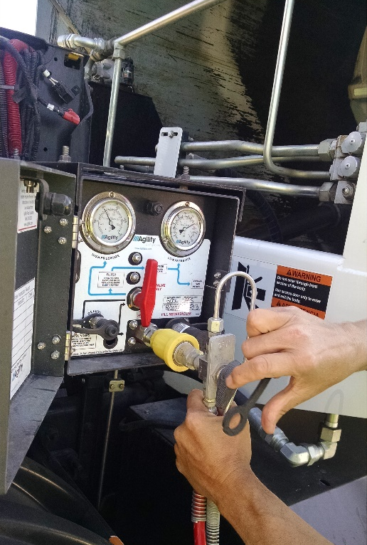
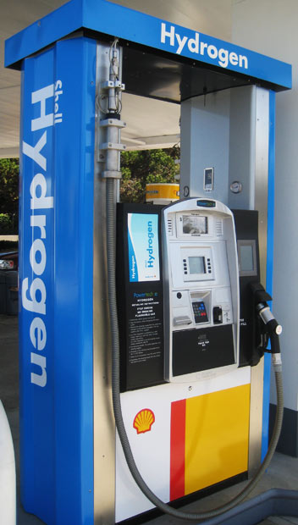
Alternative Fuel Infrastructure
EV Charging Station
CNG Charging Station
FCEV Charging Station
Notes:
Permitting, making process easy on both government and businesses. Where? How many?

Slide 14
Potential AFV Incentives
Incentive Type | CNG | LNG | BEV | LPG | H2 | E85 | BD | PHEV
HOV Lane | X |  | X | X | X |  |  | X*
Federal Tax Credit |  |  | X |  | X |  |  | X
State Rebate |  |  | X ($2,500) |  | X ($5,000) |  |  | X ($900-$1,500)
LCFS Credit | X | X | X |  | X | X | X | X
RFS2 RIN | X | X | X |  |  | X | X | n
Discounted Fueling | X |  | X |  |  | X | X | X
Insurance Discount | X |  | X | X | X | X |  | X

Slide 15
Data Collection Topics
What level of awareness do city employees have about AFVs?
Which San Mateo county cities have AFV fueling infrastructure? Which fuels?
Where are there potential biofuel sources in San Mateo county? (E.g. landfill gas or waste water treatment)
What are the key obstacles retailers and installers encounter when trying to build a new fueling station?

Slide 16
Questions?
Contact Info:
jhoang@co.sanmateo.ca.us
kspringer@smcgov.org
Henderson@lifecycleassociates.com
Notes:
Ashley

