Slide 1
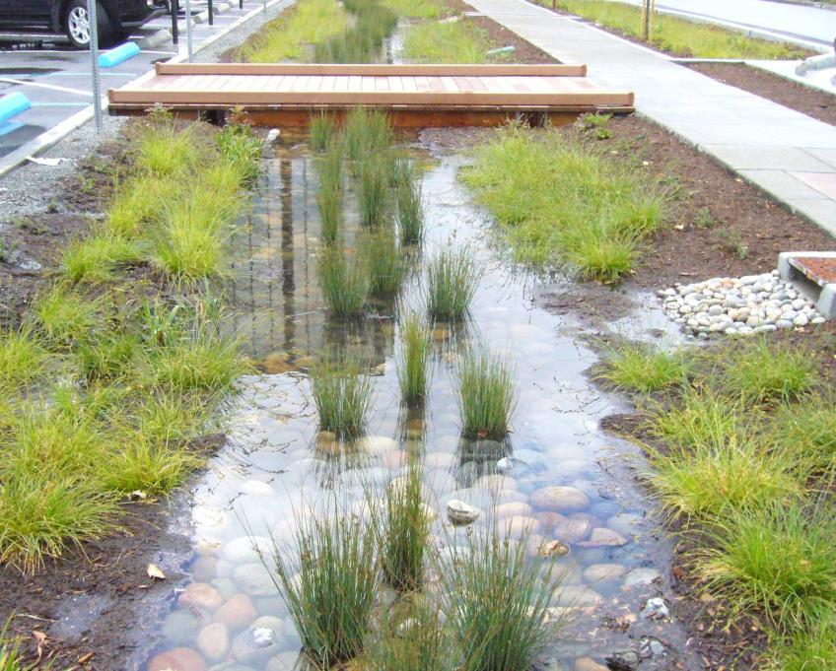
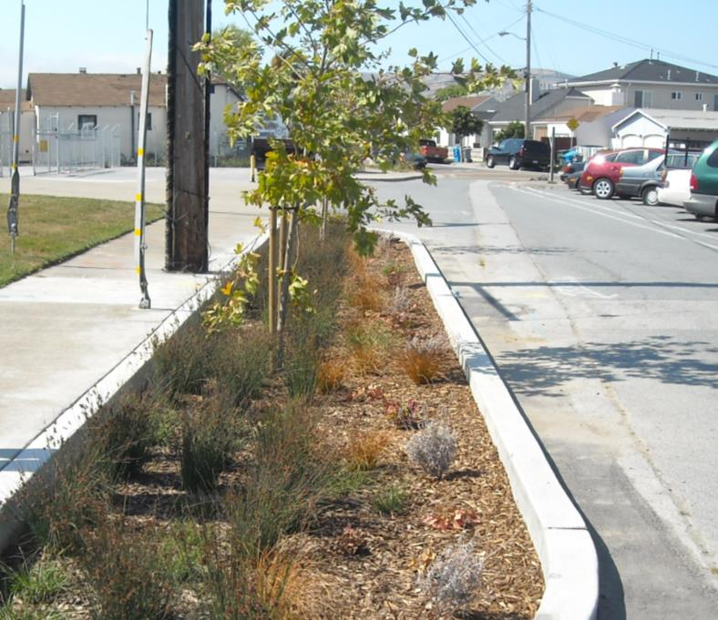
Green Infrastructure:
Planning for the Future
Matthew Fabry, P.E.
Program Manager
San Mateo Countywide Water
Pollution Prevention Program
Resource Management & Climate Protection Committee
April 15, 2015

Slide 2
The Municipal Regional Permit
Mercury/PCB TMDLs
New & Redevelopment
Low Impact Development Treatment
Hydromodification Management
Trash
Pesticides
Future Concerns?
Nutrients, Pathogens, PAHs, Others?

Slide 3
MRP 1.0 → MRP 2.0, 3.0, 4.0…
Conclusion?
Solution is long-term (multi-decadal) disconnection of impervious surfaces in urbanized areas using green infrastructure

Slide 7
Big Questions
How much through new/redevelopment?
What about streets and other land uses?
What will it do for water quality?
What will it do for other issues?
How long will it take?
How much will it cost?
How will we pay for it?

Slide 8
Stormwater Permit Compliance Needs
Estimated mercury/PCBs cost: $23M/year
Estimated trash cost: $ 7M/year
Estimated other cost: $16M/year
Estimated existing revenue: $ 9M/year
Shortfall: $37M/year
Public support for parcel tax limited: $8-12M/year
Conclusion?
Need other revenue or drive down costs of compliance

Slide 9
Climate Change & Sustainable Communities Strategies
AB 32/SB 375
Greenhouse gas emission reduction targets
Sustainable Communities Strategies
Bay Area SCS – long-term integrated land use/housing strategy
Priority Development Areas
Dense housing around transit
Support with bike/ped infrastructure
Primary goal: Get people out of their cars

Slide 10
Climate Change & Sustainable Communities Strategies
Metropolitan Transportation Commission
$14 billion for active transportation in Priority Development Areas by 2040
Opportunity:
A large amount of money will be spent on projects that impact the surface drainage system (curb and gutter).

Slide 11
EXISTING STREETS

Slide 12
COMPLETE STREETS

Slide 13
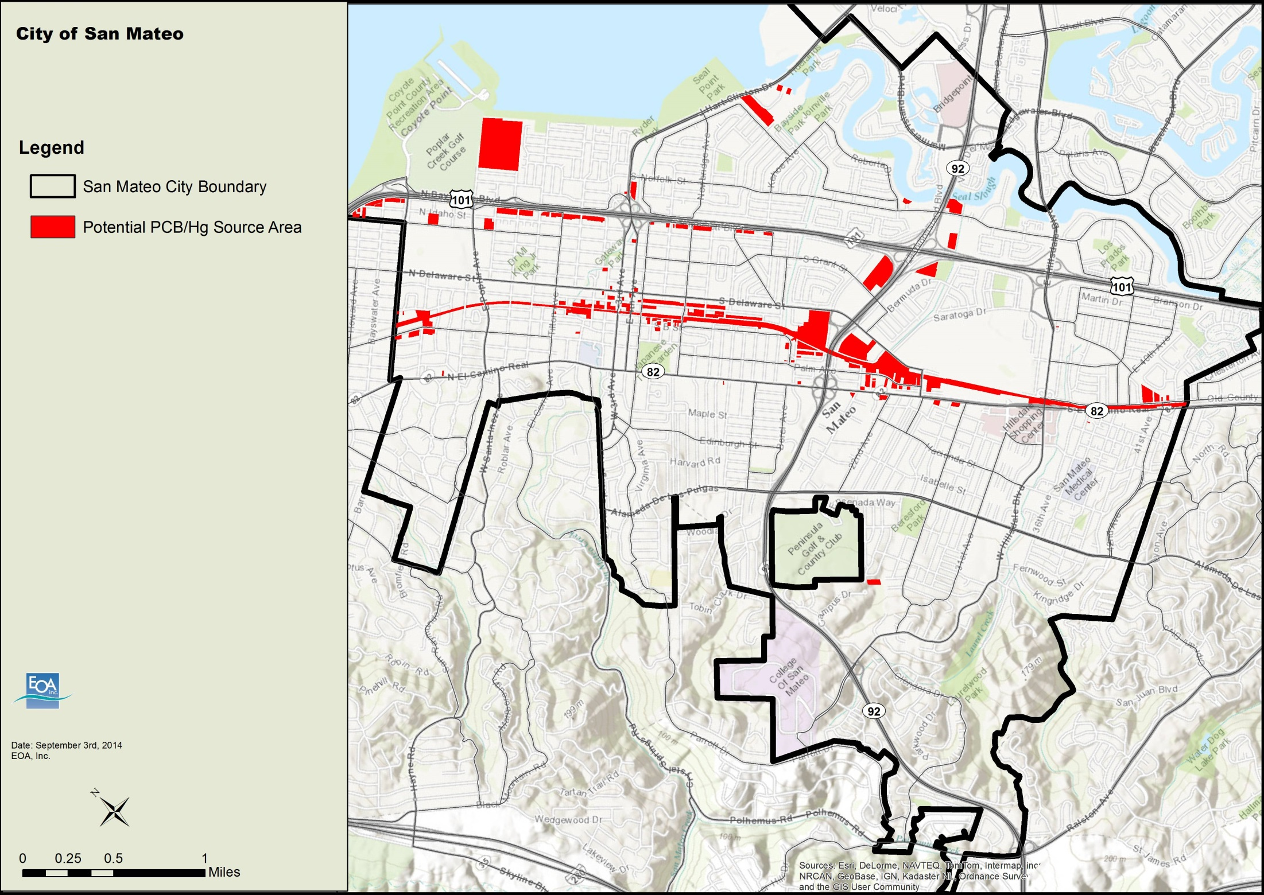

Slide 14
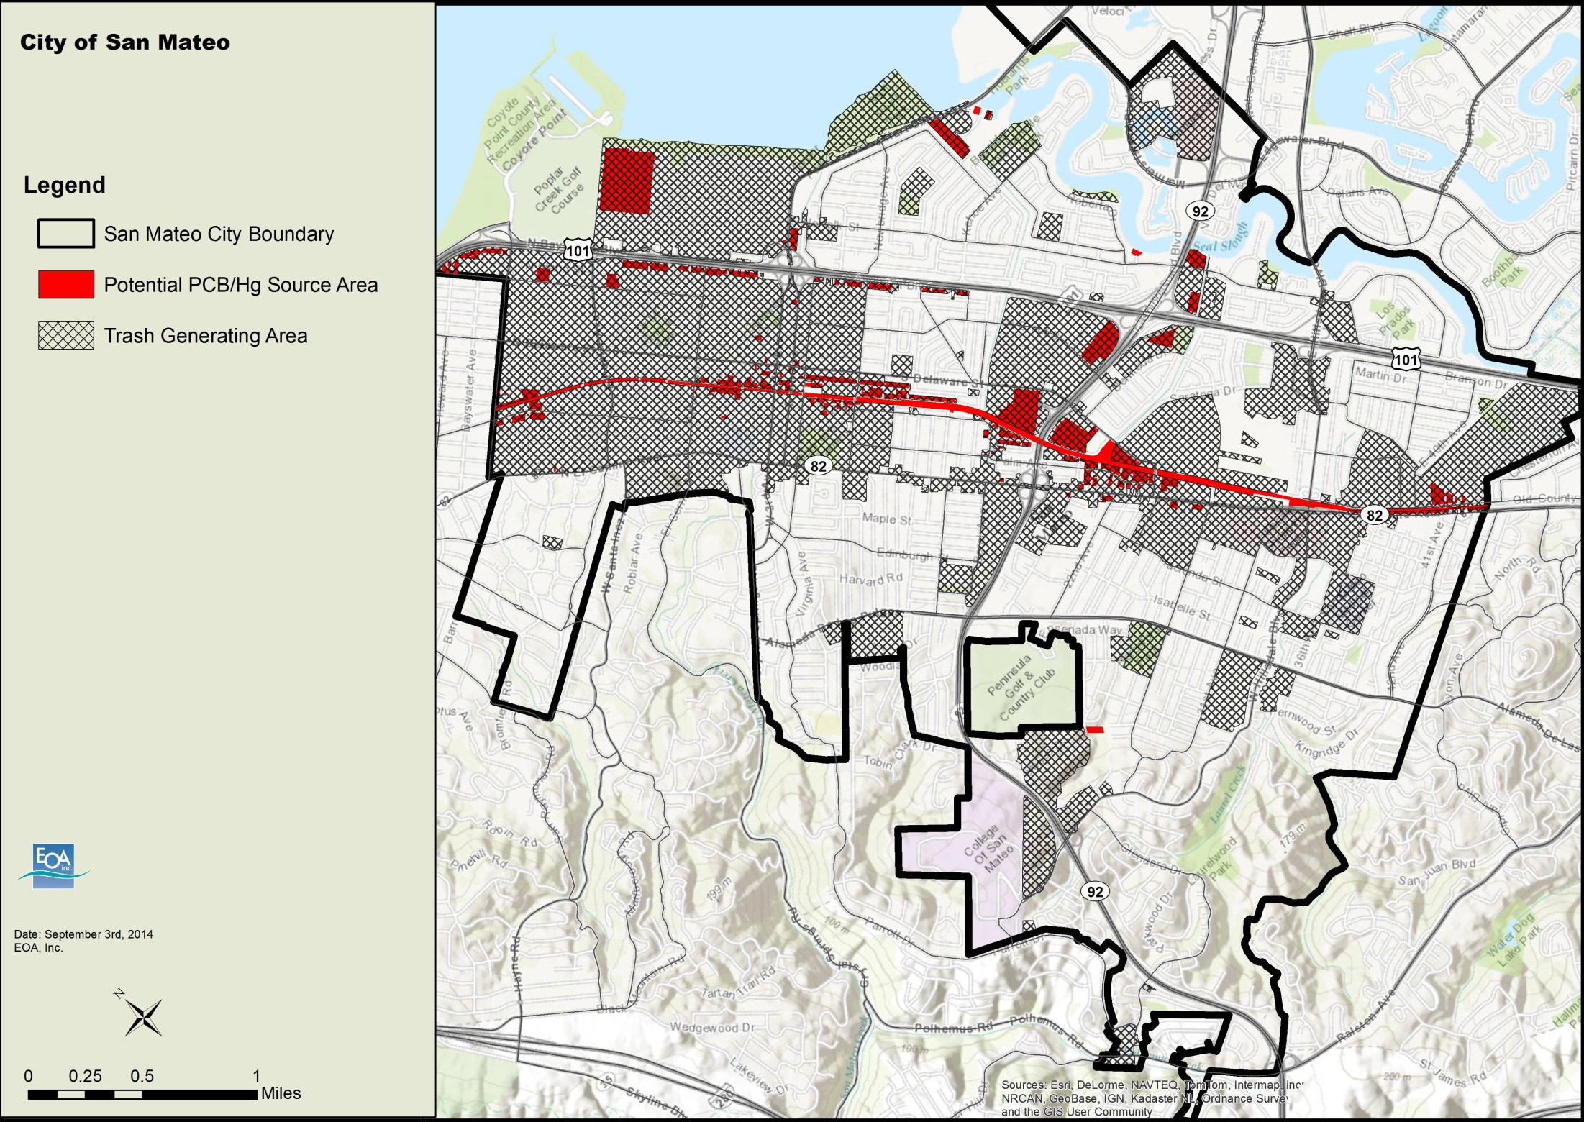

Slide 15
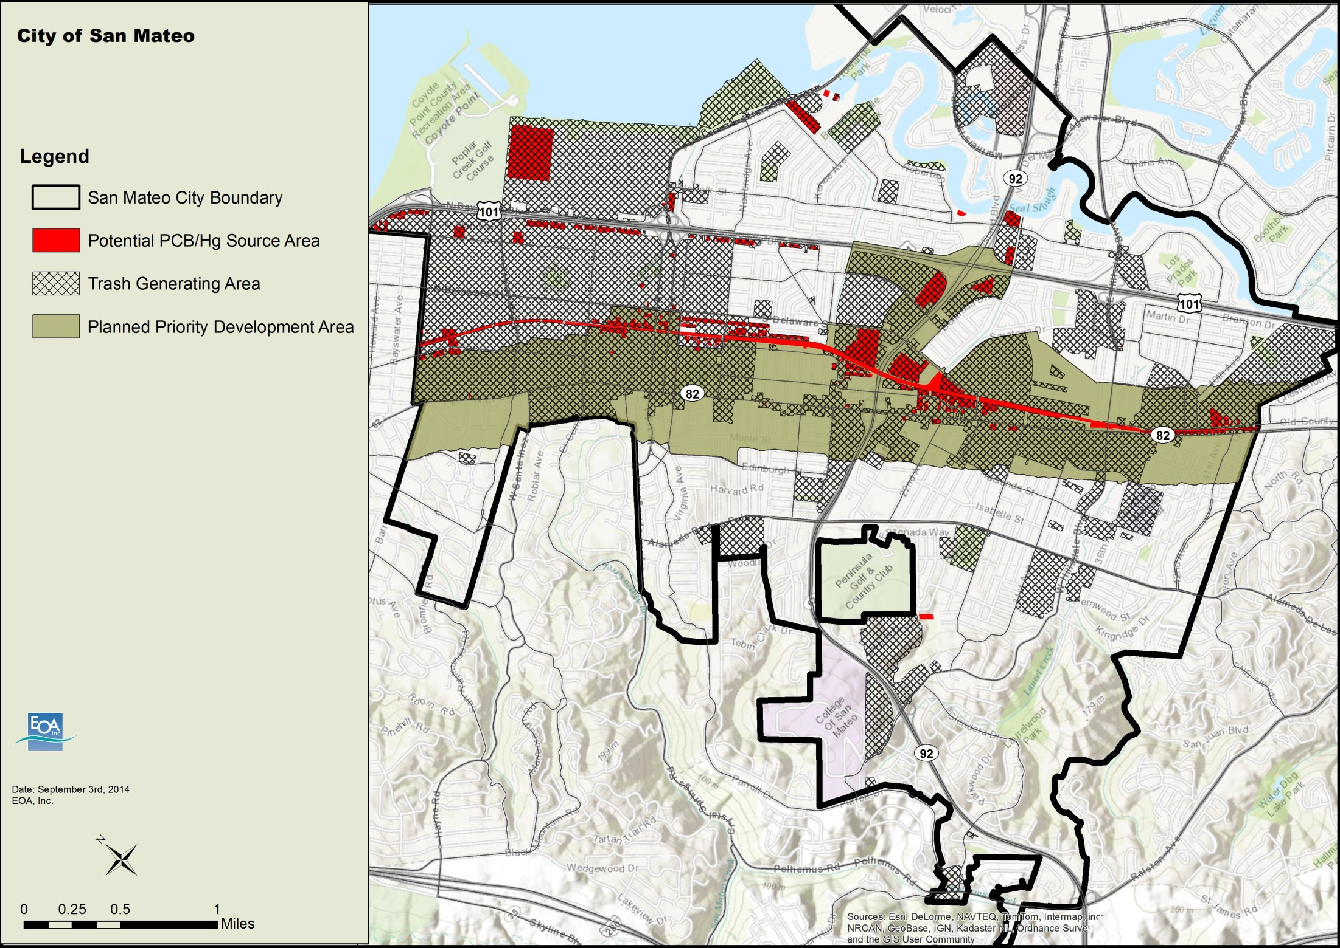

Slide 16
City of San Mateo Sustainable Streets Plan
Complete Streets
Accommodate all modes, all ages, safely
Green Streets
Manage stormwater runoff
Put them together: Sustainable Streets
San Mateo’s Sustainable Streets Plan
www.sustainablestreetssanmateo.com

Slide 17
EXISTING STREETS

Slide 18
COMPLETE STREETS

Slide 19
SUSTAINABLE STREETS

Slide 20
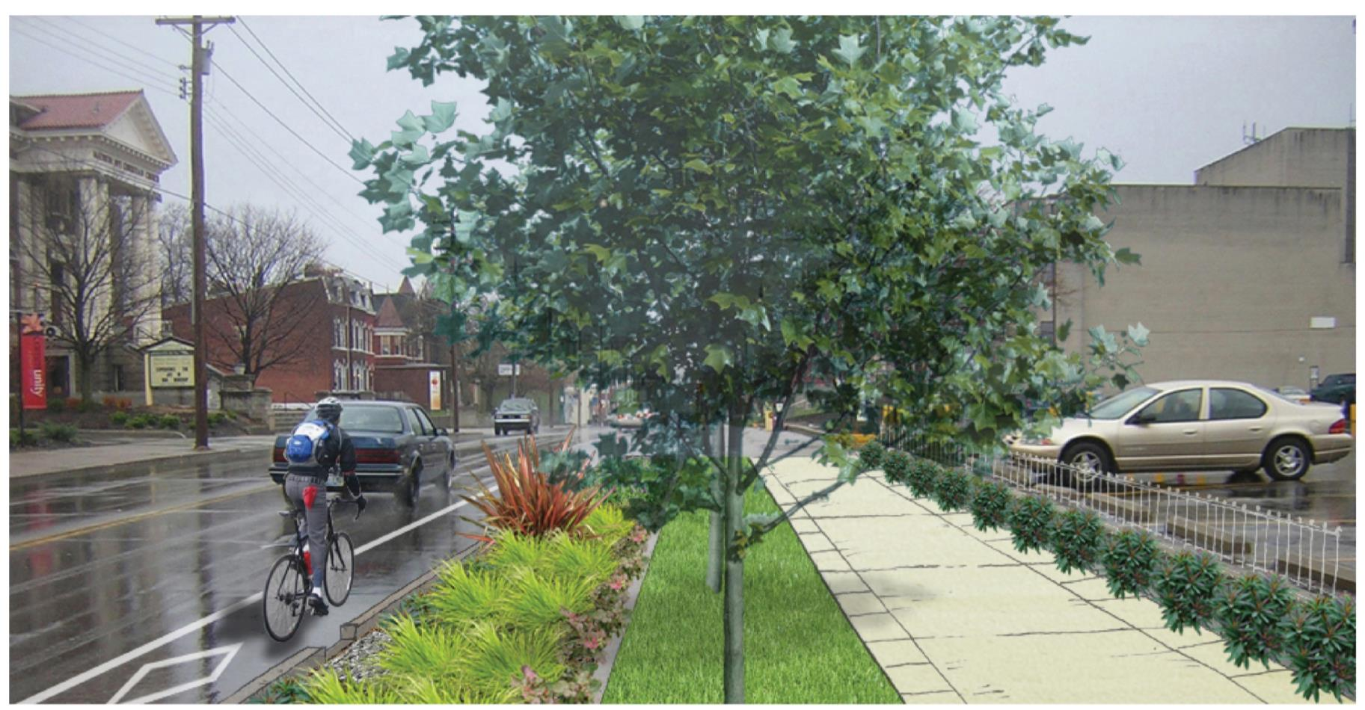

Slide 21
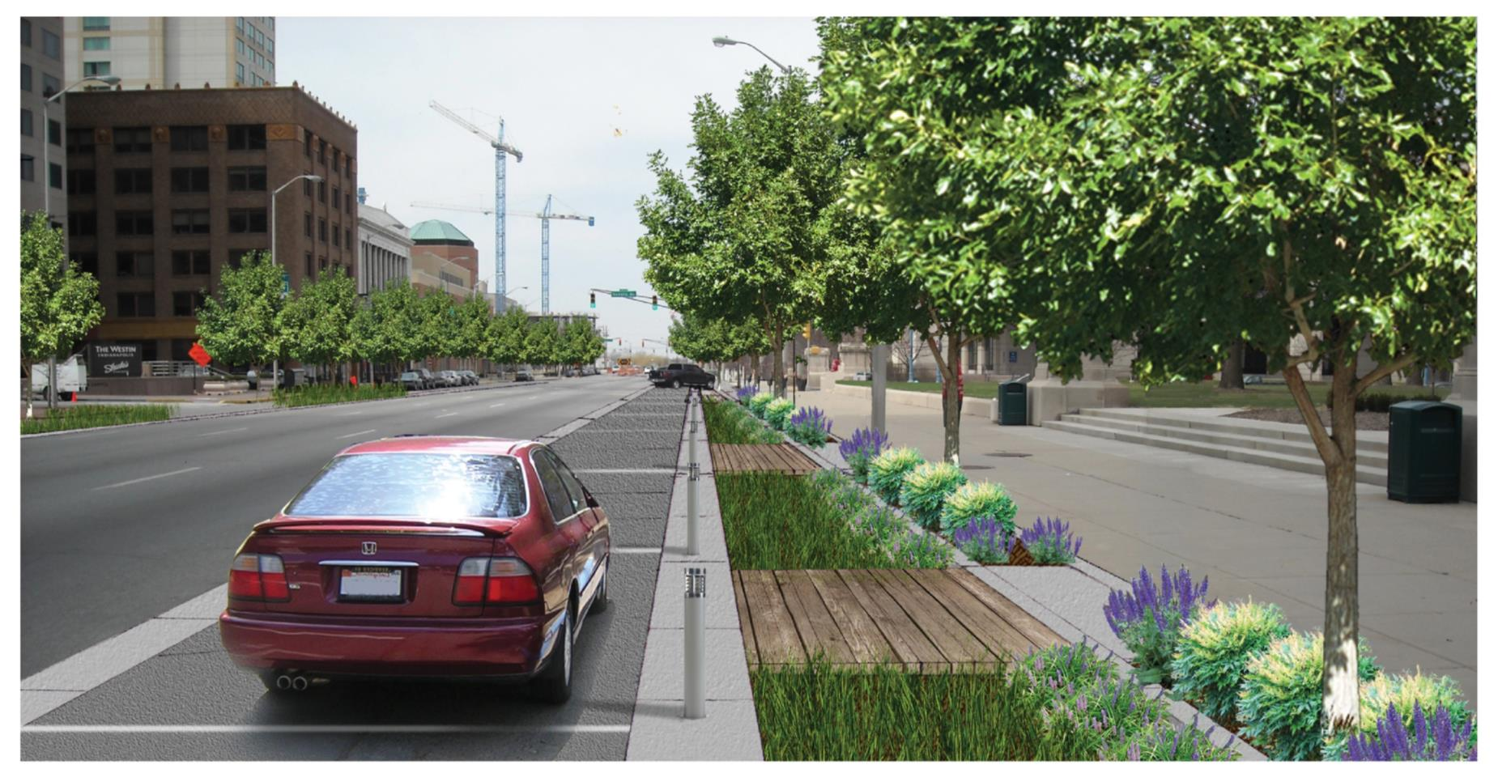

Slide 22
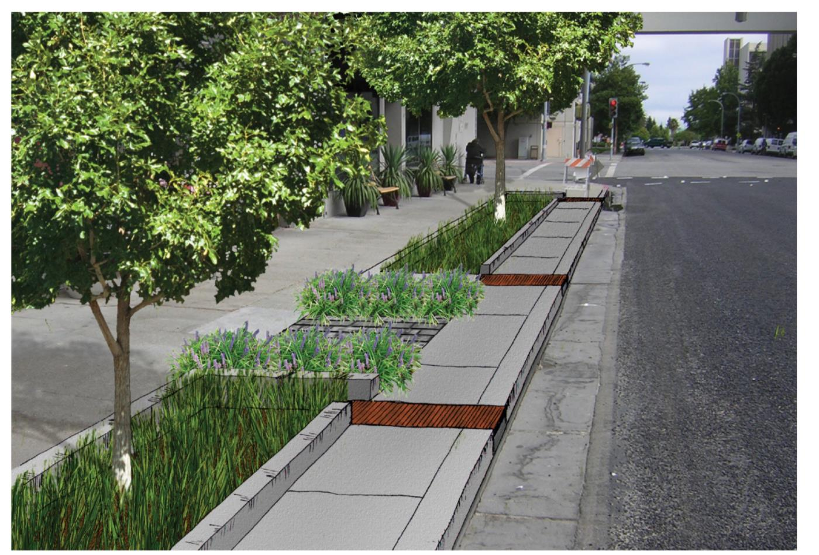

Slide 23
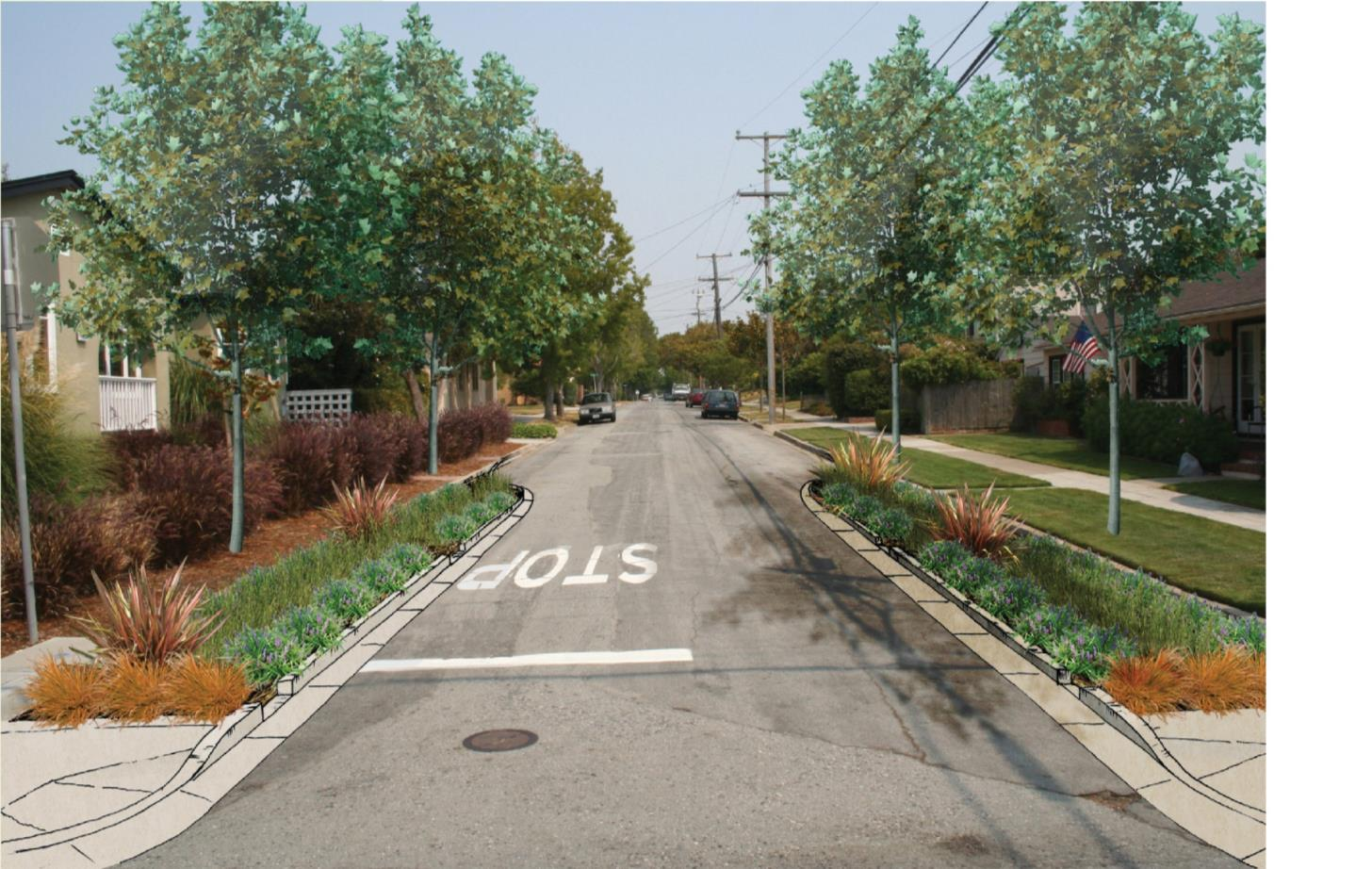

Slide 24
Why Sustainable Streets?
Multi-benefit
Water quality and quantity benefits
Air quality/greenhouse gas reduction
Heat island mitigation
Traffic calming
Increase property values
Improve bike/pedestrian environment
Additional green space
Public education

Slide 25
Why Sustainable Streets?
Multi-benefit
Water quality and quantity benefits
Air quality/greenhouse gas reduction
Heat island mitigation
Traffic calming
Increase property values
Improve bike/pedestrian environment
Additional green space
Public education
Not stormwater issues

Slide 26
Sustainable Streets Plan
Integrates GI and active transportation goals
Sets up local funding mechanism
Sets up City to compete for regional/state $
Enables cost sharing based on multiple benefits

Slide 27
Next Steps
MRP 2.0 will require GI master planning
Replicate San Mateo’s effort, but also address:
Private development information
Water quality prioritization
Pollutant load reduction estimates
Countywide, regional templates & tools

Slide 28
Matthew Fabry, Program Manager
(650) 599-1419
mfabry@smcgov.org
www.flowstobay.org
@mattfabry

