Slide 1
California Solar Initiative
Solar Thermal Program
Domestic Hot Water / Commercial Process Heat / Space Heating / Space Cooling / Pool Heating

Slide 2
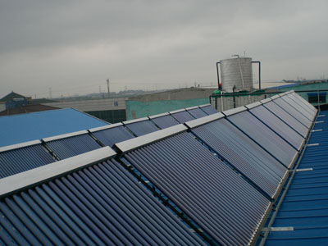
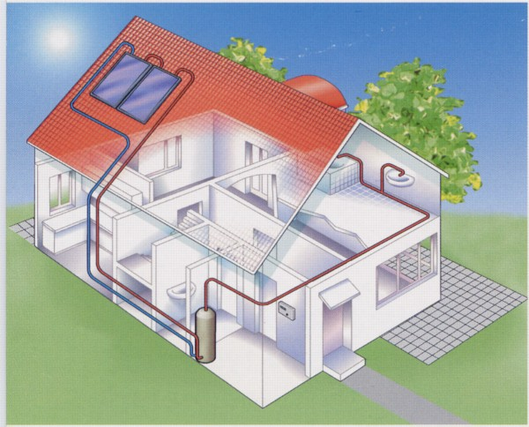
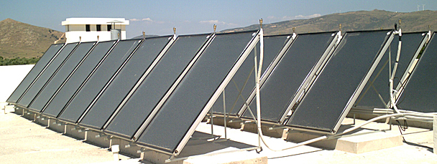
What Is the CSI-Thermal Program?
What the heck Is Solar Thermal??
Using the power of the sun to heat water – an old and reliable idea!
Water or glycol is heated in tubes; it then exchanges heat to a boiler allowing it to run less frequently
This is a “bolt-on” technology; collectors, piping, transfer fluid, tank
Evacuated Tubes
Residential System
Flat Plate Collectors

Slide 3
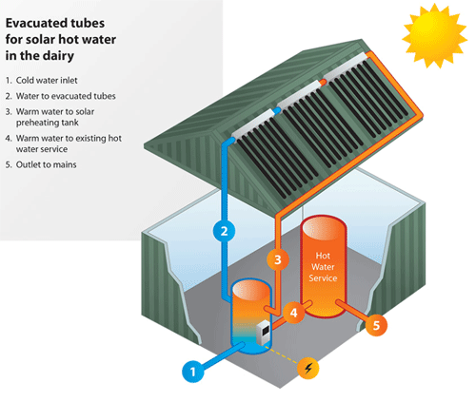
Here’s How It Works……
For a dairy, a food processor, a brewery, a laundramat..….
Step 1: Inlet water enters new
storage tank
Step 2: Water is pumped up to
the solar thermal collectors on
roof where it is heated by sun
Step 3: Hot water re-enters
the new storage tank where it
is now available to the
current hot water heating system.
Step 4 and 5: When there is hot water
demand, the current water heater draws upon
the preheated water, working less, saving $$

Slide 4
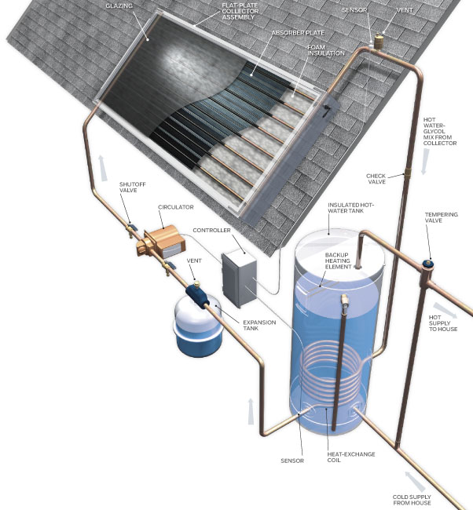
Residential System

Slide 5
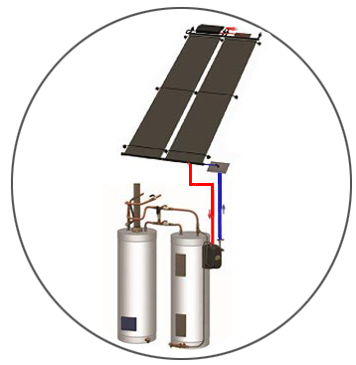
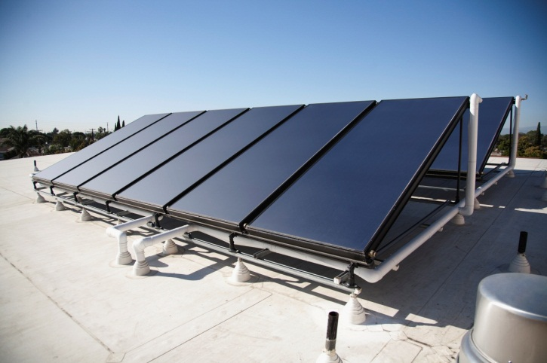
California Solar Initiative - Thermal Program
What is the CSI Thermal Program?
Incentives for customers that install solar thermal technology on their home, business or farm to offset natural gas consumption for heating water.
Basic Principle:
The sun heats water!
Hot water can do work.
High incentives can result in an attractive payback!
$800,000 max incentive. Projects can pay back ~3 – 8 yrs
Incentives: $20.19/th; Low Income Incentive: $24.89/th
Safe, reliable and “cutting-edge” technology
Utilized commercially in the U.S. for over 100 years!
Business Sector
Multifamily units
Food service industry
Retirement Homes / Nursing
Hotels & Motels
Wineries & Breweries
Gymnasiums & Schools
Food Processing
Ideal Customers
High hot water use
Consistent water use
Temps ~120 – 180 F
Roof and/or ground space
Company green initiatives
LARGE ENERGY COSTS

Slide 6
Why Does This Matter to Communities?
And what’s New in Solar Thermal & the CSI Thermal Program?
INCENTIVES JUST INCREASED SIGNIFICANTLY!
This is a GROWING PROGRAM: Whereas there are no more incentives for PV, CSI-Thermal has plenty of incentives!
Non-residential Pools now receive incentives.
Technology, installation improvements; superior quality equipment and installation requirements improve production & profits, reduce risk.
Better returns and payback than ever for Commercial; rebates and incentives, install costs can be offset 50% - 70%; payback ~3 – 8 yrs

Slide 7
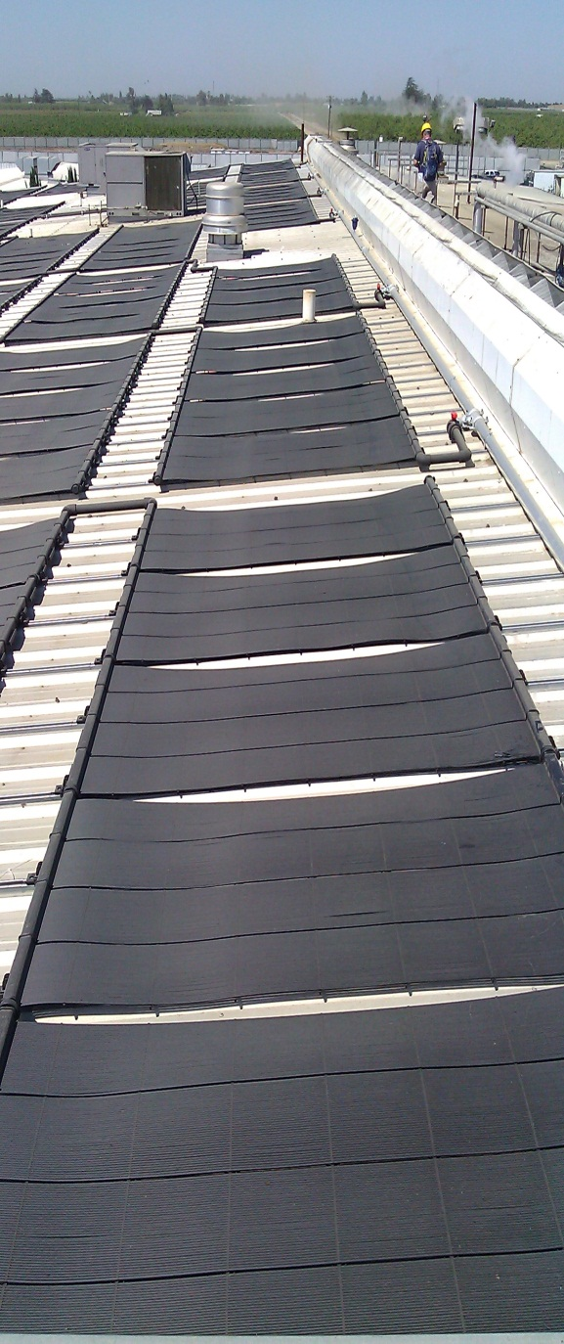
Case Study; food processor
Project: Food processing plant in California Central Valley
Need: Offset high energy bill. Integrate ‘green’
Extensive and expensive water heating (gas) for cleaning, sanitizing, and other domestic hot water demands in food processing facility
+300,000 gallons hot water used per day
Solution: ~310 unglazed solar thermal collectors; 10,000 gallon storage tank. Drainback system.
Savings: ~34,000 therms/yr – at OLD incentive rate
Project Cost: ~$700,000
Incentive: ~$490,000
Net Cost before 30% ITC: ~$215,000
30% ITC: ~$65,000
After MACRS, project probably pays back < 2 yrs

Slide 8
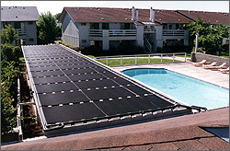
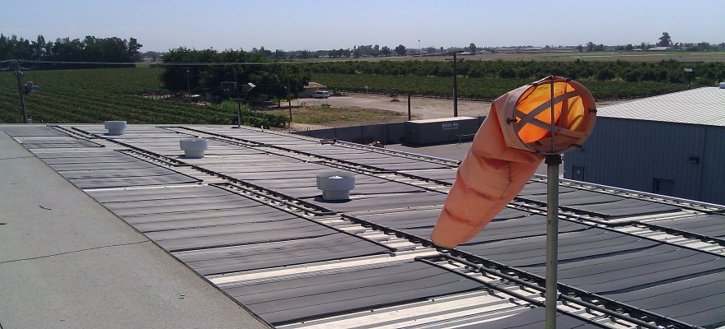
2014 and Beyond: GROWTH!
Program lasts until end of 2017
Petition to increase incentives approved!
Promoting SMB, CIA installs for PG&E’s
biggest natural gas users
Pools Program; benefits schools, Govt
NEW MARKETING EFFORT
Swimming Pools Incentives
Reliable energy production for +25 yrs
Flexible and advanced technologies

Slide 9
Customer Targeting
Heavy water use segments
Market analysis was performed to determine the prospects most likely to benefit within each customer class
Business
High gas bill
2014
Targets
Residential*
Multi-family
Way Wired, Eco Active, Gadget Family, Heart & Home
High gas bill
5+ dwelling units
Central water heater or pool

Slide 10
CSI-Thermal Program Resources
Program Manager: Steve Whitworth (and Brian Bishop)
Email: S3SO@pge.com
Phone: 415.973.0720
General Solar Email: solar@pge.com
Solar Thermal Website: www.pge.com/csithermal

