Slide 1
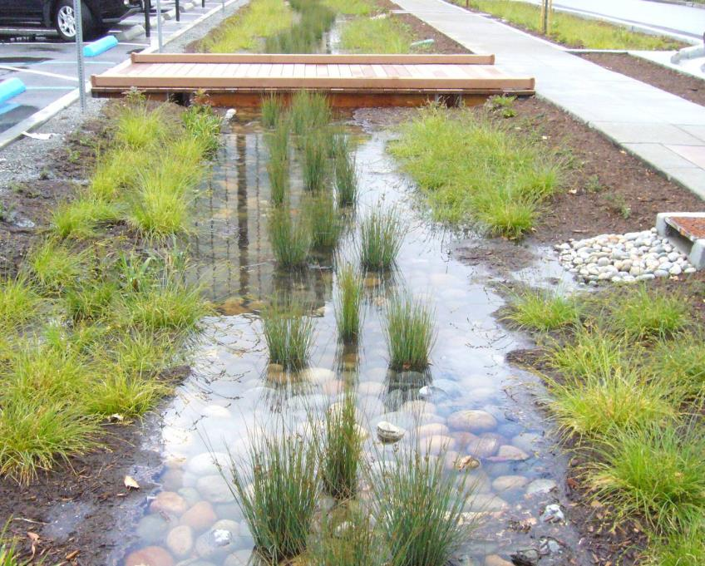

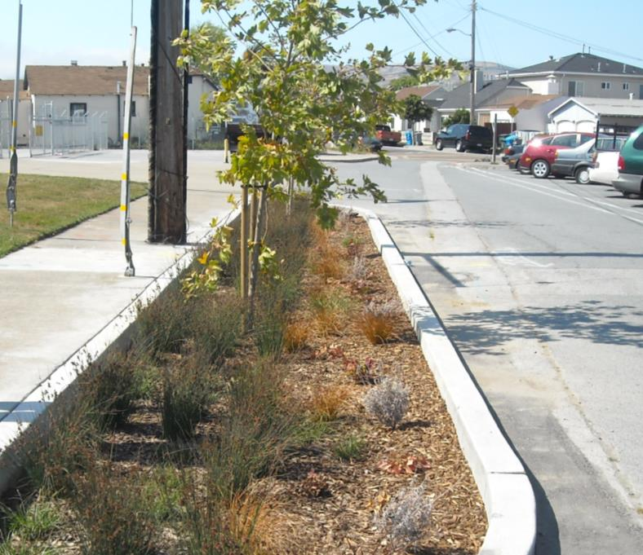
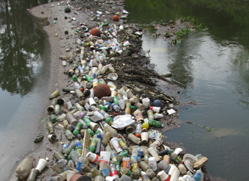

Water Pollution Prevention Program Highlights, 2014-15
Matthew Fabry, Program Manager
C/CAG Board of Directors
September 10, 2015

Slide 2
What is SMCWPPP?
San Mateo Countywide Water Pollution Prevention Program
Funded by property tax and vehicle license funds
Support member agencies in meeting stormwater regulatory requirements from the State
  Do compliance directly for member agencies
  Support local program implementation
  Participate in regional compliance efforts

Slide 4
Highlights 2014-15
  Training & Education
    36 committee/subcommittee/workgroup meetings
    Three corporation yard trainings
    Construction site inspection workshop
    Low impact development workshop
    Construction site best management practices training
    Landscape integrated pest management workshop
    Litter reduction roundtable
    Visual litter assessment training

Slide 5
Highlights 2014-15
  Outreach & Engagement
    Website redesign & mobile responsiveness (flowstobay.org)
    Social media (Facebook, Twitter, Instagram)
    Car wash incentive program
    Coastal cleanup day coordination
    School age education programs
    Cigarette butt pilot program
    Tabling events (County Fair and local)
    Presentations (Rotary clubs, neighborhood associations)

Slide 6
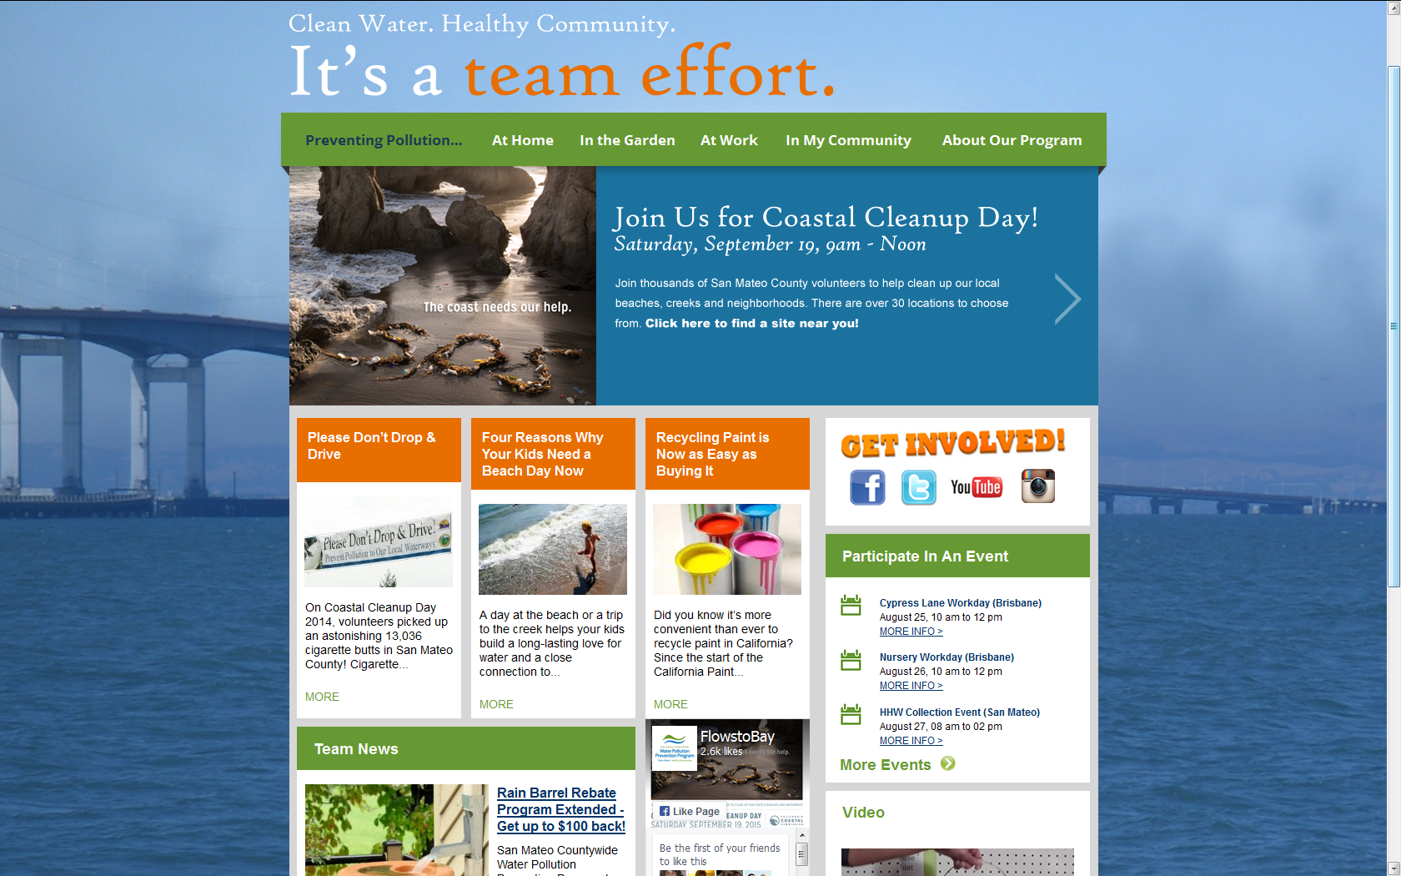

Slide 7
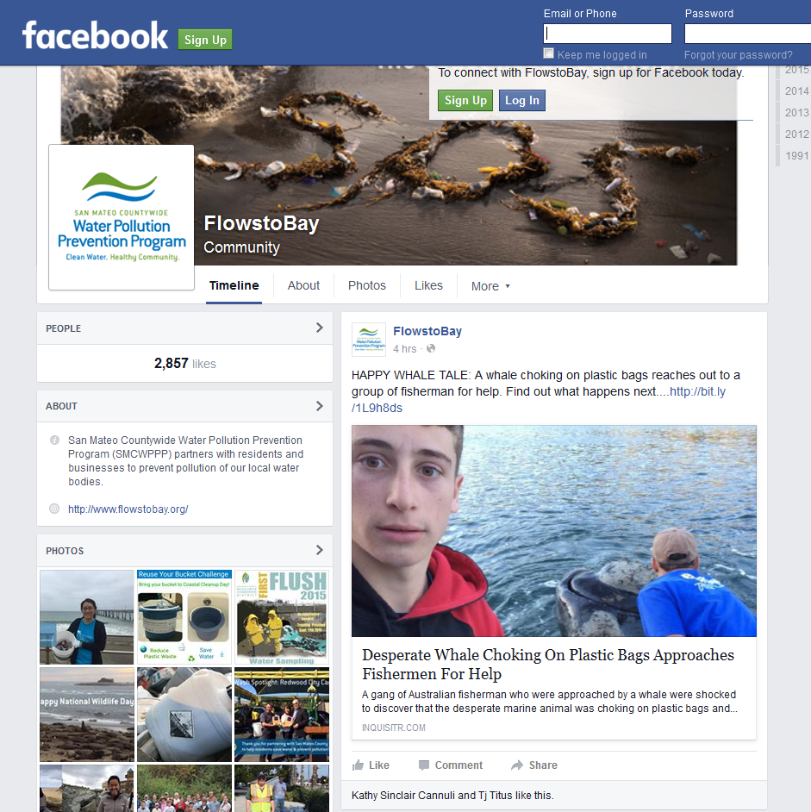
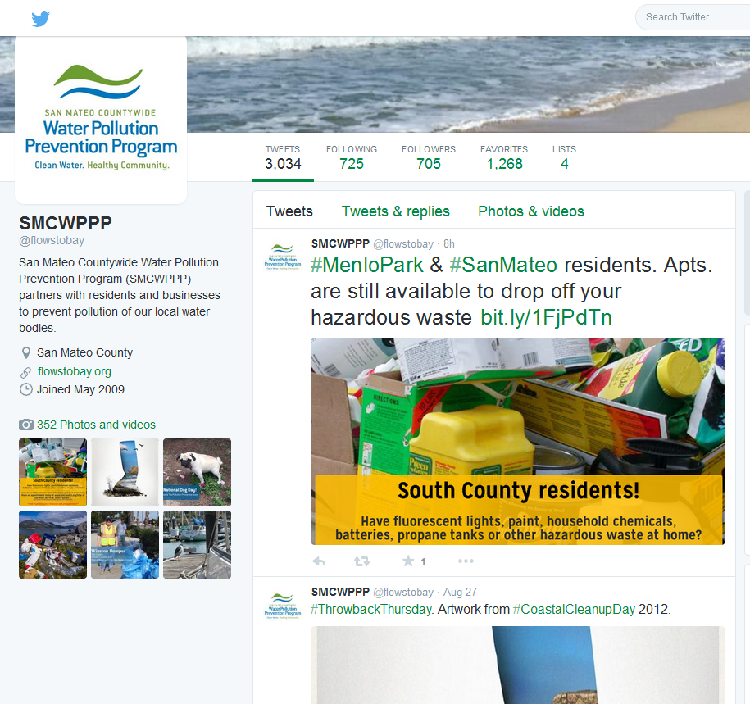

Slide 8
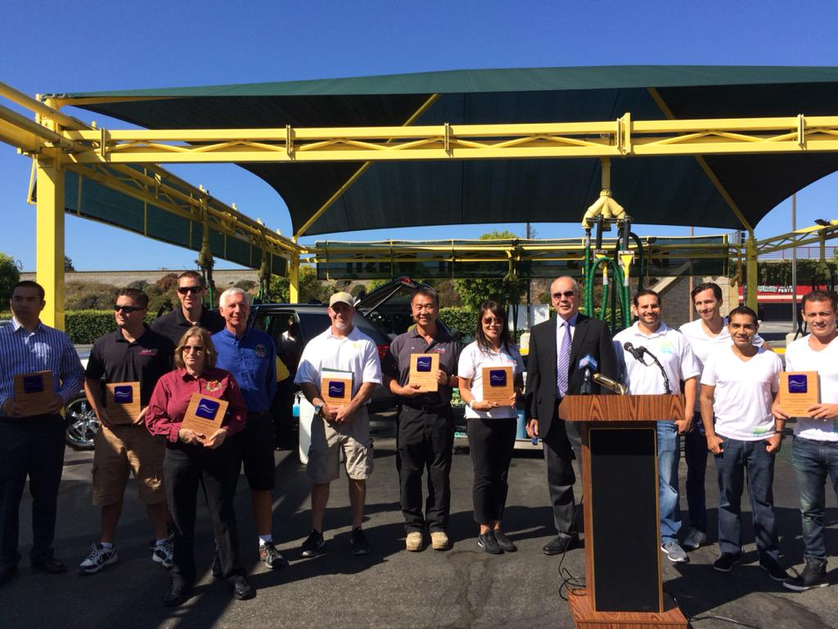

Slide 9
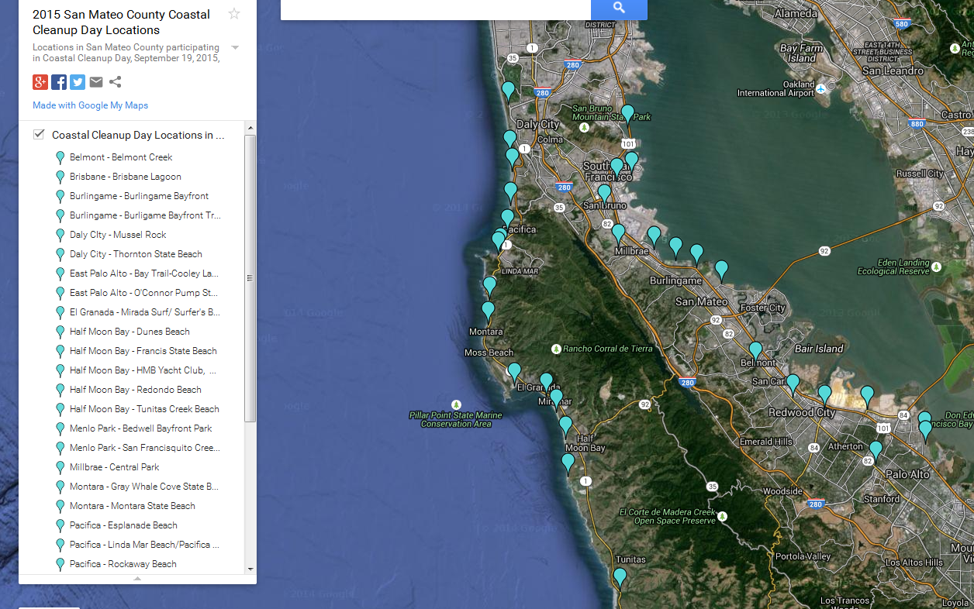

Slide 10
Highlights 2014-15
  Water Quality Monitoring
    Creek monitoring throughout the county (status and trends)
    Pollutants of concern monitoring (San Carlos)
    PCBs and mercury opportunity area analysis
    Regional monitoring program

Slide 11

Highlights 2014-15
  Pesticide Toxicity Control
    Point-of-Purchase outreach & trainings (22 stores)
    Outreach to pest control operators
    Regional and statewide participation
    (grants and regulatory)

Slide 12
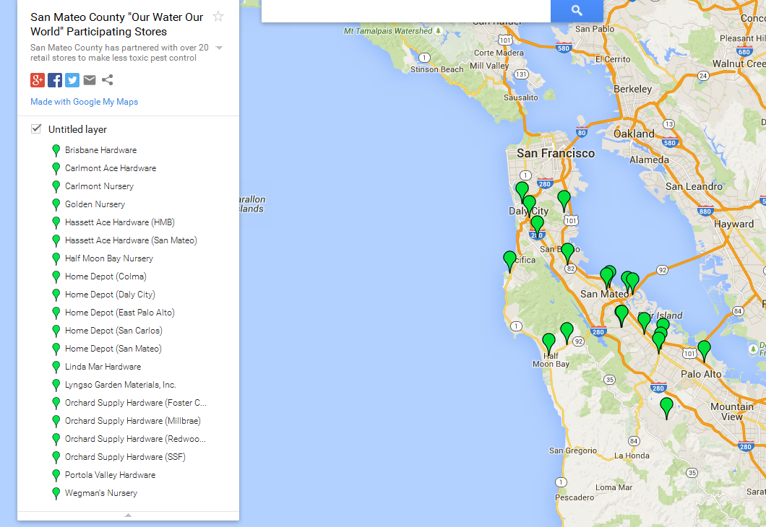

Slide 13
Highlights 2014-15
  Trash Load Reduction
    Long-term plan updates
    Pilot trash assessment strategy (On-land visual assessments, database, staff training)
    Litter workgroup (stormwater and solid waste connection)
    Regional grant participation

Slide 15
Highlights 2014-15
  Mercury & PCBs
    Source Identification Pilot Project
    Pilot studies: data review/reporting
      Enhanced O&M
      Treatment retrofit
      Diversion to sanitary sewer
    Permit reissuance negotiations/support

Slide 16
Highlights 2014-15
Rain Barrel Rebate Program
  C/CAG provides $50 per barrel countywide
  Water agencies choose to participate
  328 rain barrels installed in San Mateo County
  Twice as many installed where water agencies partner
  Over 100 barrels in Alameda & Santa Clara Counties

Slide 17
Highlights 2014-15
Laurel Elementary Demonstration Project
  Integrates stormwater and Safe Routes to School
  Partnership with City of San Mateo and San Mateo/Foster City School District

Slide 18
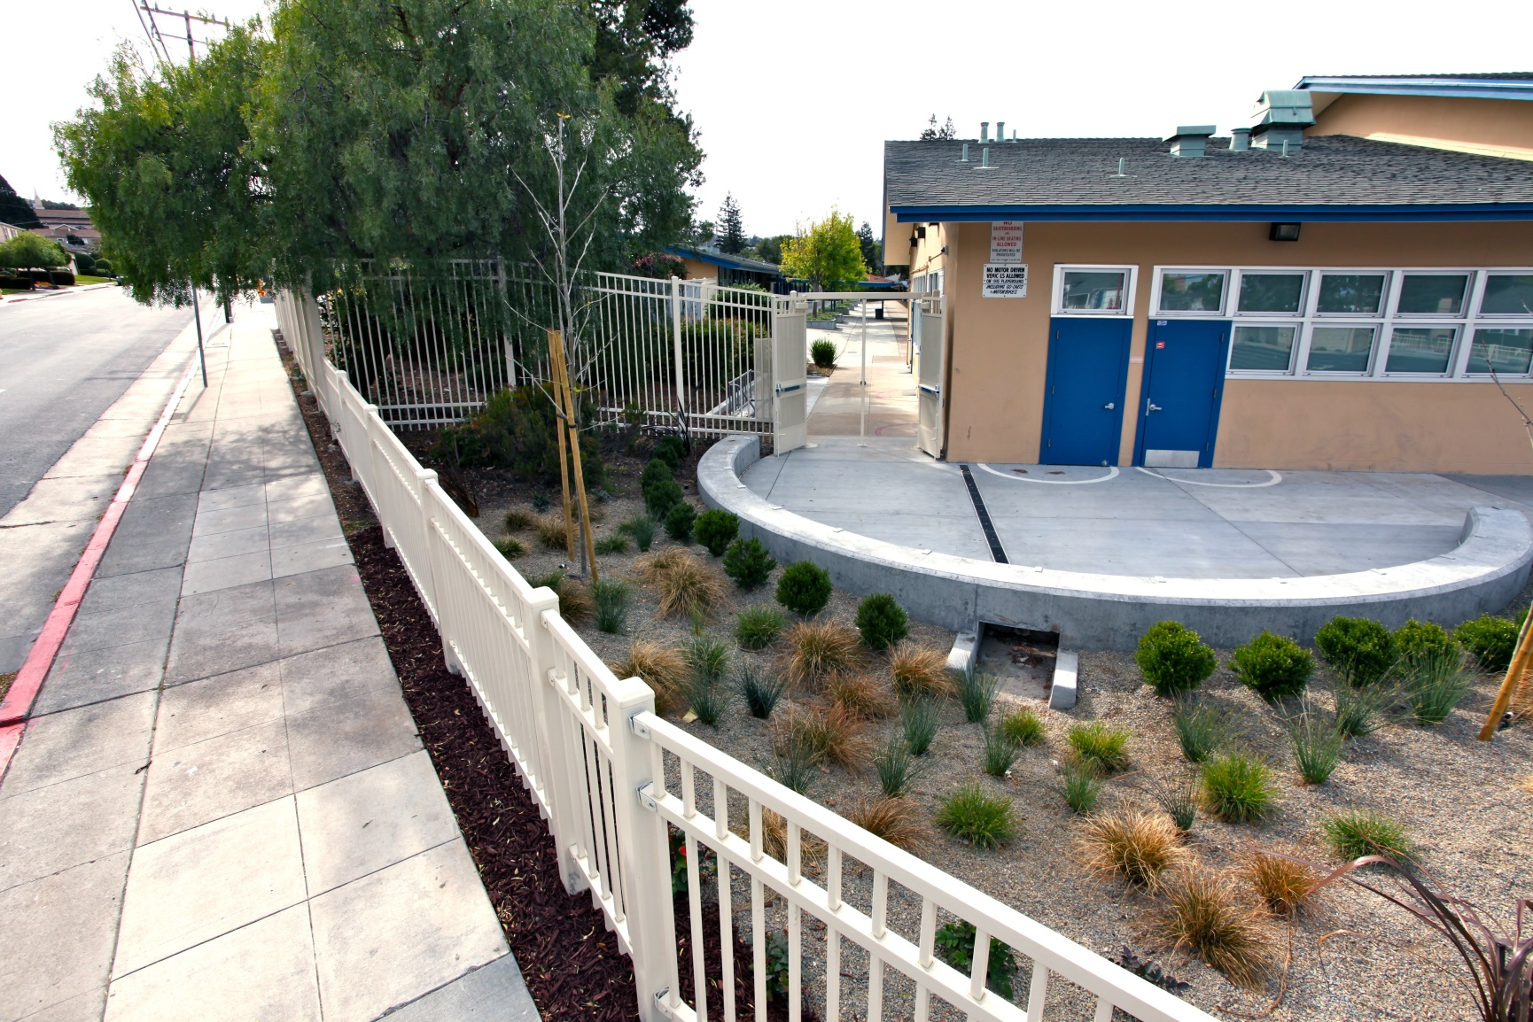
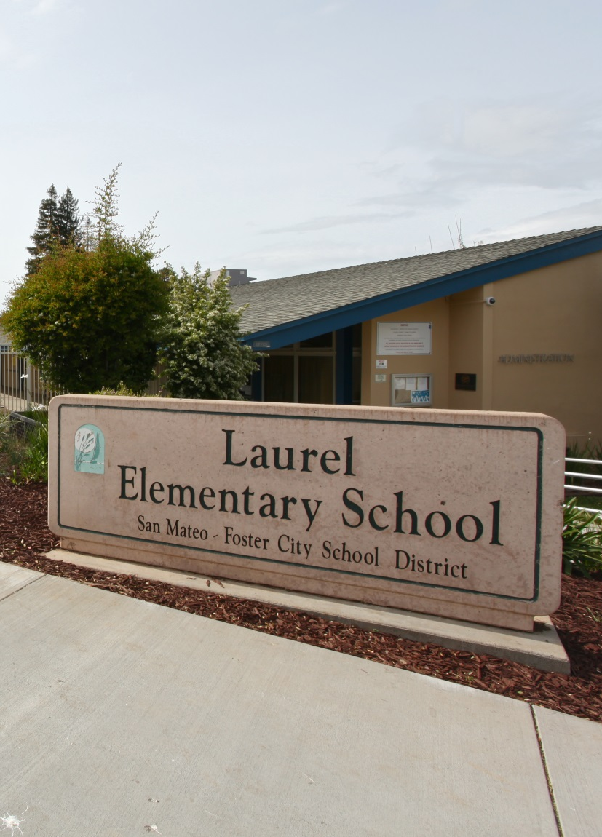
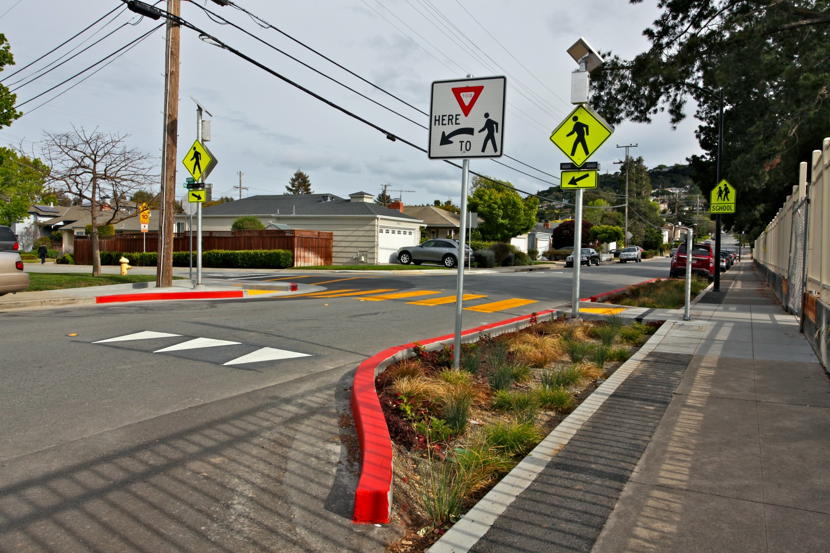
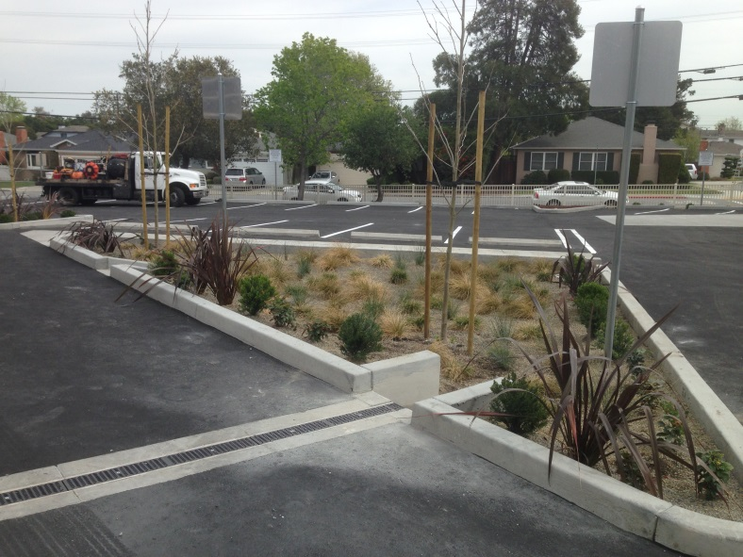
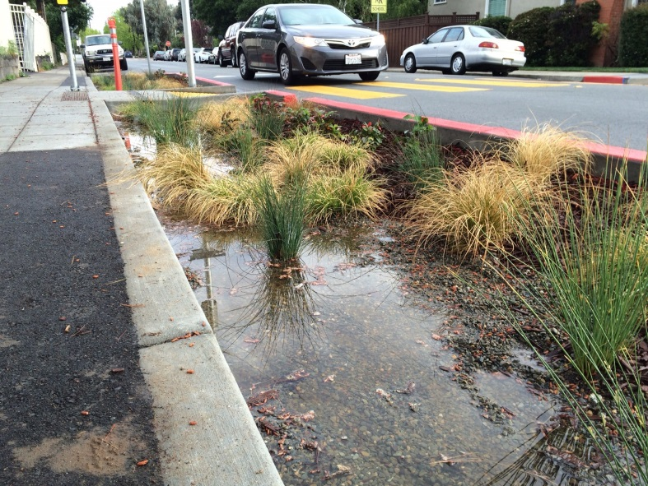
Laurel Elementary School
Stormwater & Safe Routes to School
City of San Mateo

Slide 19
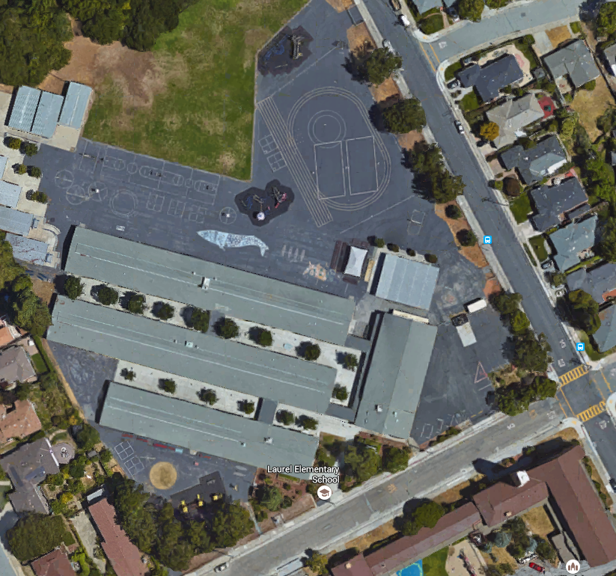
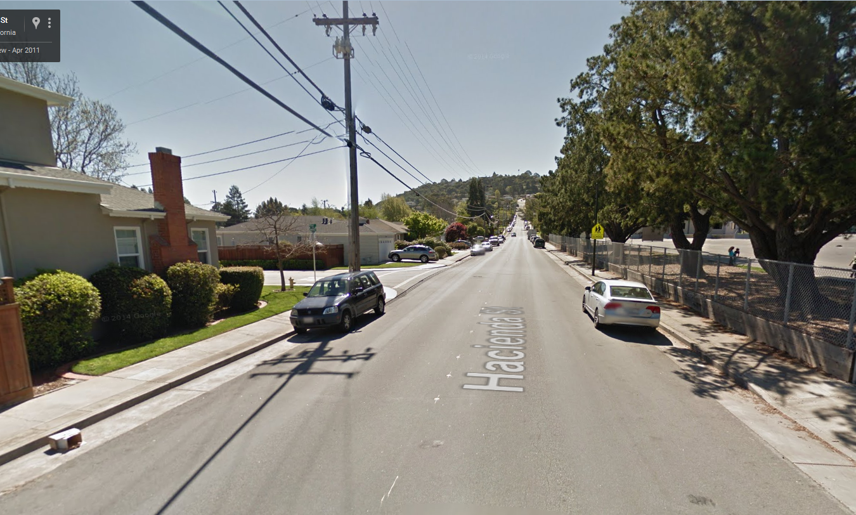
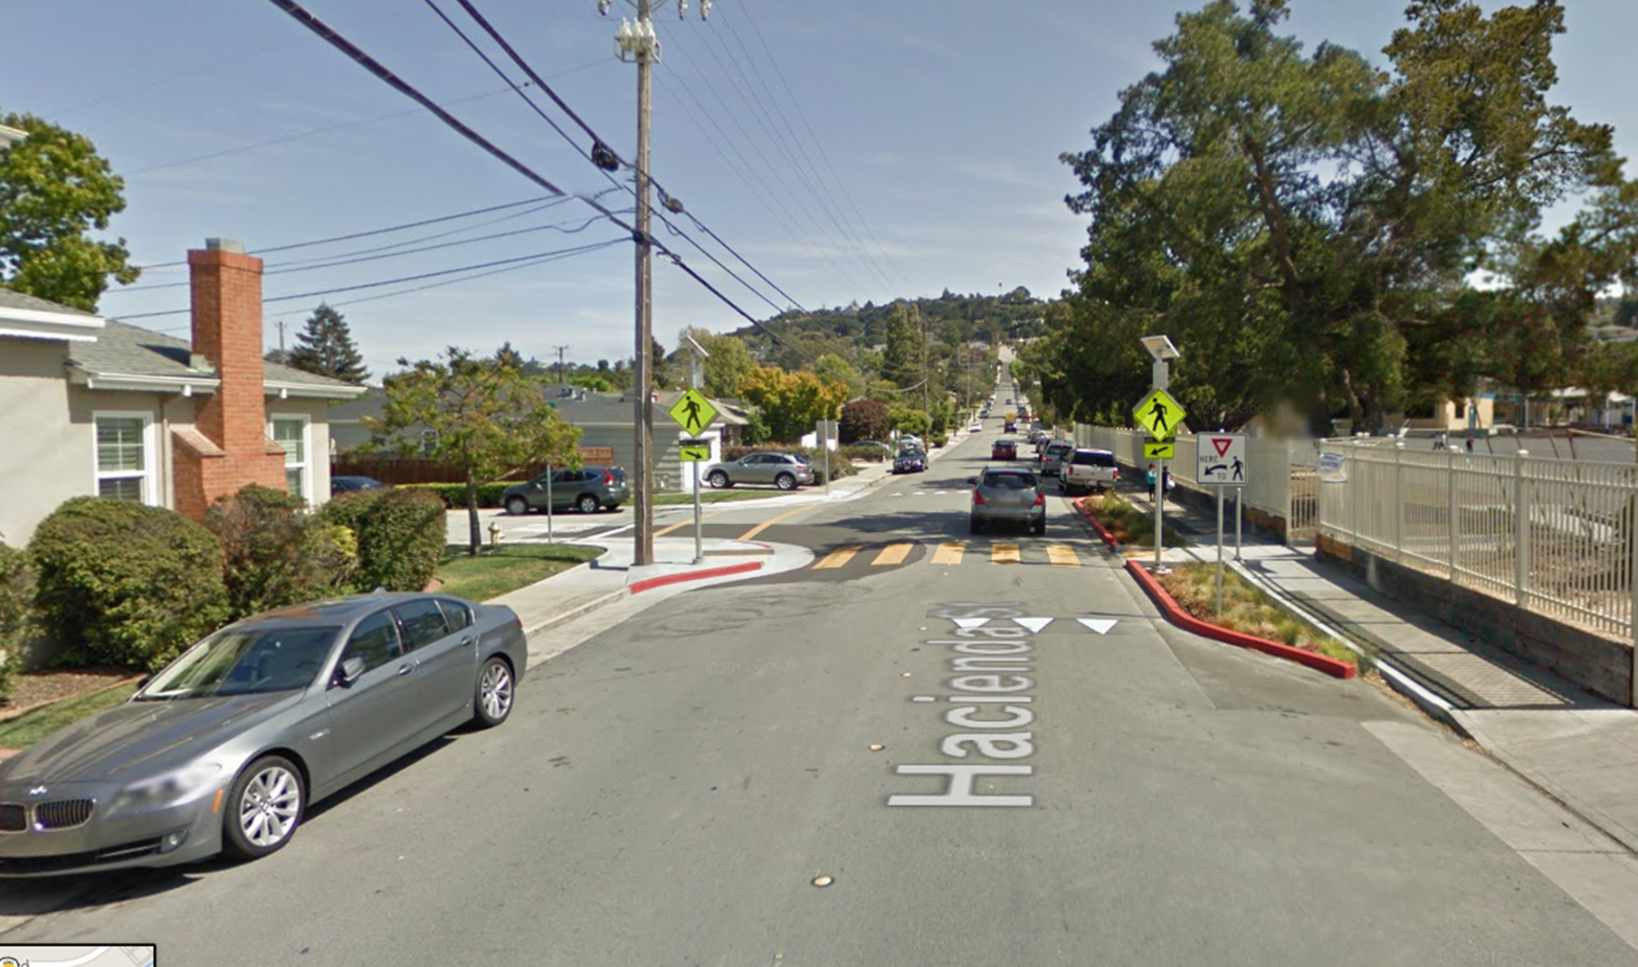
Laurel Elementary
City of San Mateo

Slide 20
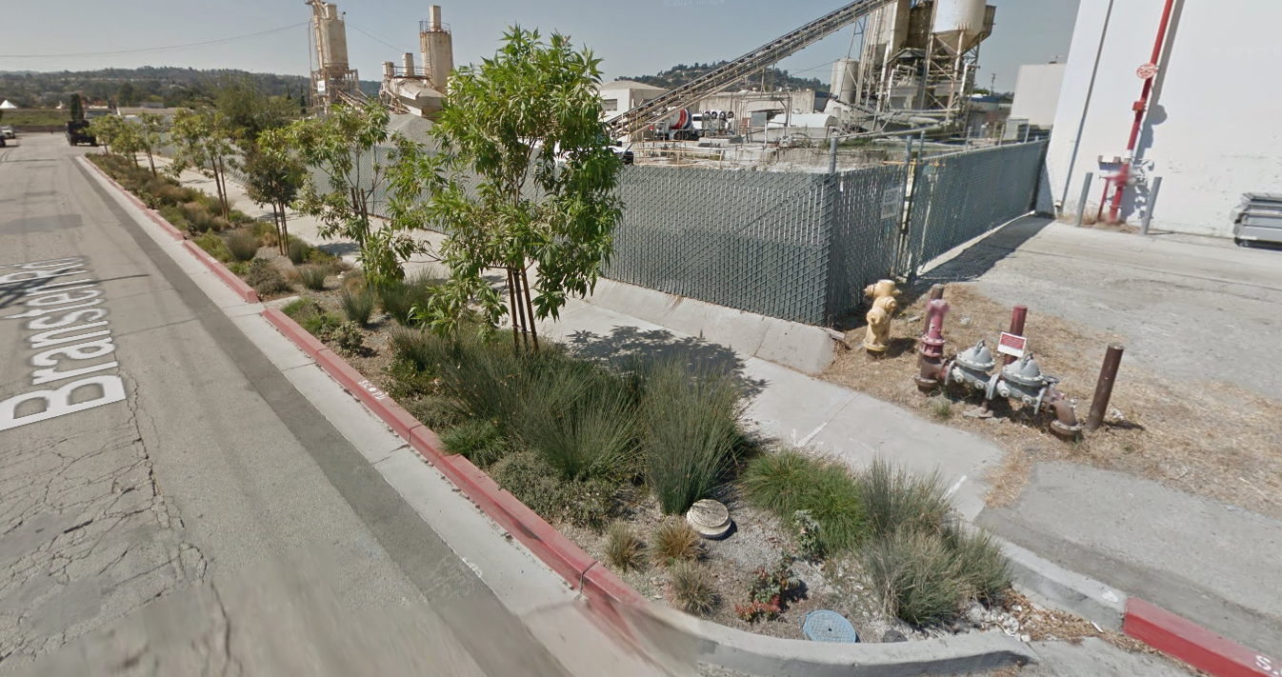
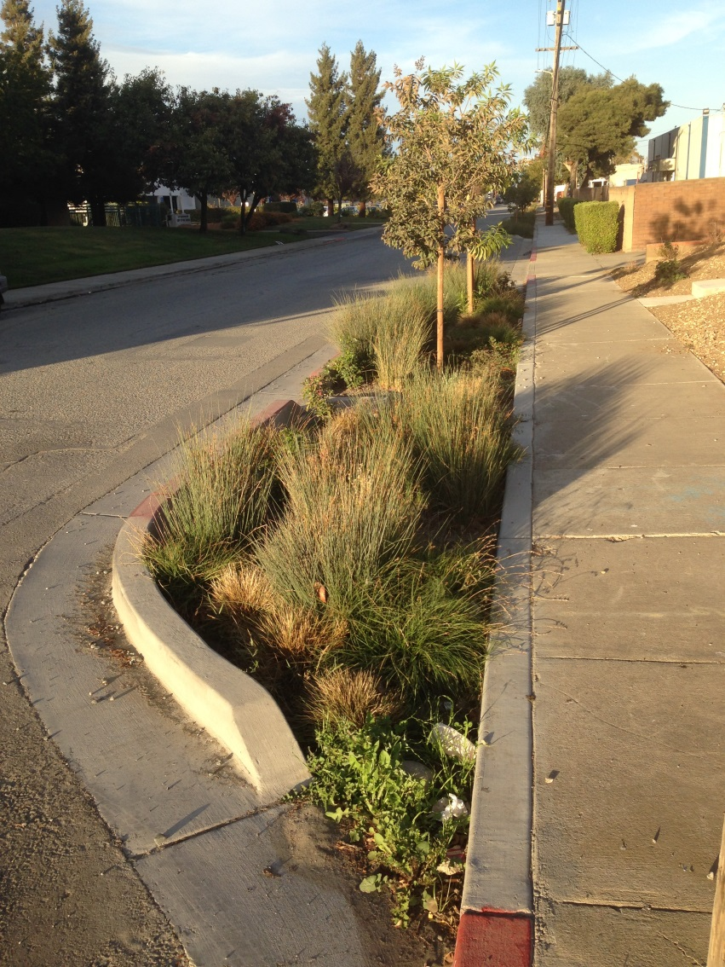
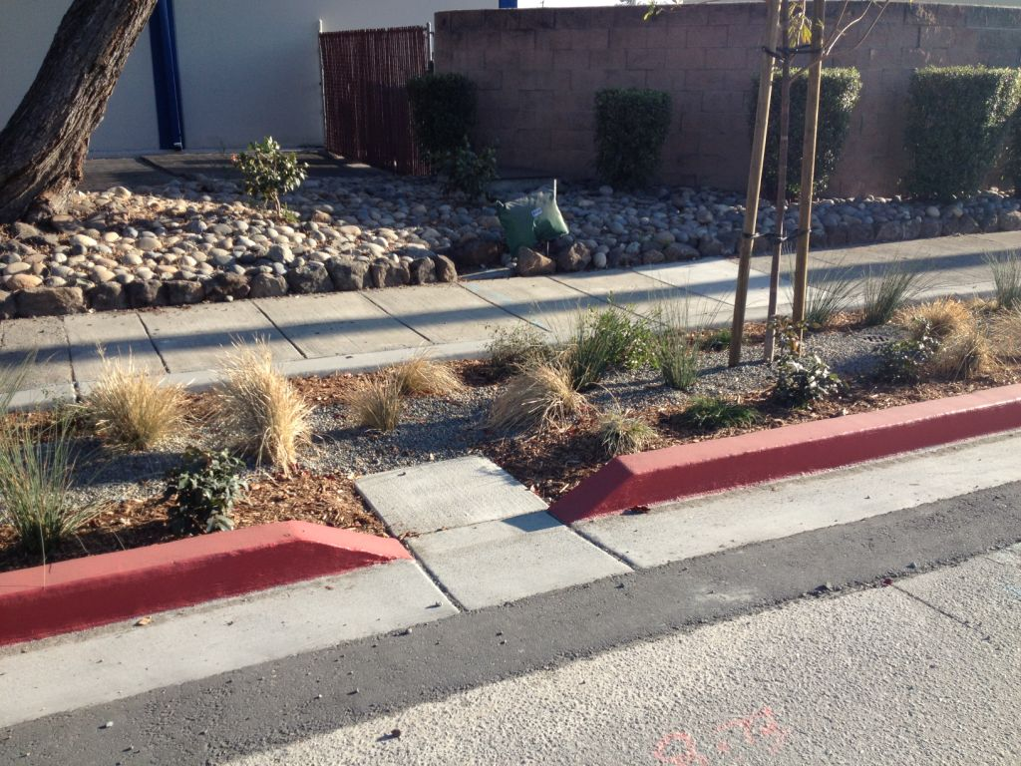
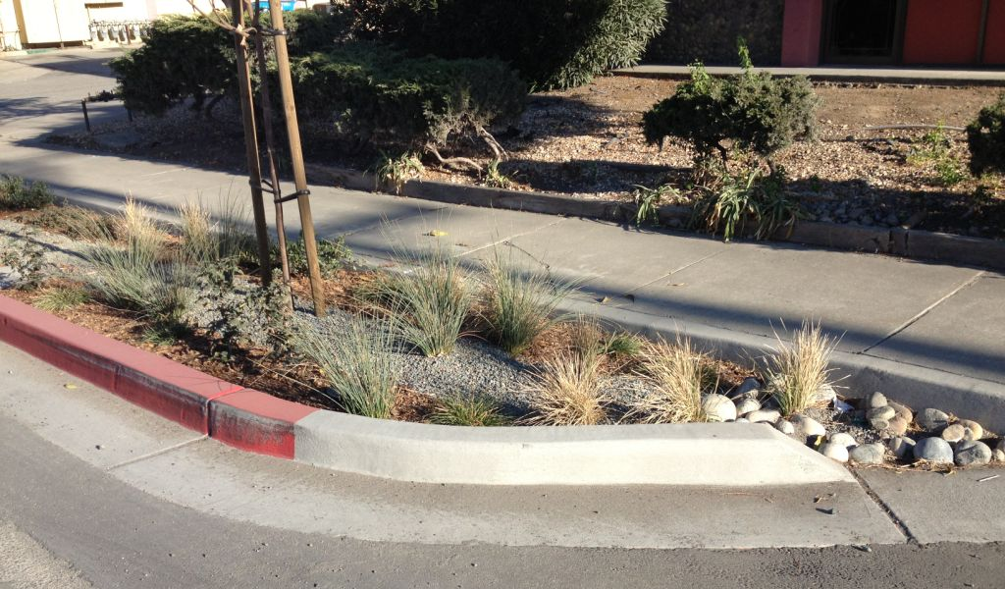
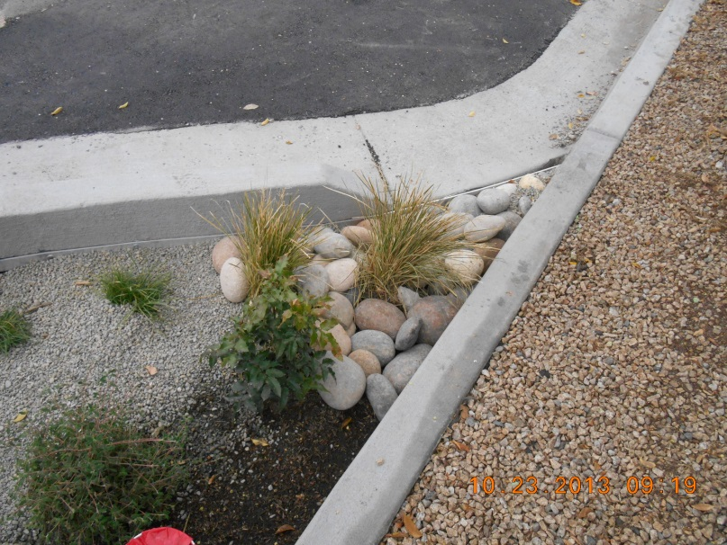
Bransten Road
City of San Carlos

Slide 21
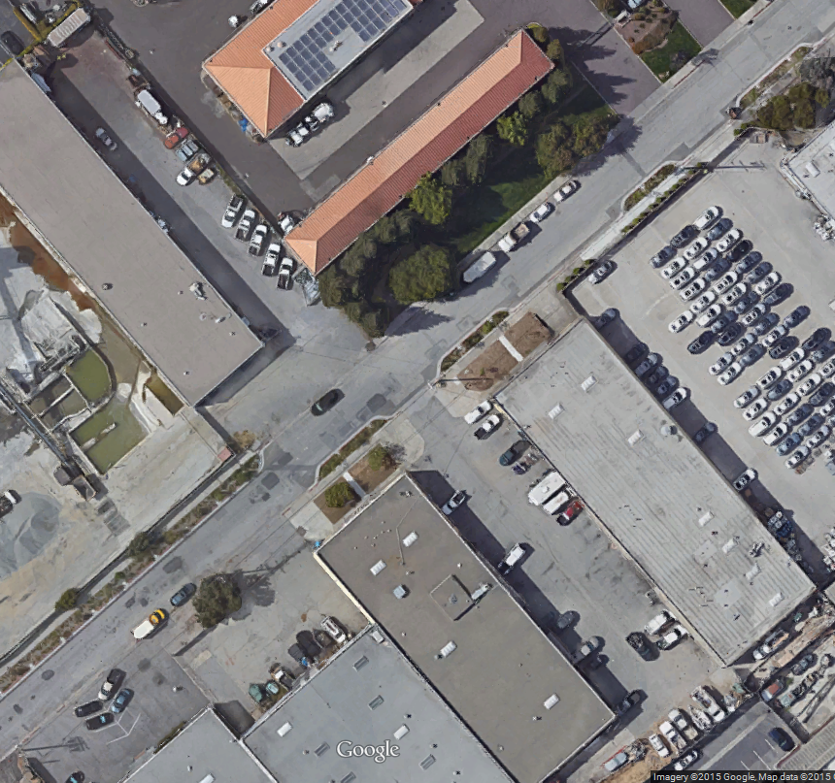
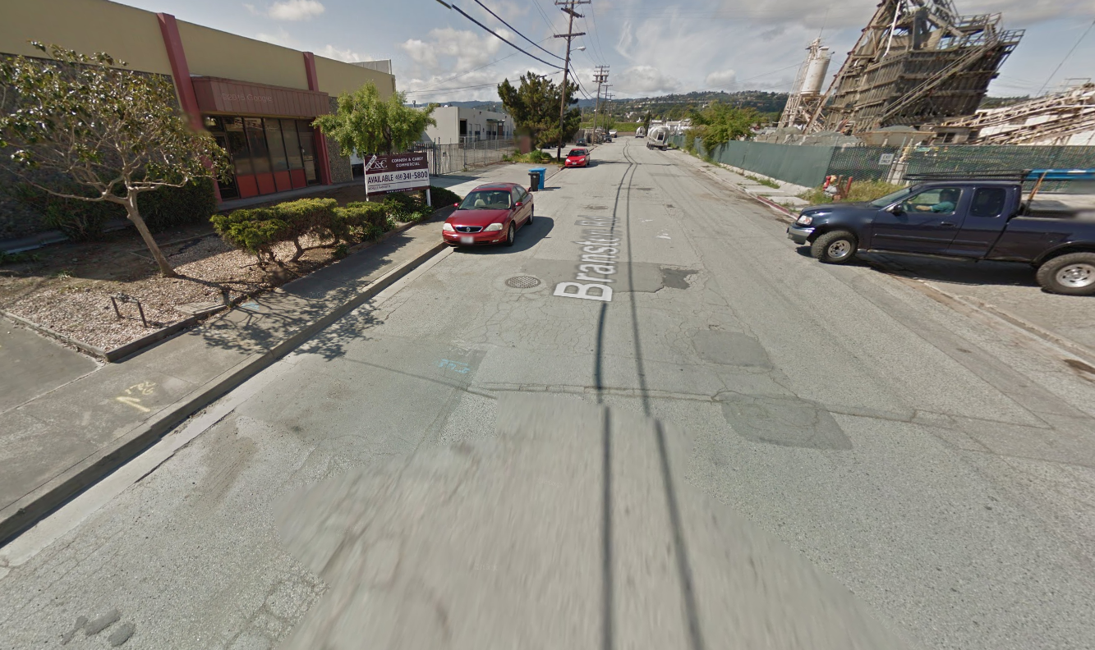
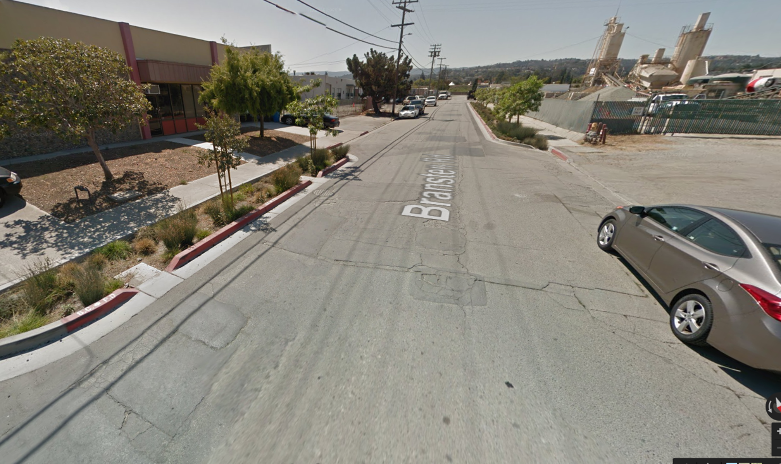
Bransten Road
City of San Carlos

Slide 22
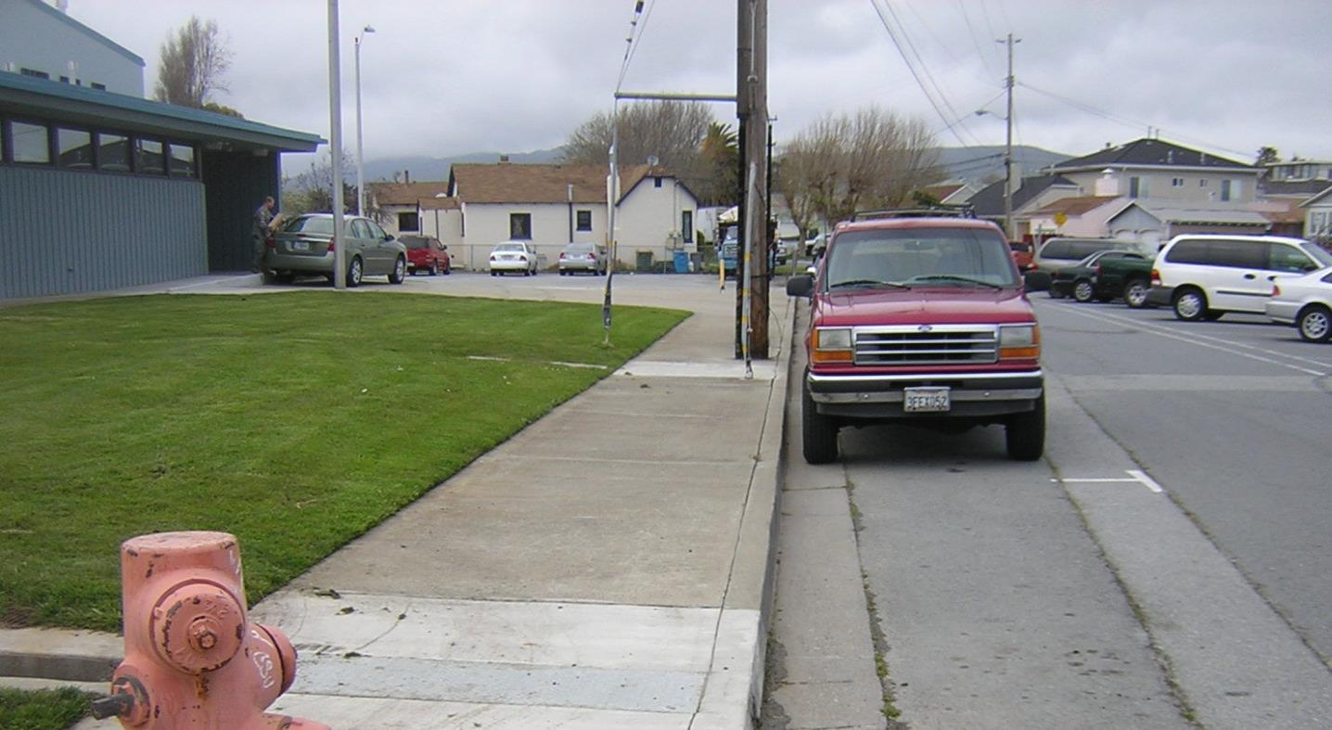
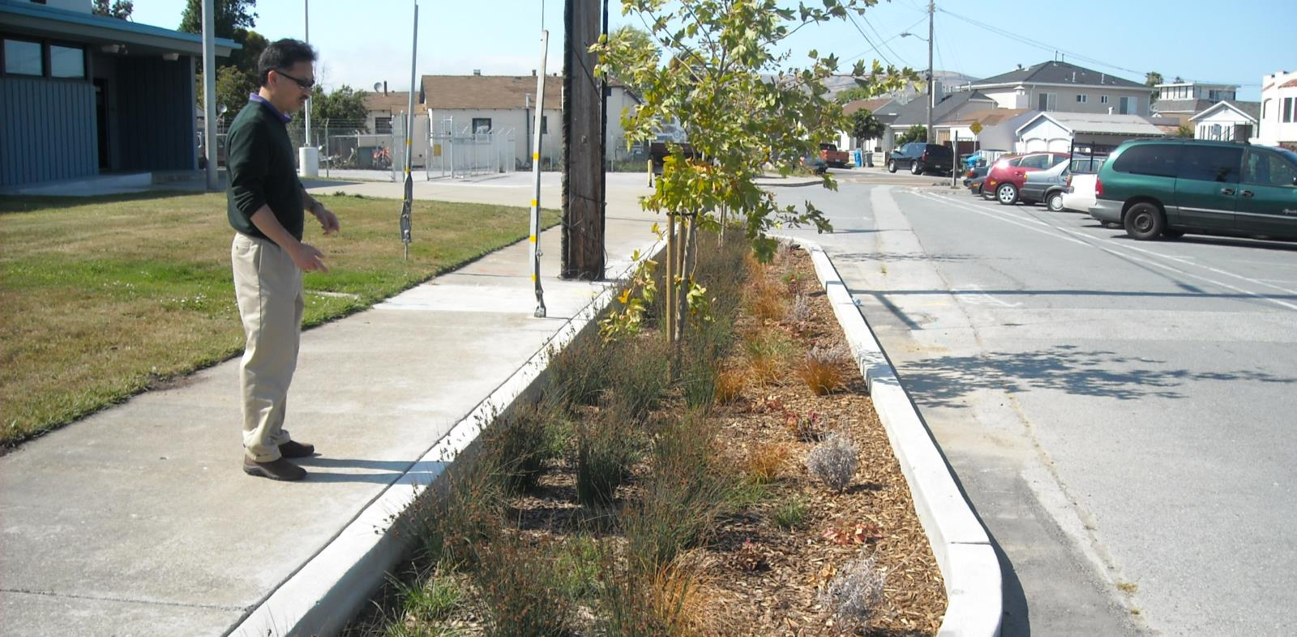
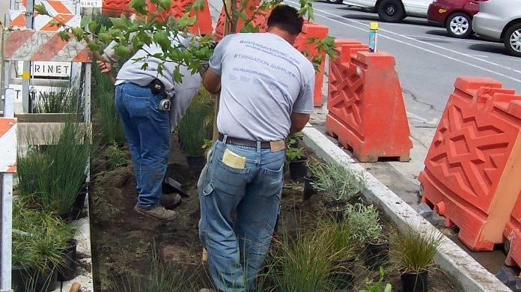
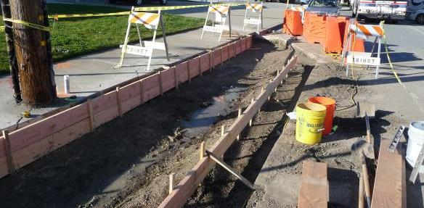
Stormwater Curb Extension
City of San Bruno

Slide 23
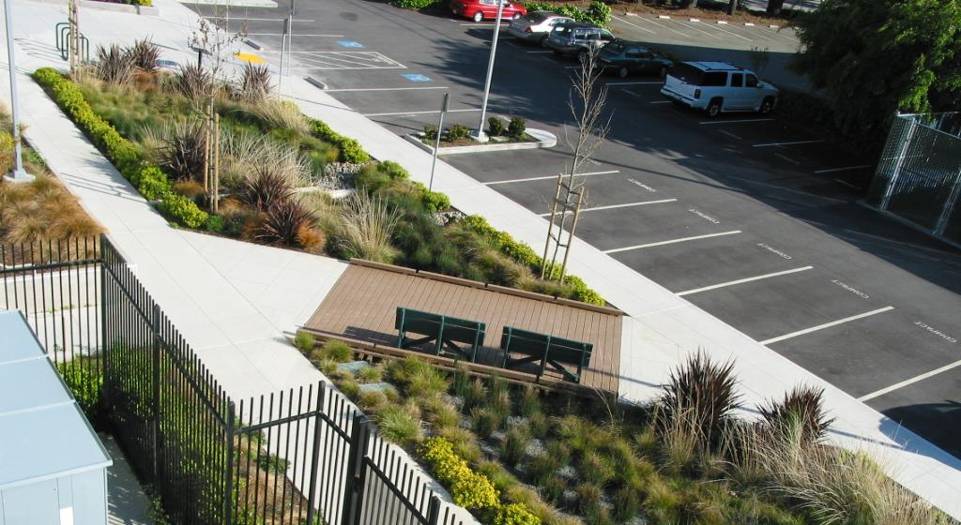
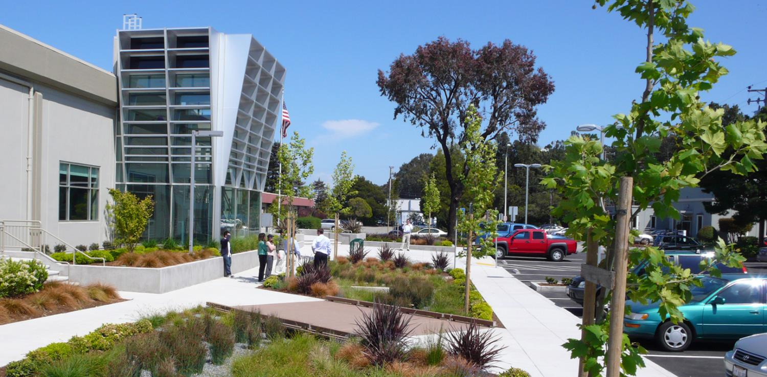
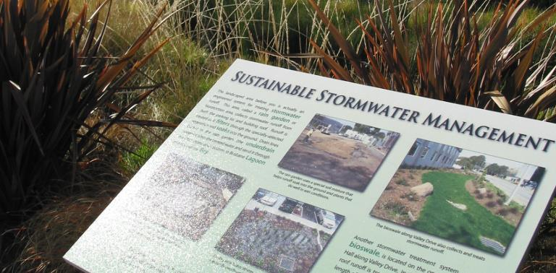
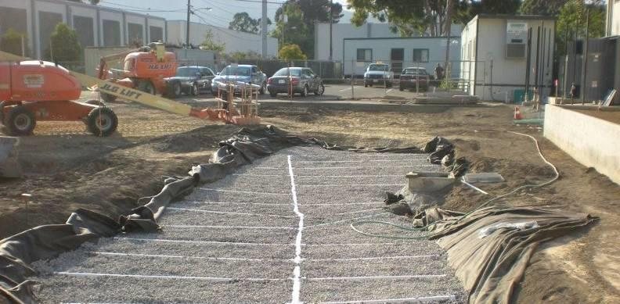
Rain Garden
Brisbane City Hall

Slide 24
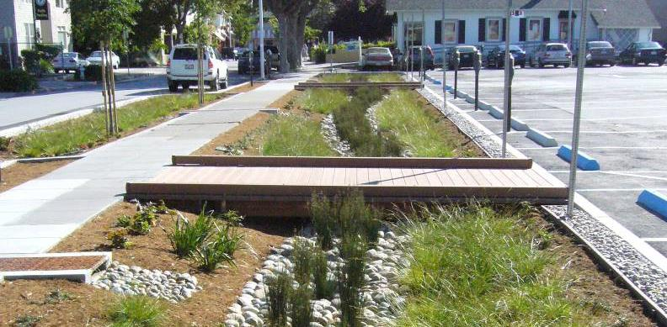
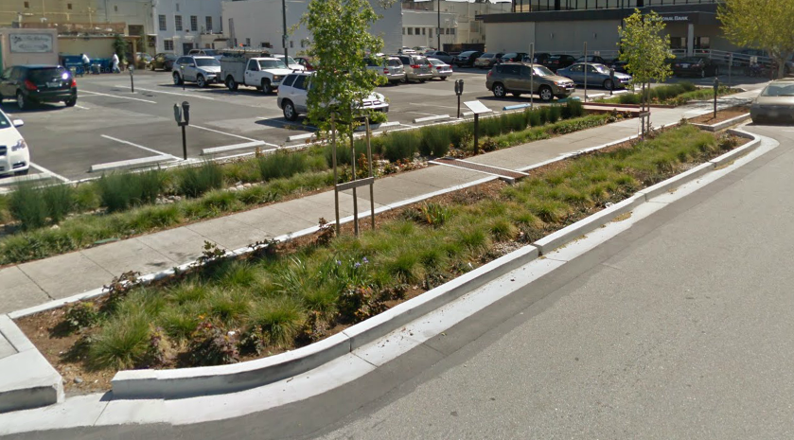
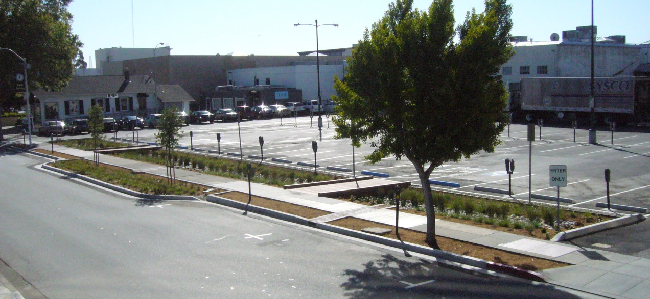
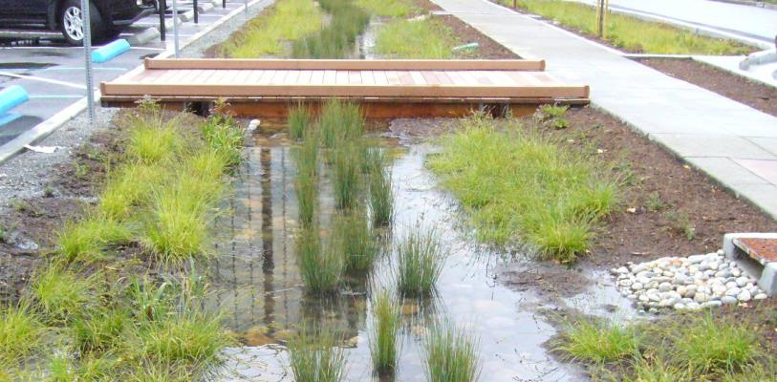
Rain Garden and Curb
Extension
City of Burlingame

Slide 25
MRP 2.0
Main Concerns
  Green Infrastructure Plans
    Transition “grey” to “green” infrastructure over decades
  Trash Load Reduction
    70% Reduction by 2017, maybe 90% by 2019
  PCB Load Reduction
    Numerical load reductions mandated
    Green infrastructure, building materials, property referral
    Significant uncertainty in ability to comply

Slide 26
MRP 2.0
Revised draft likely out next week
No written comments, oral testimony only
Adoption at November 18 Water Board hearing
Last chance to influence Board decision
Strongly urge elected official participation
Staff will provide guidance and talking points

Slide 27
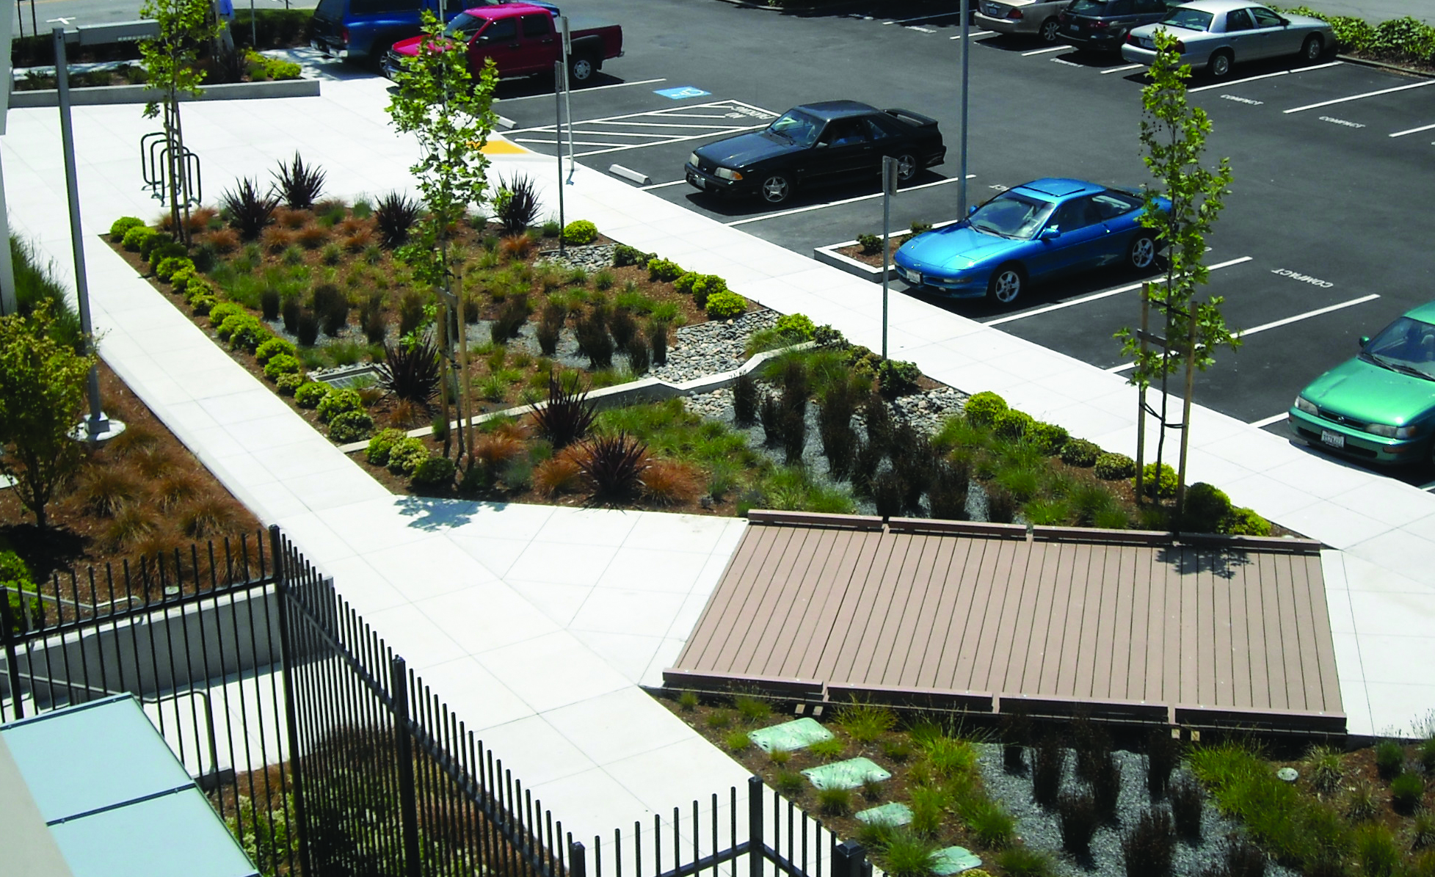

Matthew Fabry, Program Coordinator
(650) 599-1419
mfabry@smcgov.org
www.flowstobay.org

