Slide 1
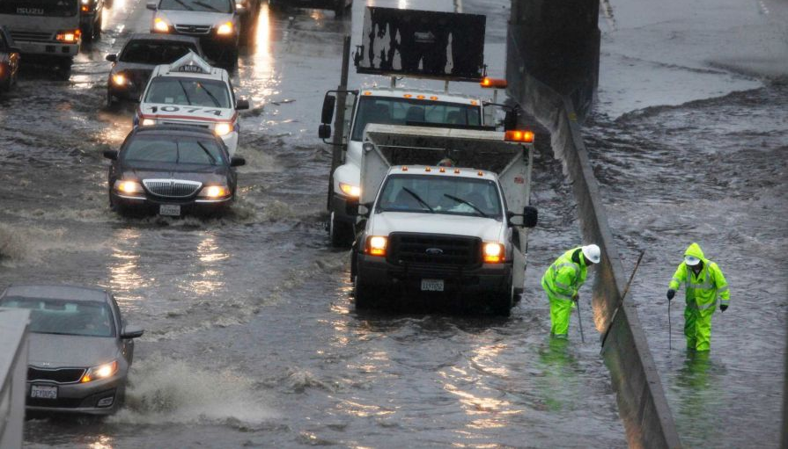
San Mateo County Sea Level Rise Vulnerability Assessment
C/CAG Stormwater Committee October 15, 2015
Photo by Lea Suzuki-The SF Chronicle
Notes:
Intro slide for those on the webinar

Slide 2
What this study will accomplish?
Develop County-specific approach
Gather data and categorize assets
Inundation exposure analysis and mapping
Vulnerability and risk analysis
Initial adaptation planning
Actionable outcomes
Notes:
Describe process for study/major tasks

Slide 3
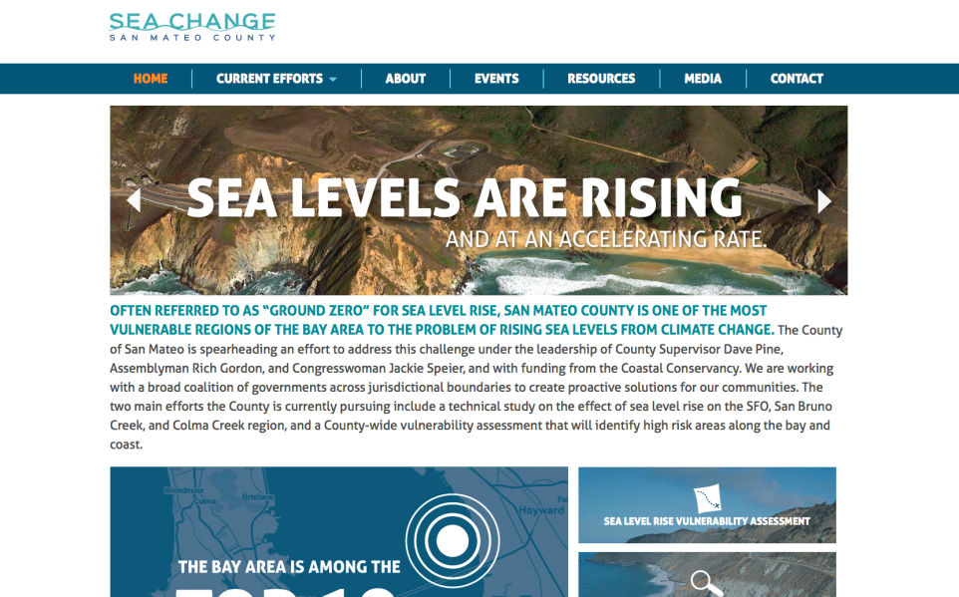
http://seachangesmc.com/
Notes:
All information about the project is available on our website, seachangesmc.com. We just launched an expanded version of the website. If you have any projects or resources from your city that you would like to see on the website, please send to me.

Slide 4
Actions to Date
Methodology Report complete
Asset Categorization Report complete
Sea Level Rise Scenarios
Convened Technical Working Group & Policy Advisory Committee
Community Task Force

Slide 5
Best Available Science on SLR
National Research Council Report on SLR Projections for California
Year | Projections | Ranges
2030 | 6 +/- 2 inches | 2 to 12 inches
2050 | 11 +/- 4 inches | 5 to 24 inches
2100 | 36 +/- 10 inches | 17 to 66 inches
Sea Level Rise Projections for San Francisco; Ranges for South of Cape Mendocino
Notes:
June 2012 National Research Council report on Sea Level Rise for the Coasts of CA, OR and WA

Slide 6
Scenario Examples
SLR / Storm | MHHW | King Tide | 1 yr | 20 yr | 100 yr
0cm |  | HMB
25cm |  |  | Marin | Marin | HMB
30cm
50cm |  | Humboldt |  | Marin | HMB
100cm |  | Humboldt |  |  | MC
150cm |  | Humboldt
200cm |  | Humboldt |  |  | Marin
Marin
HMB

Slide 7
Scenario Examples + SMC Scenarios
SLR / Storm | MHHW | King Tide | 1 yr (100%) | 20 yr (5%) | 100 yr (1%)
0cm |  | HMB |  | SMC (?) | SMC
25cm |  |  | Marin | Marin | HMB
30cm
50cm |  | Humboldt |  | Marin | HMB
100cm |  | Humboldt |  |  | HMB S MC
150cm |  | Humboldt
200cm |  | Humboldt |  |  | Dd
SMC
Marin
HMB
SMC
Marin

Slide 8
Asset Categorization
Assets will be organized into classes based on:
Public health, safety, welfare (built assets)
Ecosystem and habitat (natural assets)
Social vulnerability (human assets)

Slide 9
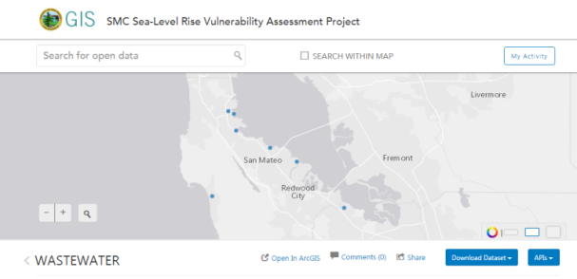
Data Collection
Open Data Portal – available here: http://slrsmc.smcmaps.opendata.arcgis.com/
Still working on filling in dataset
Needs review for completeness
Notes:
Data sets:
Some stormwater infrastructure. Will get the complete dataset from Matt.
Wastewater treatment facilities
Schools
Fire
Roads
Transportation / Railroads
Outfalls
Lift stations
Pump stations
Airports
Underground storage tanks
Clean up sites
Solid Waste facilities
Closed landfills
Schools
Hospitals
Natural gas pipelines
Electricity distribution lines
Demographic information
Jail/ Police
Trails, parks, and beaches

Slide 10
Data Sets
Stormwater*
Wastewater
Fire
Roads
Transportation/ Railroads
Energy infrastructure
Airports
- Clean up sites
Solid Waste facilities
Underground Storage tanks
Closed landfills
Schools
Senior Centers
Hospitals
Affordable housing units*
Evacuation routes
Parcel data
Port facilities*
* Data still needed

Slide 11
Next Steps
Inventory of Assets
Short List of potential representative Assets
Your review and feedback on Short List
Selection of 30 assets
Asset manager interviews and research
Develop Asset Vulnerability Profiles

Slide 12
Upcoming Meetings & Engagement Opportunities
Technical Working Group Meetings
December 10 1-4pm – Sobrato Center
February 9, 9-12pm – San Mateo Library
Policy Advisory Committee Meetings
March 8

Slide 13
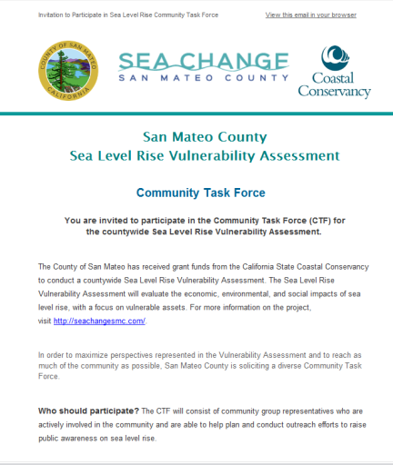
Public Engagement Opportunities
Community Task Force
Public Workshops
For more info:
Contact TJ Carter
tjcarter@smcgov.org
or visit
www.seachangesmc.com
Notes:
If you know of any active community members or organizations, please let me or TJ know.

Slide 14
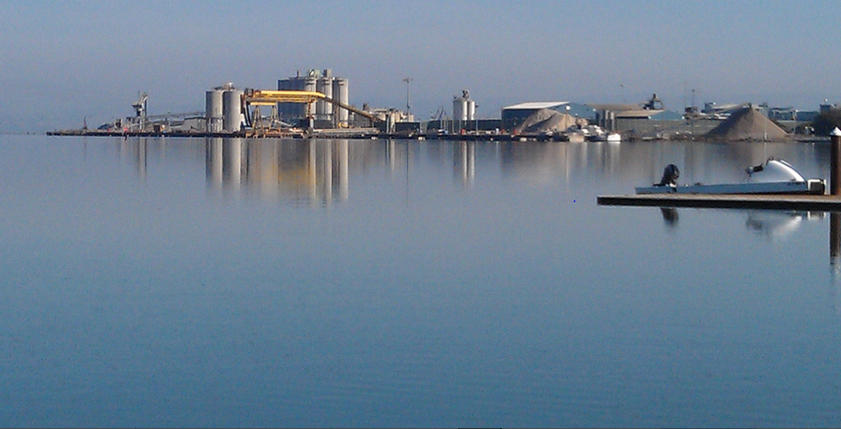
Questions?
Contact Info:
Hilary Papendick, Climate Resilience Specialist
hpapendick@smcgov.org
650-363-4194
http://seachangesmc.com/
Port of Redwood City
Photo by Jen Kalt, all rights reserved

Slide 15
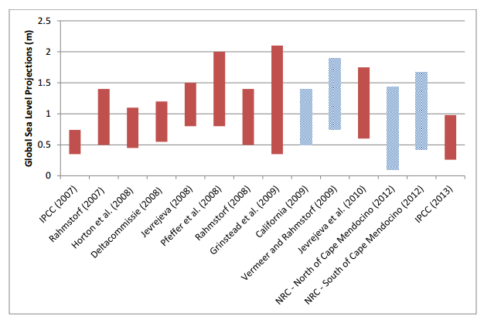
Notes:
Add hansen projections

Slide 16
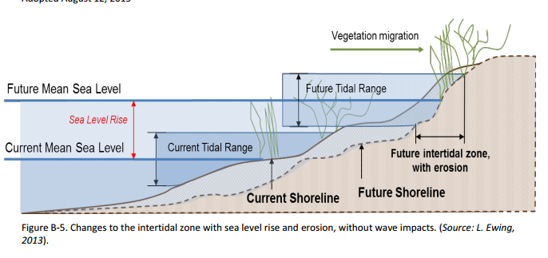

Slide 17
