Slide 1
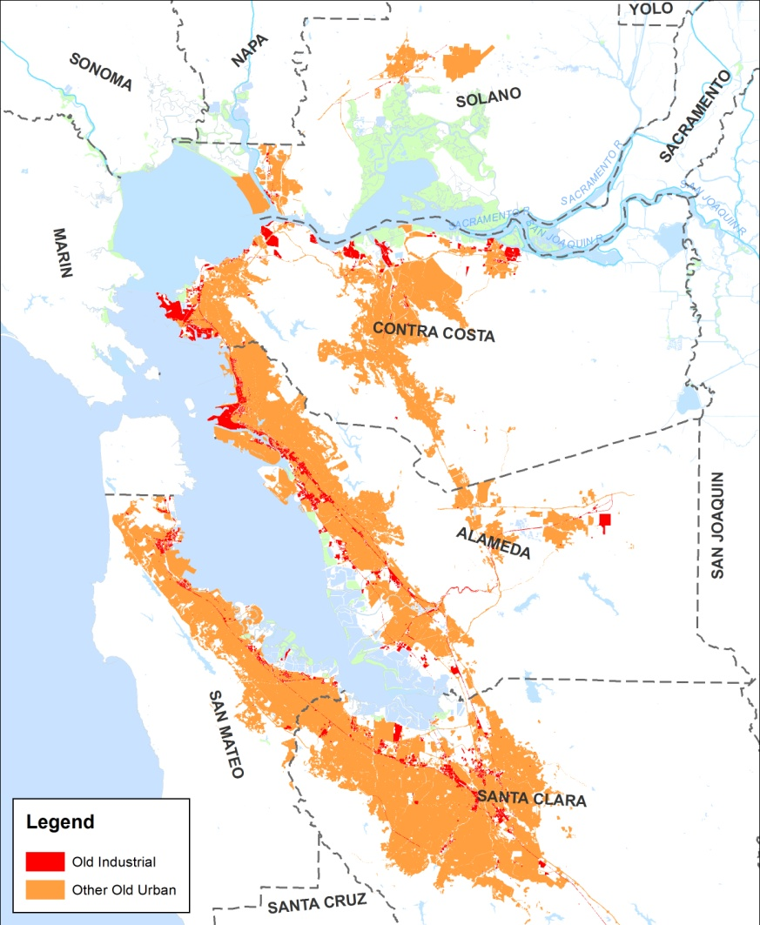
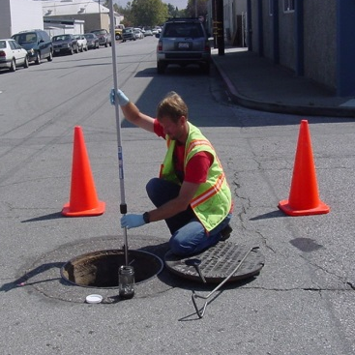
PCBs and Mercury Source Identification Study
Jon Konnan - EOA, Inc.
October 15, 2015

Slide 2
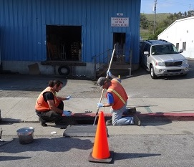
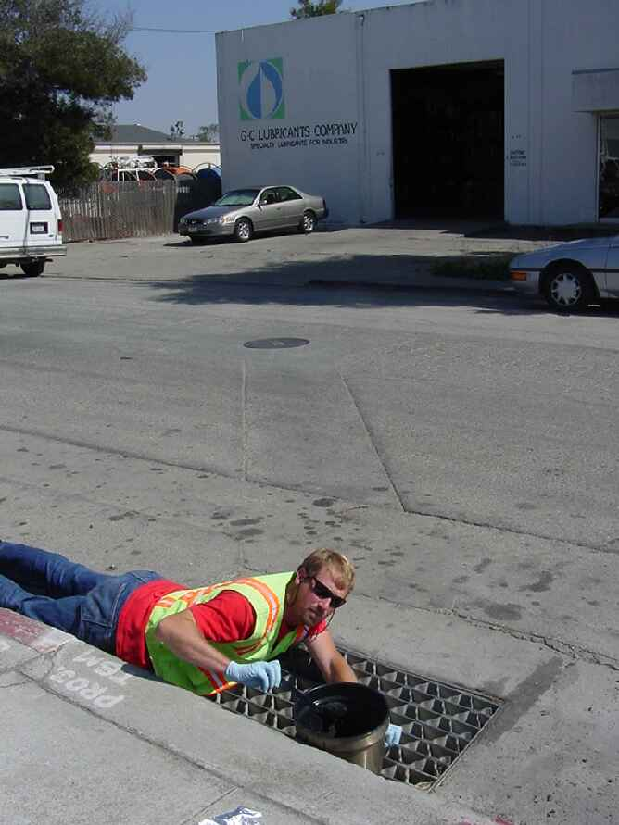
Overview
Goal - identify:
Areas with evidence of PCBs for further investigation
Eventually, opportunity areas for cost-effective controls
>90% of old industrial land uses in SM County screened
Desktop component: historical land use and site condition
Field component: 101 sediment samples tested for PCBs & mercury

Slide 3
Preliminary Map of Old Industrial and Other Old Urban Land Uses

Slide 4
Opportunity Categories and Rough Estimates of PCB Loads
High Opportunity – about 20% of PCB load
Mainly a portion of old industrial land uses
Higher concentrations and yields
Controls are most cost-effective: consider full tool-box
Moderate Opportunity – about 70% of PCB load
Old urban and remainder of industrial land uses
Controls less cost-effective: focus on multi-benefit Green Infrastructure, redevelopment, building materials
Low/No Opportunity – about 10% of PCB load
Parks, open space, residential, schools, universities, new or redeveloped urban land uses
Low concentrations and yields
Controls are not cost-effective

Slide 5
Screen For Potential Source Areas
Develop initial maps and database
Consider every parcel with priority land uses (e.g., old industrial, electrical, recycling, railroad) as potential source area
Redevelopment status
Unpaved and erosional areas
Electrical equipment
Tanks, drums, scrap materials
Housekeeping
Violations
Presence of stormwater treatment
Work with municipal staff to refine maps and prioritize parcels of interest
Develop sampling and analysis plan and collect sediment samples in field

Slide 6
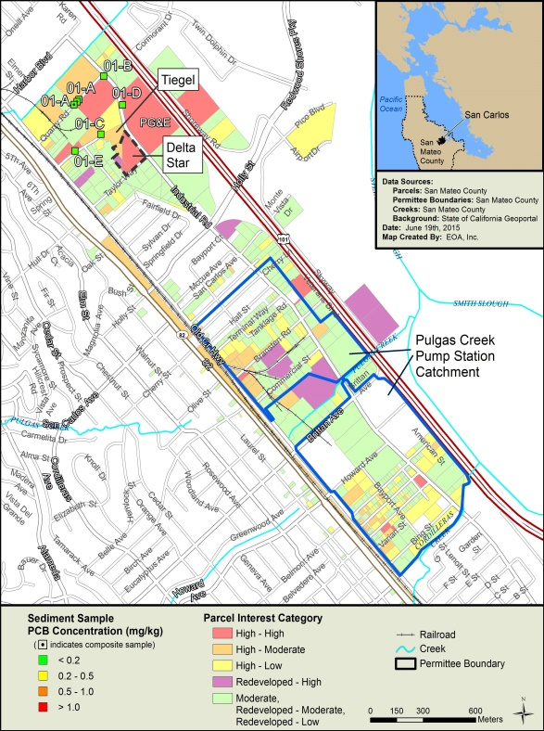
Example Map

Slide 7
Results: Elevated Sample Locations
Agency | High Interest Areas |  | Number of Samples with PCBs > 0.5 ppm | Number of Samples with Hg > 0.5 ppm
 | Parcels | Area (Acres)
Brisbane | 76 | 605 | 1 | 0
Burlingame | 125 | 181 | 0 | 1
East Palo Alto | 125 | 92 | 0 | 0
Menlo Park | 94 | 271 | 1 | 0
Redwood City | 192 | 299 | 1 | 1
San Carlos | 169 | 191 | 0 | 0
San Mateo (City) | 167 | 173 | 0 | 1
South San Francisco | 287 | 580 | 1 | 2
San Mateo County | 225 | 494 | 1 | 0

Slide 8
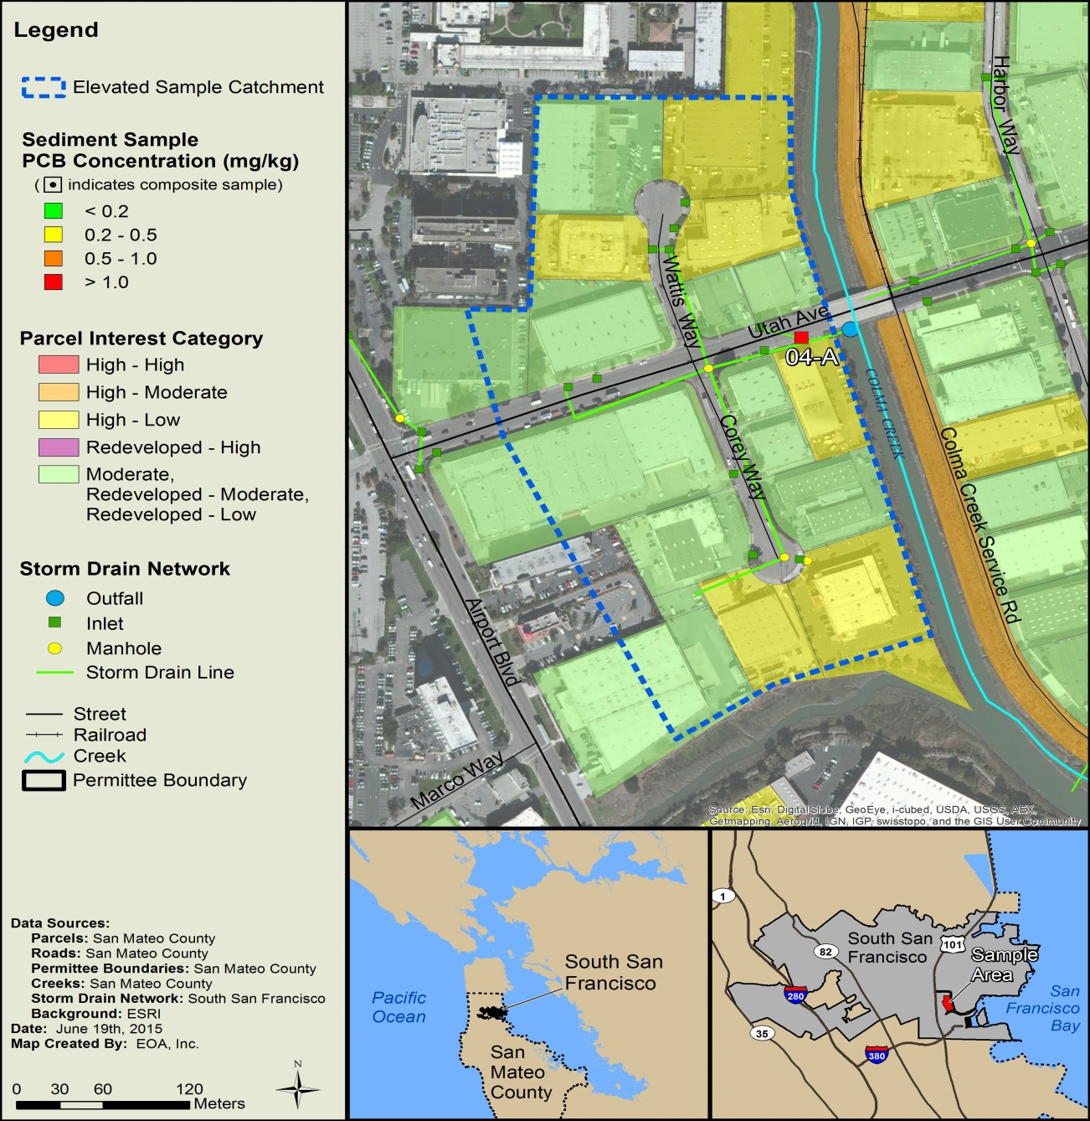
PCBs Results: SSF Example

Slide 9
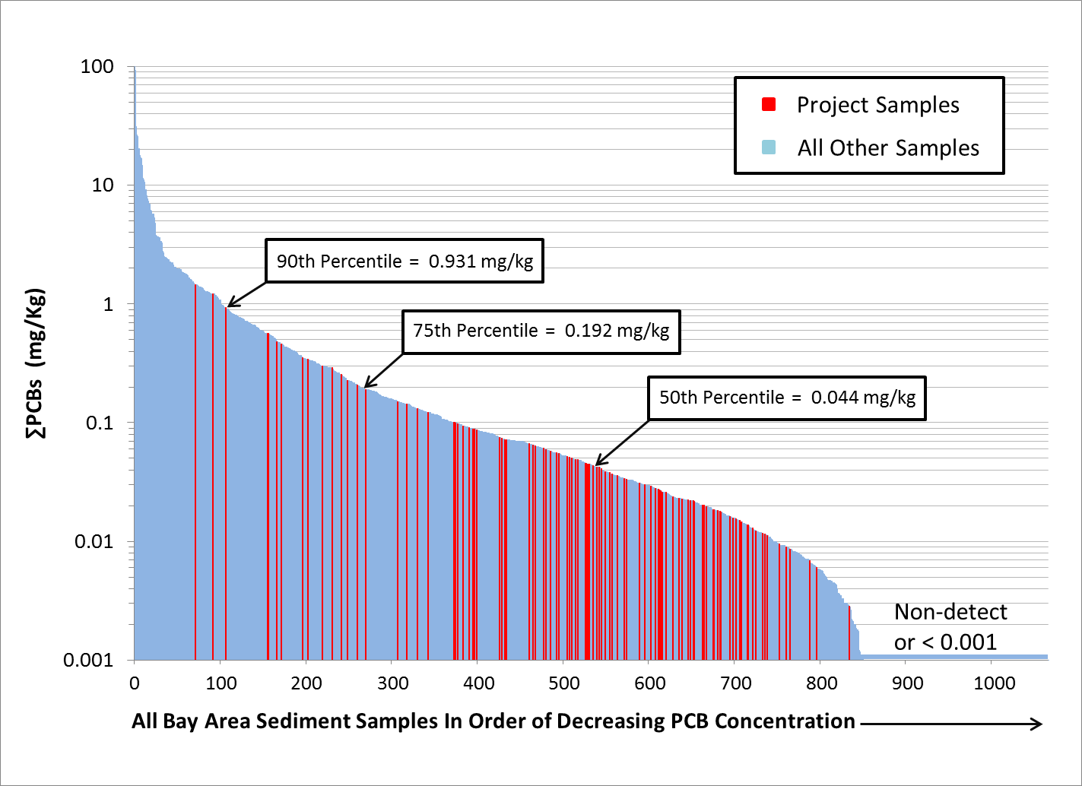
PCBs Results: Study vs. Bay Area
TMDL sediment goal = 0.001 mg/kg

Slide 10
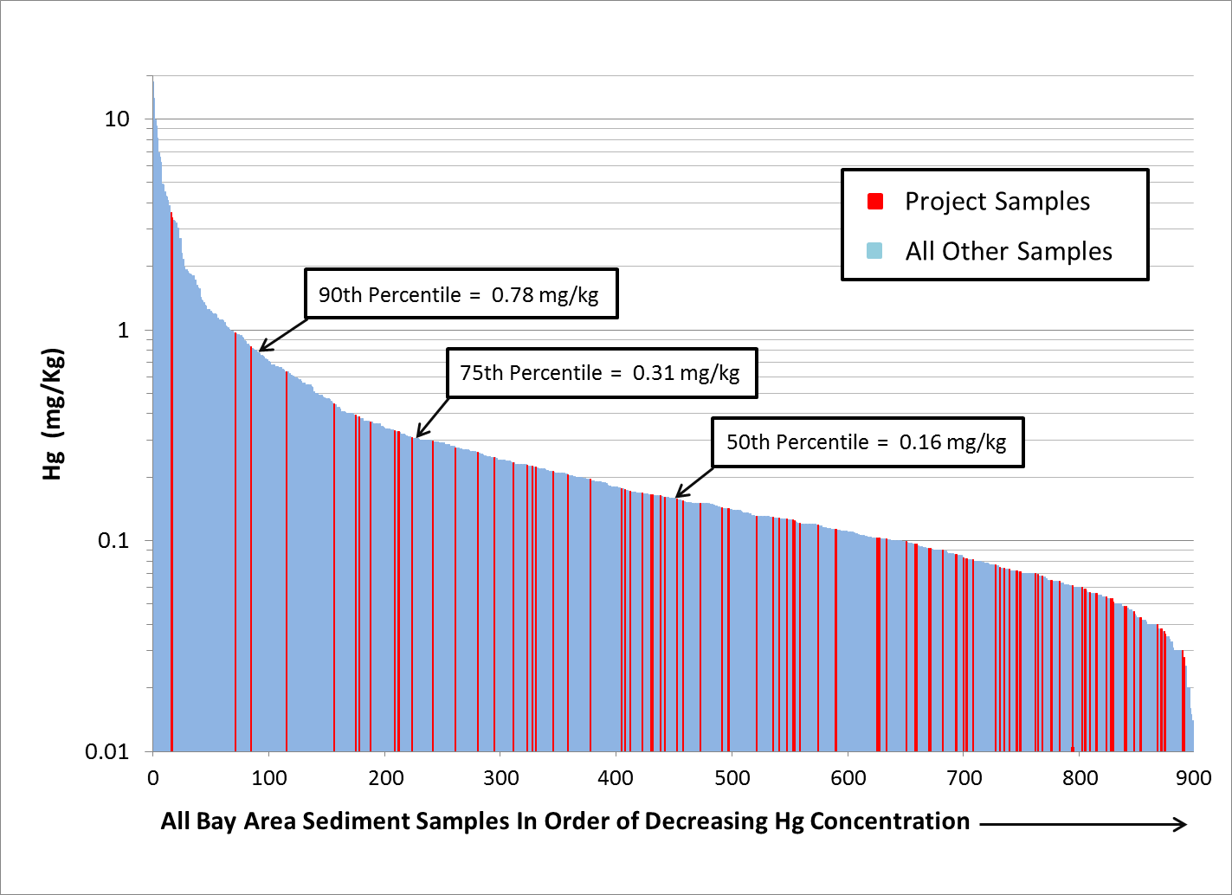
Mercury Results: Study vs. Bay Area
TMDL sediment target = 0.2 mg/kg

Slide 11
Land Use & Site Condition Not Correlated with Sample Results
Desktop screening limitations:
Amount/quality of available historical land use data
Aerial photo and site conditions interpretation
Potential PCBs contribution from building materials not screened for
Too much weight on unpaved parcels?
Need higher density of samples?
Chemical analysis results highly variable, can’t prove negative

Slide 12
Study Results and Conclusions
Only five percent of PCBs samples > 0.5 ppm
Consider refining screening process
Identifying additional source areas in SM County becoming more challenging
PCBs are diffuse in urban landscape
Diffuse sources challenging to control

Slide 13
Next Steps (MRP 2)
Plan and continue source area investigations: attempt to identify high vs. moderate opportunity areas
Develop approaches to achieve required load reductions consistent with accounting
High opportunity areas: full pollutant controls tool-box
Moderate opportunity areas: Green Infrastructure planning, redevelopment, and PCBs in building materials management
Reasonable assurance analysis
Revise TMDL at end of permit term? – extend timeframe
Full toolbox for low hanging fruit
Greening of urban landscape over decades (e.g., Green Street retrofits, redevelopment)
Natural degradation and flushing

Slide 14
TMDL

Slide 15
Questions?

