Slide 1
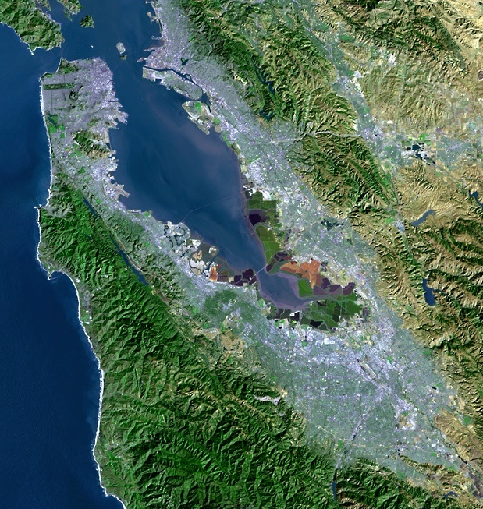
Current Water Supply Conditions and Conservation Update
“A multicounty agency authorized to plan for and acquire supplemental water supplies, encourage water conservation and use of recycled water on a regional basis.”
[Bay Area Water Supply and Conservation Agency Act, AB2058(Papan-2002)]
Adrianne Carr
Senior Water Resources Specialist
Bay Area Water Supply and Conservation Agency
March 16, 2016

Slide 2
Reservoir Storage Levels on 3/13/2016

Slide 3
Other Reservoirs in California

Slide 4
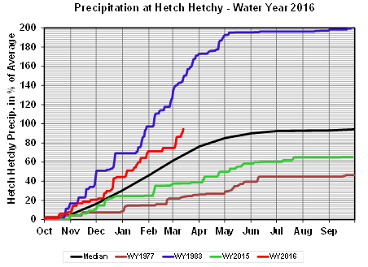
Cumulative Precipitation 2016

Slide 5
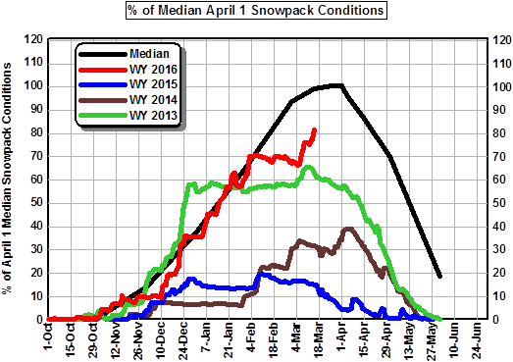
Snowpack Conditions

Slide 6
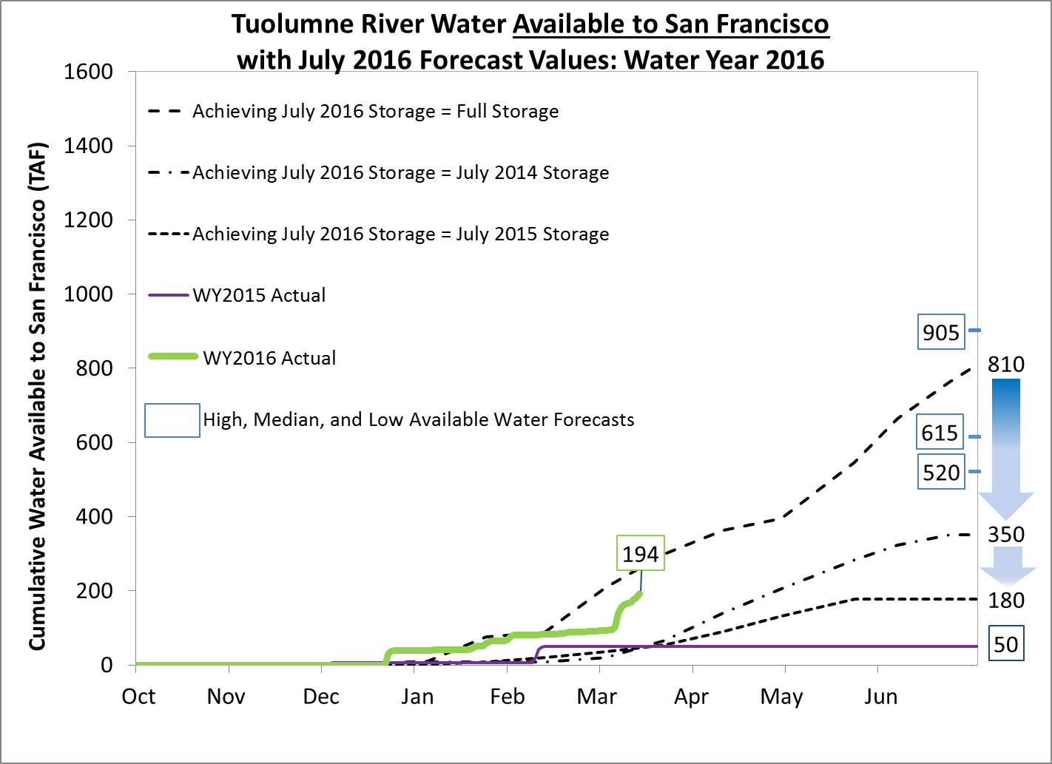

Slide 7
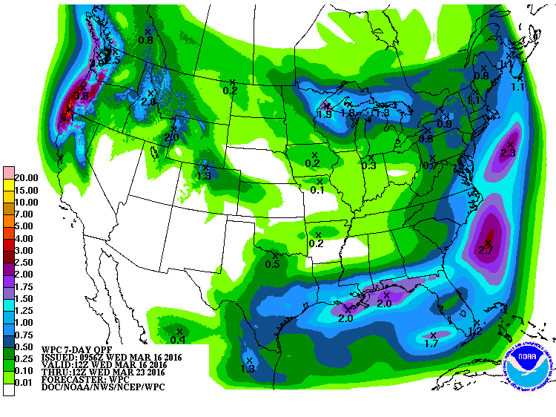
7-Day Precipitation Forecast

Slide 8
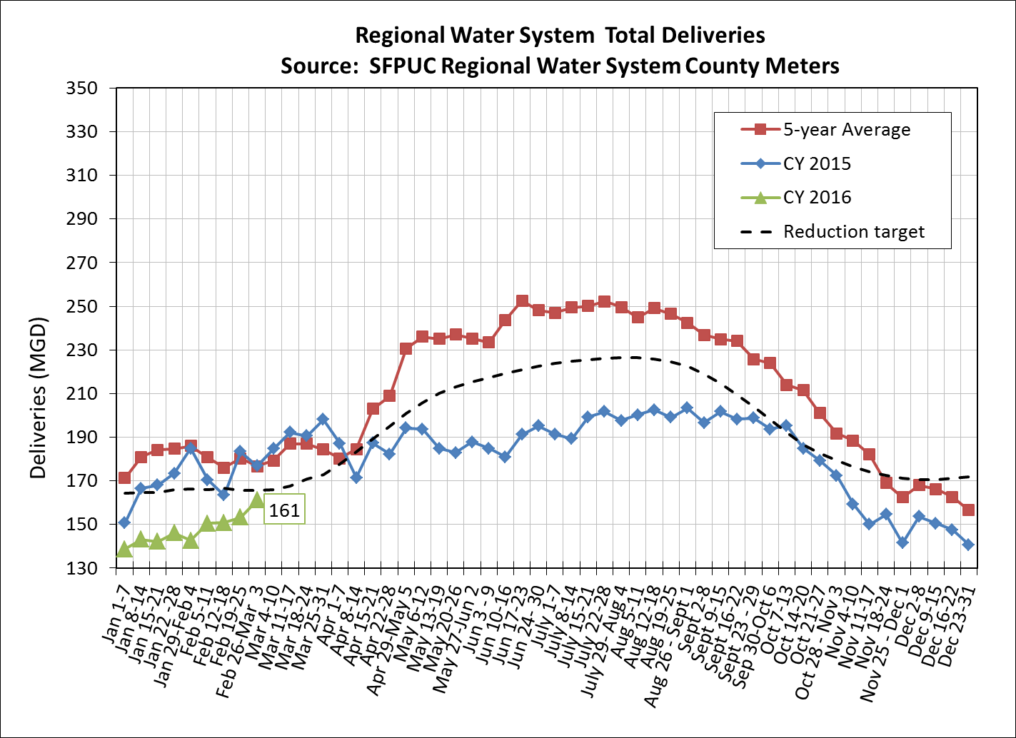
Total Deliveries
Notes:
T:\WS_Ops\Operations\Engineering\Demands\demands\Monitoring Year 9 2015
Consumption Report v2.6_2014.xlsm
Check that plot is current.
Add data label to last point.
Resize to 6.24 height

Slide 9
Agencies Achieved 27% Cumulative Savings June 2015 through Jan. 2016
27% Cumulative Savings from 2013

Slide 10
State Considering Additional Changes to Emergency Regs
Recent precipitation may result in easing of conservation mandates. SWRCB Chair Marcus:
  "In May, we'll be either lifting it or changing it significantly…."
BAWSCA participated in conference call with State Board staff to discuss potential changes
  Short-term: move away from per capita target towards a system based on individual agency supply reliability
  Long-term: SWRCB directed to work with DWR to achieve desired results
Staff to report back to State Board with options by May 1

