Slide 1
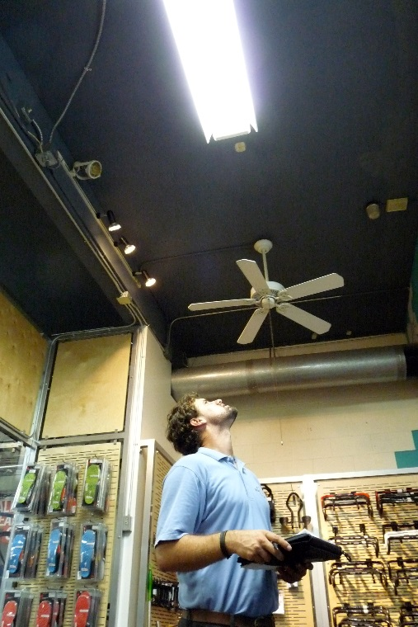
PG&E Incentive Programs in San Mateo County
Upstream (Manufacturer/model – Wholesale)
Midstream (Customers – Retail)
Downstream (Direct Install, Streetlights, Municipal Retrofits)
New Construction (Residential and Commercial)

Slide 2
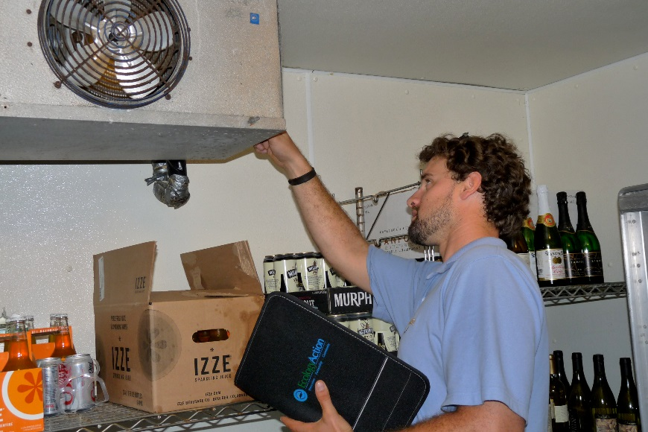
Program Designations
Residential upstream incentives (e.g. at the manufacture or distributor level)
Non-residential upstream incentives (e.g. at the manufacture or distributor level)
Residential mid stream incentives (e.g. at the retail level)
Non Residential mid stream incentives (e.g. at the retail level)
Residential down-stream incentives (which includes streetlights)
Non Residential down stream
Residential direct install (El Concilio)
Non-Residential Direct Install (Ecology Action)
Non Residential Retrofit (Calculated)
Non Residential new construction
Residential new construction
(Does not include BayREN. Portion of RDI, NRDI and NRR tied to SMCEW)

Slide 3
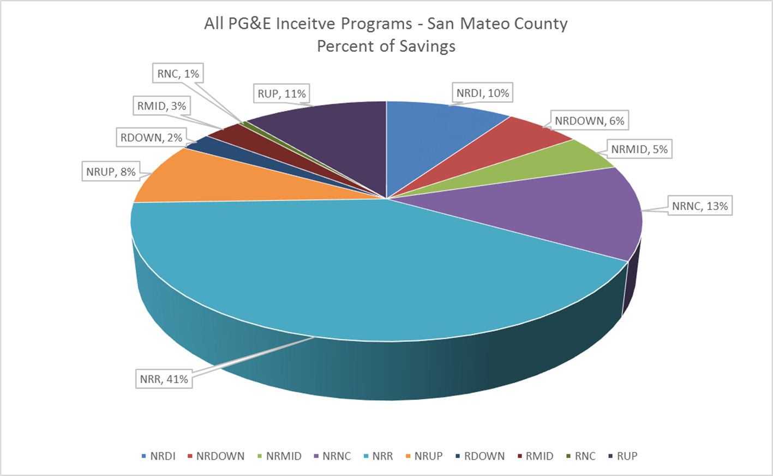

(based on data from 2013-2015)

Slide 4
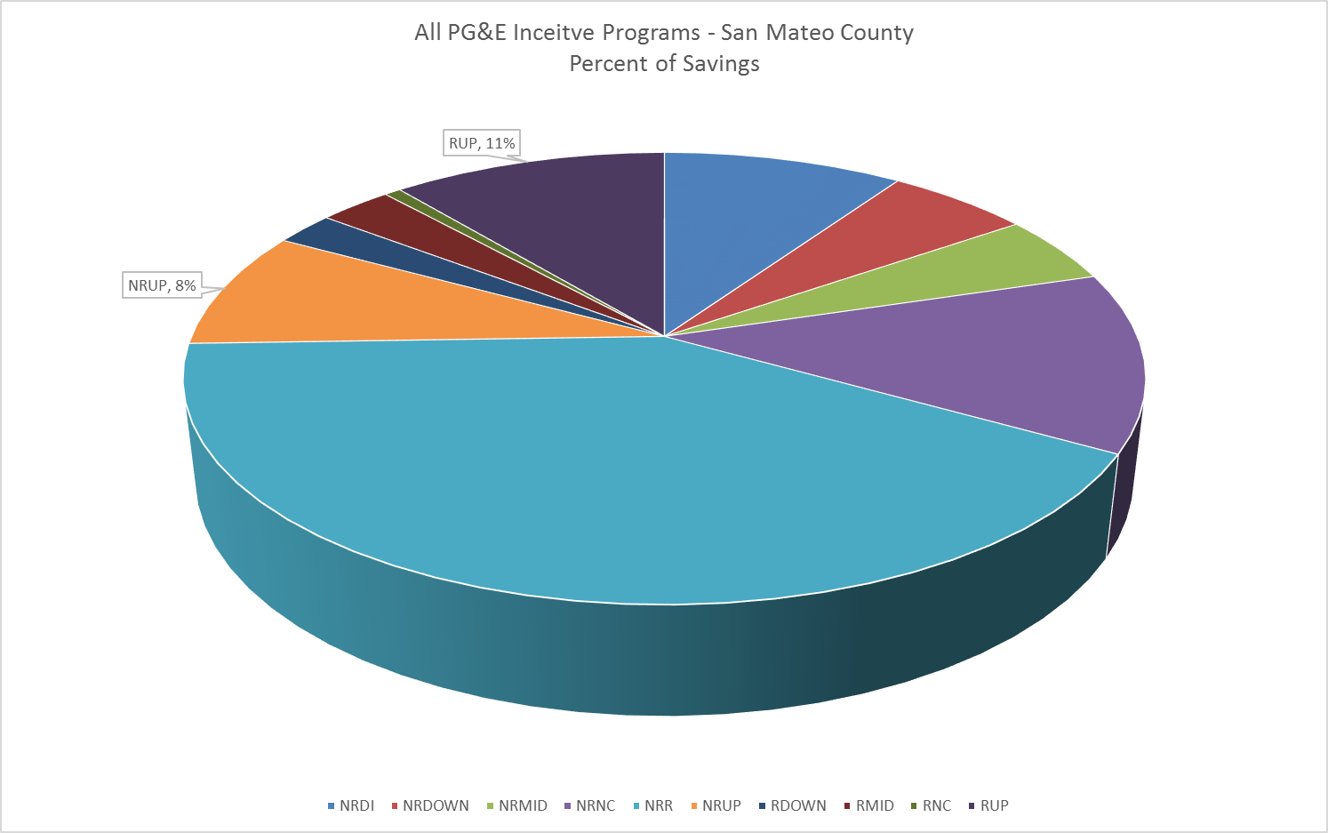
Upstream (manufacturer/distributor) - 19%

Slide 5
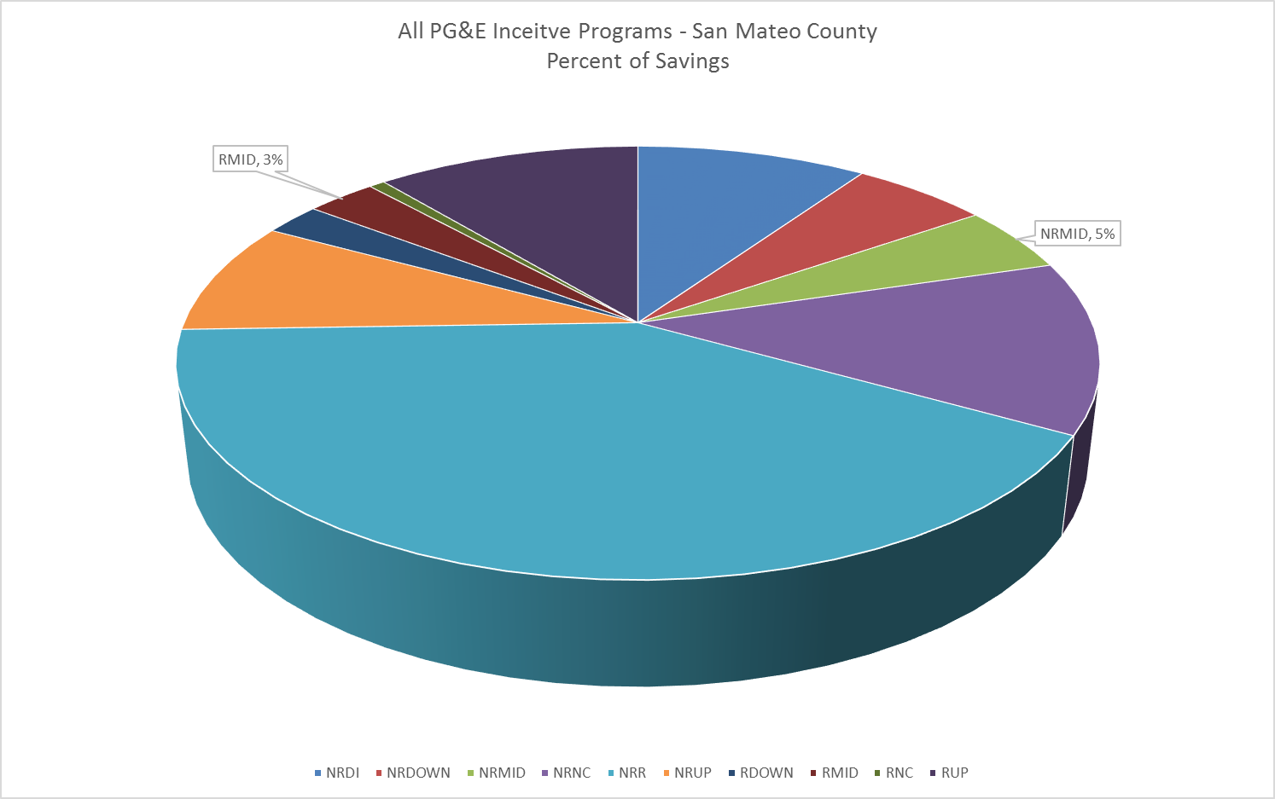
Midstream (retail level) - 8%

Slide 6

Downstream (deemed incentives) - 8%

Slide 7

Direct Install and Retrofit - 51%

Slide 8
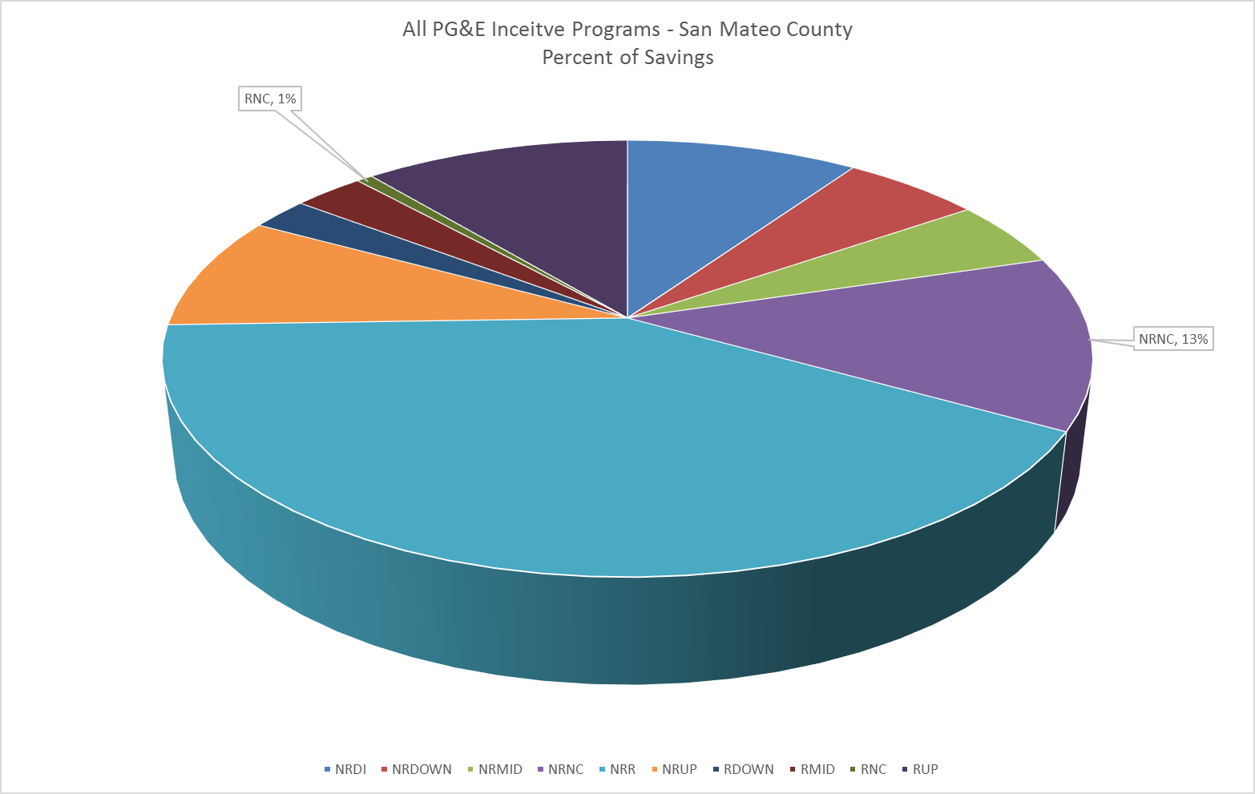
New Construction - 14%

