Slide 1
SMCEW 2015 Review
Resource Management and Climate Protection Committee
February 17, 2016

Slide 2

SMCEW Outcomes
Program Energy Savings
  kW Saved: 666kW
    157% of goal
  kWh Saved: 5,806,110 kWh
    164% of goal
Types of Projects:
    Lighting
    Boilers
    Chillers
    EMS
Notes:
Jacki

Slide 3
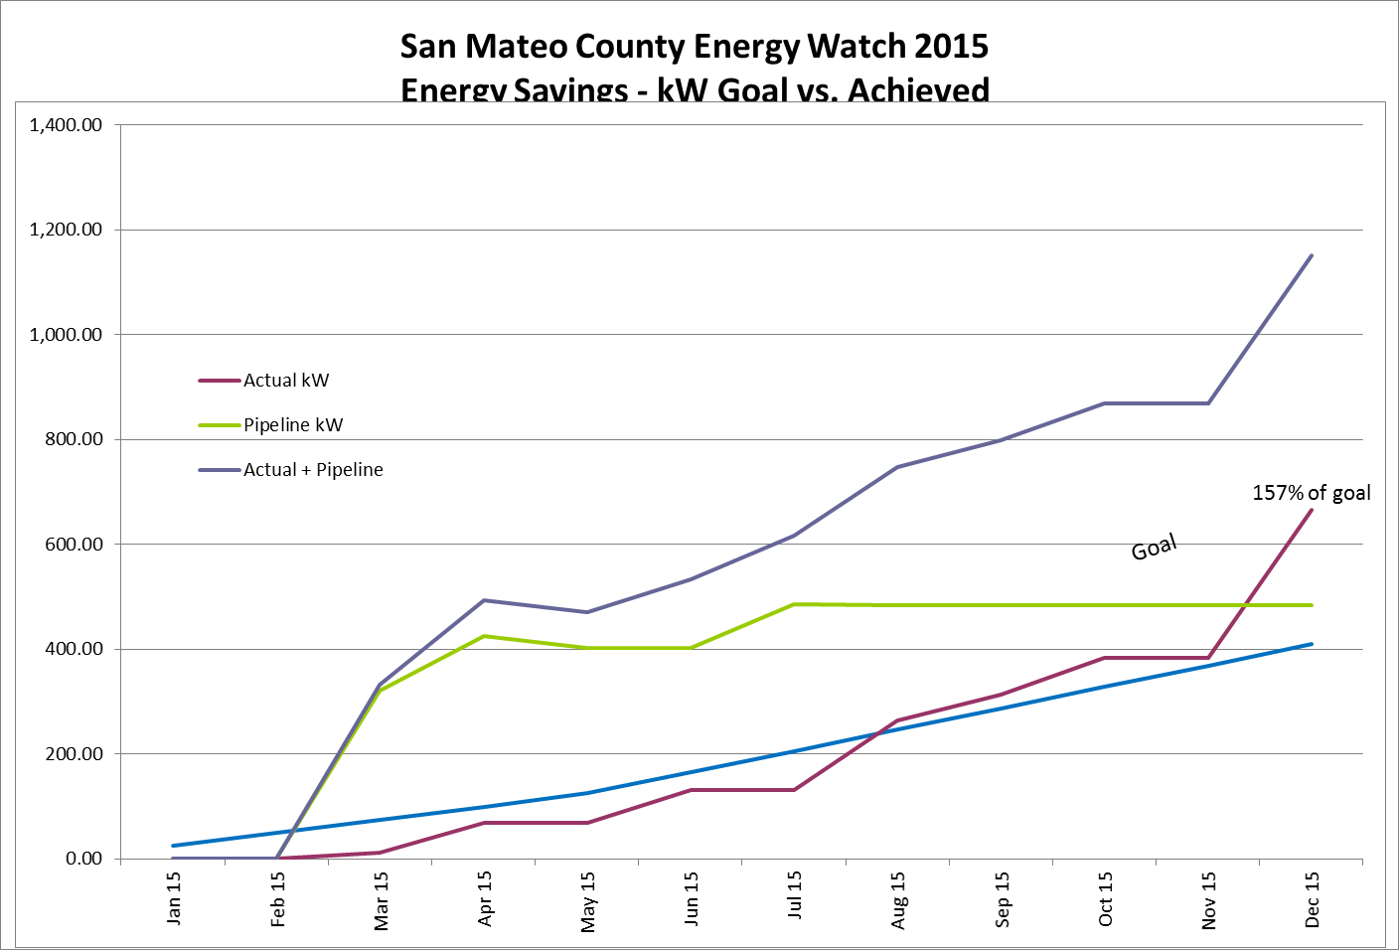
kW Savings Chart
Notes:
Jacki

Slide 4
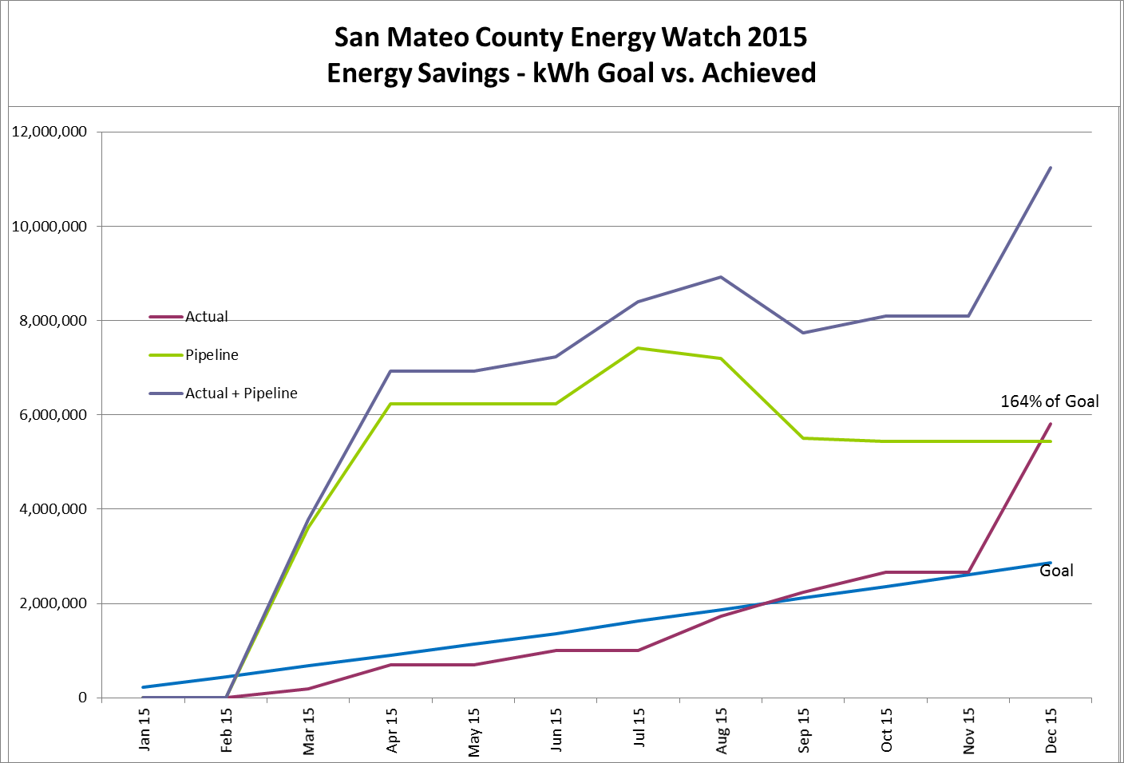
kWh Savings Chart
Notes:
Jacki

Slide 5

Comparison with last (2-year) cycle
2015
2013-2014
666 kW
Rebates:
$1,590,459
781 kW
Rebates:
$1,690,597
5.8 m kWh
6.8 m kWh
29,226 Thm
-10,787 Thm (no goal)
Notes:
Kim:
This is the contract structure of the program.
--
One of ways PG&E administers EE programs is “Local Government Partnership”
In SM County, the partnership is between C/CAG and PG&E.
C/CAG contracts with the County - Public Works RecycleWorks department to staff and manage the SMC Energy Watch program
PG&E likes working through countywide local government entities to serve “hard-to-reach” customers (these customers are explained on the next slide)…

Slide 6

School Assistance
  SMCEW assisted 9 school districts with energy audits/reports
  1 expenditure plan submitted and approved (all SMCEW)
  4 districts were given water audits for one or more schools
So far, 11 school districts have approved
expenditure plans totaling $5.5M
Even though SMCEW has engaged every
school district in San Mateo County, $$$ of
Prop 39 funds remain without expenditure plans.
Prop 39 is more than ½ way through the 5-year cycle
Notes:
Jacki

Slide 7

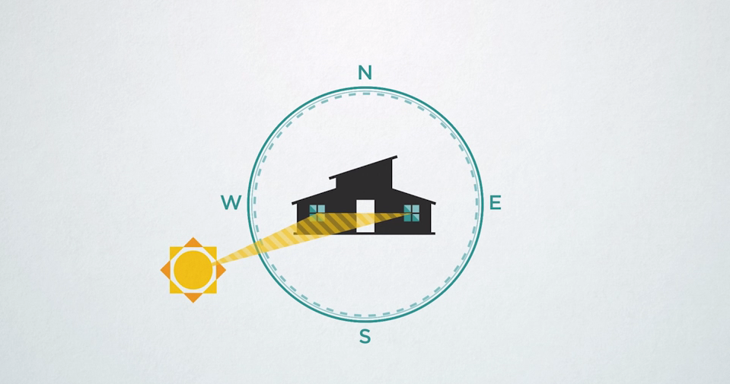
Zero Energy Program
  SMCEW Zero Energy Strategic Plan Draft
  Facilitation of HouZE Living Lab in SMC (possible Skyline College)
  2 full day workshops
  2 Webinars
  Animation Videos
General Contractor Builders Homeowners Developers
Notes:
Jacki

Slide 8

Water Conservation
Megan Waters (CivicSpark) - trained for Water Auditing
Water Audit Program for Schools
  Efficiency assessment of indoor and outdoor water-using fixtures, and historical analysis of water usage
  Identifies projects with high water saving potential and low payback time
  Identifies available rebates through BAWSCA and the district’s water agency
  Provides school districts with cost-benefit analyses for budgeting purposes
Recent Participants: Jefferson Union High School District, Ravenswood City Elementary School District, Belmont-Redwood Shores Elementary School District
Notes:
Megan

Slide 9

Small and Medium Business (Direct Install)
Completed Projects
City | Number of Projects
Belmont | 14
Brisbane | 9
Burlingame | 23
Colma | 7
Daly City | 10
East Palo Alto | 2
Foster City | 4
Half Moon Bay | 10
La Honda | 1
Menlo Park | 16
Millbrae | 1
City | Number of Projects
Montara | 1
Pacifica | 7
Redwood City | 21
San Bruno | 2
San Carlos | 15
San Mateo | 35
South San Francisco | 38
Total Projects Completed: 216
Notes:
Adrian

Slide 10
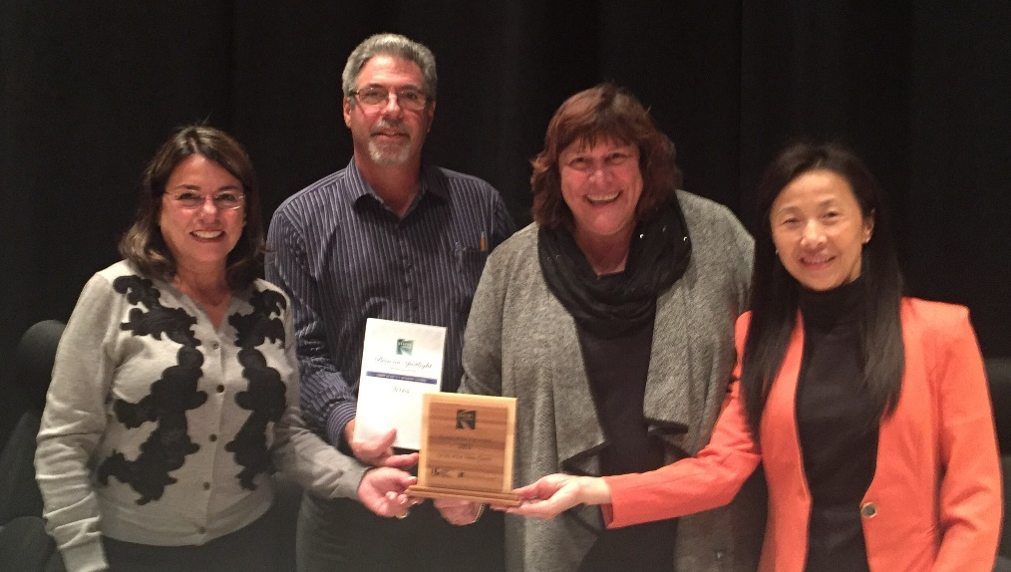

2015 Beacon Award Efforts
  11 Cities and the County received Spotlight Awards
  2 Cities received (full) Beacon Awards
  County is first to receive a Beacon Award in California
  SMC collaboration has become a model that LGC desires to replicate
  C/CAG receives Beacon Award Champion recognition
Notes:
Karalee

Slide 11
Next Steps for 2016-2018
Building Pipeline for Municipal Facilities
Small Business
Implementation of ZE Strategic Plan

Slide 12
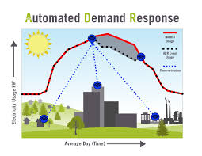
Building Pipeline for Municipal Facilities
Automated Demand Response Workshop
  March 2nd 8:30am-11:30am
  Sobrato Center, Redwood Shores
  Municipal facilities, large commercial
Special Districts
Going for deeper retrofits at city facilities
Notes:
Jacki

Slide 13

Small Business
Hard to Reach Criteria (businesses must meet 2/3)
  Primary language spoken at business is non-English
  Less than 10 employees
  Rents or leases facility
Data-driven Outreach Campaign:
  Using a combination of PG&E and public data to identify quality leads
Notes:
Adrian

Slide 14

Implementation of ZE Strategic Plan
Template Language
  RFPs
  Ordinances
  General Plans
Workforce Development
  Trainings for Contractors and Engineers
Public Building Interventions
March & May: Zero Net Energy Workshops for Schools
Notes:
Jacki

Slide 15
Annual Funding from PG&E - 2016, 2017, 2018
Staffing and Outreach and Climate Action

Slide 16
Annual Funding from PG&E - 2016, 2017, 2018
Other Services

Slide 17

Questions?

Slide 18

Climate Action Planning and Implementation Technical Support
Calendar Years 2016-2018

Slide 19

Contracting
RFP completed
contract negotiated
Approved at C/CAG Board February 11

Slide 20
Scope of Work and Timeline

Slide 21
Questions?

