Slide 1
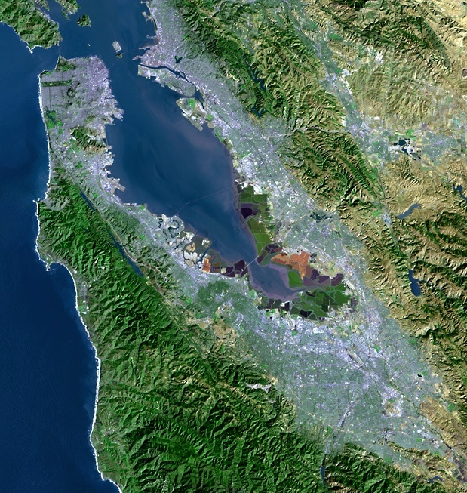
Update on Recent State
Water Policy Actions
“A multicounty agency authorized to plan for and acquire supplemental water supplies, encourage water conservation and use of recycled water on a regional basis.”
[Bay Area Water Supply and Conservation Agency Act, AB2058(Papan-2002)]
Adrianne Carr
Senior Water Resources Specialist
Bay Area Water Supply and Conservation Agency
November 16, 2016

Slide 2
Outline of Recent State Water Policy Actions
Long-term water conservation policy actions
Addressing water losses - SB 555
Penalties for excessive use - SB 814
Update of the Bay-Delta Water Quality Control Plan – 2016 Draft SED

Slide 3
State Agencies Kickoff Process to Implement Executive Order
Governor Brown’s May 9th Executive Order calls for:
  Longer-term water conservation policy actions for both the urban and agricultural sectors
  Possible further extensions of emergency regulations if conditions are dry this coming winter
DWR, State Board and CA PUC hosted kickoff of Urban Advisory Group (UAG) in Sacramento on 8/15
UAG will assist in process for implementing Governor’s Executive Order B-37-16

Slide 4
BAWSCA Participating in ACWA Efforts to Support UAG
Association of California Water Agency (ACWA) Leadership Group on Long-term Conservation Policy is developing recommendations for process
Group includes UAG members
BAWSCA seeking to ensure that unique Bay Area water user characteristics are considered as part of the UAG process

Slide 5
Initial Meeting Focused on Longer Term Efforts
UAG made up of invited representatives of water agencies, NGOs, industry and other interested parties
UAG has focused on two main policies:
  Strengthen Local Drought Resilience (i.e. Water Shortage Contingency Plans)
  Use Water More Wisely (i.e. Water Use Targets)

Slide 6
Proposed Reporting Timeframe Aligns with UWMPs
Agencies would submit Water Shortage Contingency Plans to DWR every 5 years as part of Urban Water Management Plan (UWMP) reporting
Proposed framework favors plans that are locally appropriate and prescriptive in timing and actions
If local/State conditions trigger mandatory stage, effected suppliers submit to State:
  Current annual “drought risk” assessment
  Additional data to inform State reporting, compliance, and enforcement procedures.

Slide 7
State Proposing Water Budget Approach for Water Use Targets
Water Use Sector | Proposed Target Setting Metric
Indoor Residential | -55 GPCD provisional standard -Revise downward in 2018, to be achieved by 2025
Outdoor Irrigation | -Based on aerial measurements of irrigable area -(ETAF) x (Landscape Area) x (ETo) = volume -State to conduct pilot study to determine landscape area and irrigation rates -State to provide aerial imagery and ETAF data
CII | -Performance measures rather than target, including: -Water budgets for dedicated irrigation meters -NAICS classification and benchmarking -Required dedicated irrigation metering by 2021 -Audits/management plans for high volume CII customers
Water Loss | -Standards set through SB 555 process -Include real and apparent losses

Slide 8
Timeline for Executive Order Implementation is Aggressive
Required to develop water use targets and issuing a draft framework by Jan. 10, 2017
Check the following Dept of Water Resources website for information and materials
  www.water.ca.gov/wateruseefficiency/conservation/
To join EO B-37-16 list serve, go to this link
  https://LISTSERV.STATE.CA.GOV/wa.exe?SUBED1=DWR_URBAN_WATER_MGT_PLAN_ANNCMNT&A=1
Notes:
To receive future notices concerning the EO B-37-16 Long term urban conservation policy process/Urban Advisory Group/Urban Water Management Plan process go to this link: https://LISTSERV.STATE.CA.GOV/wa.exe?SUBED1=DWR_URBAN_WATER_MGT_PLAN_ANNCMNT&A=1

Slide 9
Proposed Schedule Calls for Compliance by 2025
2017 | State framework report released (January 10, 2017) State begins outdoor land use pilot project
2018 | Technical Guidance on Water Budget Target Reporting/Compliance DWR provides land use area data for all suppliers (summer) Final indoor, outdoor, and CII 2025 standards established
2019 | Suppliers calculate and report provisional targets to DWR Water loss standard set by SWRCB
2020 | Suppliers submit progress reports on water use targets (annually)
2021 | Suppliers calculate new targets based on 2025 standards and report in UWMP (along with SBx7-7 target compliance)
2022-2025 | Suppliers submit progress reports State reevaluates targets and revises for 2030
2026 | Suppliers submit compliance report on water use targets Suppliers submit 2025 UWMP update Suppliers that do not meet 2025 target subject to SWRCB enforcement

Slide 10
SWRCB Preparing Proposal for New Conservation Standards
New emergency proposal is anticipated in January and would return to state-assigned conservation standards
Implementation of proposal is dependent on
  Statewide water supply conditions
  Conservation levels through 2016
Recent SWRCB comments regarding conservation levels generally positive
In September 2016
  Californians reduced total water use 18.3% (compared to 26.2% in September 2015)
  BAWSCA agencies reduced total water use 15.3%

Slide 11
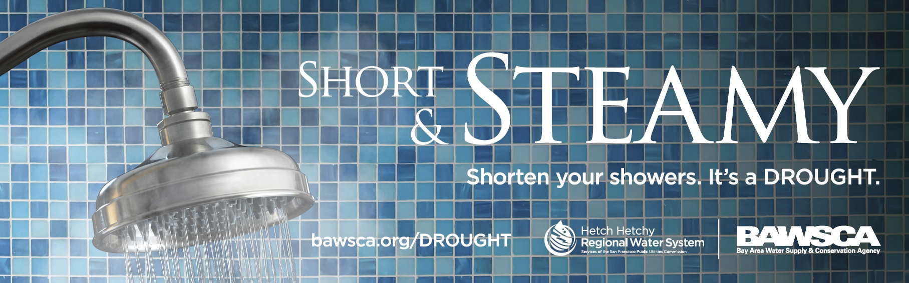

Slide 12
SB 555 Validated Water Loss Reporting
State determined that Governor’s mandate on water loss can be acted on through implementation of SB 555 (Oct 2015)
SB 555 requires water suppliers to submit annual validated water audit beginning October 2017
State guidelines anticipated in January 2017
State Water Board to offer financial assistance for leak detection/repair to systems in emergency shortages
I-Bank CLEEN state revolving loan fund available to public and non-profit water suppliers
CEC is piloting leak detection technologies
  Acoustic monitoring
  Satellite imagery
  Pressure reduction

Slide 13
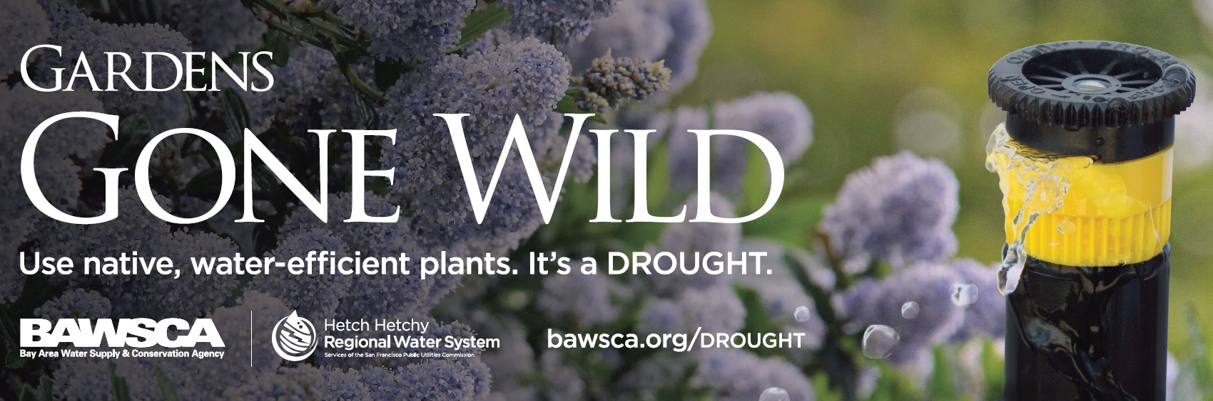

Slide 14
SB 814 (Reducing Excessive Use) Signed Into Law
Bill is intended to prevent unreasonable use of water of water during:
  Any period where urban water supplier has implemented mandatory water use reductions
  A period when local supplier is affected by Governor declared emergency due to local drought conditions
Bill prohibits excessive water use and requires water suppliers to either:
  Establish a rate structure that includes water budgets or rate surcharges for excessive water use, or
  Establish an excessive use ordinance
Notes:
SB 814 will require both public and private urban retail water suppliers – agencies that directly provide potable municipal water to more than 3,000 users – to levy fines against residential excessive water users
If a water supplier elects to adopt an excessive water ordinance, the water supplier sets a definition of excessive use and the ordinance must include a fine of up to $500 for each ccf above the excessive use definition. Suppliers may issue warnings before assessing a fine.

Slide 15
Bill Requires Specific Actions to Curb Excessive Water Use
Bill sets specific requirements for excessive use fines
  Excess use must be measured by use (gallons or ccf) within a billing cycle
  Suppliers may issue fines up to $500 per ccf for use above the threshold
  Fine must be added to monthly water bills
  Agencies must establish an appeals process
“Excessive Use” defined by each water supplier

Slide 16
Regional “Excessive Use” Definition in Development
BAWSCA agency managers requested that Water Resources Committee discuss common definition
Water Resources Committee discussion found:
  Significant variation among residential use for each BAWSCA agency
  Common definition may be based on percentage of individual agencies’ average use
BAWSCA agencies to discuss data analysis and path forward in December meeting
Law takes effect in January

Slide 17


Slide 18
BAWSCA Taking Action to Respond to Recent State Proposal
On Sept. 15th, State Water Resources Control Board released “SED”
BAWSCA working closely with SFPUC to evaluate the impacts of the proposal on water supply and economy
BAWSCA will submit detailed legal and technical comments on the SED
Engage allies to gather support for BAWSCA position
Notes:
Recirculated Draft Substitute Environmental Document in Support of Potential Changes to the Water Quality Control Plan for the San Francisco Bay-Sacramento/San Joaquin Delta Estuary: San Joaquin River Flows and Southern Delta Water Quality (SED)

Slide 19
State Updating the Bay-Delta Plan
State Water Board establishes water quality objectives to protect beneficial uses of water in the Bay-Delta through its Water Quality Control Plan for the San Francisco Bay/Sacramento-San Joaquin Delta Estuary (Bay-Delta Plan)
State Water Board has been proposing to update two elements of the 2006 Bay-Delta Plan:
  San Joaquin River flow objectives to protect fish and wildlife
  Southern Delta salinity objectives

Slide 20
Bay-Delta Plan Update Originally Released in 2012 SED
State released its original CEQA document, the Substitute Environmental Document (SED), for the Bay-Delta Plan update in 2012
BAWSCA and SFPUC provided comments that the 2012 SED was inadequate:
  State did not analyze the full effects that water shortages will have in the San Francisco Bay Area
  BAWSCA and SFPUC comments included analysis of the socioeconomic impacts of the water shortages
Based on all comments received, the SED was recirculated on September 15, 2016

Slide 21
What are the Next Steps for the State in Pursuing the Plan?
Deadline for comments extended to January 17, 2017
Public hearing dates moved to 11/29, 12/16, 19,20 & 1/3 (Sacramento, Stockton, Merced, and Modesto)
  BAWSCA and SFPUC plan to comment verbally on 1/3
SWRCB planning to consider approving the proposed Bay-Delta Plan amendments in July 2017
Implementation of Plan on the Tuolumne River would be through:
  Federal Energy Regulatory Commission relicensing of the Don Pedro Project, or
  Water rights proceedings and action

Slide 22
What Are BAWSCA’s Next Steps to Respond to State’s Proposal?
Currently analyzing the water supply and socioeconomic impacts of the flow proposal
  “…businesses are going to produce less, they’re going to sell less, jobs will be lost, purchasing power will decline and residents will have less disposable income.”
Preparing comments on the adequacy of the CEQA document in conjunction with SFPUC. BAWSCA is requesting that:
  The environmental and economic impacts of any shortage on the System, and the associated lost jobs and delayed development, be fully and adequately analyzed; and
  That these impacts given at least equal weight with the other elements of the State’s subsequent deliberations and decision making
  Adequate time for a voluntary agreement to be reached amongst the stakeholders. State has shown support for these agreements.
Working with member agencies and allies to secure comment letters & support for BAWSCA’s position

Slide 23
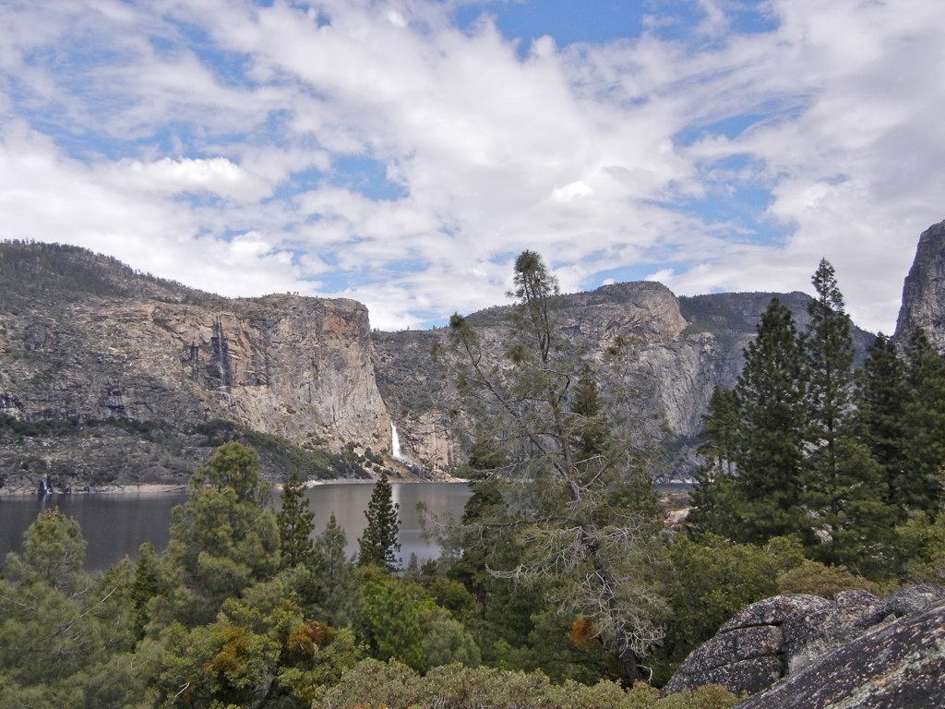
Jensen, 2011

