Slide 1
Bay Area Confluence & Onsite Wastewater Reuse Events
David Jaeckel | office of sustainability

Slide 2
Overview
Bay Area Confluence Event – 11/10/16
WERF/CWEA Onsite Wastewater Reuse Workshops – 11/2/2016

Slide 3
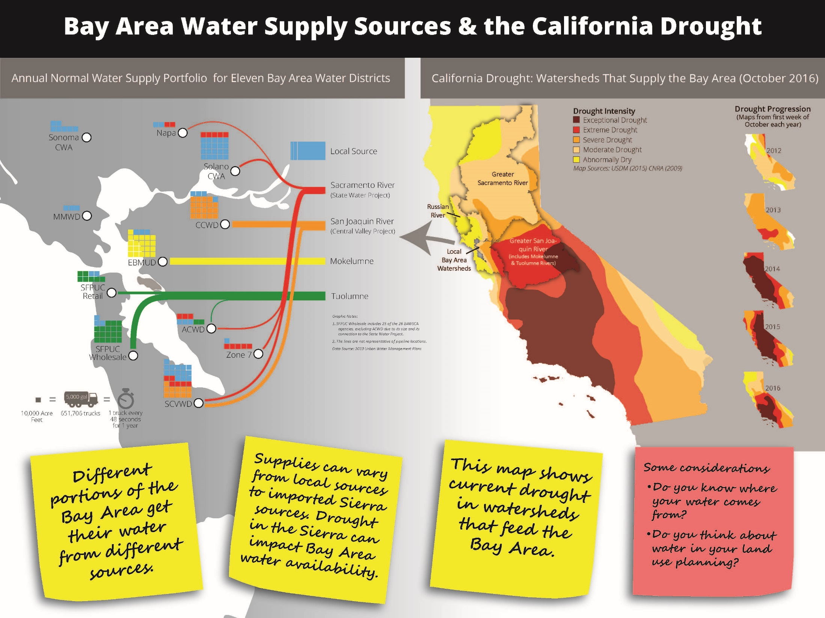
Need to diversify water portfolio

Slide 4
Bay Area Confluence Event
David Sedlak – Four New Local Water Taps
Stormwater Harvesting
City of LA – ‘stormwater park’ where water is routed to wetland and then gravel quarry where it percolates to aquifer. Naturally treated through wetland /percolation but still connected to treatment system for redundancy. This is very common in Australia as well (MAR). Solves problem of supply (winter) and demand (summer) in CA, whereas rainwater harvesting does not.
Wastewater Reuse
Water recycling for irrigation is expensive due to building new purple pipe infrastructure.
More cost effective – Direct Potable Reuse (using Reverse Osmosis and Advanced Oxidation).
Engineered treatment wetland on Santa Ana River – wetland located adjacent to river (consisting of treated effluent) treats water, goes back to river, and then gets percolated back into groundwater.

Slide 5
Bay Area Confluence Event
David Sedlak – Four New Local Water Taps
Water Conservation
Needs to happen outdoors – CA friendly landscaping.
Seawater Desalination
Energy intensive, but outdated thinking.
Shouldn’t be implemented everywhere, but time and place.

Slide 6
Bay Area Confluence Event
Creative Approaches to Future Water Challenges in Bay Area
Develop water supply scenarios for mid-century and beyond that take into account changes to the amount and timing of precipitation.
Evaluate the vulnerability of water supply and delivery systems to earthquakes.
Prioritize water efficiency and conservation best management practices.
Require new development to be highly water efficient.
After demand management measures are implemented, prioritize:
Conjunctive use, monitored groundwater projects, and indirect/direct potable reuse projects.
Recycled water, on-site water reuse systems, and banking and transfers.
Desalination and surface supplies.
Employ water rationing as temporary measure only.

Slide 7
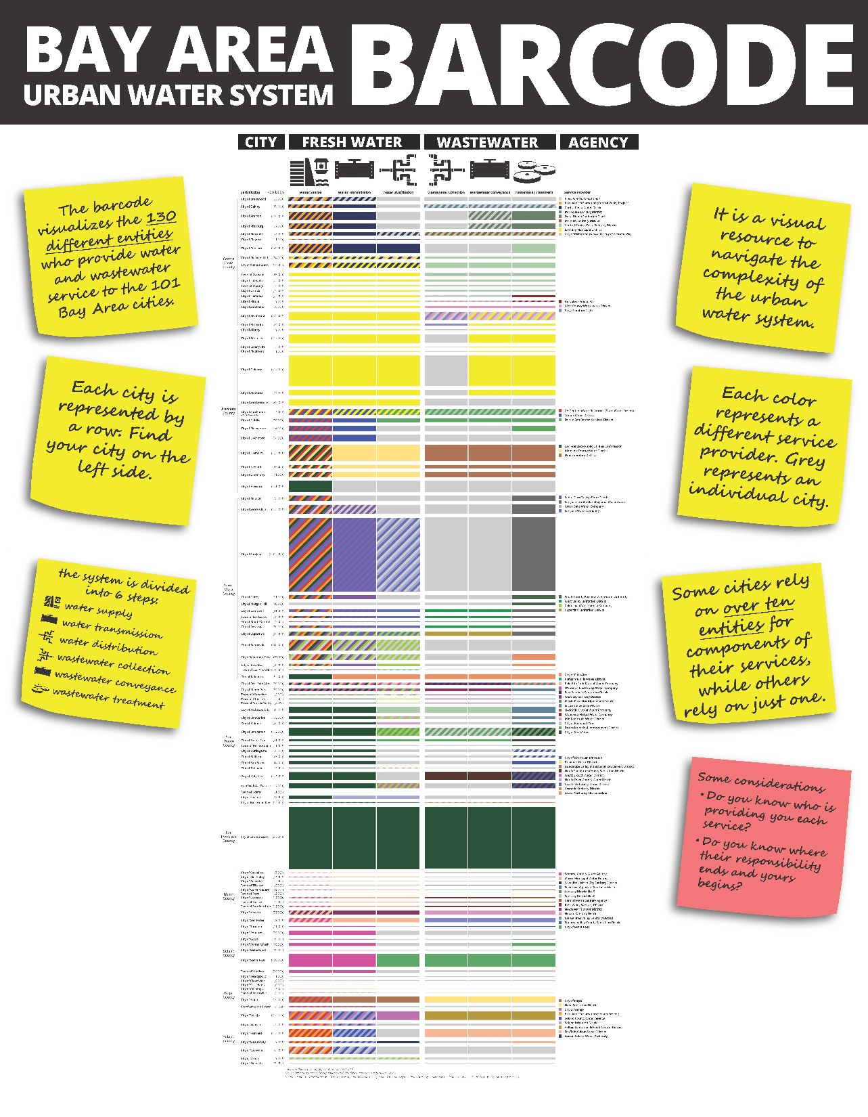
Shows all of the different agencies managing freshwater (water source, water transmission, water distribution) and wastewater (wastewater collection, wastewater conveyance, and wastewater treatment)

Slide 8
San Mateo County freshwater and wastewater agencies

Slide 9
Bay Area Confluence Event
Earthquake Risk | Goals
Water service should be 100 percent restored for critical earthquake response functions, such as firefighting, within four hours of an event.
90 percent of a system’s customers have water service restored within three days, and 95 percent of customers have water service restored within 30 days.
Water utilities should use these metrics, or adopt similar ones, to evaluate system vulnerabilities and to plan reinvestments in their critical lifeline infrastructure, if they haven’t already. Because two-thirds of the region’s water supply is imported from outside the region and major aqueducts to the region cross several earthquake faults, resilient pipelines and reliable water service are critical to the health and welfare of our growing population.

Slide 11
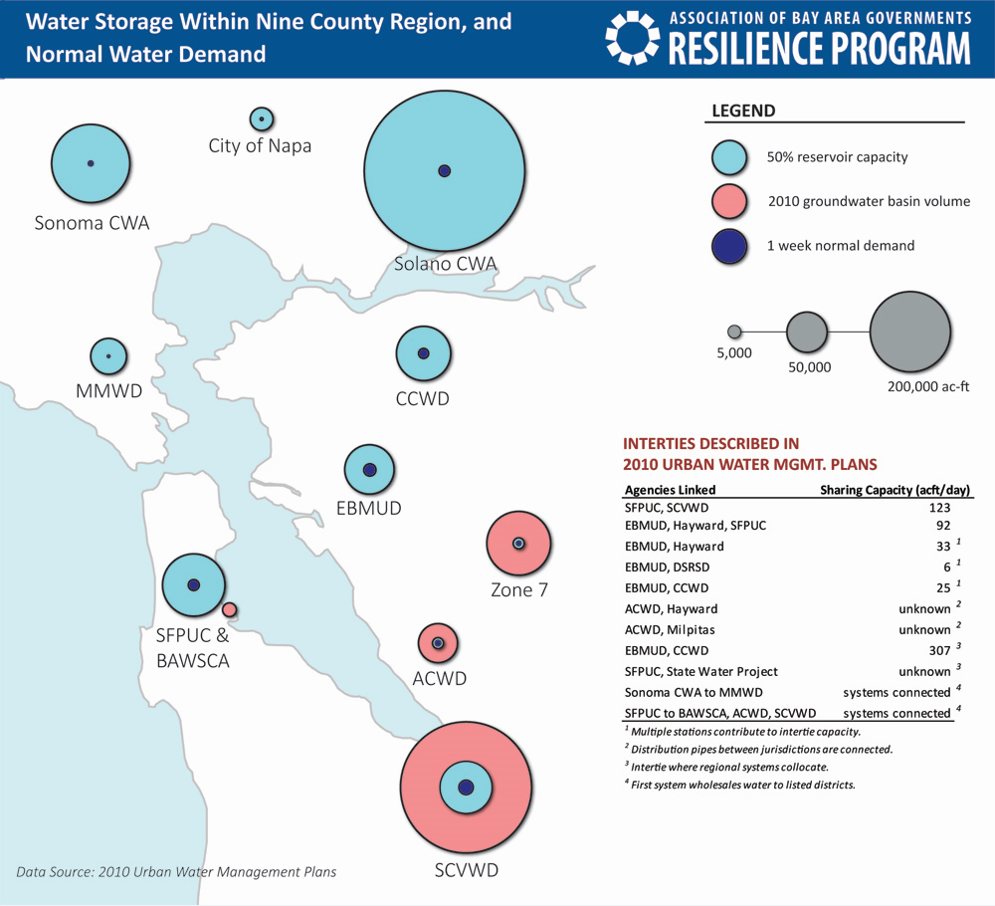

Slide 12
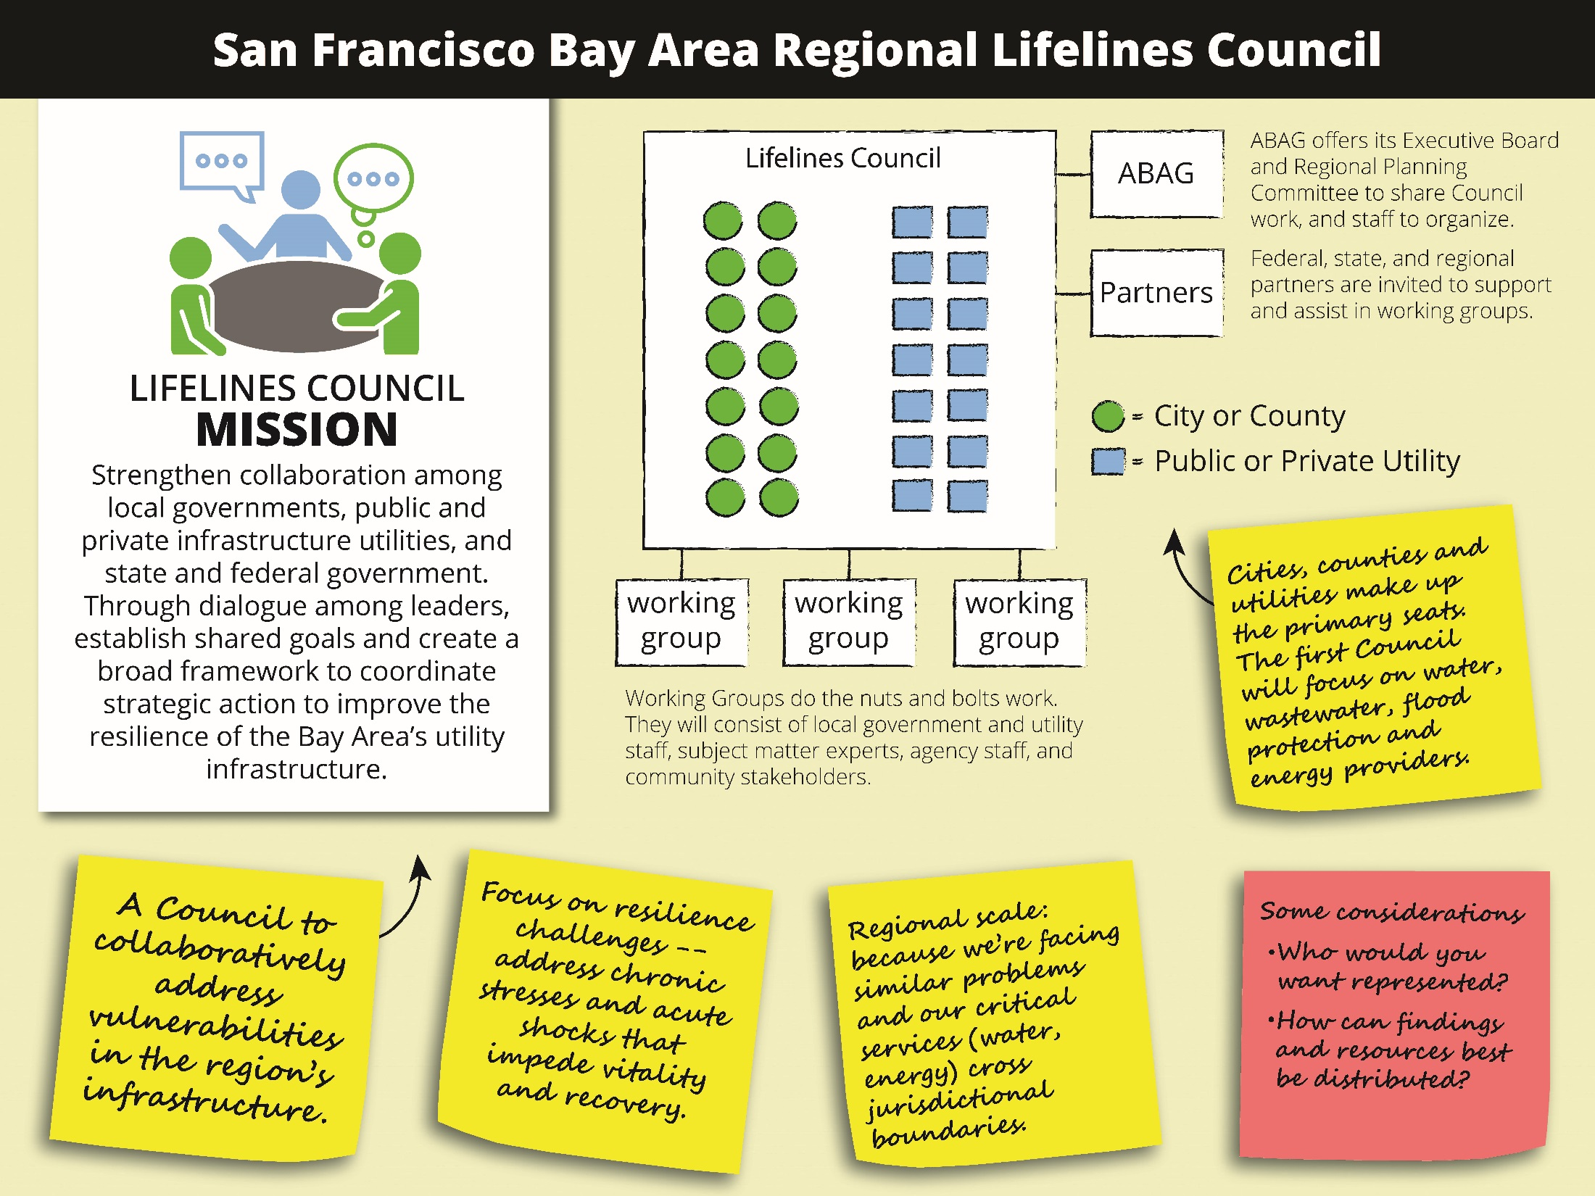

Slide 13
WERF/CWEA ONSITE WASTEWATER REUSE WORKSHOP
Background
How to integrate smaller, decentralized, onsite water systems into our broader centralized systems?
Many buildings in NYC, SF, Santa Monica, Seattle, Tokyo and Sydney are collecting and treating wastewater onsite to serve their own non-potable needs.
+ augments existing supply + treats water only for end use application + minimizes stormwater flows to storm drains + increases resiliency of infrastructure
Workshop goals: implementing local programs that can build on existing plumbing, public health, and building codes while addressing water, stormwater, and wastewater management programs in a coordinated and streamlined manner.

Slide 14
WERF/CWEA ONSITE WASTEWATER REUSE WORKSHOP
10 Steps to Developing a Program for Wastewater Reuse
Convene a working group
Engage a small group of public health, planning, and bldg. officials along with water and wastewater utilities have jurisdictional authority in your area.
Select the types of alternate water sources
Rainwater, stormwater, graywater, foundation drainage, irrigation well and blackwater (currently banned by County). Possible to select one source and phase others in over time.
Identify end uses
Toilets, spray irrigation, cooling/ process water, subsurface irrigation, clothes washers, and irrigation of food/ crops
Develop water quality standards
Plumbing codes (UPC), EPA, state municipal recycled water regulations, NSF/ANSI, etc.

Slide 15
WERF/CWEA ONSITE WASTEWATER REUSE WORKSHOP
10 Steps to Developing a Program for Wastewater Reuse
Identify and supplement local building practices
Consider including: system bypass, backflow prevention devices, cross connection controls, storage tanks, non-potable system identification.
Develop monitoring and reporting requirements
Standards do not typically exist for ongoing operation and maintenance.
Prepare an operating permit process
Consider including: start-up permit, temporary use permit, and final permit.
Develop guidelines and implement the program
Consider including for design phase: application, engineering report, and construction permits.
Consider including for construction phase: treatment system review, construction certification, and cross connection control test.

Slide 16
WERF/CWEA ONSITE WASTEWATER REUSE WORKSHOP
10 Steps to Developing a Program for Wastewater Reuse
Monitor and evaluate the program
Monitor regulatory compliance of projects and collect data on the types and end uses of alternate water sources.
Grow the program
Increase from a single building to a district or neighborhood scale.
Provide financial incentives.

Slide 17
Questions??

