Slide 1
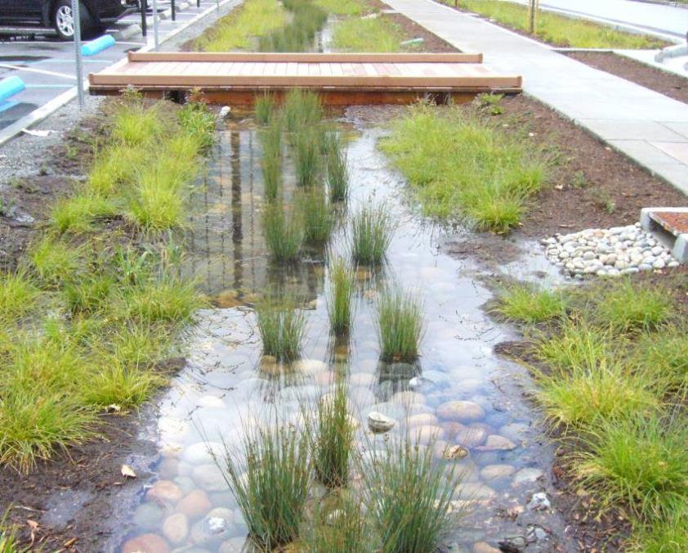
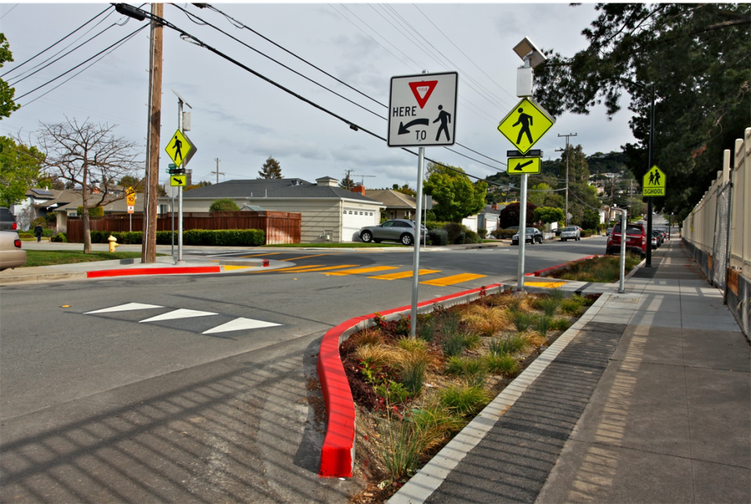


Safe Routes to School & Green Streets Infrastructure Pilot Program
Matthew Fabry, P.E.
Stormwater Program Manager
San Mateo Countywide Water
Pollution Prevention Program
Bicycle and Pedestrian Advisory Committee
June 22, 2017

Slide 2
Safe Routes to School Program
The Safe Routes to School Program, a joint partnership between C/CAG and the San Mateo County Office of Education, encourages and enables school children to walk and bicycle to school by implementing projects and activities that improve the health, well-being, and safety of children, and which result in less traffic congestion and emissions caused by school-related travel.

Slide 3
San Mateo Countywide Water Pollution Prevention Program
A program of C/CAG, the San Mateo Countywide Water Pollution Prevention Program (SMCWPPP) was established to reduce the water pollution carried by stormwater into local creeks, the San Francisco Bay, and the Pacific Ocean. Water pollution degrades surface waters making them unsafe for drinking, fishing, swimming, and other activities.

Slide 4

The 6 E’s of SRTS
Education
Encouragement
Engineering
Enforcement
Evaluation
Equity

Slide 5
The 6 E’s of SRTS
Education
Encouragement
Engineering
Enforcement
Evaluation
Equity

Slide 6
Green Infrastructure
Using natural systems to capture, treat, and infiltrate stormwater
Restores “natural” stormwater management
Distributed, small-scale systems
Multi-benefit, including for key water issues
Adaptation for climate change impacts
Flooding
Groundwater recharge
Includes public and private projects

Slide 7
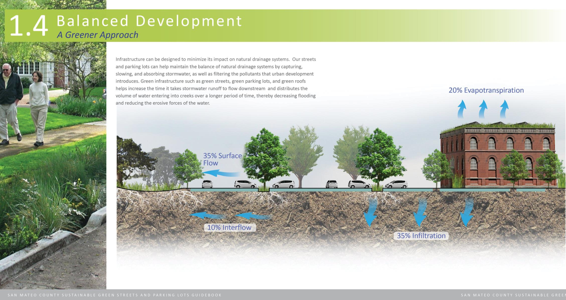

Slide 8
Green Infrastructure Planning
Each agency must adopt GI Plan by 2019
Describe gradual shift from gray to green
Achieve specific pollutant load reduction via green infrastructure countywide by 2040

Slide 9
SRTS & Green Streets Infrastructure Call for Projects
The primary goal of this pilot program is to demonstrate that green infrastructure can be cost-effectively integrated with traditional Safe Routes to School infrastructure projects to enhance safety and achieve stormwater pollutant reductions.
Notes:
Cost-effective integration – in theory, any pedestrian improvement project in the ROW is an opportunity to also implement stormwater management in support of achieving GI goals for addressing PCBs/Hg in the MRP.

Slide 10
Project Funding
Up to $2 million available for local assistance
Equal funding from local vehicle registration fees (Measure M – SRTS and AB1546 – Countywide Stormwater Pollution Reduction)
15% local cash match required for eligible capital costs
$100,000 - $250,000 per project (2 project limit per jurisdiction = $500,000 total)

Slide 11
Eligible Applicants
Local governments (cities, towns and the County) in San Mateo County

Slide 12
Eligible Projects
Infrastructure only (e.g., educational programs are not eligible)
Only eligible capital costs are reimbursable
In a Walk Audit or Pedestrian/Bike Plan – or located within a ½ mile radius of a school with adequate justification
Balanced integration of SRTS and green infrastructure

Slide 13
Eligible Project Components
Vegetated curb extensions
Pedestrian bulb-outs (in combination with stormwater features)
Pedestrian striping/crosswalks
Curb ramps
Signage
At intersections or mid-block crossings

Slide 14
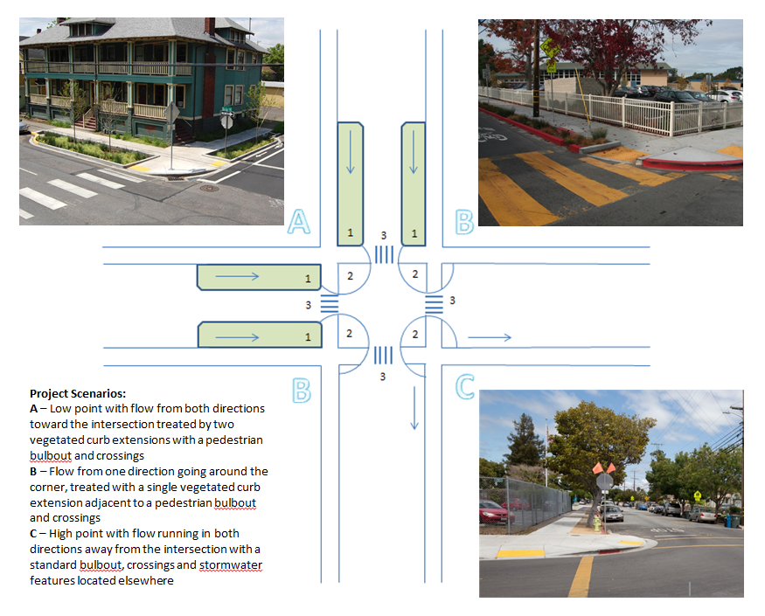

Slide 15
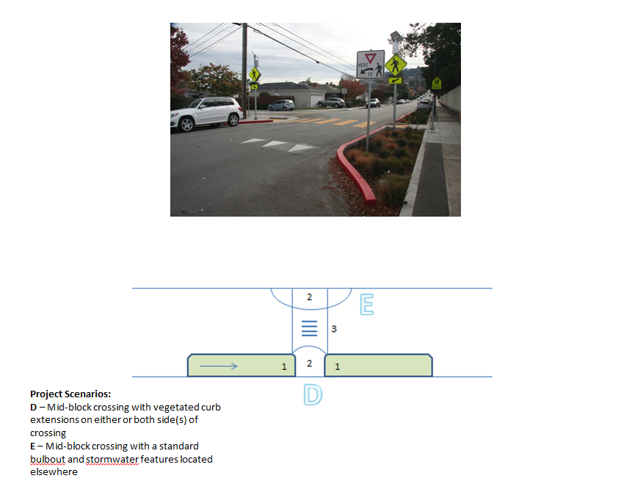

Slide 16
Ineligible Components
In order to balance funding for stormwater and SR2S infrastructure, the pilot program will not fund:
Pedestrian streetlights
Rectangular rapid flash beacons
Illuminated crosswalks
Raised crosswalks

Slide 17
Ineligible Components (cont.)
Landscaping elements not designed to capture and manage stormwater, unless proposed as part of a pedestrian bulbout that is not suitable for stormwater management due to site constraints
Porous pavement/asphalt/concrete or pavers in-lieu of vegetated curb extensions or bulbouts

Slide 18
Feedback from the CMP TAC and Stormwater Committee (June 15, 2017)
List of eligible project elements should offer more flexibility
An option for the cities to break out SRTS and stormwater costs in their project proposals
While a 50/50 split between the two programs is the goal, consider allowing a range between a 50/50 split and a 60/40 split.

Slide 19
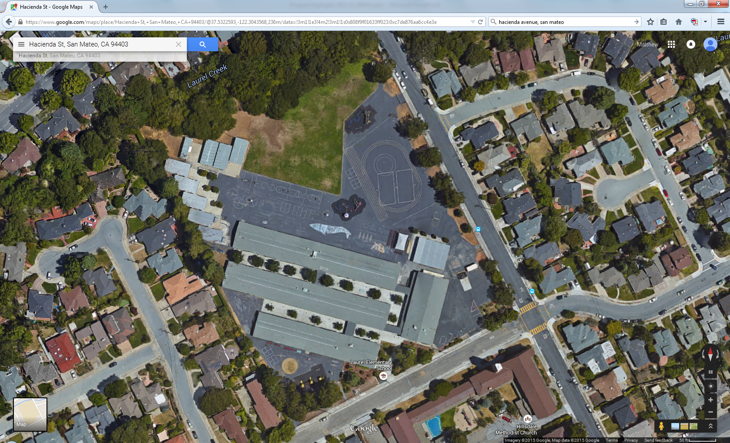
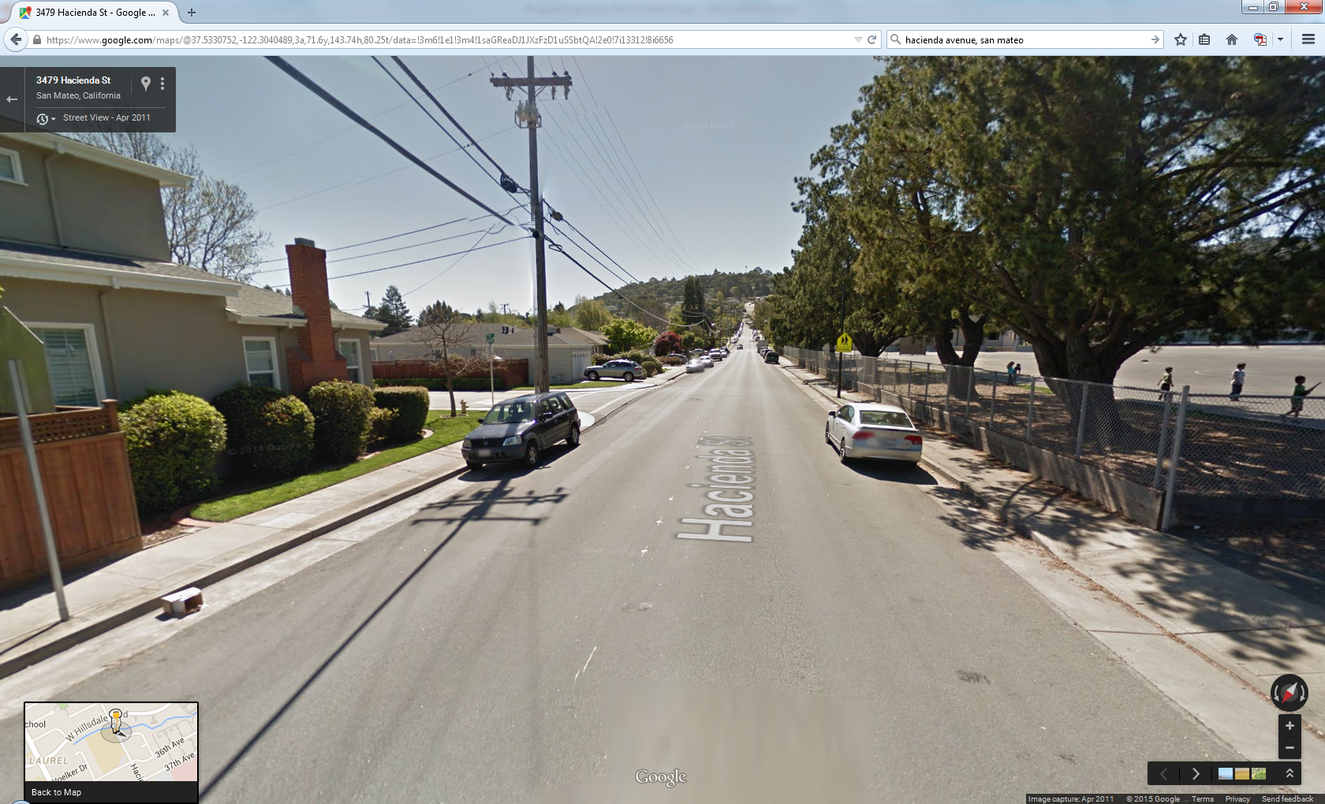
Laurel Elementary
City of San Mateo

Slide 20
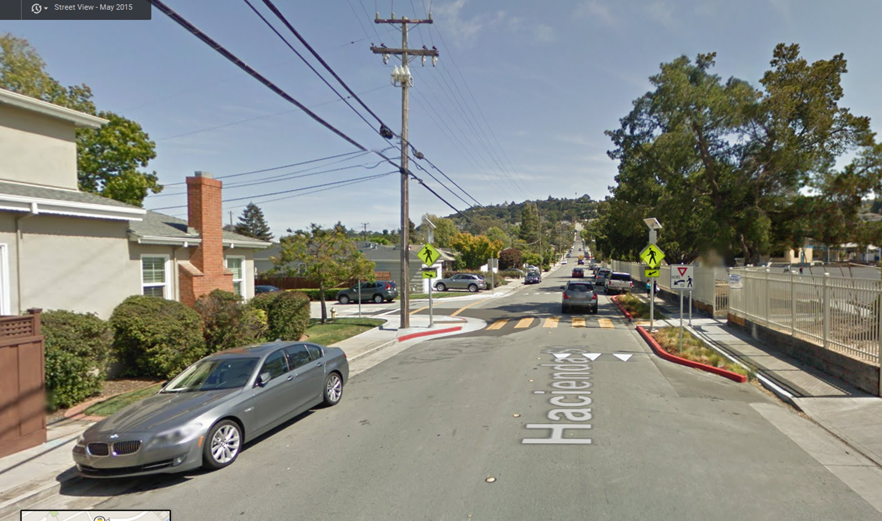
Laurel Elementary
City of San Mateo

Slide 21
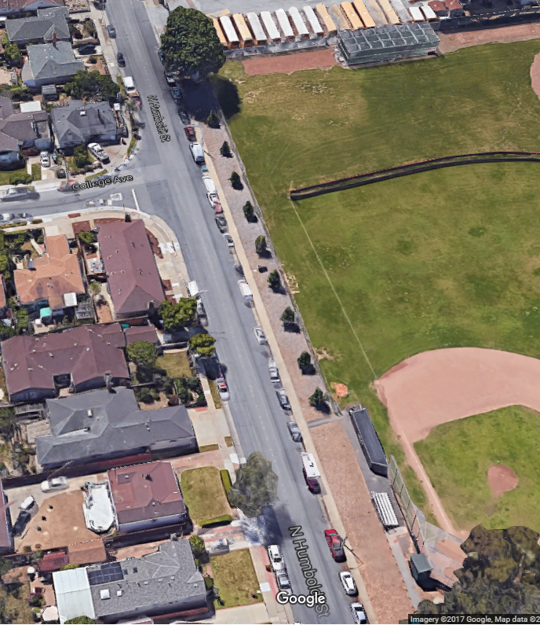
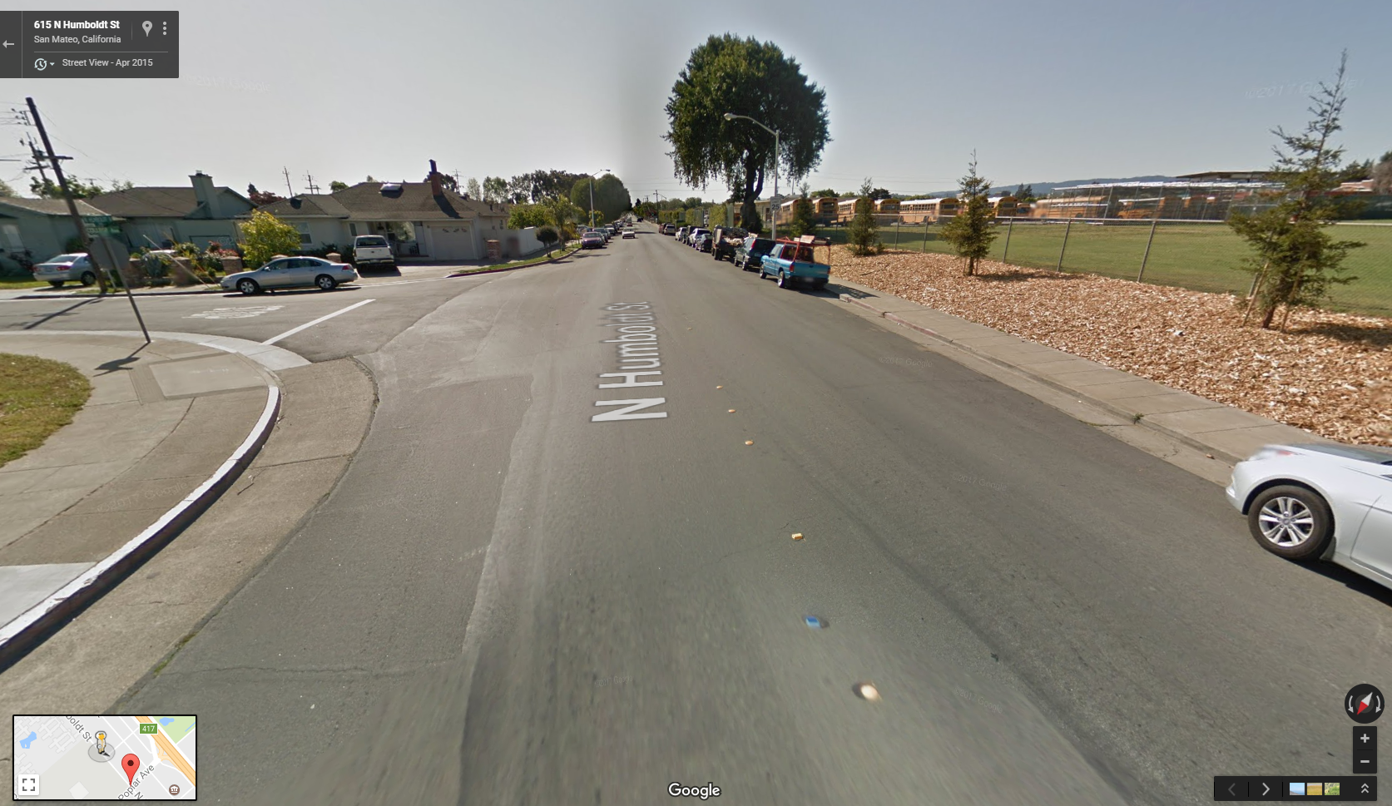
Humboldt St.
Curb Extensions and Bulb-outs
City of San Mateo

Slide 22
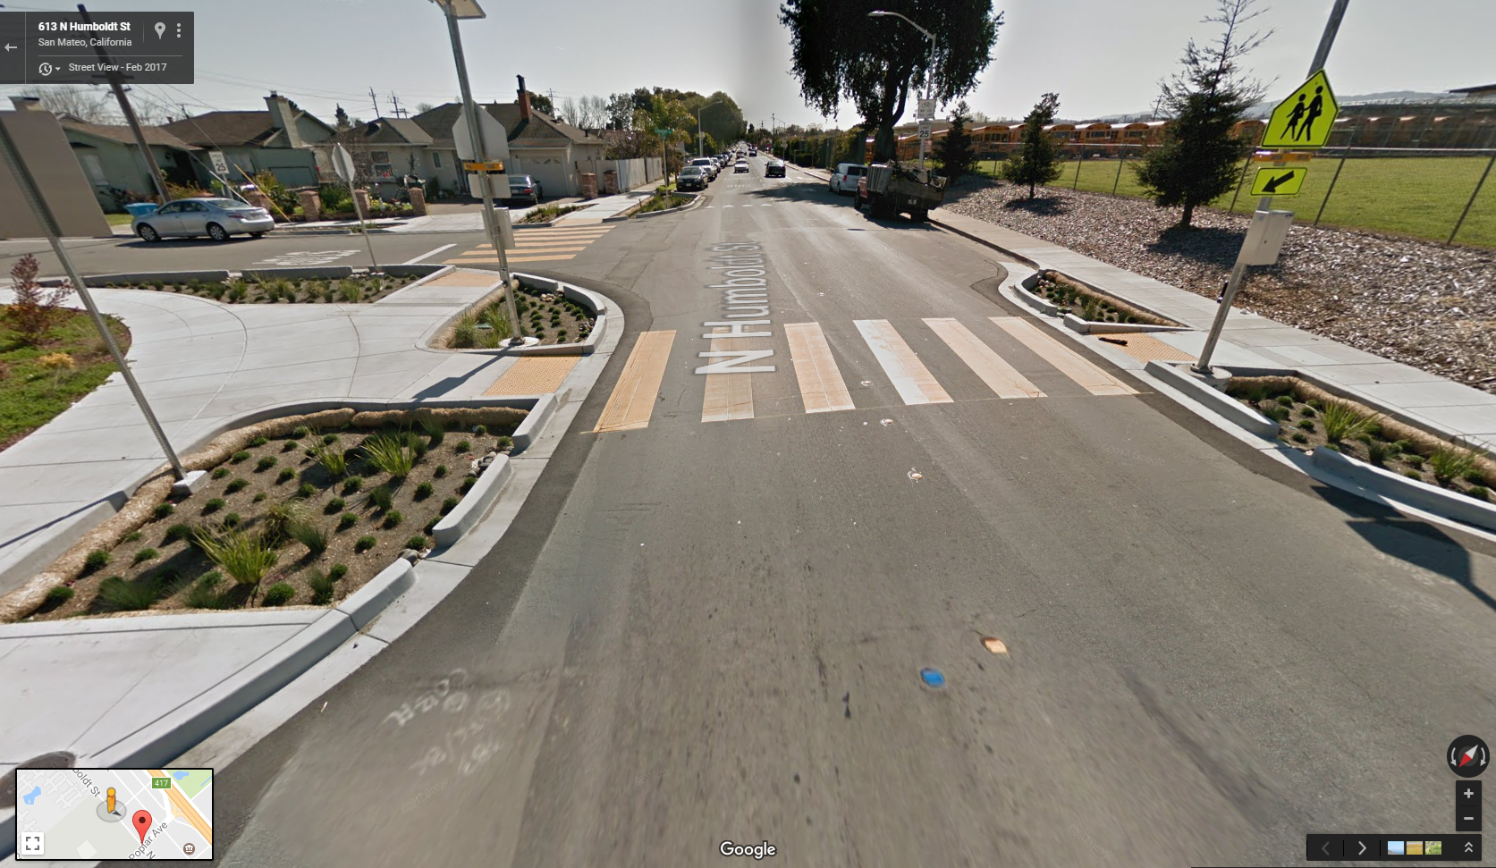
Humboldt St.
Curb Extensions and Bulb-outs
City of San Mateo

Slide 23
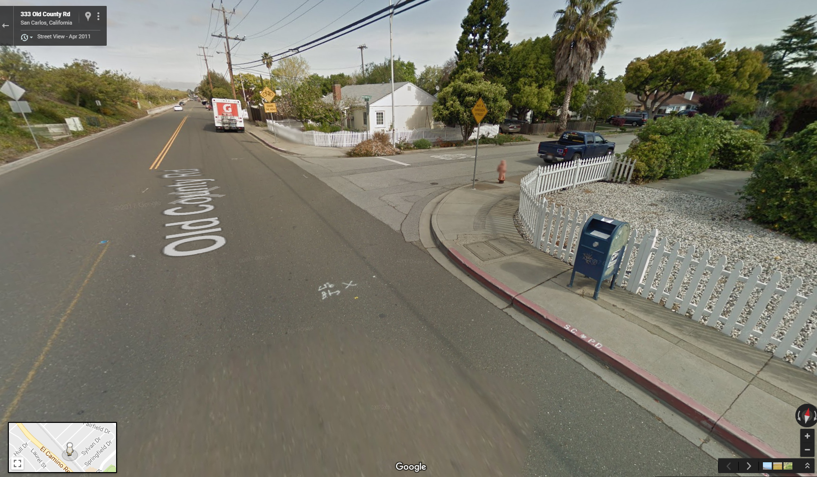
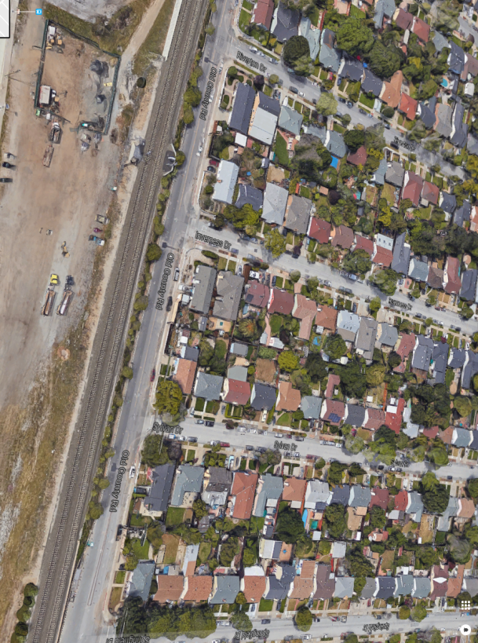
Old County Rd.
Curb Extensions
City of San Carlos

Slide 24
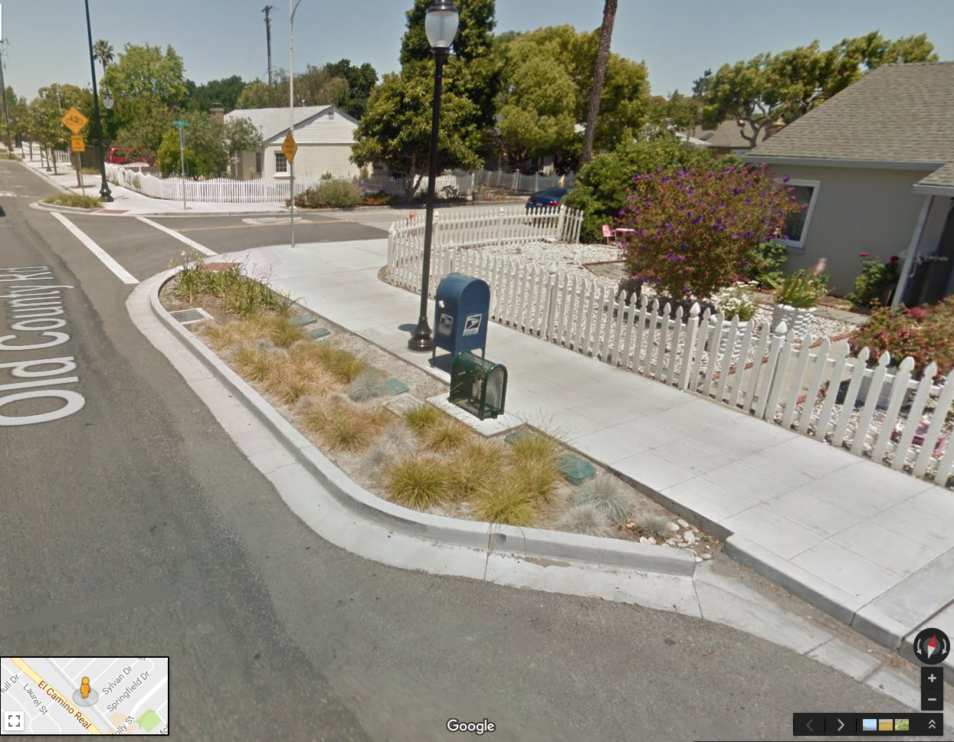
Old County Rd.
Curb Extensions
City of San Carlos

Slide 25
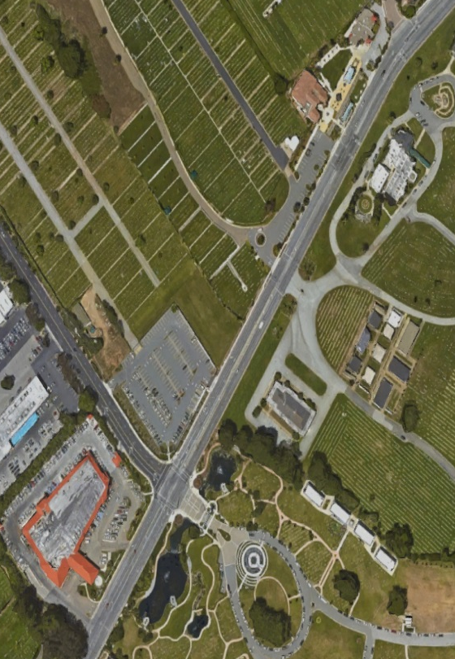
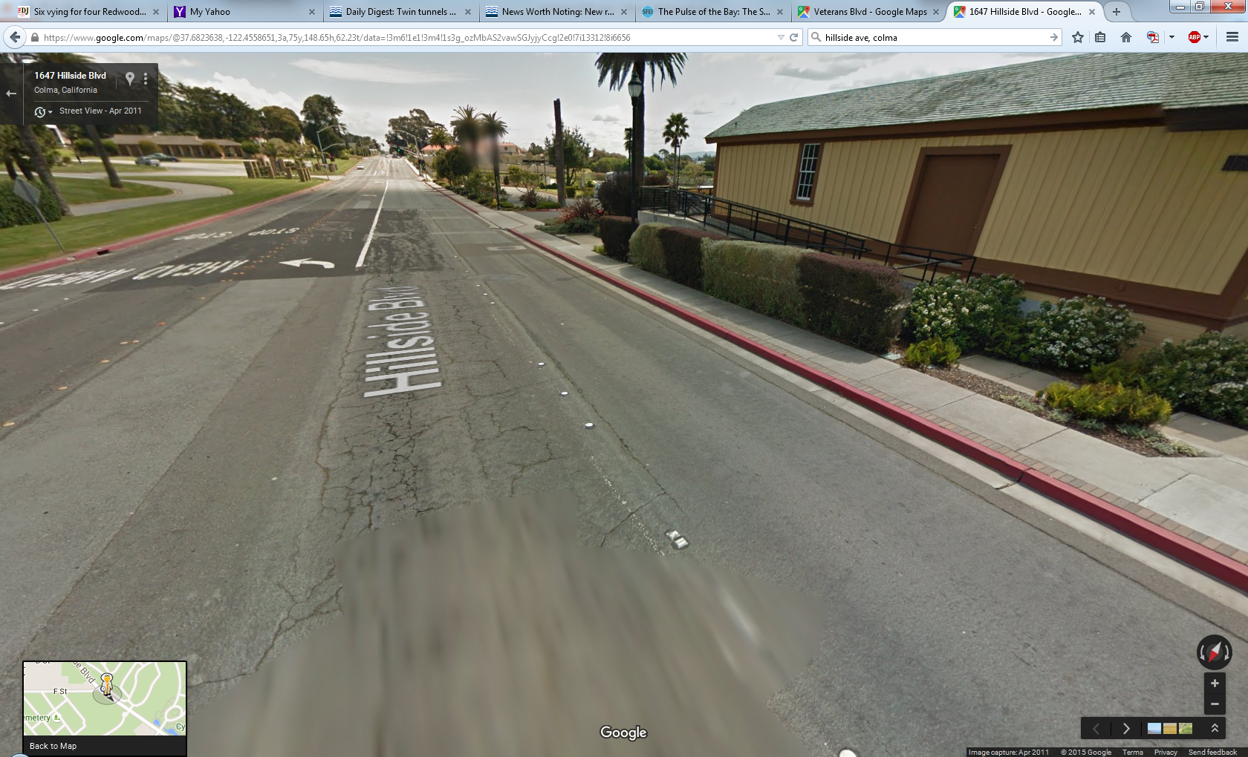
Hillside Blvd
Curb Extensions
Town of Colma

Slide 26
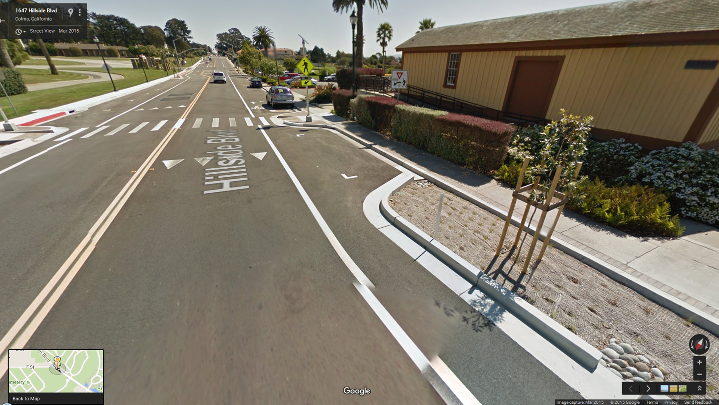
Hillside Blvd
Curb Extensions
Town of Colma

Slide 27
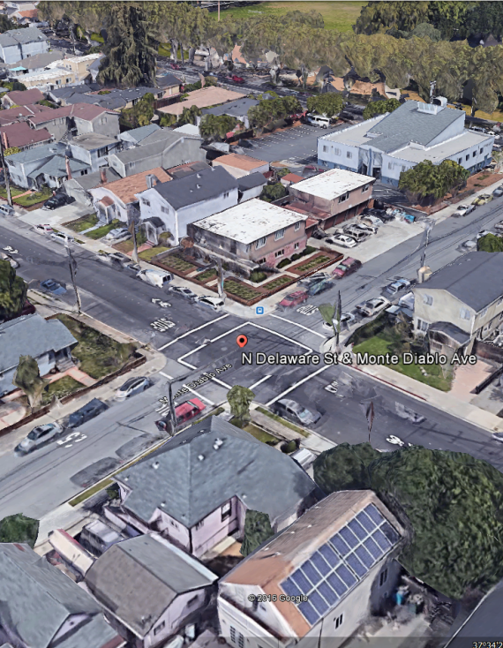
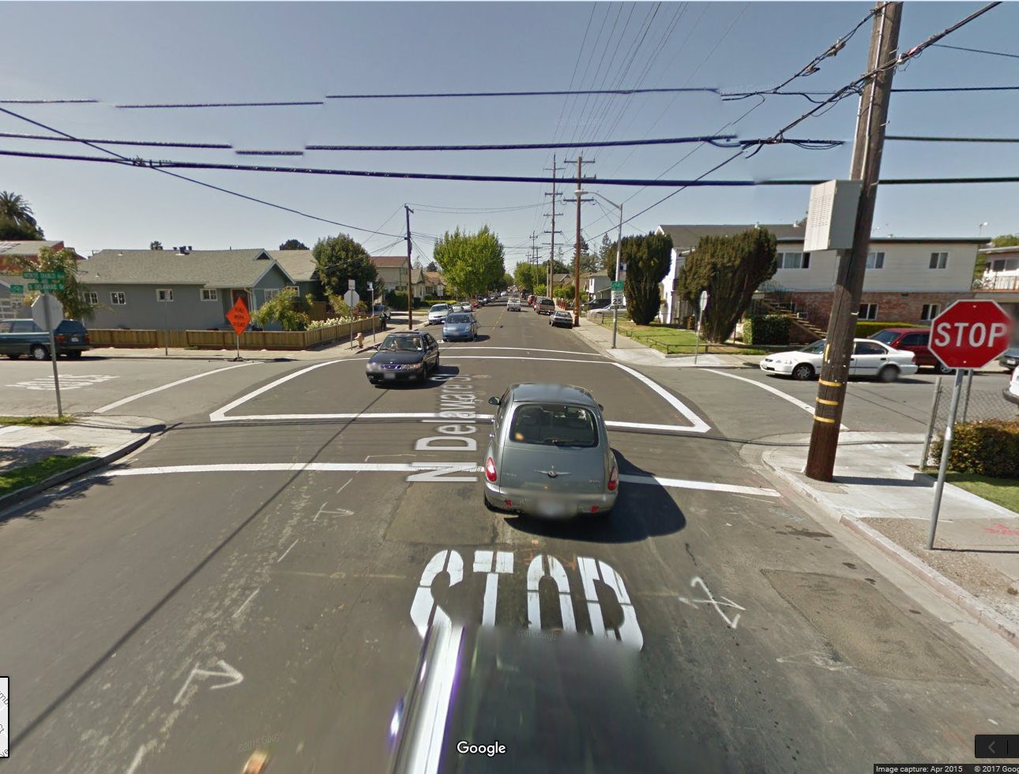
Delaware St
Curb Extensions
City of San Mateo

Slide 28
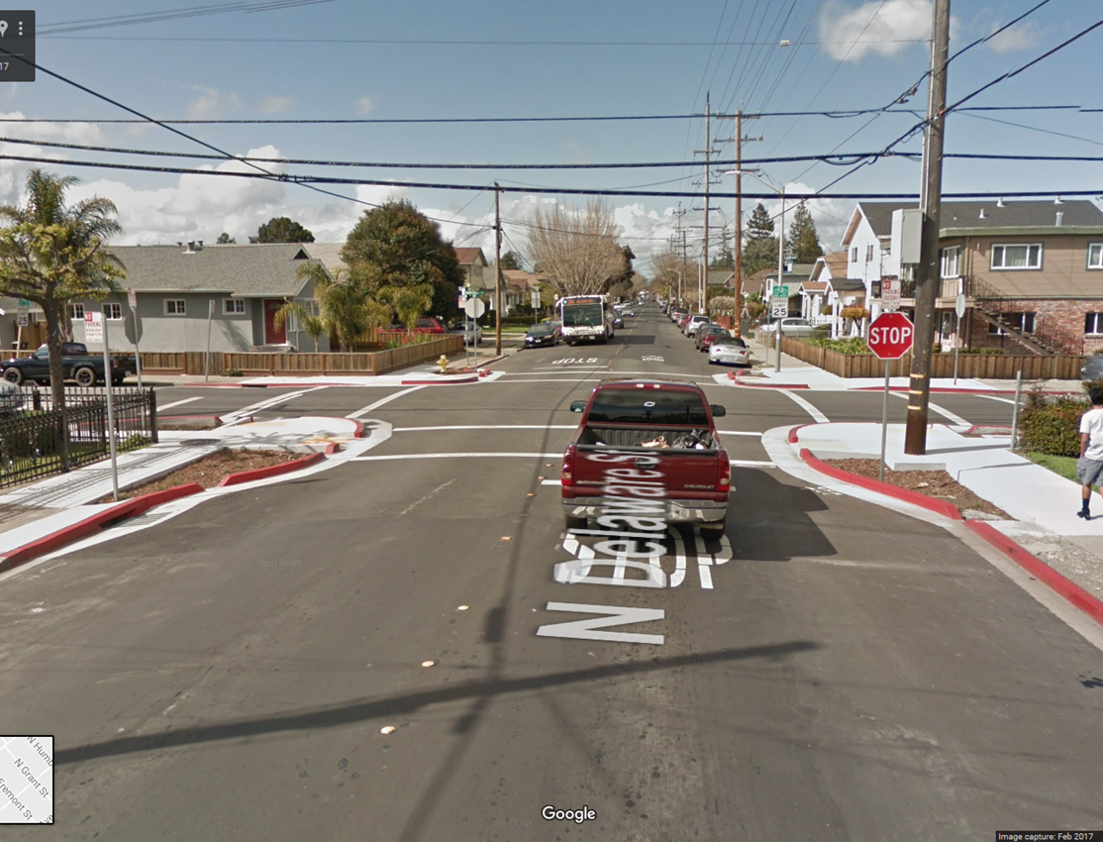
Delaware St
Curb Extensions
City of San Mateo
Design for C.3 Sizing for Stormwater Treatment

Slide 29
Application Requirements
Letter of support from School District
Map of project area and land use information
Project schematic or conceptual design, with stormwater feature sizing calculations and drainage delineation
Long-term operations and maintenance plan with funding identified
Preliminary budget and schedule

Slide 30
Additional Scoring Criteria
Additional community letters of support
Integration of educational signage
Benefitting schools that participate in SRTS or are practicing SRTS initiatives (e.g., established in existing plans or participating in community outreach efforts)
Address localized drainage or flooding issues
Readiness to proceed
Identified in other local or countywide plans (bike/ped master plans, complete/sustainable streets plans, community-based transportation plans, etc.)

Slide 31
Schedule (tentative)
C/CAG Board considers call – July 13
Release call for projects – Mid-July
Applications Due – Mid-September
C/CAG Committees review selection panel recommendations – October
C/CAG Board considers recommended projects – November 9
Projects completed – October 2019

Slide 32

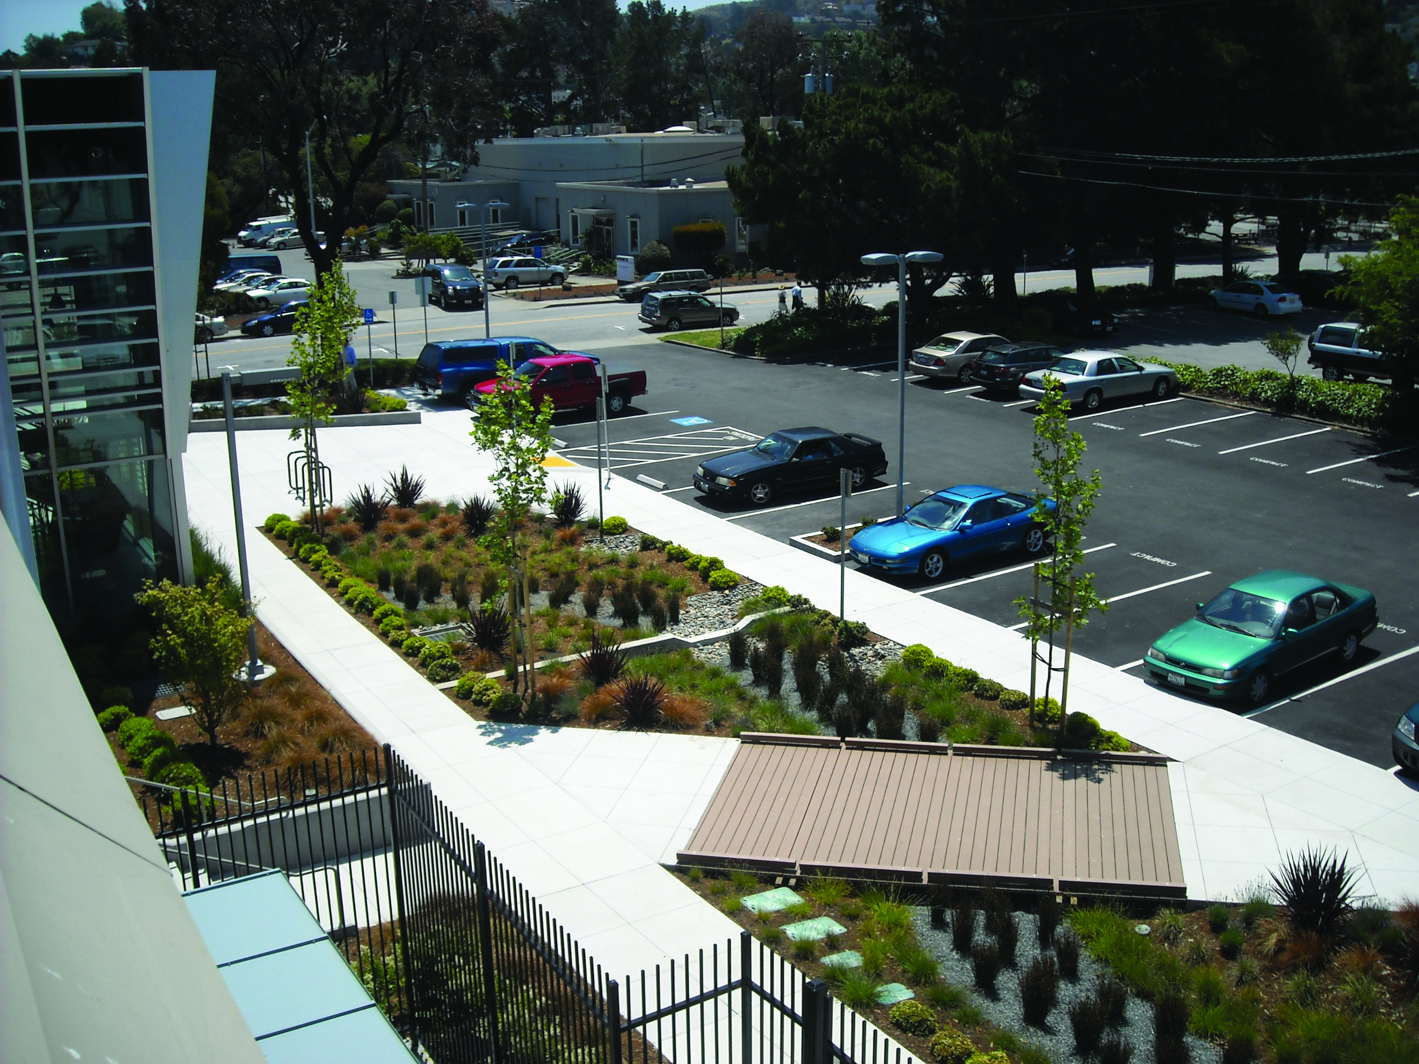
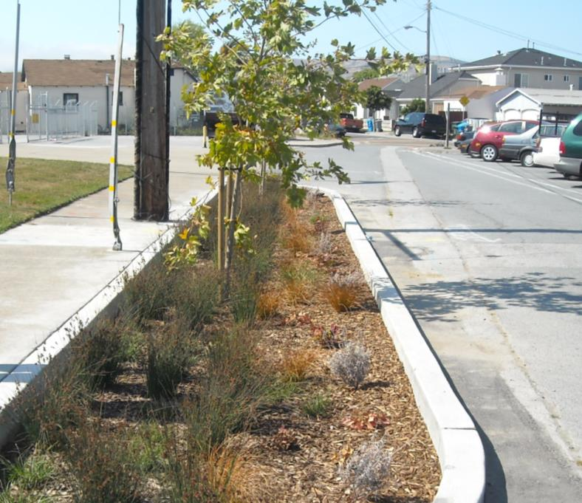


C/CAG Staff:
Matthew Fabry, Program Manager
(650) 599-1419 mfabry@smcgov.org
Reid Bogert, Stormwater Program Specialist
(650) 599-1433 rbogert@smcgov.org
Eliza Yu, Transportation Programs Specialist
(650) 599-1453 eyu@smcgov.org

