Slide 1



San Mateo Plain
Groundwater Basin Assessment
CCAG Water Coordinating Committee
Charles Ice | January 17, 2018

Slide 2
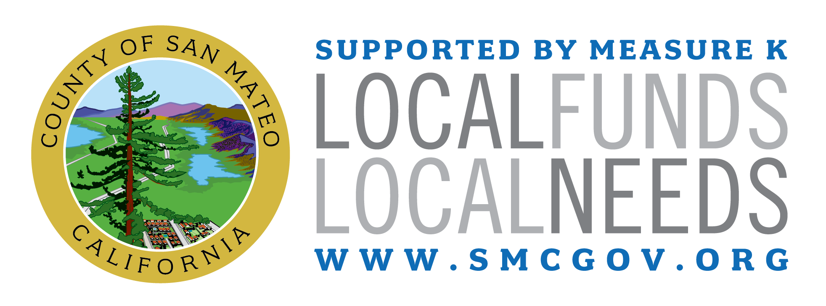
San Mateo Plain Groundwater Assessment
Issues with Groundwater From County’s Perspective
  Below average rainfall causing severe drought
  Historical impacts from groundwater extraction
  Increasing use of groundwater
  Sustainable Groundwater Management Act
Funded through Measure K and Office of Sustainability

Slide 3
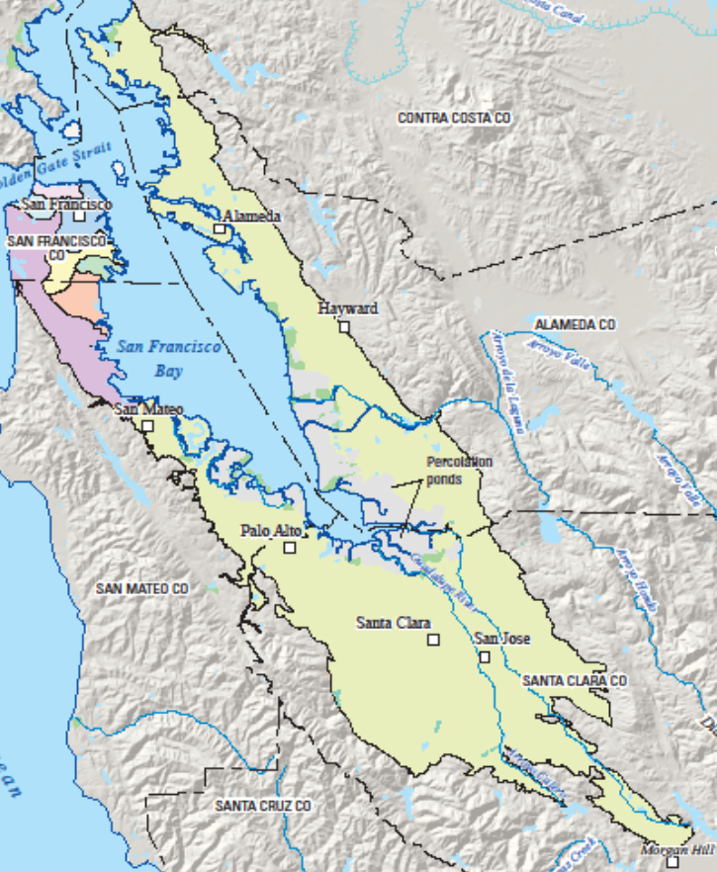
San Mateo Plain Groundwater Assessment
Management of Neighboring Basins
  Santa Clara Valley Water District
  Alameda County Water District
  East Bay Municipal Utility District and Hayward
  Westside Basin Partners and SFPUC

Slide 4

The Project is being executed in three phases
Phase 1
Phase 2
Phase 3
  Stakeholder Coordination and Public Outreach
  Data Compilation, Unification, and Sharing
  Develop Initial Basin Conceptual Model
  Develop Basin Groundwater Numerical Model
  Evaluate Potential Basin Management Strategies
  Prepare Phase I Report
  Public Outreach
  Fill Selected Data Gaps
  Update Database
  Update and Refine Conceptual and Numerical Models
  Public Outreach
  Conduct Scenario Evaluations
  Prepare Final Report
Jul 2016 – Dec 2017
Sep 2017 – Apr 2018

Slide 5
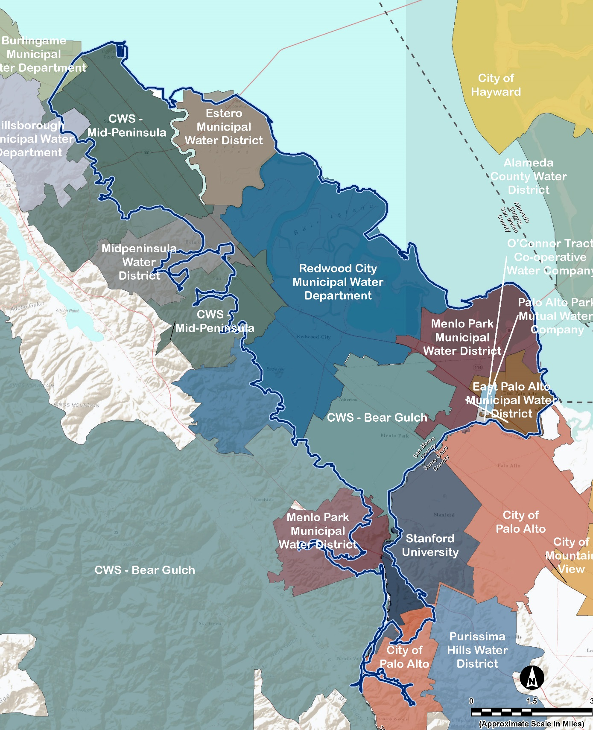
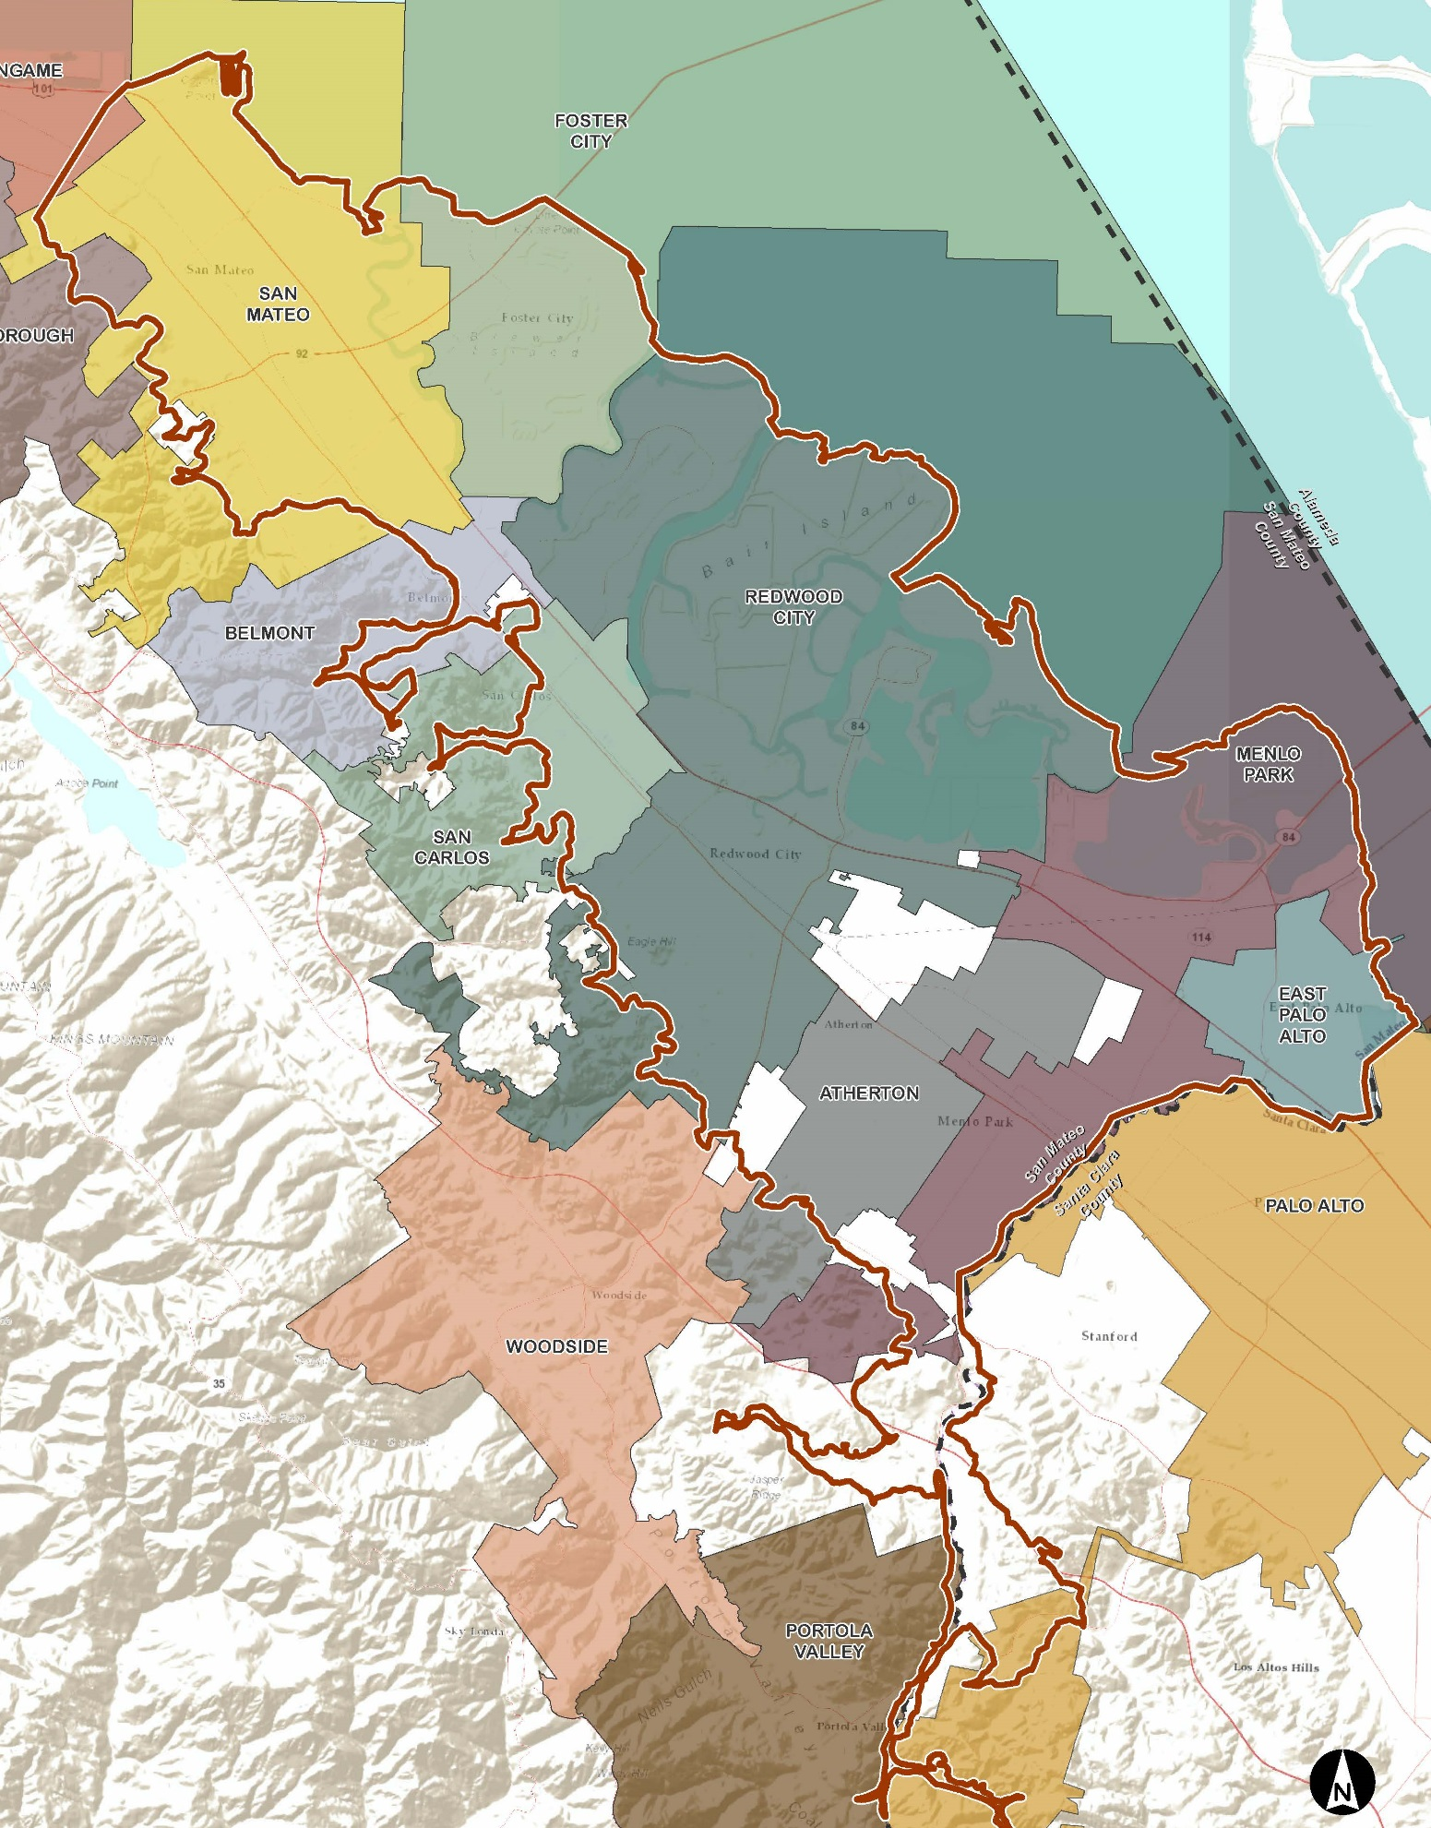
On-Going Stakeholder Outreach
Small group and one-on-one meetings
43 governing bodies
Stakeholder workshops
smcsustainability.org/
smplain
County’s Open Data Portal

Slide 6
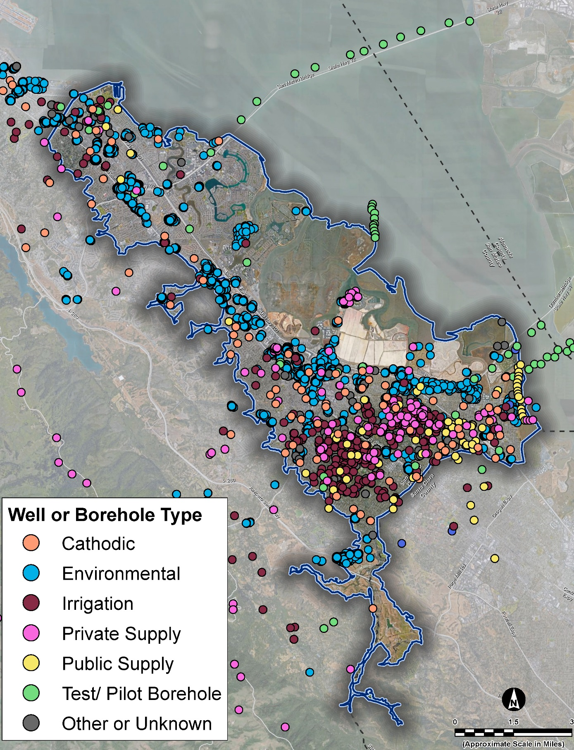
San Mateo Plain Subbasin
Information from ~3,000 wells and boreholes
Previous groundwater reports and studies (USGS, BAWSCA, Cities, County well records, State database)

Slide 7
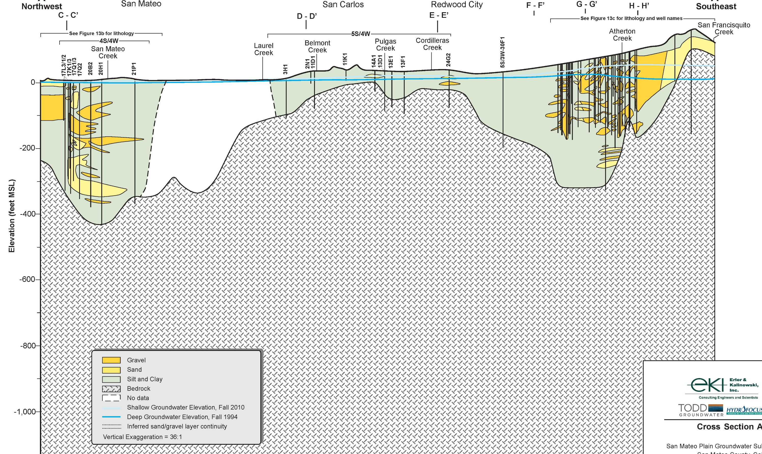
North-South Cross-Section

Slide 8
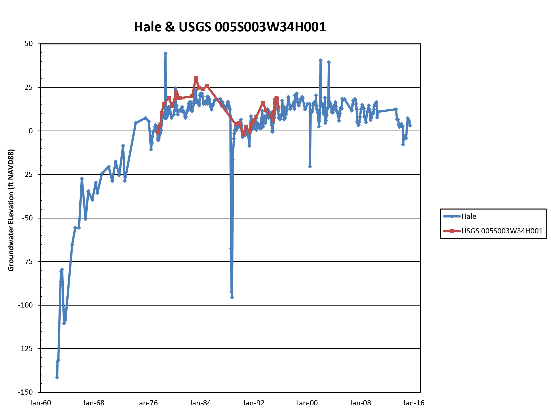
Groundwater Hydrographs

Slide 9
Water Budget Balanced

Slide 10
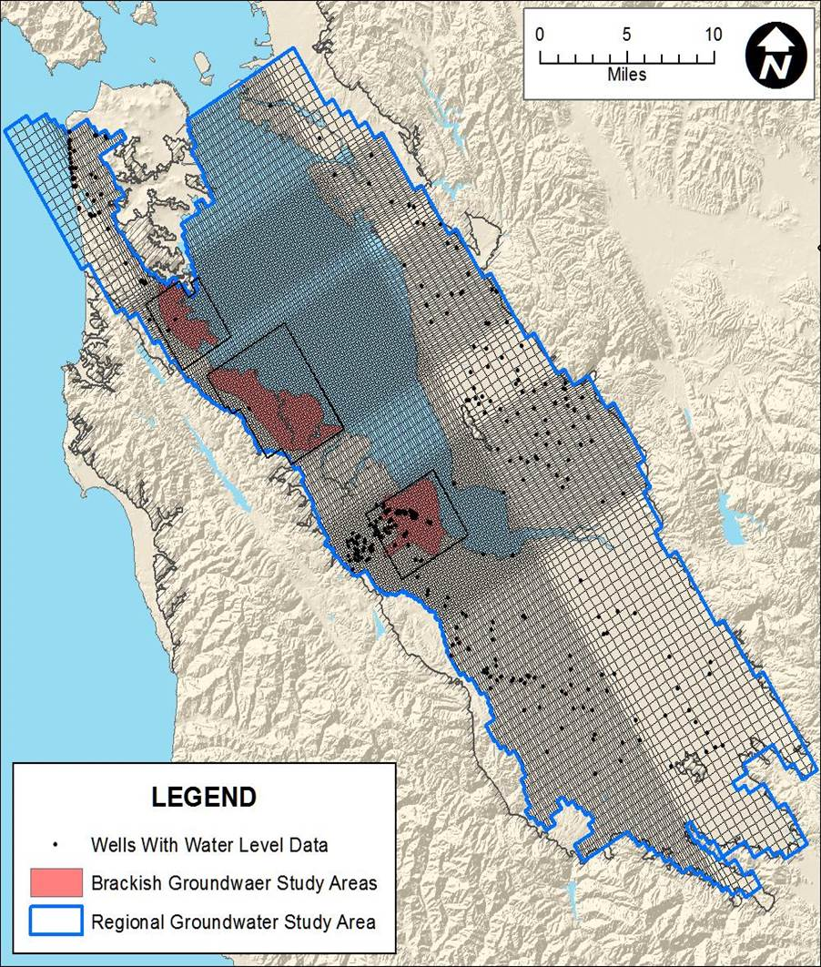
Numerical Model
Westside Basin Model (1959-2009)
Niles Cone and South East Bay Plain Model (1965-2000)
  MODFLOW (EBMUD)
  IGSM (ACWD)
USGS Santa Clara Valley Model (1970-1999)
Project Database and Conceptual Model

Slide 12
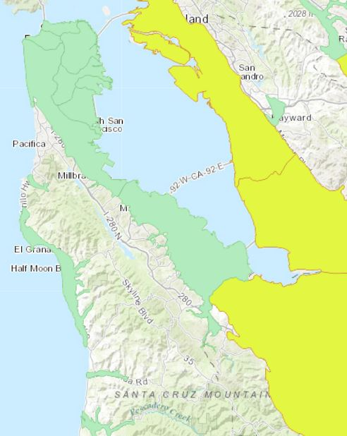
Relevance of SGMA to Basin
Basin is not currently required to comply with SGMA
  Designated as ‘Very Low’ priority by DWR in 2014
Basin may have to comply with SGMA in the future
  Basin could be re-prioritized in 2018 or in the future
  Analysis will include updated groundwater use data versus minimum threshold value
East Bay Plain
Westside
Niles Cone
San Mateo Plain
Santa Clara
Very Low priority
Medium priority

Slide 13
Groundwater Elevation Monitoring
Makes the groundwater elevation information available publicly
No monitoring entity, local agencies ineligible for certain state funding
  Enforcement of this has been focused on higher priority basins

