Slide 1
Resource Management and Climate Protection Committee
1/17/18

Slide 2
Municipal Energy Efficiency Call for Projects
Updated Timeline:
Event | Date
Draft Guidelines to RMCP | September 20, 2017
Develop Guidelines – Approve by C/CAG Board | October 12, 2017
Call for Projects Issued | October 20, 2017
Application Workshop | November 6, 2017 at 2:00pm San Carlos City Hall (Enterprise Room)
Applications Due | December 15, 2017
Evaluation Panel Review | December 15 – January 15, 2018
C/CAG Board Approves Evaluation Results | February 8, 2018
Execute Funding Agreements with Project Sponsors for Awarded Projects | By March 1, 2018
Final Reimbursement Requests Due | December 31, 2018

Slide 3
Municipal Energy Efficiency Call for Projects
Responses:
Agency | Project Title | Tier 1 | Tier 2 | Total
City of San Mateo | City of San Mateo 2018 Energy Efficiency Upgrades | $20,000 | $30,000 | $50,000
Colma | Colma Facilities Energy Efficiency Project | $20,000 | $30,000 | $50,000
Portola Valley | Town Center – Heating & Lighting Retrofit | $20,000 |  | $20,000
Redwood City | PD Municipal Energy Efficiency Project | $20,000 | $30,000 | $50,000
Daly City | Energy Efficiency Upgrades at City Facilities | $20,000 | $30,000 | $50,000
South San Francisco | South San Francisco: Powering Whole Communities Project | $20,000 | $30,000 | $50,000
Brisbane | Glen Park Pump Station Design for Efficiency and Mission Blue Center Audit | $20,000 |  | $20,000
Burlingame | Energy Efficiency Upgrades | $20,000 | $30,000 | $50,000
Foster City | HVAC Upgrades at City Hall and City Council Chambers | $20,000 |  | $20,000
Half Moon Bay | Window Pane and Lighting Upgrades | $20,000 | $30,000 | $50,000
Pacifica | Council Chambers HVAC and Lighting Retrofit | $20,000 |  | $20,000
County of San Mateo | San Mateo Medical Center Boiler Replacement Youth Services Center CogenHeat Exchanger Upgrade Project San Mateo Medical Center, Exterior Lighting Upgrade Project | $20,000 | $30,000 | $50,000
 | TOTAL: | $240,000 | $240,000 | $480,000

Slide 4
Municipal Energy Efficiency Call for Projects
Outcome to date:
immediate engagement from agencies – at announcement
projects which were audited, but never pursued by agencies
Potential Outcome:
hundreds of thousands of kWh saving
transition into 2019
potential Round 2 – focused on School Districts
Next steps:
negotiate and finalize funding agreements
February 8, 2018 C/CAG Board approval and signatures
launch projects with all cities

Slide 5
2017 Program Outcomes
Energy Savings
Implementation
Library Kits
RICAPS
Inventories
CAPS
Marketing
Website
Newsletters
Administration
Monthly Reporting
Invoicing

Slide 6
Energy Savings
Savings Type | 2016-2018 Goal | Savings (2016 thru Nov. ‘17) | Percent of Goal
kW | 1405 | 883 | 63%
kWh | 7,402,865 | 5,636,305 | 76%
Therms | 0 (neutral) | 5,907 | +

Slide 7
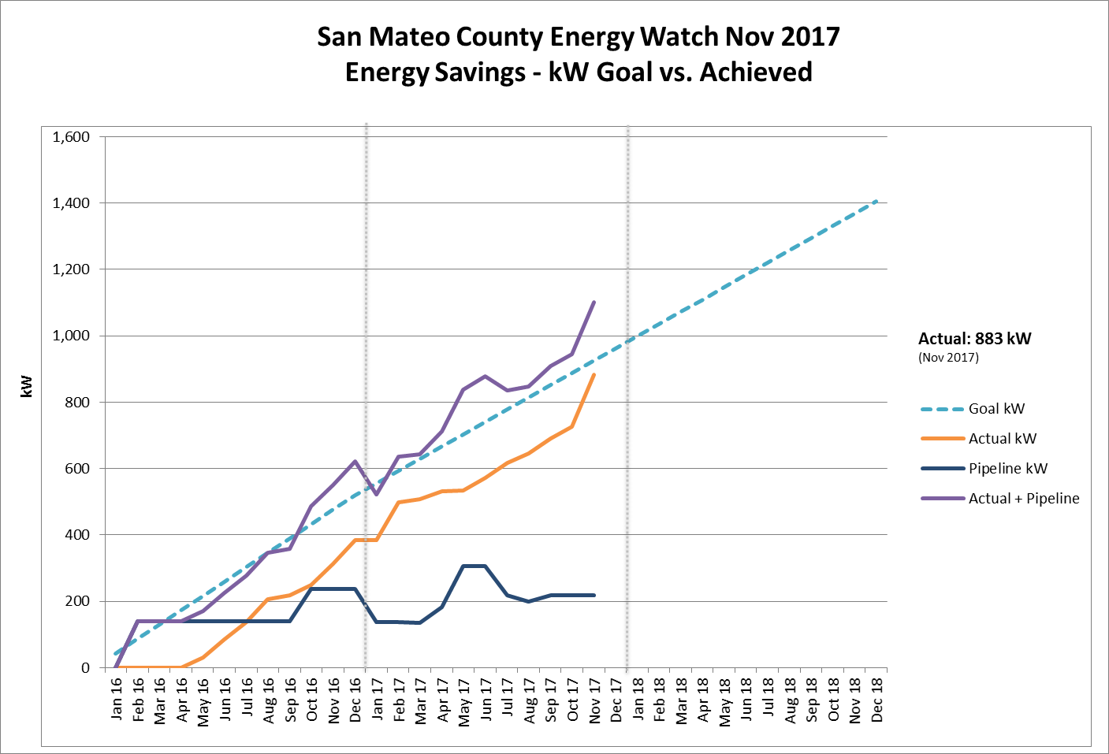

Slide 8
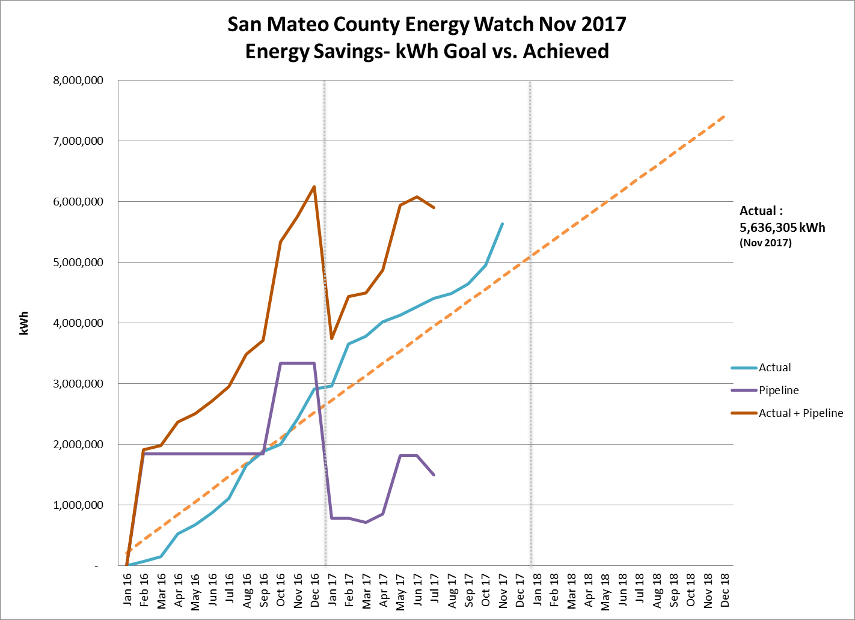

Slide 9
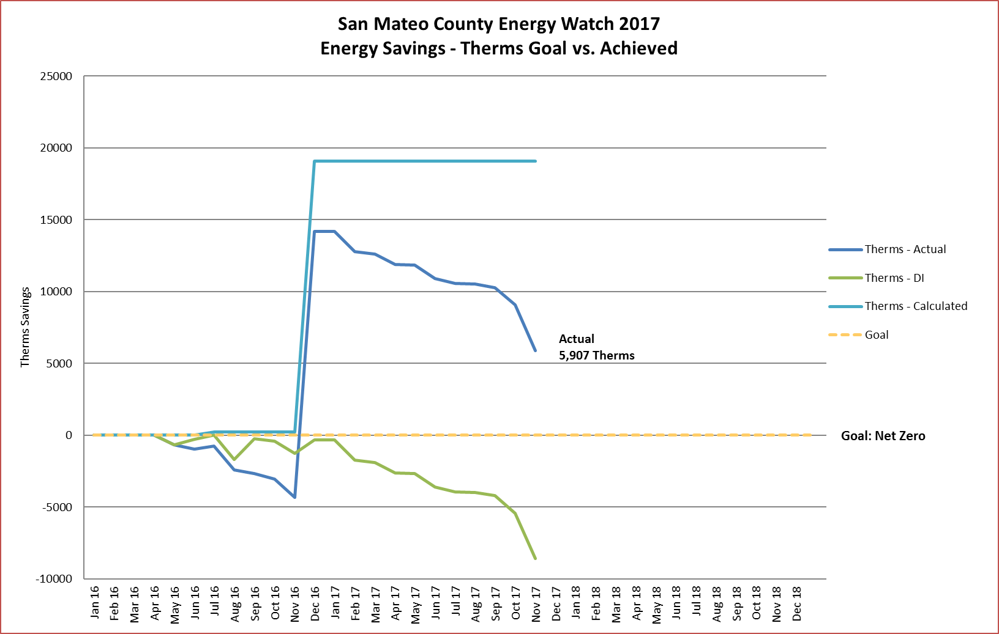

Slide 10
2017 Program Outcomes
Energy Savings
Implementation
68 projects completed through Nov 2017
8 were at cities or school districts
Library Kits – 382 checkouts since April 2017 (Earth Day)
RICAPS – Countywide Progress
Inventories
2014 and 2015 Community-scale inventories completed for all cities
8 - 2015 Gov Ops inventories complete, 5 – in progress
CAPS
16 Adopted CAPs, 1 Draft Completed, 4 Draft in Progress
Re-contracting with DNV GL
C/CAG Board meeting – February 8

Slide 11
2017 Program Outcomes
Marketing
Website
Maintained
Online Data Portal – 11 types of data
RFP to prepare for Drupal to WordPress
Newsletters
24 monthly newsletters
Administration
Invoicing
Monthly Reporting

Slide 12
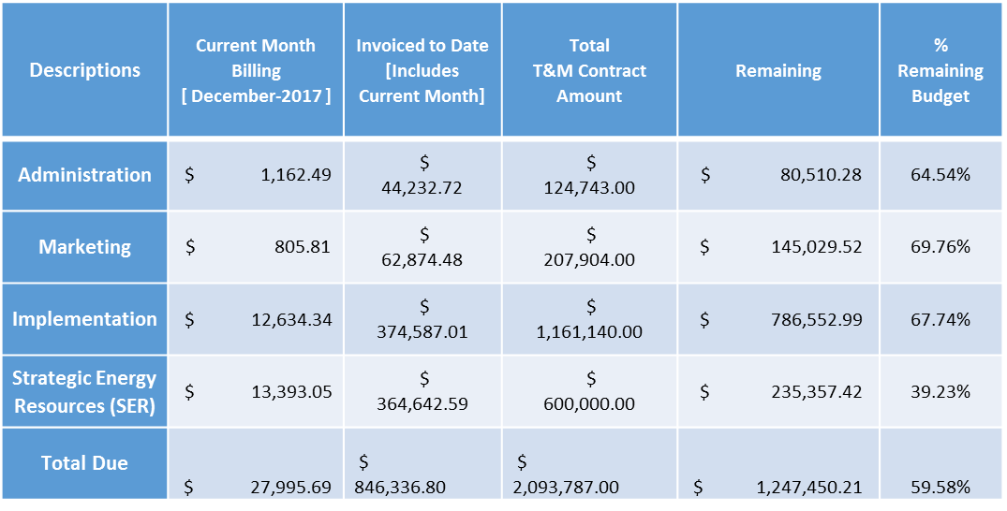
2017 Program Outcomes
January 2018 Budget

Slide 13
2018 - 2019 Program Transition
CPUC Business Plan process
Program scope
Public Sector (specific) Program is born
Unlikely to continue to include commercial
Unsure of SER (long terms strategic planning funding – RICAPS)
Budget and segments
60% of overall Public Goods-funding via PG&E outsourced to competitive bid
Up from 20% but will be stepped up to 60% through Dec 2022
As a result - Budget likely reduced – but not sure how much
Customer segments will include:
Municipalities
School Districts
Special Districts

Slide 14
2018 - 2019 Program Transition
2018 Planning for 2019
Transition Strategies
Build on School District relationships
Transition Website
Clarify SER funding for program
Work on State-level community-scale emission inventories
Prioritize finalizing CAPs and updating existing CAPs to 2030
Support PG&Es effort to regionalize the program
Support PG&Es effort to hire technical contractors for Public Sector Program
Possibly hire more technical internal staff at OOS for 2019 onward
Collaborate with bidders for outsourced funds – commercial in SMC
Suggestions?

