Slide 1
RMCP Committee Work - 2018
San Mateo County Energy Strategy:
Adopted in 2009
Goals
Energy – reduce by 25% from 2005 levels of non-renewable energy use – DONE
Water – 5.2 million GPD of conservation in 2030 from 2001 baseline – NOT SURE
Collaboration – partner with Utilities across city boundaries to address environmental issues more effectively – ONGOING
Economy – support Clean Tech sector to strengthen the economic health of San Mateo County – ONGOING
Leadership – encourage environmental leadership from the top in the public sector, business, and community, to meet Energy Strategy goals - ONGOING
Governor's Climate Conference:
September 12-14, 2018
In San Francisco (probably Moscone Center)
Getting in the conference
Letter to the Cities and Stakeholders
Green Tech
City Accomplishments
Engagement with the Governor’s Office
Planning a session
Other Potential Efforts:
?
?

Slide 2
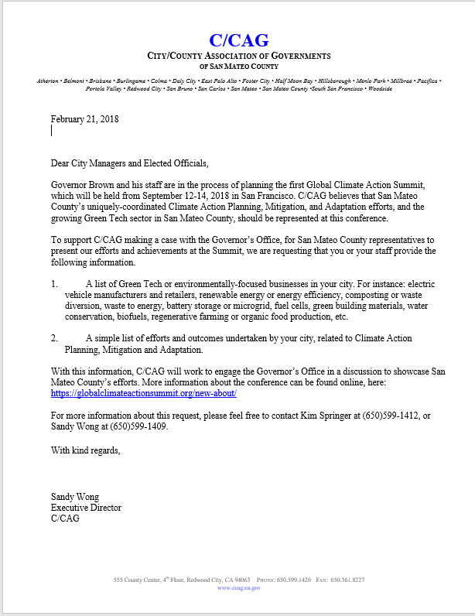
Draft letter to Cities:
Stakeholders:
SAMCEDA
BAWSCA
Others?

Slide 3
Meeting Dates
March 21 August 15
April 18 September 19
May 16 October 17
June 27 (4th week due to SEEC Forum) November 28 (4th week due to Thanksgiving)
July 18 December 19

