Slide 1
Update on Water Supply and Recent State Actions
Adrianne Carr, Senior Water Resources Specialist

Slide 2
BAWSCA Update on Water Supply and Recent State Actions
Outline
  Update on water supply conditions
  Overview of water conservation legislation
  State actions on groundwater in San Mateo County

Slide 3
June 17, 2018 Reservoir Storage Levels

Slide 4
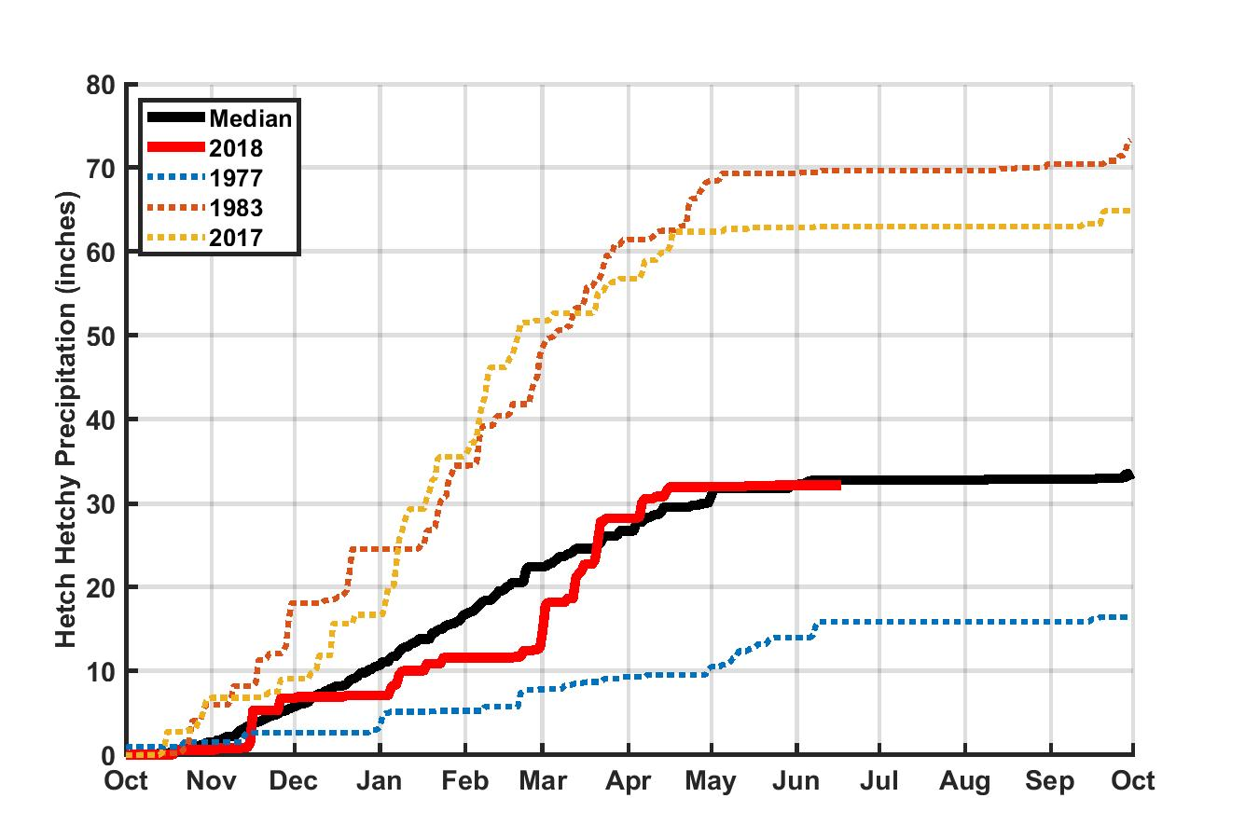
Hetch Hetchy Precipitation

Slide 5
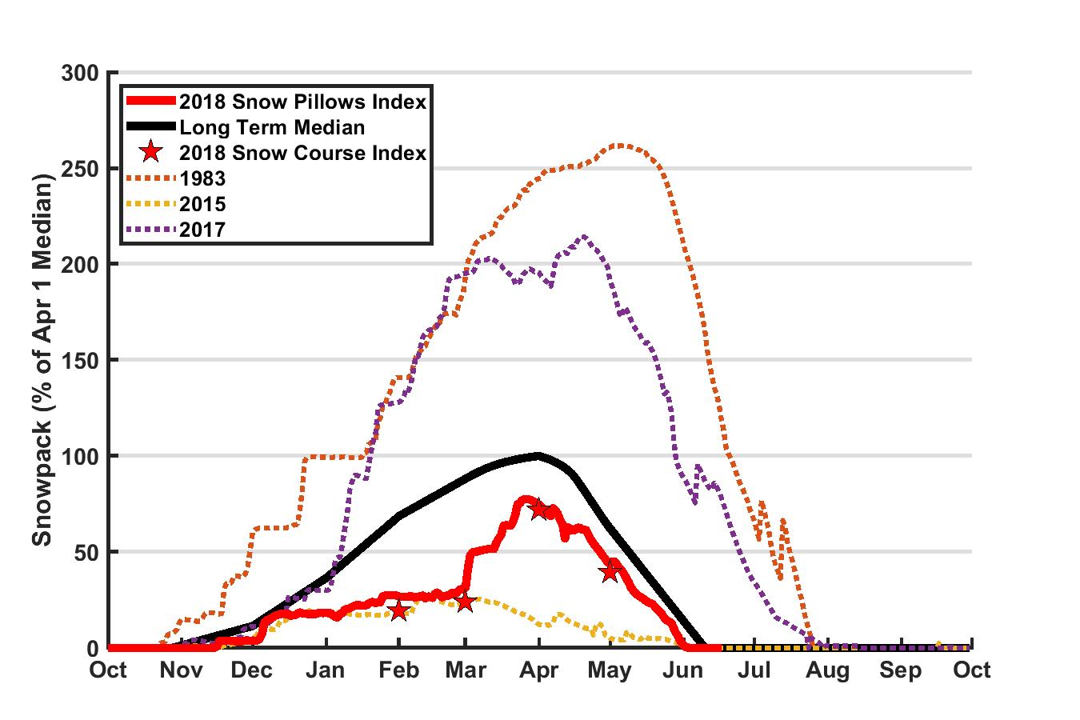
Upcountry Snowpack

Slide 6
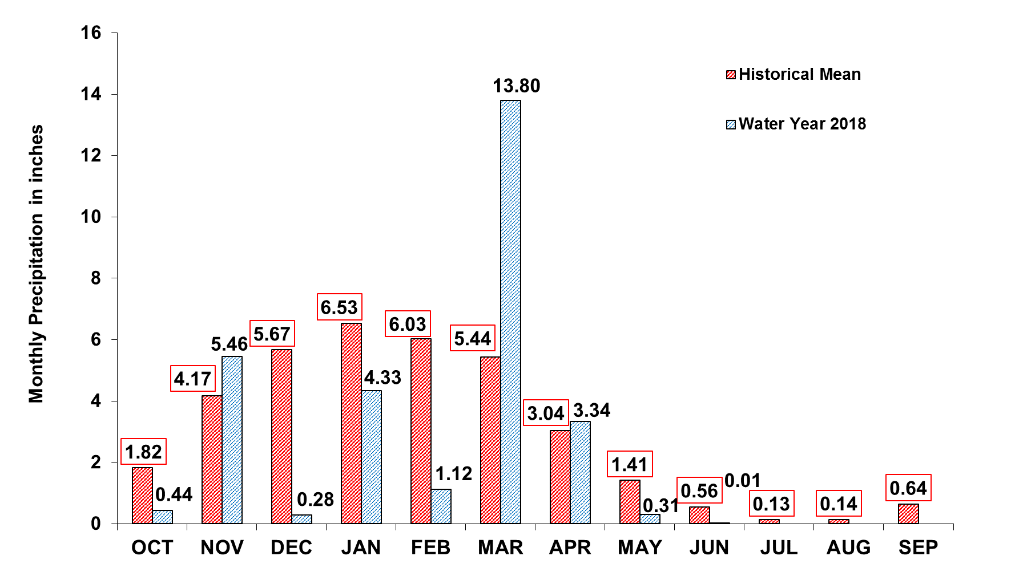
Upcountry 6-station Precipitation Index as of June 17, 2018
Annual Total: 35.6 inches
YTD Total: 29.09 inches

Slide 7
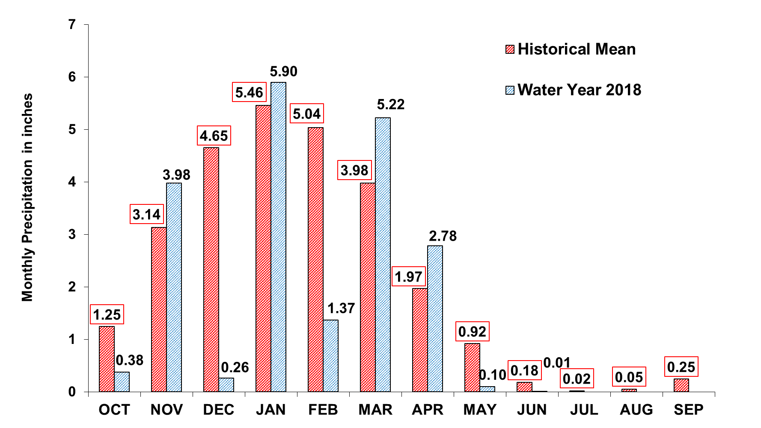
Bay Area 7-station Precipitation Index as of June 17, 2018
Annual Total: 26.9 inches
YTD Total: 19.99 inches

Slide 8
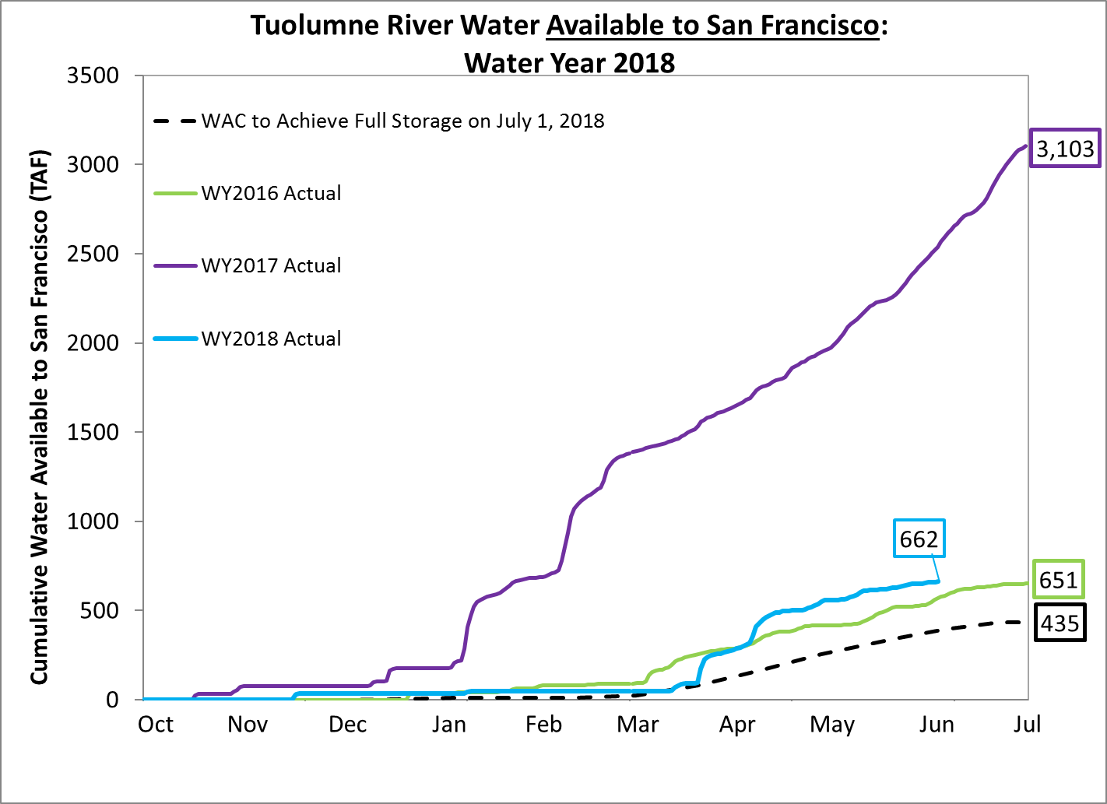
Tuolumne River Water Available to the City

Slide 9
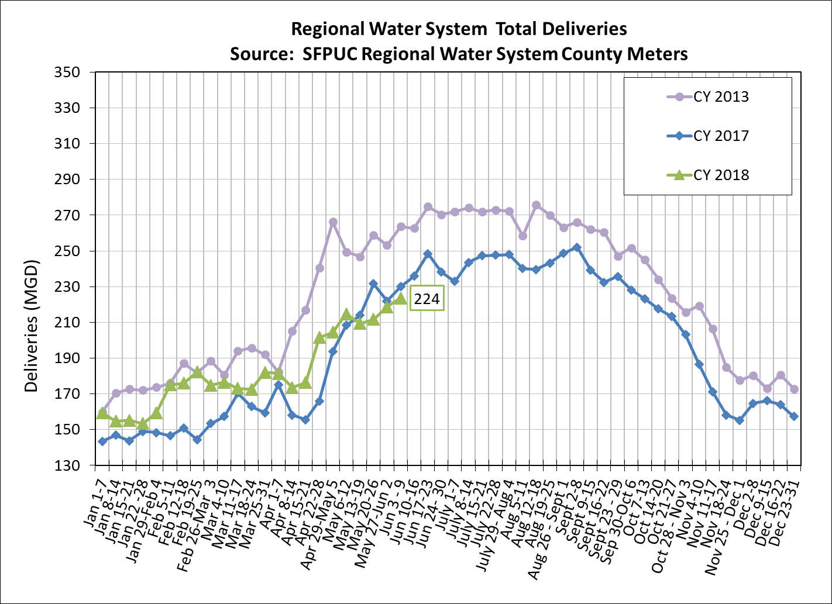
SFPUC Water Deliveries

Slide 10

L. Ash, 2017

Slide 11
BAWSCA April 2018 Total Potable
Water Use 26% Less Than April 2013
Note: Data does not include City of Burlingame as water use not yet reported.

Slide 12
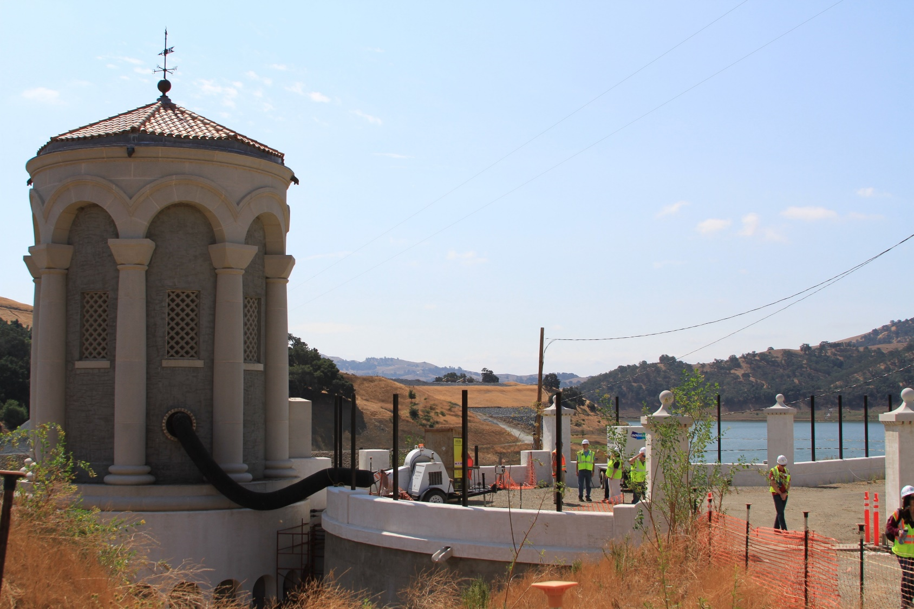
L. Ash, 2017

Slide 13
Governor Signed Water Use
Efficiency Legislation
AB 1668 and SB 606, companion bills for new long term water efficiency requirements, signed into law
Bills require that retail urban water suppliers:
  Calculate and report an urban water use objective and compare to actual water use annually
  Complete an annual water supply and demand assessment
Bills establish a multi-year timeline for development and implementation of the standards

Slide 14
Urban Water Use Objective
Urban water suppliers to calculate urban water use objective annually (calendar or fiscal year)
  First reporting due November 1, 2023
  Reporting will compare the target to actual water use
Target will be calculated as:
  Efficient indoor residential water use, plus
  Efficient outdoor residential water use, plus
  Efficient CII outdoor water use (dedicated irrigation) , plus
  Efficient water loss, plus
  Variances as appropriate, plus
  Potable reuse credit as applicable

Slide 15
Phased Enforcement Actions
2023: SWRCB may issue information order to an urban water supplier that does not meet its urban water use objective
2024: SWRCB may issue written notice to urban water supplier that does not meet its urban water use objective
2025: SWRCB may issue conservation order to urban water supplier that does not meet its urban water use objective. Issuance of a conservation order does not require the imposition of a civil liability.

Slide 16
Implementation Timeline
Date | Implementation Action
1/1/2020 | DWR to recommend to legislature standards for indoor residential water use. 2. DWR to provide data regarding irrigable lands, at level of detail sufficient to verify accuracy at the parcel level
10/1/2021 | DWR to recommend to the State Board: Standards for outdoor residential use to SWRCB Performance measures for CII water use Variance provisions Standards for outdoor irrigation for landscapes with dedicated meters
6/30/2022 | State Board to adopt long-term standards for efficient water use: Outdoor residential Outdoor irrigation of landscapes with dedicated meters Water loss Performance measures for CII water use
11/1/2023 | Urban Water Suppliers to submit first reporting

Slide 17
Water Shortage Contingency
Plan Requirements
Annual water supply and demand assessment and report by June 1st to DWR
  Anticipated shortage
  Triggered shortage response actions
  Compliance and enforcement actions
The new Water Shortage Contingency Plans must include:
  Standardized shortage levels from 10% to >50%
  Shortage response actions
  Customer communication plan
  Enforcement plan
  Financial plan
Likely to be enforced through the next Urban Water Management Plan submittal in 2021

Slide 18
“Making Conservation a Way of
Life” Project Update
BAWSCA currently reviewing and revising Conservation Strategic Plan Report
Report will incorporate adopted legislation and associated changes to proposed BAWSCA actions
FY 2018-19 consultant contracts have been approved to support agencies in preparing for compliance
  Water Loss Management Program
  Indoor-Outdoor Water Use Study
  Commercial/Industrial Audit Pilot Program

Slide 19
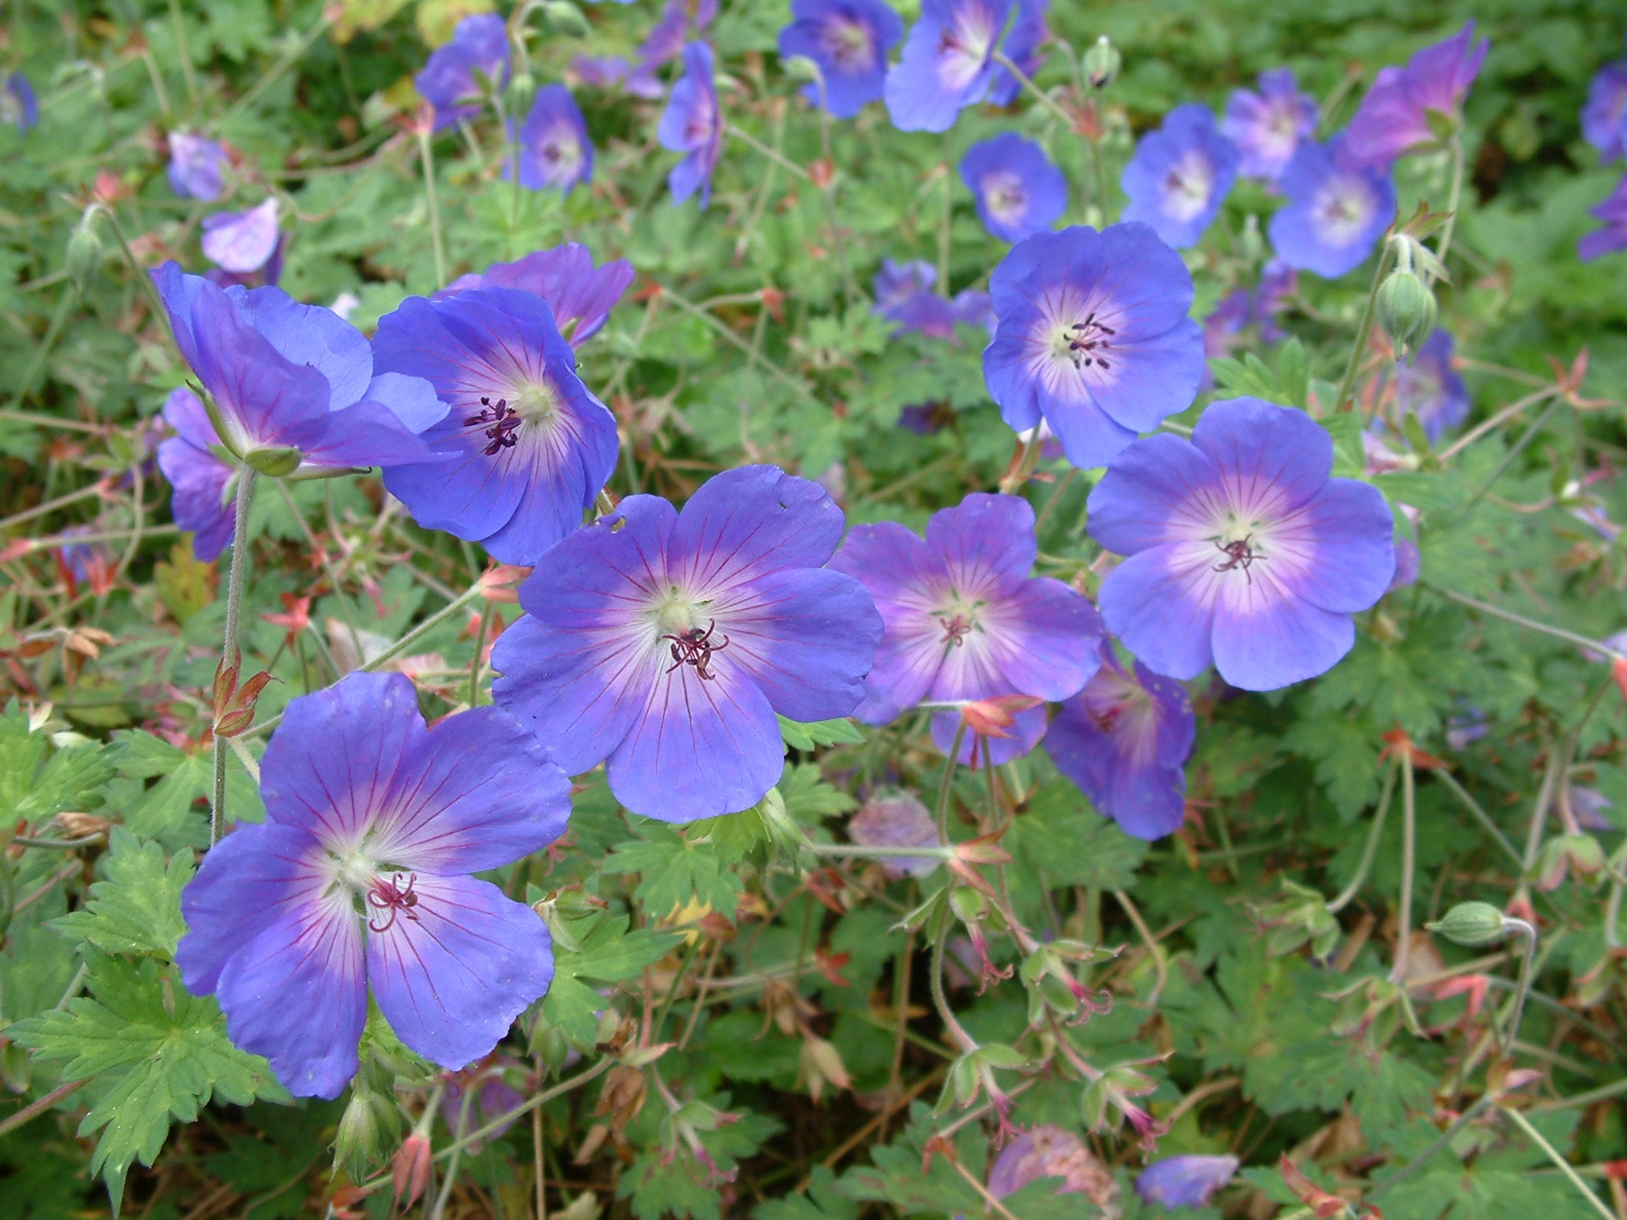

Slide 20
DWR Reprioritized Groundwater Basins
DWR released a draft reprioritization of California groundwater basins on May 18, 2018
  California Statewide Groundwater Elevation Monitoring Program (CASGEM) ranking was redone based on new information
San Mateo Plain Sub-basin, Westside Basin, and Half Moon Bay Terrace Basin now each require SGMA compliance
  Medium and high priority basins

Slide 21
What is Sustainable Groundwater Management, as Required by SGMA?
SGMA defines sustainable groundwater management as the “management and use of groundwater in a manner that can be maintained during the planning and implementation horizon without causing undesirable results”

Slide 22
DWR Reprioritized Groundwater Basins
County hosted two meetings with DWR staff and basin stakeholders
  Half Moon Bay Terrace Basin
  San Mateo Plain Sub-basin and Westside Basin
Meetings were well attended and identified some significant issues that need to be addressed
  Question as to what data was used to support the reprioritization
  Data used by DWR for reprioritization not 100% publicly available
Comment period open through August 20th
  Was to close on July 18th
  County and BAWSCA developed comment letter to request extension of deadline providing 60-days after all data has been released
  23 agencies signed letter, submitted to DWR on June 15th
Final basin priority anticipated in November 2018

Slide 23
Initial Concerns with Basin Reprioritization
Initial concerns
  Data used by DWR for reprioritization may have inaccuracies
  Accelerated timeline
    2 years to form a GSA;
    5 years to prepare a GSP (timelines are parallel vs. in series)
  Agencies concerned about the process of coordination on GSA and GSP efforts
  Costs and potential lack of funding opportunities

