Slide 1
Project Update
July 2018 through January 2019

Slide 2
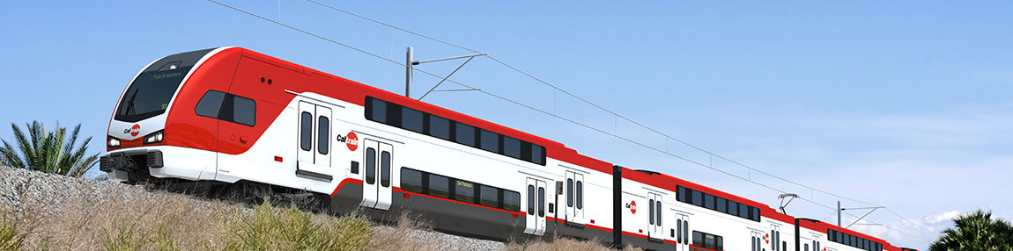
Business Plan Overview
Business Plan Overview
A Vision for Growth
Crafting Scenarios
Looking Beyond the Tracks
Outreach & Next Steps

Slide 3
What
Why
Addresses the future potential of the railroad over the next 20-30 years. It will assess the benefits, impacts, and costs of different service visions, building the case for investment and a plan for implementation.
Allows the community and stakeholders to engage in developing a more certain, achievable, financially feasible future for the railroad based on local, regional, and statewide needs.
What is
the Caltrain Business Plan?
3

Slide 4




What Will the Business Plan Cover?
Technical Tracks
Service
Number of trains
Frequency of service
Number of people riding the trains
Infrastructure needs to support different service levels
Business Case
Value from investments (past, present, and future)
Infrastructure and operating costs
Potential sources of revenue
Community Interface
Benefits and impacts to surrounding communities
Corridor management strategies and consensus building
Equity considerations
Organization
Organizational structure of Caltrain including governance and delivery approaches
Funding mechanisms to support future service
4

Slide 5
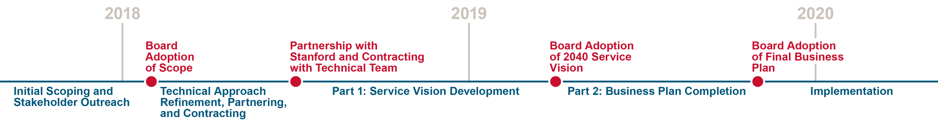
Where Are We in the Process?
We Are Here
5

Slide 6
A Vision for Growth
Business Plan Overview
A Vision for Growth
Crafting Scenarios
Looking Beyond the Tracks
Outreach & Next Steps

Slide 7
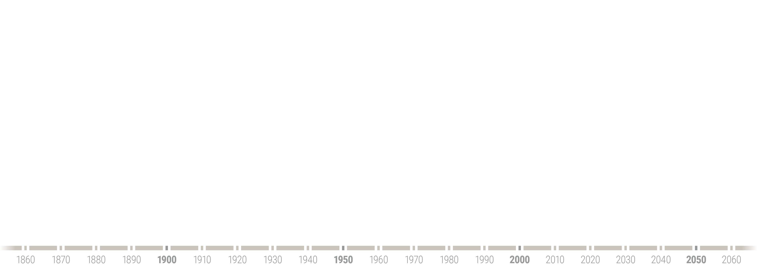
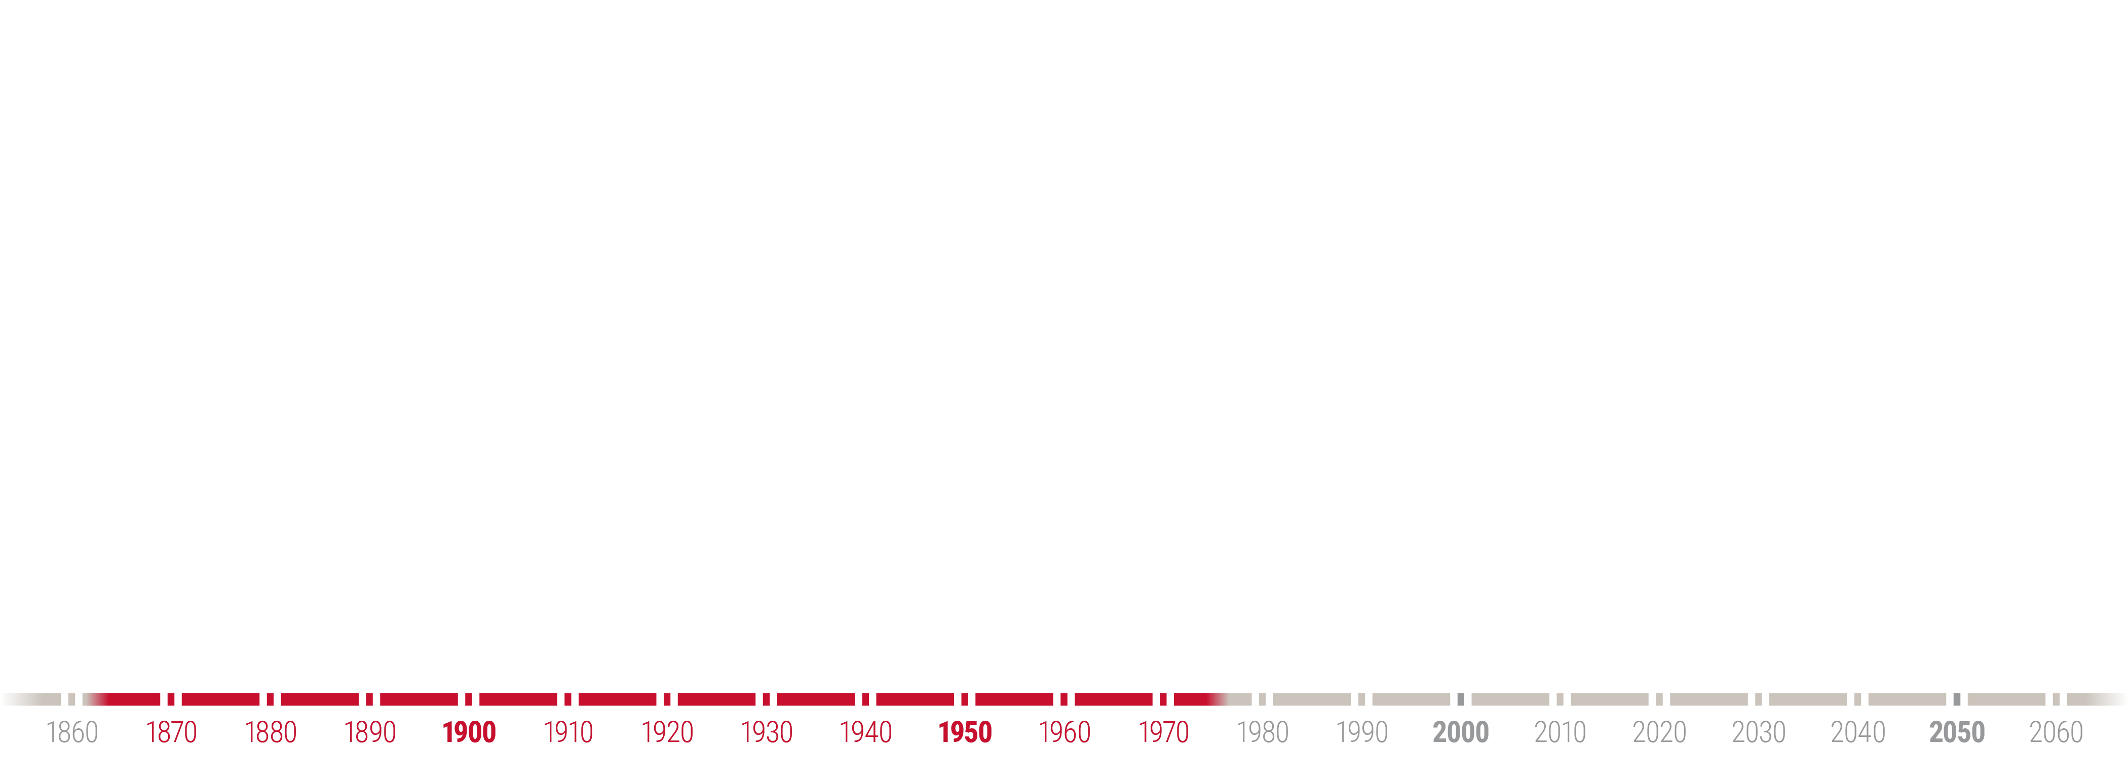
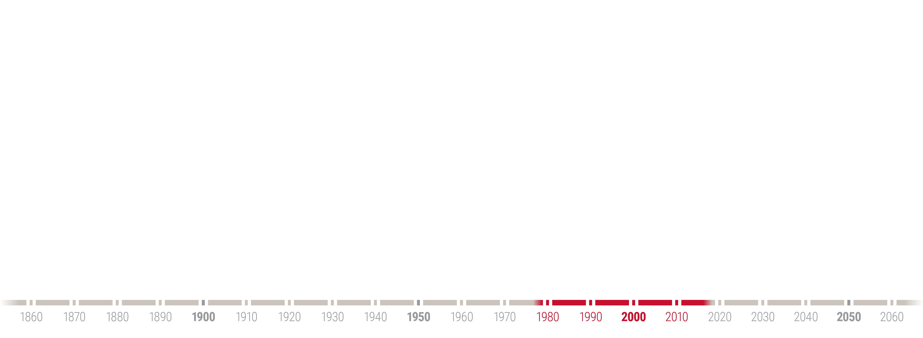
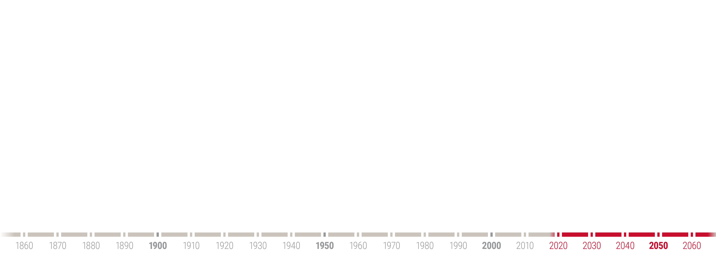
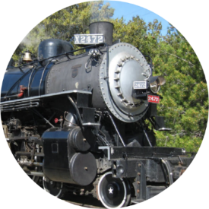
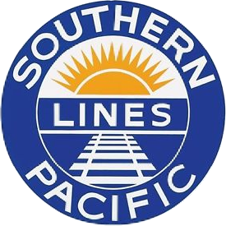
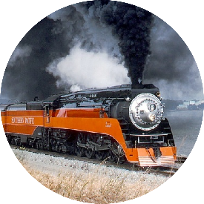
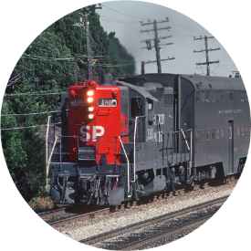
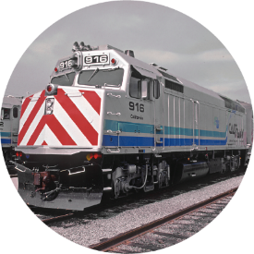
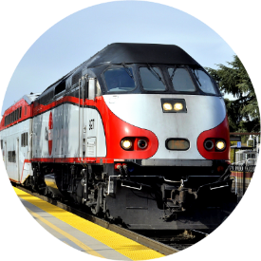
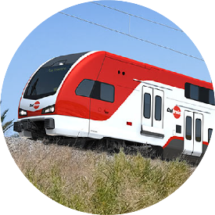
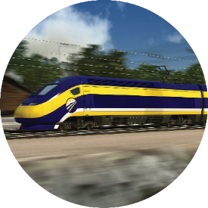
200 Years on the Caltrain Corridor
Yesterday
Today
Tomorrow
1863
Passenger service begins on the corridor
1870
Southern Pacific Railroad purchases the corridor
1940s – 1970s
Passenger and freight traffic boom during WWII then begin steady decline
1977
Caltrans subsidizes Southern Pacific commute service
1987
Caltrain and
Joint Powers Board are formed
2004
Baby Bullet service is introduced
2022
Corridor electrification is completed
2027 and Beyond
Caltrain and High- Speed Rail operate using Blended System

Slide 8
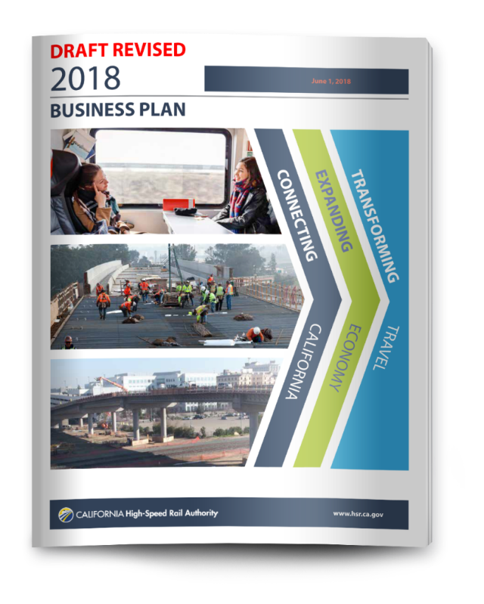
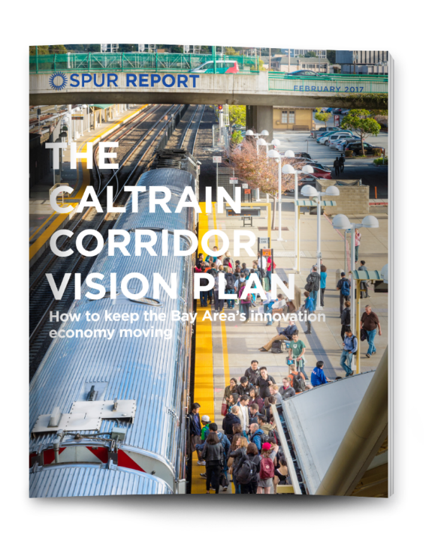
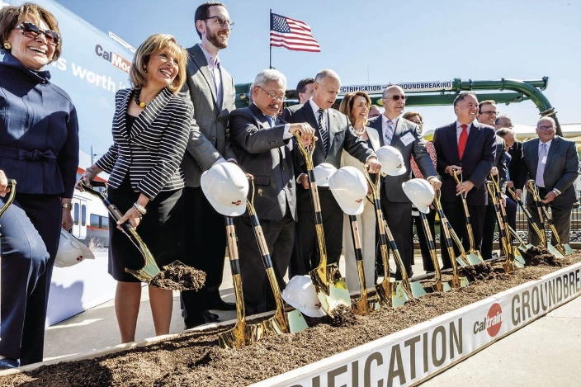
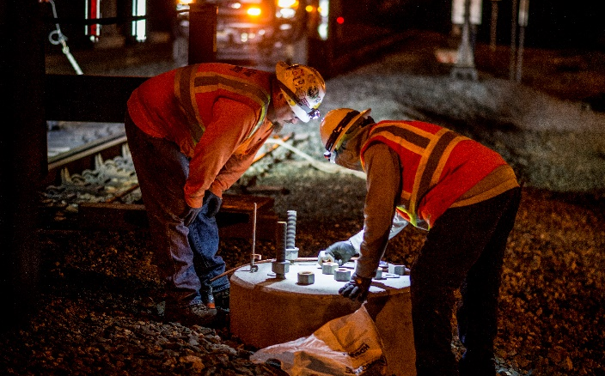
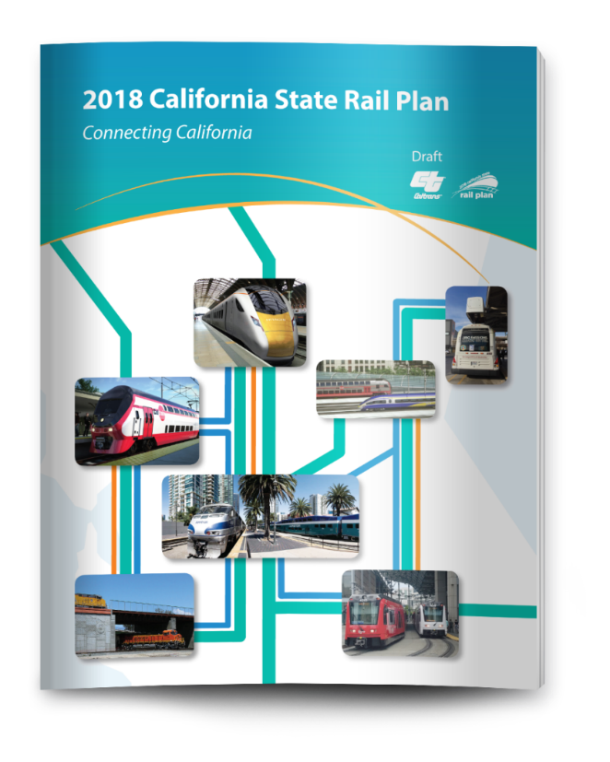
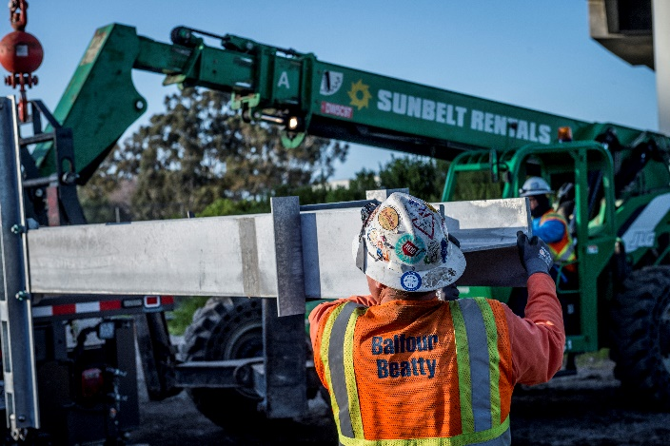
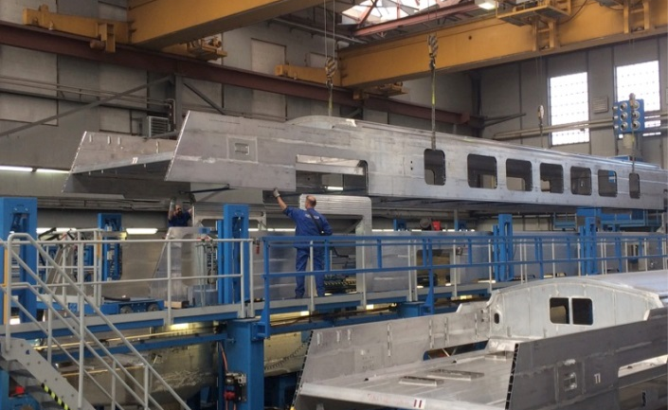
Electrification is the Foundation for Growth with Plans for More

Slide 9
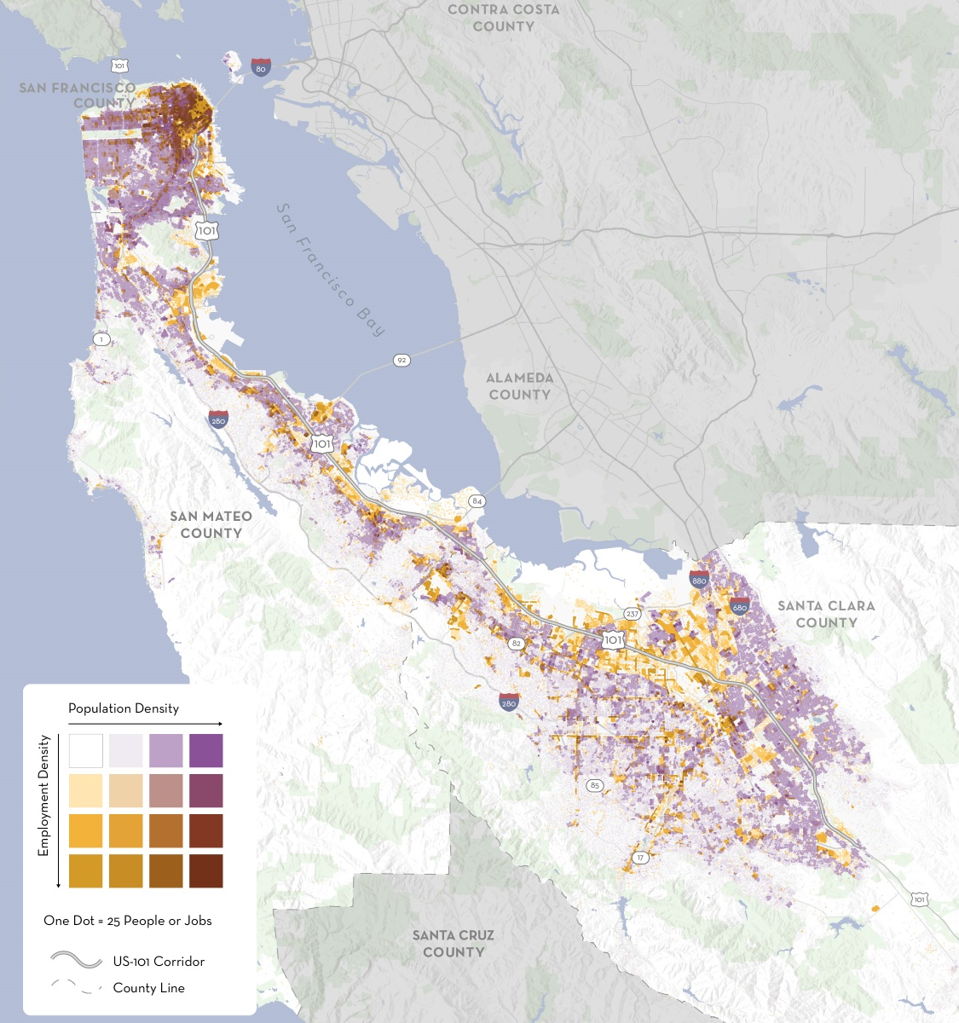
2040 Demand
2015 Population & Jobs
The Caltrain corridor is growing
By 2040 the corridor expected to add 1.2 million people and jobs within 2 miles of Caltrain (+40%)¹
80% of growth expected in San Francisco and Santa Clara Counties
Major transit investments are opening new travel markets to Caltrain
Downtown Extension and Central Subway to provide more direct connections to downtown San Francisco
Dumbarton Rail, BART to San Jose, and improvements to Capitol Corridor and ACE to strengthen connectivity with East Bay
HSR and Salinas rail extensions to increase interregional travel demand
¹Based on Plan Bay Area forecasts and approved projects by individual cities
9

Slide 10
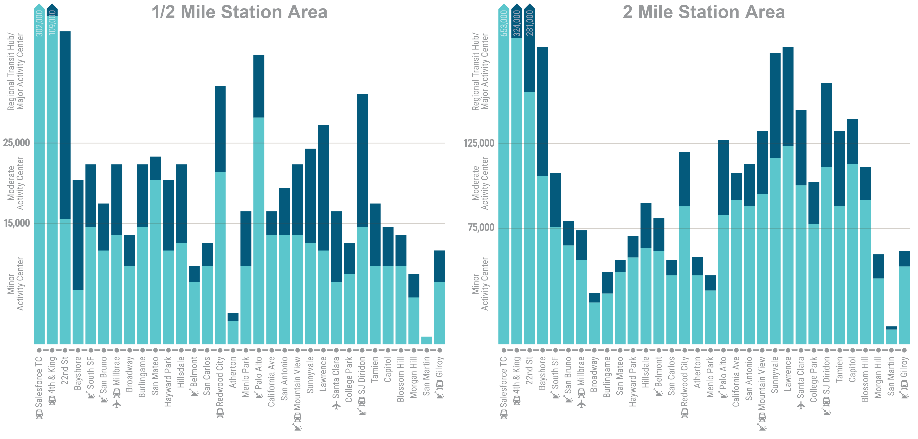

2040 Land Use & Transportation Context
1 million people and jobs within 1/2 mile of Caltrain stations
4.2 million people and jobs within 2 miles of Caltrain stations
# of People + Jobs
# of People + Jobs
Indicates a station where substantial growth beyond Plan Bay Area forecasts is anticipated, but not yet approved

Slide 11
Crafting Scenarios
Business Plan Overview
A Vision for Growth
Crafting Scenarios
Looking Beyond the Tracks
Outreach & Next Steps

Slide 12




Where do We Start?
The Caltrain corridor is not a blank slate
Existing Policy Decisions
Commitment to a Blended System
Primarily a 2-track corridor
Planned Projects
Stations
Connecting services
Grade separations
Community Acceptability
Tangible benefits
Mitigated or acceptable impacts
Market Responsiveness
Origins and destinations
Capacity
Travel times
Coverage
Fiscal Reality
Realistic scale
Value for money

Slide 13


Planning within Constraints –
Key Choices and Tradeoffs
Service can be improved and expanded but tradeoffs and choices are required across all scenarios. There is no perfect answer.
1. Service Differentiation
How can local, regional and high speed services be blended and balanced on the corridor to best serve multiple markets?
2. Peak Service Volume
How much growth in peak train traffic volume can the corridor support and what kinds of growth may be required to meet long term demand?
3. Service Investments
What types of investments into operations, systems and infrastructure will be required to achieve the desired types and volumes of service?

Slide 14
Baseline Growth
High Growth
Moderate Growth
Baseline Growth
2033
High Speed
Rail Phase 1
Amount of Investment /Number of Trains
2033
High Speed
Rail Phase 1
2040 Service Vision
2022
Start of Electrified
Operations
2018
Current
Operations
2018
Current
Operations
Design Year

Slide 15
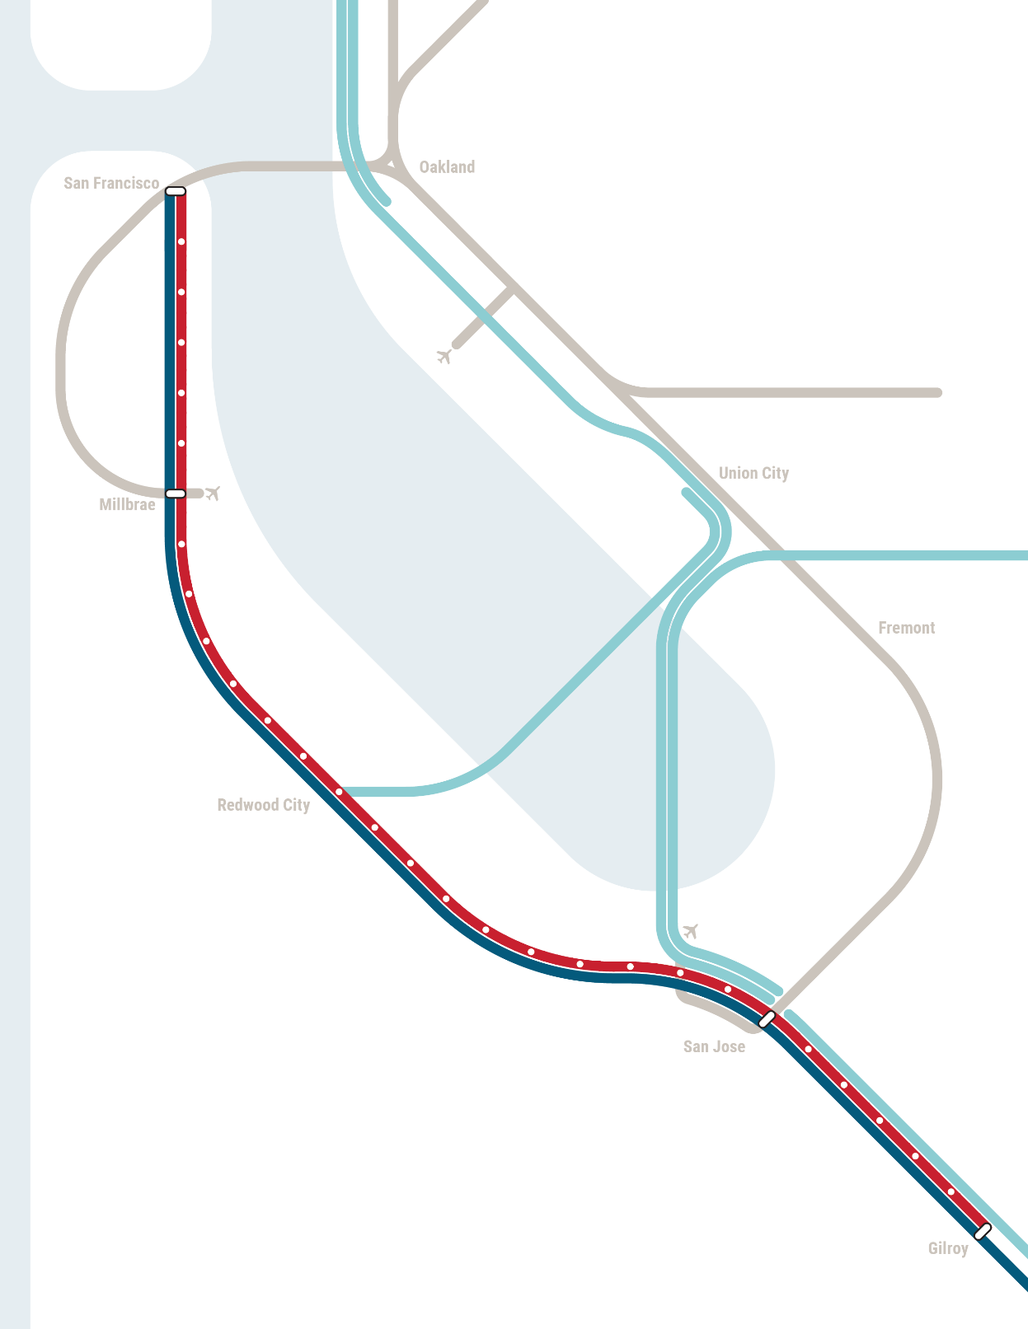
2040 Baseline
2015 Population & Jobs
The “Baseline” growth scenario includes service assumptions that meet the JPB’s existing policy commitments and reflect past and ongoing Blended System planning
Operating Parameters
Blended service with 10 trains per hour, per direction north of San Jose (6 Caltrain, 4 HSR)
Blended operations with existing/committed levels of Caltrain service assumed south of San Jose (equivalent of 4 round trip Caltrain trains per day)
Service Pattern
Historically, Caltrain has planned to operate a skip stop service after electrification
Blended service planning with HSR has carried forward this concept
  There is some flexibility in service levels and stopping patterns at individual stations
15

Slide 16
2040 Baseline Scenario (6C+4HSR Trains)
San Francisco
22nd St
Bayshore
South San Francisco
San Bruno
Millbrae
Broadway
Burlingame
San Mateo
Hayward Park
Service Type
Hillsdale
Belmont
Skip Stop
High Speed Rail
San Carlos
Blossom Hill
Morgan Hill
San Martin
PEAK PERIOD ,
EACH DIRECTION
Redwood City
Tamien
Capitol
Gilroy
Atherton
2 Trains / Hour
Menlo Park
Service Level (Trains per Hour)
2 Trains / Hour
Palo Alto
2 Trains / Hour
California Ave
4 3 2 1 <1
4 Trains / Hour
San Antonio
Infrastructure
Mountain View
4 Trains / Hour
Conceptual 4 Track
Segment or Station
Sunnyvale
Lawrence
Features​
Blended service with up to 10 TPH north of Tamien
(6 Caltrain + 4 HSR) and up to 10 TPH south of Tamien (2 Caltrain + 8 HSR)
Three skip stop patterns with 2 TPH – most stations are served by 2 or 4 TPH, with a few receiving 6 TPH
Some origin-destination pairs are not served at all
Passing Track Needs​
Less than 1 mile of new passing tracks at Millbrae associated with HSR station plus use of existing passing tracks at Bayshore and Lawrence
Options & Considerations
Service approach is consistent with PCEP and HSR EIRs
Opportunity to consider alternative service approaches later in Business Plan process
Santa Clara
College Park
San Jose Diridon

Slide 17
Higher Growth Scenarios
High Growth
Moderate Growth
Baseline Growth
2033
High Speed
Rail Phase 1
Amount of Investment /Number of Trains
2033
High Speed
Rail Phase 1
2040 Service Vision
2022
Start of Electrified
Operations
2018
Current
Operations
2018
Current
Operations
Design Year

Slide 18
Exploring the Potential Long Term Demand for Caltrain Service
Using Plan Bay Area numbers for projected growth in jobs and housing, an unconstrained model run of high frequency, all-day BART-like service in the Caltrain corridor suggests that by 2040 there could be underlying demand for approximately 240,000 daily trips on the system
Description | 2017: 92 Trains/Day | 2040: ~360 Trains/Day
Daily | 62,000 | 240,000
Peak | 50,000 | 185,000
Off-Peak | 12,000 | 55,000

Slide 19
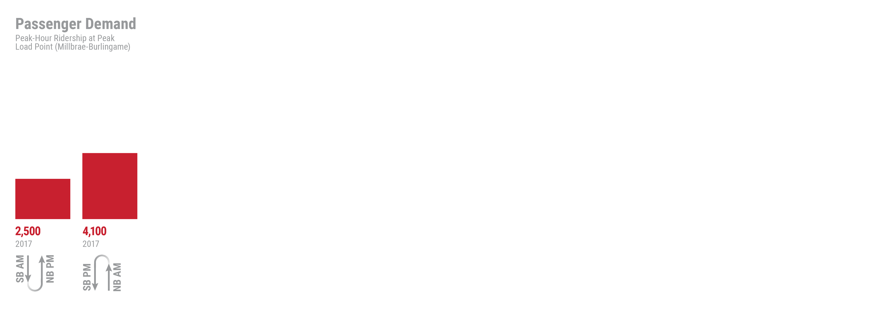
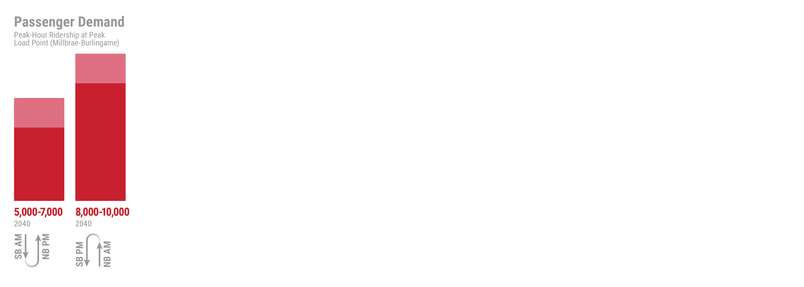
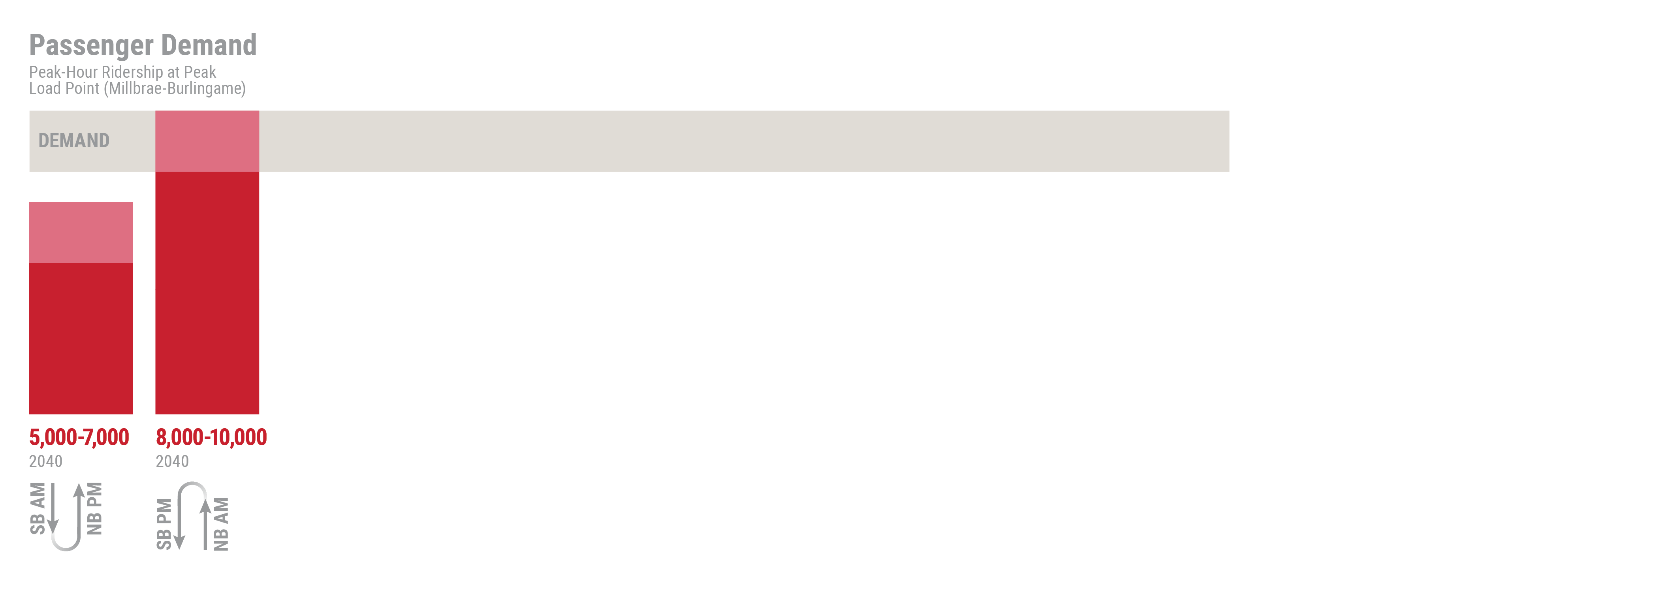
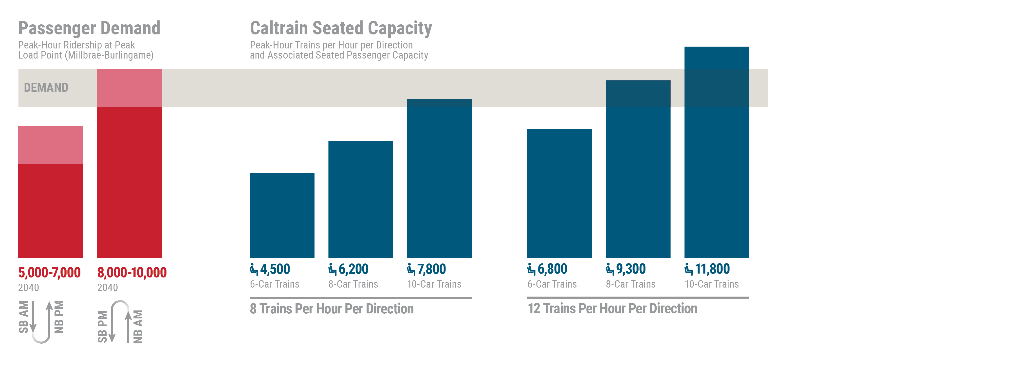
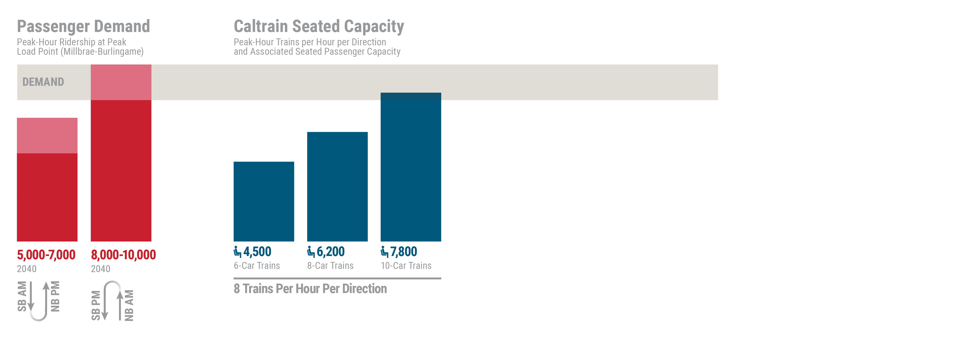
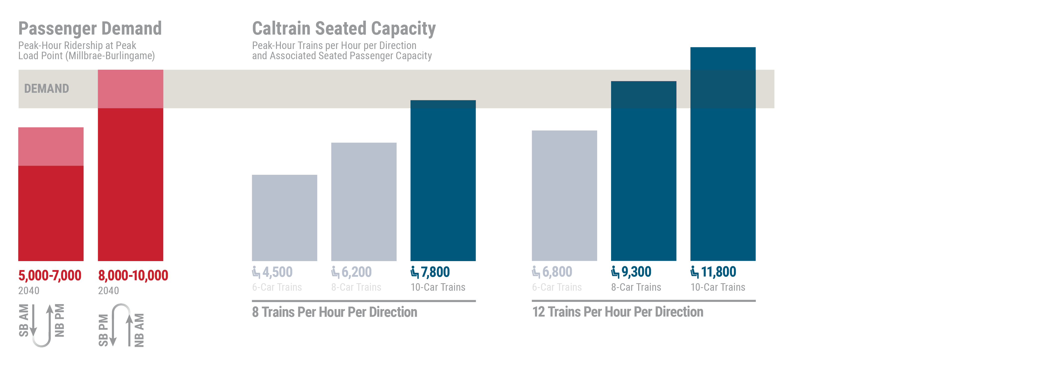

Throughput Demand vs. Capacity
To comfortably serve the full potential market for rail in 2040, Caltrain would need to operate 8 trains per hour, per direction (TPHPD) with 10 car trains or 12 TPHPD with 8 or 10 car trains
Seated capacity based on Stadler EMU with different door and bike car configurations. Does not include consideration of potential HSR capacity to serve demand

Slide 20
Service Goals
Maximize Ridership
With fast and frequent service between major markets
Improve Coverage and Connectivity
By ensuring that most stations are connected with frequent service
Enhance Capacity and Convenience
With service that is comfortable and easy to understand
“Right Size” New Infrastructure
By investing strategically to provide corridor-wide benefits

Slide 21
Screening & Evaluation Results
Zone Express
Local/Express
(Minimal Passing Tracks)
Local/Express
(Expanded Passing Tracks)
Skip Stop
A - 12 Trains
B - 16 Trains
C - 12 Trains
D - 16 Trains
E - 12 Trains
F - 16 Trains
G - 16 Trains
4
4
4
4
4
4
4
4
4
2
2
4
4
4
4
4
4
4
4
4
4
4
4
4
4
4
San Francisco
22nd St
Removed through Screening & Evaluation Process
Removed through Screening & Evaluation Process
Removed through Screening &
Evaluation Process
Bayshore
South San Francisco
San Bruno
Millbrae
Broadway
Burlingame
San Mateo
Hayward Park
Hillsdale
Belmont
San Carlos
Redwood City
Atherton
Station service level TBD through further analysis
Menlo Park
Palo Alto
California Ave
High Speed Rail
San Antonio
Mountain View
Sunnyvale
Lawrence
Conceptual 4-track segment or Station
Santa Clara
College Park
San Jose Diridon
Assumes standardized HSR service; the 2018 HSR Business Plan expects 2 trains per hour, per direction at Millbrae

Slide 22
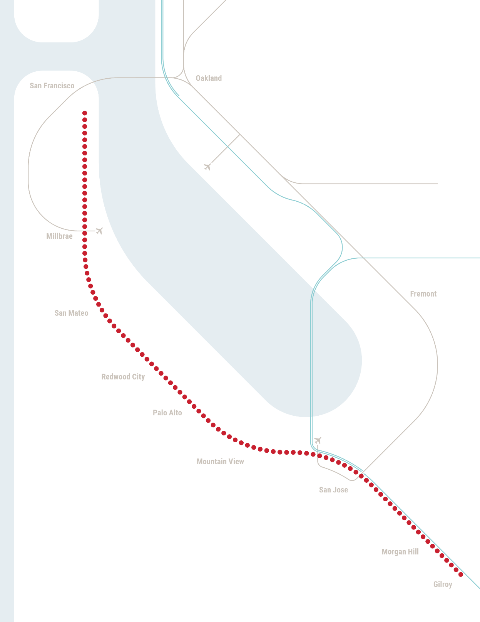
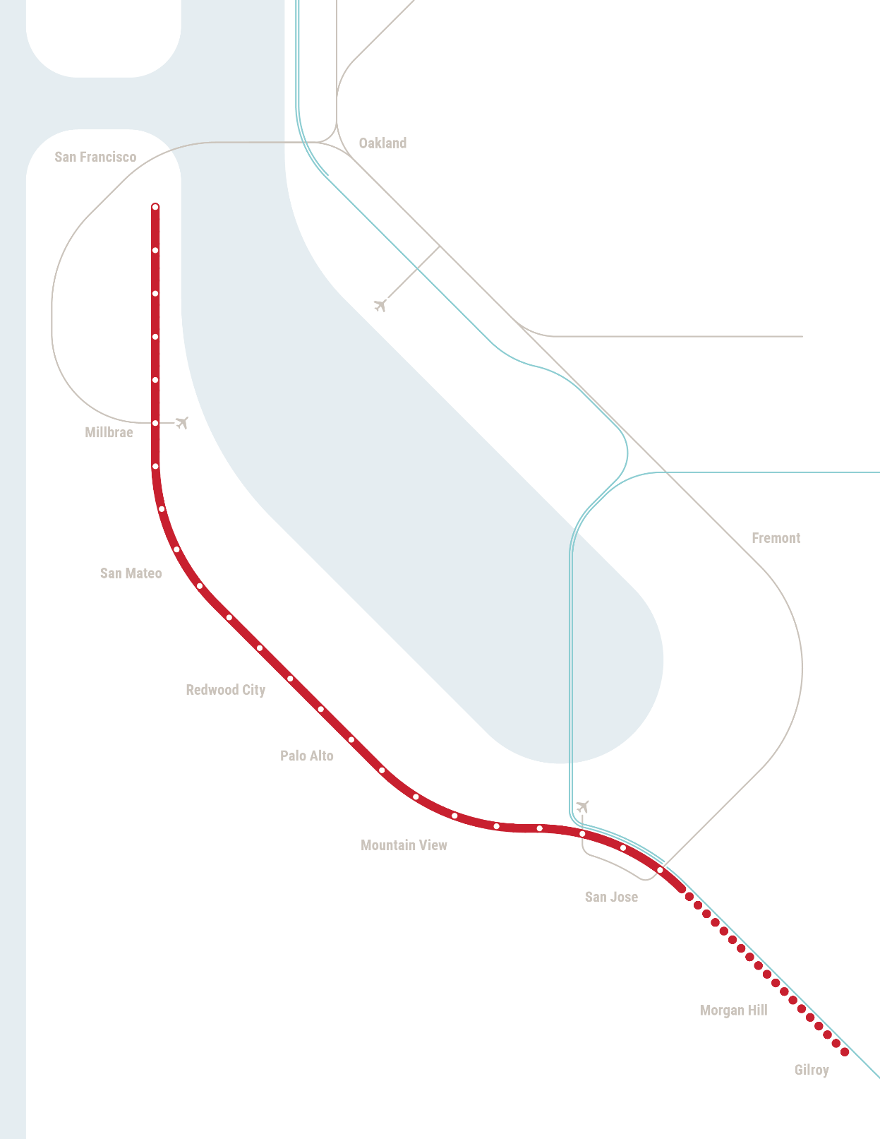

Expanding Concepts South of San Jose
North of San Jose
Corridor between San Francisco and Tamien owned by Caltrain
Electrification under construction
Caltrain will share corridor with HSR
South of San Jose
Union Pacific owns existing corridor between Tamien and Gilroy
HSR and State of California negotiating with UP
2018 HSR Business Plan contemplates building two electrified tracks alongside non-electrified freight track
Creates an opportunity to extend electrified Caltrain service south to Gilroy
22

Slide 23
Moderate Growth Scenario (8C + 4HSR Trains)
San Francisco
22nd St
Bayshore
South San Francisco
San Bruno
Millbrae
Broadway
Burlingame
San Mateo
Service Type
Hayward Park
Hillsdale
Local
Express
High Speed Rail
Belmont
San Carlos
Blossom Hill
Morgan Hill
PEAK PERIOD ,
EACH DIRECTION
Redwood City
Tamien
Capitol
San Martin
Gilroy
Atherton
Service Level (Trains per Hour)
4 Trains / Hour
Menlo Park
4 Trains / Hour
Palo Alto
4 3 2 1 <1
4 Trains / Hour
California Ave
Infrastructure
San Antonio
4 Trains / Hour
Conceptual 4 Track
Segment or Station
Mountain View
Sunnyvale
Features​
A majority of stations served by 4 TPH local stop line, but Mid-Peninsula stations are serviced with 2 TPH skip stop pattern
Express line serving major markets – some stations receive 8 TPH
Timed local/express transfer at Redwood City
Passing Track Needs​
Up to 4 miles of new 4-track segments and stations: Hayward Park to Hillsdale, at Redwood City, and a 4-track station in northern Santa Clara county (Palo Alto, California Ave, San Antonio or Mountain View. California Ave Shown)
Options & Considerations
To minimize passing track requirements, each local pattern can only stop twice between San Bruno and Hillsdale ​- in particular, San Mateo is underserved and lacks direct connection to Millbrae
Each local pattern can only stop once between Hillsdale and Redwood City​
Atherton, College Park, and San Martin served on an hourly or exception basis
Lawrence
Santa Clara
College Park
San Jose Diridon

Slide 24
High Growth Scenarios (12C +4HSR Trains)
San Francisco
22nd St
Bayshore
South San Francisco
San Bruno
Millbrae
Broadway
Burlingame
San Mateo
Hayward Park
Service Type
Hillsdale
Belmont
San Carlos
Blossom Hill
Morgan Hill
Local
Express
High Speed Rail
PEAK PERIOD ,
EACH DIRECTION
Redwood City
Tamien
Capitol
San Martin
Gilroy
Atherton
4 Trains / Hour
Menlo Park
Service Level (Trains per Hour)
4 Trains / Hour
Palo Alto
4 Trains / Hour
California Ave
4 3 2 1 <1
4 Trains / Hour
San Antonio
Infrastructure
Mountain View
4 Trains / Hour
Conceptual 4 Track
Segment or Station
Sunnyvale
Lawrence
Features​
Nearly complete local stop service – almost all stations receiving at least 4 TPH
Two express lines serving major markets – many stations receive 8 or 12 TPH
Passing Track Needs​
Requires up to 15 miles of new 4 track segments: South San Francisco to Millbrae, Hayward Park to Redwood City, and northern Santa Clara County between Palo Alto and Mountain View stations (shown: California Avenue to north of Mountain View)​
Options & Considerations
SSF-Millbrae passing track enables second express line; this line cannot stop north of Burlingame
Tradeoff between infrastructure and service along Mid-Peninsula - some flexibility in length of passing tracks versus number and location of stops
Flexible 5 mile passing track segment somewhere between Palo Alto and Mountain View
Atherton, College Park, and San Martin served on an hourly or exception basis
Santa Clara
College Park
San Jose Diridon

Slide 25
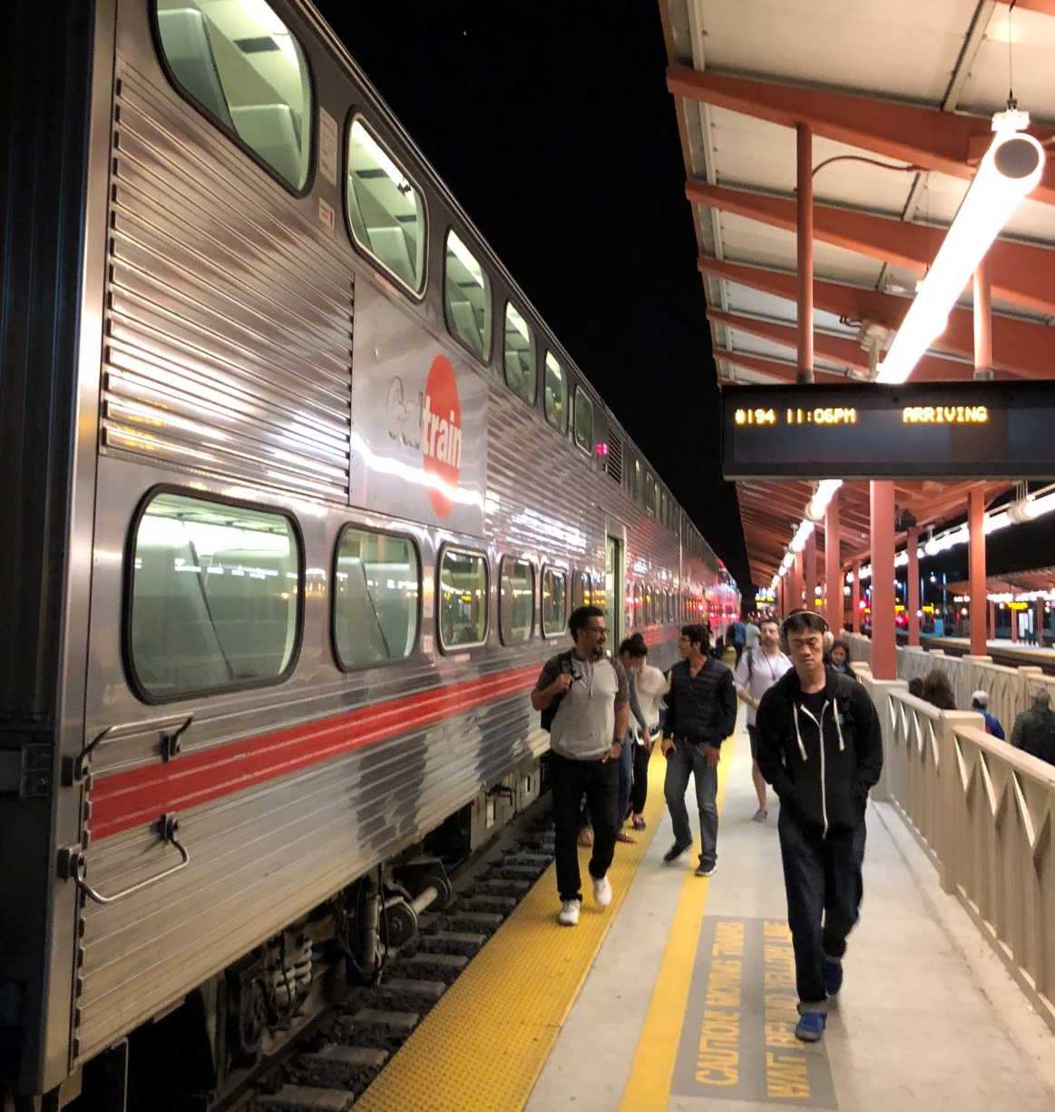
Developing All Day Service Plans
Off-peak and weekend service provides unique opportunities and challenges for Caltrain
The Caltrain corridor has very high all-day travel demand, 7 days a week
Demand for off-peak service may increase overtime along with corridor development and densities
Early morning, midday, evening, and weekend periods all present different challenges and opportunities related to operating costs and work windows for construction and maintenance
25

Slide 26
Service
How do we Choose a Service Vision?
This update describes different illustrative 2040 service concepts that underlie each Growth Scenario. The different concepts shown are not proposals or recommendations. They represent an indicative range of options for how Caltrain service could grow given different levels of investment in the corridor
Business Case
Choosing a long range “Service Vision” is not just about picking which service pattern looks the best- it requires evaluating which package of service and investments will deliver the best value to the corridor and the region
During the spring of 2019 the Business Plan team will develop a detailed “Business Case” analysis for each of the different growth scenarios. The Business Case will quantify the financial implications and wider costs and benefits of each growth scenario
26

Slide 27
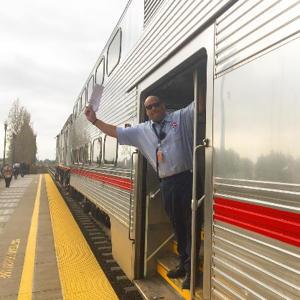
Planning to Deliver
How will the Caltrain Organization Support the Service Vision?
Key Concept- Service Delivery
How Caltrain operates and manages service (both on and off the corridor)
Includes activities like train operations, maintenance, capital project delivery, joint development, planning, and budgeting
Key Concept - Governance
The manner in which Caltrain is overseen by the Board
Focus on the agency’s decision making process and the Board’s oversight of the Caltrain organization
Analysis and Outcomes
Interviews with stakeholders, organizational “mapping” and analysis of current Caltrain structure
Comparison with national and international peer railroads
    Understand the range of potential organizational structures for both service delivery and governance and evaluate at a high level
    Work with JPB and JPA members to determine strategy and next steps
    Identify near term priorities related to Business Plan implementation

Slide 28
Looking Beyond the Tracks
Business Plan Overview
A Vision for Growth
Crafting Scenarios
Outreach and Looking Beyond the Tracks

Slide 29
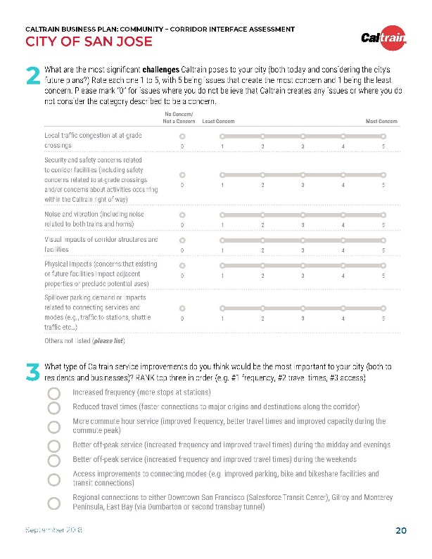
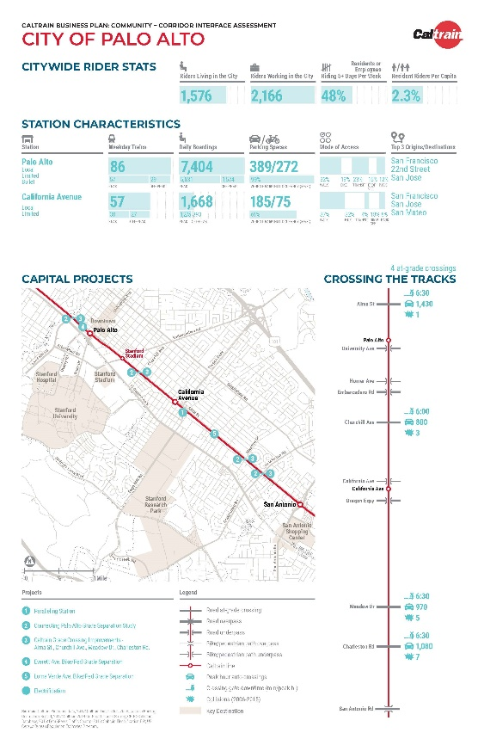
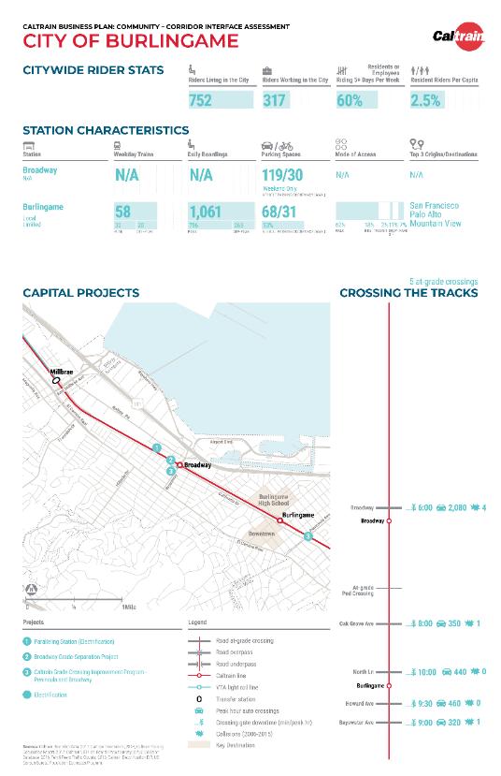
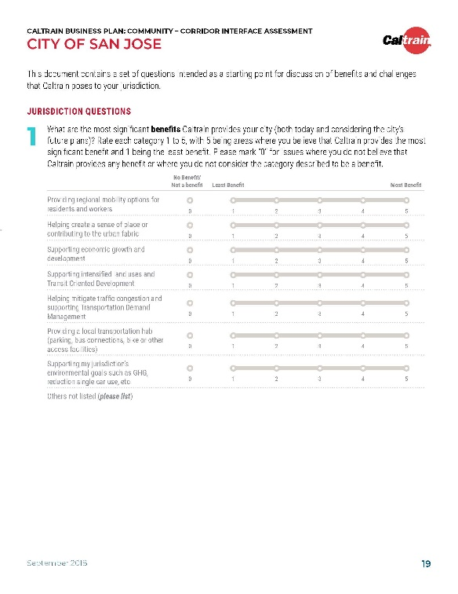
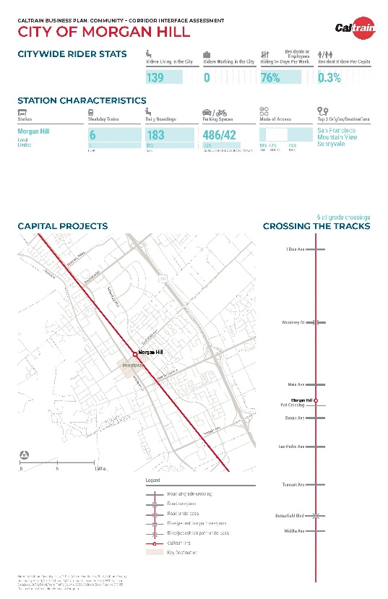
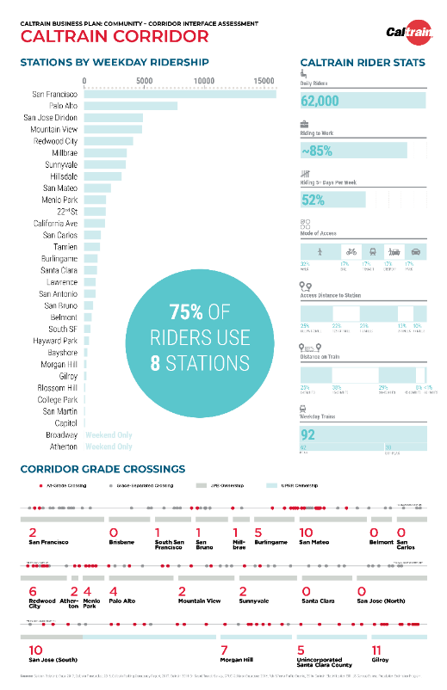
Direct Engagement with Local Jurisdictions is Central to this Effort

Slide 30


Key Themes From Discussions with City Staff
Service Levels & Schedules
Travel demand and mode split goals in relation to existing and anticipated roadway congestion
Physical
Corridor
Grade crossings, grade separations, and the stretches of fencing, walls, and vegetation in between
Land
Development
Placemaking, jobs-housing balance, transit-oriented development, and zoning changes
Station Connectivity
& Access
Local first/last mile solutions, multi-modal access, and equitable incentive programs

Slide 31
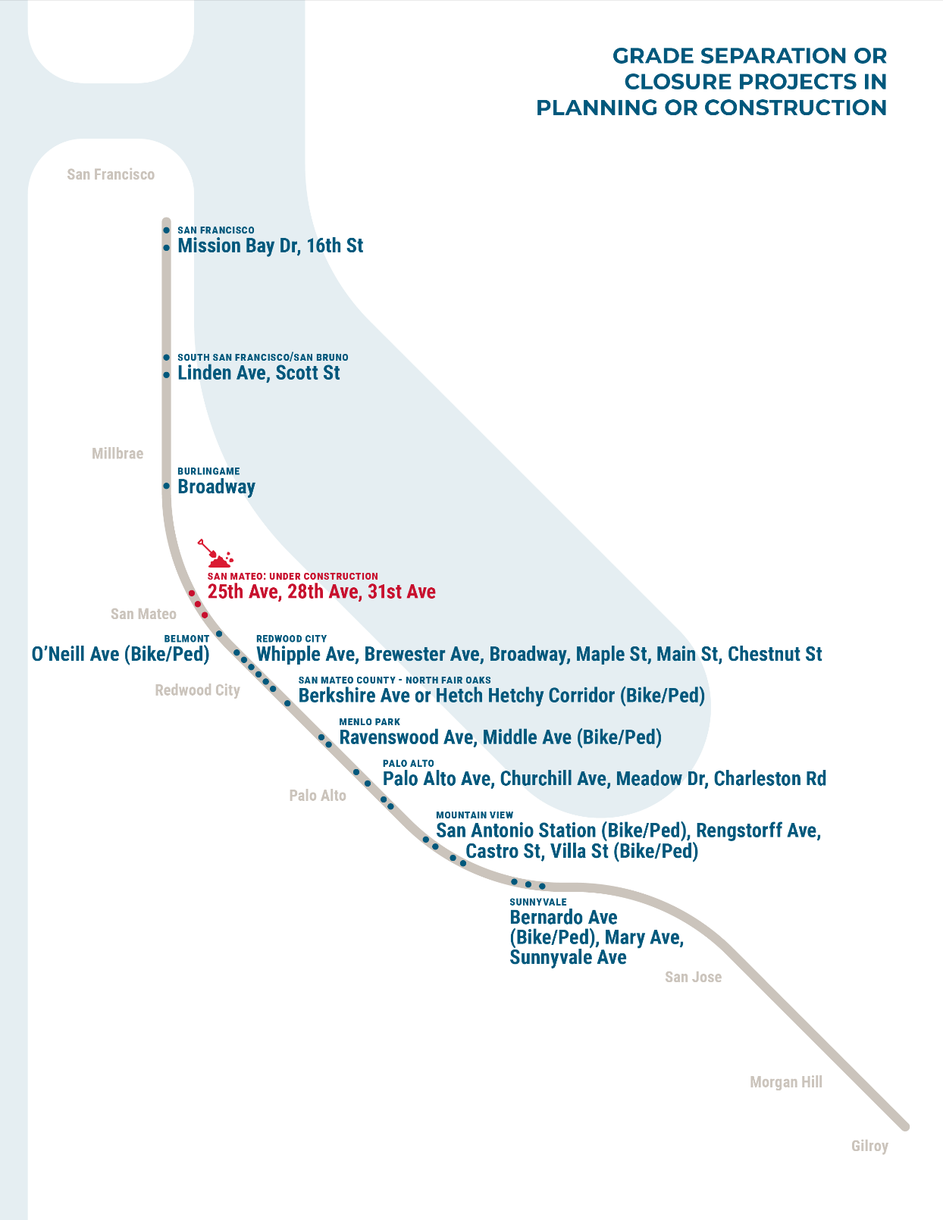
Grade Separations are Critical
All of the scenarios being considered involve significant increases in the number of trains per hour operating in the corridor
The Business Plan will consider the costs and challenges associated with grade separations and improvements to at-grade crossings as part of the overall plan
31

Slide 32
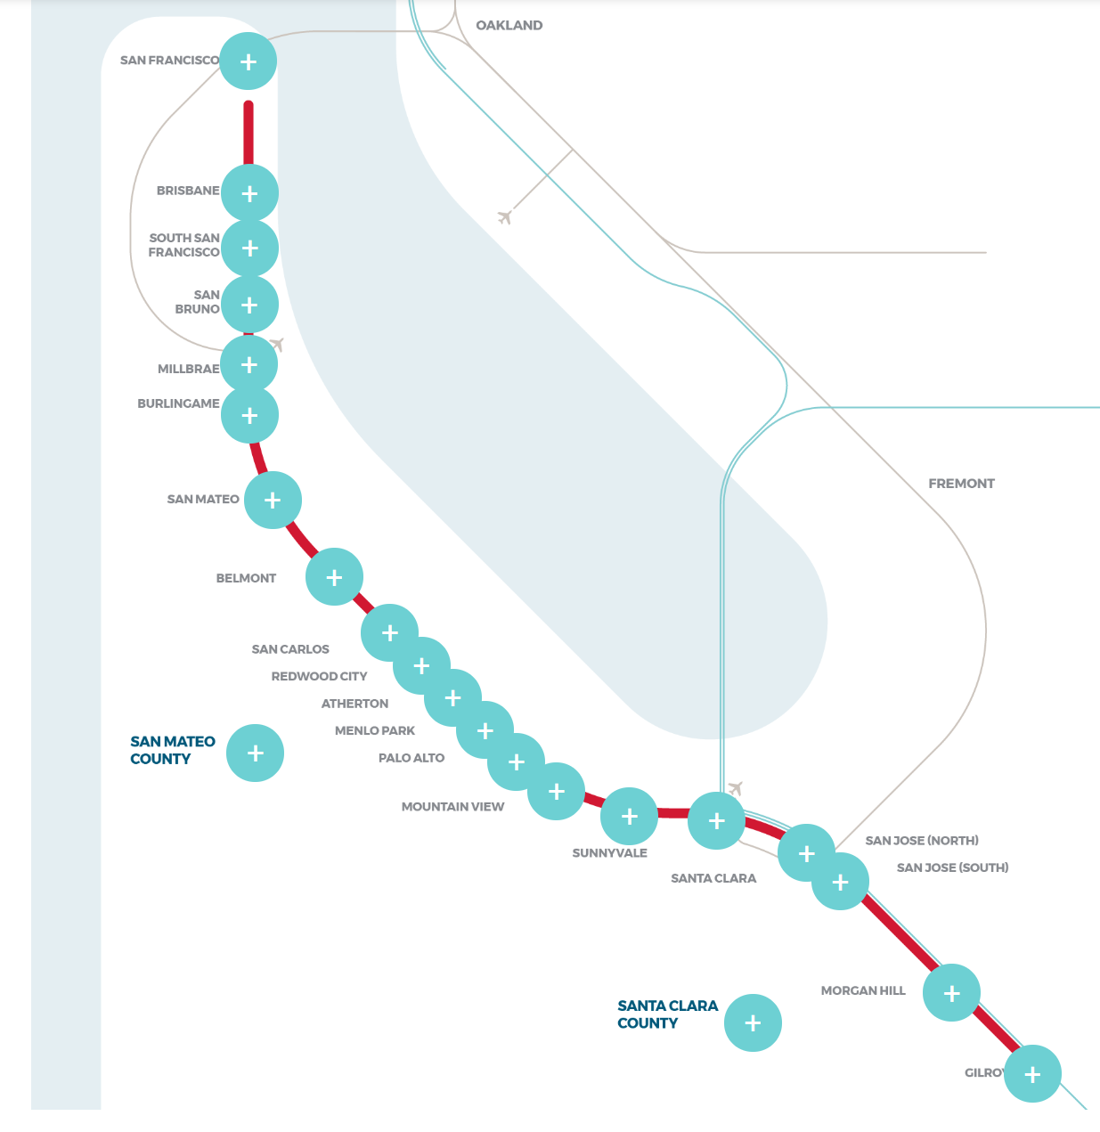
Business Plan Website is Up!
Project timeline
Project summary
Corridor-wide factsheet
Jurisdiction-specific factsheets
Monthly presentations
Glossary of key terms
FAQs
www.caltrain2040.org
32

Slide 33
Outreach Activities to Date
July – December Timeline
July
August
September
October
November
December
Local Policy Maker Group
City/County Staff Coordinating Group
Project Partner Committee
Community Interface Meetings
(One Per Jurisdiction)
Stakeholder Advisory Group
Partner General Manager
Website & Survey Launch
Community Meetings (One Per County)
Sister Agency Presentations

Slide 34
Outreach Activities to Date
July – December by the Numbers
Stakeholders Engaged
21
26
39
93
Jurisdictions
Public Agencies
Stakeholder Group Meetings
Organizations in Stakeholder Advisory Group
Public Outreach
18
700+
2,600
27,000
Public Meetings and Presentations
Survey Responses
Website Hits
Social Media Engagements

Slide 35
Next Steps
We Are Here
35

