Slide 1
Why Walking Matters Walk Audits
Theresa Vallez-Kelly
Safe Routes to School Coordinator
June 27, 2019

Slide 2
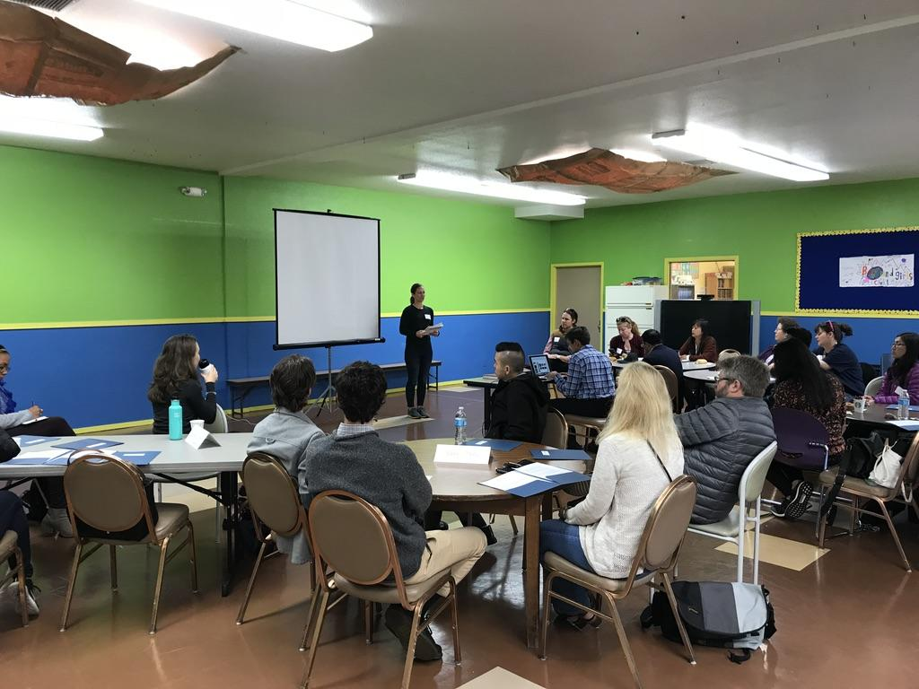
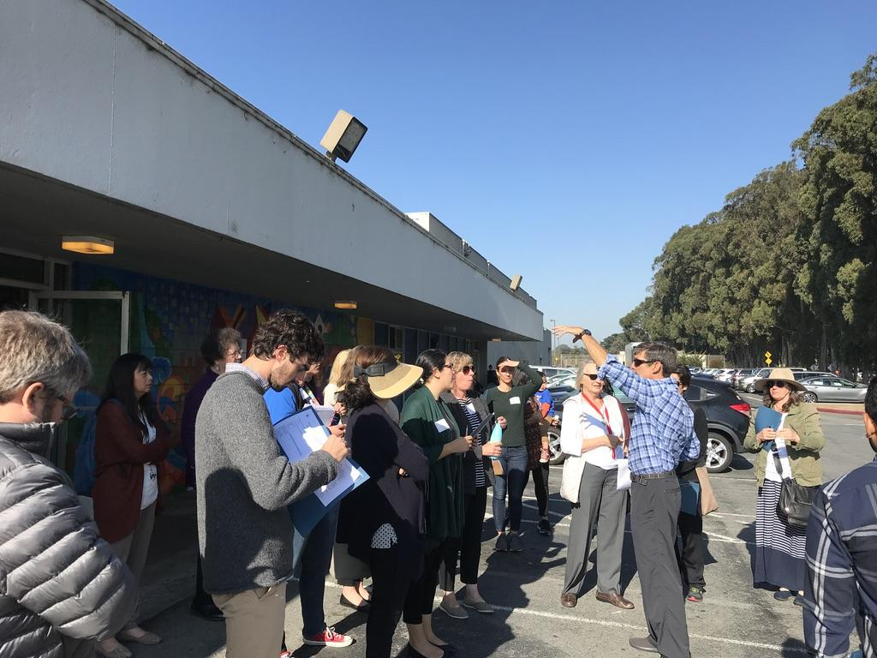
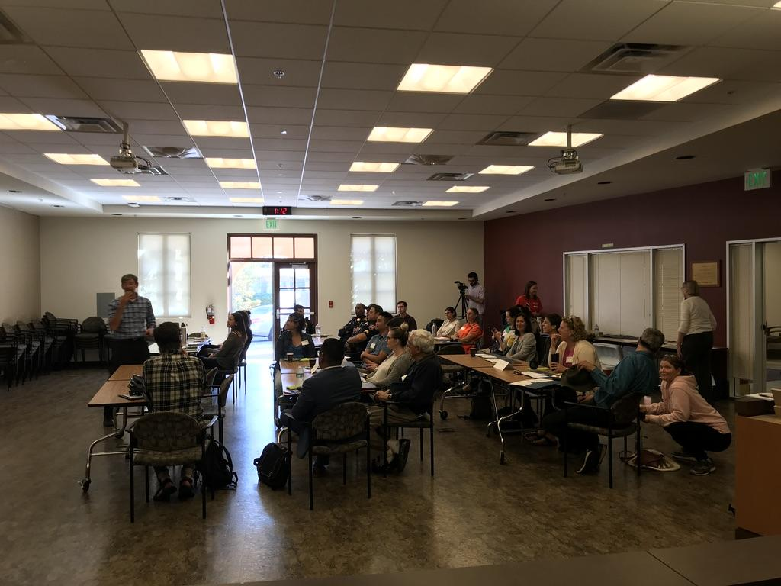
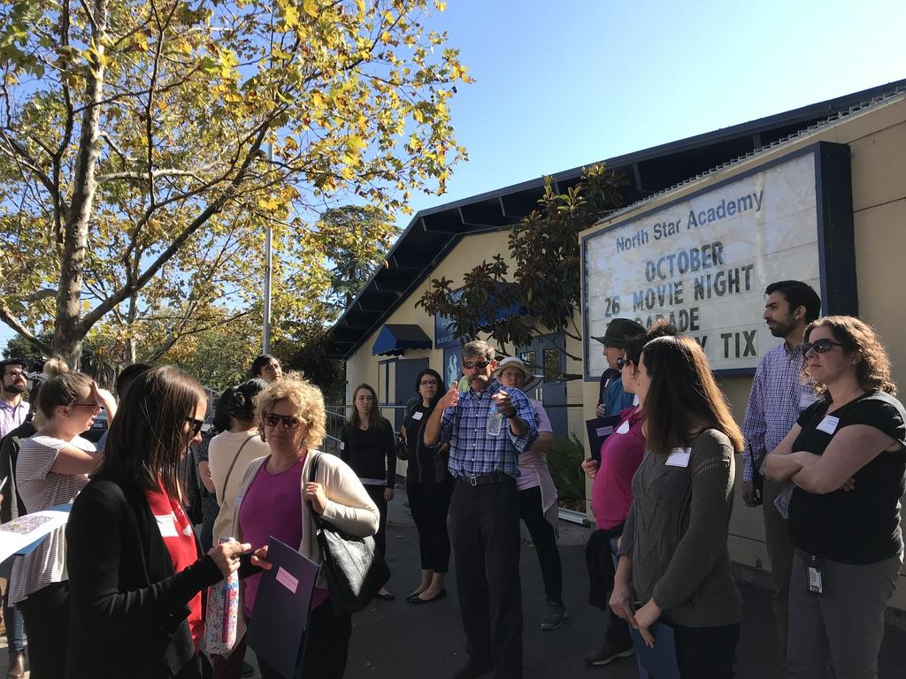
Why Walking Matters
www.markfenton.com

Slide 3
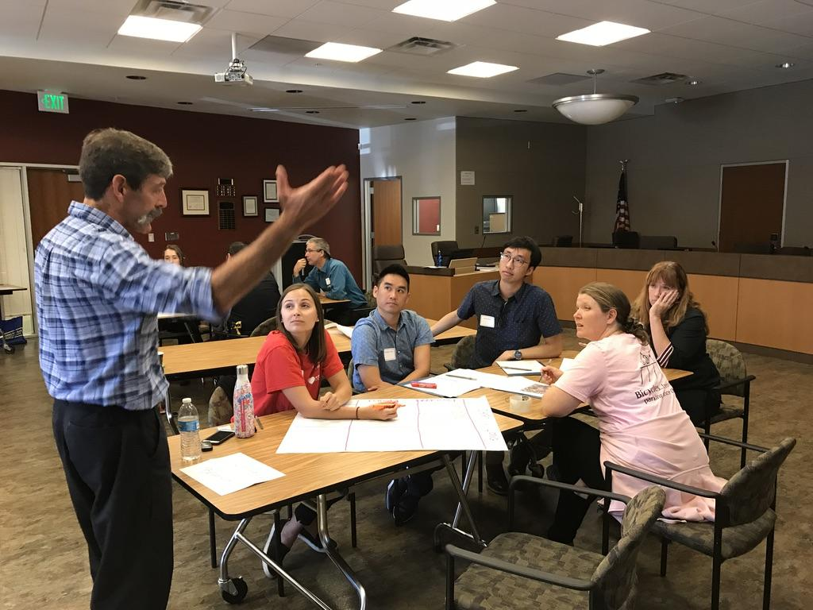
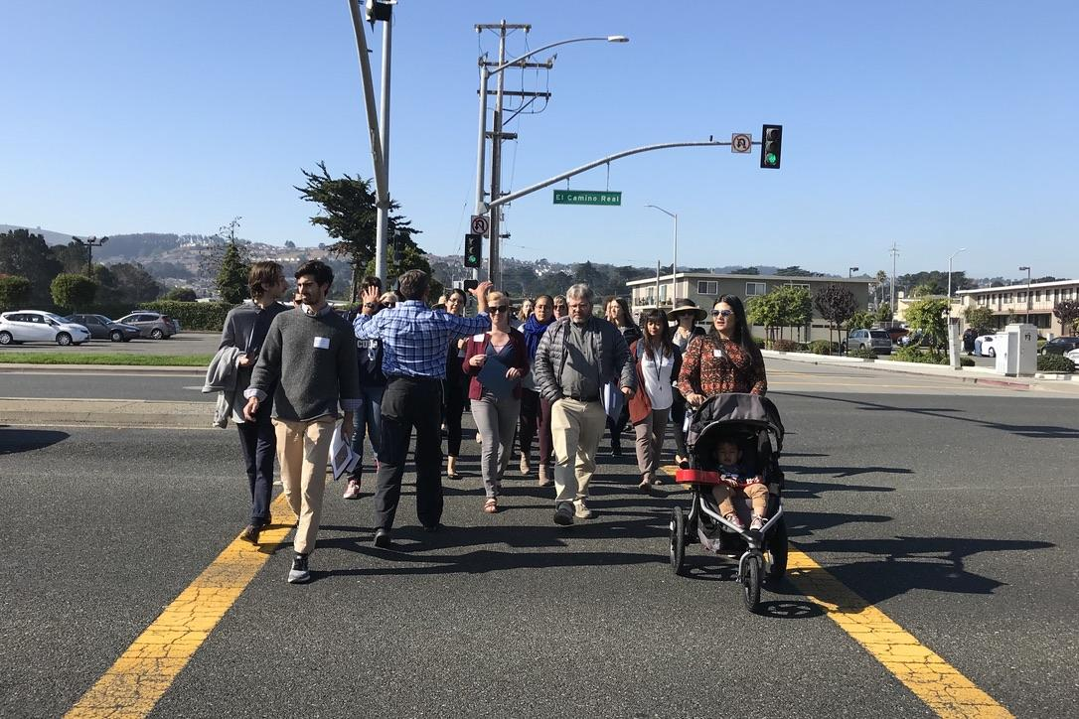
Why Walking Matters
www.markfenton.com

Slide 4
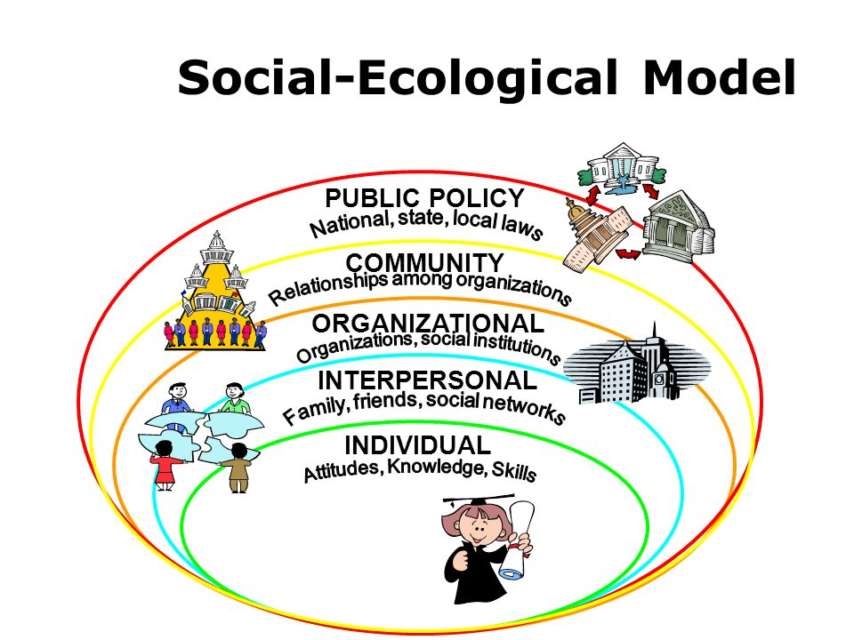
Notes:
https://slideplayer.com/slide/6300971/
https://borgenproject.org/social-ecological-model/
People do not act in isolation, which is why it is important to understand the ways they interact with their communities and environments, in order to determine why they do what they do.
Policy – advocacy - Policies and laws that are instigated at local, national and global levels make up the broadest level of the Social Ecological Model. These policies have the potential to impact large numbers of people.
Community – social mobilization - These associations include businesses and functions of the “built environment,” such as parks.
Organizational – social change communication - Organizations are instrumental in the development of behaviors as they often enforce behavior-determining regulations and restrictions. A school, for example, controls the dissemination of knowledge. This influence is significant when it comes to communicating information about safe health practices.
Interpersonal – behavior change communication and social change communication - The relationships and social networks that a person takes part in also have great potential to impact behaviors. Families, friends and traditions are key players at the interpersonal stage of the model.
Individual – behavior change communication - An individual’s various traits and identities make up this level of the Social Ecological Model. These characteristics have the capacity to influence how a person behaves. Age, education level, sexual orientation and economic status are some of the many attributes noted at this interval. These factors are important to consider when constructing public health strategies, as characteristics such as economic status are linked to an individual’s ability to access healthcare.

Slide 5
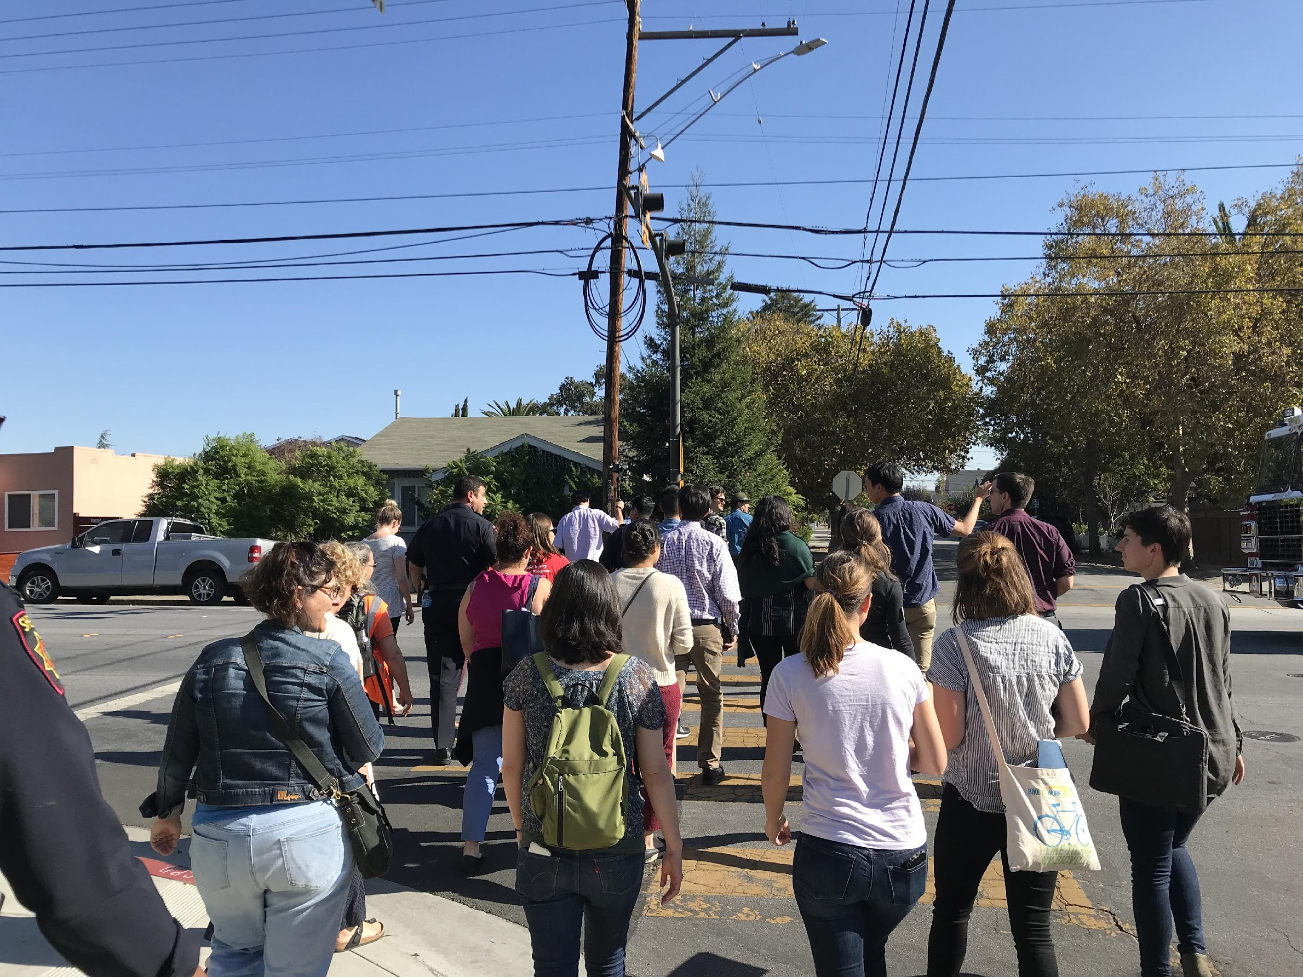
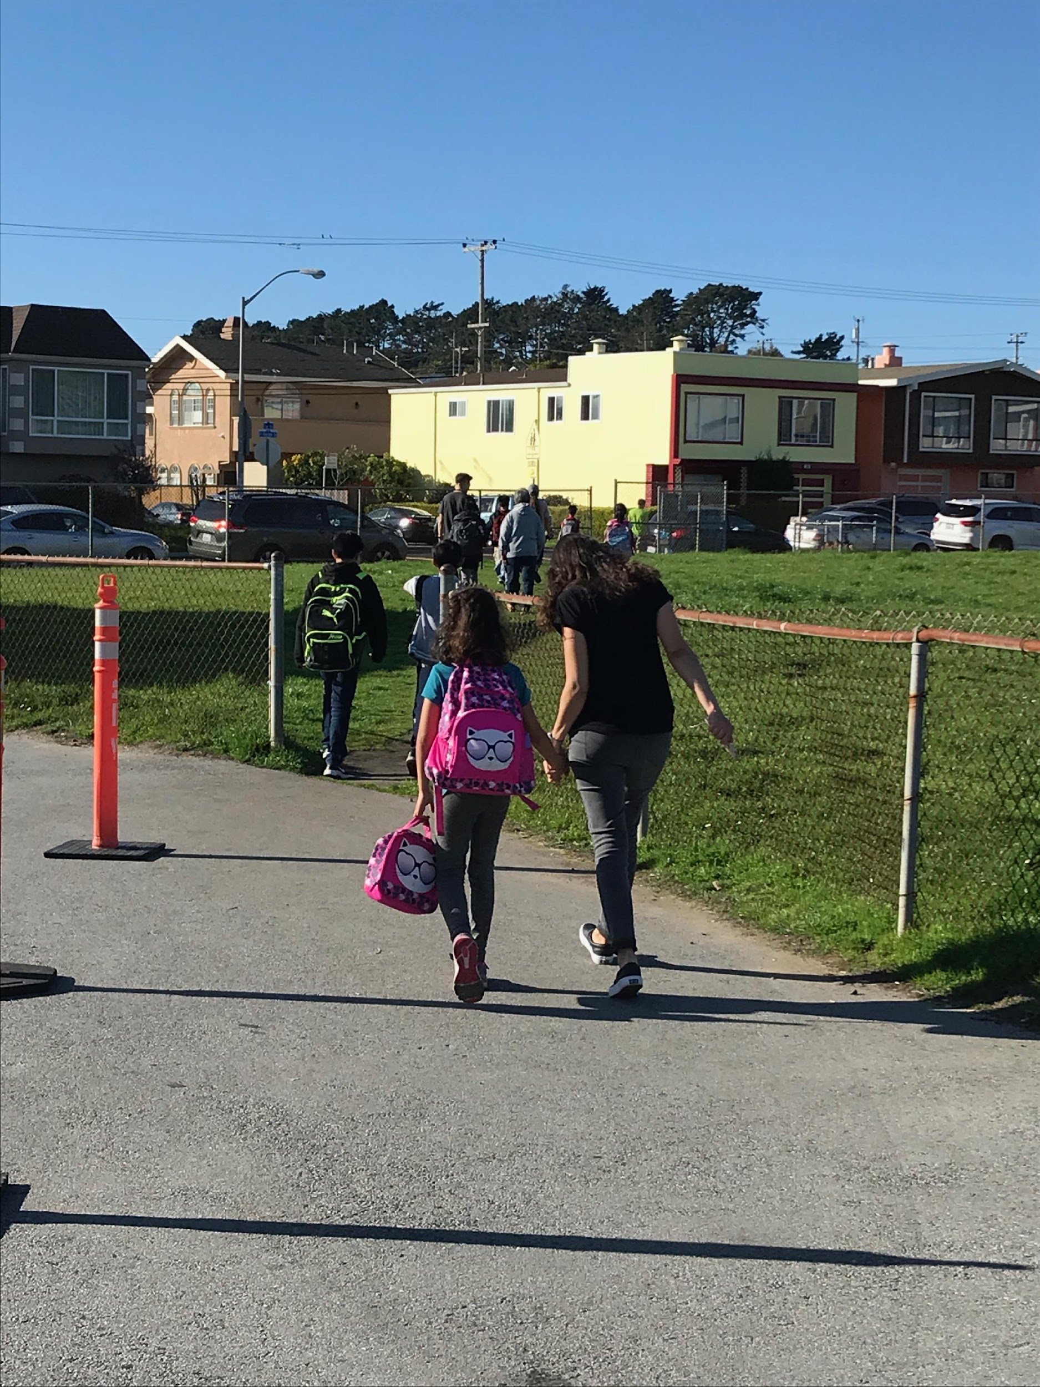
What is a walk audit?
Peoria IL
Hutchinson KS
Facilitated group walk to explore level of support for physical activity & active transportation.
Followed by discussion & planning to develop recommendations for action.
Not experts giving answers; an act of shared discovery solutions.

Slide 6
Three potential benefits . . .
Learn how to improve settings for active transportation.
Gather participant input on challenges and priorities.
Inspiration to actually try something.
Kearney NE

Slide 7
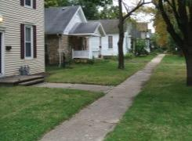
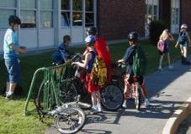
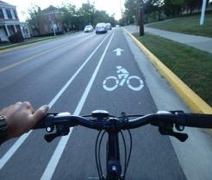
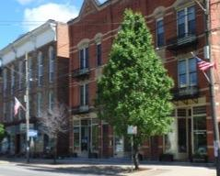
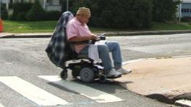
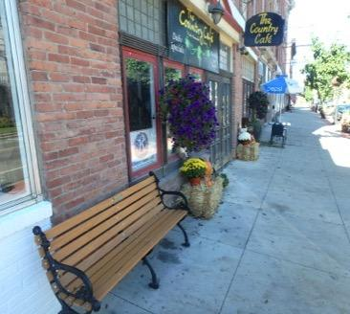
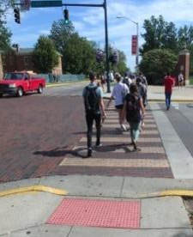
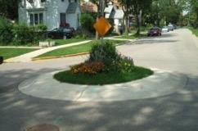
4 elements encouraging active transport . . .
Network
Land Use
Safety & Access
Site Design
www.markfenton.com
Notes:
Network - Sidewalks, curb cuts, bike lanes, non-motorized trails.
Shorter blocks, few cul-de-sacs, more connections.
Accessible, affordable, frequent transit.

Slide 8
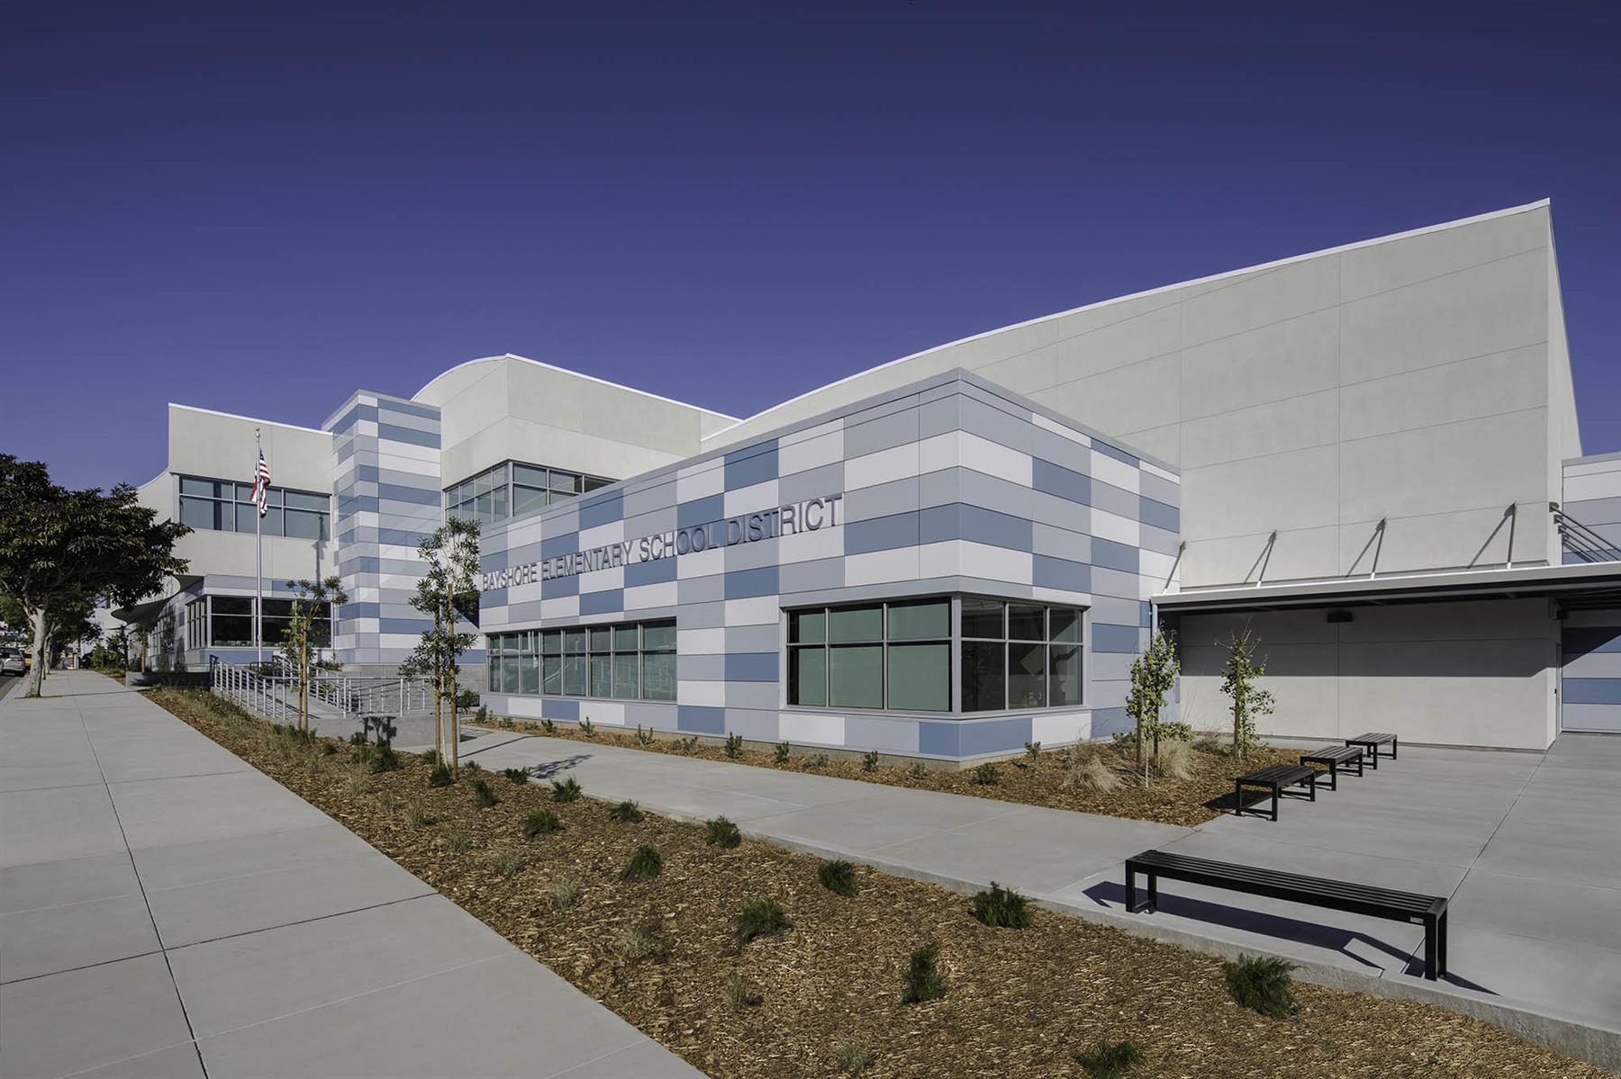
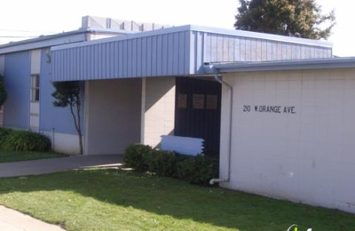
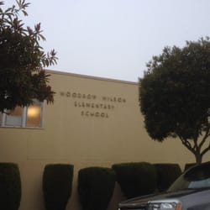
Walk Audits
Los Cerritos, SSF
Bayshore, DC
Woodrow Wilson, DC

Slide 9
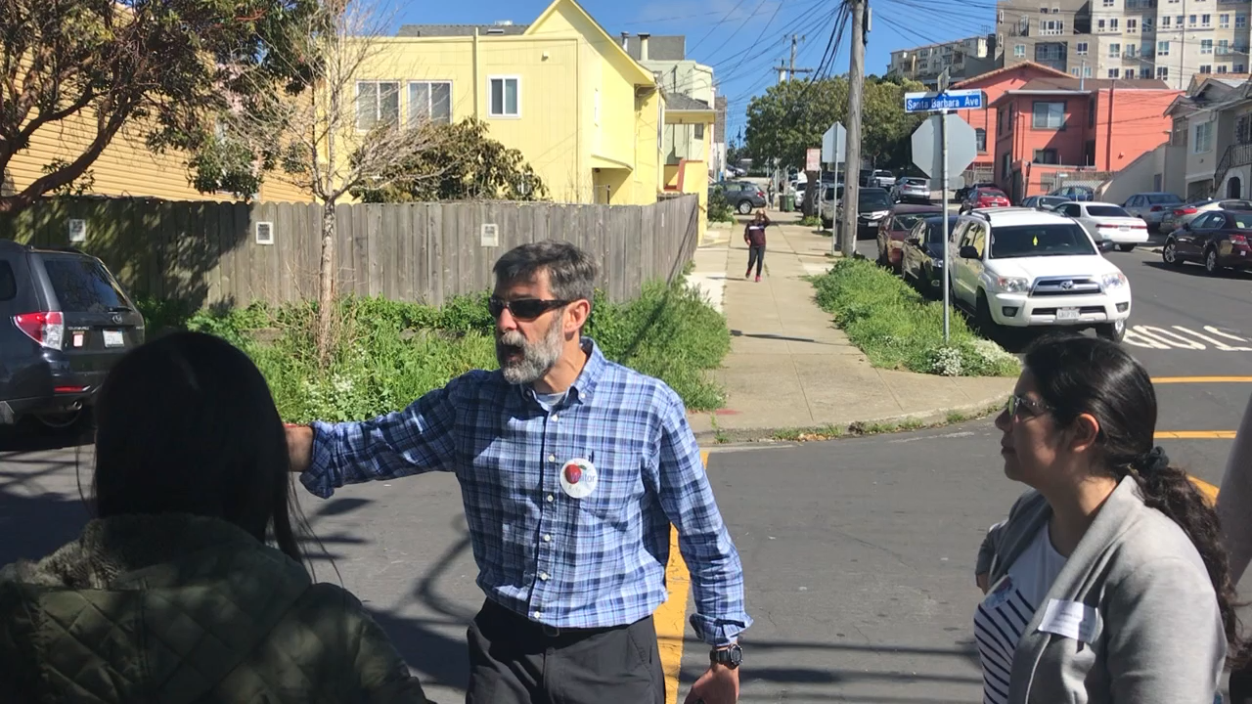
Notes:
This is a video.

Slide 10
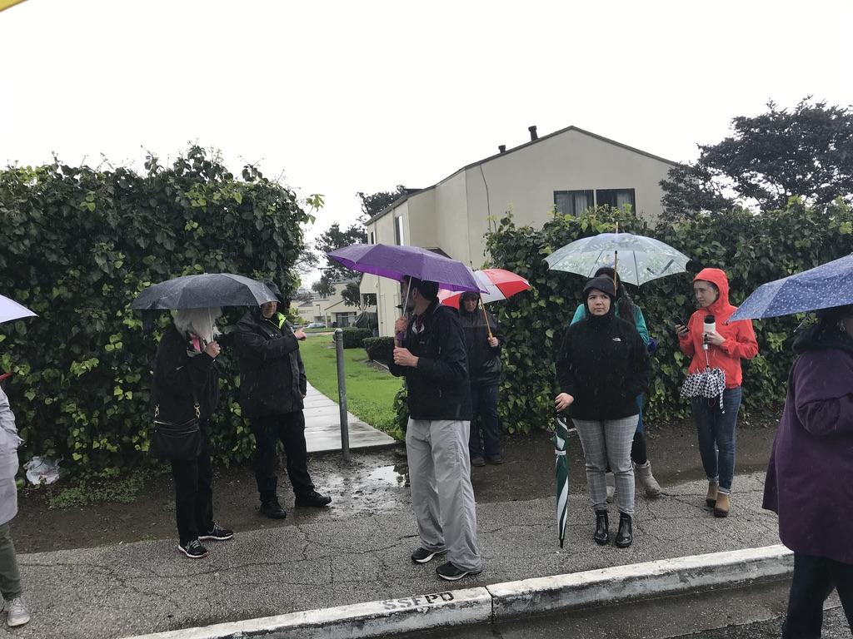
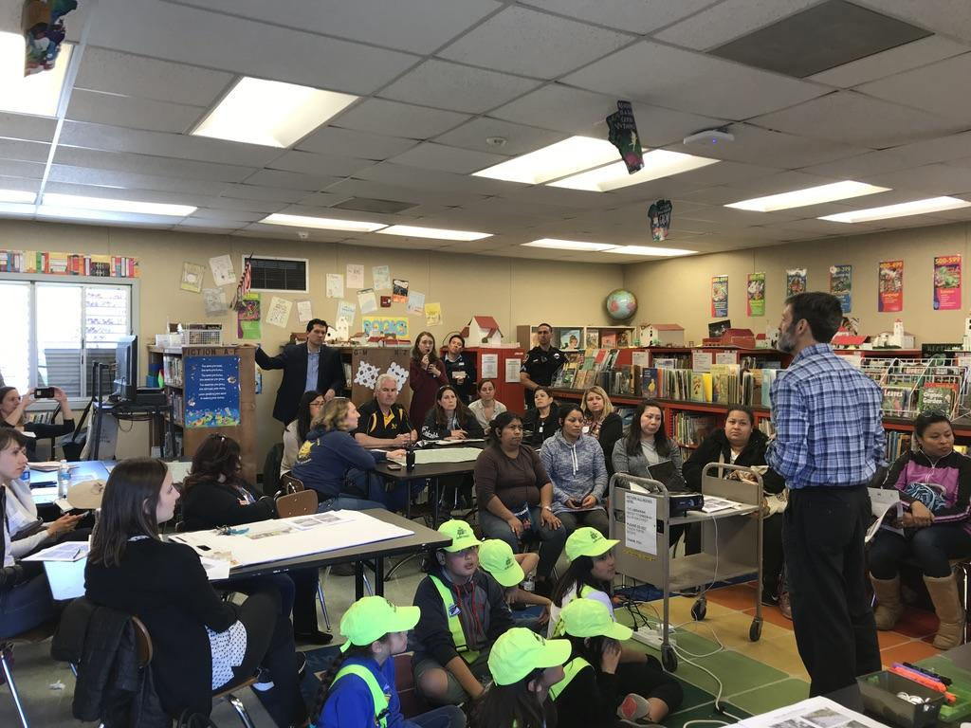
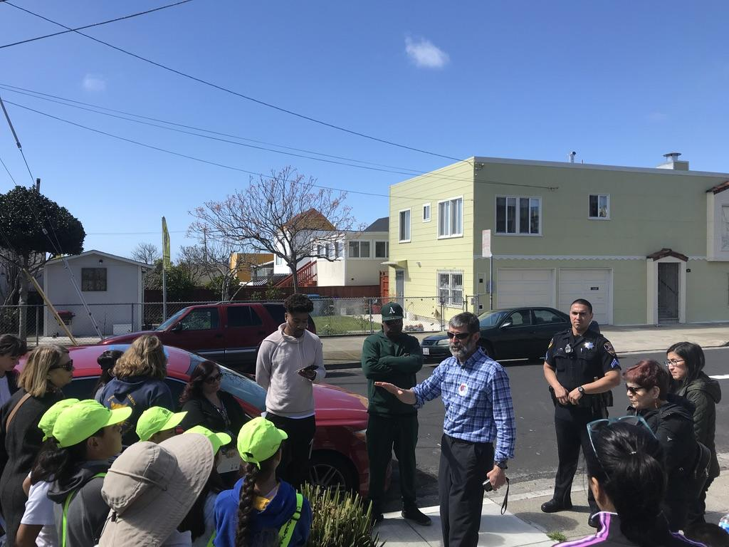
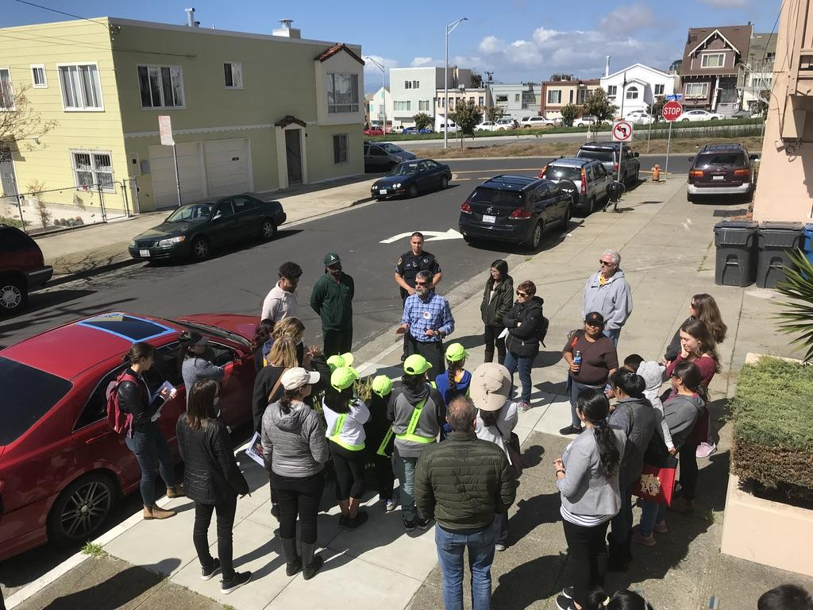

Slide 11
Recommendations
Notes:
See walk audit reports

Slide 12
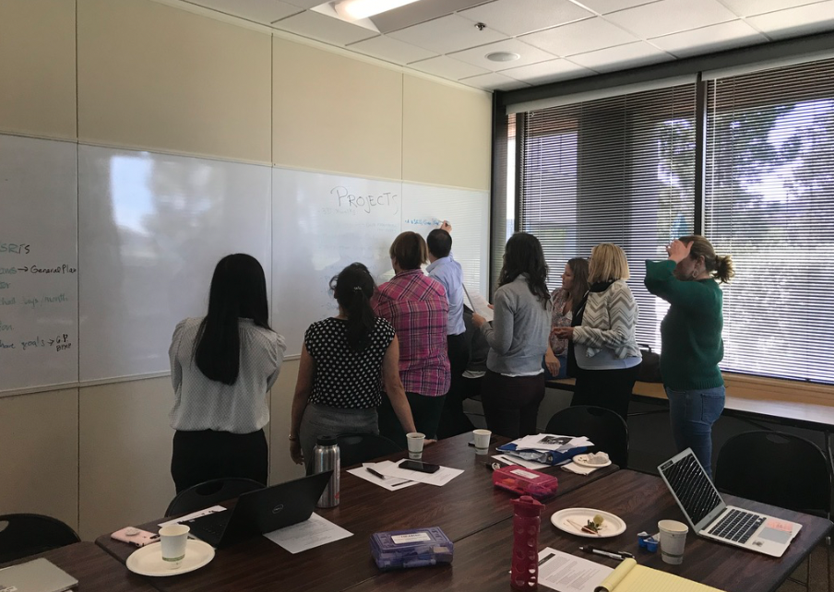
Collective Impact Project

Slide 13
Thank You!

