Slide 1
A energy saving program for all PG&E customers.

Slide 2
HEA (Home Energy Analytics)
Founded by Steve and Lisa Schmidt in 2009, based on Steve’s exploration of energy waste starting in 2008
HomeIntel
Free energy saving service from PG&E
Both Smart Audit (software) and energy coach (person)
Smart Audit – web app
Web app
Self service, utilizes smart meter data
Energy Coach
Personal coach
Support via phone, email and home visits

Slide 3
HomeIntel in a nutshell
Diagnose/Analyze
Smart meter with customer input to create home energy profile
Adapt/Reinforce
New energy data with consultation to create updated energy plan
Treat/Change
Online audit with energy coach and reduction plan
Monitor/Engage
Ongoing savings through helpful content and energy coach
There is no such thing as the “typical” home!

Slide 4
HomeIntel is a 4 way win!
For San Mateo Communities
A free EE program for all residents.
Accurate and different energy insights.
For Residents
New EE service focuses on plug loads.
Suited for high energy users.
Available to owners and renters.
For PG&E
Guaranteed “to get what they pay for”.
Targets a new customer group.
For HEA
The more we help clients save, the more we get paid.

Slide 5
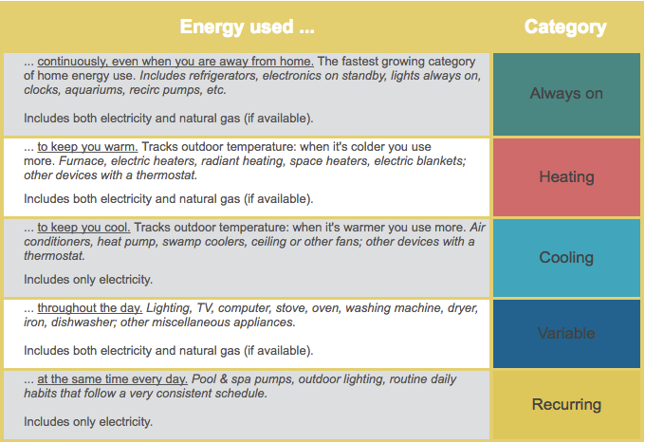
Key components
Algorithms
8 energy categories
Smart Audit web app
Energy education based on AMI data
Constantly updated with energy data
Service
Email, phone and in-house based on savings potential

Slide 6
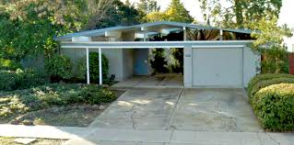
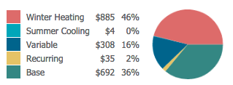
Every home is unique
$1927/year
Focus on
Plug Loads
There is no such thing as an “typical” home.
Focus on HVAC
$1,924/year

Slide 7
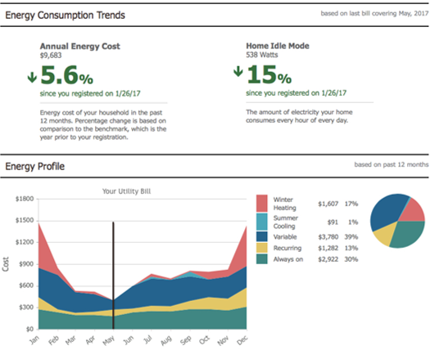
Example high energy home

Slide 8
“huh?”: Forgotten
$8,000/year
$200/year
Pool pump timer disabled, so pump was running 24/7.
Fan set up in crawl space after flood damage forgotten; left running for over a year.
$2,500/year
$300/year
2 electric resistance baseboard heaters always on in unoccupied space
Fan setting on thermostat changed from “auto” to “on”; left running for over a year.
8

Slide 9
“really?”: Surprisingly Inefficient
$700/year
$400/year
Outdoor lighting with over 20 bulbs (300w). Halogen bulbs.
Heated towel rack using 120 watts running continuously.
$800/year
$1,500/year
Continuous hot water recirc pump ($400 for gas, $400 for electricity)
20+ year old fridge with 4 bottles of beer plus two dorm fridges with bottled water in each.
9

Slide 10
“leaks!”: Getting Nothing
$1,500/year
$600/year
Two “Instahot” hot water dispensers (250W each). Rarely used.
Electrically heated bathroom floor on when “off” (200W). Had to turn off breaker.
$700/year
$0.47 vs. $0.13
Whole-house audio amplifier plugged in but unused for years.
Charging an EV at peak times versus middle of the night.
10

Slide 11
Results as of 8/20/19
1448 participants
11,960 MMBs saved

Slide 12
Can you help us get the word out?
Newsletters
Websites
Facebook posts
NextDoor
Handouts
Community Events
Educational seminars
Please remember HomeIntel anytime sustainability is promoted!

Slide 13
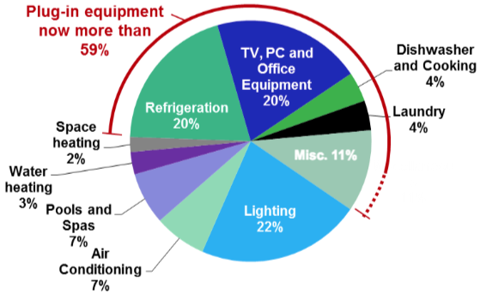
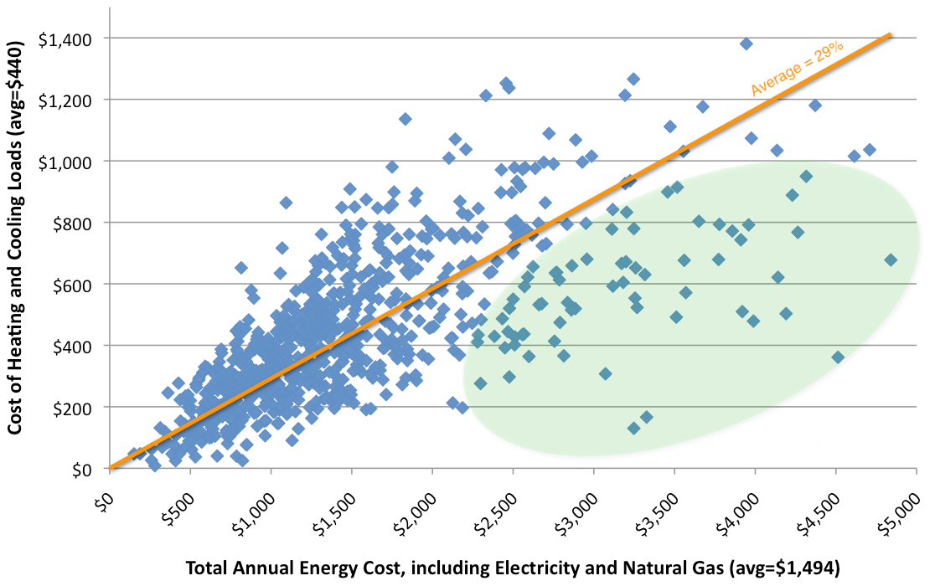
Increasing plug loads
Energy consumed by plug loads is growing to be >50% for target homes.
Percentage of plug load energy use is higher in high energy homes.

