Slide 1
Accelerating Cleantech for Climate Restoration
Presented to
Resource Management & Climate Protection Committee
11/20/2019

Slide 2
Who am I?
Thank you for having me
Brett Gentry
Concerned citizen and startup mentor
Recent interest in climate change
Mentor at a couple of Cleantech accelerators and independently
Notes:
Thank you for having me
Brett Gentry
Concerned citizen and startup mentor
Recent interest in climate change
Mentor at a couple of Cleantech accelerators and independently

Slide 3
Why am I here?
We need to move faster in solving climate change
3 approaches to restoring our world:
Emissions reduction
Climate mitigation
Emissions removal
Notes:
So why am I here today?
We need to move faster in solving climate change
I break it down into 3 approaches to restoring our world
Reduction:
--reducing & replacing fossil fuel consumption with clean energy
--AND we’ve been trying this for a long time
Mitigation:
--SINCE reduction isn’t enough, we started preparing for the negative impacts
And now we realize we need to remove the carbon from the atmosphere and oceans.
The carbon we’ve all added to the environment since the industrial revolution began

Slide 4
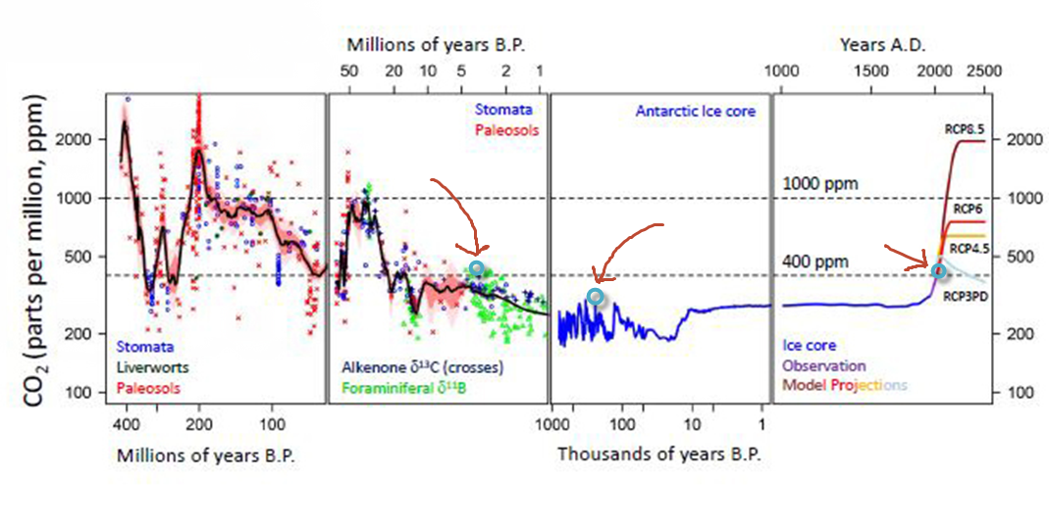
Removal need
2
3
1
Notes:
GHG REMOVAL is now a REQUIREMENT per the latest IPCC report
--Here’s some context
*CO2 remains in atmosphere for 5-200 years which is much longer than the other GHG’s
https://archive.ipcc.ch/ipccreports/tar/wg1/016.htm
**Last time we had this much CO2 (~410 ppm (((1)))
----3 million years ago (((2)))
---2-3 Celcius warmer but 10 Celcius warmer in the arctic
---Sea levels 15-25m higher
---homo sapiens began 400,000 yrs ago (((3)))
---last ~10,000 yrs CO2 has been extremely stable at ~300ppm, which is where we need to be.
**https://e360.yale.edu/features/how-the-world-passed-a-carbon-threshold-400ppm-and-why-it-matters
*** Since the industrial revolution, we’ve added 2,000 gigatonnes of CO2
https://www.pbs.org/newshour/science/this-new-battery-aims-to-spark-a-carbon-capture-revolution
It’s a HUGE challenge to remove.
https://informationisbeautiful.net/visualizations/how-many-gigatons-of-co2/
Basically, it’s the fossil fuel industrial revolution (~100 years) in reverse
The sooner we can do this
--the easier it will be because there will be less of it (~40GT/yr) and
--the fewer negative impacts we have to contend with

Slide 5
Amazing clean tech in the pipeline
batteries that capture CO2 as they charge
proteins made from captured CO2 to feed the world
splitting water efficiently to produce hydrogen and clean water
super heated solar capable for industrial applications
…
Notes:
If we can do this, we will have an incredibly green and sustainable world.
--batteries that capture CO2 as they charge
--proteins made from captured CO2 to feed the additional billions of people
--splitting water efficiently to produce hydrogen and clean water
--super heated solar capable for industrial applications
These are all new technologies and startups
The list goes on, which is awesome, and extremely encouraging
----------------------------------------------------------------------------------------------
https://www.pbs.org/newshour/science/this-new-battery-aims-to-spark-a-carbon-capture-revolution
https://www.kiverdi.com/
https://news.stanford.edu/press-releases/2019/03/18/new-way-generateen-fuel-seawater/
https://www.cnn.com/2019/11/19/business/heliogen-solar-energy-bill-gates/index.html
https://today.uconn.edu/2019/11/breaking-co2-faster-cheaper-efficiently/

Slide 6
Cleantech to the rescue?
Unfortunately, new technology and businesses takes years to
Develop
Prove
Scale
And replace existing modes of business
Notes:
Unfortunately, new technology and businesses takes years to
--Develop
--Prove
--Scale
--And replace existing modes of living and business
Look at solar and wind
We don’t have many years left
The climate train has left the station and has plenty of momentum…
SO, unfortunately, Cleantech won’t magically save us unless we can accelerate it’s adoption

Slide 7
The Ask
How can we accelerate new Clean technology adoption?
Notes:
So my Ask today is:
Can we accelerate Cleantech adoption?
Let’s brainstorm together
BUT before we do this
let me go over some of the challenges startups face

Slide 8
Startup Challenges
Specifically Cleantech

Slide 9
Major Startup Challenges
Customer Discovery
Pilots
Funding
Notes:
There are a lot of reasons startups fail
BUT these 3 are the primary ones that perhaps the county and cities can help with
Customer Discovery: making a product or service someone will actually PAY for
Pilots: deploying, testing, and iterating with a patient interested partner
Funding: money to scale the business
--------------notes--------
See slide at end of deck for 20 reasons startups fail

Slide 10
1. Customer Discovery
~40-50% failure rate for ALL startups
Additional Cleantech startup challenge?
Often scientists not business people
It OFTEN takes a lot of time
Notes:
So Customer Discovery…
~40-50% of ALL startups fail do to the inability to find customers willing to pay for their technology or service
Cleantech has additional challenges
--They’re usually scientists not business people
--It takes time and a large number of meetings with potential customers to uncover genuine product market fit, despite having awesome tech.
I spoke with a revolutionary battery startup full of scientists so focused on their technology they didn’t know who their customers were
Another example, is I mentor a startup by a Harvard physicist that converts captured CO2 into various products: biochar, oils, fuel, etc…
Their challenge has been finding enough industry partners to speak with, to understand how they can fit into their existing businesses

Slide 11
2. Pilots
Prove it before you can sell it
Additional Cleantech startup challenge?
Often immature technology
Often takes years to develop into a commercial product/service
Often requires significant infrastructure to validate
Notes:
All startups need to prove it before they can sell it
And Cleantech is really tough because
--Often the technology is very immature
--Because of this, it often takes years to develop into a commercial product/service
--And often requires significant infrastructure to validate
Good patient partners help you validate and create the market proof needed to validate market fit, become commercially viable and get funding
There’s actually a HUGE opportunity to lower emissions AND sequester CO2 in building materials, production and operation.
For example, if concrete were a country it would be the third largest emitter of CO2 behind the US and China.
--There’s a startup in Los Gatos, called Blue Planet, that wraps aggregate with Calcium Carbonate derived from captured CO2, sequestering in concrete. This lowers concrete emissions AND sequesters CO2.
--And another startup I know is trying to find landfill partners to validate their Lawrence Livermore Lab technology to capture and utilize methane
---And there’s an AI startup I know that’s focus has been on predicting snow and water runoff but mentioned they could actually help PG&E better predict where fires might start and therefore shut off power to far fewer homes.
Wouldn’t it be great if they could help
----------------- References ---------------
If concrete were a country it would be the third largest emitter of CO2.
https://www.bbc.com/news/science-environment-46455844
Buildings and their construction together account for 36 percent of global energy use and 39 percent of energy-related carbon dioxide emissions annually. https://www.worldgbc.org/sites/default/files/UNEP%20188_GABC_en%20%28web%29.pdf
In 2018, the residential and commercial sectors accounted for about 40% of total U.S. energy consumption. https://www.eia.gov/tools/faqs/faq.php?id=86&t=1

Slide 12
3. Funding
Often needed to scale ANY business
Additional Cleantech startup challenge?
Currently very limited Federal funding
Too early for majority of Venture Capital
Often very capital intensive
Notes:
Most startups require funding to scale
Cleantech has additional challenges beyond scale
--Currently very limited Federal funding and even state funding is very small
--Cleantech is too early for majority of Venture Capital.
VC want revenue, Revenue only comes with customers, Customers only come after pilots, Pilots only happen with good patient partners, and Cleantech products/services only happen after years of development and investment
--And finally, Cleantech is Often very capital intensive which requires money
I don’t expect the county or cities to provide funding but perhaps we can expedite customer discovery and pilots that will naturally attract funding?
Some context
VC Cleantech funding has been in decline since it peaked in 2011 at $8B. I THINK this is for all of the US…
https://www.greentechmedia.com/articles/read/how-do-cleantech-startups-get-funded-in-2019
Government funding, like CalSeed, has a $24 million fund
Grants are often between 50k-$2m over multiple years
Oil companies invest I recall $64m in DAC
"Technology companies in the Bay Area raised more than $10 billion in the first three months of 2018"
https://phys.org/news/2018-04-bay-area-dominates-venture-capital.html
We need this magnitude of investment to stop the climate train, and perhaps more

Slide 13
Brainstorming
Public-Private Partnerships

Slide 14
Initial thoughts on Public-Private Partnership
Perhaps you are already doing some of these ideas...
Connect with Clean tech accelerators & incubators
Creates a clear path for startups and filters startup quality
Cleantech Open West, Carbon180, LACI,…
Very open, moonshot style, ongoing RFP process
Defines for startups a clear need to solve with instant customer discovery success & solves big problems for public.
City Innovate, Empower Innovation,…
Ongoing regularly scheduled Open House events for collaboration
Encourages organic solutions, idea sharing, networking, accelerating change
Available resources listing?
Creates bi-directional expertise and resource synergy
Staff, infrastructure, business pilots, potential customers,…
List of funding sources
State and private grants (e.g. CalSeed), economic development dollars?
Economic Outreach
Bring exciting new research and new businesses to SMC
Notes:
Perhaps you are already doing some of these ideas...
Connect with green tech accelerators & incubators
Creates a clear path for startups and filters startup quality
Cleantech Open West, Carbon180, LACI,…
Very open, moonshot style, ongoing RFP process
Defines a clear need to solve with instant customer discovery success for startups & solves big problems for public. City Innovate, Empower Innovation,…
Ongoing regularly scheduled Open House events for collaboration
Encourages organic solutions, idea sharing, networking, accelerating change
Available resources listing?
Creates bi-directional expertise and resource synergy
Staff, infrastructure, business pilots, potential customers,…
List of funding sources
State and private grants (e.g. CalSeed), economic development dollars?
Economic Outreach
Bring exciting new research and new businesses to SMC

Slide 15
Thank you
Let’s accelerate Cleantech adoption

Slide 16
Carbon Capture / Sequestration / Utilization
Startup List: http://www.airminers.org/
Carbon Removal & Utilization paper: https://www.nature.com/articles/s41586-019-1681-6

Slide 17
Some CTO West Startups from 2019 cohort
CrossnoKaye: leverage novel physics-based models and mathematical optimization to predict facility behavior and proactively respond to electricity price signals
Oasense: motion-controlled showerheads conserve water
Radii Robotics: Aerial Robotics for High Altitude Wind Turbine Inspection & Maintenance
Repurpose Energy: recycled EV batteries used to provide large scale storage solutions
Swirltex: buoyancy based filtration solution
Skycool Systems: reduces electricity usage on cooling systems
InPipeEnergy: generates low cost, clean electricity from the flow of water in gravity-fed water pipelines

Slide 18
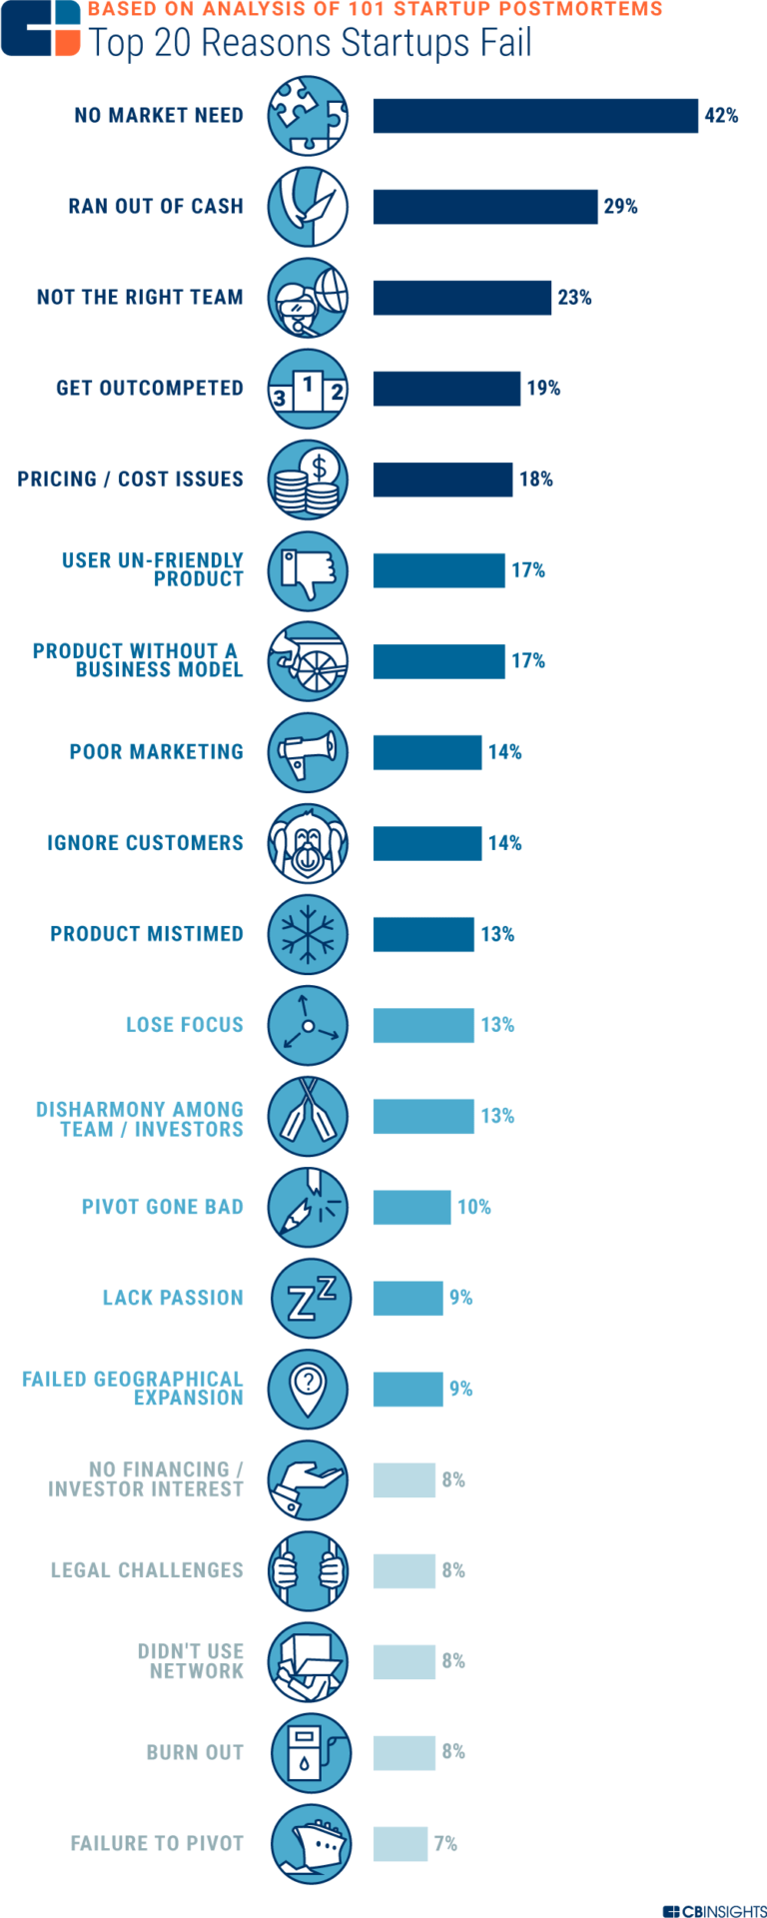
Reasons Startups Fail
Around 70% of funded tech startups fail
https://www.cbinsights.com/research/startup-failure-post-mortem/
Notes:
https://www.cbinsights.com/research/startup-failure-reasons-top/

