Slide 1




RMCP Meeting
November 20, 2019
RICAPS technical assistance is available through the San Mateo County Energy Watch program, which is funded by California utility customers, administered by Pacific Gas and Electric Company (PG&E) under the auspices of the California Public Utilities Commission and with matching funds provided by C/CAG.
Notes:
-Thanks for joining + happy new year
-Goal of meeting
-Logistics: attendees are muted and can post questions throughout in the chat box

Slide 2
CAP 2.0 Design
Reduce the number of measures, and build in flexibility to accommodate technological advances
Target deep reductions through comprehensive and systemic changes, not incremental measures
Design measures so that implementation metrics can be monitored (not only total emissions, as these can be unreliable and may reflect trends other than local action)
Specify required implementation resources to carry out the plan

Slide 3
CAP 2.0 Trends
Somehow include Consumption
Improve integration of Equity and Opportunity
Show Connection to Adaptation

Slide 4

Update Policies from Original Template
SB 32 – Reduce GHGs x% from 1990 by 2030
SB 100 – Fossil fuel-free electricity by 2045
Executive Order – California’s economy → Carbon Neutral by 2045
Climate Emergency Declaration by San Mateo County Board of Supervisors – achieve carbon neutrality before 2045. Other cities may follow suit.
UN Sustainable Development Goal #13 – Take
urgent action to combat climate change and its impacts

Slide 5
Update Goals
GHG Reduction Goal by 2030
  Minimum: 40% GHG reduction from 1990 baseline /
  49% GHG reduction from 2005 baseline
  Individual cities can be more aggressive
Carbon Neutrality Goal by/before 2045
  Text will explain:
    What is carbon neutrality
    We’re working on defining carbon neutrality and quantifying it

Slide 6
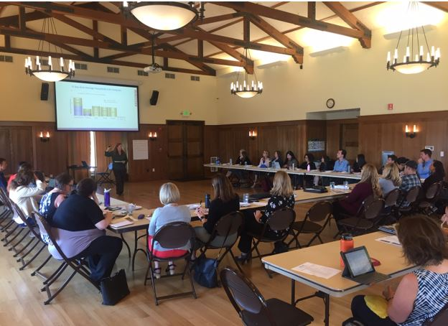
Proposed to Cities
Add:
  Consumption-based measures
  Carbon sequestration measures
  Closed landfill measures
  Adaptation/resilience integration
Group measures in a simple, focused way
Provide formulas, quantification, and cost-effectiveness
Indicate plans to collaborate countywide and/or regionally on implementation and tracking

Slide 7
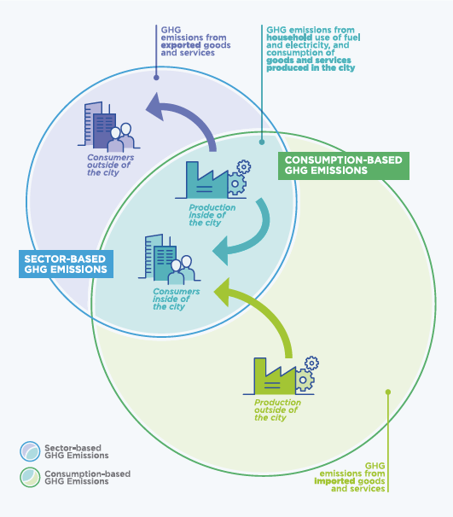
What is a consumption-based inventory?

Slide 8
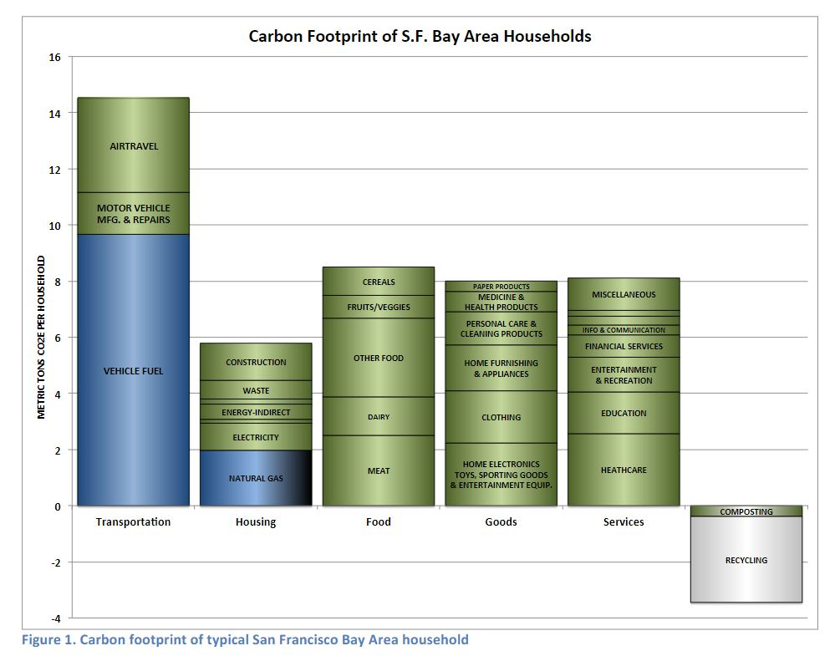
BAAQMD SF Bay Area Example

Slide 9

Regional Opportunities Being Discussed
Opportunities to address certain issues regionally
  Transportation
  Electrification
  Materials management, share economy, circular economy, durable reuse
Improve GHG inventory consistency & automation
Identify standardized implementation metrics
Coordinate sector-level goals
Share CAP consultant scopes, best practices, ...

Slide 10
RICAPS Meeting Feedback

Slide 14



THANK YOU!

