Slide 2
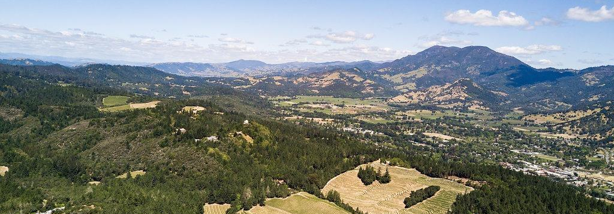
Establishing a Community Microgrid
A resilient, renewable energy solution
John Sarter
Program Manager
415-342-7199 mobile
johns@clean-calition
Malini Kannan
Senior Engineer
650-533-8039 mobile
malini@clean-coalition.org
Monica Meagher
Programs Engineer
831-359-6618 mobile
monica@clean-coalition.org
Frank Wasko
Managing Director
949-501-0967 mobile
frank@clean-coalition.org
5 Nov 2019

Slide 3
Calistoga Community Microgrid in the News
Notes:
3

Slide 4
Community Microgrid Project Summary
Phase 1
Feasibility Assessment
Phase 2
Planning and Engineering
Phase 3
RFP and Project Completion
Aim for 70% accurate cost estimates.
Aim for 90% accurate cost estimates.
Finalized costs.
Perform solar siting survey.
Shortlist 5 sites for basic technical and economic analysis.
Gather basic site details including load data, and perform a technical and economic analysis.
Gather all site details and perform site visits to develop more accurate cost estimates.
Detailed technical and economic analysis.
Develop conceptual and functional design.
Engage EPC to develop key engineering documents needed for utility buy-in e.g. SLDs.
City uses Clean Coaltion conceptual and function design to complete designs.
City develops bid package based on designs.
City receives bids, selects build vendor, and completes projects.
Notes:
This slide describes the proposal developed for Calistoga
The proposal covers the feasibility assessment (solar siting survey, early stage shortlisting of sites, basic technical and economic analysis)
Outcomes include a presentation with preliminary findings, and ongoing meetings
Planning and Engineering- deep dive feasibility assessment for 5-6 critical facilities or priority sites
Meetings will include on-site assessments, finance meeting, design reviews, and a meeting with the utility
Outcomes include draft and final design and economics presentations with:
Electric load analysis, utility bill analysis, system sizing analysis, and economics overview
Electrical contractor will provide: interconnection summary, single line diagrams, and civil site drawings
Develop RFP specifications:
Develop RFP specifications and work with the city to integrate it into the city's boilerplate RFP language so there can be a competitive bid process.
Total of ~442 hours, $69,000

Slide 5
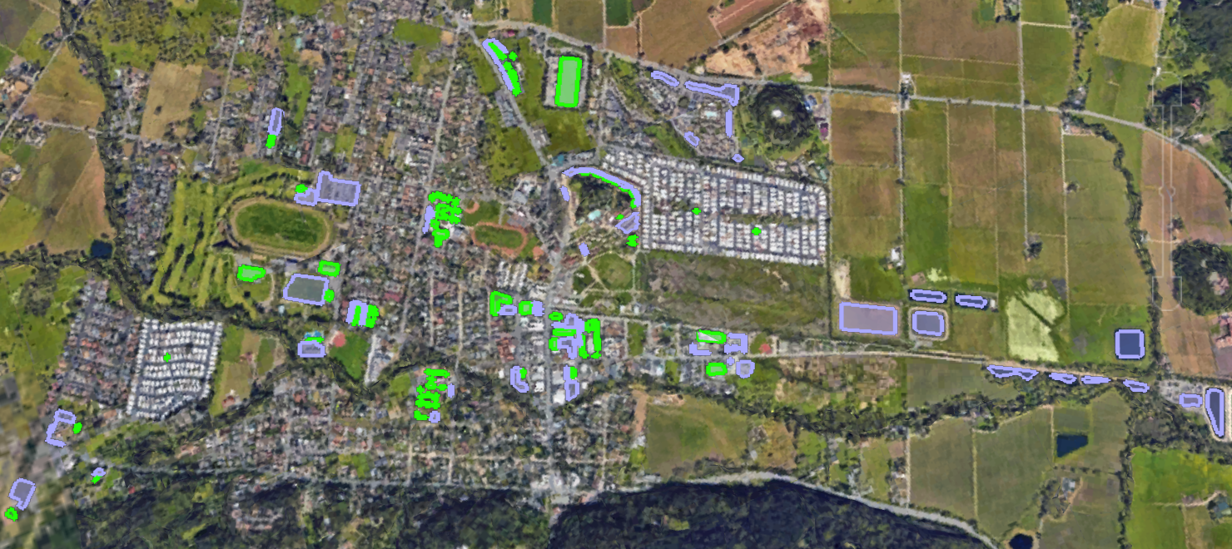
Solar Siting Survey
Green - Rooftop
Purple - Parking lot / other
Identified available space for over 25 MW of solar panels
Notes:
Survey city via Google Earth to determine viable rooftops and parking areas
Includes schools, municipal buildings, and large private buildings
Estimate physical size of PV solar system through available space
Use available space and PV module size to determine electrical size of PV solar system
Identified available space for over 25 MW of solar panels

Slide 6
Stakeholder Engagement
Discussed potential microgrid sites with various business owners, city council members, facilities managers
Vestibulum congue
Community benefit
Vestibulum congue
Power Shut Down Impacts
Project Specifics
Vestibulum congue
Notes:
quantitative and qualitative evaluation process

Slide 7
Technology Analysis
 | Proven Technology | Low Carbon Footprint | Fuel Source Reliability
Fuel Cell
Geothermal (1 MW)
Solar & Storage

Slide 8
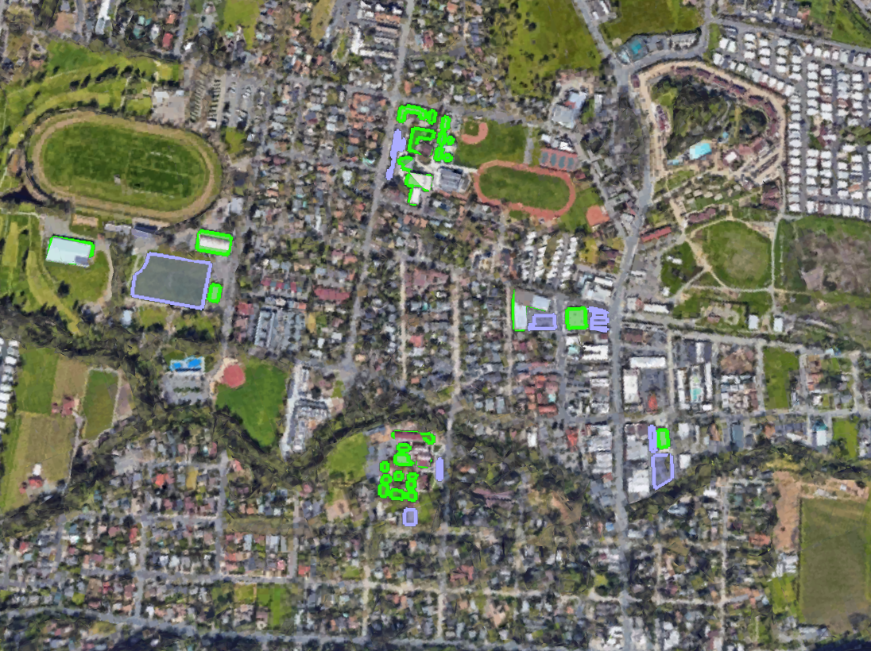
Site Selection
Jr-Sr High School
Annual load offset: 100%
Cal Mart
Annual load offset: 70%
Fire Station
Annual load offset: 100%
Fairgrounds
Annual load offset: 104%
Elementary School
Annual load offset: 100%
Dunaweal WWTP
Annual load offset: 100%
Notes:
Stakeholder outreach process involved getting a list of contacts from the City Manager, and having phone calls with each one
Asked stakeholders what the most critical facilities in town were, in the context of PSPS, but also other possible emergencies
Focused on sites not being addressed through PG&E’s resilience zones
Shortlist of sites were compared- see the Site Evaluation Matrix slide in appendix

Slide 9
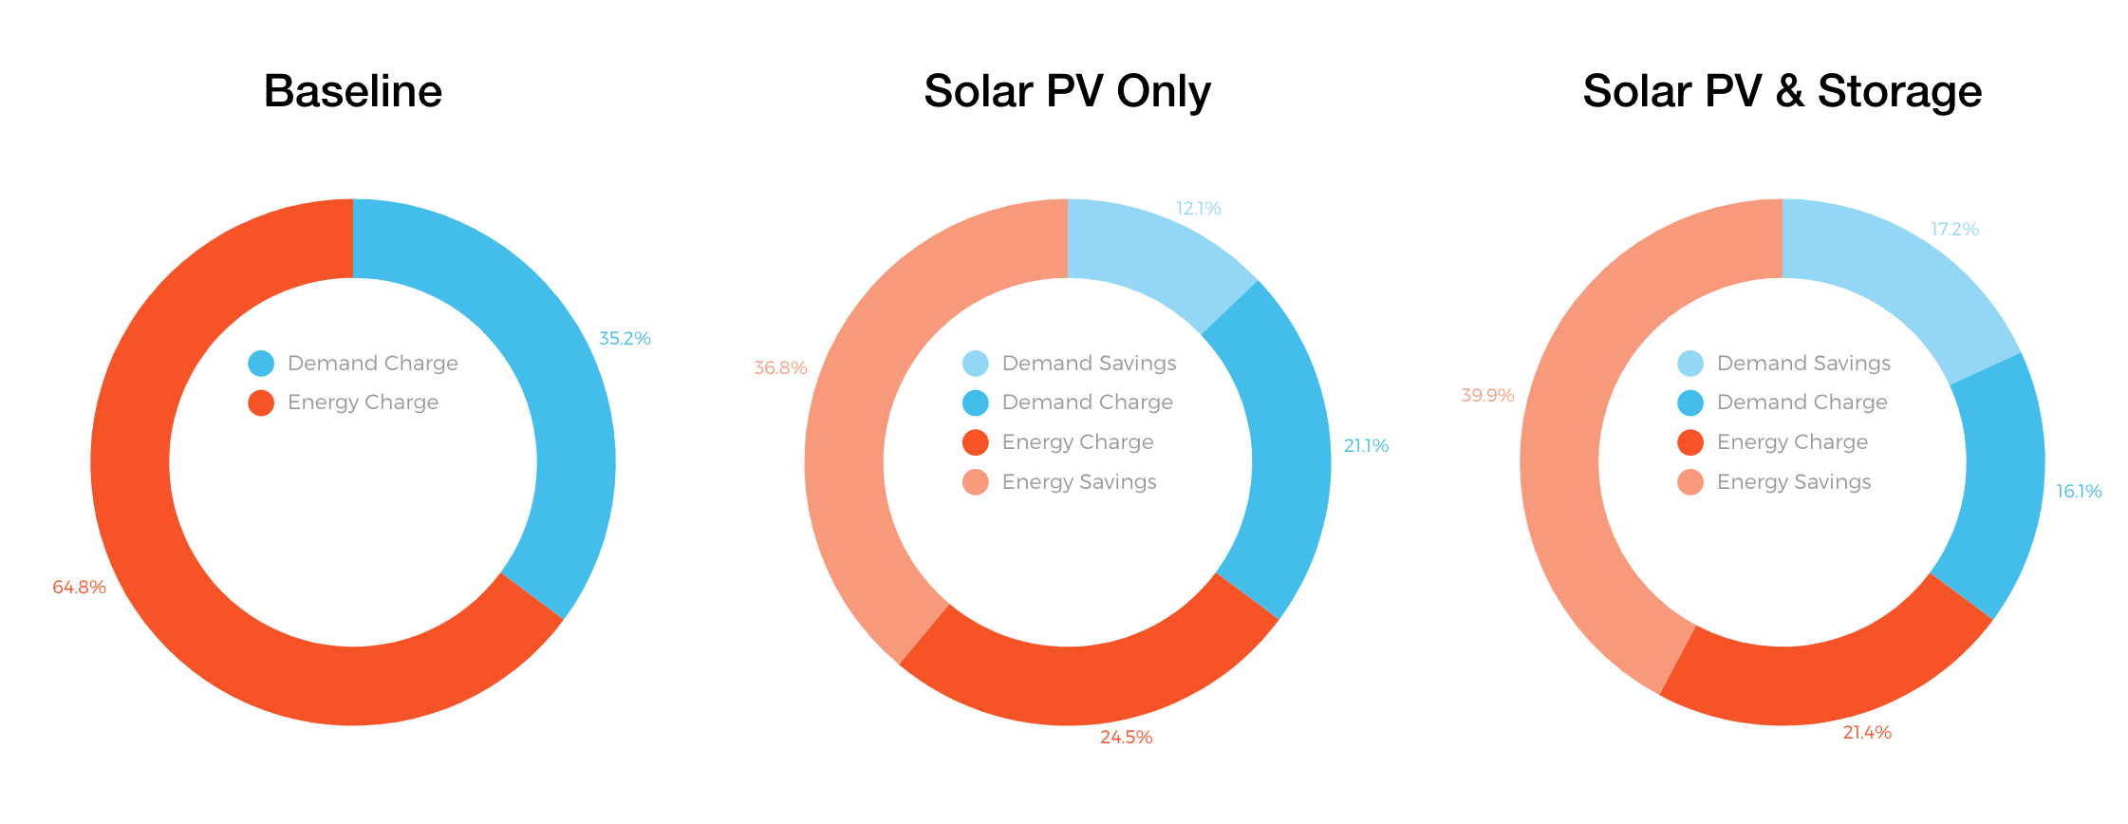
Savings Analysis Example: Cal Mart
Used Geli’s ESyst tool to determine financial benefit for a grid-connected system that takes advantage of peak shaving and demand charge management.

Slide 10
Site Summary
Site | Total Annual Energy Use [kWh] | Existing Solar [kW AC] | New Solar [kW DC] | New Annual Solar Gen. [kWh] | Battery [kW] | Battery [kWh]
Cal Mart | 900,501 | - | 480 | 626,310 | 300 | 2,000
Calistoga Elementary School | 219,617 | 65 | 145 | 220,899 | 60 | 180
Calistoga Fairgrounds | 308,559 | - | 210 | 322,927 | 120 | 1,440
Calistoga Jr-Sr High School | 92,846 | 46 | 64 | 93,218 | 30 | 150
Dunaweal WWTP | 1,017,489 | - | 660 | 1,015,618 | 200 | 2,000
Fire Station | 63,002 | - | 42 | 63,984 | 30 | 90
TOTALS | 2,602,014 | 111 | 1,601 | 2,342,956 | 740 | 5,860

Slide 11
Portfolio Summary
Proposed New Assets | 1,601 kW Solar 740 kW / 5,860 kWh Energy Storage
Annual Generation | 2,342,956 kWh
Percentage of Load Served | 111% of current usage
Current Annual Electricity Spend* | $563,100
Annual Electricity Savings | $346,557
Payback Period** | 8.5 - 25 years / site
*Electricity costs are expected to increase 3% annually; savings will scale with cost increases.
**Payback assumes converter and battery need to be replaced every 10 years

Slide 12
Financing Options
Power purchase agreement (PPA)
Typically a must-take contract. Whoever it’s contracted to must purchase all.
90% of commercial PV systems are financed through PPAs.
Energy services agreement (ESA)
Similar to a PPA, but includes energy efficiency technology as well.
Direct purchase
Large capital costs make this option difficult for most customers.

Slide 13
Potential incentives
Incentive | Provider | Form | Technologies | Restrictions
Federal Investment Tax Credit - 26% | Fed | Tax incentive | Solar PV, energy storage | Incentive step-down:2020- 26%, 2021- 22%, 2022- 10%
MACRS accelerated or Bonus Depreciation | Fed | Tax incentive | Solar PV, energy storage
Self-Generation Incentive Program | California State | Tax incentive | Energy storage
MCE NEM Credit- $0.01/ kWh more than PG&E | MCE | Energy bill credits | Solar PV | $5,000 cap for monthly credit rollover
Qualified Energy Conservation Bonds (QECBs) | Fed | Bond | Renewable Generation | Tax credit at 70% of rate set by Treasury
Certified Renewable Energy Bonds (CREBs) | Fed | Bond | Renewable Generation | Tax credits are taxable income
Department of Energy Loan Guarantee Program | Fed - DoE | Loan Guarantee | High risk technologies
Notes:
Federal ITC dates are based on commencing construction before Dec 31, of each year listed above
MACRS - modified accelerated cost recovery schedule- this tax incentive allows the depreciation (for tax purposes) to be accelerated to 5 or 6 years instead of over the 25 year life of the PV system. Bonus depreciation allows the entire solar PV and energy storage system to be written off in the first year. The developer must find a partner with adequate tax appetite to take the full incentive.
Self-Generation incentive program: Currently the program offers an incentive of $0.35/Wh, if ITC is taken, the incentive decreases to $0.25/Wh. This is for PG&E SGIP program Step 3. More info here: https://www.selfgenca.com/home/program_metrics/
MCE NEM Credit- A special meter tracks the difference between the amount of electricity your solar panels produce and the amount of electricity you use during each billing cycle. When your panels produce more electricity than you use, you receive a credit on your bill. MCE pays premium rates for excess electricity – crediting customers an extra $0.01/kWh –and rolls over excess credits every month (up to $5,000). If you earn credits of $100 or more, you’ll have an option to “cash out” each April. More info here: https://www.mcecleanenergy.org/solar-customers/

Slide 14
John Sarter
Program Manager
North Bay Community Resilience Initiative
415-342-7199
johns@clean-coalition.org

Slide 22
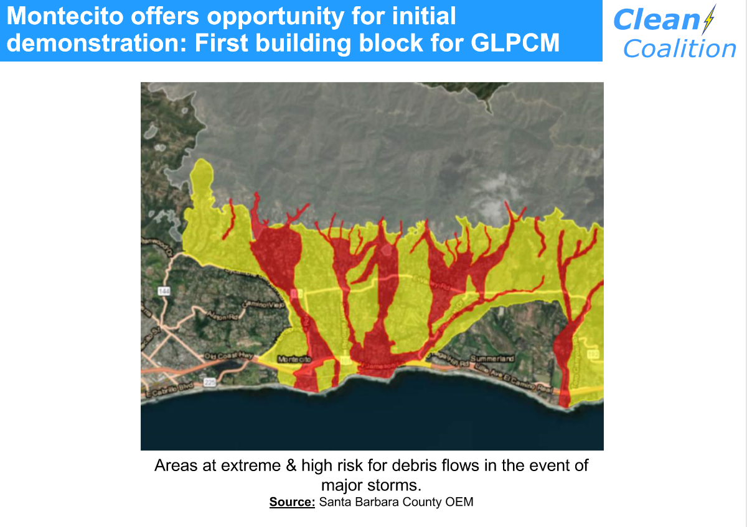

Slide 23
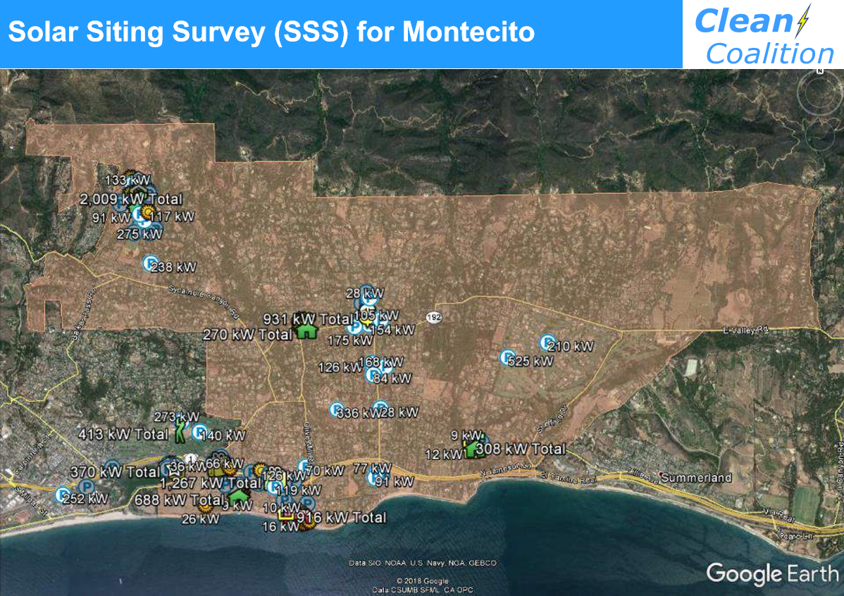

Slide 26
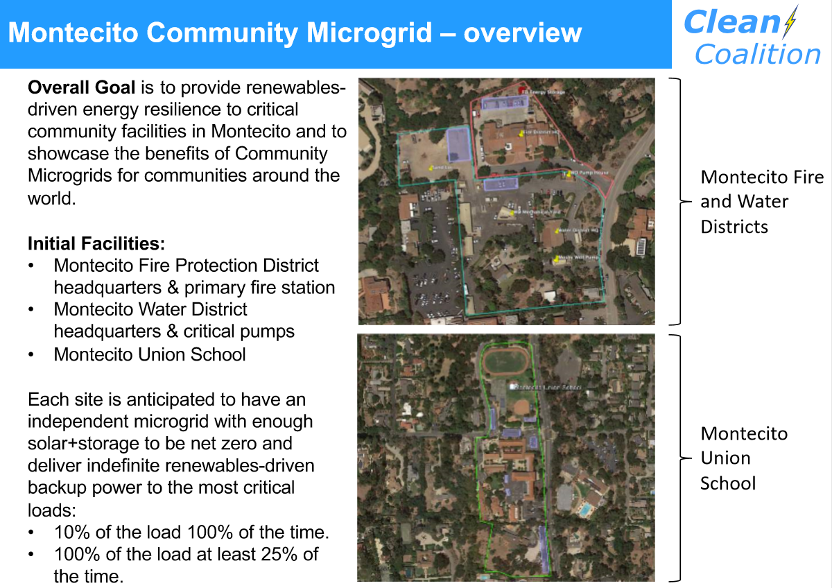

Slide 27
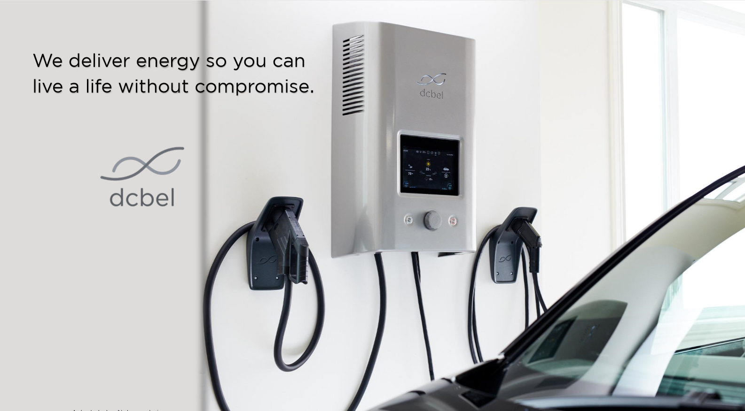
Introducing V2X for Everyone

Slide 28
Solar Inverter + Bi-Directional Fast Charging

Slide 29
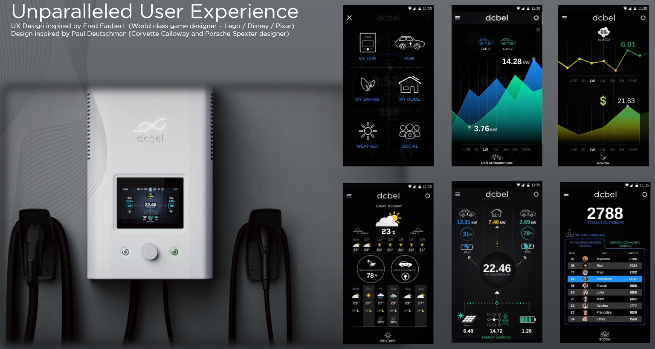
User Interface : Cloud and site based

Slide 30
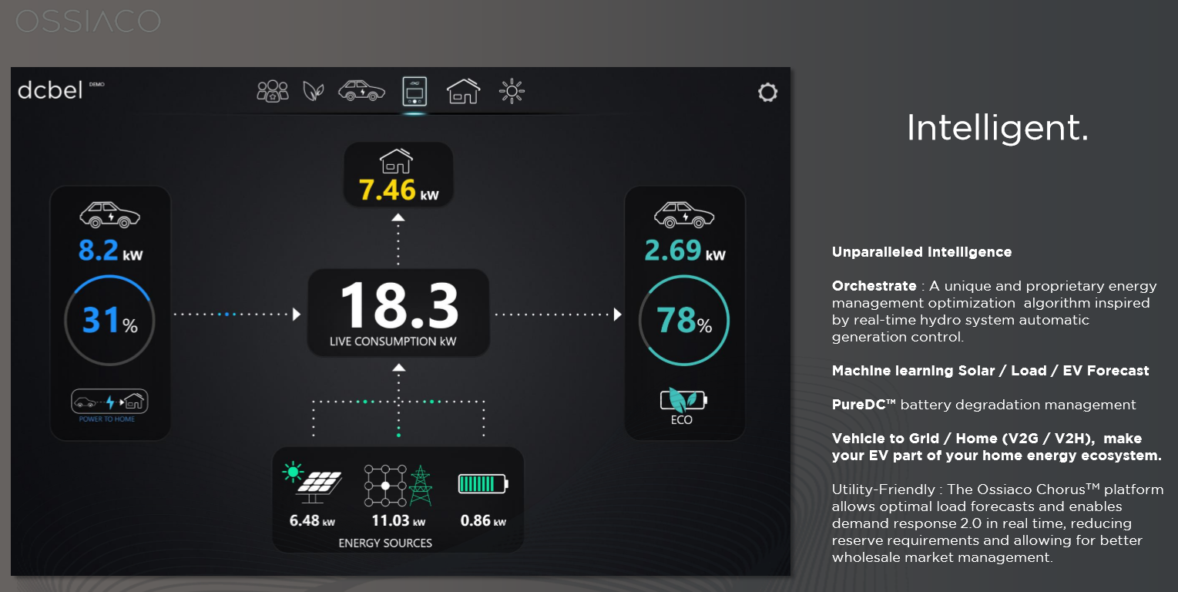
User Friendly Dashboard

Slide 31
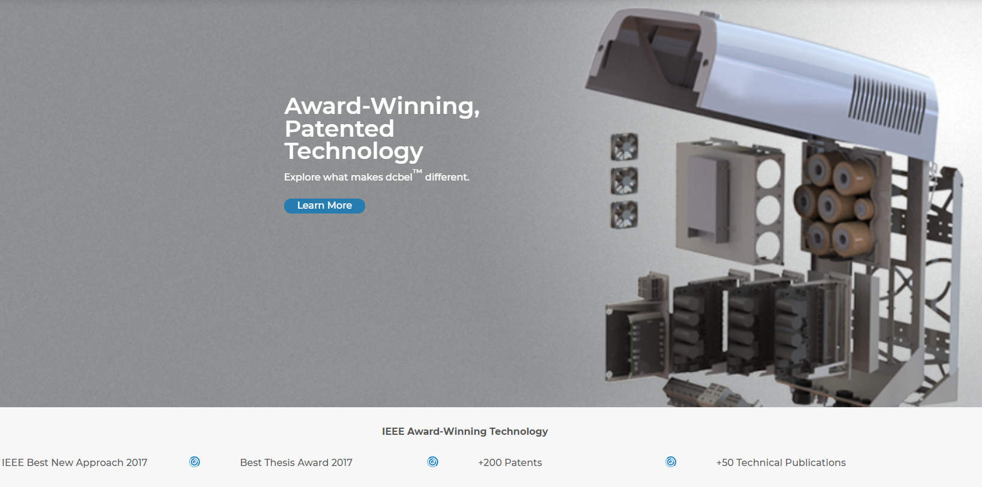
IEEE Awards and over 200 Patents

Slide 32
REAL and Available Q1 2020 !

