Slide 1
Systems Mapping Project Decarbonization of Existing Single-family Homes
RMCP Committee
November 18, 2020
Notes:
Good afternoon RMCP committee, my name is Denise and I am a sustainability coordinator with the Office of Sustainability. Susan and I will be sharing what we have been working on with the BayREN program.

Slide 2
Why Electrify?
“Electrification is the conversion of a system to the use of electrical power.”
Electrifying systems makes them:
Cleaner
More efficient
Safer
Healthier

Slide 3
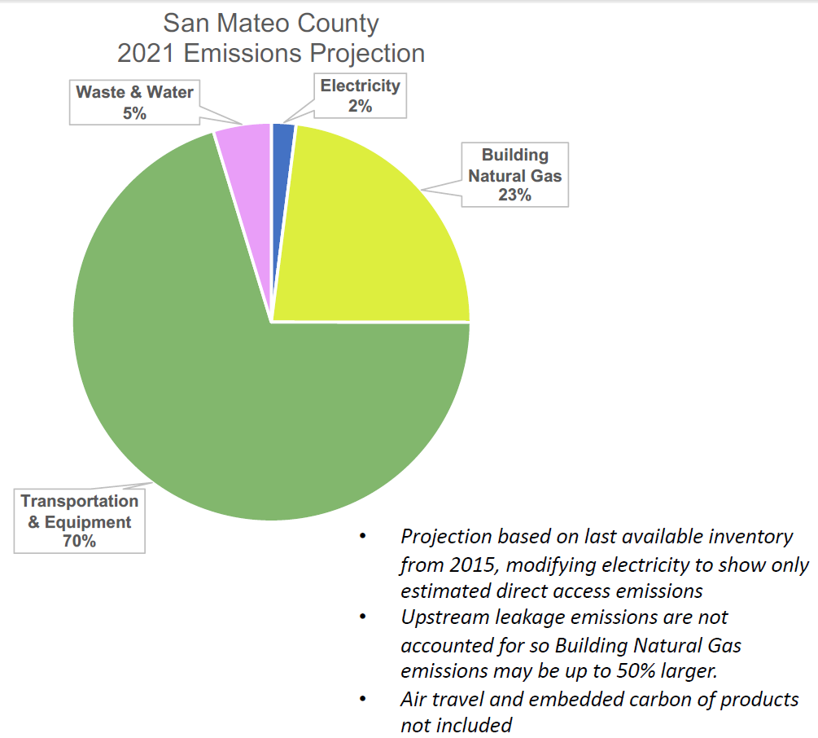
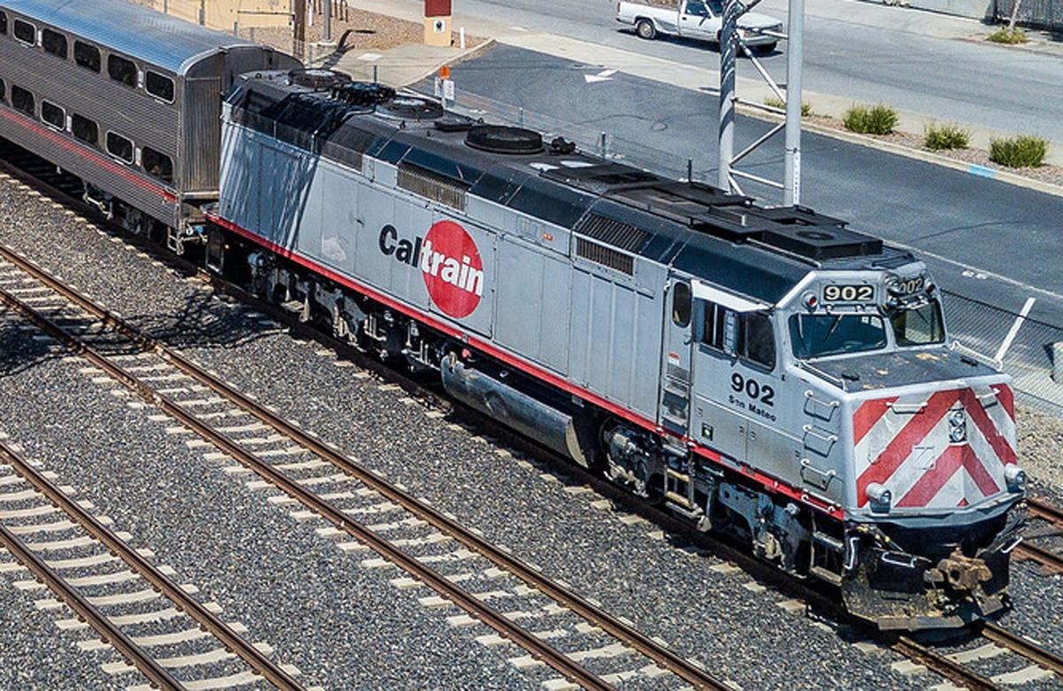
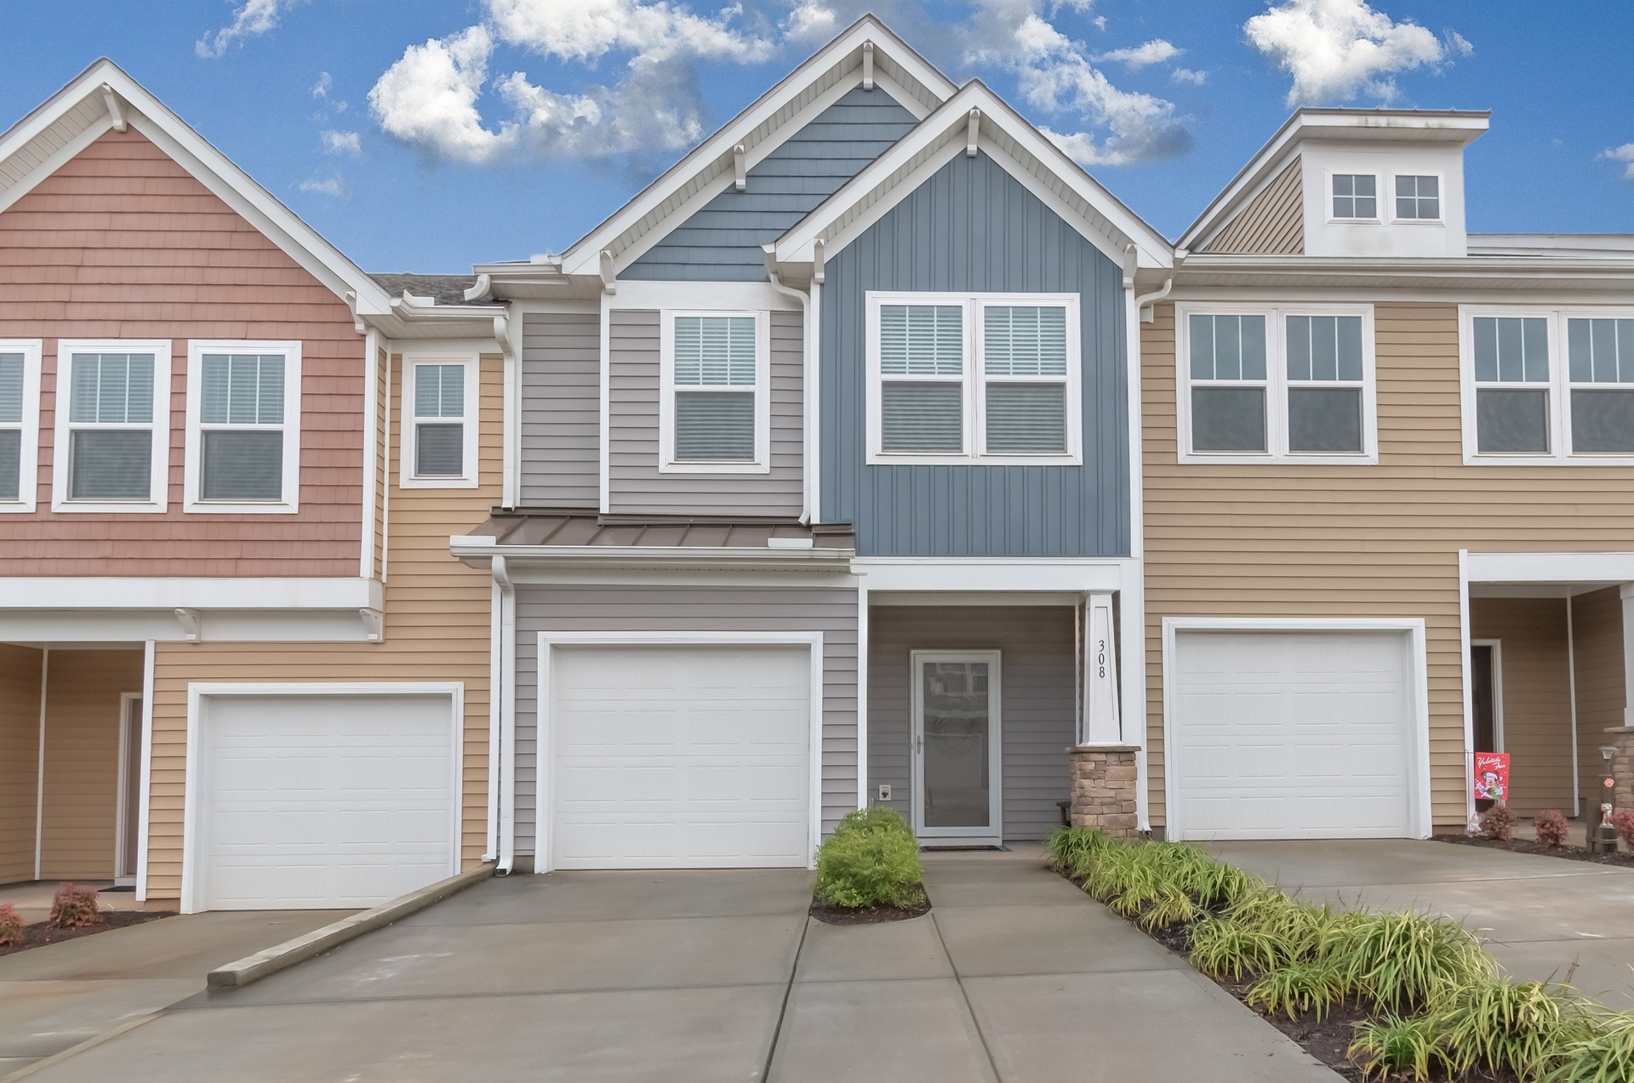
Electrifying Reduces GHG Emissions
Passenger Vehicles
Transit
Buildings
Notes:
John

Slide 4
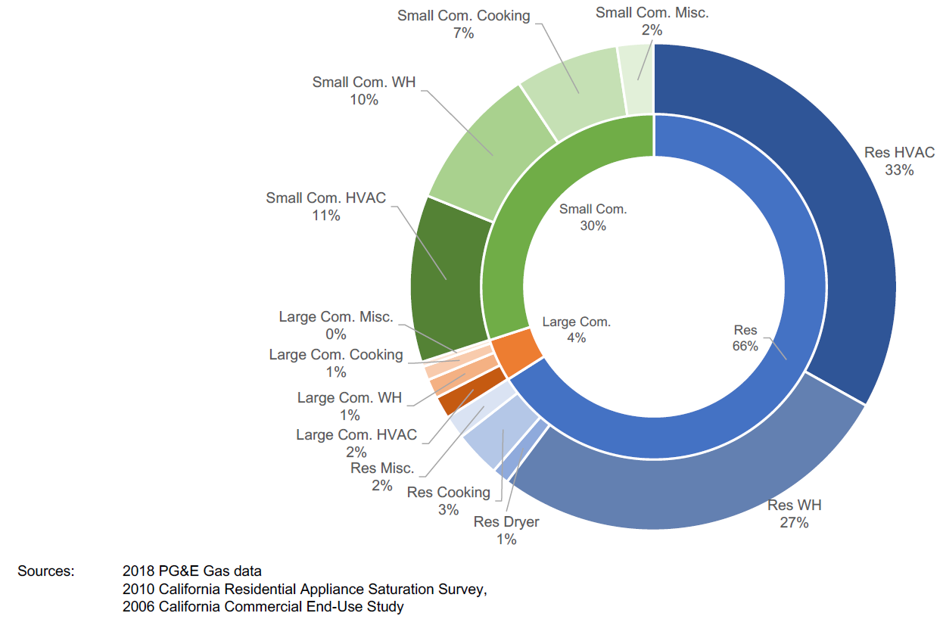
Big Opportunity: Residential Sector
Natural Gas Emissions by Sector

Slide 5
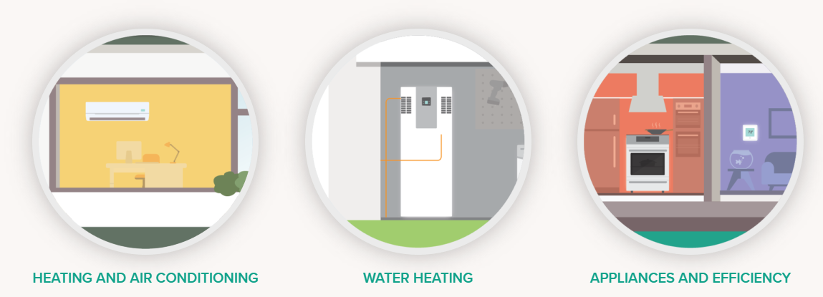
3 Main Opportunities to Electrify
Others: pool heaters, outdoor cooking, mowers and blowers and whackers
Notes:
Kim
Graphics came from here: https://www.svcleanenergy.org/electric-home/
Induction stoves
Heat pump water heaters
Heat pump space heaters

Slide 6
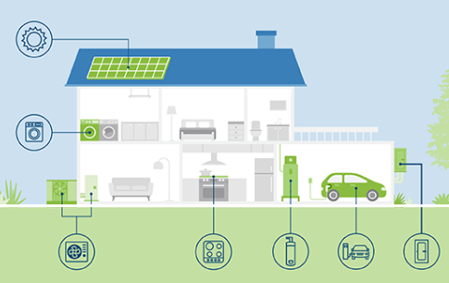
Many Organizations Have Jumped In
City of Palo Alto Home Electrification Readiness Assessment
Notes:
Susan As we began working on electrification of single-family homes, we learned that there are a LOT of other organizations working in this space. There are gaps and opportunities – a way to figure that out is systems mapping to get a comprehensive look at the landscape.

Slide 7
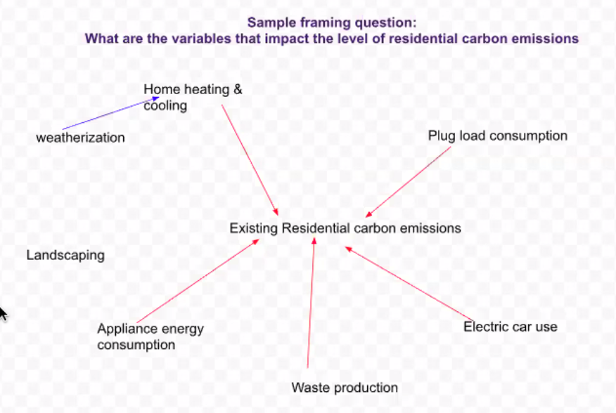
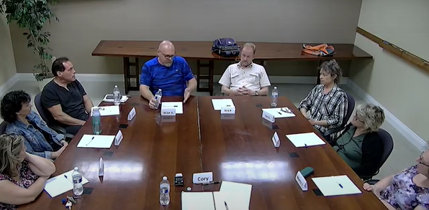
Funding to “Map” the System
2 Stakeholder workshops
October 28
December 9
2 Focus groups
Contractors – Dec. 1
Homeowners – Dec. 2
Notes:
Susan – A systems map puts the thing you’re trying to impact at the center of the diagram – in this case, decarbonization of existing single family homes – and then looks at all the things and organizations that have influence on that. To create our systems map, we’re bringing together about 30 stakeholders involved in this space for an online workshop on October 30. The participants will represent different viewpoints – from products to contractors to policy development to financing to real estate. Follow that workshop, we will have two focus groups to dive into areas of particular interest and complexity… contractors and homeowners. We’ll finish up with a final stakeholder workshop on December 9. The outcome of this process will be a report that will hopefully be a springboard for increased alignment of efforts as well as identification of gap areas where we need to focus.

Slide 8
1st Stakeholder Workshop – 40 Attendees
BayREN
Building Decarbonization Coalition
Building Efficiency
City of Berkeley
Clean Tech Entrpreneur
CLEAResult
County of San Mateo
Drawdown Bay Area
East Bay Clean Energy
EE consultant
Electrify My Home
emeraldECO
Energy Coalition
Financial advisor
Greenlining Institute
GRID Alternatives
Grounded Research
Home Intel
International Brotherhood of Electrical Workers
Marin Clean Energy
Menlo Spark
Peninsula Clean Energy
PG&E
Sonoma County Regional Climate Protection Authority
Realtor
Rescape
Rincon
StopWaste
SunWork
Yellowtin

Slide 9
Six Pieces of the Puzzle
1. Energy appliances
HVAC
Water heating
2. Funding and finance
Access to capital
Tax credits
3. Energy generation & storage
Solar
Kitchen appliances
Electrical appliances
Rebates
Battery
Resilience during power shut-offs
4. Market forces
5. Policy and regulations
6. Consumer behavior
Building trends
Contractor and supplier behavior
Price signals
Real estate trends
Permitting
Building codes
Restrictions
State law
Ordinances
Purchasing preferences
Biases
Overall knowledge
Health concerns
Attitudes about comfort & convenience

Slide 10
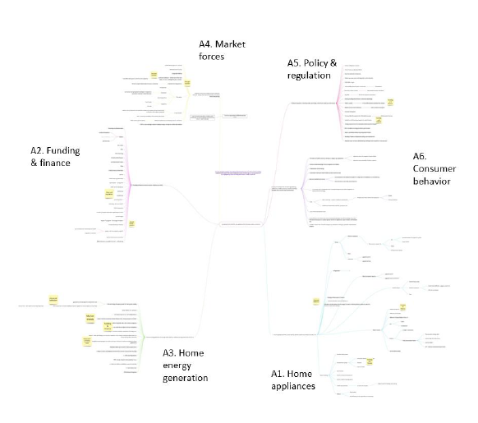
Part 1: “Mind-Mapping”
Increase home retrofits and appliances that decrease emissions

Slide 11
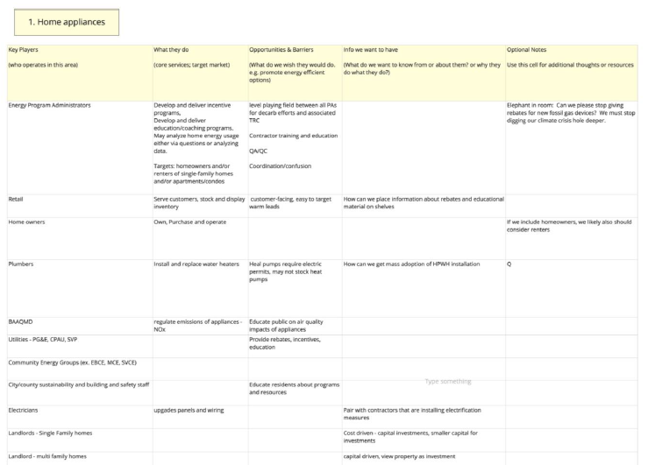
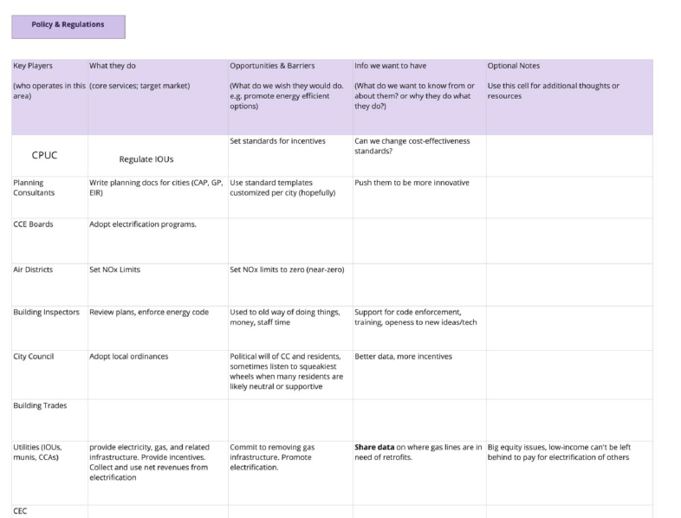
Part 2: Stakeholder Analysis
Group #
Key Players (who operates in this area) | What They Do (core services; target market) | Opportunities & Barriers (what we wish they would do e.g. promote energy efficient options) | Info We Want to Have (what we want to know from or about them, why do they do what they do?) | Optional Notes (additional thoughts or resources)

Slide 12
Key Research Questions
What would make financing for homeowners simple? What kinds of financing could banks or utilities offer?
How can we get retailers and contractors to help sell the idea of electrification? What is the price point that makes it worthwhile?
How might unions support the move to transition to electricity?
What role can realtors play? What can we tell them to help sell homes?
What motivates landlords to upgrade or retrofit a property?
How do we encourage and/or coordinate with federal agencies and regulations?
What about groups that advocate for social justice, housing equity and environmental justice? What policies might also support their goals?

Slide 13
Focus Groups
GOAL: Discover barriers and opportunities to converting single-family homes from natural gas to electricity, especially heat pump water heaters
Contractors:
Tuesday, Dec. 1 3:30-5pm
Homeowners:
Wednesday, Dec. 2 8:30-10am

Slide 14
Looking Ahead to Stakeholder Workshop #2
Option 1: Goal Setting
Option 2: Force Field Analysis
Option 3: Inventory of Current Actions

Slide 15
Option 2: Force Field Analysis
Converting from natural gas to electricity
Players central to helping these actions | Actions to increase these actions | Forces working for it | Forces working against | Actions to mitigate or remove these forces | Players central to helping these actions
 | Building code changes to require ventilation of gas appliances | Growing concerns about health impacts of gas | Increasing unreliability of electricity
 |  |  | Lower cost of natural gas
Potential follow-up activities:
Socialize the ideas to specific agencies
Conduct a pilot

Slide 16
Discussion: What would be your ideal outcome for this mapping project?
Some ideas:
Local pilot project
Regional or local “Collective Impact” effort
Working group
Presentation to stakeholder agencies
Report/white paper

Slide 17
Thank you!
Susan Wright Senior Sustainability Specialist swright@smcgov.org

