Slide 1

Presentation for:
City/County Association of Governments in San Mateo County (C/CAG)
Board of Directors (11/12/2020)

Slide 2

Presentation Outline
Agency Update
FY 2020-2021 Work Plan Highlights
Programs Review
Strategic Planning
Discussion

Slide 3
Agency Overview
Structure:
  JPA – 18 members
  Board – elected officials
  Staff – 8 full-time, 1 AmeriCorps Fellow
Funding Partners:
  C/CAG
  San Mateo County Transportation Authority
  Bay Area Air Quality Management District (TFCA via C/CAG)
  Private Sector Employers, Property Managers, Cities

Slide 4
Board of Directors
Michael Lempres Davina Hurt Clifford Lentz*
Atherton Belmont Brisbane
Emily Beach** Rae Gonzalez Pamela DiGiovanni
Burlingame Colma Daly City
Carlos Romero Richa Awasthi Robert Brownstone
East Palo Alto Foster City Half Moon Bay
Shawn Christianson Reuben Holober Mike O’Neill
Hillsborough Millbrae Pacifica
Giselle Hale Rico Medina Sara McDowell
Redwood City San Bruno San Carlos
Rick Bonilla Richard Garbarino David Canepa
San Mateo South San Francisco County of San Mateo
* Chair
** Vice Chair Roster as of 11/2020

Slide 5
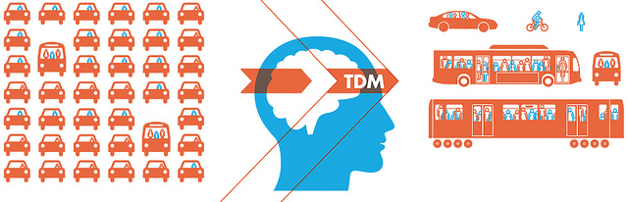

Commute.org Mission
Reduce Vehicle Miles Traveled (VMT) and Single-Occupant Vehicle (SOV) trips by commuters in San Mateo County

Slide 6

TDM Programs for San Mateo County
Commuter Programs
Employer Programs
Shuttle Program

Slide 7




Commuter Programs 2020
Try Transit
Incentives and Rewards
Guaranteed Ride Home
Challenges
STAR Store
Free Transit Tickets on SamTrans, Caltrain, BART or SF Bay Ferry
Carpool and Bicycle rewards up to $100.
Vanpool rewards up to $500
Prize drawings for all modes of commute alternatives
Free ride home in the event of an emergency
Tracking commute trips = points to redeem for prizes

Slide 8


Employer Programs 2020
Resources
& Education
Commute Programs
Compliance
Assistance
Encourage the adoption of Commute.org’s TDM programs by employers
Assist employers, property managers, municipalities with TDM compliance
Provide resources and education to all employers in San Mateo County

Slide 9
Pandemic Response
Pause aggressive outreach and messaging efforts, but continue to support employers and commuters and build for the future
Mitigate the potential increase in congestion resulting from the decrease in commuters choosing shared mobility options

Slide 10

Pandemic Response
Opportunity to stay engaged with commuters and employers during the pandemic by providing support and assistance to frontline organizations where employees continue to work on-site as well as to organizations that have shifted to a remote work model
Encourage adoption of remote work as a long-term alternative where possible (training, resources, Pledge)

Slide 11

Pandemic Response
Provide education, training, and incentives to commuters who are looking for non-drive alone alternatives – get them ready to return to work with bicycling as an option
Collaboration with SVBC, PCE, cities confirms that bicycling is positioned to gain mode share in the post-COVID period

Slide 12
Carpool Rewards 2020

Slide 13
Carpool Rewards Results in 2020
# of Rewards Earned by Month
*preliminary results through September 2020

Slide 14
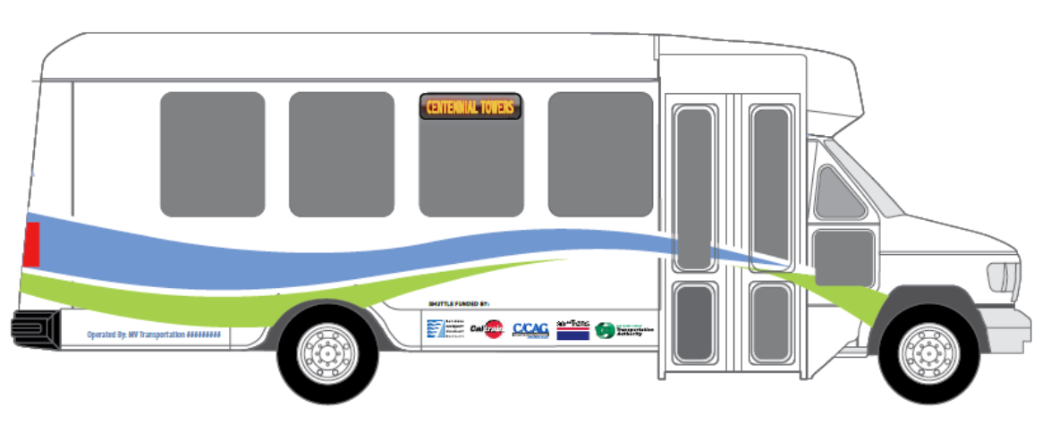
Shuttle Program
Continued operation during COVID
22 routes under Commute.org management (26 contracted routes)
Route reductions, suspensions, consolidations
Ridership in October: up 112% from May, down 85% from prior year

Slide 15
Shuttle Route Status

Slide 16
Strategic Plan Update for 2021-2025
  Planning process began in November 2019
  Ad hoc steering committee managing the process
  Stakeholder input and feedback throughout
  Simultaneous planning projects impact plan
  Target adoption in February 2021

Slide 17





Discussion
John Ford
Executive Director
PH: 650/588-8170 x105
john@commute.org

