Slide 1
Systems Mapping Project Decarbonization of Existing Single-family Homes
RMCP Committee
January 20, 2021

Slide 2
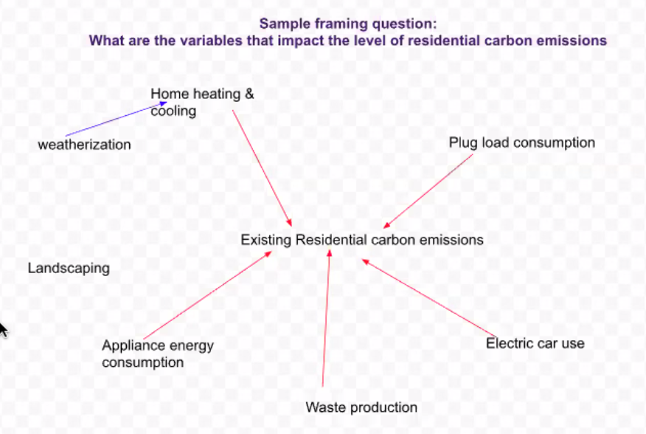
Funding to “Map” the System
2 Stakeholder workshops
October 28
December 9
2 Focus groups
Contractors – Dec. 1
Homeowners – Dec. 2
Guidance from:
Funded by:

Slide 3
Focus Groups
GOAL: Discover barriers and opportunities to converting single-family homes from natural gas to electricity, especially heat pump water heaters
Contractors
4 attendees
some BayREN contractors, some not
Homeowners
17 attendees
All are “very interested” or “somewhat interested” in converting to all-electric
Hot water heaters only, whole-house electrification contractor, energy audits
Most have done some projects, looking to do more

Slide 4
Focus Group Ideas – Program Design
Revamp rebate programs
They are currently inconsistent and uncoordinated
Consider product incentives AND outcome incentives
Instant rebates are popular
Overcome emergency-driven choices and actions
Loaner program
“Cash for clunkers” rebate: extra incentive for early retirement of working appliances
Support whole-home electrification
Combine technical & financing assistance through one central contractor & no extra charge to customer (e.g. supported by utility or county) (e.g. Boulder program)
Provide incentive for bundling/whole-house approach
Simplify financing
Desire for simplified, accessible financing, including “on-bill” financing
One large contractor provides financing through Service Financing

Slide 5
Focus Group Ideas – Information & Education
Enhancements to home advisor service
Knowledgeable about technologies, financing options, how to work with contractors, costs and “ripple” effects (e.g. needing upgrades to panel, changes to roofing material, ducting or plumbing changes, permitting requirements)
Would like a comprehensive “road map” of the full process and considerations of electrification
Would like a directory of qualified contractors with customer ratings
Create education sessions to help homeowners understand the process

Slide 6
Focus Group Ideas - Programs
Group purchasing
Variation on Sunshares program - Maybe focus bundling on specific commodities like HPWH or electrical panel upgrades that don’t vary as much across customers segments
Target outreach to certain types of homes that are likely ripe for appliance upgrades (new homeowners who may plan to remodel, houses that are 8 to 15 years old)
Create support networks
Contractors may like a LinkedIn group, lists of other vetted contractors, occasional Zoom sessions to share learning
Customers talk about an ambassador program so that people could talk with others who have done the work

Slide 7
Focus Group Ideas – Policy/regulatory
Standardize permitting
Streamline installation and inspection process
Lower permitting fees, make them the same across cities
Make permitting simpler
Allow copies of permit to suffice for rebates instead of waiting for final
Adjust CAS inspection requirements – only require in living space, not garage or not conditioned space
Create a special heat pump water heater permit, rather than separate plumbing and electrical permits
Educate city councils. Foster consistency in messaging and priorities
Offer a special, low electricity rate for all-electric homes
Eventual or phased in ban on sale of fossil fuel appliances

Slide 8
2nd Stakeholder Workshop
GOAL:
Get to a list of prioritized interventions that would benefit from coordinated, collaborative action
Identify key players that should be involved
Designate a “first next step” for each intervention

Slide 9
2nd Stakeholder Workshop – 28 Attendees
BayREN
City of Berkeley
Clean Tech Entrepreneur
CLEAResult
County of San Mateo
Drawdown Bay Area
East Bay Clean Energy
EE consultant
Frontier Energy
GRID Alternatives
Grounded Research
Marin Clean Energy
Peninsula Clean Energy
PG&E
Sonoma County Regional Climate Protection Authority
Realtor
Rescape
StopWaste
Yellowtin

Slide 10
Intervention #1: Instant rebates
Minimize paperwork with upstream rebates. Start with heat pump water heaters, then additional aspects of electrification.
Key Players
BayREN (lead) Contractor community CCAs Energy Solutions Energy Star and retail products platforms Manufacturers (Energy Star has manufacturing council) SMUD IOU program
First Next Step
BayRen will make connections with the key players. BayREN will host a kick-off meeting.

Slide 11
Intervention #2: “Cash for clunkers” rebates
Incremental incentive for residents who replace water heaters that still work. Market to homeowners and contractors.
Issues to address: Recycling, how to avoid abuse
Key Players
BayREN (lead) Contractor community CCAs Building Decarbonization Coalition Transfer stations (recycling) PG&E (ask about their refrigerator recycling program) Policy makers
First Next Steps
BayREN will host a kick-off meeting. Scope out the regulatory implications Develop marketing plan (downstream and midstream) Develop documentation requirements to prevent abuse

Slide 12
Intervention #3: Public/private financing
Financing instrument that emphasizes leveraging public/private partnerships to make it easier for customers to access. Use public capital to make private capital more affordable.
Key Players
BayREN or regional administrator (lead) Contractor community East Bay Clean Energy Coalition of CCAs Building Decarbonization Coalition BAC to move the private sector Financial institutions/banks BC3 (including community or mission-driven banks)
First Next Steps
BayREN will coordinate with EBCE to map out the likely stakeholders and how to start the conversation. (EBCE will be looking at the financials and might have models to use.) Check out the clean energy financing mechanism and TECH opportunity (Energy Solutions is working on innovative financing strategies)

Slide 13
Intervention #4: Streamline permitting
Make it easier for contractors and residents to apply for building permits for electrification installations. Goal: Statewide Electrification Program (like solar).
Key Players
BayREN Codes & Standards program (lead) Tri Chapter Uniform Code Committee California Energy commission (compliance and enforcement division) ICC Climate-friendly chief building officials State Senator Josh Becker
First Next Steps
BayREN will discuss which level to address first: local/regional vs. state Engage building officials to get their ideas to solve the problem. Clarify how much permitting is really needed Target building code officials group Educate building officials Look for support in building departments

Slide 14
Other top ideas
Develop an automated roadmap/project planning tool for electrifying a property
"Groupon for Electrification" service that allows for group purchasing of electrification plans (home visit by a building performance expert).
Help building departments with permit guidance for various electrification products with online tools (addresses knowledge gap and need for speed)
Develop an emergency water heater loaner program for contractors

Slide 15
Next Steps
BayREN project
Write final report
Share findings
Prompt “first next steps”
Develop case studies

Slide 16
Questions?
Susan Wright, County of San Mateo swright@smcgov.org

