Slide 1


Housing TA Update including REAP & PDA
Grants
C/CAG
Heather Peters
Principal Regional Housing Planner
January 14, 2021

Slide 2








REAP Delivery Model
Regional Assistance
Local Allocations
Peer Cohorts
Planning
Collaboratives
Work Groups
COUNTIES
Community Engagement
HCD
SAFE HARBORS
Regional Consulting Bench

Slide 3


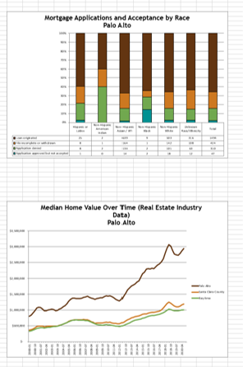
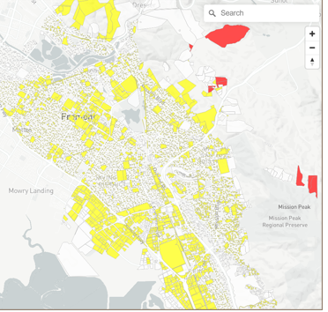

REGIONAL “VALUE ADD”
Standardized
Regional
Data
Produce common products like staff presentations of new laws once vs.109 times
Peer-to-Peer Collaboration
HCD
SAFE HARBORS
Cost Savings
FREE UP LOCAL $ FOR LOCAL PRIORITIES!

Slide 4

Regional Consulting Bench
Site Analysis
Fair Housing
CEQA
Objective Design
Zoning
Parking
ADUs
Gov Tech
Housing Elements
Urban Economics
Specific Plans
Housing Finance
Mobility
Resilience
& More…
RFQ: https://mtc.bonfirehub.com/opportunities/35148

Slide 5
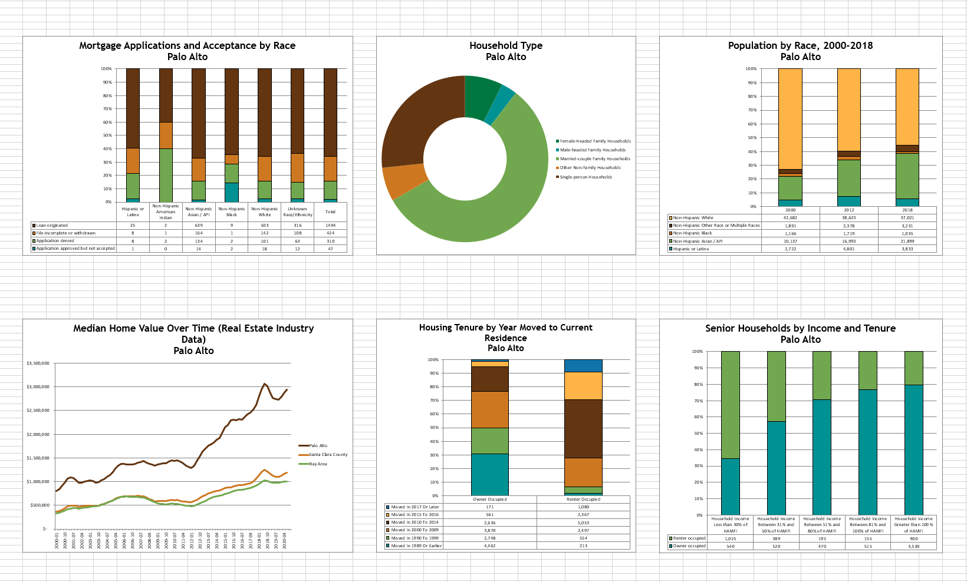
Housing Needs Data Packets
GOAL:
SAFE HARBOR
https://abag.ca.gov/sites/default/files/datatoolsoverview.pdf

Slide 6
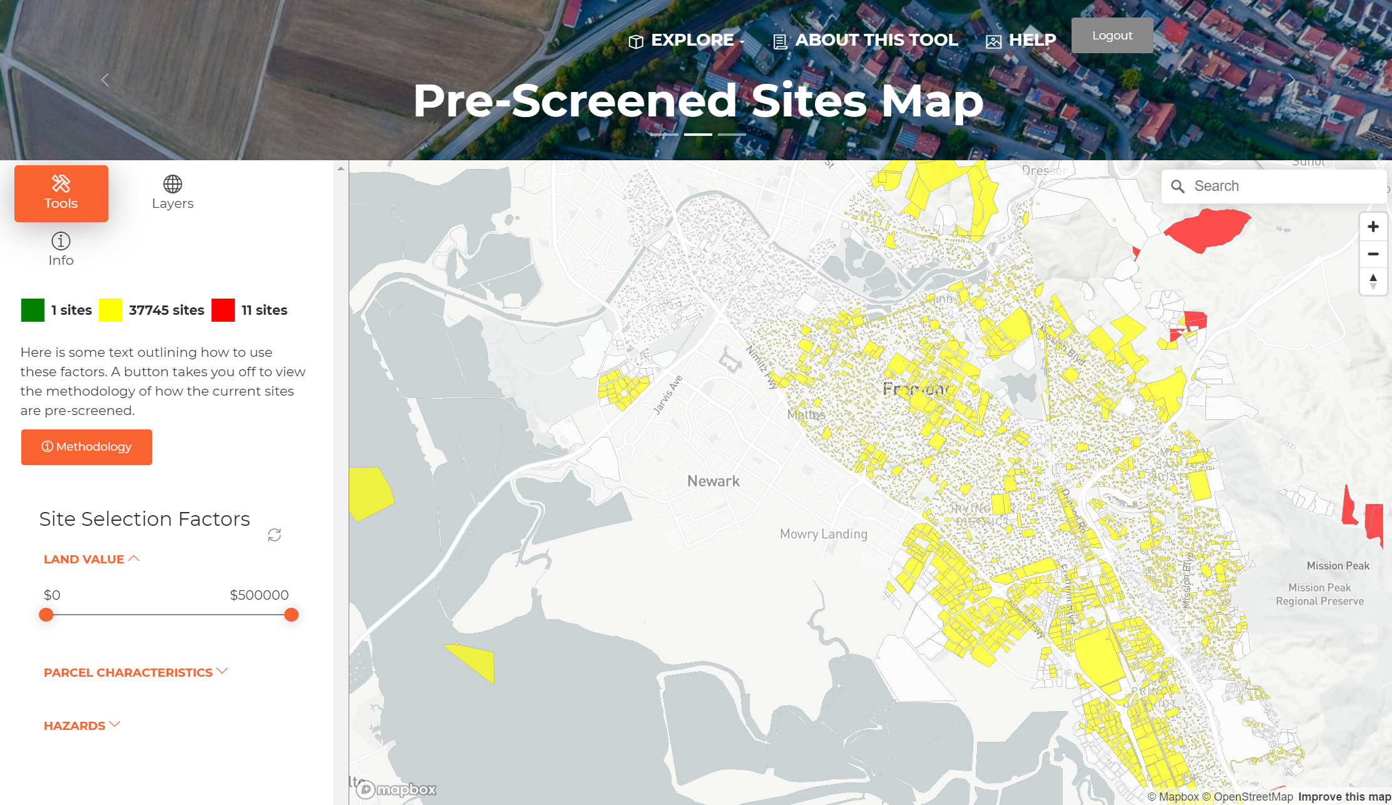
Interactive Site Selection Tool
GOAL:
SAFE HARBOR
Demo recording: https://youtu.be/6cS2ZIGTE4g

Slide 7
Bay Area Planning Grants
REAP Local Allocations
$10.9M
PDA Grants
Approx.
$6M
REAP
TA
SB 2
$24M
$13M

Slide 8
5 REAP/PDA Grants ($12M): 1 Application
TOTAL FUNDING | FUNDING SOURCE | MAXIMUM GRANT | COMPETITIVE?
$2.18M | Minimum REAP Allocation | $20,000 | No
$3M | Supplemental REAP Allocation if 1K+ RHNA units | $6-8 per unit | No
$1M | Competitive REAP Allocation | $100,000 | Yes
$6M | PDA Planning Grants | $800,000 | Yes
 | PDA TA Grants | $100,000 | Yes
TIMELINE: Release date: December 18, 2020 Due date: February 12, 2021 | WEBINARS TO FIND OUT MORE: December 29, 2020, 12:30PM–2PM January 6, 2021, 9:30AM-11AM January 8, 2021, 1:30PM-3PM January 15, 2020, 9:30AM-11AM
FOR MORE INFO: https://abag.ca.gov/housing-technical-assistance-program
      https://abag.ca.gov/our-work/land-use/pda-priority-development-areas
      loi@bayareametro.gov

Slide 9
For more information
Subscribe at:
https://abag.ca.gov/housing-technical-assistance-program
Contact:
HousingTA@bayareametro.gov

