Slide 1
Non-Potable Water Re-use in San Mateo County
For the Resource Management and Climate Protection Committee of C/CAG
July 21, 2021
Gregory J. Smith (Smitty), PG, REHS
Supervisor Water Protection and Land Use Programs

Slide 2
Non-Potable Water Re-use
Gray Water
Treated Gray Water
Stormwater
Rainwater
Recycled Water

Slide 3
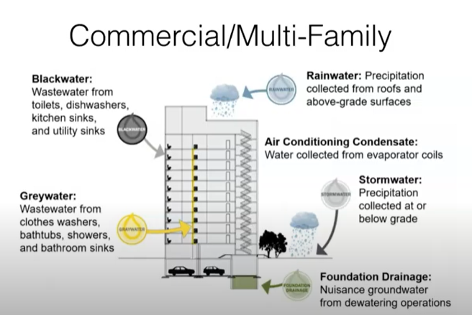

Slide 4


Slide 5
California Uniform Plumbing Code
Chapter 15 – Alternate Water Sources for Nonpotable Applications
  Section 1501 – General Requirements
  Section 1502 – Inspection and Testing
  Section 1503 – Gray Water Systems (untreated)
  Section 1504 – Subsurface Irrigation System Zones
  Section 1505 – Recycled Water Supply Systems in Buildings
  Section 1506 – Non-Potable Treated Gray Water Systems
Chapter 16 – Nonpotable Rainwater Catchment Systems
  (Stormwater used indoors follows Treated Gray Water requirements)

Slide 6
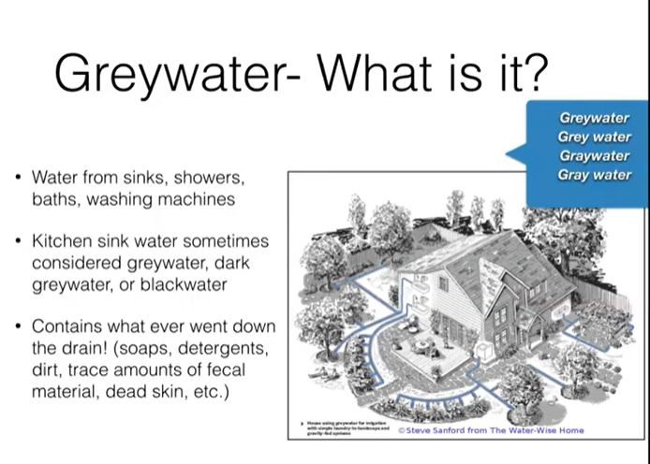
Gray Water
What is it ?
Wastewater from
  Washing machines
  Showers / baths
  Sinks
NOT FROM
  Kitchen sink / dishwasher
  Toilets
Contains what ever went down the drain; chemicals, soaps, detergents, dirt, trace amounts fecal material, dead skin, etc.

Slide 7
What’s in Gray Water?
If people AREN’T thinking about what goes down the drain….
  Chemicals
  Soaps / detergents (salts, boron, chlorine)
  Dirt
  Fecal material (tr.), dead skin, hair, lint, spit
  Food, grease

Slide 8
What’s in Gray Water?
If people are INTENTIONALLY thinking about what goes down the drain….(plant friendly products)
  Chemicals
  Soaps / detergents (salts, boron, chlorine)
  Dirt
  Fecal material (tr.), dead skin, hair, lint, spit
  Food, grease
  Don’t use sodium-based water softener water

Slide 9
Residential Gray Water
Don’t store >24 hours
Infiltrate to at least 2-inch mulch
Minimize human/animal contact
Must be able to divert to sewer
Best for trees, shrubs, NOT root crops
Know what you put down the drain
Signage/manuals
Maintain proper setbacks

Slide 10
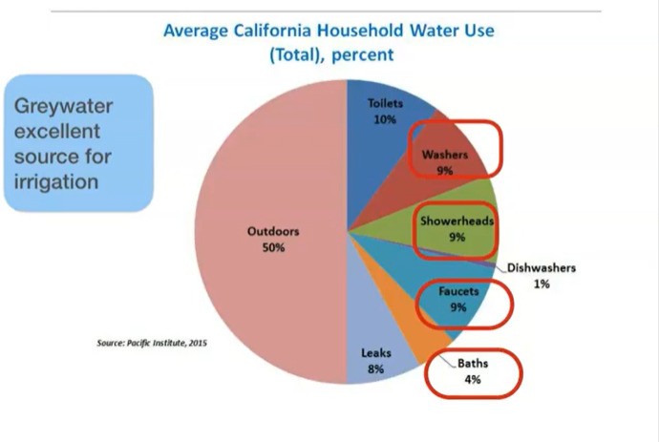

Slide 11
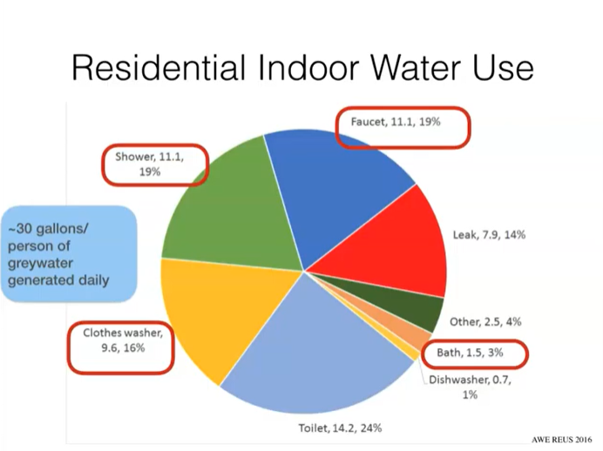

Slide 12
Role of San Mateo County Environmental Health
CPC 1506. Onsite Treated Non-Potable Gray Water Systems
  1506.2 Plumbing Plan Submission
  “Prior to commencing the issuance of indoor gray water systems……local agency shall seek consultation with the local public health department to ensure that local public health concerns are addressed in local standards or ordinances, or in issuing permits.”

Slide 13
Role of San Mateo County Environmental Health
CPC 1506. Onsite Treated Non-Potable Gray Water Systems
  1506.9.1 Minimum Water Quality
    On-site treated nonpotable gray water… shall be disinfected.
    The minimum water quality shall meet requirements for intended application as determined by the Public Health Authority Having Jurisdiction.
    In the absence of local water quality requirements, the requirements of NSF 350 shall apply

Slide 14
Role of San Mateo County Environmental Health
San Mateo County Public/Environmental Health does not have an ordinance or published standards related to gray water that would be more restrictive than CPC, Chapter 15 (or 16).
Therefore, water quality standards as cited in CPC for indoor use of gray water are in effect.

Slide 15
Risk-Based Water Quality Standards
Senate Bill SB-966 passed in 2018
  Requires the SWRCB (with Building Standards Commission and Dept. of Housing and Community Development) to establish uniform statewide recycling criteria for each varying type of use of recycled water to protect public health
  By December 1, 2022, adopt regulations for risk-based water quality standards.
  Local jurisdiction that elects to establish a program for nonpotable water systems must adopt local ordinance incorporating those quality standards
  CPC must adopt by December 1, 2023.

Slide 16
Risk-Based Water Quality Standards
Where does the SWRCB stand on developing the standards
  Sheryl Rosilela, P.E., Technical Operations Section
  July 8, 2021
  “We are in the middle of criteria development. I anticipate that we should be able to roll out a stakeholder workshop on the draft criteria by this fall.
  We are reaching out to individual local agencies, particularly those with existing local onsite reuse programs, and talk to local agencies that expressed interest in setting up or considering developing their programs.”

Slide 17
Risk-Based Water Quality Standards
Only required to adopt regulations for risk-based water quality standards for nonpotable end uses in
  Multifamily residential
  Commercial
  Mixed-use buildings
DOES NOT ADDRESS single-family or duplex
  This follows the same format as exists in CPC currently

Slide 18
Risk-Based Water Quality Standards
Local jurisdiction that elects to establish a program for nonpotable water systems must adopt local ordinance incorporating those quality standards
  Would effectively on cover 1 year from December 1, 2022 to incorporation into CPC by December 1, 2023
  Environmental Health vs. Building Departments
    If EH, coordinate implementation and reporting with 20 cities, other special districts (sewer, etc.), 40+ public water systems, etc.
  May vary by Building Department

Slide 20

CONTACT US
Gregory J. Smith – “Smitty”
2000 Alameda de las Pulgas
Suite 100
San Mateo, CA 94403
650-372-6279 T
650-730-0292 M
GJSmith@smchealth.org
smchealth.org/eh

