Slide 1
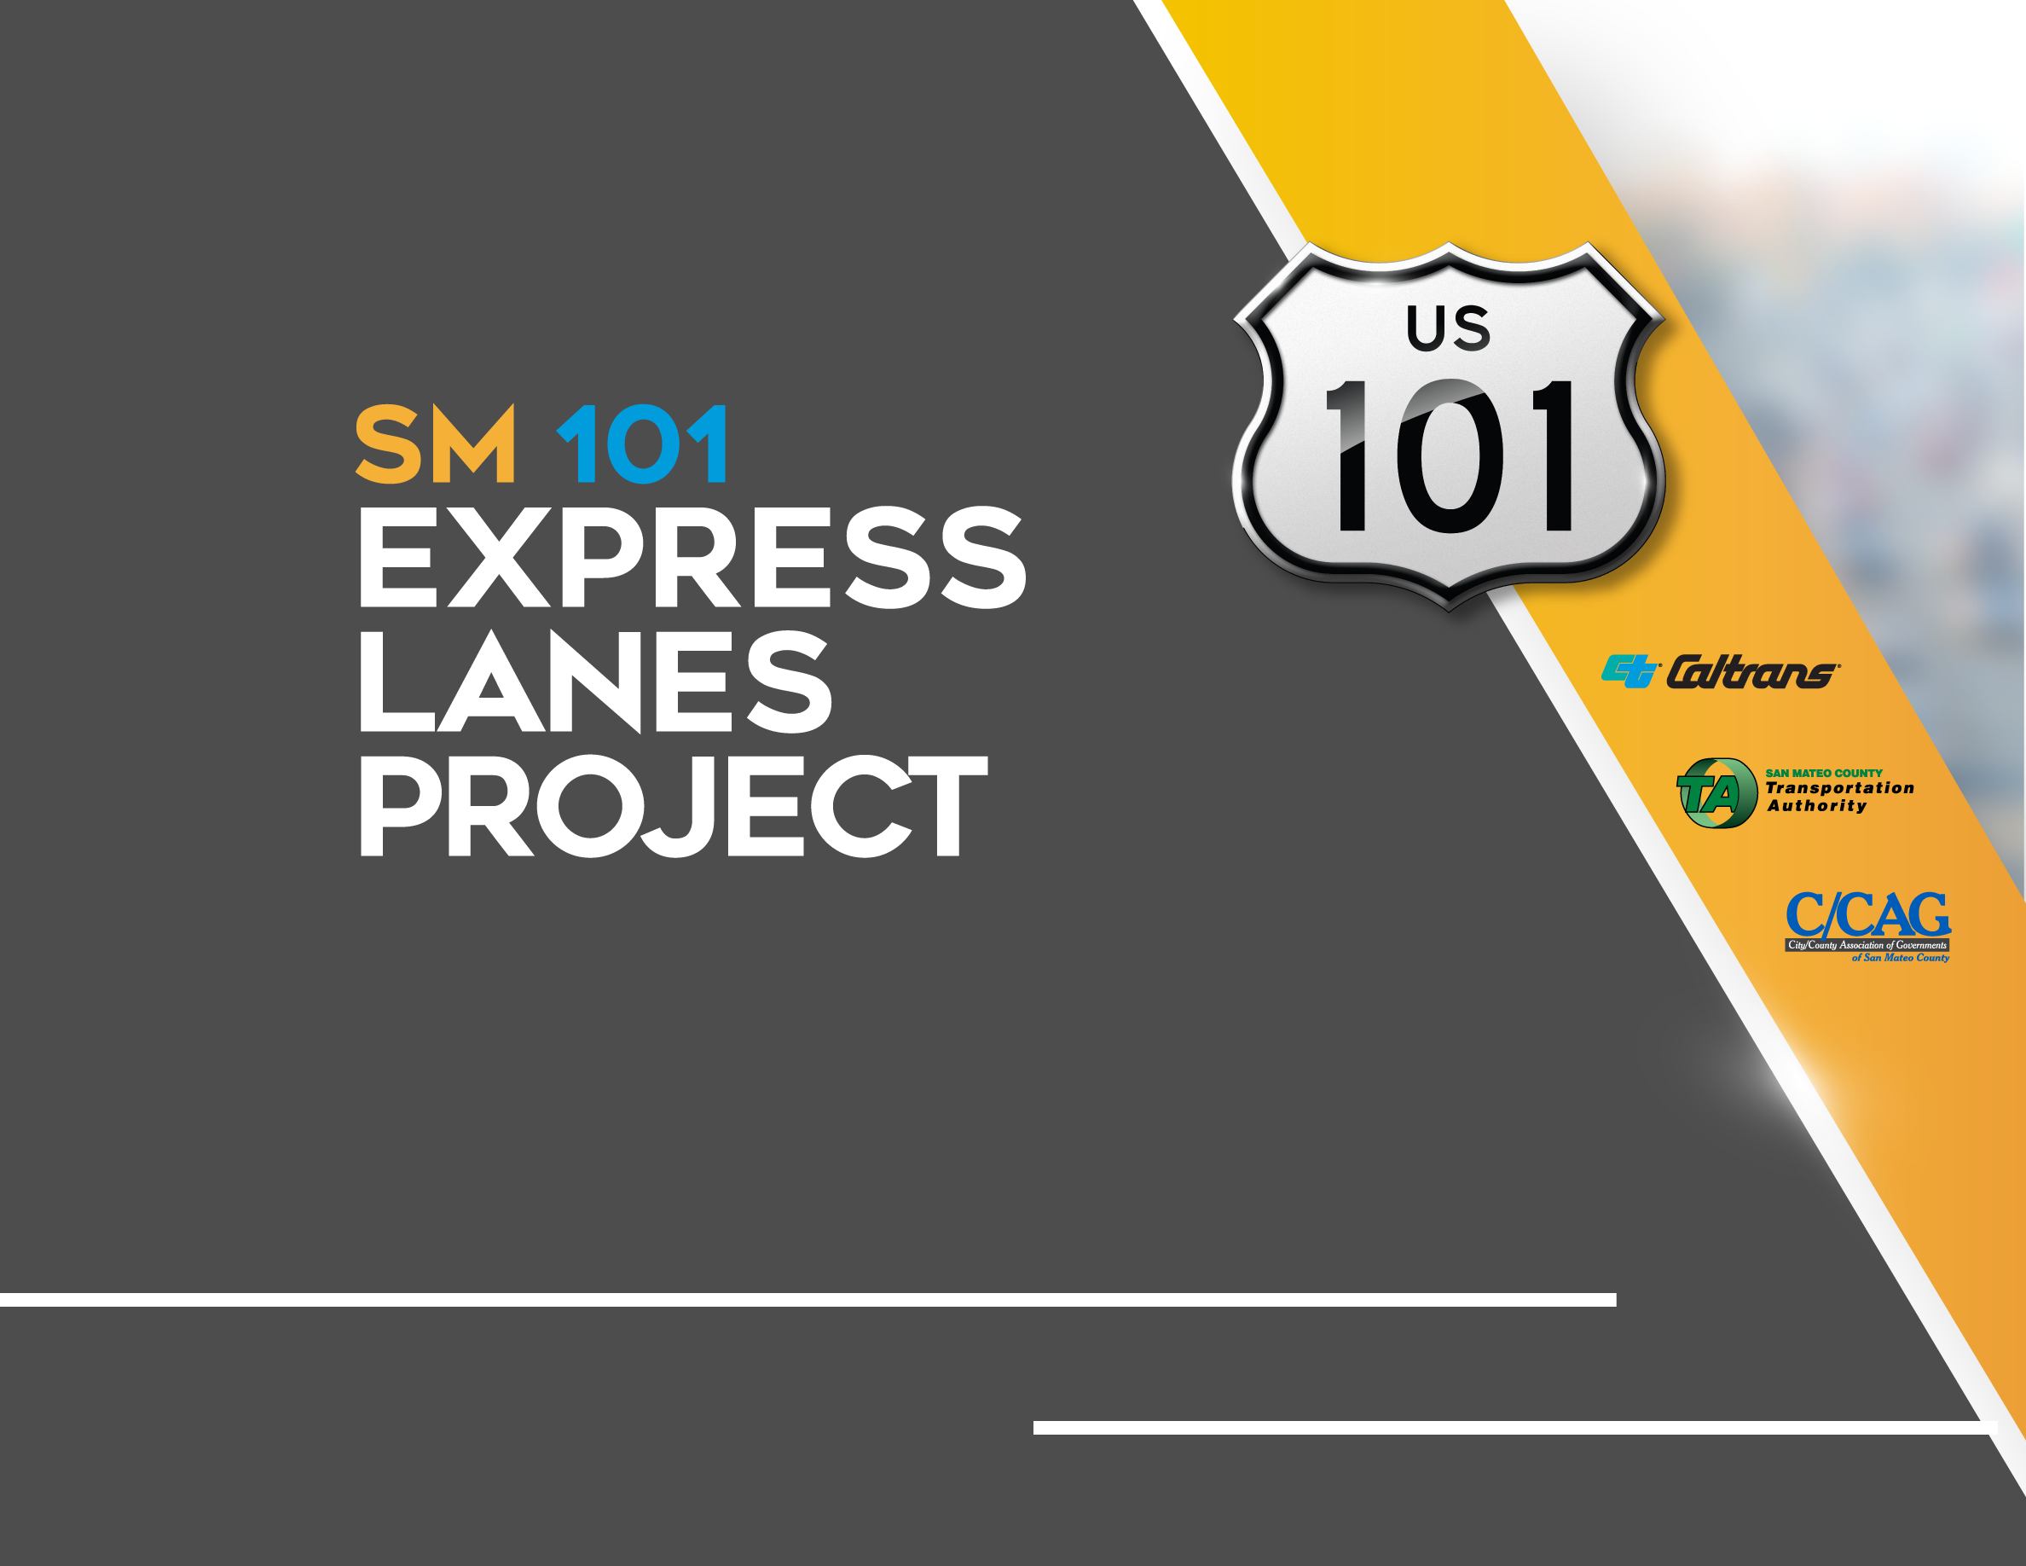
Quarterly Project Update
C/CAG Board Meeting September 9, 2021

Slide 2
AGENDA
Construction Progress
Construction Spotlight
Financial and Risk Status
Public Outreach Activities

Slide 3
Construction Progress
Construction Spotlight
Financial and Risk Status
Public Outreach Activities

Slide 4
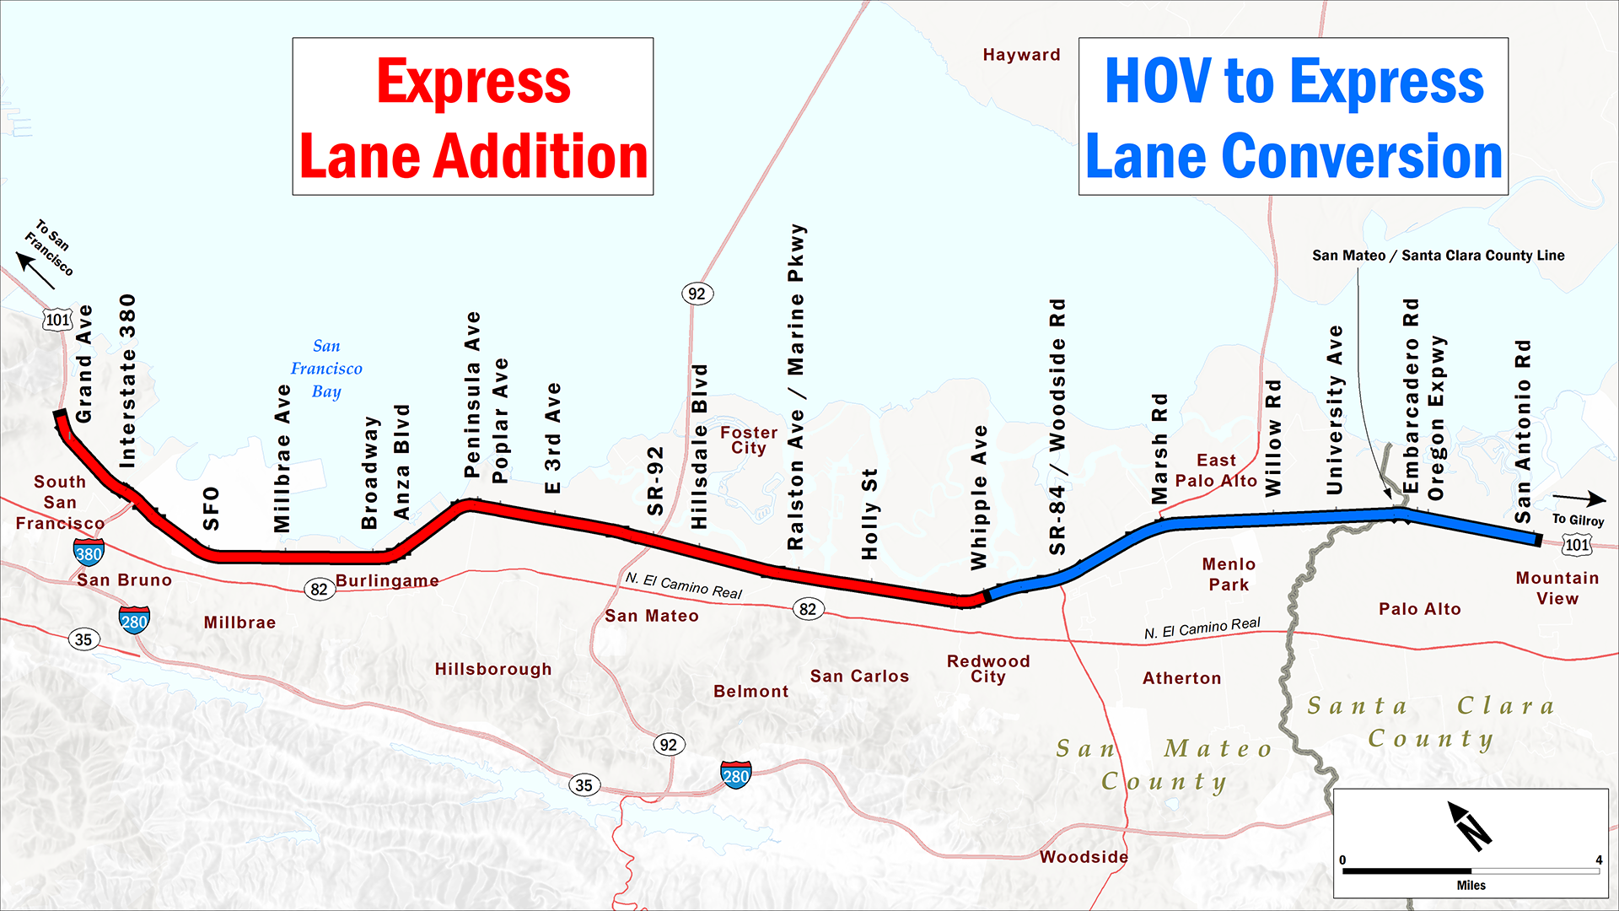
PROJECT LIMITS
Notes:
The SM101 project includes building a new express lane on the northern half, and converting the existing HOV lane in the southern half.

Slide 5
PROJECT SCHEDULE
Express
Lane
Addition
Begin Toll System
Installation
Summer 2021
Begin Construction
March 2020
Begin Toll Systems Testing
Summer 2022
Open Express Lanes
Late 2022
North of
Whipple
2020
2021
2022
South of
Whipple
Open Express Lanes
Late 2021
Begin Toll System Installation
Fall 2020
Begin Toll Systems Testing
Summer 2021
HOV to
Express Lane
Conversion
Notes:
The northern and southern sections will both be built and launched at different times. On both sides though, there are 3 main tasks: construction, toll systems installation, and opening the lane.

Slide 6

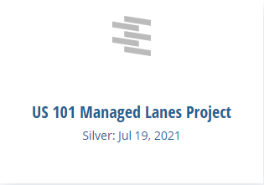
SUSTAINABILITY CERTIFICATION
“The project team worked diligently with the community to collaborate and find ways to address climate-change risks, enhance social equity, protect the natural environment, and ensure safety. The Envision Silver award provides ample proof that everyone involved went above and beyond to deliver a resilient, sustainable, and equitable civil infrastructure project.”
-Melissa Peneycad, ISI’s Managing Director
Notes:
The northern and southern sections will both be built and launched at different times. On both sides though, there are 3 main tasks: construction, toll systems installation, and opening the lane.

Slide 7
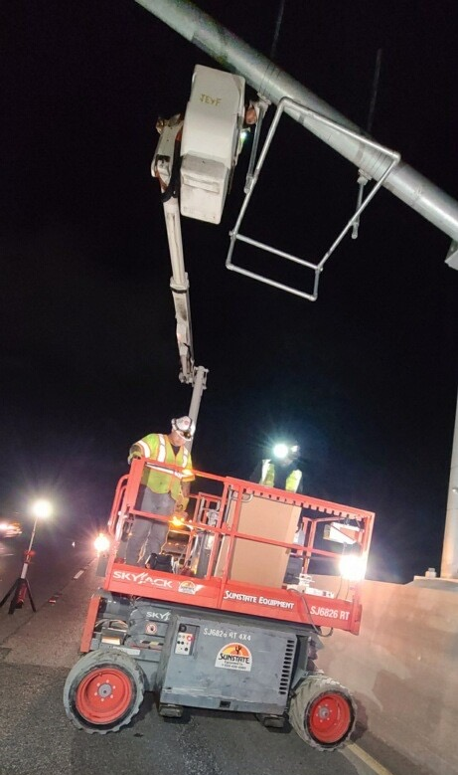
SOUTH CONTRACT WORK COMPLETED
South of Whipple
through July:
Completed installation of equipment on the northbound side
Installation of equipment on southbound side nearly complete

Slide 8
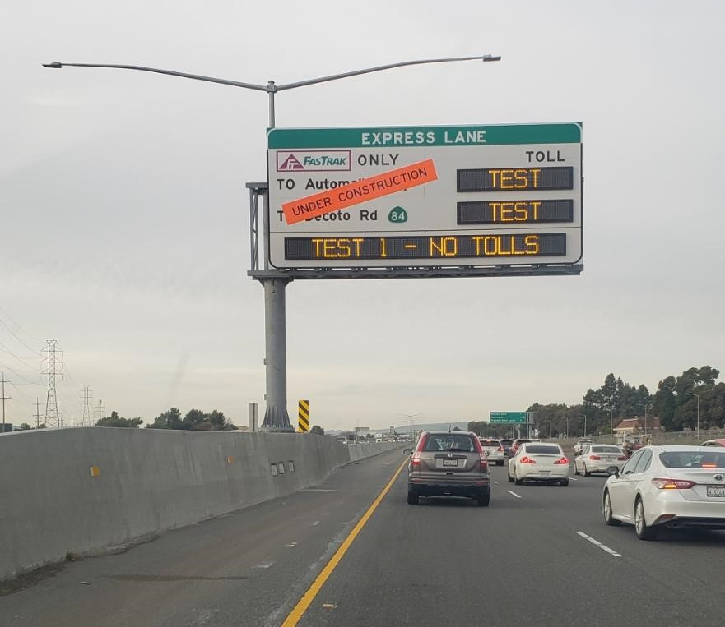
UPCOMING WORK: August – October
South of Whipple:
Licensing of equipment in city rights of way
Testing of tolling equipment
Testing of toll system
Photo of testing on the I-880 corridor

Slide 9
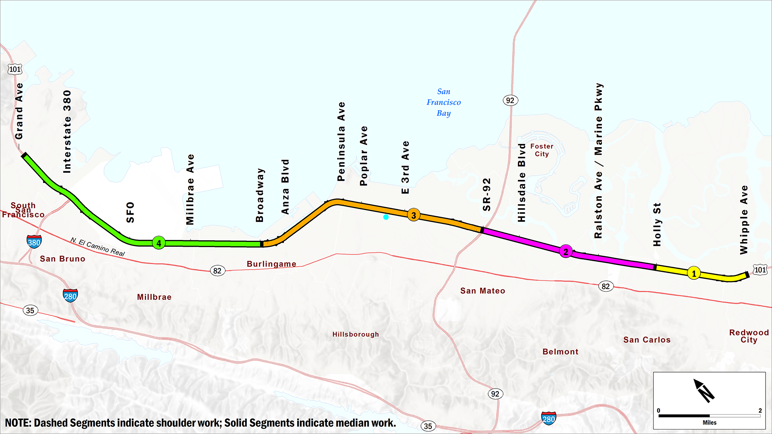
NORTH CONTRACT CONSTRUCTION BLOCKS

Slide 10
NORTH CONTRACT WORK COMPLETED
North of Whipple through July:
$221.68M of $326M completed (68%) with 53% time elapsed
Completed demolition of median barrier
New median barrier complete in Block 4
Median sign foundations complete in Block 4
Completed median paving
Installed new protective plates on underpass foundations at Hillsdale Boulevard and 3rd Avenue
Capital Preventative Maintenance (CAPM) (roadway rehabilitation) paving substantially complete

Slide 11
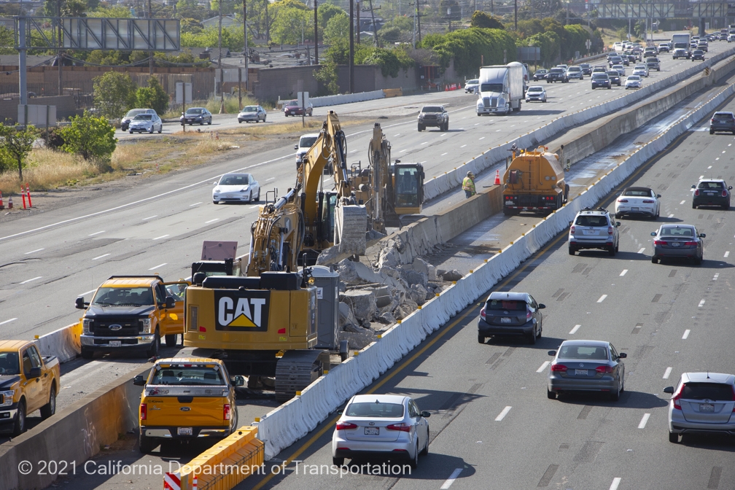
NORTH CONTRACT WORK ONGOING
Median Barrier Demolition

Slide 12
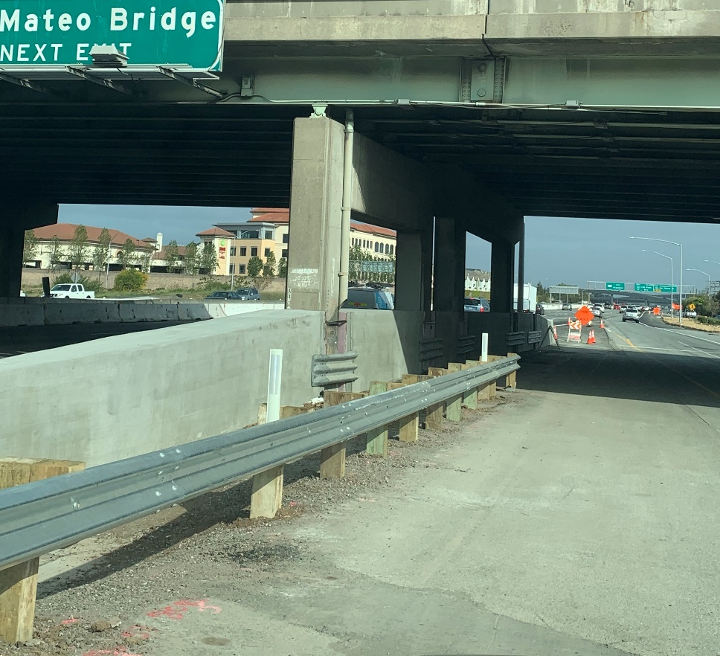
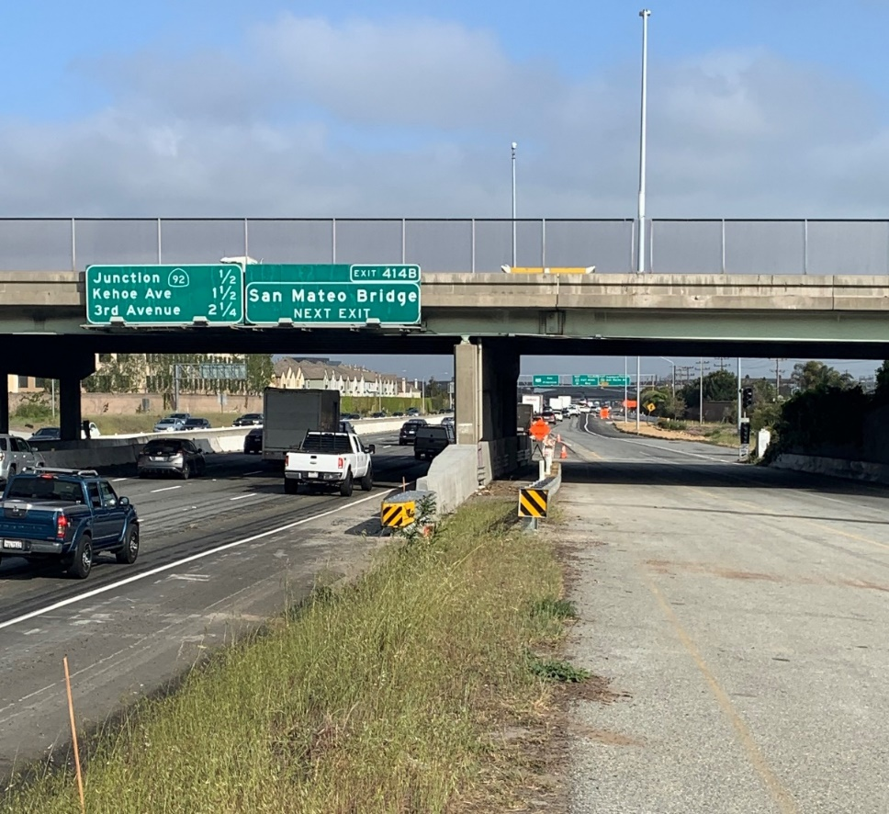
NORTH CONTRACT WORK COMPLETED
Protective Plates at Hillsdale Boulevard Underpass

Slide 13
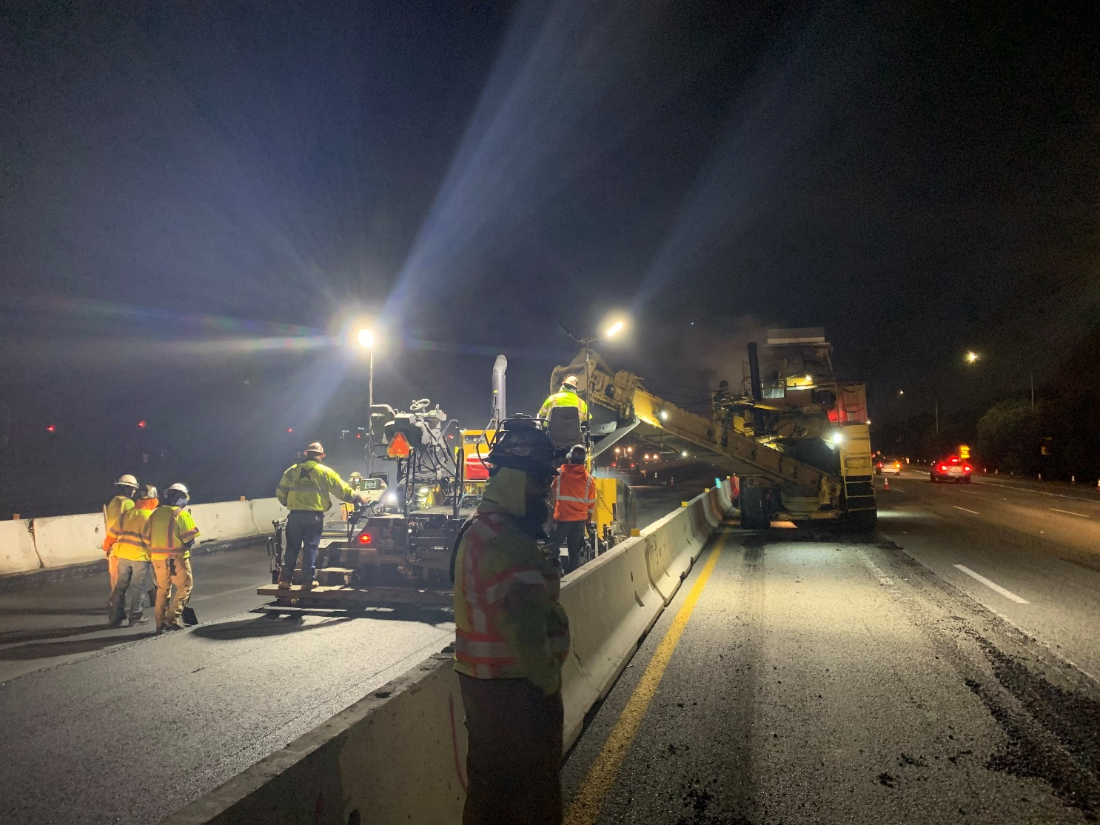
NORTH CONTRACT WORK ONGOING
Median Paving

Slide 14
UPCOMING WORK: August - October
North of Whipple:
Completion of Block 4 paving
Completion of sign foundations in Blocks 1, 2, and 3 Installation of lights and sign structures in Blocks 1 and 4
Installation of tolling equipment (TransCore)
Notes:
For the “northern contract” or second phase, there will be work in Palo Alto on both the freeway and on City Streets (confirmed by contractor)

Slide 15
Construction Progress
Construction Spotlight
Financial and Risk Status
Public Outreach Activities

Slide 16
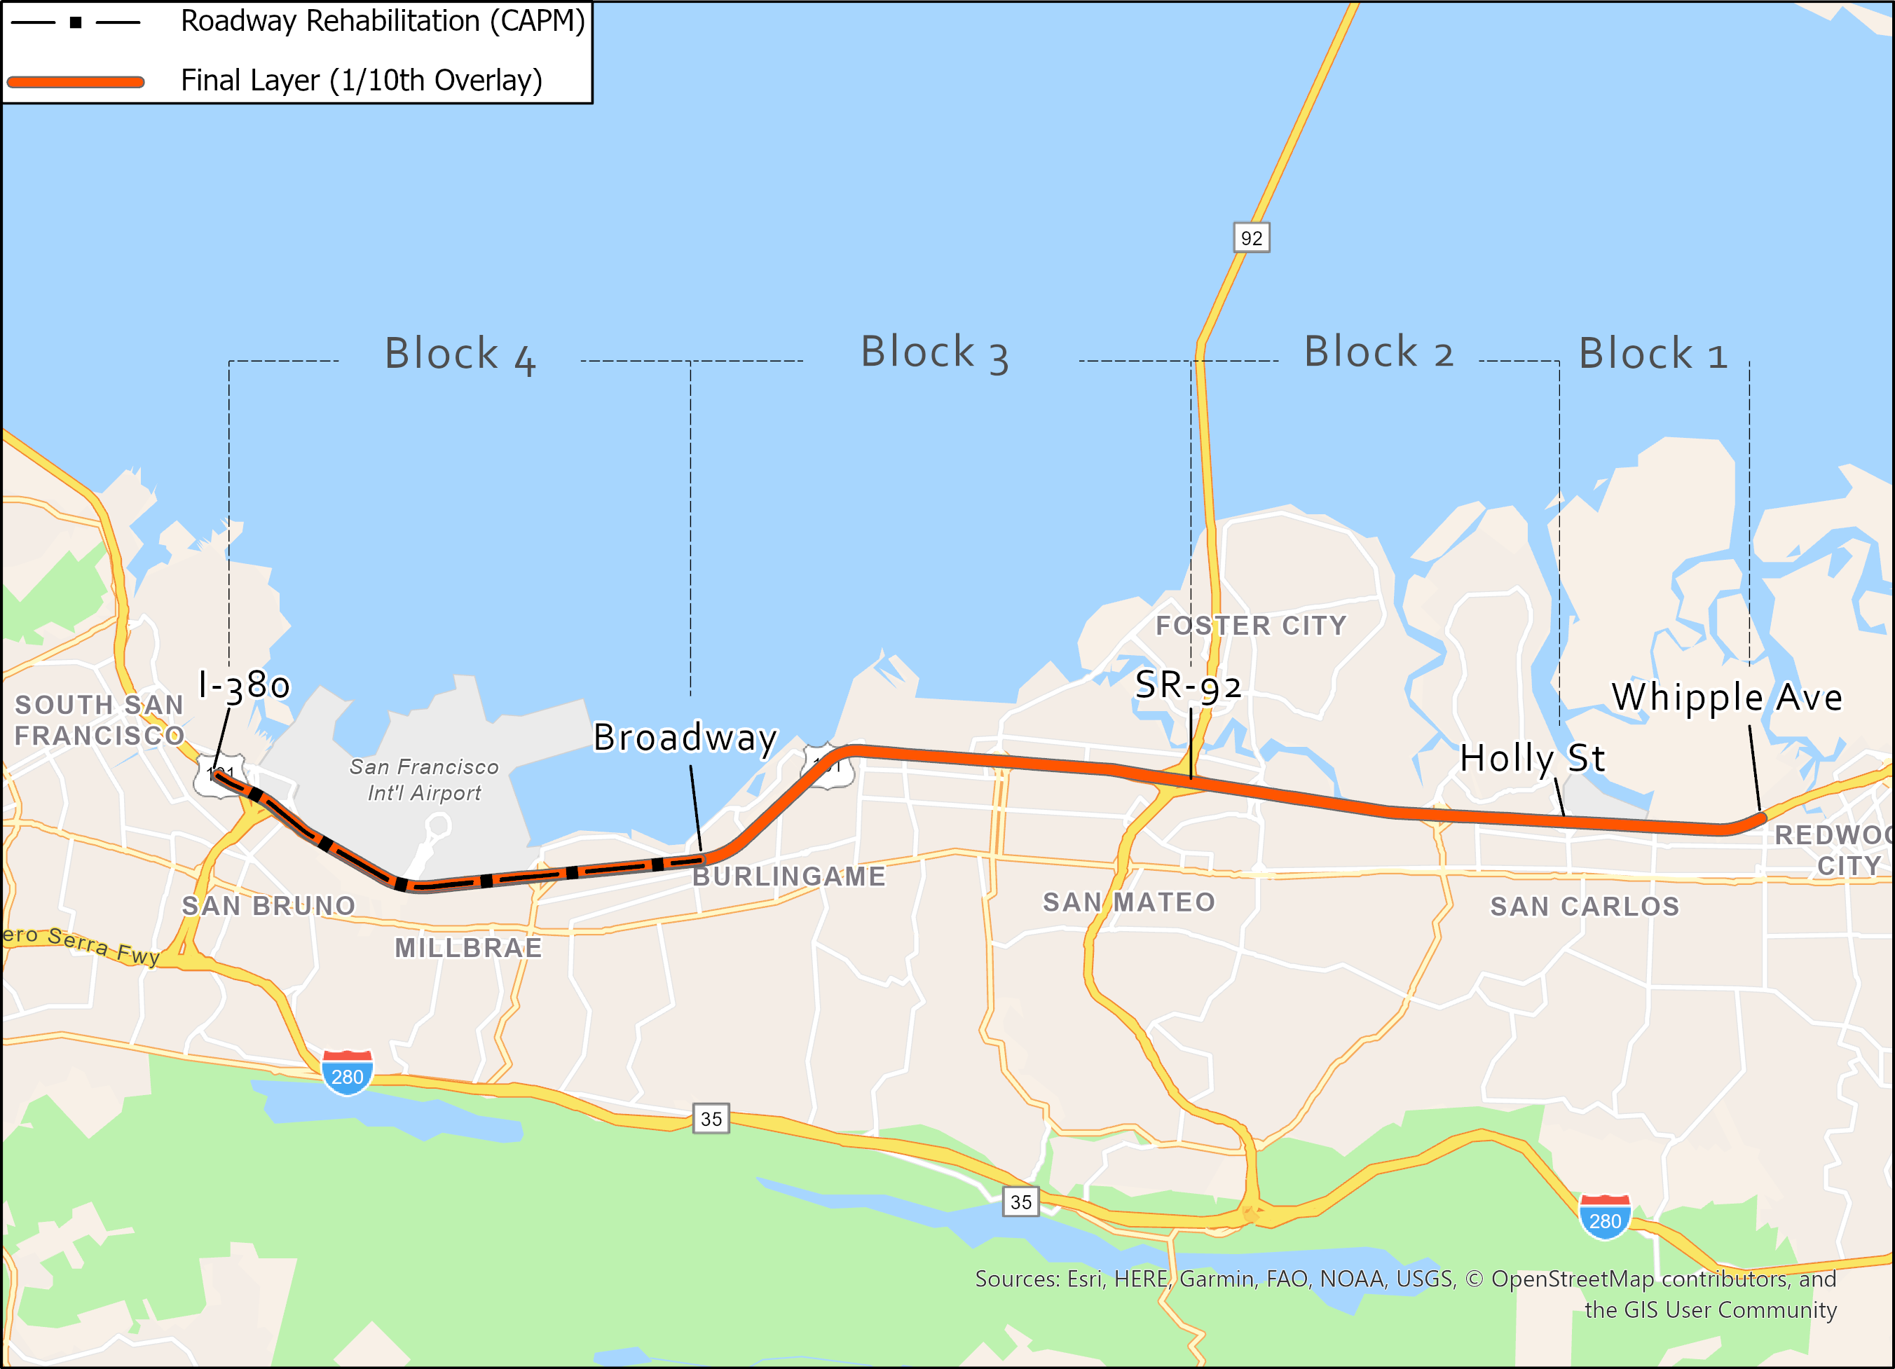
Paving Overview

Slide 17
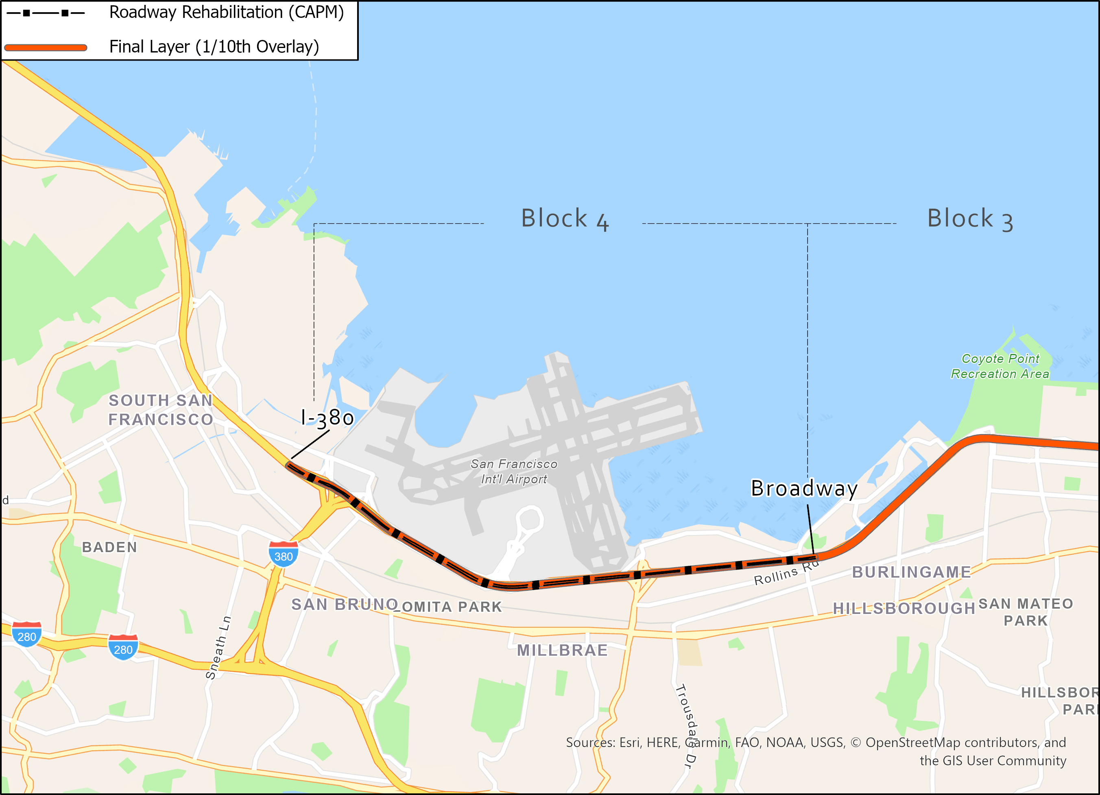
CAPM Paving

Slide 18
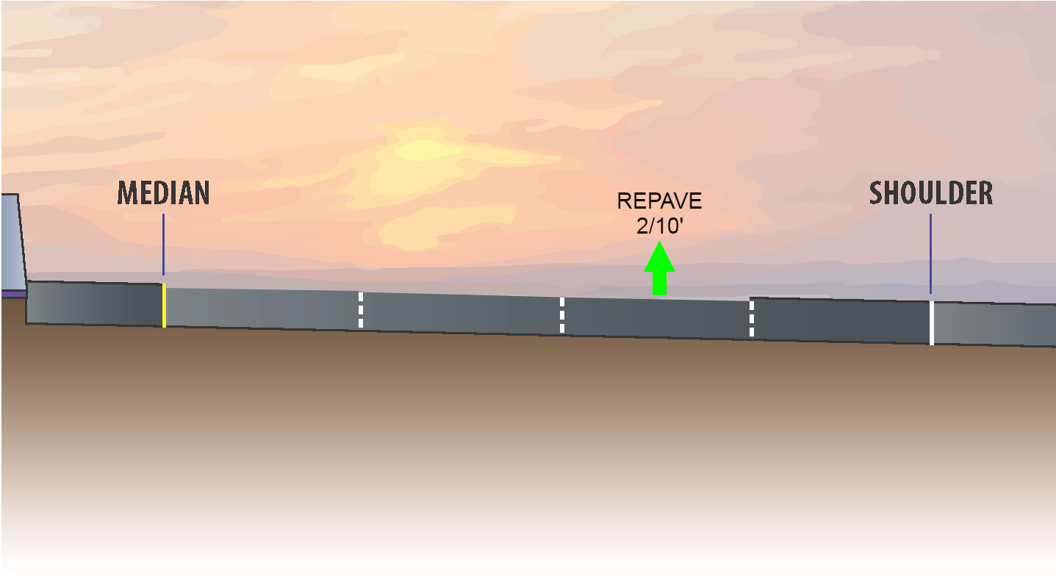
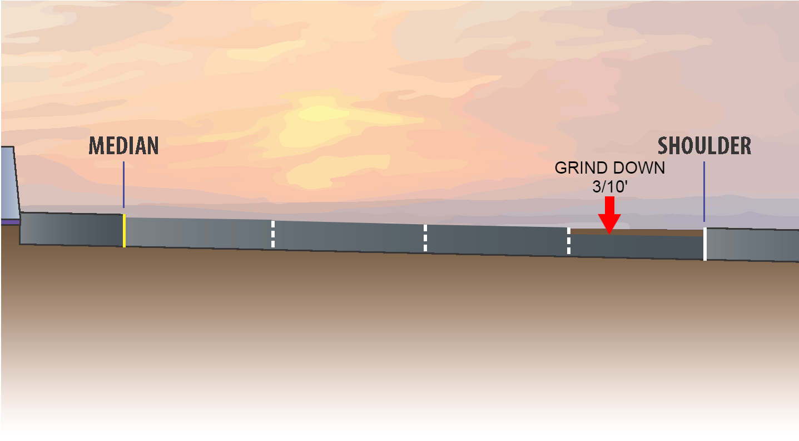
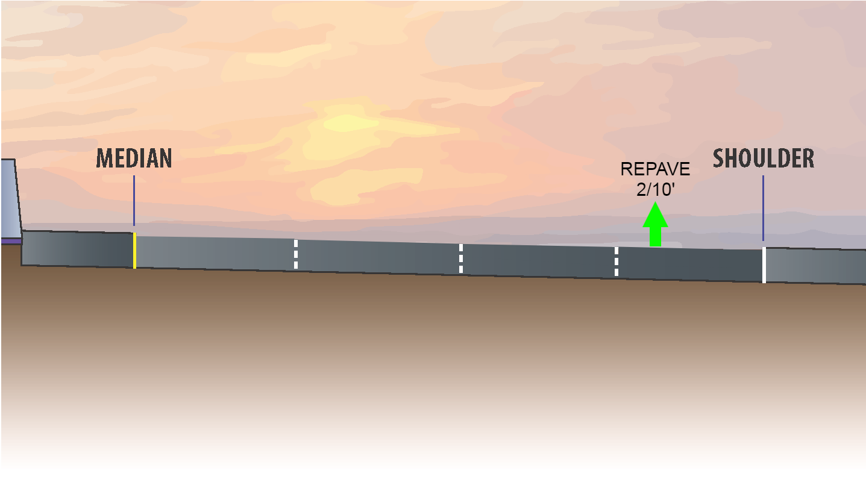
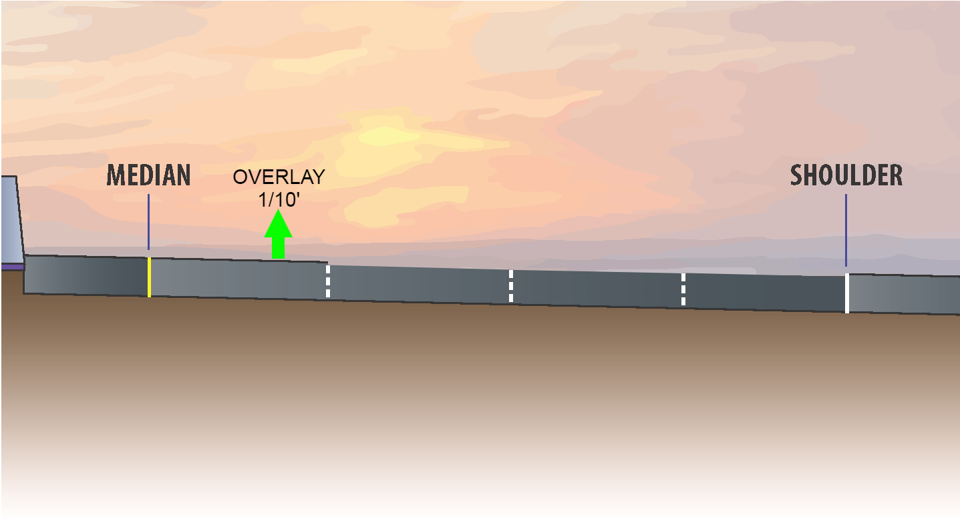
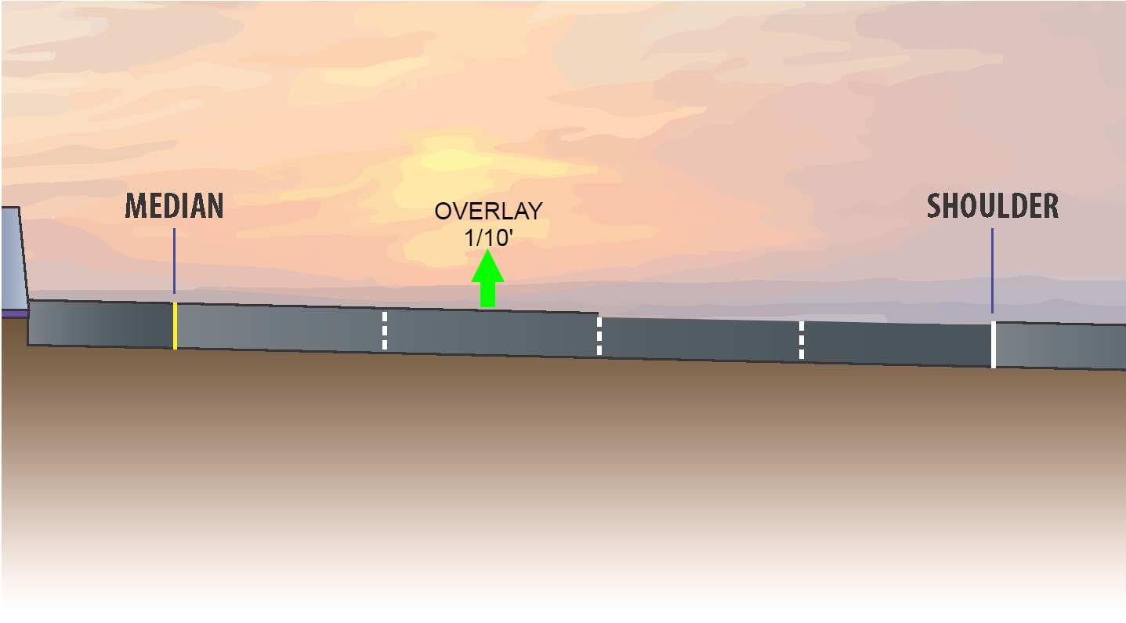
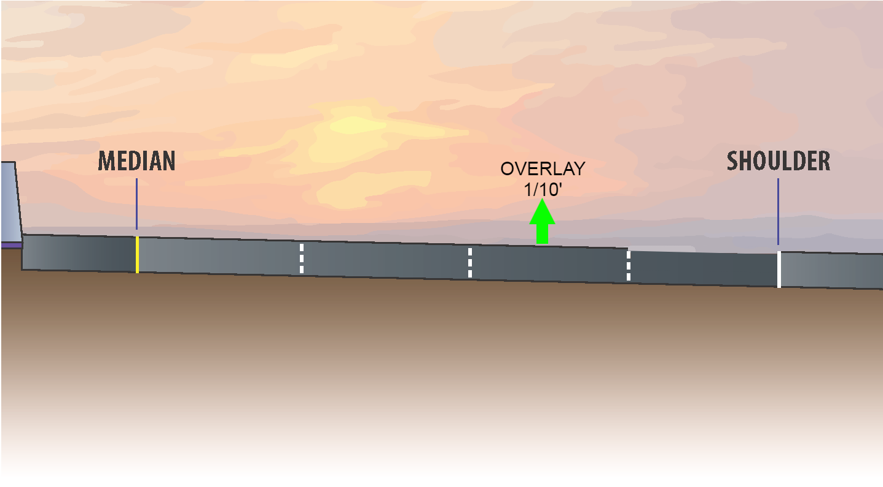
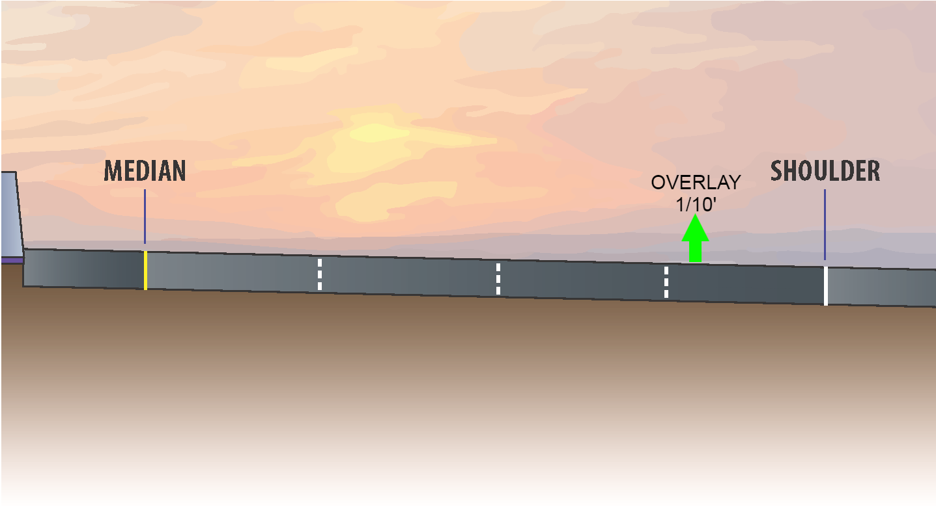
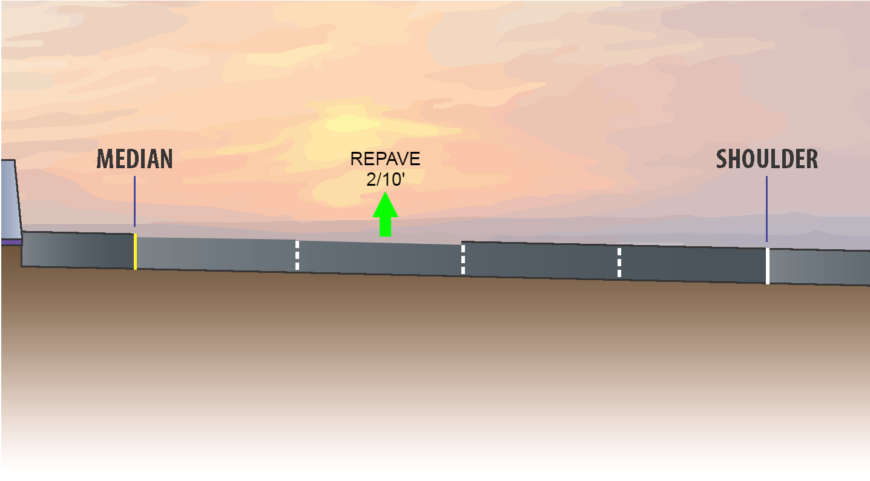
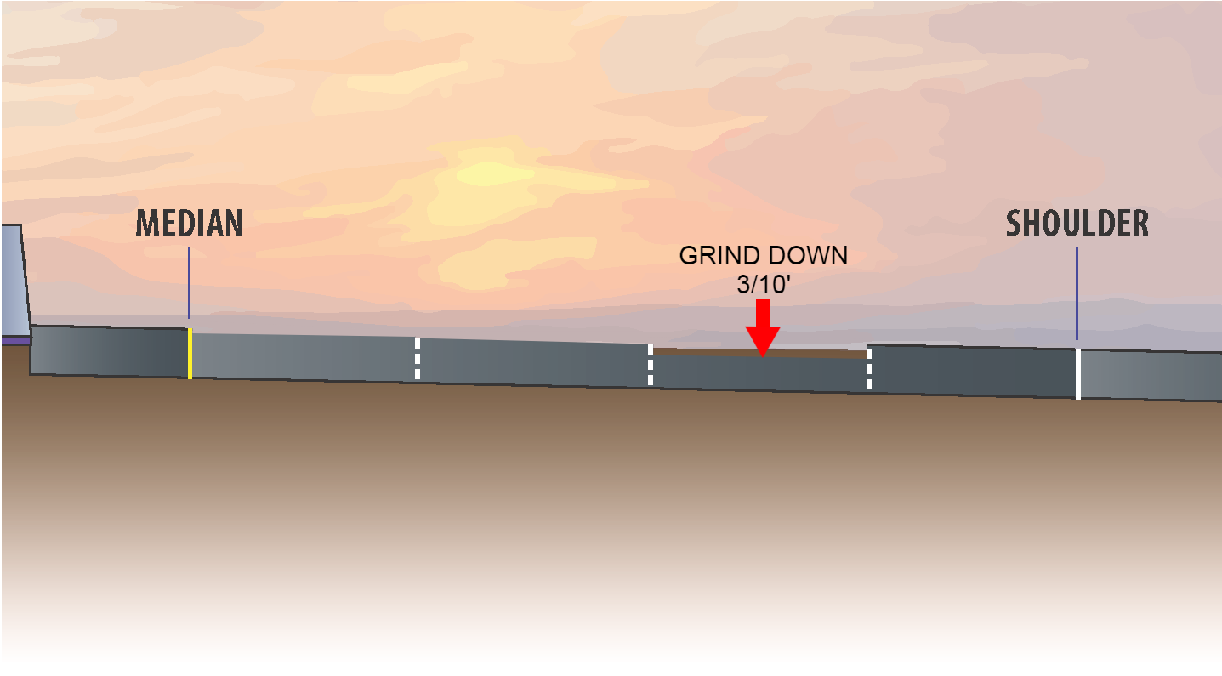
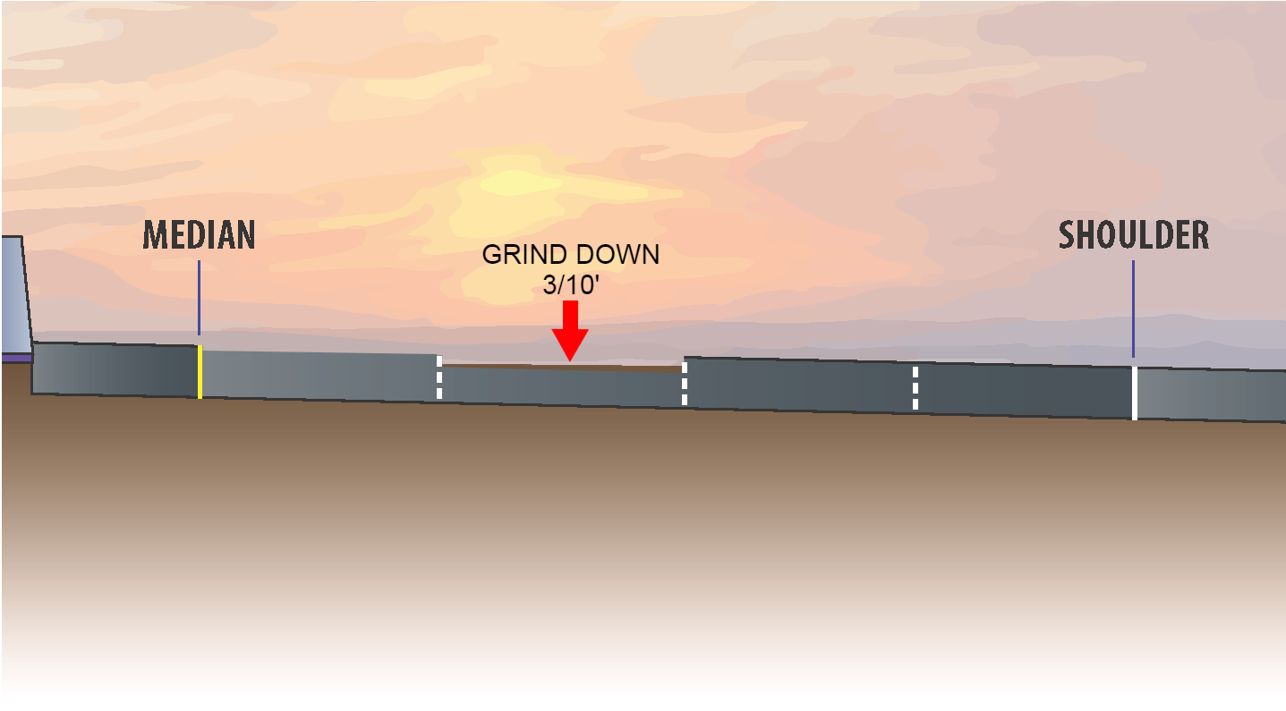
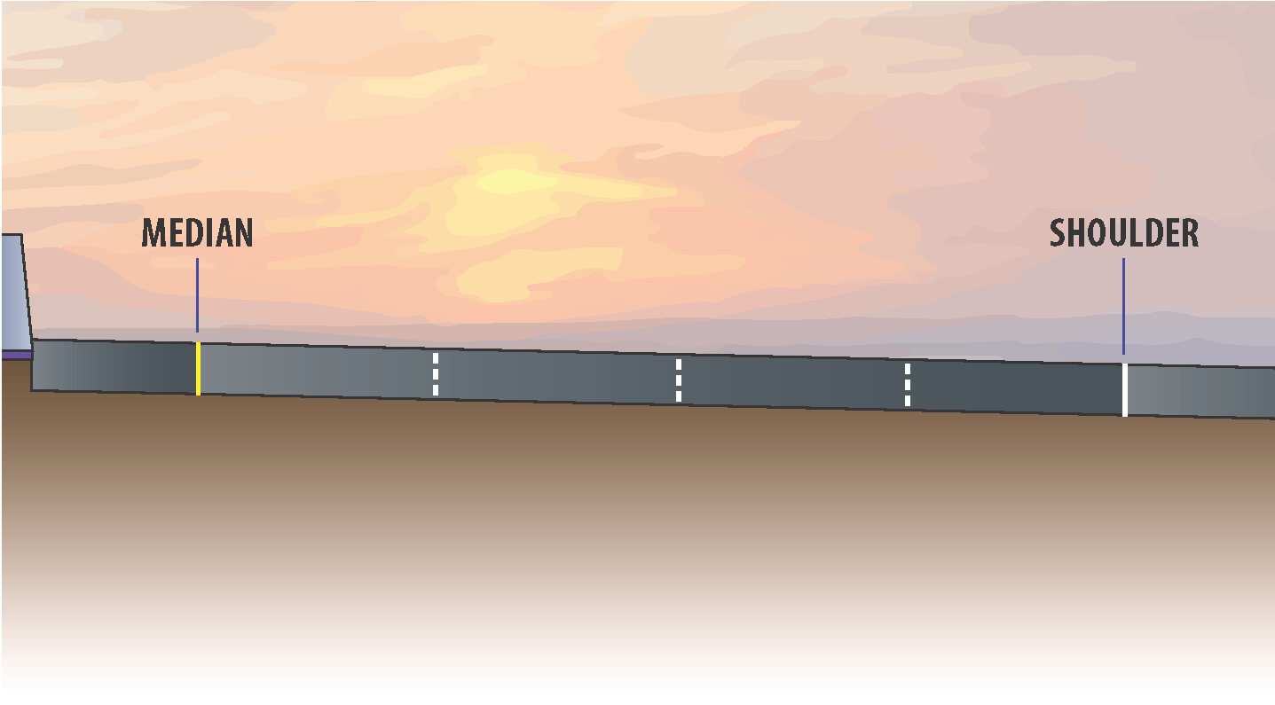
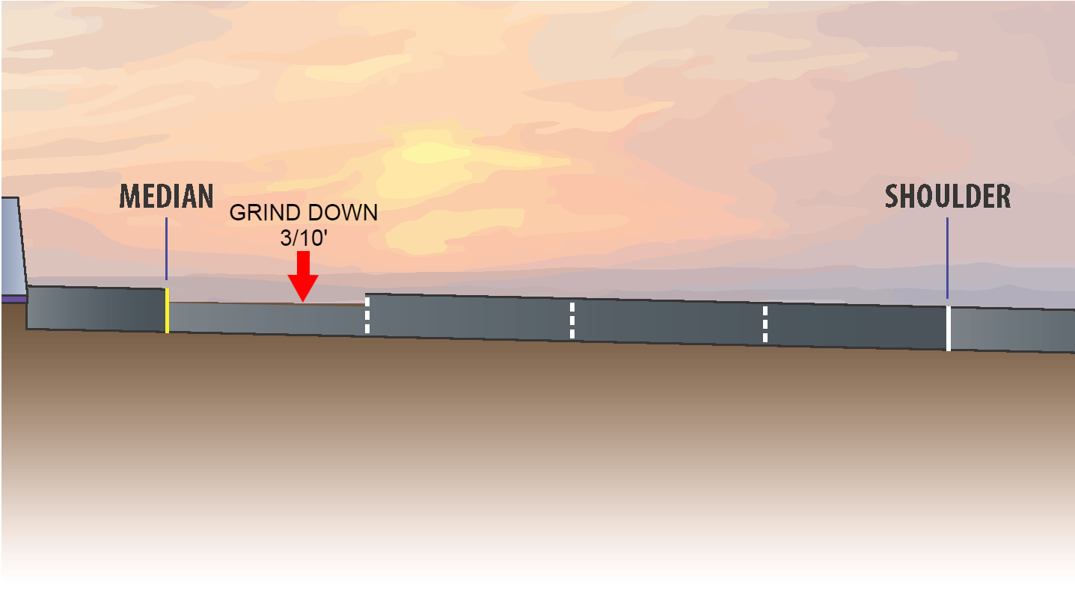
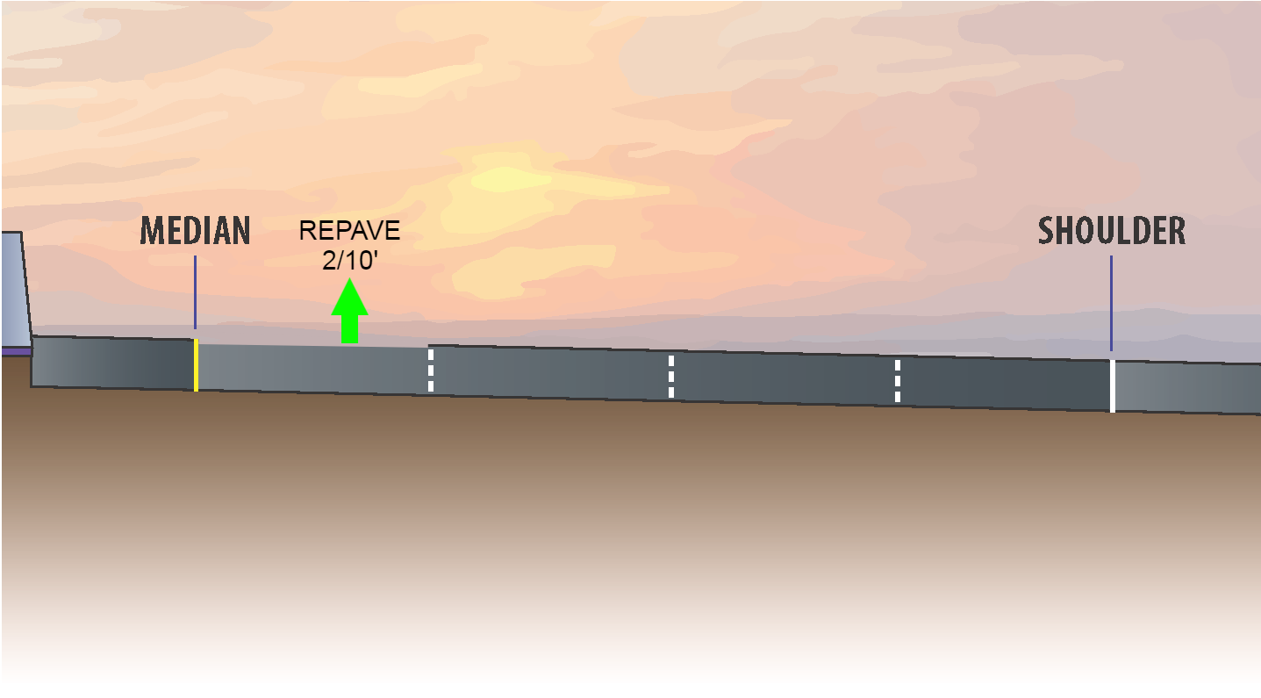
CAPM Paving
Notes:
Caltrans pavement rehabilitation project combined was with the express lanes project to improve the finished pavement product in the corridor
Scope work:
Grind the pavement 3/10th foot
Add back 2/10th foot
Complete 1/10th foot
All lanes are being repaved, northbound and southbound, as well as ramp transitions (not the ramps themselves though)
This work is currently ongoing, and is anticipated to conclude in early August 2021
Limits: between Broadway and Produce Avenue

Slide 19
Final Layer (1/10th Overlay) Limits

Slide 20
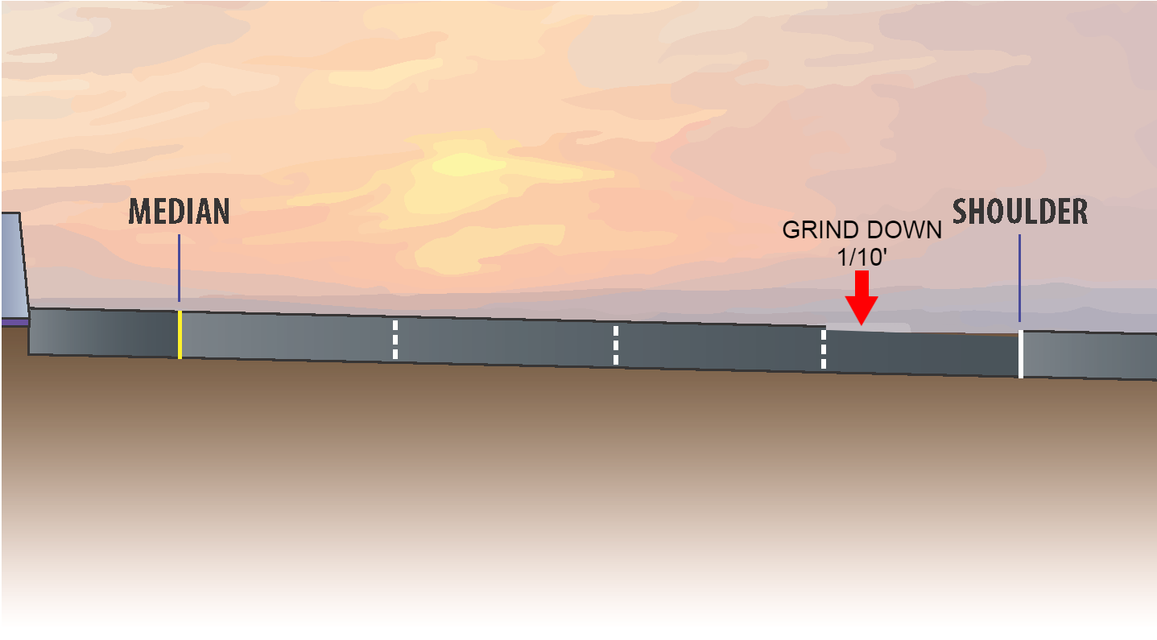
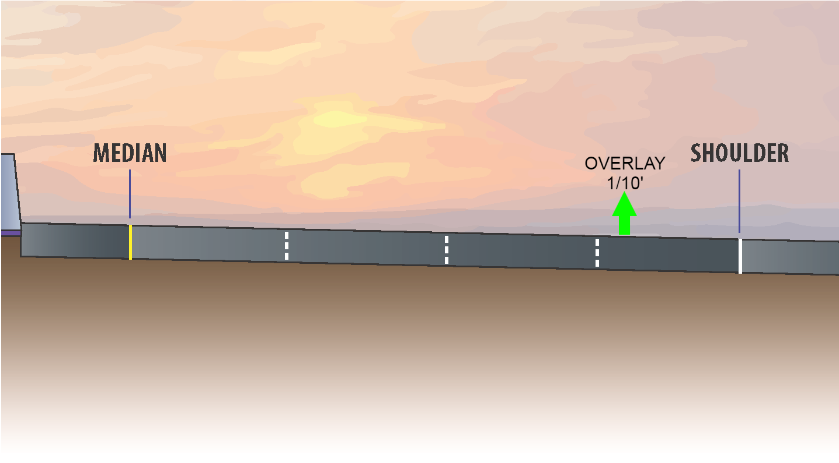
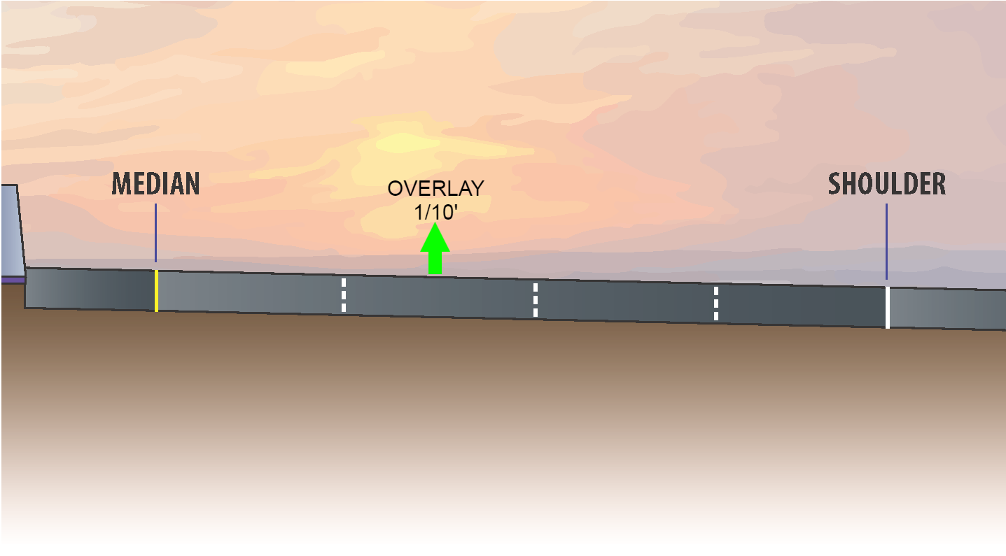
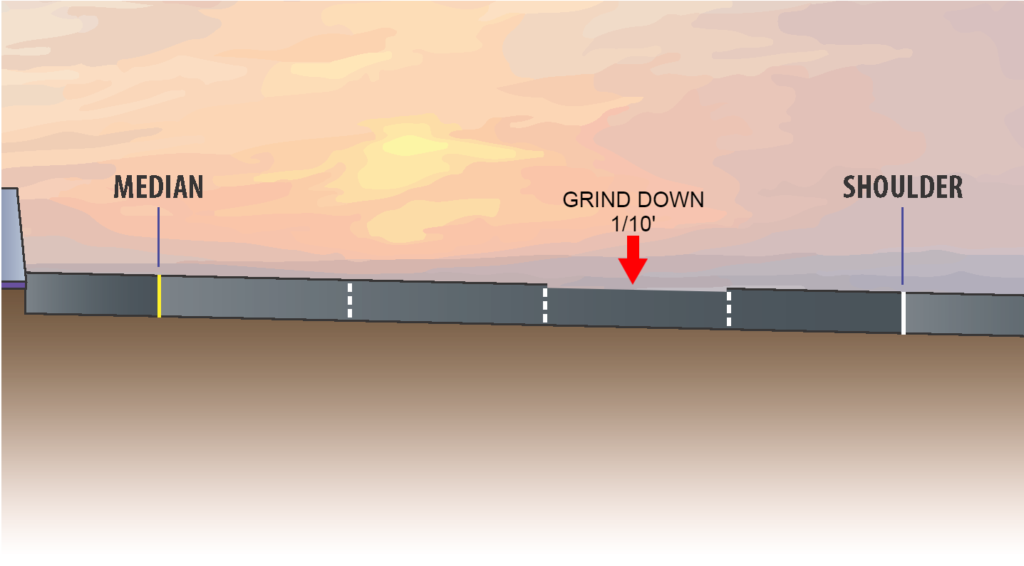
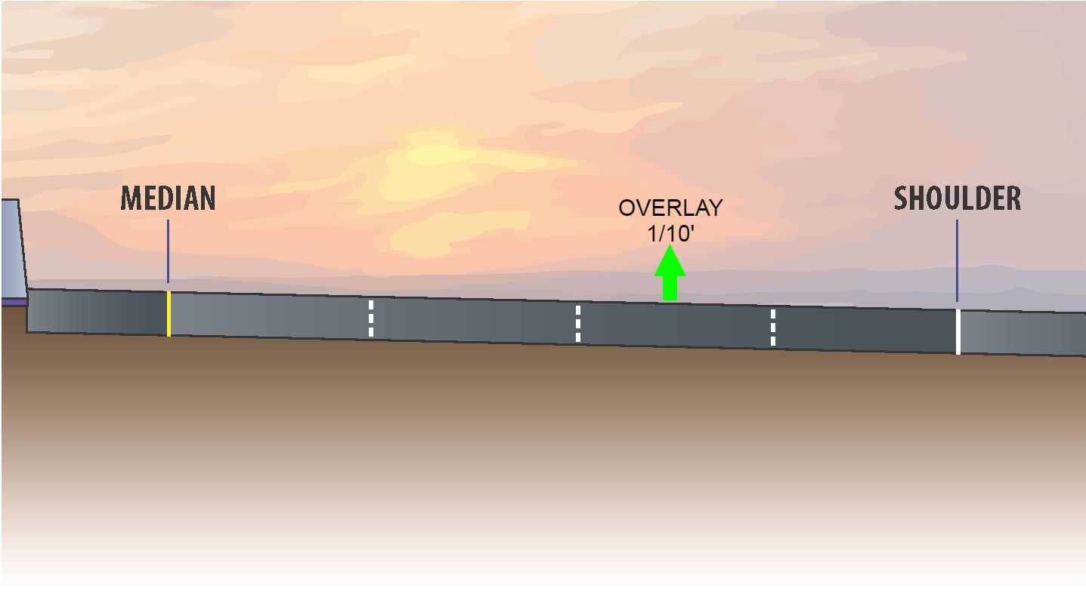

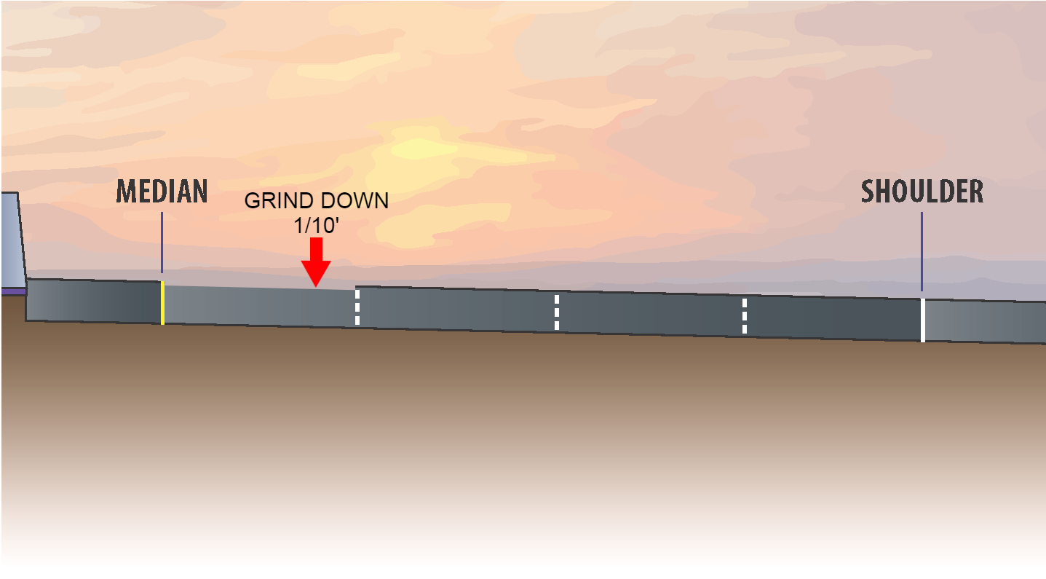
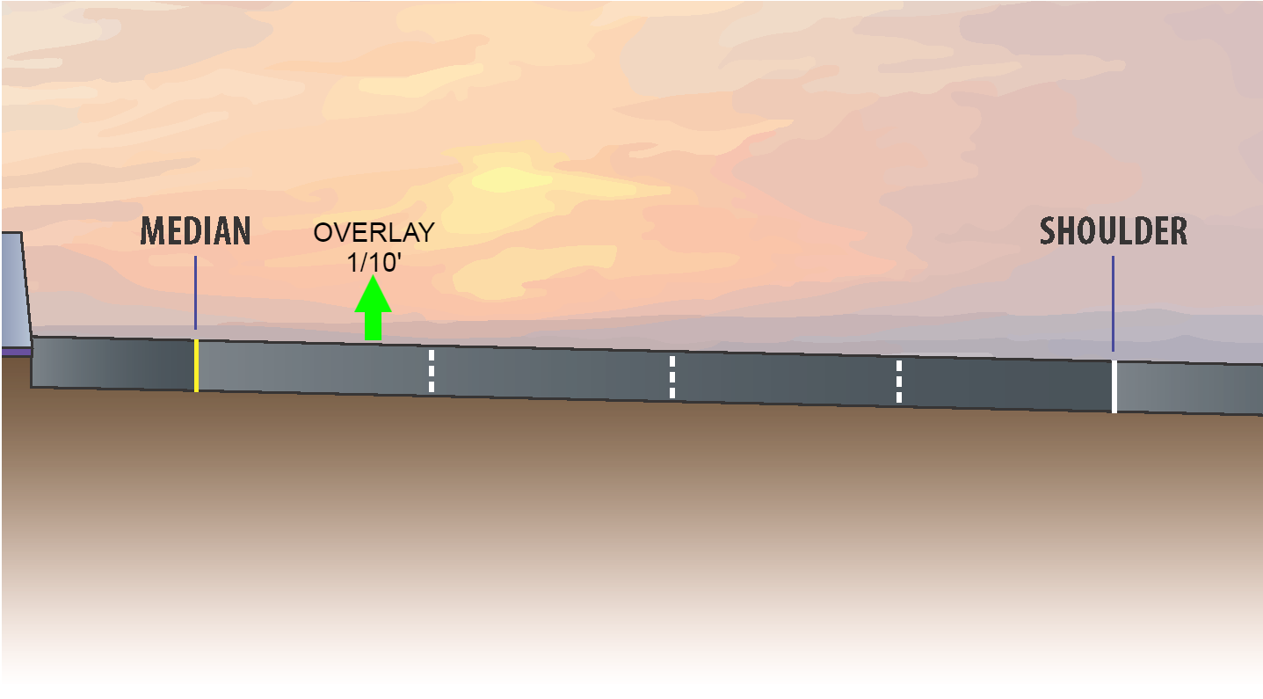
Final Layer (1/10th Overlay)
Notes:
Scope of work:
Grind 1/10th foot of existing asphalt pavement
Add an overlay of 1/10th foot asphalt pavement
In blocks 1, 2 and 3, this work will begin once concrete barrier work is complete. The anticipated start is in Spring 2022
This will begin after the CAPM paving. It is anticipated to begin in August 2021, and conclude in late 2022
There are weather-related restrictions on when this work can take place
Limits: over the entire width of the existing pavement from Whipple Avenue to just past the I-380 interchange

Slide 21
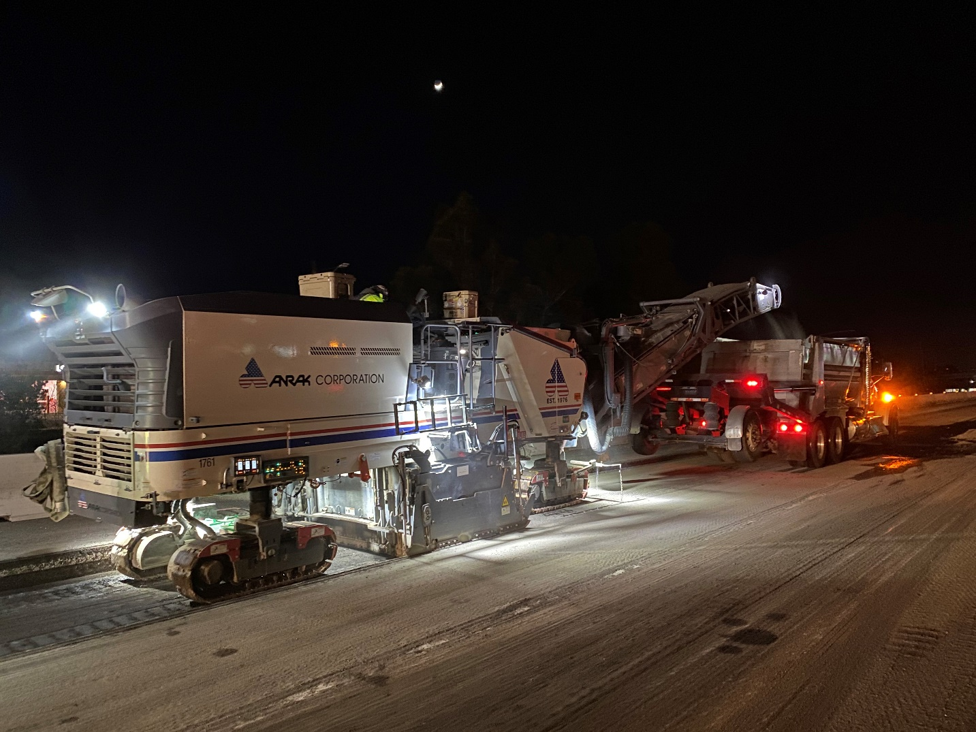
NORTH CONTRACT WORK ONGOING
Roadway Rehabilitation (CAPM) Paving

Slide 22
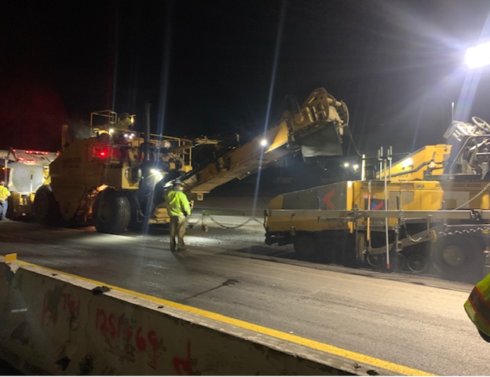
NORTH CONTRACT WORK ONGOING
Roadway Rehabilitation (CAPM) Paving

Slide 23
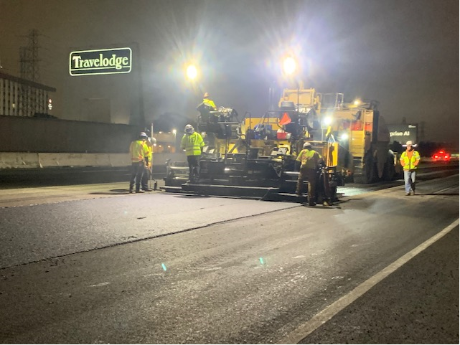
NORTH CONTRACT WORK ONGOING
Roadway Rehabilitation (CAPM) Paving

Slide 24
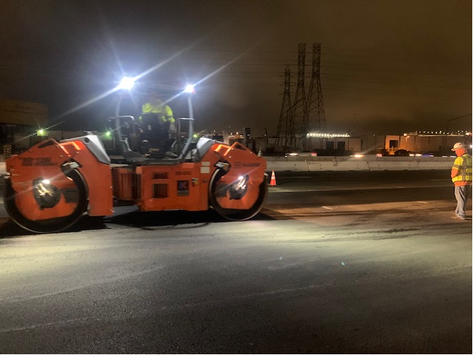
NORTH CONTRACT WORK ONGOING
Roadway Rehabilitation (CAPM) Paving

Slide 25
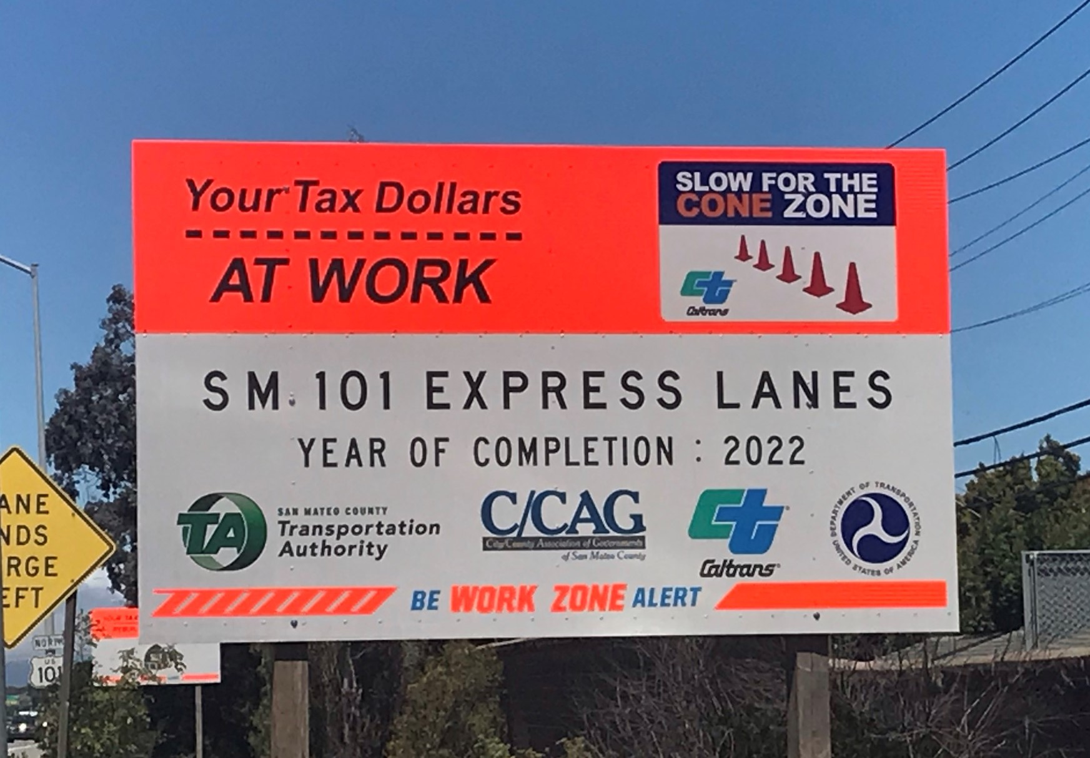
NORTH CONTRACT WORK ONGOING
Sponsorship Sign

Slide 26
Construction Progress
Construction Spotlight
Financial and Risk Status
Public Outreach Activities

Slide 27
CURRENT COST ESTIMATE - CONTRACT FOCUSED
(1) Estimated Cost represents current estimated cost to complete each contract.
(2) Expenditures include $12M deposit against North Contract – Civil.
(3) Percent completes shown are based on qualitative assessment of physical % complete per milestones and schedule.
(4) Å = Within budget, Å = identified potential risks that may significantly exceed budget if not mitigated, Å = Known impacts to budget - changes forthcoming.
Assume 100% utilization of Project Contingency in overall estimated cost of project
Percent of Project Contingency utilized to date

Slide 28
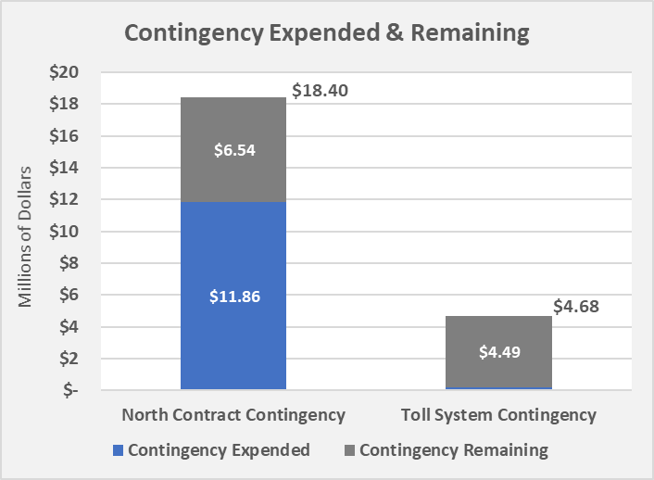
CURRENT CONTINGENCY USAGE & BALANCE – CONSTRUCTION PHASE
$0.19
Contingency expended includes the following:
New contract change orders for various reasons including, barrier foundation revisions, grade revisions, maintenance of landscape areas, and misc. signage issues
Contract bid item overruns

Slide 29
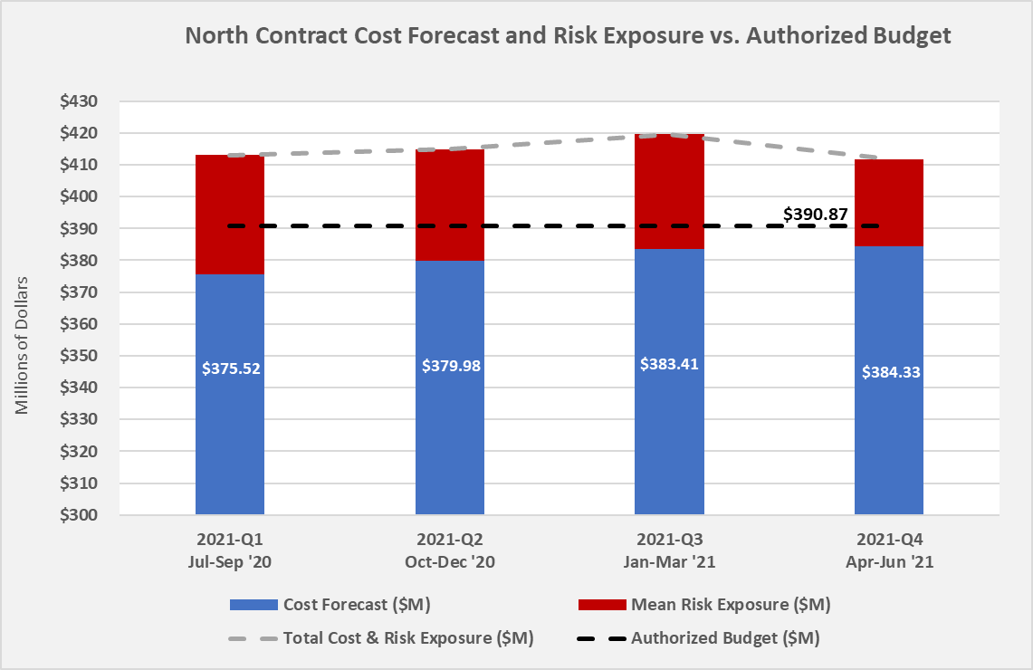


















28.80
30.03
22.26
24.11
24.11
28.80
24.53
22.26
7.46
6.23
10.89
10.89
7.46
16.53
15.35
10.89
10.24
15.35
15.35
16.53

Slide 30
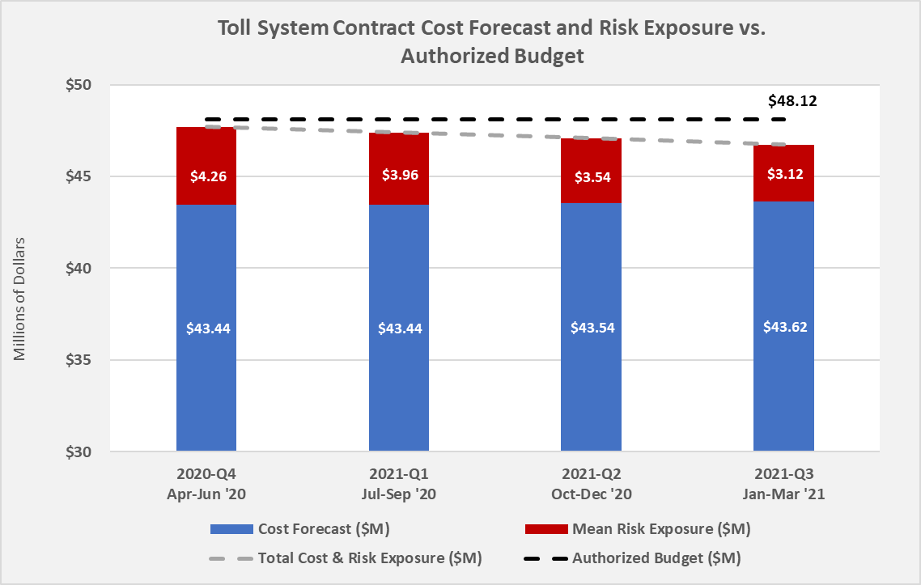
Does not include risk associated with potential new median barrier impacts. Will be assessed and added to the risk register in the next week.

Slide 31
Construction Progress
Construction Spotlight
Financial and Risk Status
Public Outreach Activities

Slide 32
WEBSITE STATISTICS FOR 2021

Slide 33
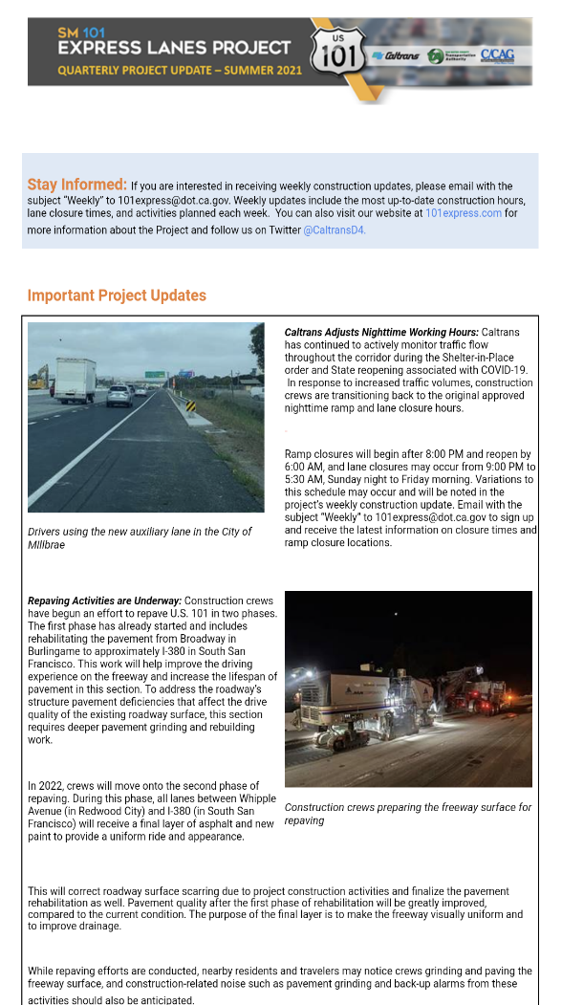
PUBLIC INFORMATION – RECENT EFFORTS
Recent highlights in the quarterly update:
Adjusted nighttime working hours due to increased traffic volumes
Ongoing and upcoming repaving work
Notes:
Weekly construction information, including ramp closure details, emailed to those signed up on the project email list and posted to website
Ramp closure notification posted on ramps up to two weeks in advance of closures
Quarterly “newsletter” distributed via email to Elected Officials, City Officials, etc.
Focused information to cities/jurisdictions to distribute as requested

Slide 34
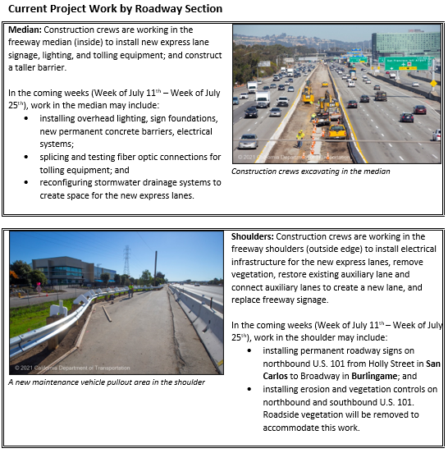
PUBLIC INFORMATION – RECENT EFFORTS
Redesigned Weekly Email Update
More photos
Explanation of work by roadway section
More context to connect weekly work with the overall project plan
Notes:
Weekly construction information, including ramp closure details, emailed to those signed up on the project email list and posted to website
Ramp closure notification posted on ramps up to two weeks in advance of closures
Quarterly “newsletter” distributed via email to Elected Officials, City Officials, etc.
Focused information to cities/jurisdictions to distribute as requested

Slide 35

PUBLIC INFORMATION – UPCOMING EFFORTS
Upcoming Public Information Efforts:
Turning attention to the opening of the lanes
Developing robust communications in coordination with VTA and MTC
Continuing to communicate construction details
Integrating outreach for construction and express lane opening
Notes:
Weekly construction information, including ramp closure details, emailed to those signed up on the project email list and posted to website
Ramp closure notification posted on ramps up to two weeks in advance of closures
Quarterly “newsletter” distributed via email to Elected Officials, City Officials, etc.
Focused information to cities/jurisdictions to distribute as requested

Slide 36

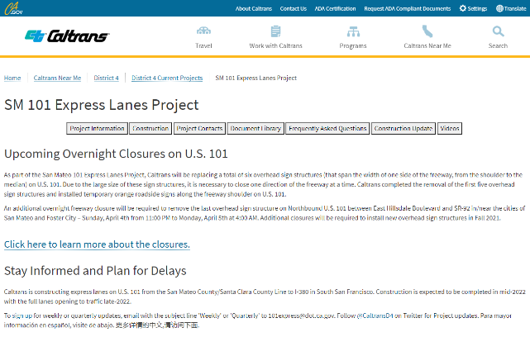
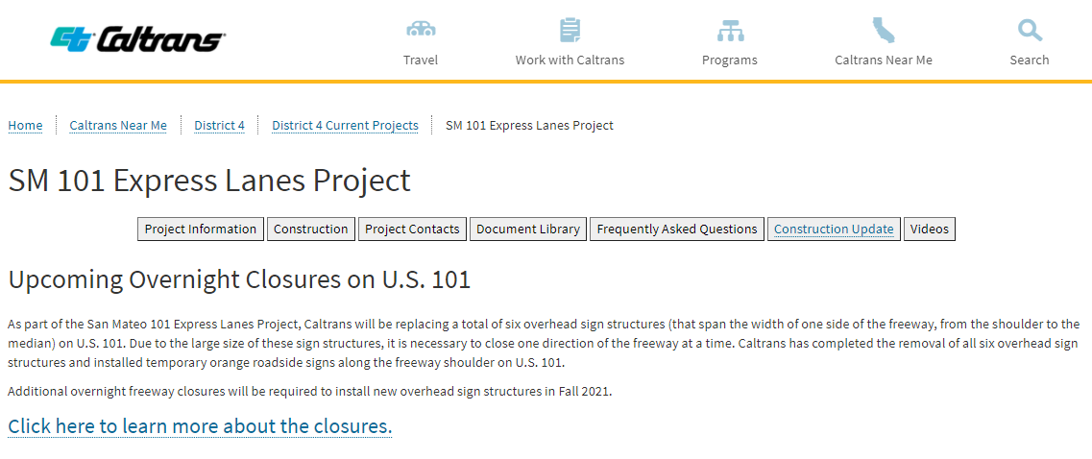
PUBLIC INFORMATION OVERVIEW
101Express.com
Visitors can sign up for updates, contact Caltrans to ask a question, and view project status.
To sign up for weekly or quarterly updates, email with the subject line 'Weekly' or 'Quarterly' to 101express@dot.ca.gov. Follow @CaltransD4 on Twitter for Project updates.
Notes:
Weekly construction information, including ramp closure details, emailed to those signed up on the project email list and posted to website
Ramp closure notification posted on ramps up to two weeks in advance of closures
Quarterly “newsletter” distributed via email to Elected Officials, City Officials, etc.
Focused information to cities/jurisdictions to distribute as requested

Slide 37
Questions?

