Slide 1
Resource Management and Climate Protection Committee Equity Perspectives from Sept. 1 BayREN Forum
October 20, 2021

Slide 2
Home Repairs Program & Electrification September 2021

Slide 3
What is a Critical Home Repar? Typical Scopes of Work
Health & Safety
Focus on anything needed to guarantee long term health & safety of client. Includes combustion safety, mold remediation, etc.
Water Intrusion
Ensure no long term damage can be caused by water. Correct problems we find.
Accessibility
Basic aging in place accommodations. Work to ensure owner can get around easily in the home.
Thermal Comfort
Basic weatherization, air sealing, or insulation improvement to ensure home is cool in summer and warm in the winter.
Exterior Façade
Work on exterior of building to ensure home remains an asset to the owner and larger community.
Quality of Life
Listen to owner and try to address concerns they have and then ensure the best possible quality of life.

Slide 4
206 Repairs Since 2008
$38,548
92%
468 people in safe, affordable, livable housing
Average household income is 40% Average Median Income (AMI)
Clients served identify as BIPOC

Slide 5
Critical Home Repair Program Next Seven Years = Growth
Goal is to double our production over the next seven years
Continue to secure new public and private funding to expand program
Expand scopes to >$25,000 per project
Expand into new neighborhoods: Belle Haven & Visitation Valley
Grow partnerships and address growing need in communities
Consider effects of climate change in the program

Slide 6
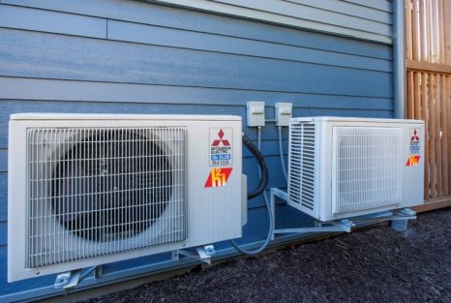
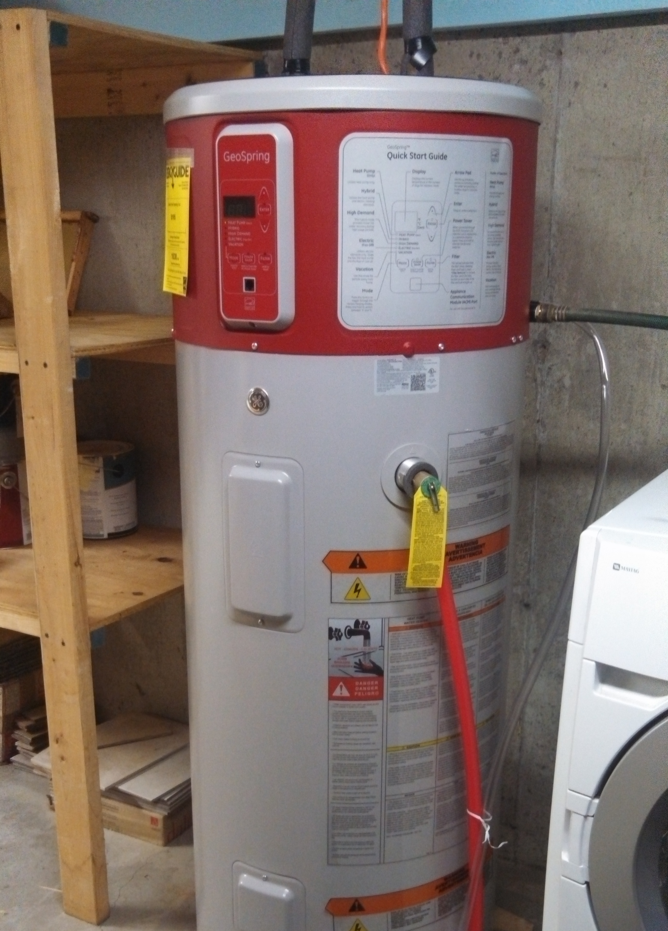
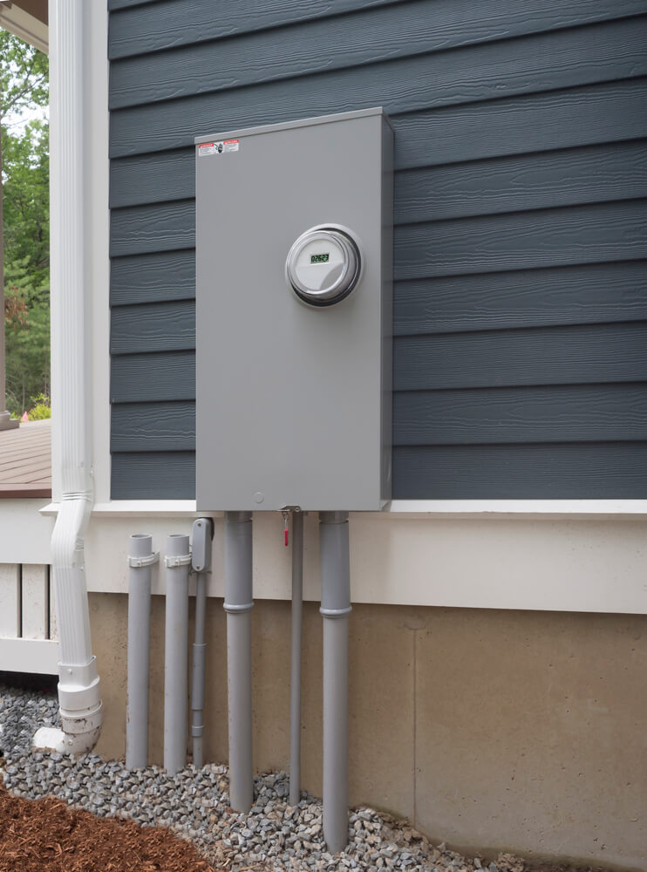
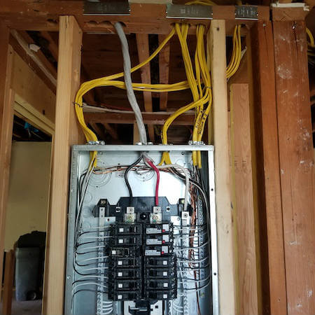
Decarbonization 1. Electrical System Upgrades
Largest barrier to a fully electric home will be the need to upgrade the electrical system.
This process is expensive and intrusive to the homeowner.

Slide 7
Critical Home Repairs 2. Work with Homeowners & Make Decarb Critical
Ask Questions & Listen
Do not assume what owners know about decarbonization.
Remember that low-income communities feel the brunt of climate change.
Educate Community
Engage local community leaders.
Promote decarb efforts alongside other community programs.
Honest about benefits
Make sure the program has real concrete benefits.
Ensure these benefits are felt by owners:
- Lower utility bills
- Healthier families
- Resilient communities
- Increased home value

Slide 8
Critical Home Repairs & Decarb 3. Expect Owner Hesitancy
Doesn’t electricity cost more than gas?
I like my gas stove.
This sounds complicated – how long will it take? Can I stay here?
I really like my gas stove.
How much paperwork do I have to sign and how much will it cost?
Will my favorite pans work on an electric stove? I love my gas stove.
My house is cold in the winter and hot in the summer. Will this help?

Slide 9
Critical Home Repairs & Decarb 4. Help Habitat and Keep It Simple
Streamline Process:
Think about selection criteria, permitting hurdles, historic preservation rules, reporting, etc.
Make sure program is a simple as possible for the owner.
Funding Sources:
Help providers like Habitat find funding sources that really work.
Fund larger more comprehensive projects.
Incentivize Owner:
Help non-profits make a program that is simple, tangible, and has a real benefit.
How will the city meeting climate goals benefit the owner directly?

Slide 10
Decarbonization A possible framework
#1. Critical Home Repair
#2. Energy Efficency Upgrades
#3. Solar Generation & Electrical Panel Upgrade
#4. Full Home Decarbonization
Ensure Health & Saftey
Lower Utility Costs
Financial benefit & resiliency
A Step towards climate goals

Slide 11
Thank You!
Doug Fowler, Senior Project Manager
dfowler@habitatgsf.org | (415) 625-1002
Repairs Program Contact
homerepairs@habitatgsf.org | (415) 625-1036

Slide 12
Draft Berkeley Existing Buildings Electrification Strategy (BEBES)
BayREN Forum
September 1, 2021

Slide 13
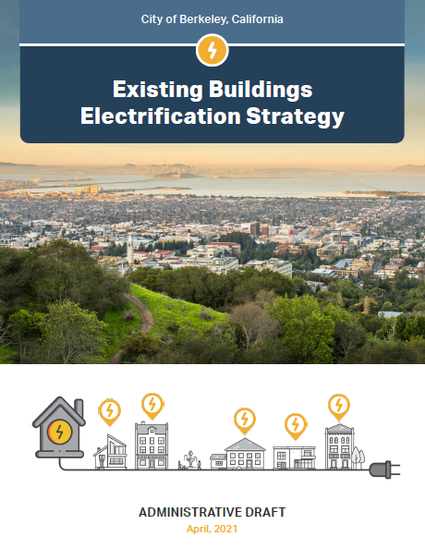
Project Scope
Equitable electrification of all existing buildings
Determine date possible
Provide short- and long-term solutions
Focused on low-rise residential buildings
Building stock analysis
Cost & savings modeling data analysis
Community engagement
www.cityofberkeley.info/electrification

Slide 14
Green the Church & Berkeley Black Ecumenical Ministerial Alliance (BBEMA) Electrification Meeting

Slide 15
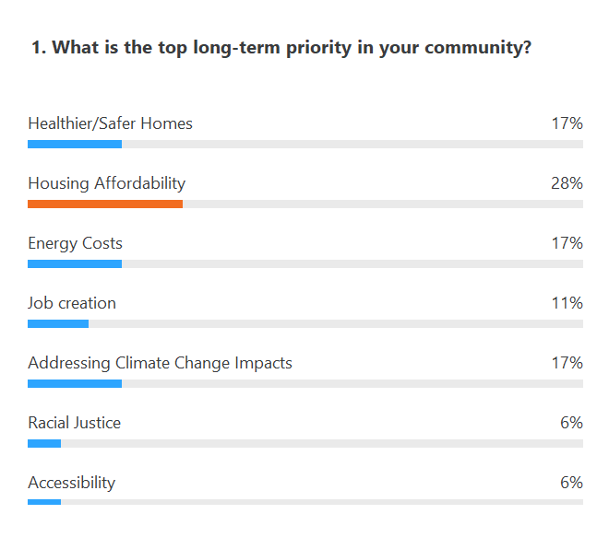
Green the Church & BBEMA Electrification Meeting

Slide 16
“Traditional” Outreach vs. Targeted Engagement

Slide 17
Draft Equity Guardrails
ACCESS TO HEALTH & SAFETY BENEFITS
ACCESS TO ECONOMIC BENEFITS
MAXIMIZE EASE OF INSTALLATION
PROMOTE HOUSING AFFORDABILITY & ANTI-DISPLACEMENT
Ensure equitable access to marginalized communities and others most impacted by climate change, to health, safety and comfort benefits from electrification for both home owners and renters. Due to the upfront costs of electrification, many households will need financial support to have access to high quality upgrades and the benefits of electrification, including long-term cost savings.
Ensure all community members, especially marginalized communities have equitable access to affordable funding and financing mechanisms, and to high-road job opportunities.
Ensure that incentives and programs for the community provide meaningful support to renters, owners, and marginalized community members to provide a simple process that minimizes the burdens and impacts associated with the installation of high quality electric equipment installed by a fairly paid and well trained workforce
Ensure upgrades don’t displace renters or over-burden homeowners. Programs should support housing production, housing preservation, and tenant protections.

Slide 18
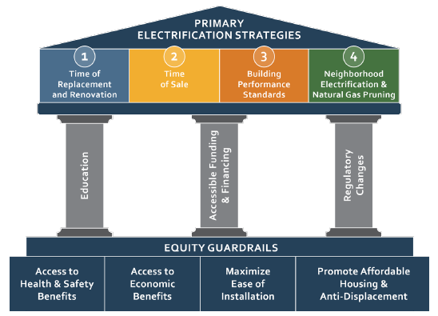
Draft Strategy Overview

Slide 19
CA Cities Collective Action
What can be applied to other cities?
Equity guardrails & framework
Building analysis and cost analysis will only apply to similar city makeups, climate zones
What is a good starting place for other cities?
Community engagement with equity focus
Building inventories
Socioeconomic mapping
Pilot projects
How can we take collective action as cities?
Advocate for accessible funding & financing programs
Advocate for equitable utility rates including NEM 3.0
Advocate for utility accounting and planning reform

Slide 20
Thank You!
Katie Van Dyke
City of Berkeley
Office of Energy & Sustainable Development
kvandyke@cityofberkeley.info
www.cityofberkeley.info/electrification

Slide 21
Thank You Full presentations and recordings posted on bayrencodes.org/events

