Slide 1
Water Supply and Drought Update
C/CAG RMCP
Tom Francis
Water Resources Manager, BAWSCA
November 17, 2021

Slide 2
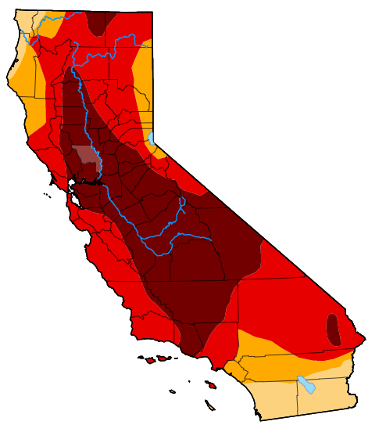
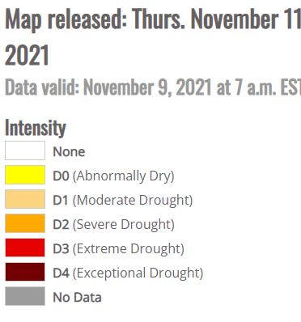
California Drought Monitor – Most of California is in an Extreme or Exceptional Drought

Slide 3
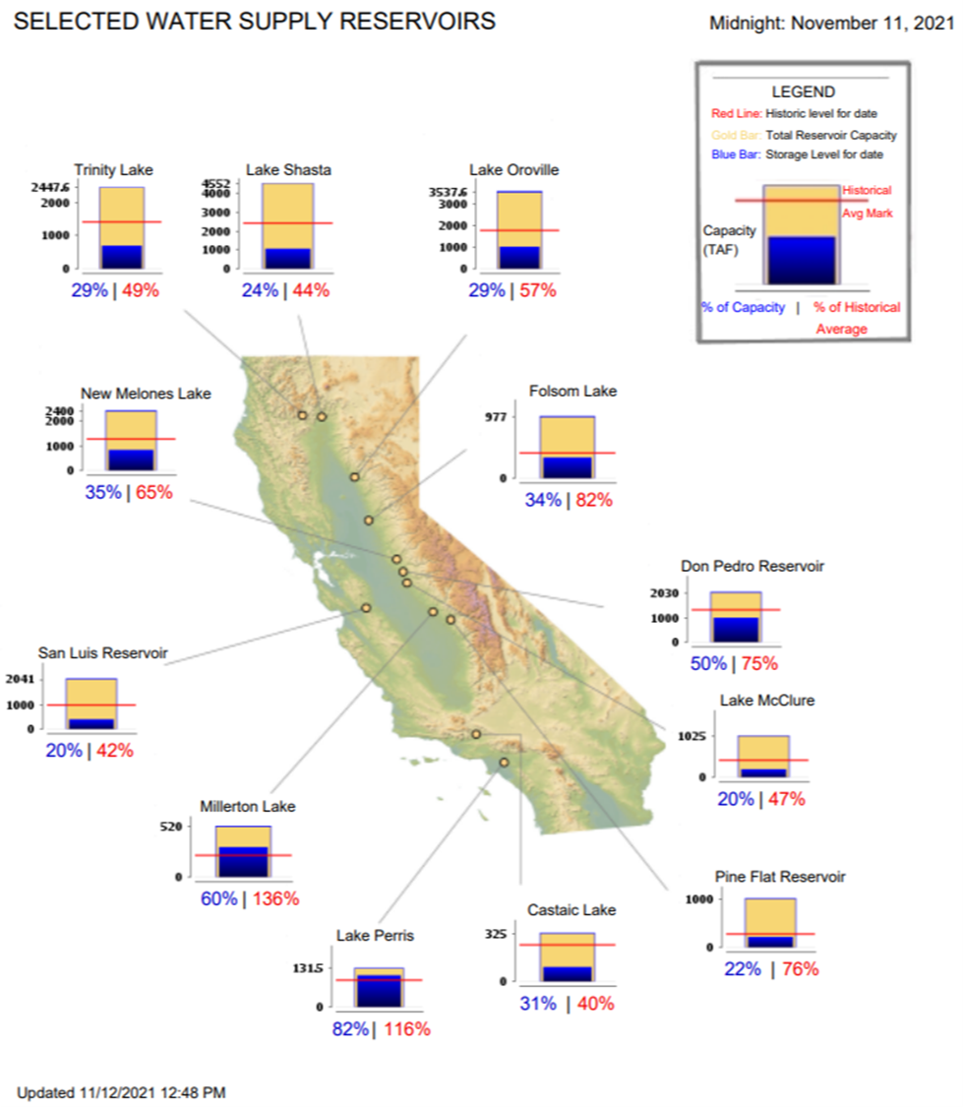
Reservoir Conditions in Large
California Reservoirs
Storage conditions in large California reservoirs. Lake Shasta, Lake Oroville, Folsom Lake, San Luis Reservoir are at historic lows

Slide 4
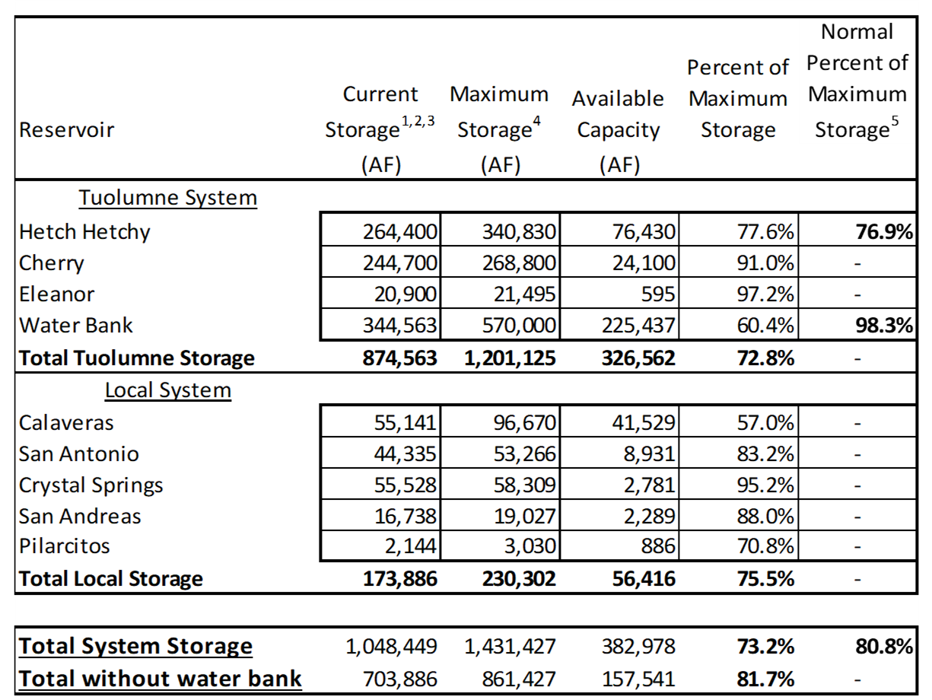
SF Regional Water System Storage as of November 15, 2021

Slide 5
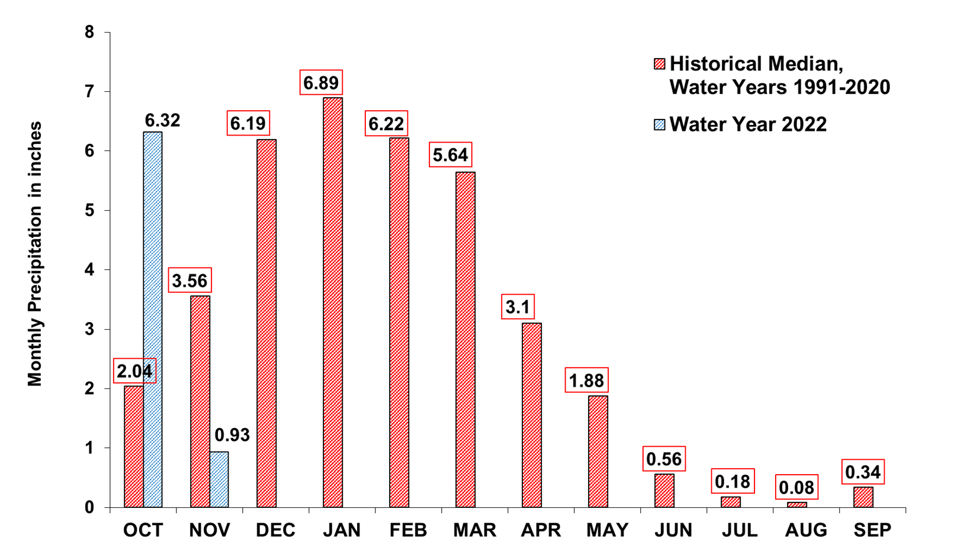
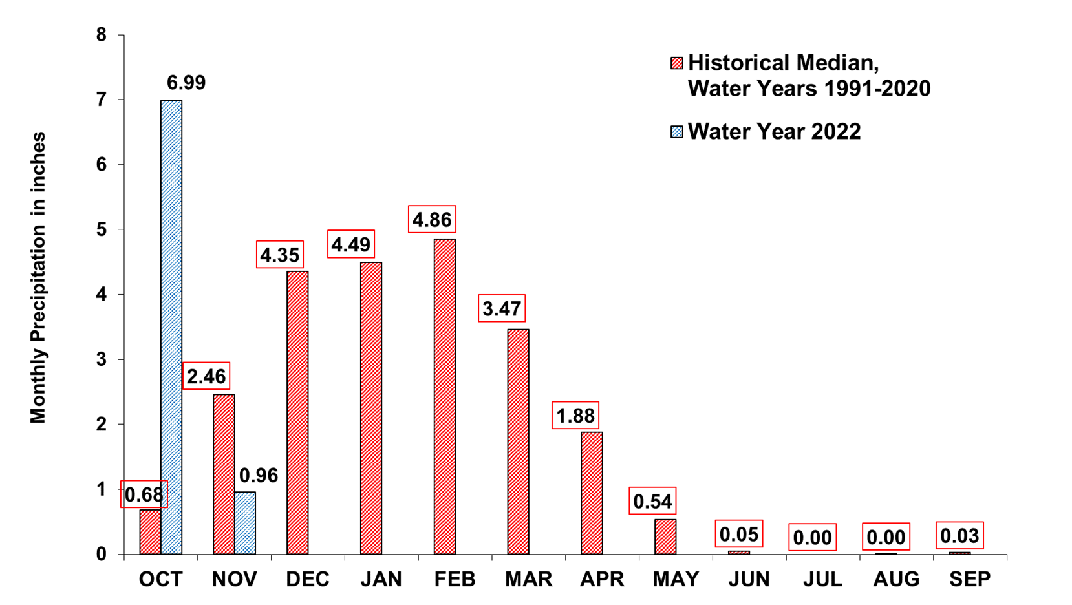
Year to Date Precipitation as of November 11, 2021
Upcountry 6-Station Precipitation Index
Average Annual Total: 36.68 inches
YTD Total: 7.25 inches
Bay Area 7-Station Precipitation Index
Average Annual Total: 22.80 inches
YTD Total: 7.95 inches

Slide 6
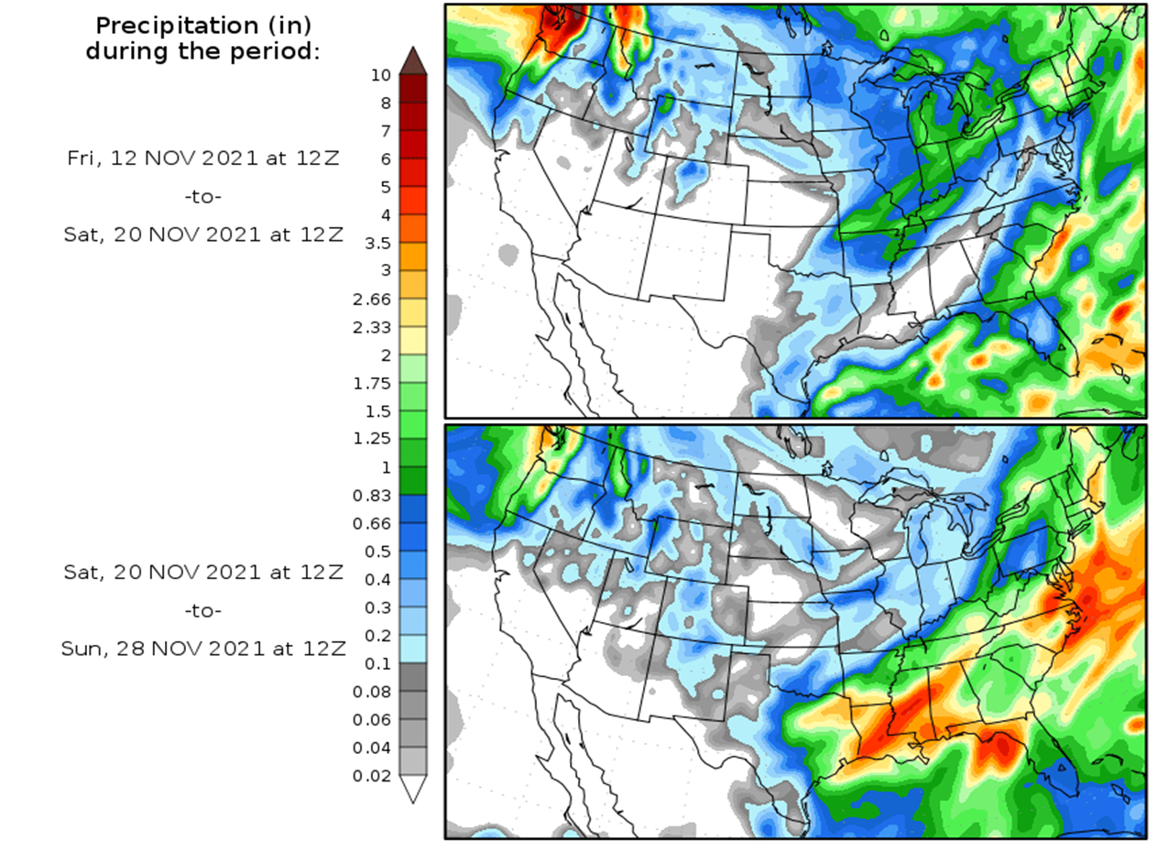
National Precipitation Forecast

Slide 7
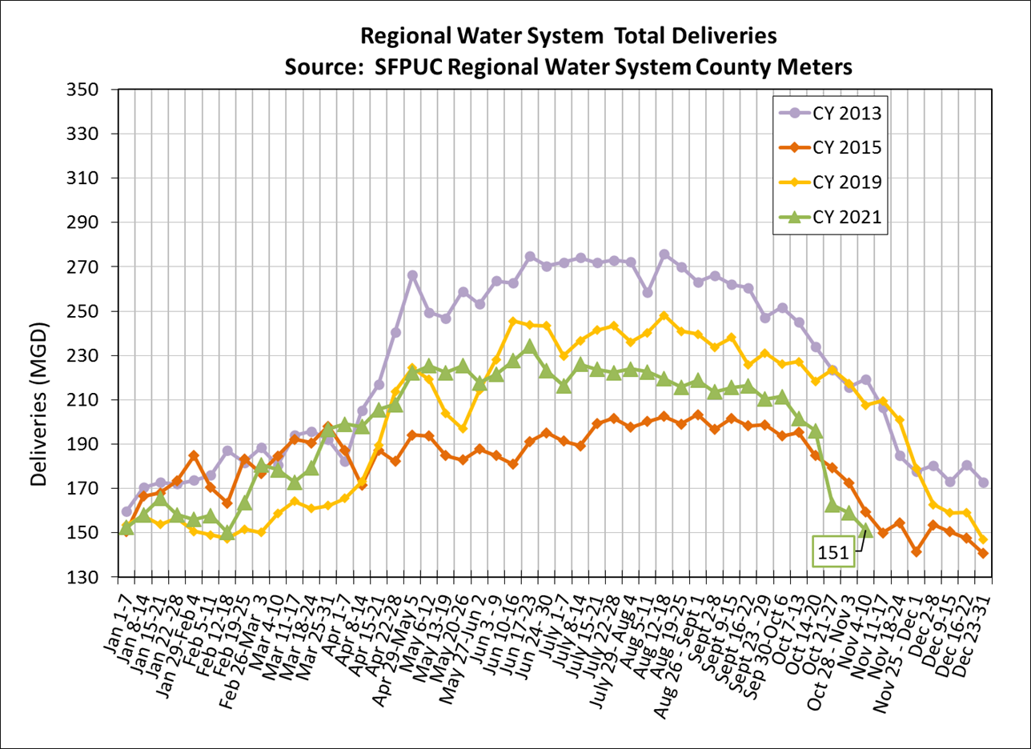
Regional Water System Customers are Responding to Drought and Using Less Water in 2021

Slide 8
Water Customers Achieved 26.5% Cumulative Savings During Last Drought (June 2015 - Feb. 2016)
26.5% Cumulative Savings from 2013
8/12
Notes:
For this drought, 8 agencies have adopted a water shortage State 1 or 2
2 have is scheduled tentatively
Brisbane – Stage 1, July 20th
Burlingame – Stage 1, July 15th
CalWater – Stage 1, July 15th
Coastside – Stage 1, May 11th
Mid Peninsula WD – Stage 1
Milpitas – Stage 2
Santa Clara – Stage 2, July 12th
Sunnyvale – Stage 2, July 27th
Tentative Sept 14th – Millbrae – Stage 1
Tentative Sept 12th – Westborough – Stage 1

Slide 9
Effects of Tuolumne River Diversion Curtailments
Went into effect for our Tuolumne River diversions on August 20
The curtailments eliminate access to the Water Bank in Don Pedro
SFPUC is meeting all of the curtailment obligations by releasing water from Cherry Lake and Lake Eleanor so that we can divert water into Hetch Hetchy
SFPUC has requested a Health and Safety exception for diversions allowing us to divert enough water to supply 55 GPCD to our entire service area (there are conditions)
Through the San Joaquin Tributaries Authority, SFPUC filed suit against the State over the underlying regulations for curtailments
To date, the State has periodically lifted curtailments to allow storage during some of the most recent rainfall events

Slide 10
BAWSCA and SFPUC Taking Action to Address Drought Conditions
Governor Newsom has asked all Californians to voluntarily reduce water use by 15 percent from 2020 levels
BAWSCA and SFPUC strongly support Governor’s request for increased conservation
Next week, SFPUC Commission to consider declaring a Water Shortage Emergency and required 10% system-wide reductions from 2019/20 levels
If this Winter remains dry, the SFPUC will likely consider further action to reduce water use
Possibility of mandatory cutbacks
SFPUC will pursue water transfers and the completion of existing capital water supply projects
BAWSCA and SFPUC closely monitoring State Water Board actions related to water rights curtailments and will respond accordingly
SFPUC’s water rights have formally been curtailed at this time
If that curtailment is extended, it could prevent the ability to store rainfall / runoff during the coming winter, impacting supplies available next year
BAWSCA and SFPUC increasing education and outreach to the water customers regarding the need to conserve
Notes:
Note that the Gov may make such a decision in late Sept or October, but that is highly speculative

Slide 11
SFPUC’s Long Term Vulnerability Assessment
The LTVA is a collobrative effort between the SFPUC’s water systems experts, academic researchers and top climate scientists
Study sponsored by the Water Research Foundation
Study led by the University of Massassuchests
Study is proposed to be released to the public in mid to late November 2021

Slide 12
Long Term Vulnerability Assessment – Approach and Considerations
Approach:
Provide a comprehensive understanding of water system performance under a wide range of uncertainties
Explore a range of plausible futures rather than relying on a “best guess” prediction
Focus on addressing vulnerabilities and building robustness
Provide a framework for evaluating water supply portfolios and operations
Climate change considerations:
Effect of warming (possible temperature change) on local and Tuolumne watersheds
Effect of changes to precipitation on local and Tuolumne watersheds
Sensitivity considerations:
How does the system respond to changes in water demand
How does the system respond to new regulatory requirements (Bay-Delta Plan)
How do possible climate change scenarios impact water quality
Other considerations:
Is the current infrastructure sufficient to support future challenges
What is the possible impact of future changes on water rates

Slide 13
LTVA Roll-Out
SFPUC held a Workshop where information was provided on the contents of the LTVA on October 29, 2021 = found at https://www.sfpuc.org/about-us/boards-commissions-committees/sfpuc-commission/agendas-minutes-resolutions-log
Publication:
Mid-to late November 2021
Planned SFPUC Presentations:
BAWSCA Board Policy Committee – December 8, 2021
SFPUC has requested that BAWSCA not be the entity to initially present results of the study to the public, particularly while the report has yet to be published

Slide 14
Questions and Comments
Tom Francis
TFrancis@BAWSCA.org
Cell: (510) 944-4392
14

