Slide 1




San Mateo County Energy Watch
2020 – 2023 Program Cycle Progress Report

Slide 2
Presentation Agenda
Susan Wright | Program Background
Alexandria Gallizioli | Program Cycle Updates
Municipal and Special District Projects
  Spotlight: Heat Pump Water Heater Pilot
Hard-to-Reach Small Businesses
  Spotlight: Community Relationship & Outreach Database
Public School District Relationship Building
  Spotlight: 2022 Annual Schools Summit

Slide 3
Program cycle updates
2020 - 2023

Slide 4
History of SMC Energy Watch
Launched in 2008
  PG&E contracted with C/CAG to implement the Local Government Partnership for San Mateo County
  C/CAG Board executed agreement with County to administer SMC Energy Watch
Similar agreements for subsequent program cycles (typically 2-3 years each)
Current program cycle: July 2020 – June 2023

Slide 5
Recent Changes
 | Original | Now
Funding | PG&E allocated funding for LGPs throughout territory | Competitive procurement for 2020-2023 program cycle (RFA/RFP in 2019/2020)
Services | Resource program (embedded technical assistance – direct installation, project management, and engineering services) | Non-resource program (referrals to other programs only since 2019)
Customers | Municipalities, special districts, school districts, small businesses, nonprofits, farms, middle income residents | Municipalities, special districts, school districts, hard-to-reach small businesses
Contracting | C/CAG contracted directly with OOS and major consultants | C/CAG contracts with OOS; OOS contracts with major consultants

Slide 6








SMCEW Program Partners
+ Resource Program Implementers
20 cities
+ County
Community-Based Organizations
+ local chambers
Notes:
PG&E finds local government partnerships valuable because they can tap into our relationships with community partners. The Energy Watch currently collaborates with BayREN, Peninsula Clean Energy, the Green Business Network, County Office of Education, and many local Community-Based Organizations.
Now, I’ll turn it over to Alexandria, who will give an overview of the current offerings.

Slide 7
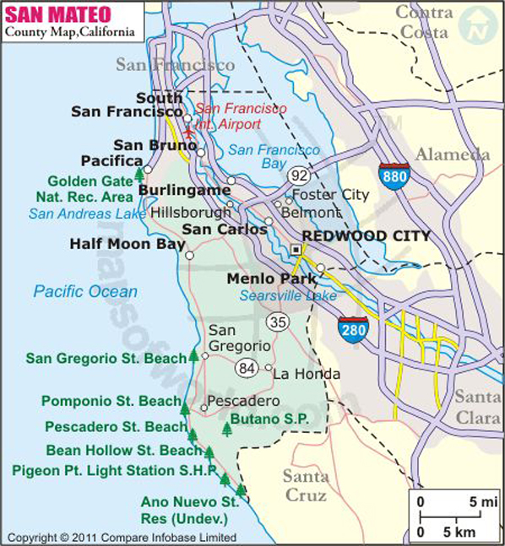
Municipalities & Special Districts
SMC Municipalities
20 Cities, plus County
SMC Special Districts
22 Special Districts
  Water and Sanitation
  Fire Protection
  Open Space
  Vector Control

Slide 8


No-Cost Municipal Support Services
Available to All
Decarbonization Guidance Document
  Coming Soon!
Benchmarking Reports & Energy Bill Rate Analyses
CIP List Review & Project Suggestions
Participation in the SMCEW Public Facilities Working Group

Slide 9



Municipal Partner Offerings
Available for Projects
Portfolio Review
ZNE Assessment & Retrofit Strategies
Building Electrification Support
Financing Application Support & Submission
Contractor/Implementor Referrals

Slide 10
Municipal Program Performance
Excelling in outreach and engagement with jurisdictions
Referrals to energy programs are surpassing expectations
Shifting focus from benchmarking to RICAPS and Facilities Working Group Sessions
 | Totals
Target | Target | Actual
ACTIVE: 14 meetings each year. | 18 | 36
PASSIVE: 4 emails each year. | 5 | 16
Year 1: 4 referrals, Year 2: 11 referrals, Year 3: 12 referrals | 8 | 10
14 Benchmarking reports each year | 17 | 7
21 Community-scale GHG emission inventories per year | 21 | 0

Slide 11

Spotlight: Heat Pump Water Heater Pilot
Partnership between Willdan Energy Solutions and SMC Energy Watch
  Domestic Sized HPWH’s (40-75 gallons)
  Must reduce or maintain current energy utility bill
  Ready to implement by December 31, 2021
Pilot funding provided by Willdan GK12 program

Slide 12
Pilot Expectations + Timeline
Three cities, and the County of San Mateo are pursuing this opportunity
  Redwood City, Half Moon Bay, and the City of Brisbane
Projects will be completed by December 31, 2021
  Implementation by Willdan partner, Enovative
Following completion, a new municipal HPWH incentive will be launched for 2022

Slide 13

Hard-to-Reach Small Businesses
Hard-to-Reach SMB Criteria
10 employees or fewer
Space is rented or leased
Workplace has English as a Second Language
< 20kW annual energy consumption
All Small Businesses can learn more about and access energy programs through our Small Business Resource Center.

Slide 14
Small Business Program Performance
Difficulty reaching targets during PY1 due to COVID-19 restrictions
SMBs hesitant to take on new projects
PY1 Focus was on development of outreach database and building CBO relationships
HTR SMBs |  | Totals
Type | Target | Target | Actual
Contacts | ACTIVE: 500 in-person "touches" each year | 500 | 150
 | PASSIVE: 1,000 HTRS SMBS reached through partners each year | 1000 | 190
Referrals | 50 referrals each year | 50 | 7
Benchmarking Reports | Benchmarking for 25 SMBs each year | 25 | 5

Slide 15
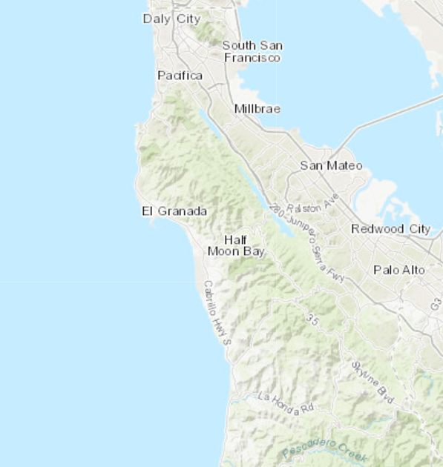


Spotlight: SMB Outreach Database
SMB Outreach Effort
Partnering with El Concilio and Nuestra Casa, two community-based organizations working with underserved communities in the County
Database Platform
Data-Entry Survey
Searchable ArcGIS Map for collection
and reporting
  Visual representation of small business outreach data

Slide 16
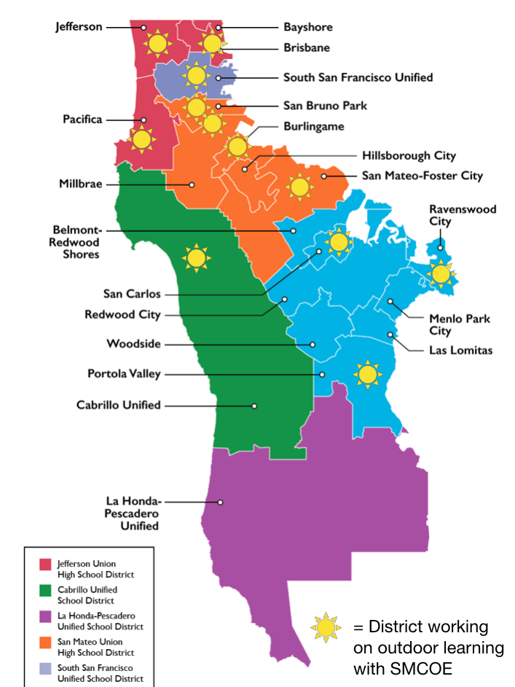
Public School Districts
Public School Districts
24 School Districts in
San Mateo County
Energy Watch Services
  Benchmarking & Energy Action Planning
Willdan GK12 Program
  Technical and Financial Assistance offerings
Notes:
***Aren’t there 24 districts?

Slide 17
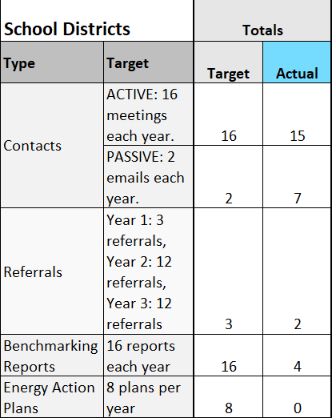
Public School Program Performance
Difficulty engaging schools during COVID-19 shutdown and re-opening
Focus on engagement through partnership with SMC Office of Education
Providing support to SMCOE’s Annual Schools Summit in early 2022

Slide 18

Spotlight: 2022 Annual Schools Summit
Summit Purpose
To bring focus to the need for San Mateo County school districts and officials to become more resilient to climate change
To provide hope and a path forward for climate action at the district level
Partners
SMC Energy Watch has partnered with SMCOE to conduct 1:1 meetings with districts following the summit with the purpose of kickstarting their climate action planning (accessing OOS and partner programs)

Slide 19
Focus Areas for Program Year 2
Municipal Program
Heat Pump Water Heater Incentive Program
Relaunching Facilities Working Group and RICAPS Working Group meetings
Small Business Program
In-field outreach via community-based organization partnerships
Completion of the outreach database
Public Schools Programs
Annual Schools Summit
Energy Action Planning for engaged districts

Slide 20



QUESTIONS?
Alexandria Gallizioli | agallizioli@smcgov.org
(628) 222-3034
Susan Wright | swright@smcgov.org
(650) 363-4372

