Slide 1
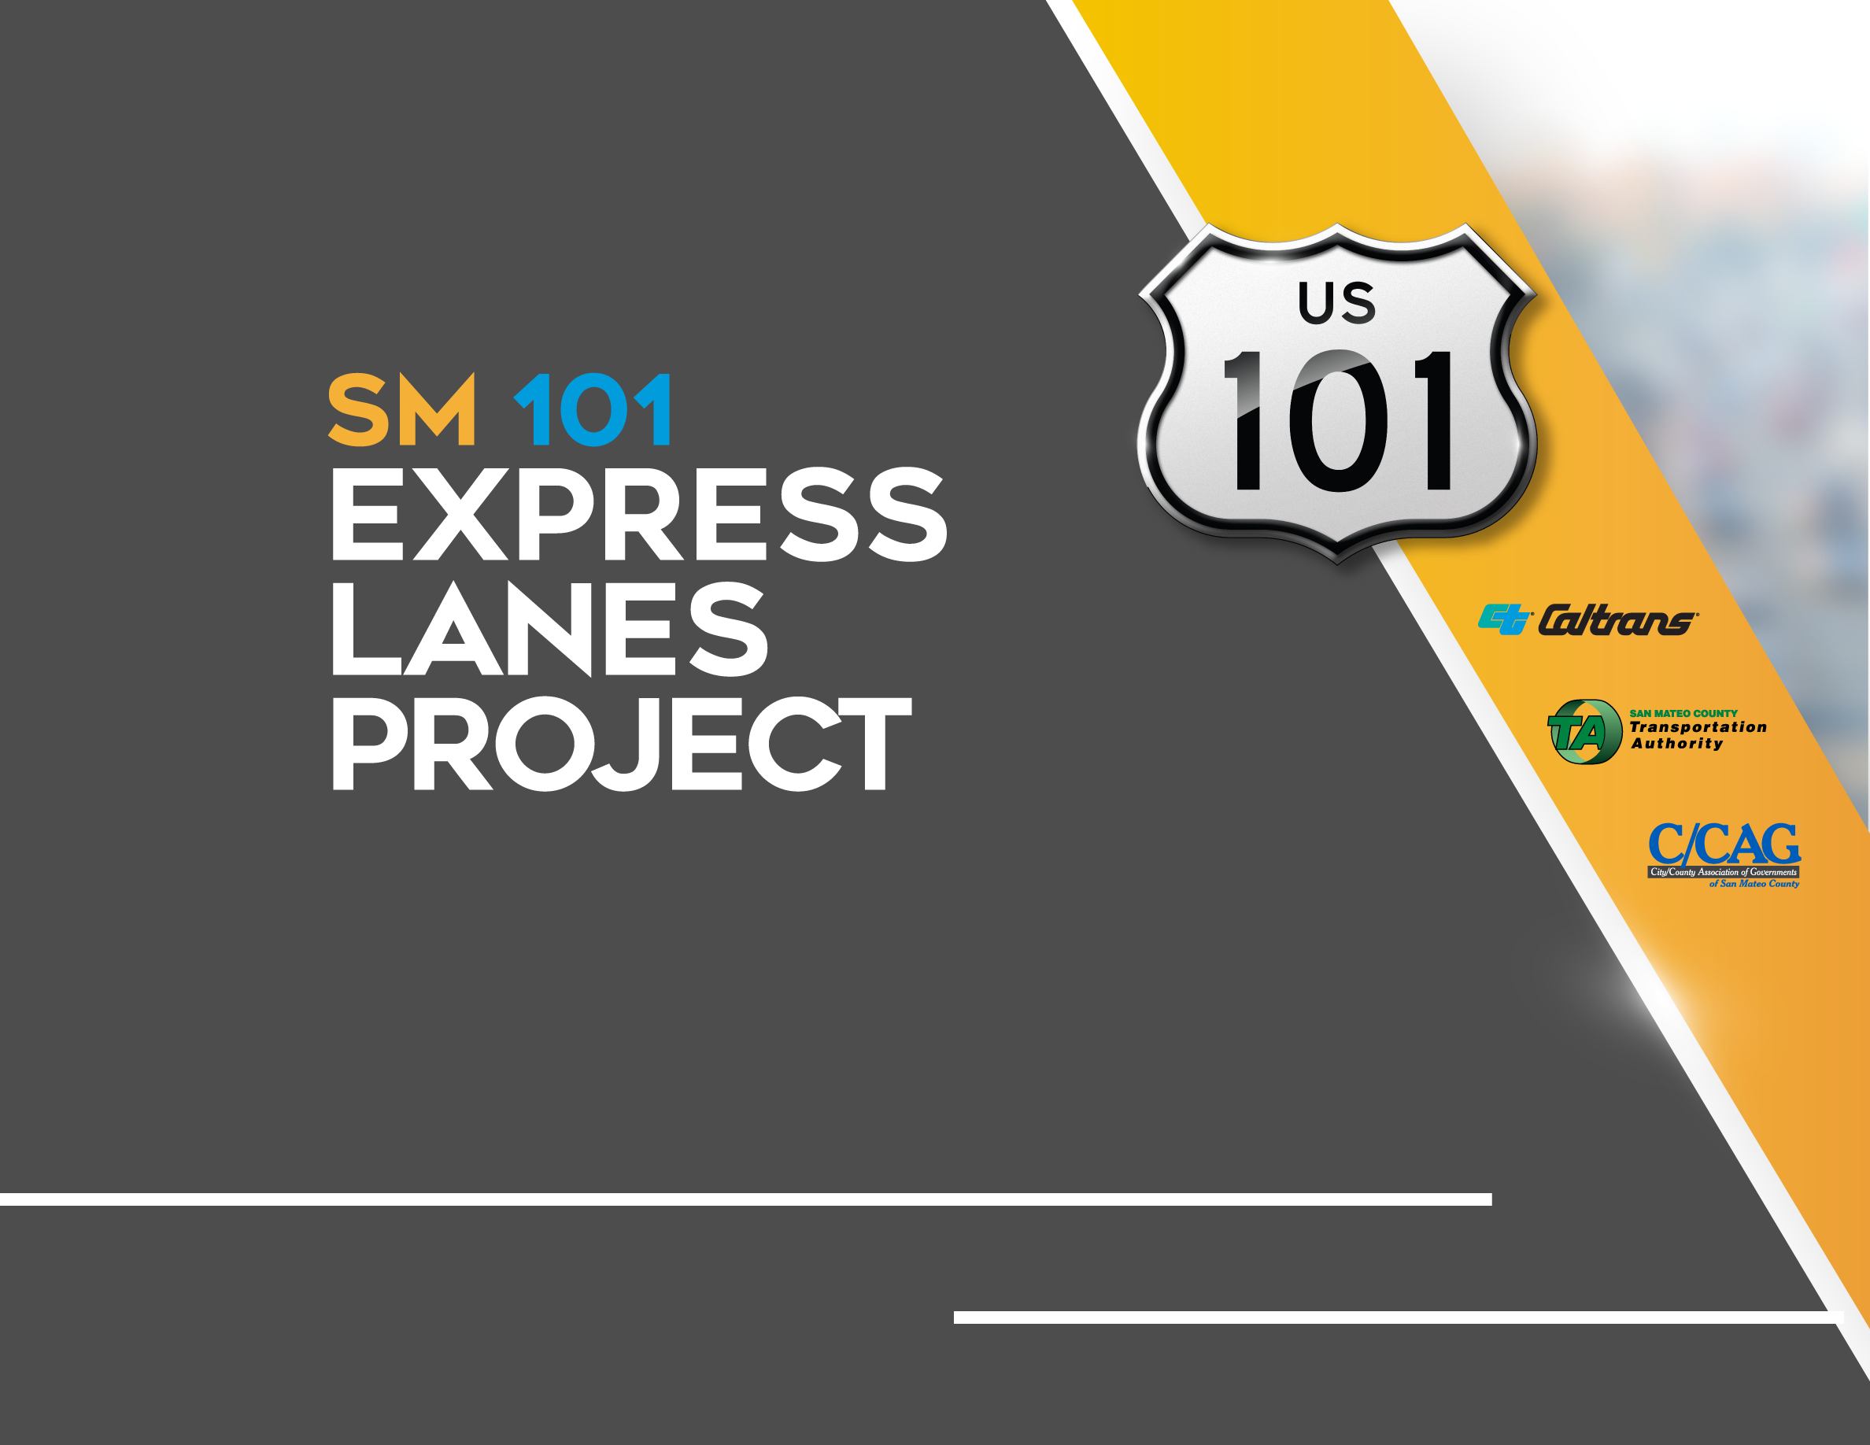
Quarterly Project Update
C/CAG Board Meeting February 10, 2022

Slide 2
AGENDA
  Construction Progress
  Project Spotlight
  Public Outreach Activities
  Financial and Risk Status

Slide 3
  Construction Progress
  Project Spotlight
  Public Outreach Activities
  Financial and Risk Status

Slide 4
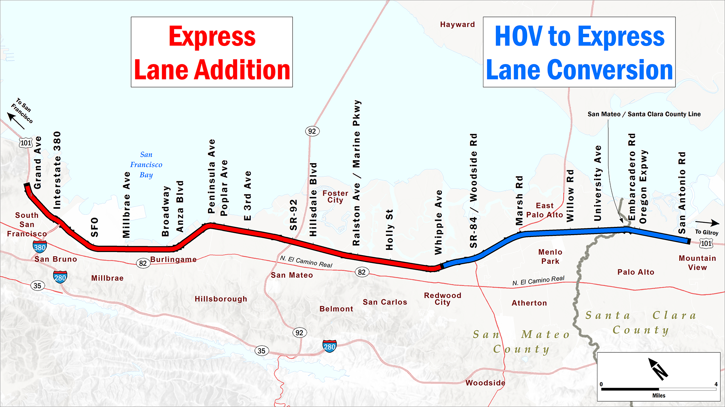
PROJECT LIMITS
Notes:
The SM101 project includes building a new express lane on the northern half, and converting the existing HOV lane in the southern half.

Slide 5
PROJECT SCHEDULE
Express
Lane
Addition
Begin Toll System
Installation
Winter 2022
Begin Toll Systems Testing
Summer 2022
Begin Tolling
Late 2022
North of
Whipple
2020
2021
2022
South of
Whipple
Begin Tolling
February 11, 2022
Begin Toll System Installation
Fall 2020
Begin Toll Systems Testing
Fall 2021
HOV to
Express Lane
Conversion
Notes:
The northern and southern sections will both be built and launched at different times. On both sides though, there are 3 main tasks: construction, toll systems installation, and opening the lane.

Slide 6
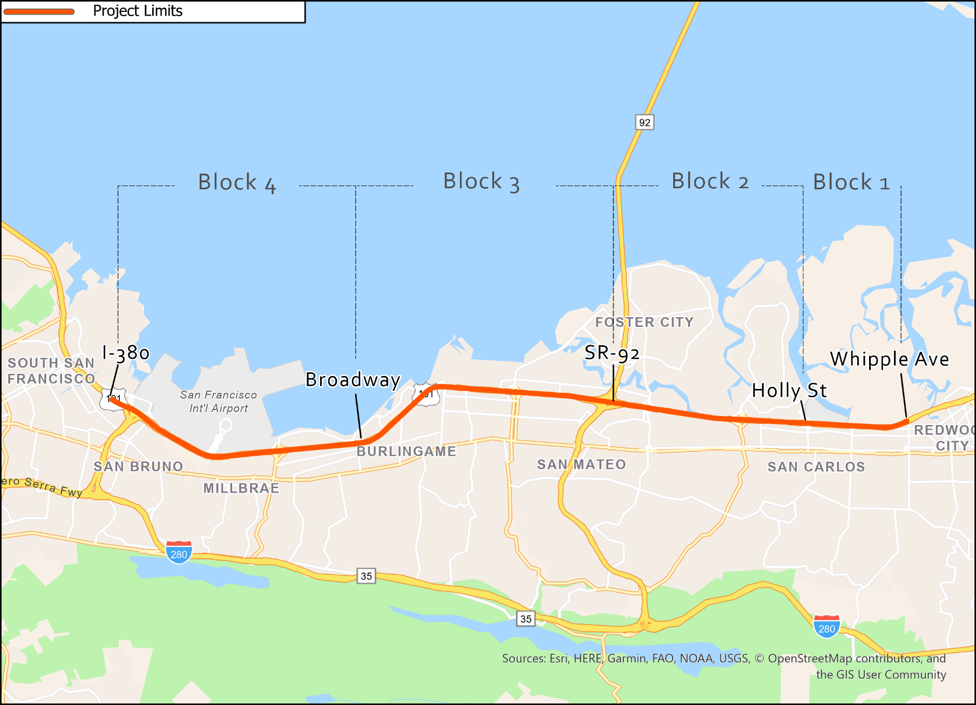
NORTH CONTRACT CONSTRUCTION BLOCKS
Paving underway
Paving underway

Slide 7
NORTH CONTRACT WORK COMPLETED
  North of Whipple through January:
  $254.28M of $326M completed (80%) with 70% time elapsed. 70% of pavement tonnage complete, with 30% of open graded asphalt concrete (final layer) laid down.
  Completed installation of tolling equipment in Block 1
  Erected lights and sign structures in Blocks 2 and 3
  Completed general purpose lane restriping in Block 1 in preparation for final layer of paving
    General purpose lanes are in final configuration, express lanes are currently blocked off
  Removed the majority of temporary concrete barrier – 30% remaining
  Applied paint and textural “Binary Hyperdrive” treatment to median barrier
  Completed installation of fiber optic cable connections

Slide 8
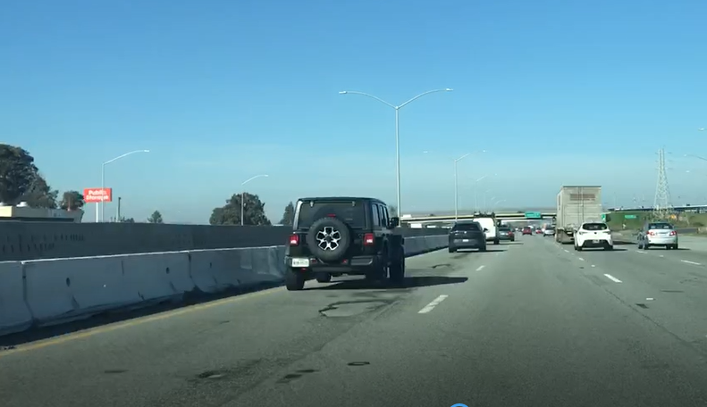
POTHOLES FROM INCLEMENT WEATHER
Pothole Repairs Mitigation

Slide 9
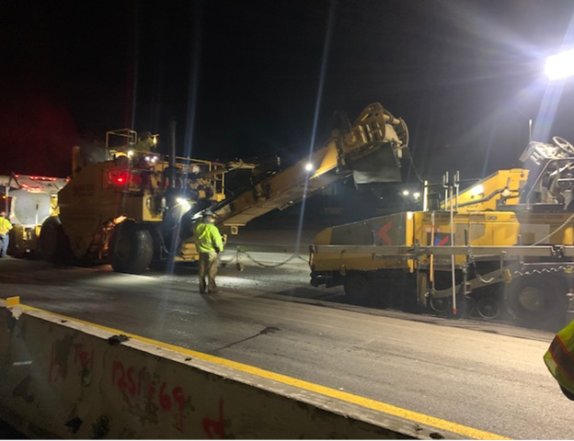
NORTH CONTRACT WORK ONGOING
Final Layer (1/10th Overlay) Paving

Slide 10
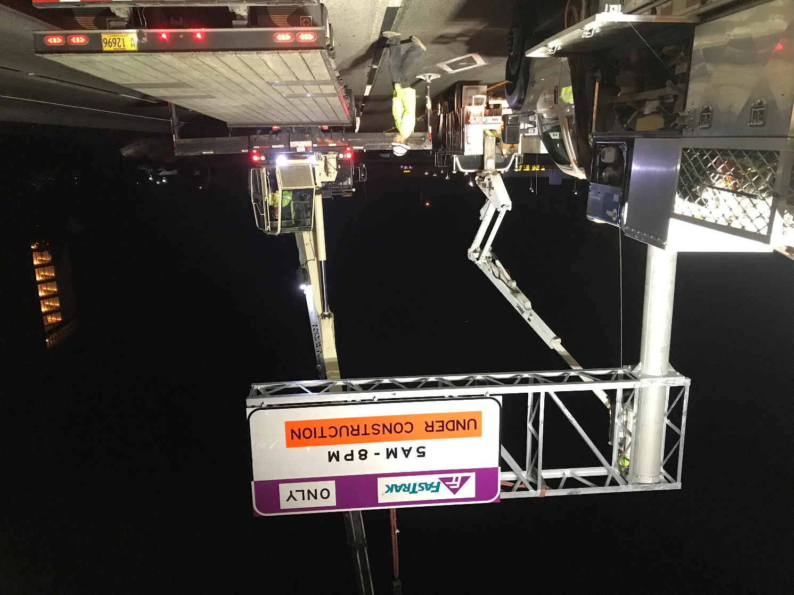
NORTH CONTRACT WORK ONGOING
Overhead Sign Installation

Slide 11
UPCOMING WORK: February - April
North of Whipple:
Final layer (1/10th) overlay paving – Block 4
Constructing, texturing, and painting median barrier
Installing sign structures and variable toll message signs in all Blocks
Installing tolling equipment in Block 4 (TransCore)
Testing and approving fiber optic cable installation

Slide 12
SOUTH CONTRACT WORK COMPLETED
  South of Whipple through January:
  Construction complete
  Toll equipment installation and testing complete
  Ready to commence tolling

Slide 13
  Construction Progress
  Project Spotlight – Express Lane Opening
  Public Outreach Activities
  Financial and Risk Status

Slide 14
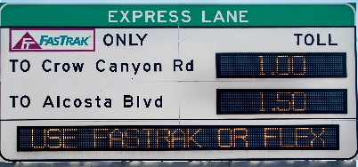
LANE OPERATING MODES DURING TRANSITION
TOLL TESTING
Marsh Rd
Ralston Ave
HOV 2+ ONLY
XXX
Marsh Rd
Ralston Ave
0.50
UNDER CONSTRUCTION
XXX
1.50
HOV 3+ NO CHARGE
HOV
EXPRESS LANE IN HOV-ONLY MODE
TOLLING
System Installation
Testing
Express Lane Operations
February 8 – 11

Slide 15
UNIQUENESS OF CONCURRENT OPENING
  The first concurrent express lane opening in the Bay Area
  Extensive coordination between VTA, JPA, BAIFA, BATA, Caltrans, and consultant staff
  VTA has upgraded their operating system
  All testing had to be run twice
  Signing and striping operations were coordinated between the two projects
  Coordinated public messaging effort
  CHP coordination and training
  -Current revised opening date is February 11-

Slide 16
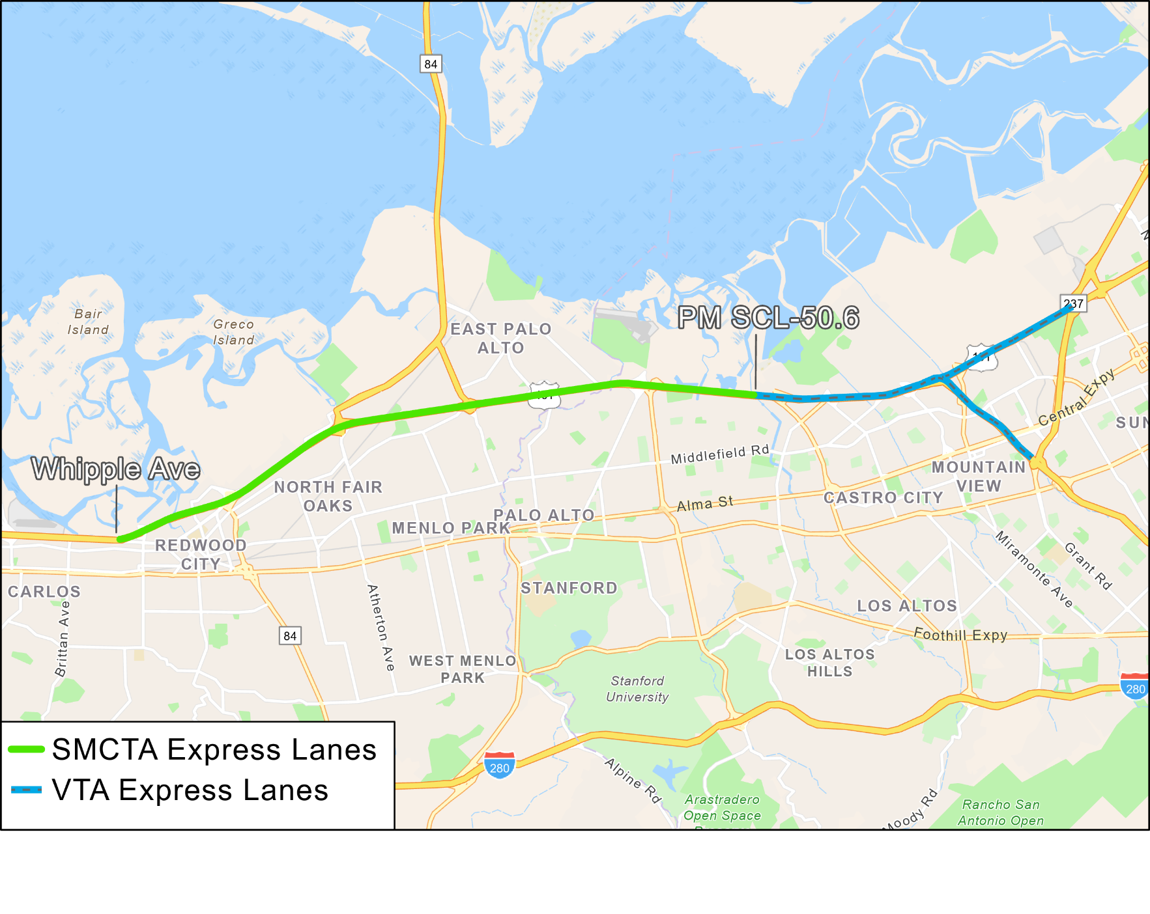
COORDINATED LANE OPENING

Slide 17
OPENING DATE RISK MITIGATION
Risks to February 11 Opening Date |  | Risk Mitigations
Syncing start of tolling with VTA |  | Communicate regularly with VTA
Weather |  | Accounted for weather days in the schedule
COVID |  | TransCore validating that crews are following COVID protocols
Testing |  | Streamlining testing process
Equipment failure and/or supply chain delays |  | Making use of North Segment equipment when it arrives
Finalize operating agreements |  | Reach closure at executive level
Obstacles to VTA’s operating system implementation |  | Opening date adjusted to February 11 to provide time to address
  Note: not anticipated to affect North Segment schedule

Slide 18
  Construction Progress
  Construction Spotlight
  Public Outreach Activities
  Financial and Risk Status

Slide 19
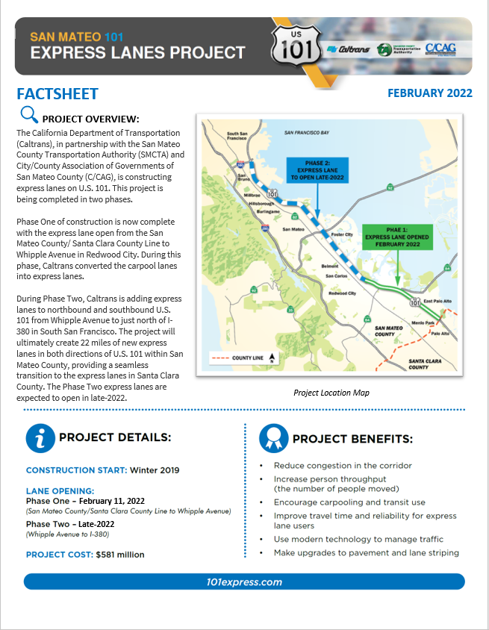
PUBLIC INFORMATION – LANE OPENING
  Construction Messaging Efforts:
  Quarterly Update
  PIO Emails
  Updated project fact sheet
  Updated website FAQs
  Caltrans traffic advisory

Slide 20
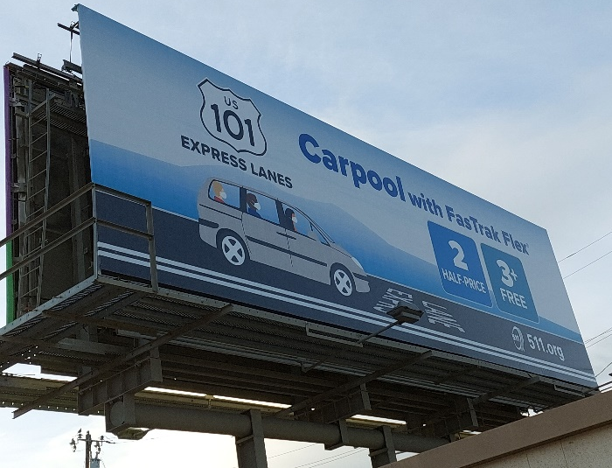
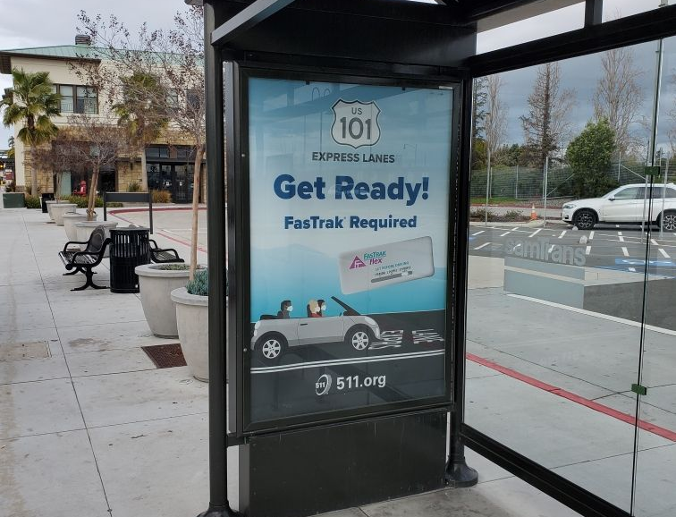
MARKETING EXPRESS LANE OPENING
  Public Information
    On Corridor Signage being set up – overhead and roadside changeable message signs
    Regional websites (Caltrans, 511.org, FasTrak)
    SMC Digital Communications team are monitoring social media channels and making posts
    Coordinating with partner PIOs for public information messaging
    Launched sponsored e-newsletter campaign with Mercury News and Multi-lingual e-newsletter channels
  Marketing/Advertising
    SMC, VTA, and FasTrak campaigns are ongoing
    Ongoing radio campaign through KCBS, Bonneville (KOIT, etc.), Pandora streaming, Univision (KBRG), News for Chinese (KEST AM1450)

Slide 21

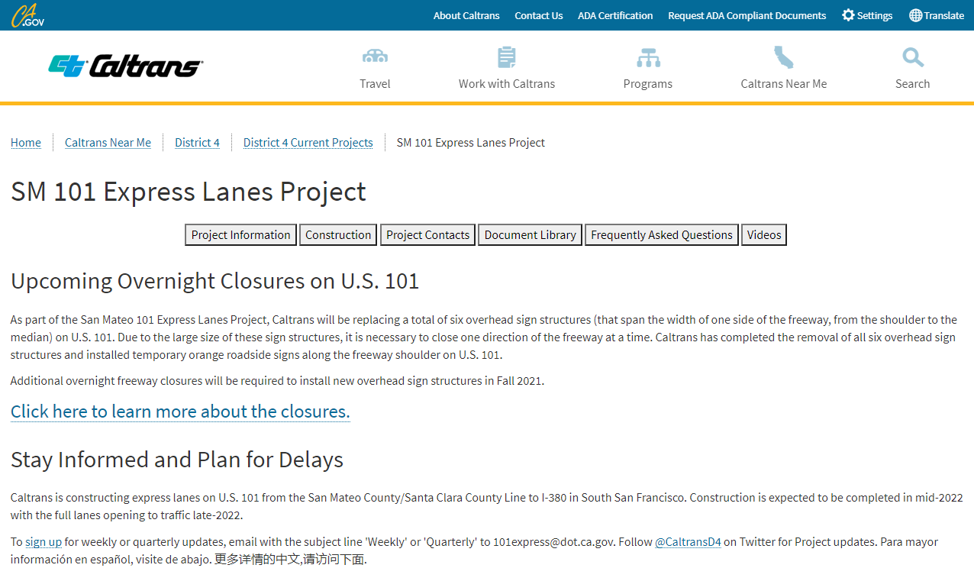
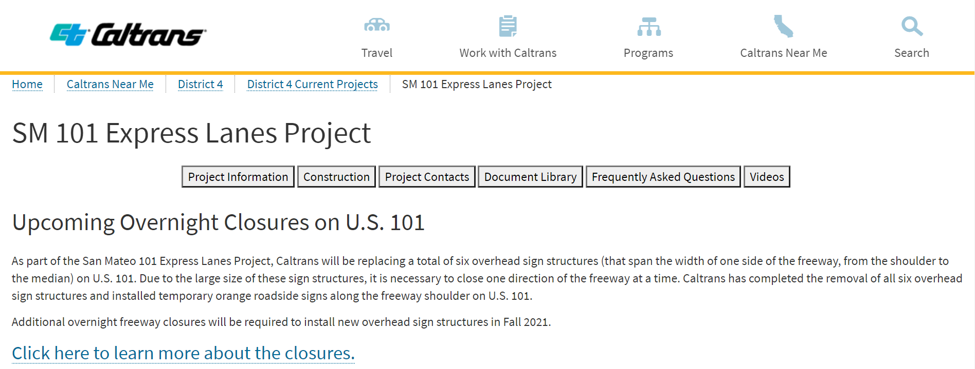
PUBLIC INFORMATION OVERVIEW
  101Express.com
  Construction updates are distributed via email.
  Visitors can sign up for updates, contact Caltrans to ask a question, and view project status.
  To sign up for weekly or quarterly updates, email with the subject line 'Weekly' or 'Quarterly' to 101express@dot.ca.gov. Follow @CaltransD4 on Twitter for Project updates.
Notes:
Weekly construction information, including ramp closure details, emailed to those signed up on the project email list
Ramp closure notification posted on ramps up to two weeks in advance of closures
Quarterly “newsletter” distributed via email to Elected Officials, City Officials, etc.
Focused information to cities/jurisdictions to distribute as requested

Slide 22
  Construction Progress
  Project Spotlight
  Public Outreach Activities
  Financial and Risk Status

Slide 23
CURRENT COST ESTIMATE - CONTRACT FOCUSED
(1) Estimated Cost represents current estimated cost to complete each contract.
(2) Expenditures include $12M deposit against North Contract – Civil.
(3) Percent completes shown are based on qualitative assessment of physical % complete per milestones and schedule.
(4) Å = Within budget, Å = identified potential risks that may significantly exceed budget if not mitigated, Å = Known impacts to budget - changes forthcoming.
Assume 100% utilization of Project Contingency in overall estimated cost of project

Slide 24
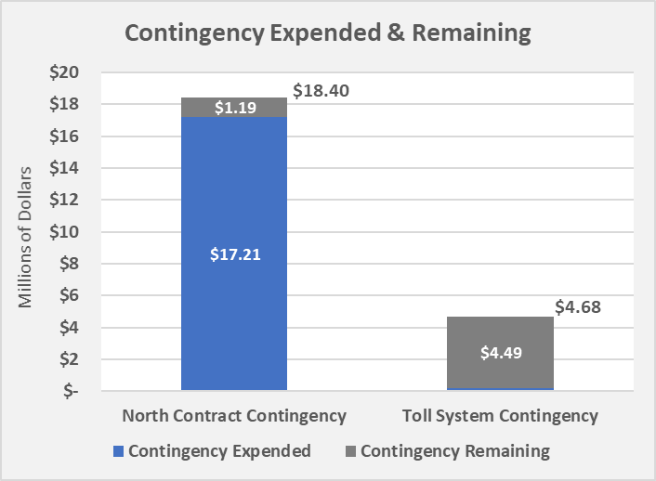
CURRENT CONTINGENCY USAGE & BALANCE – CONSTRUCTION PHASE
$0.19
Contingency expended includes the following:
  New contract change orders for various reasons including, k-rail salvage, barrier foundation revisions, grade revisions, maintenance of landscape areas, and misc. signage issues

Slide 25
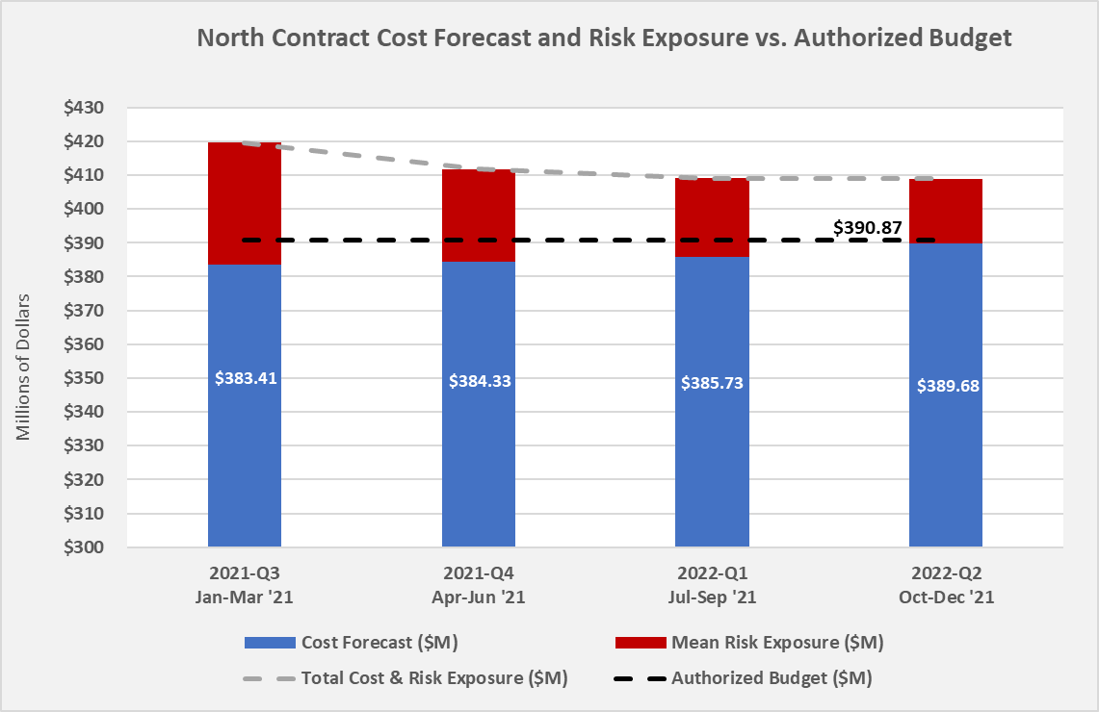





18.16
5.14

Slide 26
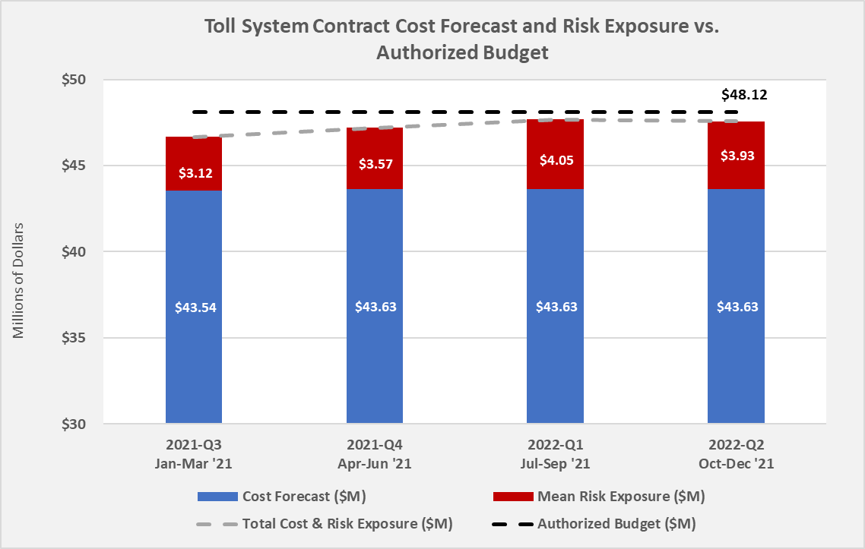

Slide 27
Questions?

